Slide 1
FND: Mutually Aware Social Navigation
IIS 1734361 • Aaron Steinfeld • Carnegie Mellon University
Lead Students: Allan Wang (PhD, est. graduation 2023) & Abhijat Biswas (MS, graduated) Collaborators: Henny Admoni (RI), Jean Oh (RI), Zakia Hammal (RI), Christoforos Mavrogiannis (UW), Francesca Baldini (Caltech), Peter Trautman (Honda Research Institute USA), & Marynel Vázquez (Yale)
February 27-28, 2020 | ARLINGTON, VIRGINIA
Challenge
Improve the way robots reason about human spatial behavior
Develop navigation methods that lead to understandable and appropriate motion patterns in social environments
Broader Impact
Create appropriate and accepted robot behaviors for public settings
Data and software for reuse and educational purposes
Accelerate system development, open-source technology
Increase capacity in the field

Slide 2
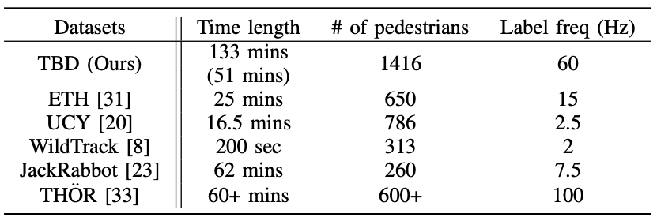
Advances This Year: Dataset and Tools
Dataset: robot-perspective view, ground-truth labels, & natural motion
tbd.ri.cmu.edu/tbd-social-navigation-datasets
SocNavBench: a simulator with photo-realistic capabilities and curated social navigation scenarios grounded in real-world pedestrian data
github.com/CMU-TBD/SocNavBench
ICRA 2022 Workshop on Social Robot Navigation: co-organizing a hands-on workshop with Yale
seannavbench2022.netlify.app
… and more data collection planned
Steinfeld IIS 1734361

Slide 3
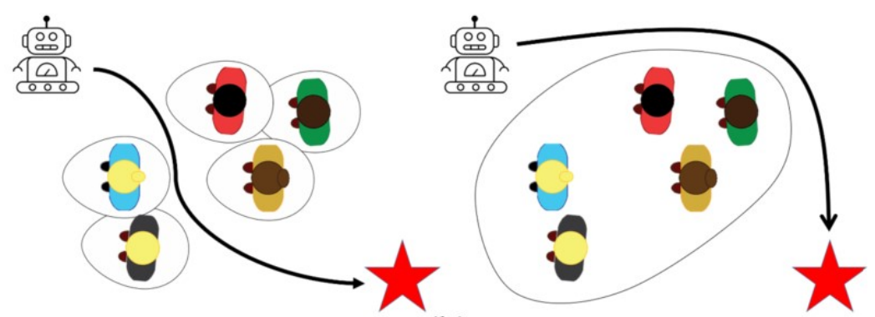
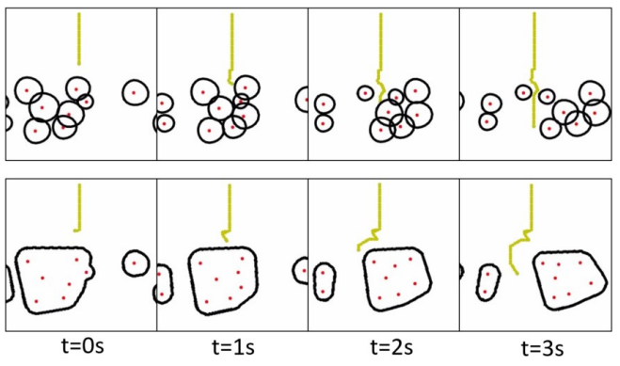
Advances This Year: Social Navigation
Wang, et al. CoRL 2022: Gestalt-based Model Predictive Control framework (G-MPC), a group-based motion prediction for navigation in crowded environments
openreview.net/forum?id=knObbYqSowX
Survey article: documenting the core challenges of social robot navigation (in review)
New algorithms: group motion and personal space in order to provide more nuanced understanding than current state of the art (in preparation)
Steinfeld IIS 1734361

