Slide 1
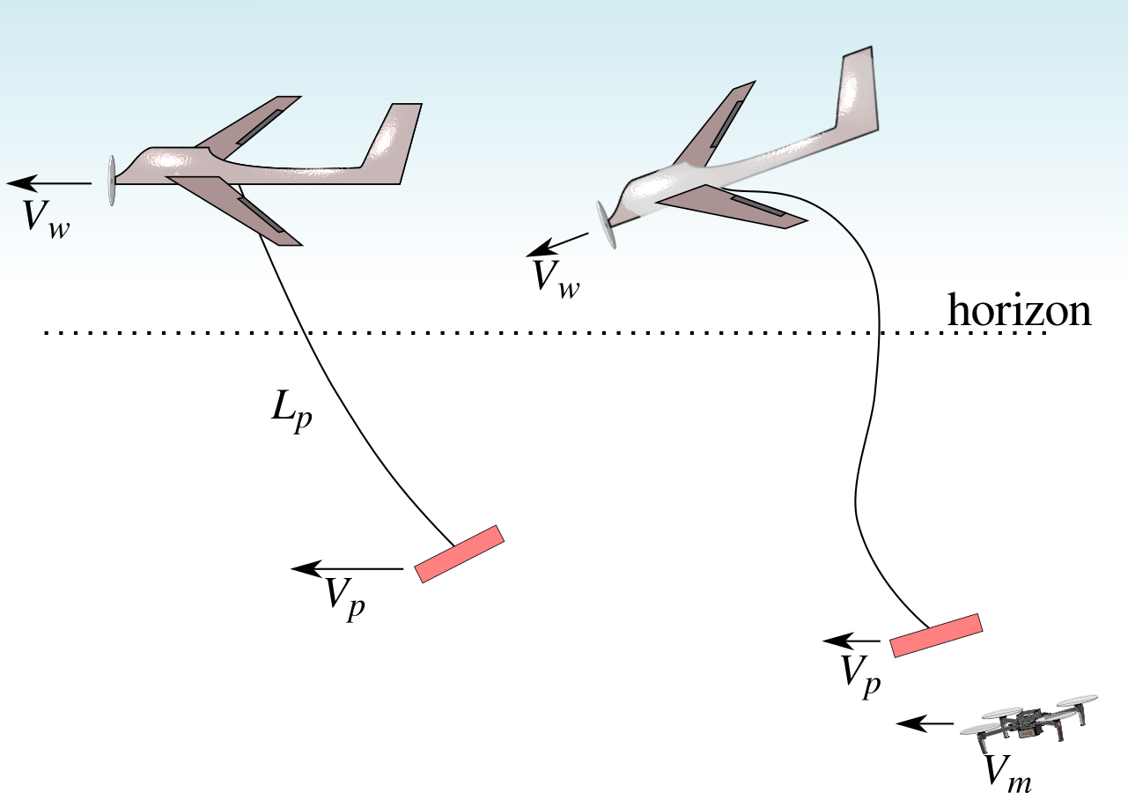
Raining Drones: Mid-Air Release & Recovery of Atmospheric Sensing Systems
IIS-1925052 & IIS-1924777: 2019-2022
TALKING HEAD
University of Nebraska-Lincoln: Carrick Detweiler, Adam Houston
University of Virginia: Sebastian Elbaum
February 27-28, 2020 | ARLINGTON, VIRGINIA
Challenge
Launch and recover UAS from moving platforms
Improve atmospheric sensing systems
Scientific & Broader Impact
Enable interactions of heterogenous UAS platforms while in motion
Evaluation of UAS based atmospheric sensing systems and sensors
Improve understanding of the lower atmospheric models
Generate unprecedented datasets
Solution
In-flight docking with optimal trajectories
Software analysis of probabilistic systems
Characterization of UAS atmospheric sensing
Contact: carrick@cse.unl.edu, selbaum@virginia.edu
Notes:
Hi. I am Sebastian Elbaum, a Professor at the University of Virginia. Together with my colleagues at the University of Nebraska, we lead the “Raining drones” projects which aims to enable the launch and recovery of UAS from moving platforms entailing complex and aggressive multi-vehicle maneuvers, and with those capabilities produce more accurate lower atmosphere models for weather prediction

Slide 2
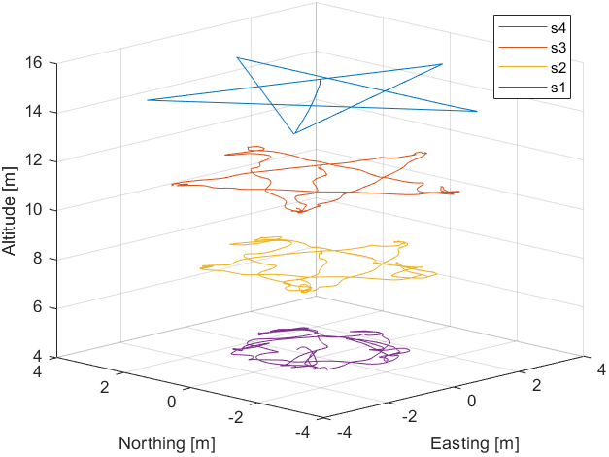
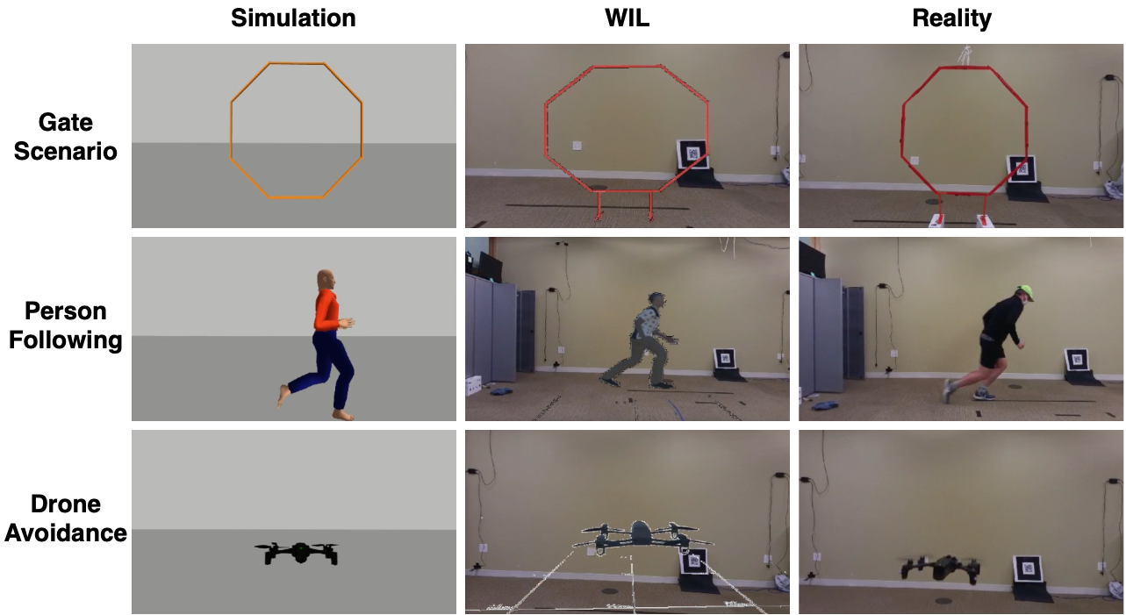
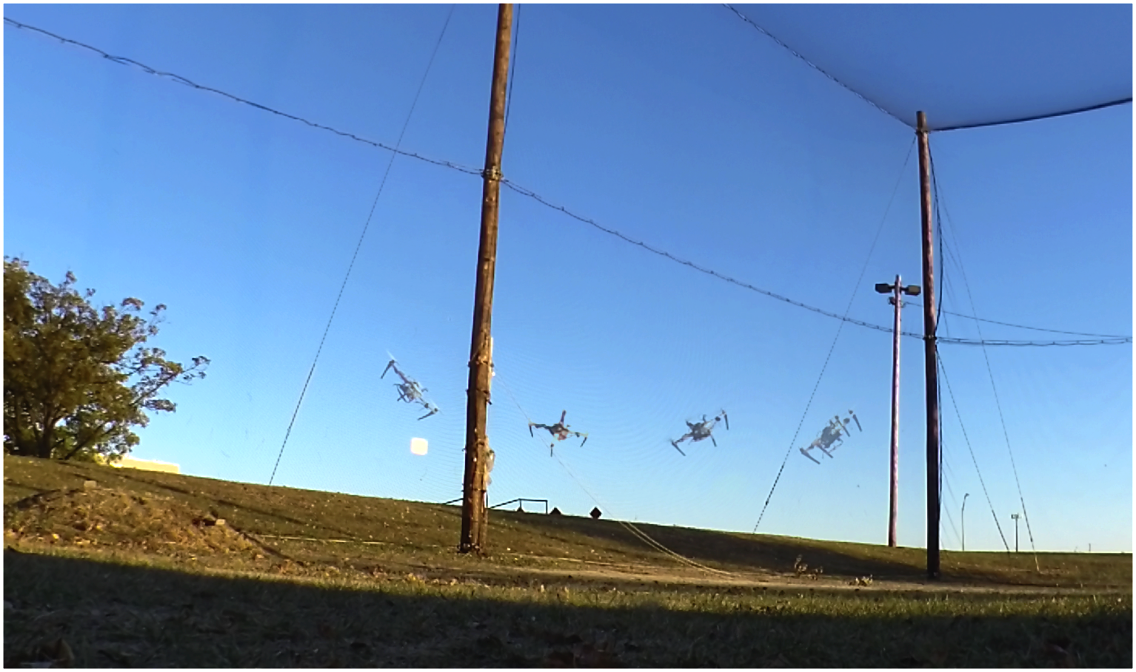
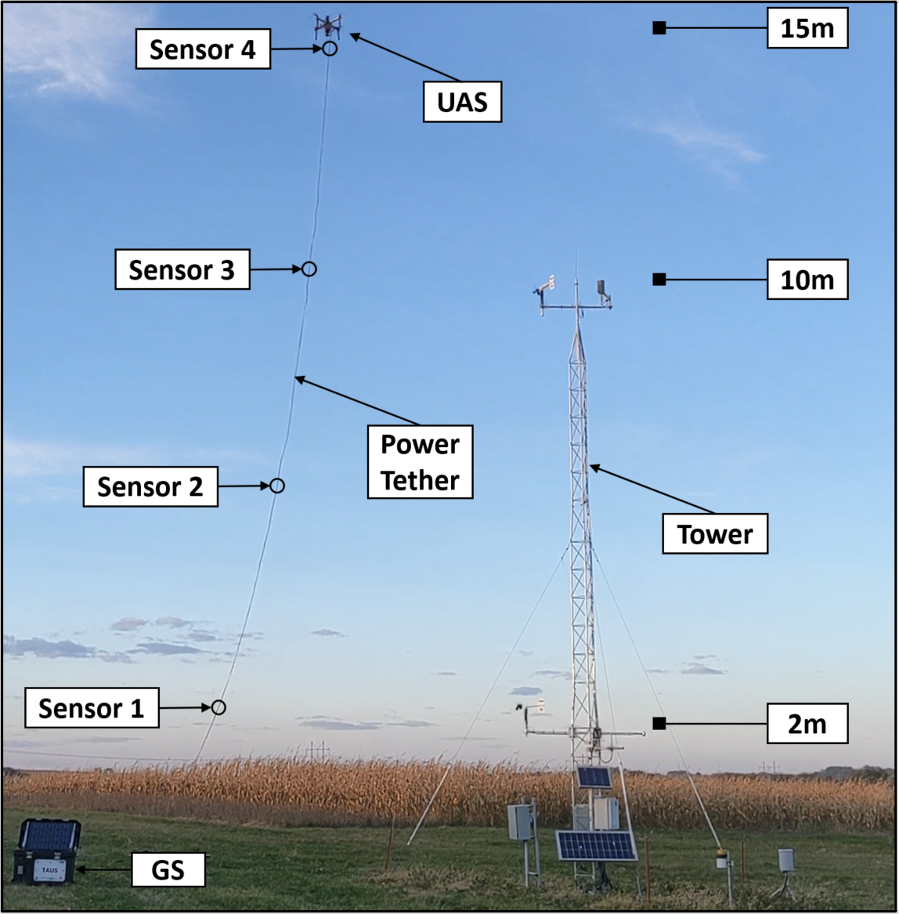
Raining Drones: Mid-Air Release & Recovery of Atmospheric Sensing Systems
University of Nebraska-Lincoln: Detweiler, Houston; University of Virginia: Elbaum
TALKING HEAD
Planning and Control
For Aggressive Maneuvers
And Rapid Aerial Deployment
Atmospheric
Deployments
Development
Techniques & Tools
https://github.com/unl-nimbus-lab/Freyja
World in the loop (WIL): reducing simulation-reality gap with mix-reality
Swarmbug: debug, fix, validates buggy behaviors caused by swarm misconfigurations.
Contact: carrick@cse.unl.edu, selbaum@virginia.edu
Notes:
The activities that we have carried out can be organized in three groups.
First, we have pursued the development and deployment of planning and control stack to perform aggressive areal maneuvers outdoors, including drone engagements, which I will demonstrate later
Second, in terms of improving the characterization of the lower layers of the atmosphere my colleagues at UNL have developed a tethered system that enables long term monitoring of atmospheric condition that continuously evaluate trajectories that optimize sensing of the atmosphere with changing winds and atmospheric properties. We aim to evaluate these in the field in the coming year.
Third, as we are building these aerial systems we have developed three general frameworks to more broadly support: control and planning, validation through a mix-reality simulation, and automatic debugging mechanisms for swarm deployments.

Slide 3
TALKING HEAD
High-level flight stack for precise multirotor control: https://github.com/unl-nimbus-lab/Freyja
Notes:
This video shows the Freja framework to support aggressive outdoor maneuver and complex trajectories

Slide 4
Raining Drones: Mid-Air Release & Recovery of Atmospheric Sensing Systems
IIS-1925052 & IIS-1924777: 2019-2022
TALKING HEAD
University of Nebraska-Lincoln: Carrick Detweiler, Adam Houston
University of Virginia: Sebastian Elbaum
February 27-28, 2020 | ARLINGTON, VIRGINIA
Challenge
Launch and recover UAS from moving platforms
Improve atmospheric sensing systems
Scientific & Broader Impact
Enable interactions of heterogenous UAS platforms while in motion
Evaluation of UAS based atmospheric sensing systems and sensors
Improve understanding of the lower atmospheric models
Generate unprecedented datasets
Solution
In-flight docking with optimal trajectories
Software analysis of probabilistic systems
Characterization of UAS atmospheric sensing
Contact: carrick@cse.unl.edu, selbaum@virginia.edu
Notes:
Please reach out to us if you have any questions.

