Slide 1
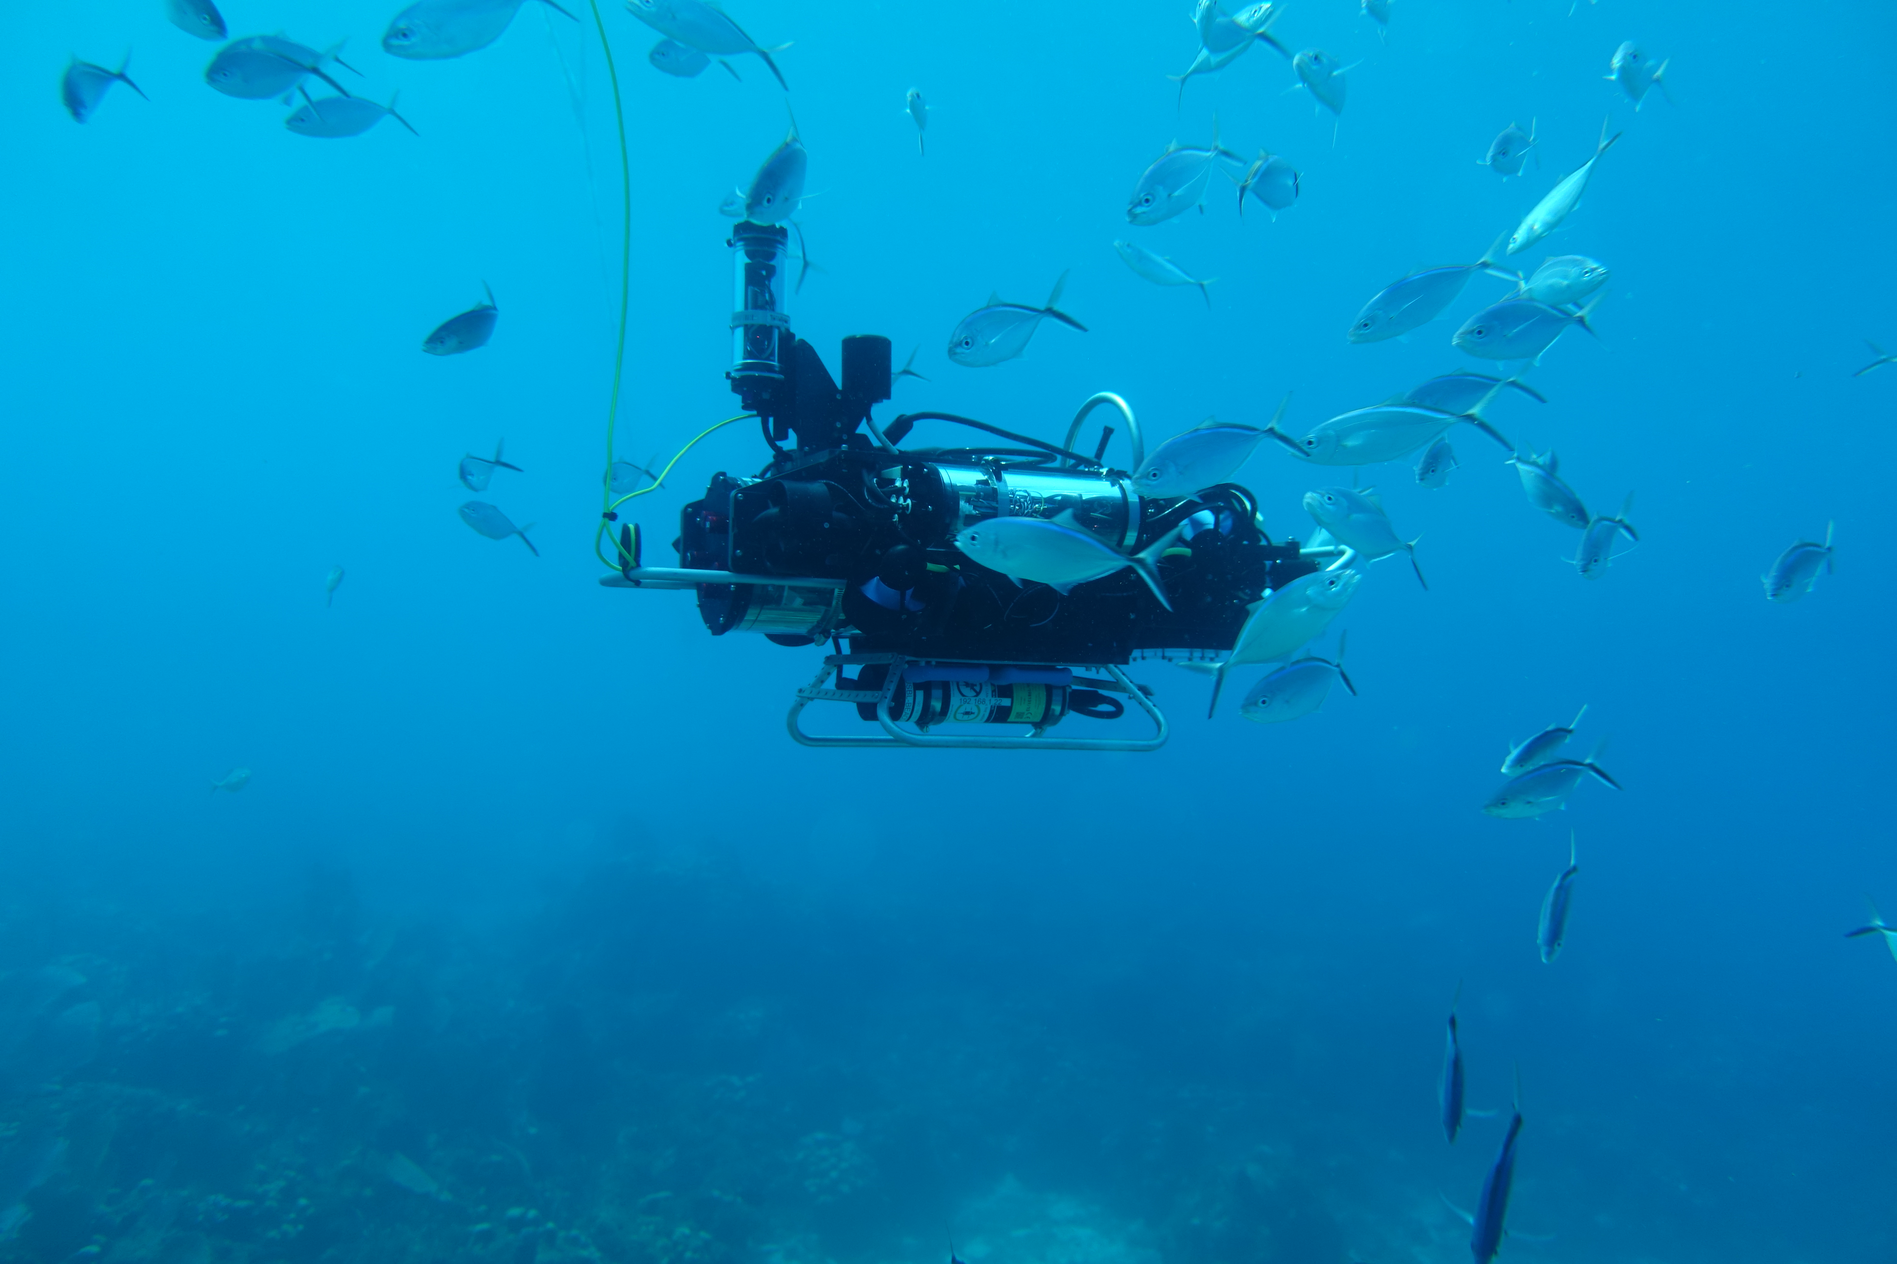
An Ecologically Curious Robot for Monitoring Coral Reef Biodiversity
Yogesh Girdhar, T. Aran Mooney, Frants H. Jensen, Seth McCammon
Notes:
Hi, I am Yogi Girdhar from Woods Hole Oceanographic Institution, and this is a joint project with Syracuse university.
We are officially one month into the project.
Coral reefs are under threat worldwide from anthropogenic disturbances and climate change. Coral reefs are one of the most diverse ecosystems on the planet. We currently do not have the tools necessary to rapidly assess the state of reefs in the presence of disturbances or interventions. This project aims to develop a robotic system that can efficiently characterize the biodiversity coral reefs.
If we had a magical robot, we would drop it on a reef, and in a short time it would come back with a spatiotemporal map of how different animals are distributed on a reef. This is however difficult to do because:
Animal taxa distribution is high dimensional; dynamic, and spatially sparse
Animals change their behavior near robots
visual observations have limited range. acoustic observations have low specificity.

Slide 2
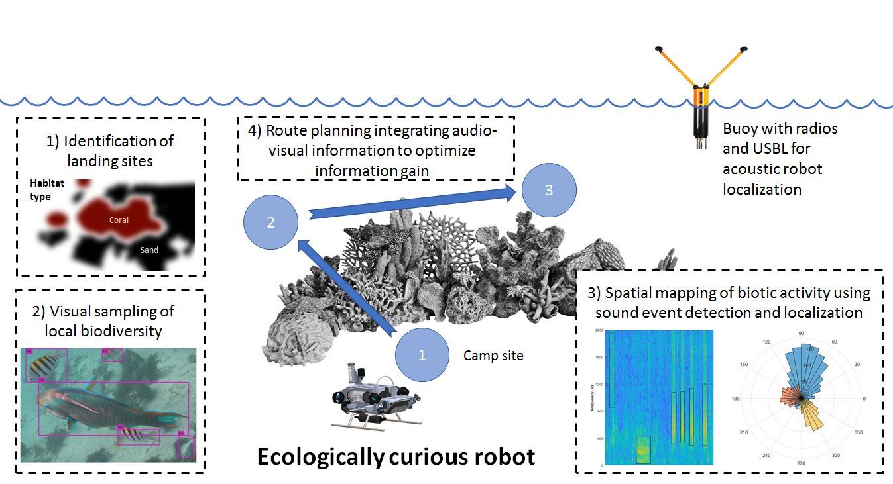

Key Ideas:
Notes:
To get over these challenges
we propose to build a robot that uses visual observations to characterize biodiversity, but uses passive acoustics to identify potential hotspots and plan information rich paths.
To enable efficient sampling of a spatiotemporal taxa distribution, we will propose to factor it using a latent variable representing different habitat types
Finally to mitigate the bias due to animal-robot interactions, we propose to only make observations when robot is stationary, and incorporating this constraint into the planning algorithm.
If you have any questions or would like to collaborate with us, please do not hesitate in contacting us.
Thank you.

