Slide 1
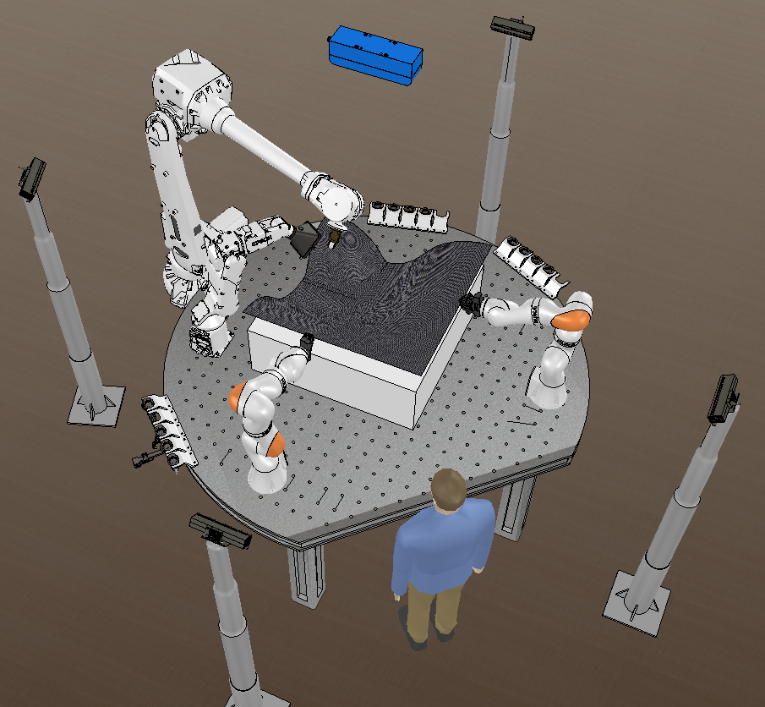
Human-Guided Robot Teams for Manipulating Large Flexible Sheets in Manufacturing Applications
Satyandra K. Gupta, University of Southern California; Award # 1925084
February 27-28, 2020 | ARLINGTON, VIRGINIA
Motivation
Advanced composites are critical to many industries
Layup of prepreg sheets is one of the main processes for realizing composite parts with complex geometries
Sheet layup process requires significant manual labor
Sheet layup automation can reduce ergonomic challenges and increase process throughput
Goals
Develop deliberative planning algorithms for collaborative manipulation by proactively accounting for interventions by controllers and humans during execution to handle contingencies
Develop algorithms for monitoring of the task progress during the execution and initiating interventions to ensure that part is manufactured in a safe and efficient manner
Integrate research results with manufacturing and robotics courses
Illustration of a hybrid cell that can be used for composite sheet layup

