Slide 1
NRI: FND: COLLAB: A Foundational Approach to Muscle Actuators that Lowers Barriers to Muscle-Powered Robotics Research
Co-PI Robert Wood, Harvard University
(PI: Michael YIP, UCSD)
Award # 1830291
Notes:
Fluid-driven robots are one of the most commonly used types of soft robots. They have been developed into a wide range of applications, wearables, prosthetics, bioinspired robots. Etc.
While these fluidic robots have the properties such as gentleness, robustness, flexibility, when you look behind the scene, they are typically tethered to rigid and bulky power sources power source to drive these robot.

Slide 2
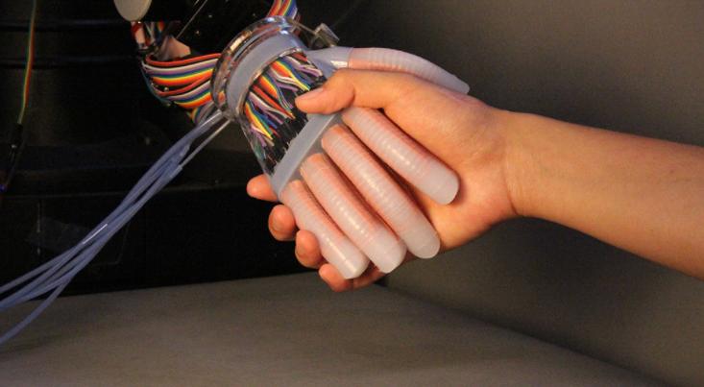
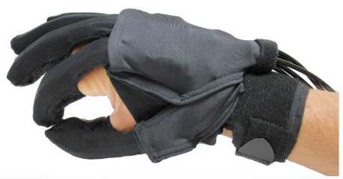
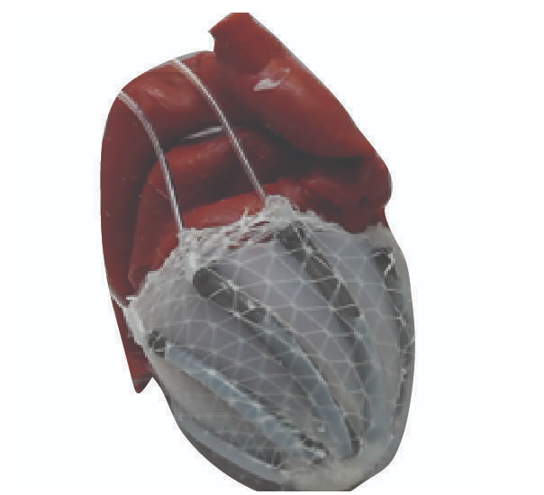
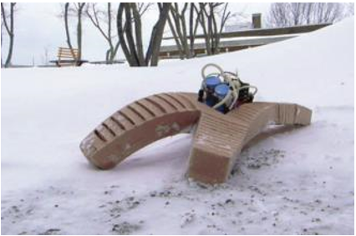
Soft Fluid-driven Robots
Soft robots driven by pressurized liquid or gas
Zhao et al, Sci. Robot., 2017
Polyferinos et al, ICRA, 2015
[3]
Roch et al, Sci. Transl. Med, 2017
Tolley et al, SoRo, 2014
Notes:
Fluid-driven robots are one of the most commonly used types of soft robots. They have been developed into a wide range of applications, wearables, prosthetics, bioinspired robots. Etc.
While these fluidic robots have the properties such as gentleness, robustness, flexibility, when you look behind the scene, they are typically tethered to rigid and bulky power sources power source to drive these robot.

Slide 3
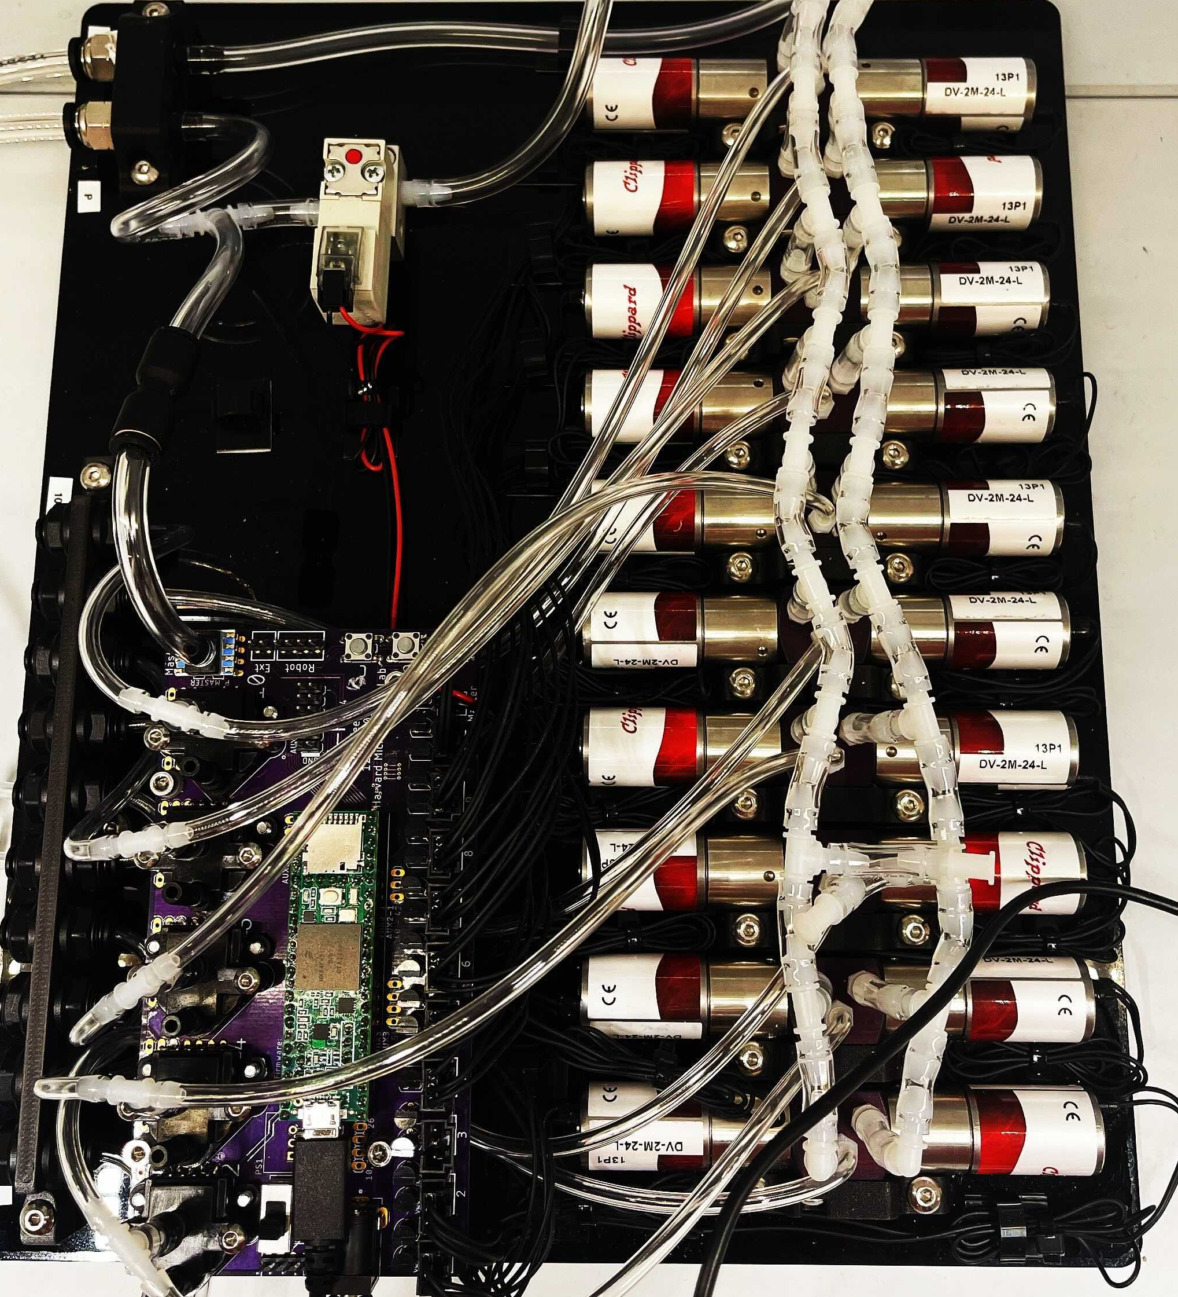
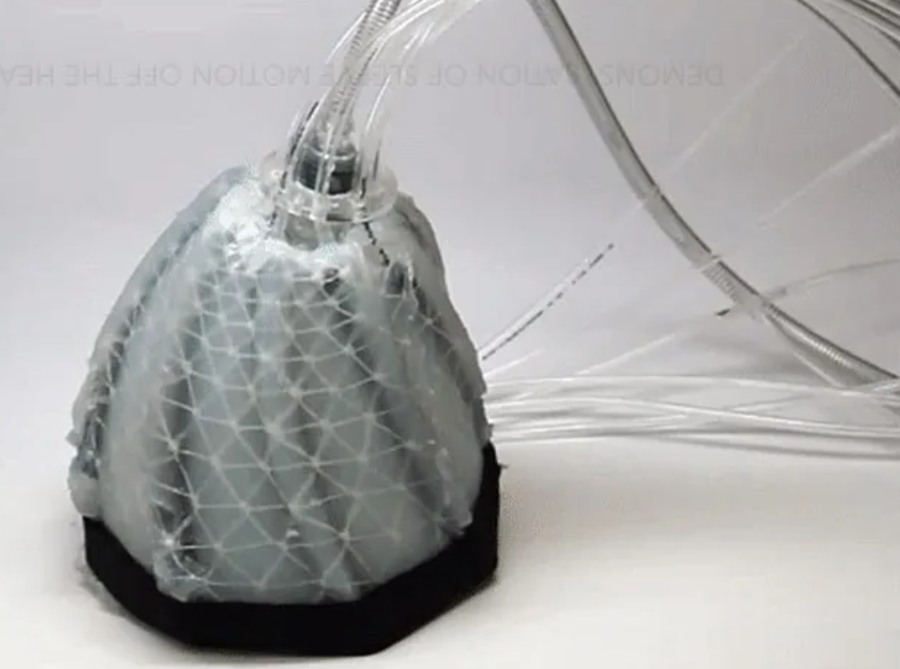
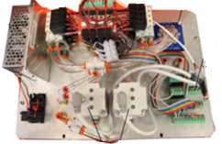
Soft Fluid-driven Robots
Fluidic robots need to be tethered to rigid and bulky power sources
Tubing
Tubing
Zhao et al, Sci. Robot., 2017
Polyferinos et al, ICRA, 2015
Tubing
Rigid pumps
Roch et al, Sci. Transl. Med, 2017
Tolley et al, SoRo, 2014
Notes:
These power systems significantly limits the mobility, compactness, and adaptability of the robot.
While microcompressors or miniature pumps could be used for conditions where low pressure is required, they are still composed of rigid component and therefore not ideal for applications where delicate objects are involved.

Slide 4
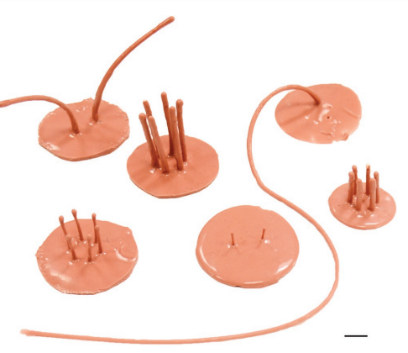
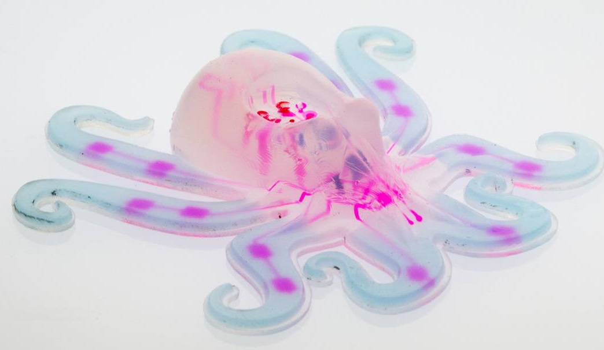
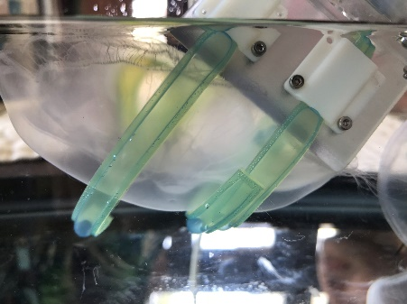
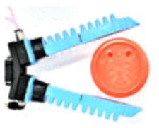
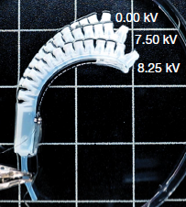
Objective: A Soft Valve
0.15-0.5g,
103-276kPa,
7g,
50kPa, 6.4mL/min
~5g / actuator,
40kPa
30g / actuator,
200kPa
30g,
15kPa, 6mL/min
Becker et al, Ad. Funct. Mater,, 2016
Wehner & Truby et al, Nature, 2016
Sinatra et al, Sci, Robot., 2019
Teeple et al, IJRR, 2020
Cacucciolo et al, Nature, 2019
Lightweight and compact
Able to regulate pressure >10kPa
Able to provide flow rate >6mL/min
Response time << 2s
Electrically responsive
Notes:
So our goal is to develop a lightweight and compact soft valve that could control these hydraulic actuators;
To be more specific,
We want the valve to regulate a pressure of at least 10 kPa, and provide a flow rate no lower than 6 mL/min.
In addition, to achieve precise motion controls, the valve should have a short response time.
Lastly, we would like the soft valve to not require any immobile pressure source, preferably to be electrically responsive for the control purposes.

Slide 5
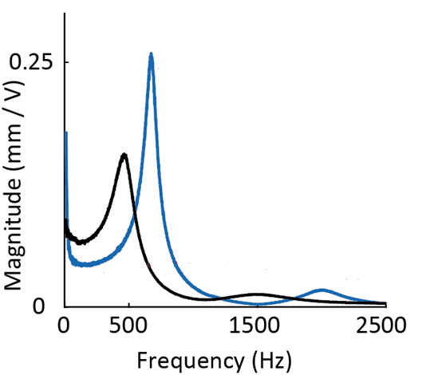
High Power Density DEA
Elastosil P7670
Low viscoelasticity and high dielectric strength
$$p= \frac{Fδ}{2m}∙f$$
$$F:blocked force$$
$δ$: free displacement
$f$: frequency
Our work
Previous work with the same DEA design
Chen et al, Nature, 2019
5mm
Notes:
Let me show you the advantage of using the Elastosil silicone as the elastomer for the DEA.
Experimentally, the power density can be estimated using DEA’s blocked force, free displacement, and operation frequency
We compare our work with a DEA of the same design developed in previous work Due the low viscoelasticity of the silicone, our DEA has a higher resonant frequency, with a much larger free displacement at the resonance.
This behavior substantially increase the displacement term and the frequency term in the power density equation.

Slide 6
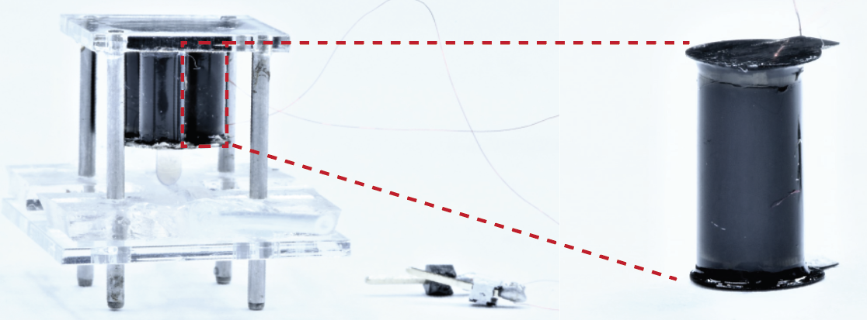
Dynamic DEA-valve
Operation frequency: 525-575Hz
DEA
Mechanical frame
Indenter
Soft channel
Fluid flow
5mm
5mm
5mm
Notes:
The DEAs are combined with the soft channel using a mechanical frame, with the channel mounted to the bottom plate of the frame, and the DEA attached to the top plate. The DEA is in contact with the soft channel via a rigid indentor.

Slide 7
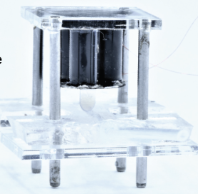
Dynamic DEA-valve
How to select the channel material?
Dissipative material?
X 0.0016
5mm
5mm
Notes:
when the DEA is at rest, the valve is open, allowing free flows through the channel
When a sinusoidal voltage signal is applied to the DEA, the it oscillates along its axial direction, fully or partially closing the valve depending on the magnitude of the voltage applied.
So I want to bring up a question here. Since the DEA is operated at its resonant frequency, how shall we select the channel material to make the valve resembles a regular quasi-static behavior? We want the valve to either open, partially open, or closed, but not oscillating between two status.
Intuitively, we would like the channel to be made of a dissipative material, so that it could damp out the high frequency input of the actuator.

Slide 8
Demonstration 1: Control of Macro-scale
soft actuators
Notes:
First , I’m gonna present the open loop control of a macro-scale actuator.
On the left, valve remains open throughout the process.
On the right, valve is operated at 1800V, and closed the channel for a few seconds. This leads to a fully stop of the actuator which caused a difference in the bending motion.
Then I’m gonna demonstrate a deceleration control of the actuator.
Again, on the left, the valve remains open throughout the actuation process.
On the right,--valve is at operated at 1400V this time. This control slows down the bending motion instead of stopping it, and it shows that the actuation speed could be tuned by the valve input voltage.

Slide 9
Demonstration 2: Control of small volume
soft actuators
Notes:
In addition to a macro-scale actuator, the DEA valve can also control a small-volume actuator due to its high operation band width.
This hydraulic system has a less than 2s actuation time.
As we operated the valve at 1800 V, the actuator was stopped during the bending process.

Slide 10
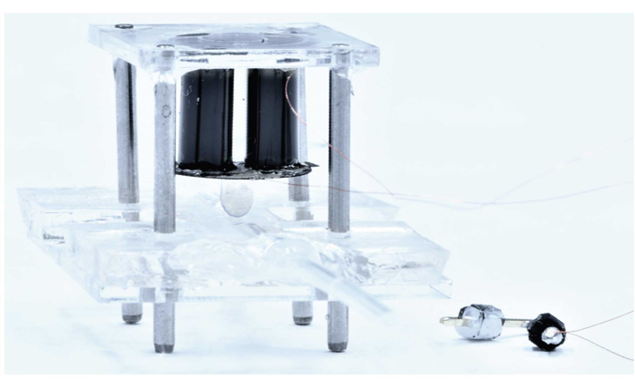
Contributions
The first electrically-controlled soft valve based on high power density DEAs that realized open- and closed-loop control of hydraulic actuators of multiple scales.
5mm
S. Xu, Y. Chen, N.P. Hyun, K. Becker, R.J. Wood, PNAS, 2021
J. Poccard-Saudart, S. Xu, et al. RAL-IROS, 2022, submitted
Notes:
To sum up this section, we developed an electrically control soft valve based on high power density DEAs, We first time demonstrate both open and closed loop control, as well as the tele-operation of hydraulic actuators,

