Slide 1
Robotic Collaboration Through Scalable Reactive Synthesis
NSF NRI FND: 1830549
PIs: Lydia E. Kavraki and Moshe Y. Vardi
Notes:
I am Lydia Kavraki and I will be presenting progress on the NRI project Robotic Collaboration through Scalable reactive synthesis. Moshe Vardi and I are co-Pis of this project at Rice University.

Slide 2
Robotic Collaboration Through Scalable Reactive Synthesis
Motivation: We want humans and robots to safely and effectively collaborate on complex tasks
Overall Approach: We formally model the human-robot ensemble as a game in order to provide formal guarantees such as:
Safety
Optimality
Correctness
Notes:
In our project we study human robot collaboration in the context of complex tasks with emphasis on manipulation. To guarantee properties such as safety, we need some formal model of how the human and robot interact. We then treat this model as a game where our goal is to synthesize a policy, a mapping from states to actions, that tells the robot what to do whenever something goes wrong.

Slide 3
What about Stochastic Actions?
Given a finite-horizon temporal specification and a stochastic model of possible human-robot actions, synthesize a policy to maximize the probability of task completion.
Helpful human
Adversarial human
Wells, M. Lahijanian, L.E. Kavraki, M.Y. Vardi. Finite Horizon Synthesis for Probabilistic Manipulation Domains, ICRA 2021
Notes:
This year we continues our work on incorporating stochastic agent models
There are many scenarios where we may want stochastic actions: Consider our example execution in this slide. If we have data that supports a belief the human will be helpful, the robot can choose to build the arc close to the human (instead of far from the human) and take advantage of the human’s help as shown in figure on the right.
The problem we are considering is the following: Given a finite-horizon temporal specification and a stochastic model of possible human-robot actions, synthesize a policy to maximize the probability of task completion.

Slide 4
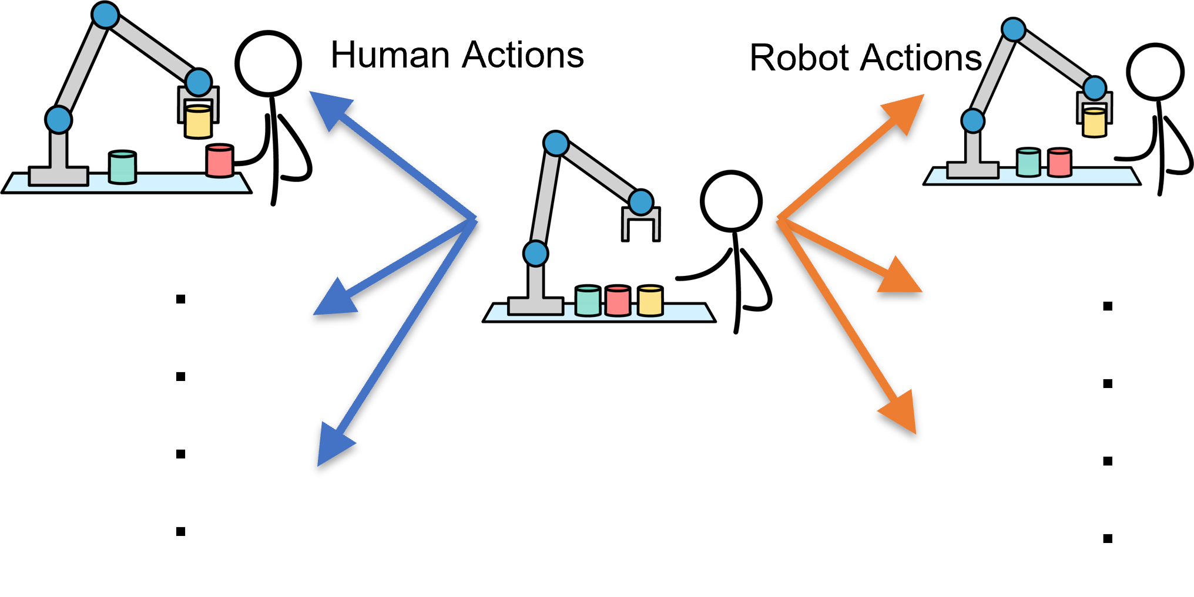
Formalizing Human-Robot Manipulation
Carefully define manipulation domain
Represent robot and human distributions with MDPs
Construct a MDP for the manipulation domain
Both human actions and robot actions have probabilistic models
Notes:
To solve this problem:
We need to carefully define our manipulation domain.
We have probabilistic models for the robot and human represented with MDPs.
We Combine the robot and human models to a manipulation MDP by solving two main challenges (namely whose turn is it and how to resolve conflicts)
========
I will not go into details here but we can do this in a way that the robot always defers to the human.

Slide 5
Symbolic Synthesis via Binary Decision Diagrams
Two main parts to our problem: Transition System and DFA
Both given with respect to some Boolean variables
BDDs compactly represent Boolean functions and sets
For scalability we analyzed different encodings for robotics:
Integer (default)
Object to Location Map (for each object, denote the location it occupies)
Location to Object Map (for each location, denote the count of occupants)
R. E. Bryant, “Graph-based algorithms for boolean function manipulation,” IEEE Transactions on Computers, vol. 100, no. 8, pp. 677–691, 1986.
Notes:
Then we perform symbolic synthesis via binary decision diagrams to obtain a policy.
We show how to obtain encoding that are specific to robotic domains and improve scalability
======
Hence we are left with a transition system and a DFA obtained from the task specification
We now exploit our earlier work on this project that showed how to achieve symbolic synthesis using binary decision diagrams. BDDs.
Scalability is always an issue in synthesis when BDDs are used. We explored different encoding for manipulation domains showing their advantages and disadvantages.

Slide 6
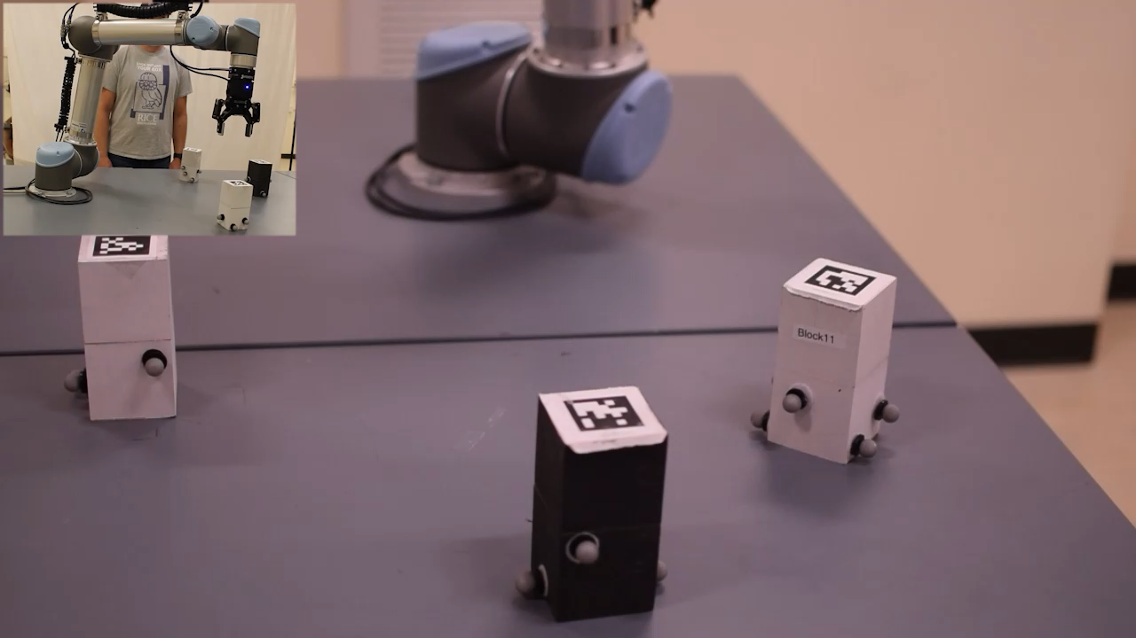
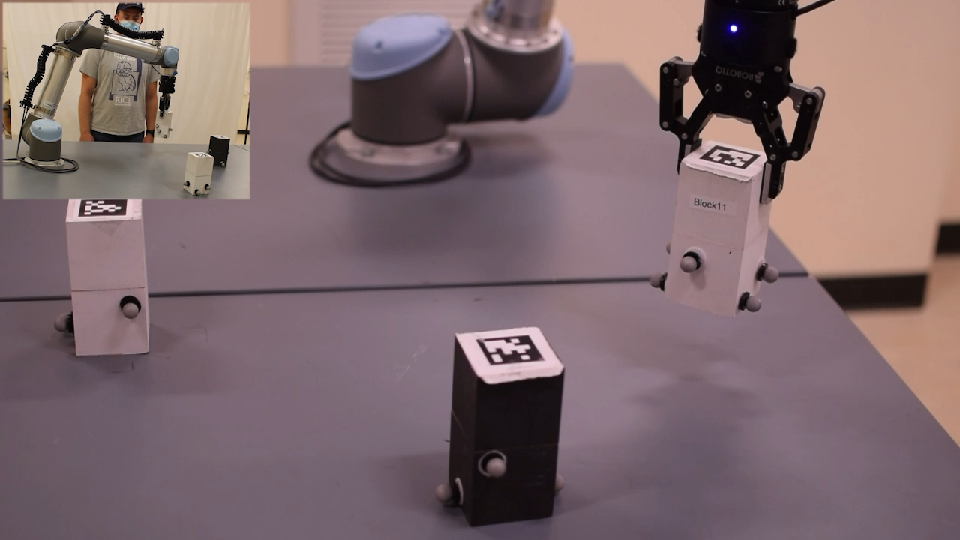
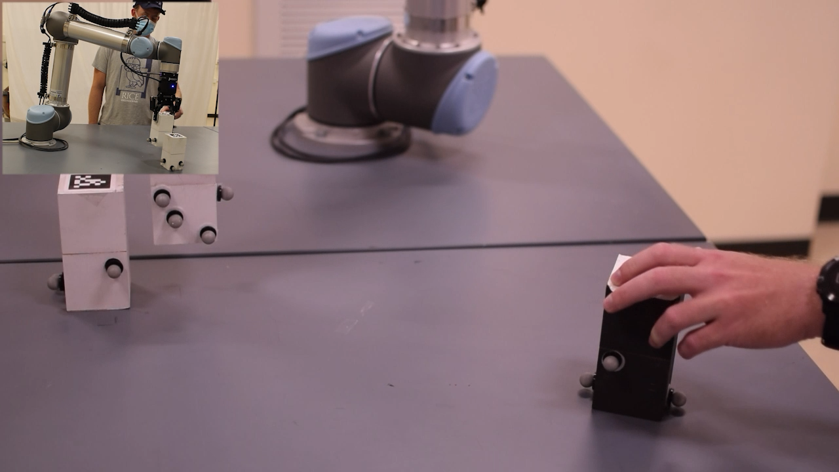
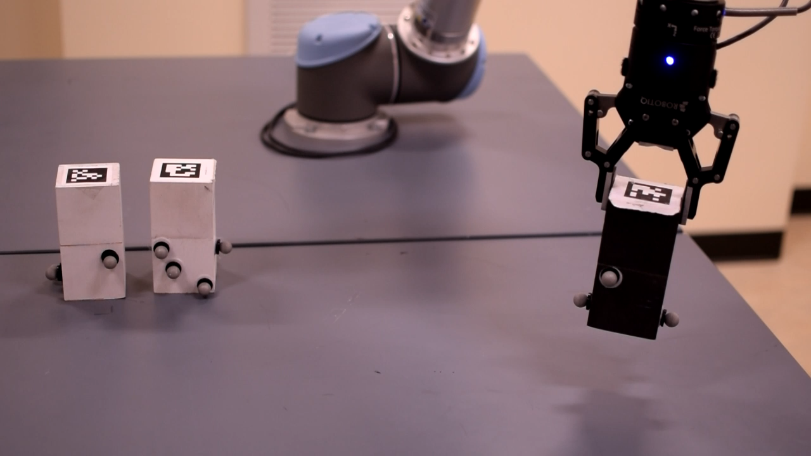
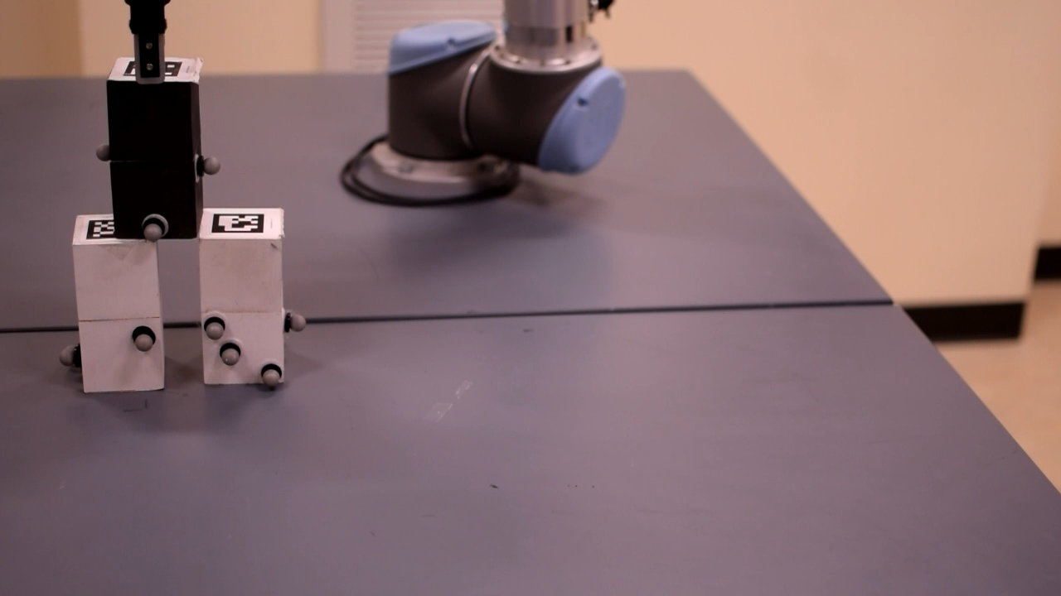
Demonstration
We demonstrate two example behaviors
The robot can complete the task despite an adversarial human
The robot and human can cooperate efficiently if the human is helpful
a)
b)
c)
d)
e)
At state (a) we anticipate adversarial human (c), leading to building the arch far away from the human (b-e).
a)
b)
c)
d)
e)
At state (a) we anticipate human cooperation (b-d), leading to faster expected task completion (e).
A. M. Wells, Z. Kingston, M. Lahijanian, L. E. Kavraki, and M. Y. Vardi, “Finite-Horizon Synthesis for Probabilistic Manipulation Domains,” in IEEE Intl. Conf. on Robotics and Automation, 2021.
Notes:
We demonstrate here two example behaviors
Top part - The robot can complete the task despite an adversarial human
Bottom part -- The robot and human can cooperate efficiently if the human is helpful

Slide 7
Summary
Introduced probabilistic synthesis for robot manipulation
Showed better encodings for symbolic synthesis for robotics
Tools are available on Github (https://github.com/KavrakiLab/probabilistic_manipulation)
Notes:
Introduced probabilistic synthesis for robot manipulation
Showed better encodings for symbolic synthesis for robotics
Tools are available on Github

