Slide 1


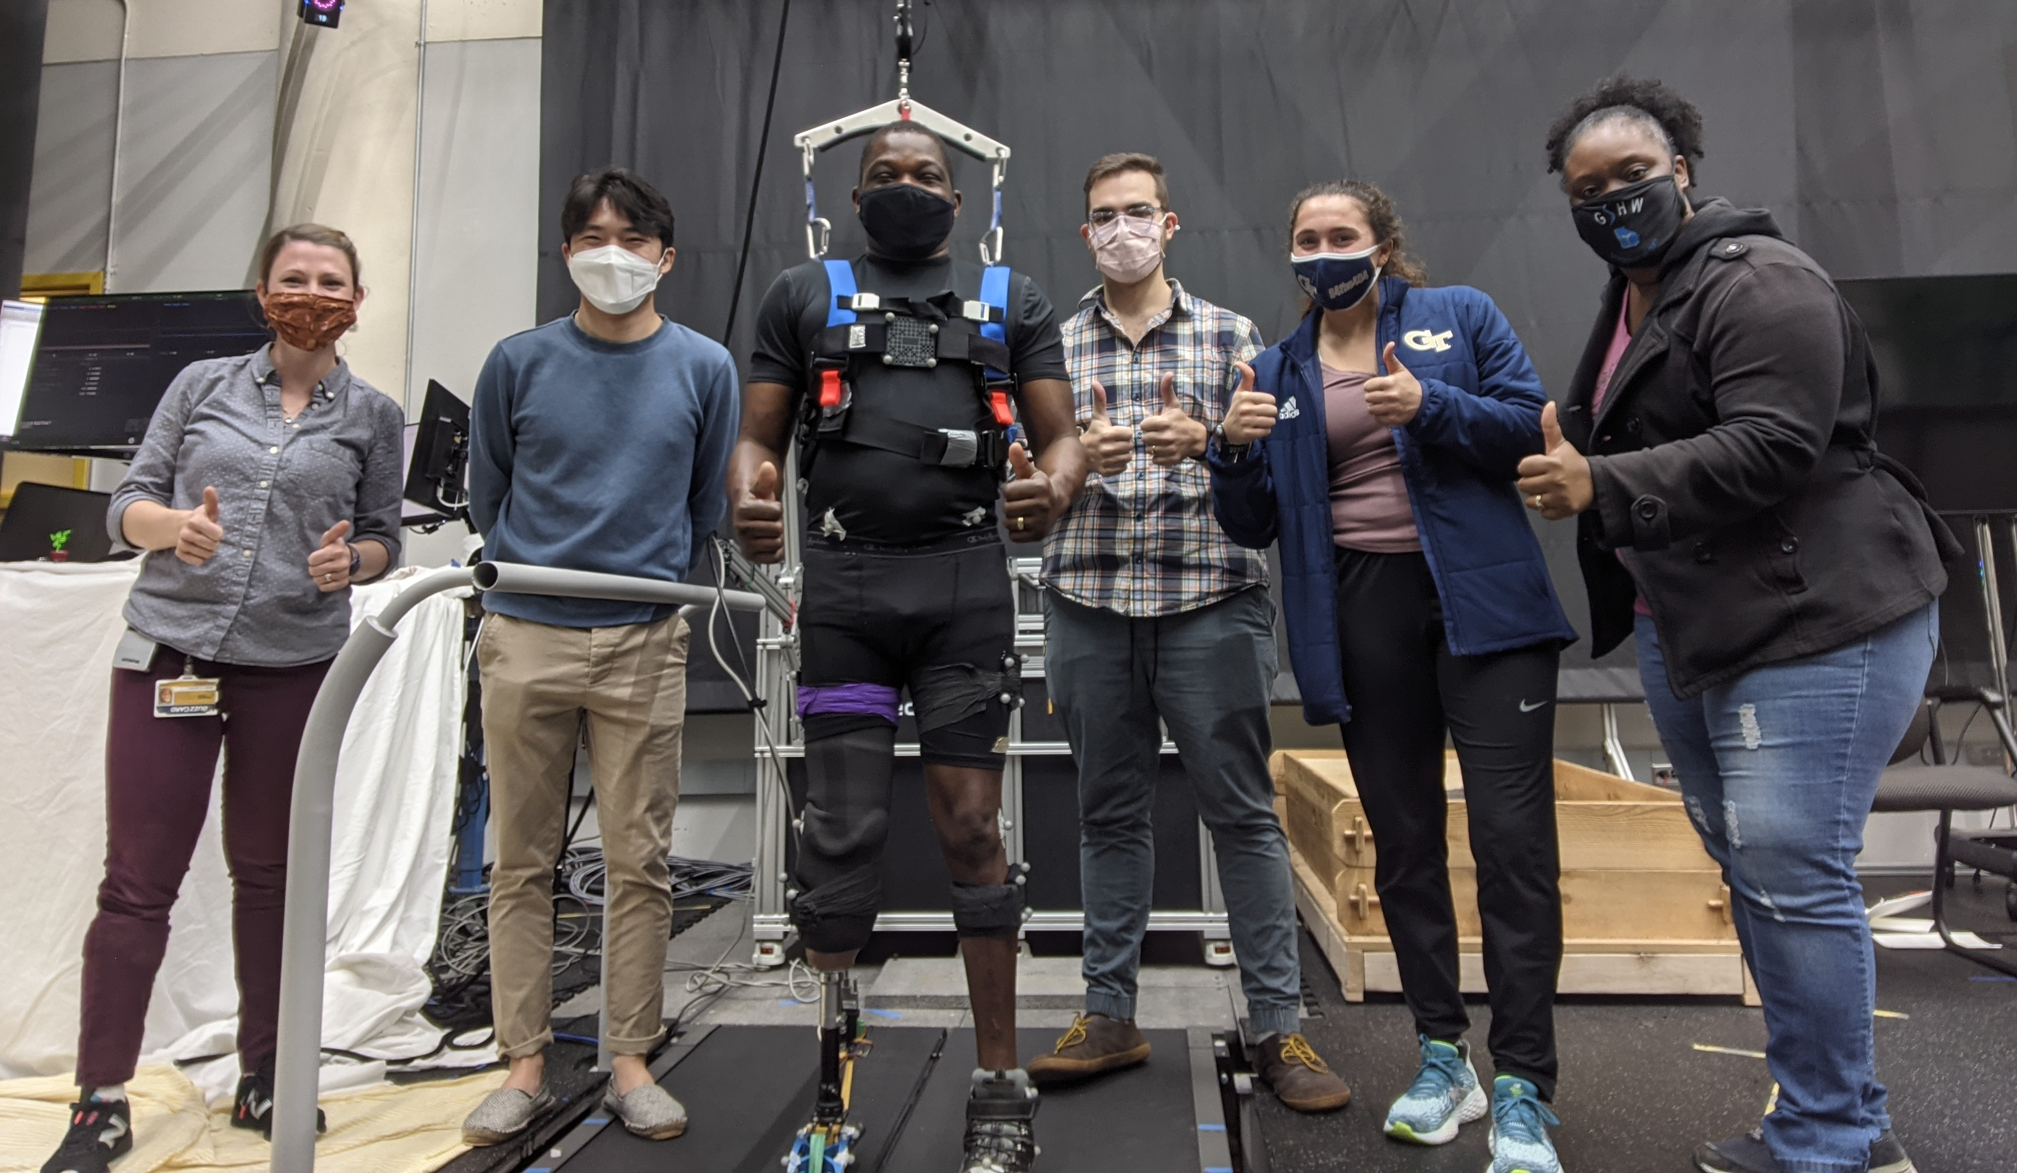






NRI:INT:COLLAB: Accelerating Large-Scale Adoption of Robotic Lower-Limb Prostheses through Personalized Prosthesis Controller Adaptation
Young-Hui Chang (PI), Kinsey Herrin, Chase Rock, Sam Kwak
Georgia Institute of Technology School of Biological Sciences, School of Mechanical Engineering
Georgia Tech
University of Alabama
Kinsey Herrin, MSPO, C/LPO, FAAOP
Mechanical Engineering
Co-PI
Xiangrong Shen, PhD
Mechanical Engineering
PD/PI
Sam Kwak
Applied Physiology
Graduate Student
Edward Sasanov, PhD
Elect & Comp Engineering
Co-PI
Chase Rock, MS
Applied Physiology
Graduate Student
* Audra Davidson MS, Margaret Berry MSPO, Gautam Desai, Saranya Gourisetti, Isabella Turner
Award #1734416

Slide 2
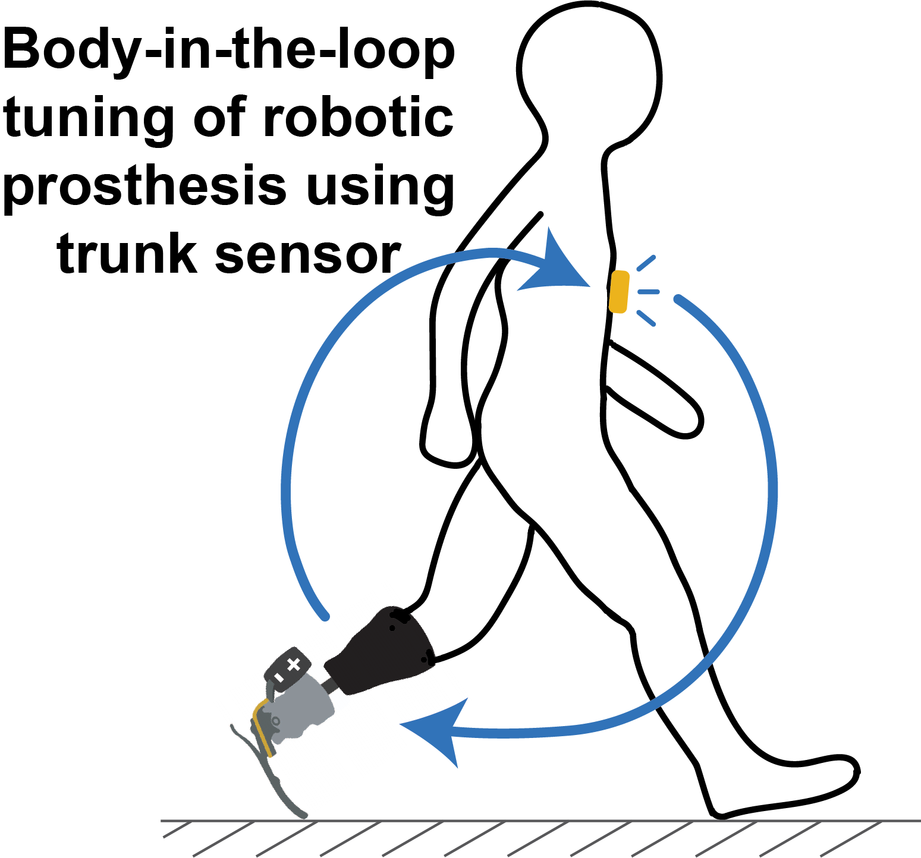
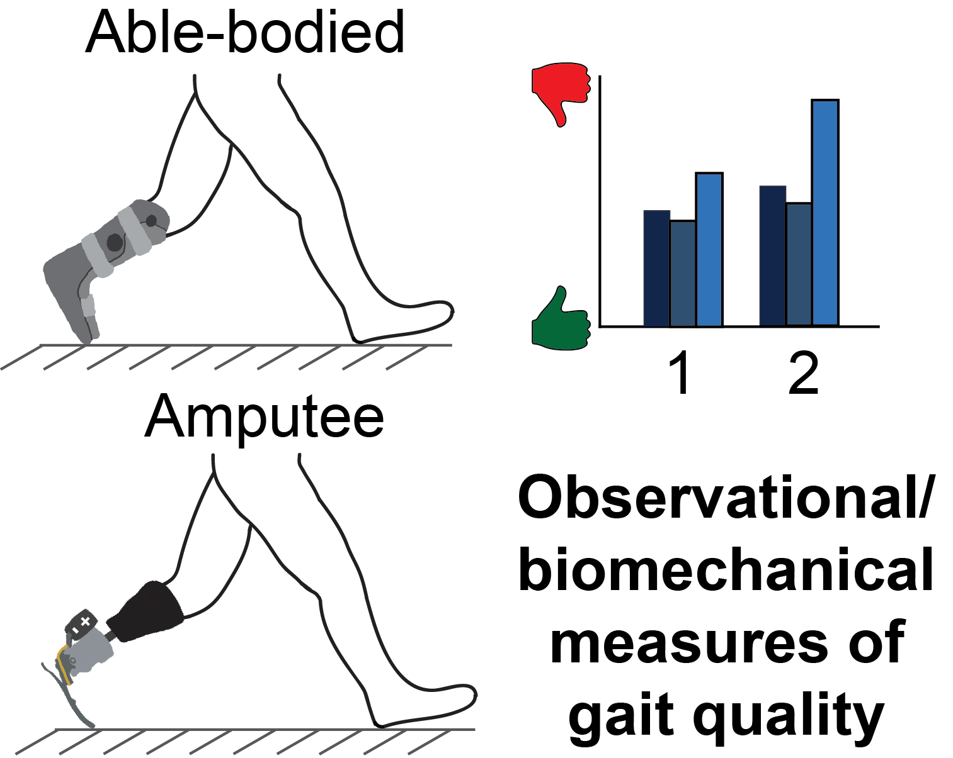
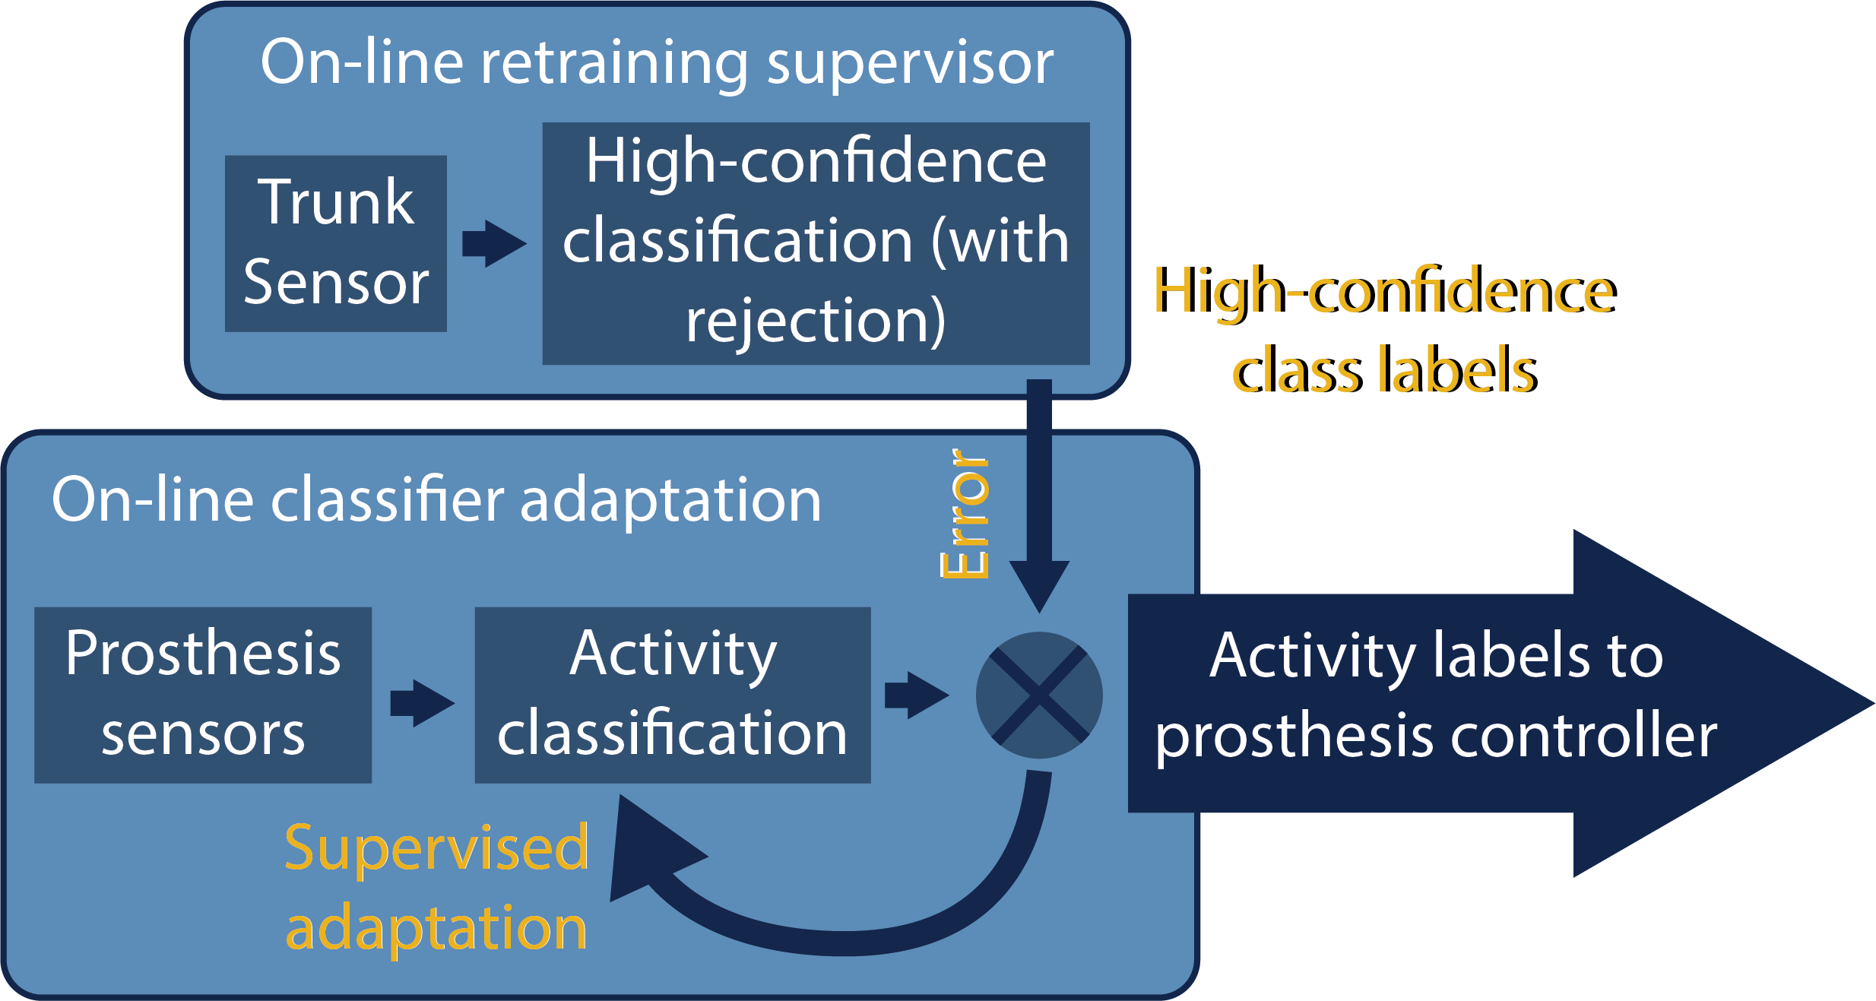
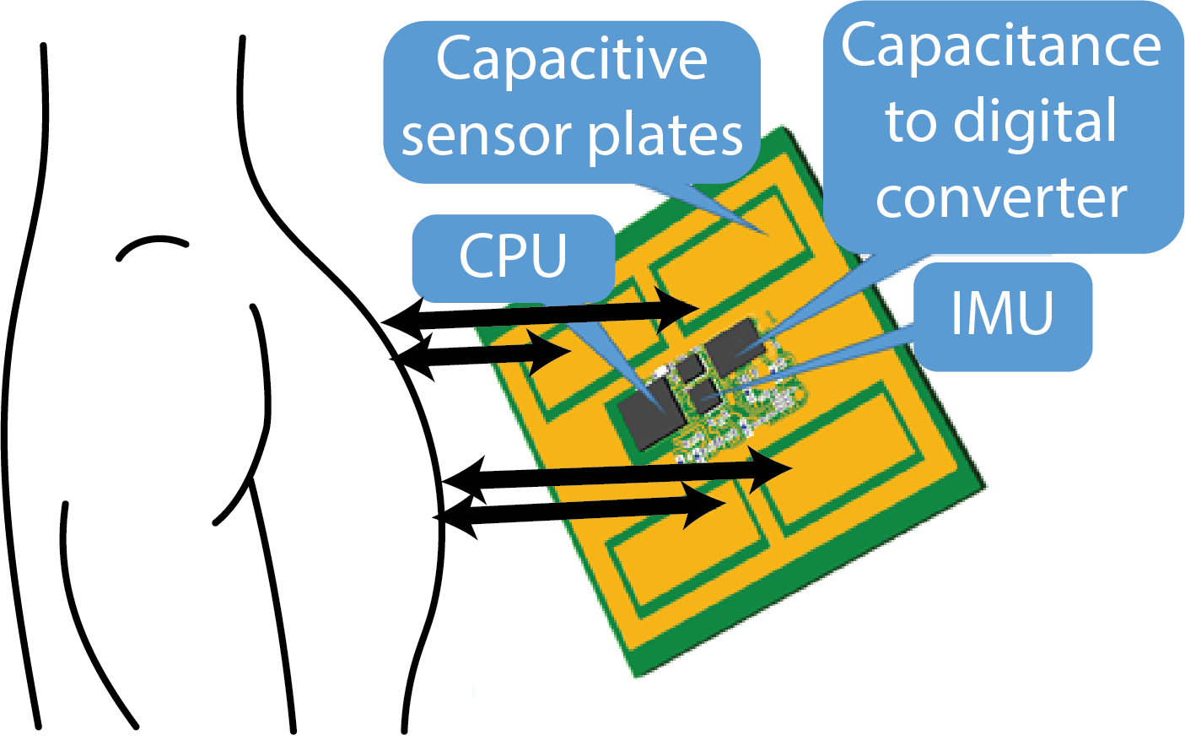

Quantifying Gait Quality for Automation
1. Quantify gait quality
2. Gait quality metrics to inform algorithm and trunk sensor development
3. Automatically tune prosthesis to optimize gait quality

Slide 3
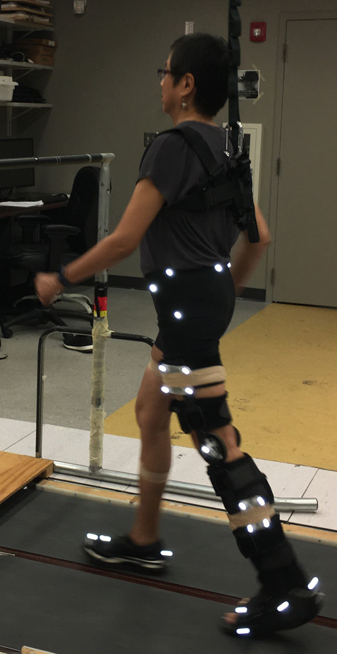
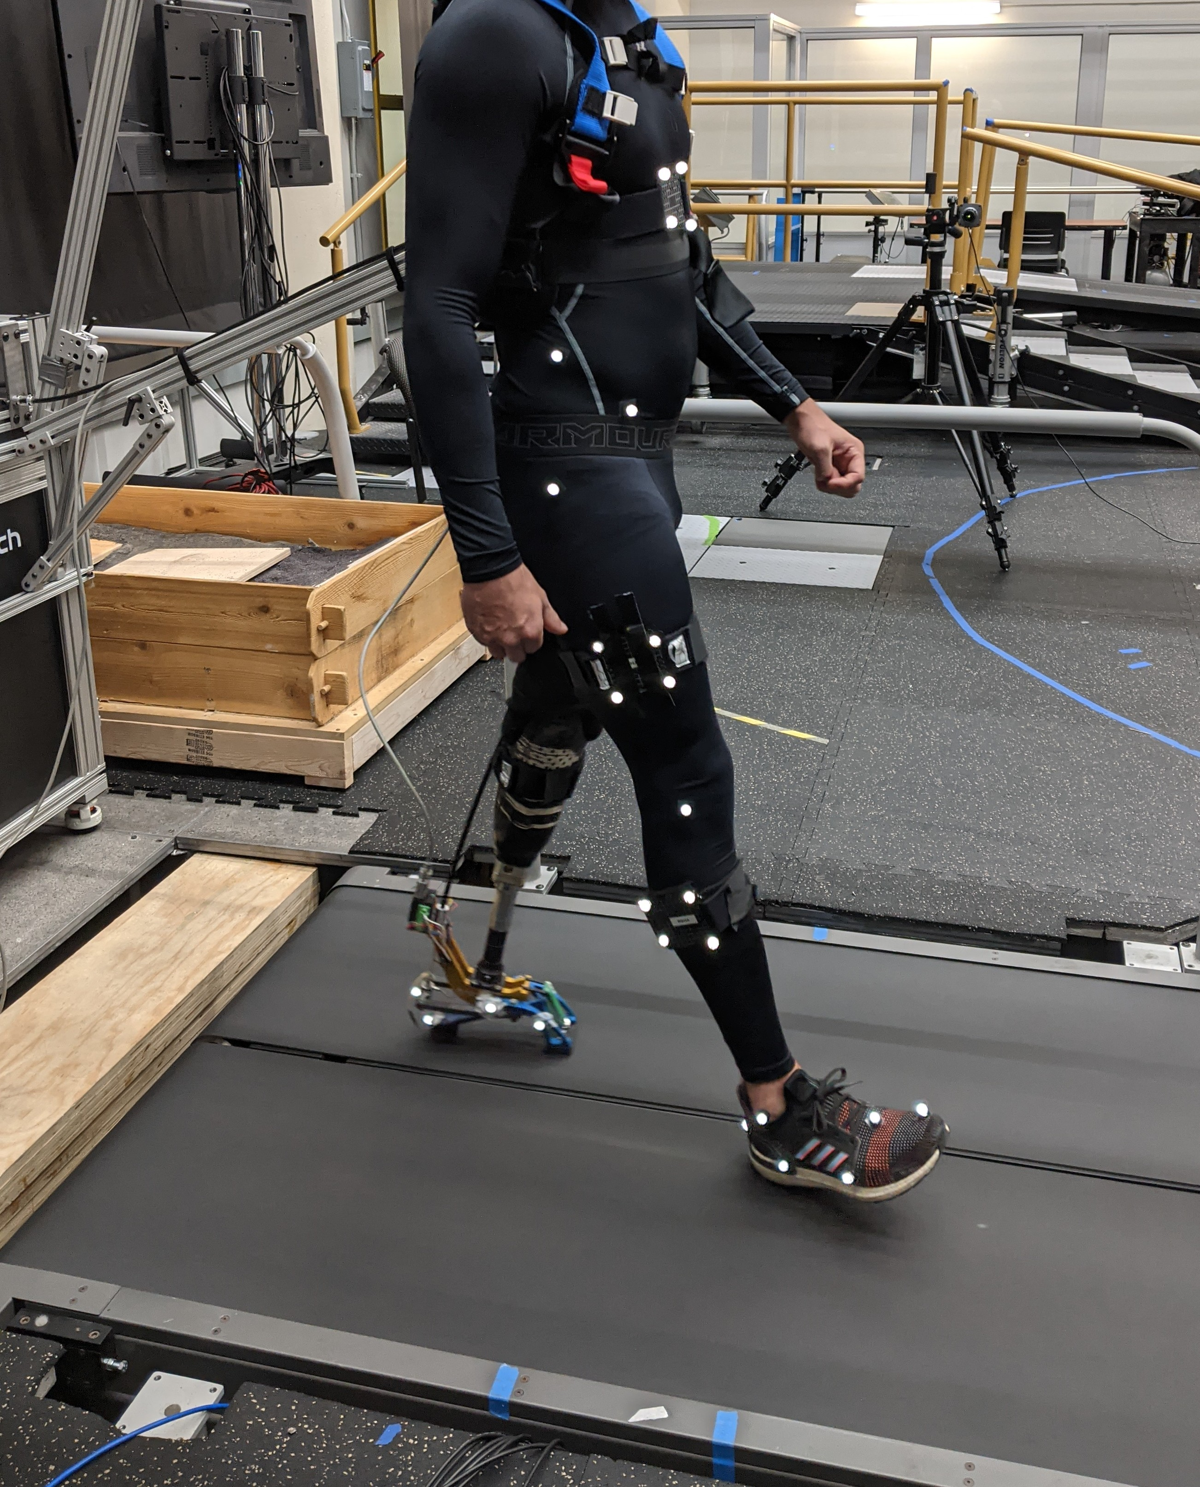
Quantifying Gait Quality for Automation
Herrin, Kwak, Rock, & Chang in review
1. Quantify gait quality
POGS
GDI/GQI
Lateral Sway
Impulse Asymmetry
TLA
LFA
Herrin, Kwak, Rock, & Chang in prep

Slide 4
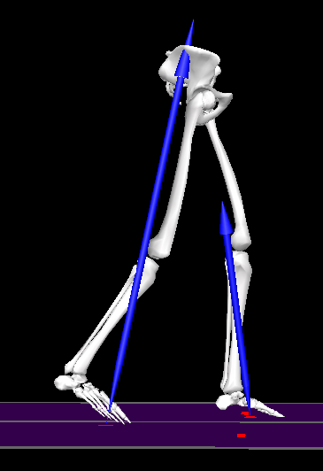

Limb-Force Alignment (LFA) distinguishes individuals
with a tuned robotic prosthesis
Limb-Force Alignment
Trailing Limb Angle (TLA)
-Sagittal Leg angle (COP->Hip)
-Lewek & Sawicki, 2019
GRF Angle (GRFA)
-Sagittal GRF angle
HumoTech, ankle-foot Px emulator
9 subjects w/ transtibial limb loss
Passive prescribed Px
Untuned Px Emulator
Tuned Px Emulator

Slide 5
Limb-Force Alignment (LFA) distinguishes individuals
with a tuned robotic prosthesis
Limb-Force Alignment
Untuned
Tuned
*
Passive
Untuned
Tuned

