Slide 1

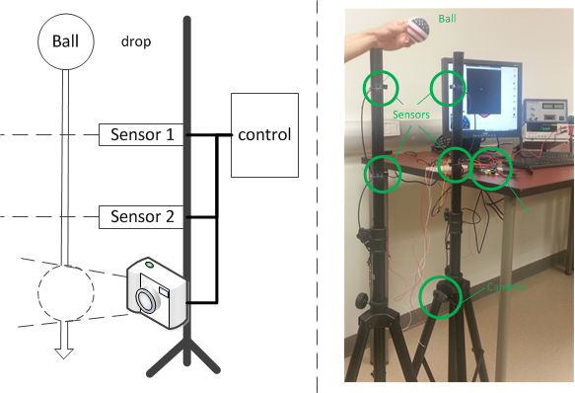
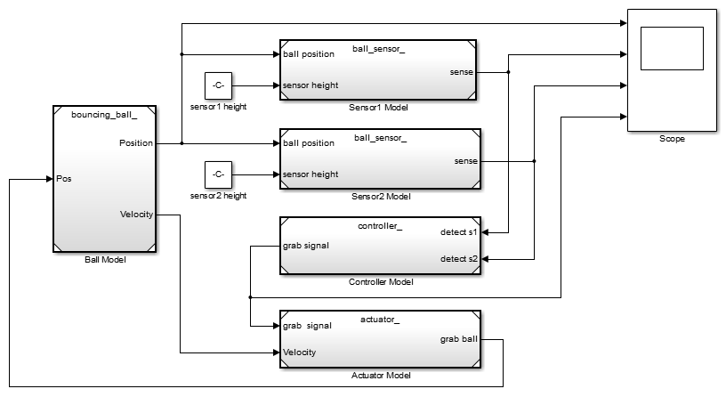
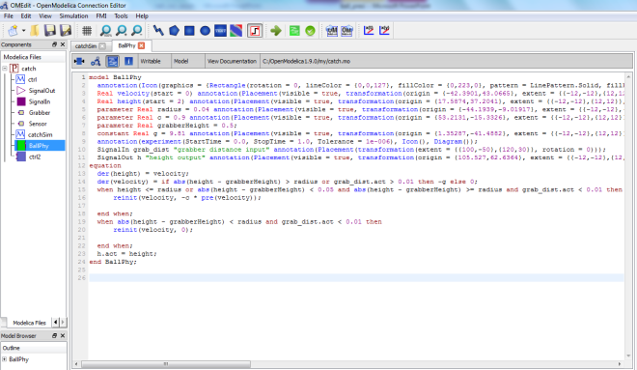
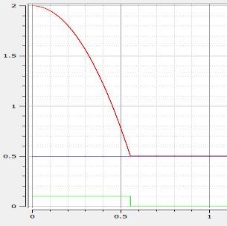
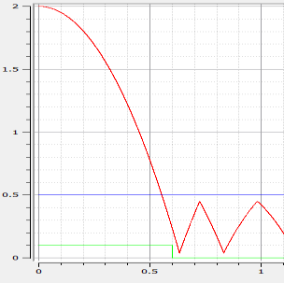
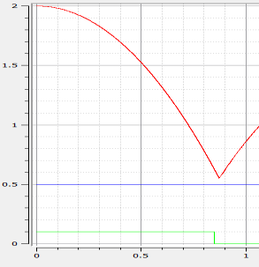
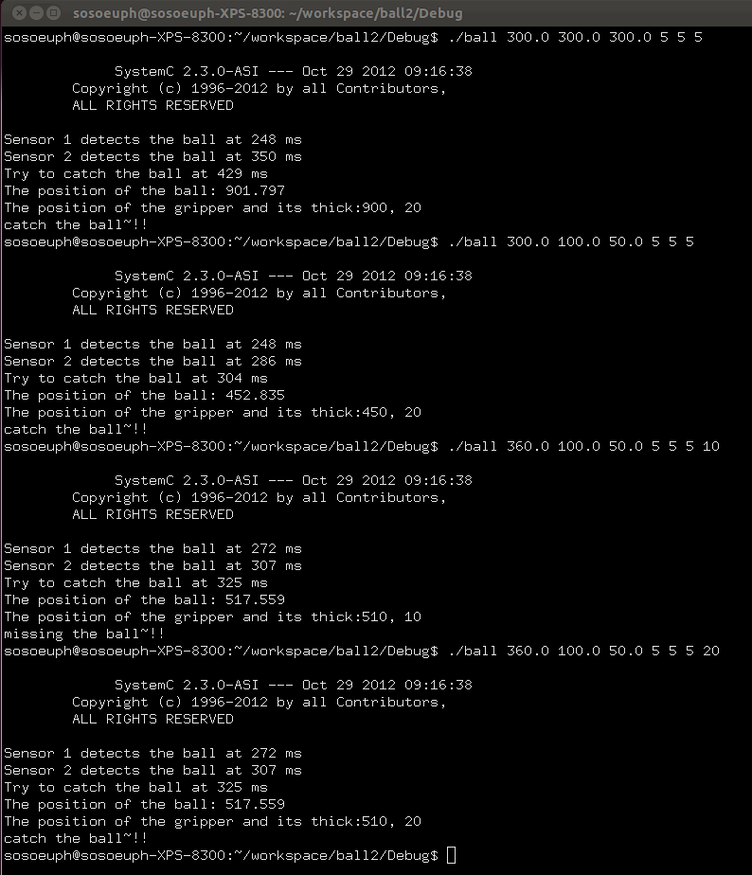

CPS Design Group
cps.ics.uci.edu
A Ball Goes to School -
Our Experiences from a Cyber Physical Systems Design Experiment
Steffen Peter, Frank Vahid, Daniel Gajski, and Tony Givargis
Motivation/Approach
Develop an educational program to teach CPS design to graduate Computer Science students.
Improve understanding of CPS design and sharpen attention in crafting solutions by teaching:
Typical design flows for CPS design
Importance of models and their limitations
Introduction to state-of-the art simulation and modeling tools
Apply small examples, that are:
Easy to understand
Possible to design and evaluate using a variety of tools and methodologies
Is implementable in the lab
The Falling Ball Example
A camera should take a picture of a falling ball that is dropped from a variable height.
Sensors mounted above the camera detect the ball.
A program in the cyber part of the system estimates the approaching time.
Benefits:
Easily understood
Need for precise timing
Physical process needing mathematical modeling
No perfect precision in cyber part
Can be build in the lab
Modeling and Implementation
Students modeled or implemented the system applying a range of tools (one per student)
Progress, advantages and problems of the selected tools are discussed in the group
Simulink
Lab implementation
running on
Raspberry Pie board
//======================================================
// Name : ball.cpp
//======================================================
#include <iostream>
#include "ball.h"
Ball::Ball(sc_module_name name): sc_module(name) {
time_us = 0;
g_force = 0.0000000098;
SC_METHOD(position_update);
dont_initialize();
sensitive << clk.pos();
}
void Ball::position_update() {
position = 0.5 * g_force * time_us * time_us;
//cout << "position:" << position << endl;
//cout << "time: " << sc_time_stamp() << endl;
time_us++;
}
Modellica
position = 0
cyber_clk @ 1KHz
physical_clk @1MHz
sensor_1
Controller Module
Ball Module
sensor_2
position
gripper
Height [m]
position = 0.5 x a x t²
Time [s]
SystemC
Results:
Conclusions:
The Falling Ball example is a suitable use case to teach CPS design
Simplicity of the example allows students to focus on the actual CPS design challenges
In four weeks (10h/week) students learned how to use tools, model the system, run simulations, test the system and evaluate the results
Discovered design challenges are good support for lecture
Discovered and discussed challenges:
Math and modeling the physical system
Separation of physical and cyber part
Design methodologies of graphical design tools
Selection of an appropriate Model of Computation
Zeno behavior and simulation time resolution issues
Project Contact: Web: Funded by:
Steffen Peter (st.peter@uci.edu) cps.ics.uci.edu National Science Foundation

Slide 2
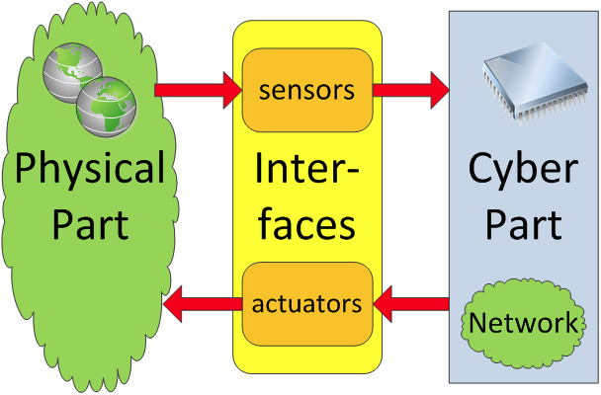
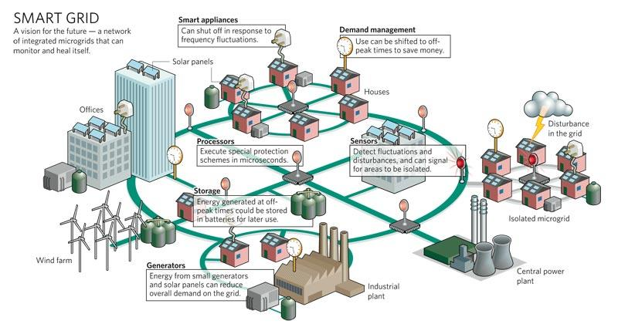
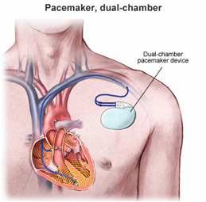
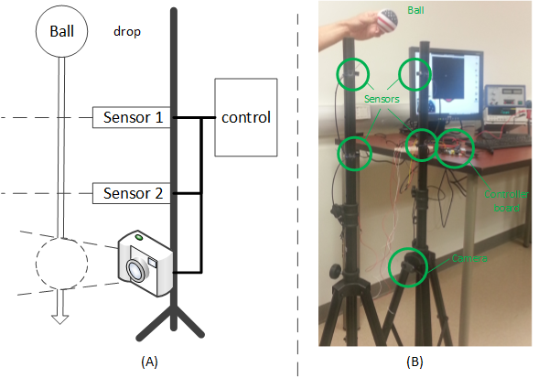
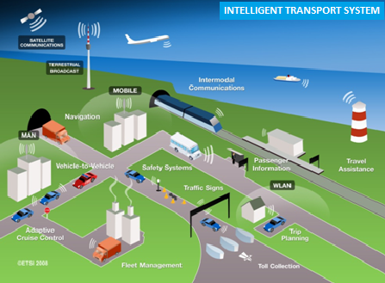

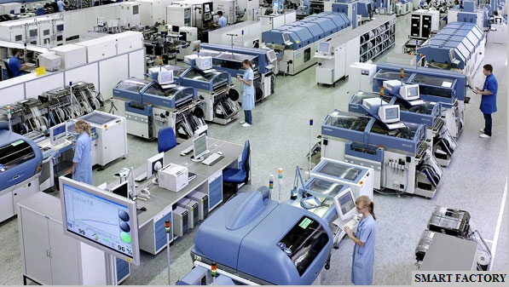
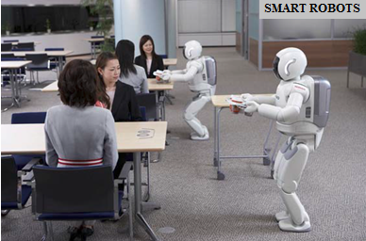
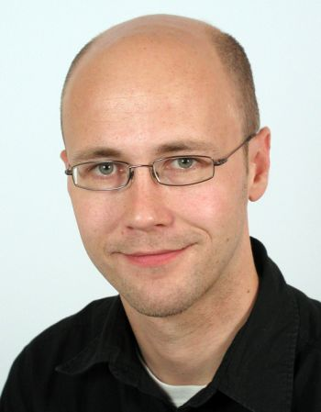

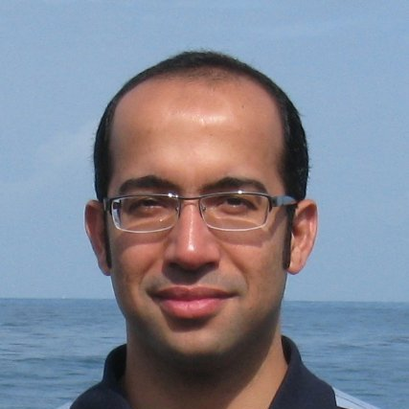

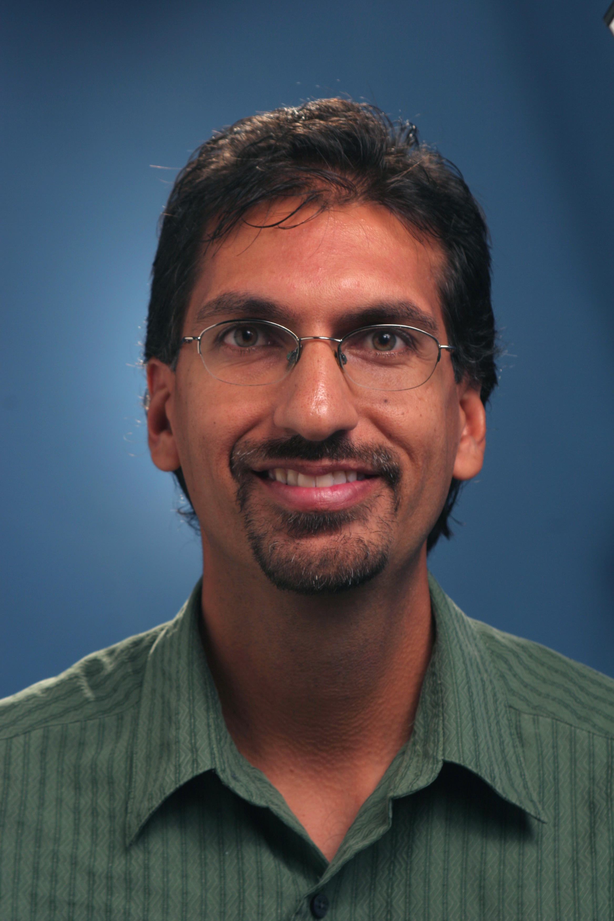

CYBER-PHYSICAL SYSTEMS (CPS) DESIGN
Project: Design Science for Cyber Physical Systems (DesignSciCPS)
Mission Statement
CPS Group’s commitment is to actively contribute to design and development of Cyber-Physical Systems to provide great insight on CPS and pave the way for the CPS research community.
Cyber Physical Systems
Cyber-Physical Systems (CPSs) are complex, multi-disciplinary, physically-aware embedded systems that integrate embedded computing technology (cyber part) into physical phenomena (physical part) by using sensor and actuator components. This integration mainly includes observation and control aspects of physical systems.
Project Goals
(1) Unified Theory & Modeling Approach:
  allows specification, modeling, design, optimization and verification of a CPS on different levels of design abstraction and different steps of production.
(2) A Design Methodology for CPS:
  builds on the unified theory.
  describes a sequence of necessary and sufficient models, design decisions, and tools that systematically lead from a specification to the design of the final product.
(3) A target platform for CPS:
  defines a platform of pre-designed high-level objects that are domain specific, but not limited to a single application.
(4) A new strategy and technology for
CPS education:
  covers the combination of necessary knowledge and educational programs for CPS.
Applications of CPS
Modeling and Implementation
The Falling Ball Example, designed and implemented in our lab: Schematic on the left (A), the practical setup on the right (B), and a Simulink model below.
Group Members:
Steffen Peter Ting-Shuo Chou Volkan Gunes Tony Givargis Frank Vahid Daniel Gajski
Bailey Miller,
Tom Springer
Project Contact: Steffen Peter (st.peter@uci.edu, 3074 DBH)
Web: cps.ics.uci.edu Funded by: the National Science Foundation
PI: Tony Givargis (givargis@uci.edu, 3076 DBH)

