Slide 1



CPS: SYNERGY: COLLABORATIVE RESEARCH:
A CYBER-PHYSICAL INFRASTRUCTURE FOR
THE “SMART CITY”
STARTING DATE: 9/2012
CNS-1239021
PI: C.G. Cassandras
Co-PIs: A. Bestavros, A. Kfoury, I.C. Paschalidis
Co-PI: R.X. Gao
CNS-1239102
CNS-1239030
Co-PI: W.B. Gong
Christos G. Cassandras
CODES Lab. - Boston University

Slide 2
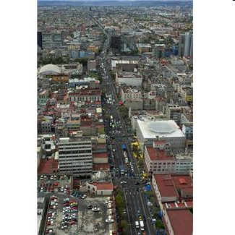
SMART CITY AS A CYBER-PHYSICAL SYSTEM
SENSOR
NETWORKS
Privacy
Data collection
Security
RESEARCH OBJECTIVES
- Establish a Cyber-Physical
Infrastructure for urban
environments
- Address fundamental
problems that involve
data collection,
resource allocation,
real-time decision making,
energy management,
safety and security
Control and
Optimization
Actions
Information
Processing
BIG
DATA
Decision Making
Safety
Energy
Management
Christos G. Cassandras CISE - CODES Lab. - Boston University
Notes:
2
2

Slide 3
RESEARCH TASKS
1. SENSING AND DATA ACQUISITION
Energy Harvesting
Dynamic Voltage Scheduling
Static and Dynamic (mobile) Data Collection
Trustworthiness of Sensing Data
CPS Security
2. DECISION SUPPORT
Dynamic Resource Allocation and Optimization
Event-Driven Control, Communication, Optimization
Constrained Flow Network Design and Analysis
Software-defined Networks for CPS Applications
Christos G. Cassandras CISE - CODES Lab. - Boston University
Notes:
3
3

Slide 4
TECHNICAL APPROACH HIGHLIGHTS:
TRUSTWORTHY SENSING
Developed a probabilistic method based on Particle Filtering that quantifies uncertainty in sensing and sensor data interpretation
Continuously update probability distribution of prediction result, using new sensing data obtained online
Provides numerical solution using Bayesian inference framework
  Combines physical knowledge and measurement data to improve sensing precision and reliability, for applications in trend prediction
APPLICATIONS:
Occupancy prediction and associated HVAC control in energy-smart buildings
B. Ai, R. Gao, and Z. Fan, “Occupancy estimation for smart building by an auto-regressive Hidden Markov Model”, American Control Conference, 2014
Christos G. Cassandras CISE - CODES Lab. - Boston University
Notes:
4
4

Slide 5
TECHNICAL APPROACH HIGHLIGHTS:
ANOMALY DETECTION FOR CPS SECURITY
Approach suited to detect novel anomalies vs. signature-based methods
Observe “data traffic” and detect instances that are “different” from the past
Developed a series of complementary approaches:
statistical, machine-learning (SVM),
classification (Adaptive Resonance Theory)
Developed new statistical methods for time-varying network behavior
Validated using real and synthetic anomalies
Wang, J., Rossell, D., Cassandras, C.G., and Paschalidis, I. Ch., “Network Anomaly Detection: A Survey and Comparative Analysis of Stochastic and Deterministic Methods”, Proc. of 52nd IEEE Conf. Decision and Control, 2013.
Christos G. Cassandras CISE - CODES Lab. - Boston University
Notes:
5
5

Slide 6
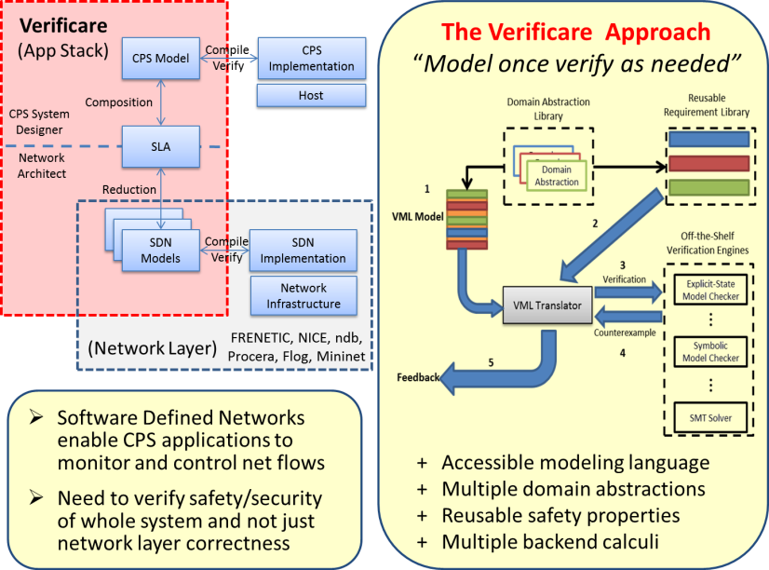
TECHNICAL APPROACH HIGHLIGHTS:
SAFETY AND SECURITY VERIFICATION OF CPS
Methodology and tools for specifying and modeling CPS such that existing formal verification techniques can be transparently used to analyze critical requirements and properties prior to system implementation
Developed a typing theory for “constrained-flow networks” – an abstraction for many CPS whose organization can be represented by a network
VERIFICARE allows for the certification of Software-Defined Network (SDN) code against safety properties to be enforced for the CPS infrastructure
R. Skowyra, A. Lapets, A. Bestavros, and A. Kfoury. Verifiably-Safe Software-Defined Networks for CPS. Proc. of HiCoNS'13: The ACM International Conference on High Confidence Networked Systems, 2013
Christos G. Cassandras CISE - CODES Lab. - Boston University
Notes:
6
6

Slide 7
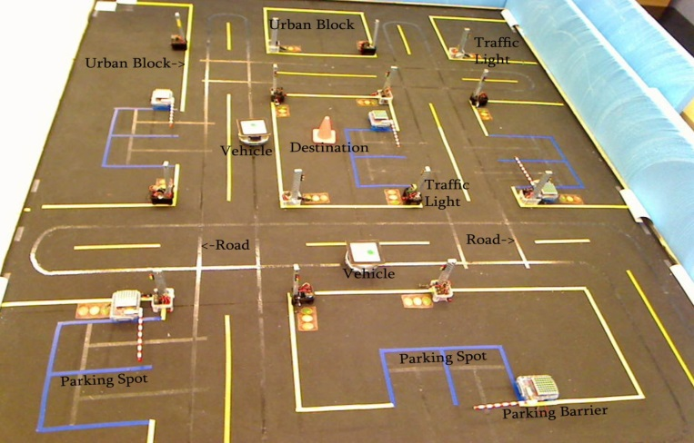
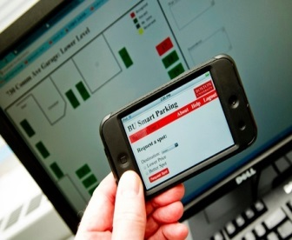
TECHNICAL APPROACH HIGHLIGHTS:
DYNAMIC RESOURCE ALLOCATION IN CPS
Developed optimization framework capturing CPS dynamics modeled as a stochastic hybrid system with interacting time-driven and event-driven components
Two classes of problems: - Dynamic optimization (e.g., Smart Parking)
- Parametric optimization (e.g.,Traffic Light Control)
Developed Infinitesimal Perturbation Analysis (IPA) estimators for real-time data-driven performance sensitivities with respect to system parameters. These provide information to solve Dynamic Resource Allocation problems.
APPLICATIONS:
Smart Parking
EV recharging
Adaptive Traffic Light Control
Geng, Y., and Cassandras, C.G., “A New “Smart Parking” System Based on Resource Allocation and Reservations”, IEEE Trans. IntelligentTransportation Systems, 2013
Christos G. Cassandras CISE - CODES Lab. - Boston University
Notes:
7
7

Slide 8


KEY INNOVATIONS – BROADER IMPACT
EVENT-DRIVEN SENSING, CONTROL, COMMUNICATION,
OPTIMIZATION – to complement the TIME-DRIVEN paradigm
REFERENCE
+
ERROR
CONTROLLER
INPUT
PLANT
OUTPUT
-
MEASURED
OUTPUT
SENSOR
EVENT-DRIVEN CONTROL: Act only when needed (or on TIMEOUT) - not based on a clock
REFERENCE
+
ERROR
CONTROLLER
INPUT
PLANT
OUTPUT
-
MEASURED
OUTPUT
EVENT:
g(STATE) ≤ 0
SENSOR
Christos G. Cassandras CISE - CODES Lab. - Boston University
Notes:
8
8

Slide 9
KEY INNOVATIONS – BROADER IMPACT
EVENT-DRIVEN SENSING, CONTROL, COMMUNICATION,
OPTIMIZATION – to complement the TIME-DRIVEN paradigm
SOME BENEFITS:
Less communication (critical in wireless settings!)
No synchronization across distributed system components
Reduced bandwidth
Lower security risks (the less we talk, the less there is to listen…)
Zhong, M., and Cassandras, C.G., “Asynchronous Distributed Optimization with Event-Driven Communication”, IEEE Trans. on Automatic Control, AC-55, 12, pp. 2735-2750, 2010.
Cassandras, C.G., “The Event-driven Paradigm for Control, Communication, and Optimization”, Journal of Control and Decision, Vol. 1, 1, pp. 3-17, 2014.
Christos G. Cassandras CISE - CODES Lab. - Boston University
Notes:
9
9

Slide 10

KEY INNOVATIONS – BROADER IMPACT
2. MOBILITY CAN HELP CYBERSECURITY WITH DYNAMIC SECRETS
k
Alice and Bob’s mobility is an unpredictable factor that can cause Eve’s information loss. Mobility greatly increases difficulty for Eve to track k.
Alice
Bob
Using dynamic secrets a stolen key or password can be quickly and automatically reverted to its secret status without disrupting communication
minimizes password theft and key theft
Eve
Xiao, S., Gong, W., and Towsley, D., Dynamic Secrets in Communication Security, Springer, 2014
Christos G. Cassandras CISE - CODES Lab. - Boston University
Notes:
10
10

Slide 11
KEY INNOVATIONS – BROADER IMPACT
GENERAL FRAMEWORK FOR CPS SAFETY AND SECURITY
AS SOFTWARE-DEFINED NETWORKS
R. Skowyra, A. Lapets, A. Bestavros, and A. Kfoury. Verifiably-Safe Software-Defined Networks for CPS. Proc. of HiCoNS'13: The ACM International Conference on High Confidence Networked Systems, 2013
Christos G. Cassandras CISE - CODES Lab. - Boston University
Notes:
11
11

Slide 12

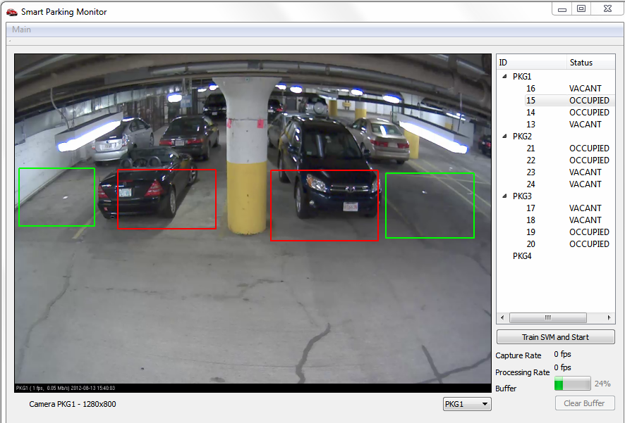
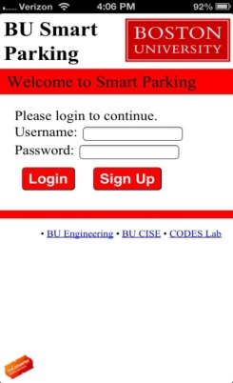



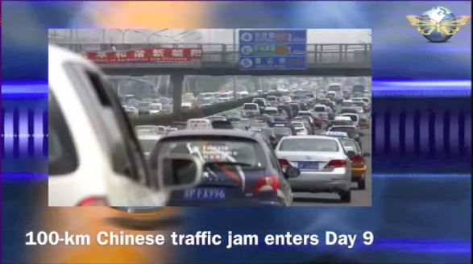
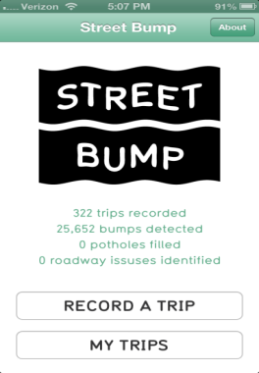
SMART CITY APPLICATIONS
SMART PARKING
ELECTRIC VEHICLE (EV) ROUTING AND
RECHARGING
STREETBUMP
TRAFFICCONTROL
Christos G. Cassandras CISE - CODES Lab. - Boston University
Notes:
12
12

Slide 13
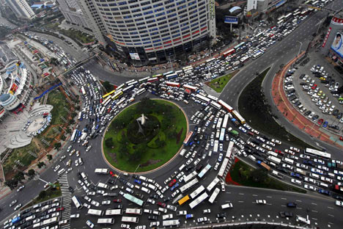
“SMART PARKING”
30% of vehicles on the road in the downtowns of major cities are cruising for a parking spot. It takes the average driver 7.8 minutes to find a parking spot in the downtown core of a major city.
R. Arnott, T.Rave, R.Schob, Alleviating Urban Traffic Congestion. 2005
GUIDANCE-BASED PARKING – DRAWBACKS…
Drivers:
City:
May not find a vacant space
May miss better space
Processing info while driving
Imbalanced parking utilization
May create ADDED CONGESTION
(as multiple drivers converge
to where a space exists)
Searching for parking ⇒ Competing for parking
Christos G. Cassandras CISE - CODES Lab. - Boston University
Notes:
13
13

Slide 14
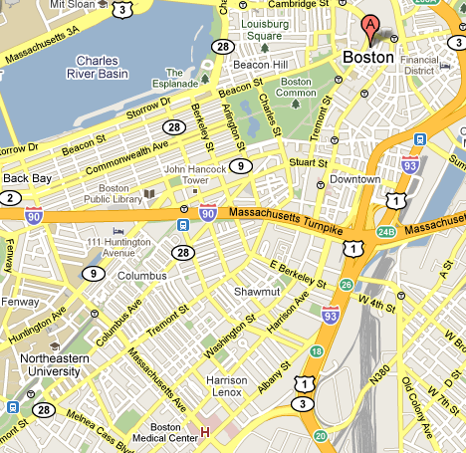

“SMART PARKING”
BEST
PARKING SPOT
Find best parking spot for DESTINATION A
LEAST DISTANCE from A
+
LEAST COST
+
RESERVE IT
Christos G. Cassandras CISE - CODES Lab. - Boston University
Notes:
14
14

Slide 15

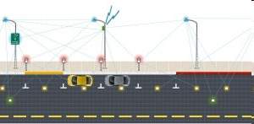

WHAT IS REALLY “SMART” ?
COLLECTING DATA IS NOT “SMART”
- JUST A NECESSARY STEP TO
BEING “SMART”
INFO
ACTION
INFO
PROCESSING DATA TO MAKE GOOD DECISIONS IS “SMART”
Christos G. Cassandras CISE - CODES Lab. - Boston University
Notes:
15
15

Slide 16

“SMART PARKING” - IMPLEMENTATION
- 2011 IBM/IEEE
Smarter Planet Challenge competition,
2nd place prize
- Best Paper/Best Poster Awards
http://smartpark.bu.edu/smartparking_ios6/login.php
Currently in operation at
BU garage
(with Smartphone app:
BU Smart Parking)
Christos G. Cassandras CISE - CODES Lab. - Boston University
Notes:
16
16

Slide 17
ADAPTIVE TRAFFIC LIGHT ADJUSTMENT
RED/GREEN CYCLES
(θ)
TRAFFIC FLOW
SYSTEM
PERFORMANCE
NOISE
REAL-TIME
SENSITIVTY
ESTIMATOR
L(θ)
CONTROLLER
STATE
Infinitesimal Perturbation Analysis (IPA)
Christos G. Cassandras CISE - CODES Lab. - Boston University
Notes:
17

Slide 18
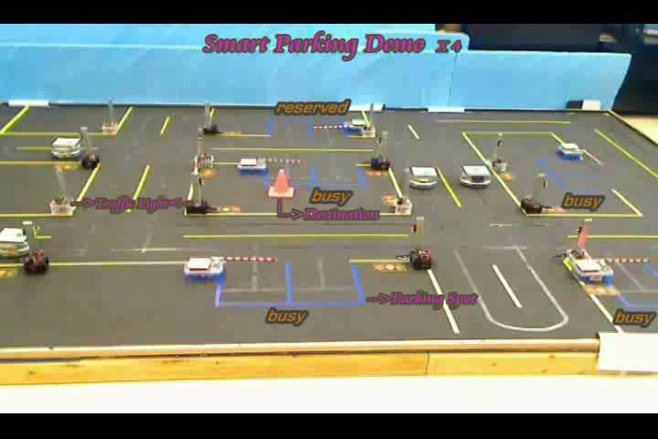
Notes:
18

Slide 19
STREET BUMP – PROCESSING “BIG DATA”
Smart Cities present a wealth of opportunities for the
LAW OF UNINTENDED CONSEQUENCES
to manifest itself !
Detect obstacles using iPhone accelerometer and GPS
Send to central server through StreetBump app
Process data to classify obstacles:
  Anomaly detection and clustering algorithms,
  similar to cybersecurity problems
Detect “actionable” obstacles
Prioritize and dispatch crews to fix problems
Christos G. Cassandras CISE - CODES Lab. - Boston University
Notes:
19
19

Slide 20
BROADER IMPACT - EDUCATION
Undergraduate students:
  Boston U. Undergraduate Research Opportunities Program (UROP)
High-School Students
- Boston U. Research Internships in Science and Engineering
(RISE) Program
- Annual NSF Workshops for High-School students and teachers
Symposium organized by I. Paschalidis at Boston U., October 2014
Plenary/Keynote talks at intl. events
Web-sites with interactive demos of major research results
Christos G. Cassandras CISE - CODES Lab. - Boston University
Notes:
20
20

Slide 21
NEXT STEPS
Several applications developed at different levels of maturity
(one patent pending)
“Law of unintended consequences” always at work in Smart Cities
Fundamental Research issues:
- Interplay of Event-Driven and Time-Driven methods
- Anomaly detection for CPS security
- Multi-agent dynamic system formulations for Smart City problems
- Exploiting data-driven opportunities (due to “big data”)
The role of Humans in Cyber-Physical Systems:
Is there an “H” (Human) or “S” (Social) missing in “CPS” ?
Christos G. Cassandras CISE - CODES Lab. - Boston University
Notes:
21
21

Slide 22
WHAT IS A “SMART CITY” ?
“A city well performing in a forward-looking way in [economy, people, governance, mobility, environment, and living] built on the smart combination of endowments and activities of self-decisive, independent and aware citizens.” Giffinger, R., et al, 2007
Smart Sustainable Cities use information and communication technologies (ICT) to be more intelligent and efficient in the use of resources, resulting in cost and energy savings, improved service delivery and quality of life, and reduced environmental footprint--all supporting innovation and the low-carbon economy. Cohen, B., 2014
Hitachi's vision for the Smart Sustainable City seeks to achieve concern for the global environment and lifestyle safety and convenience through the coordination of infrastructure. Smart Sustainable Cities realized through the coordination of infrastructures consist of two infrastructure layers that support consumers' lifestyles together with the urban management infrastructure that links these together using IT http://www.hitachi.com/products/smartcity/vision/concept/overview.html
“We believe a city to be smart when investments in human and social capital and traditional (transport) and modern (ICT) communication infrastructure fuel sustainable economic growth and a high quality of life, with a wise management of natural resources, through participatory governance.”
Meijer, A., and Bolivar, M.P.R., 2014
Christos G. Cassandras CISE - CODES Lab. - Boston University
Notes:
22
22

Slide 23
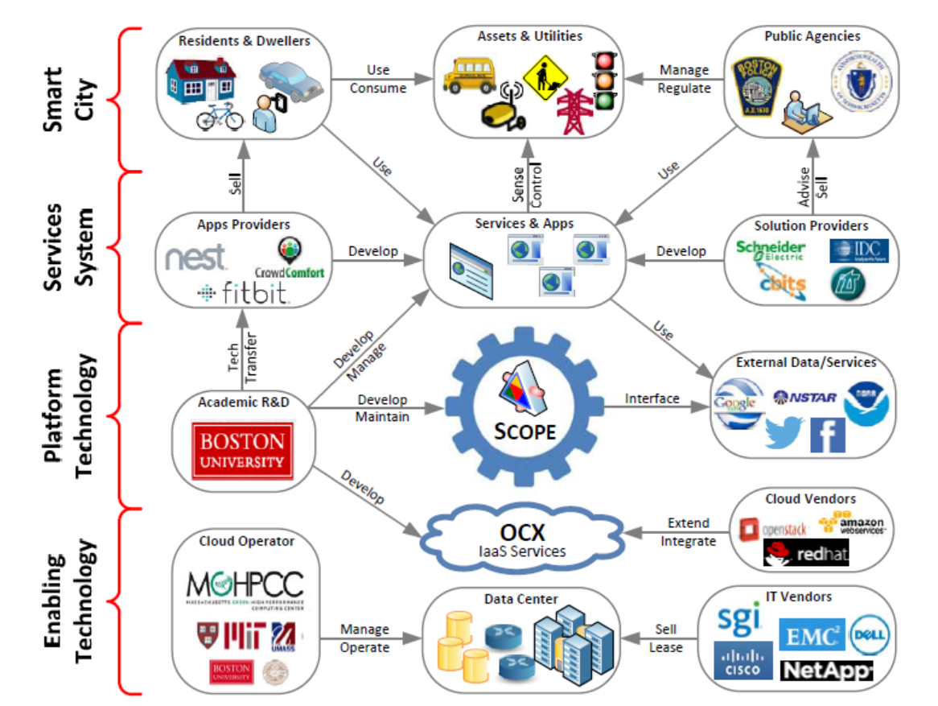
SCOPE: Smart-city Cloud-based Open Platform and Ecosystem (Mass + NSF + Corp. Partners)
NEW
PROJECT
AS OF
8/1/2014
Christos G. Cassandras CODES Lab. - Boston University

