Slide 1


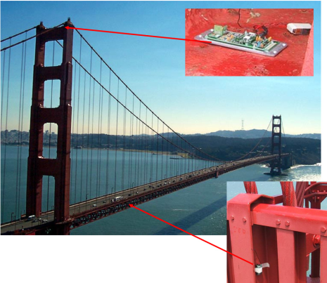


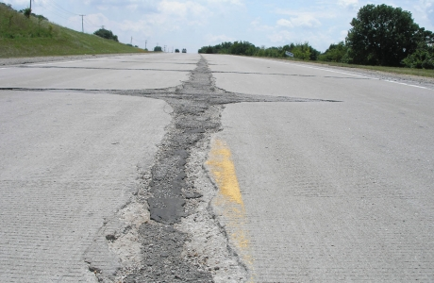
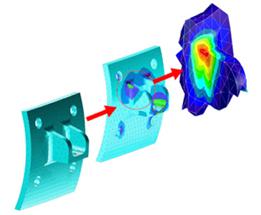
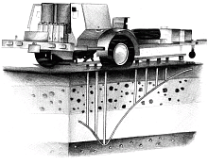
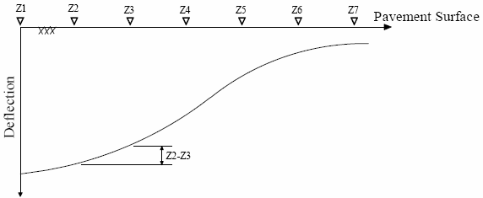


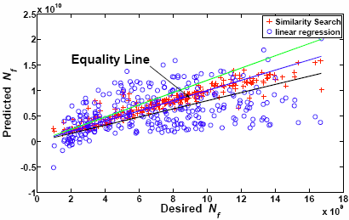
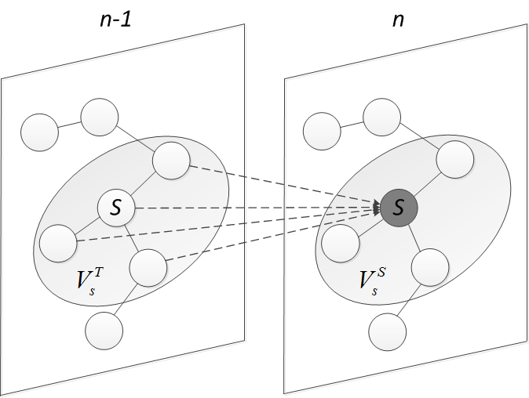


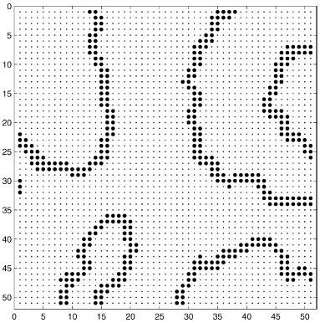
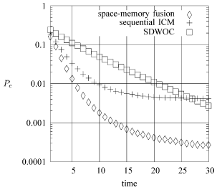
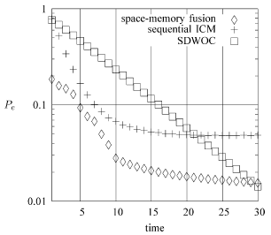
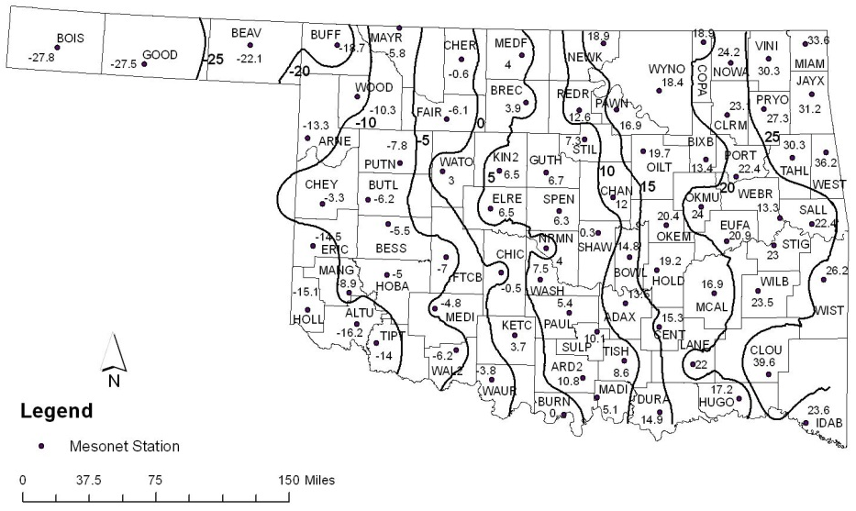
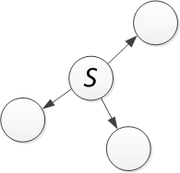
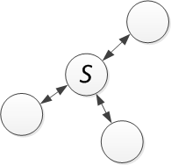
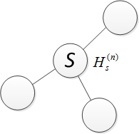
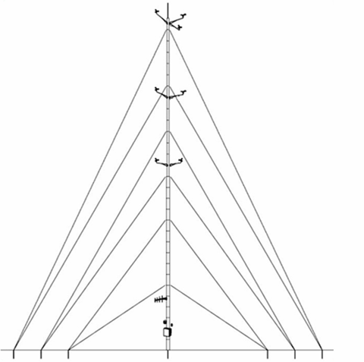
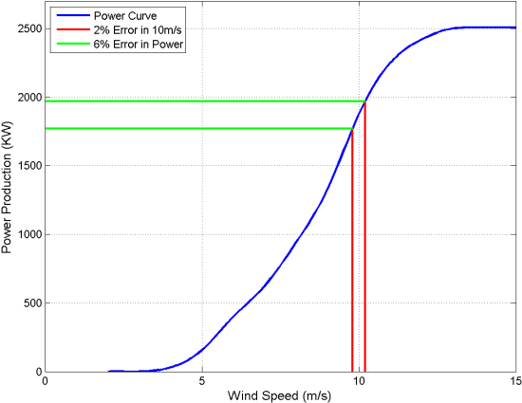
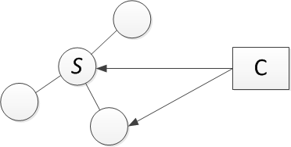
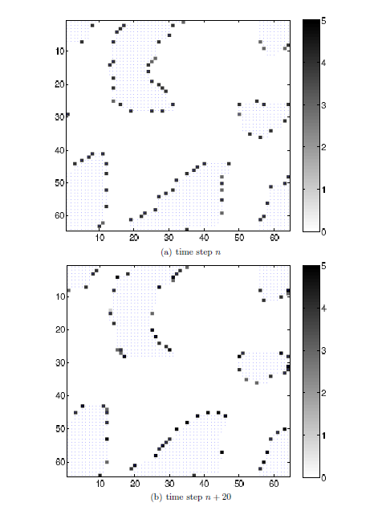
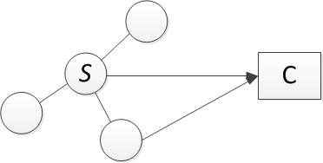
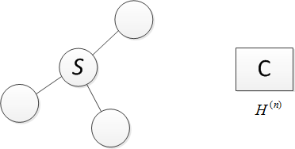
CPS PI
Meeting’13
A Unified Distributed Spatiotemporal Signal Processing Framework for Structural Health Monitoring (CNS 0932297)
PI: Dr. Qi Cheng, Graduate Students: Tao Wu, Hoa Nguyen, Longji Sun, Chao Chen, Electrical and Computer Engineering
Collaborator: Dr. Rifat Bulut, Civil and Environmental Engineering, Oklahoma State University
Needs and Challenges
Ubiquity of complex structural systems
Needs of structural health monitoring (SHM)
Outcomes and Deliverables
Research findings for the (dynamic) event region detection problem
Research findings for the pavement condition related problems
Research findings for Anemometer condition diagnosis
Student advising and publications
Airframe
Prediction of remaining service life using falling weight deflectometer (FWD) data
Enhanced Integrated Climatic Model (EICM) for modulus-based construction specifications for Oklahoma pavements
Powerfulness of Markov random fields (MRFs) for spatiotemporal modeling
Static event region and boundary region detection
T. Wang and Q. Cheng, “ Collaborative Event-Region and Boundary-Region Detections in Wireless Sensor Networks”,
IEEE Trans. Signal Processing, Vol. 56, No. 6, pp. 2547-2561, Jun. 2008.
Dynamic event region detection
T. Wu and Q. Cheng, “Online Dynamic Event Region Detection using Distributed Sensor Networks”, accepted,
IEEE Trans. Aerospace and Electronic Systems, May 2013.
Event region reconstruction at a Control Center
T. Wu and Q. Cheng, “Dynamic Event Region Detection and Reconstruction in Wireless Sensor Networks”, submitted,
IEEE Trans. Wireless Communications, July 2013.
t-1
t
FWD applies a dynamic load to a pavement surface, trying to simulate the magnitude and duration of a single heavy moving vehicle wheel load
Photonic
Crystal
Sensing
Fiber
The pavement response in terms of vertical deformations at various distances from the loading plate is measured by a serious of geophone sensors.
A pattern search algorithm along with a linear elastic theory and mechanistic-based approach are adopted
The integrity and reliability are constantly threatened
Aging/fatigue
Harsh operational and Environmental conditions
improper maintenance
Predicted results of similarity search and linear regression methods for the RSL associated with fatigue cracking and the RSL associated with rutting, respectively.
Automatically detect, diagnose, prognose and mitigate anomalies in a structure at an early state
Avoid catastrophic failures
Efficient resource management
The performance of a pavement depends on many factors: structural adequacy, properties of the materials used, traffic loading, climatic conditions and the construction methods
Objective: estimation of site specific variation in environmental factors that are used in predicting seasonal variation and long-term resilient modulus of unbound materials
Moisture index (known as the Thornthwaite Moisture Index or TMI) as a relative measure indicating the wetness or dryness of a particular region.
Inefficiency of existing SHM methodologies
Large numbers of heterogeneous sensors forming a large-scale, densely-distributed sensor network, sampling at high data rates
--- robust, real-time, scalable, energy/communication bandwidth efficient
Model-based approach
Data-driven approach
Accurate physics-based model
Drawbacks:
Deterministic and unable to address the uncertainties
Complex because of numerical methods (e.g., FEA) used to solve differential equations
Lack of sufficient domain expertise for large dynamic systems
Physical system
Monitoring system
At time n−1, each sensor passes the posterior probability of its state to its temporal neighbors;
After collecting all the neighboring information, the mean field approximation is used to predict the prior probability;
The MAP rule is then used for posterior probability calculation and decision making after taking a new observation at time n.
Inputs
Structure
Outputs
Sensing system
Model
Predictions
Processing
Inference
TMI Contour Map Based on Witczak et al. (2006) Equation.
Climatic region Contour Map Based on nonparametric methods.
Multivariate analysis, discriminant analysis, support vector machine, neural networks, classification and regression trees/forests, fuzzy rule-based systems
Drawbacks:
Approximation only of the relation between the explanatory and response variables
Limited by the size of training data and assumptions
A risk of questionable conclusions
Explanatory variables X
f(.)
Response variables Y
At time n, at the center, the prior probability is calculated using mean field approximation and, the bandwidth allocation strategy is obtained and fed back to local sensors;
At each local sensor, depending on the number of bits allocated, local quantization thresholds are determined according to the adopted local quantization rule and the quantized observations are sent to the center;
The center calculates the posterior probability regarding the field underlying state, based on which event regions are determined.
Communication protocol and communication costs
The snapshots of a sample evolution of the simulated dynamic event regions at 6 different time steps (n = 1, n = 50, n = 100, n = 150, n = 200 and n = 250). The non-event regions are blank while the event regions are shaded. “◦” denotes local sensor decision “−1” and “⊗” denotes local sensor decision “1”. The decisions are made using the proposed algorithm with two-bit quantization when the observation SNR is −10dB.
Image credit: PHM society website
Wind field around the tubular mast of a meteorological tower
Image credit: IEA 1999 report
Image credit: PHM society website
Critical feature is identified to distinguish which ones of a pair of anemometers at a same height fail based on their measurements:
Wind speed difference versus its corresponding wind direction
Two Ph.D. students and two M.S. students with theses
One book chapter, six journal papers and six conference papers published or accepted with one journal paper submitted. Five invited talks.
Project Objectives
To develop a collaborative signal processing framework by coupling sensing data with physics-based and data-driven models to detect and diagnose degradation and damages.
T. Wu, “System Design in Wireless Sensor Networks for Parameter Estimation and Dynamic Event Region Detection”, Ph.D. dissertation, July 2013.
H. Nguyen, “A Classification Framework and Application to Sleep Apnea Analysis”, Ph.D. dissertation, April 2013.
Sleep schedule
Info. for subregion
Sleep schedule
Info. for subregion
…
indicator
Sleep time
…
indicator
Sleep time
Sensor ID
Starting bit
Prior prob.
…
Sensor ID
Starting bit
Prior prob.
Examples of the bandwidth allocation results for a dynamic field with 20 time steps apart using the proposed algorithm. The dotted areas are event regions. The blank areas are non-event regions. The gray squares near the boundary indicate the allocated bandwidth in terms of bits. The darker the square is, the more bandwidth is allocated.
1
log₂M_{s}/2
…
1
log₂M_{s}/2
log₂M-C
log₂B
N_{pp}
…
log₂M-C
log₂B
N_{pp}

