Slide 1
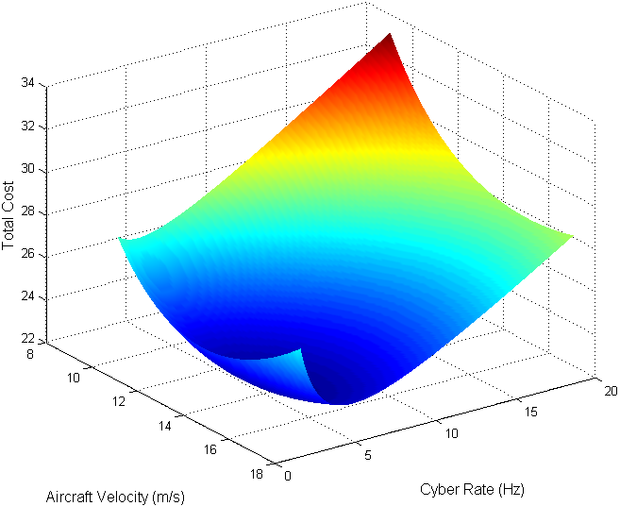
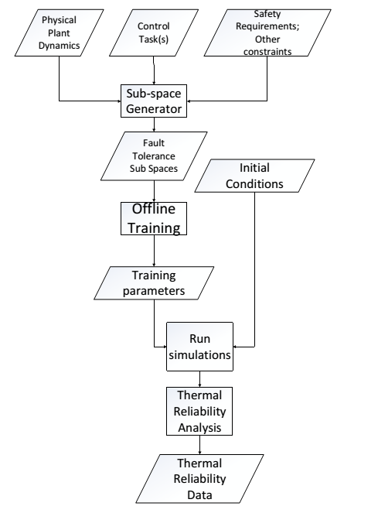
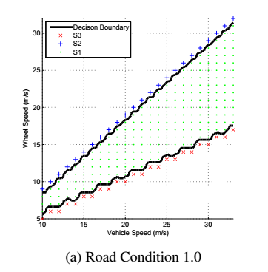
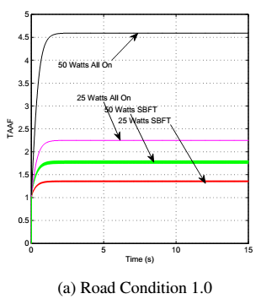
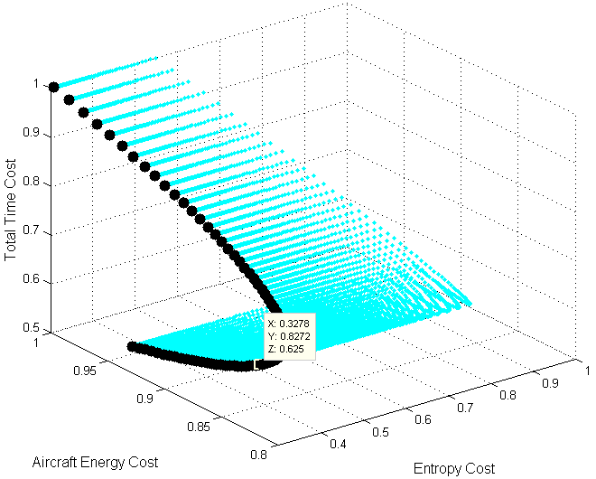
Abstraction of Cyber-Physical Interplays and Its Application to CPS Design
Core Philosophy
Controlled Plant State
Control Algorithm Repertoire
Computer response time has significance in both control and computational domains
Control Domain: Manifests itself as feedback delay; its effect is to degrade quality of control. Extent of degradation depends on current controlled plant state.
Computational Domain: Affected by scheduling algorithms and the total computational workload.
Impact of response time and computational correctness can be quantified as a function of current controlled plant state. Cost functions can be derived by analyzing controlled plant dynamics.
Task Cost Functions, Periods, Deadlines
Cyber system state and computation progress
Control Algorithm Selection, Rate
Cyber-physical
Feedback Control
F.T. Task Scheduler
Processor Architecture Configuration
Adaptive Fault-Tolerance
Energy Resources Manager
Motivation: Traditional massive redundancy is wasteful when used irrespective of controlled plant state. Adapting redundancy level to current plant state is much more efficient.
Approach: Subdivide plant allowed state-space according to how much fault-tolerance is needed.
S₁: No FT required
S₂: Fail-stop sufficient (e.g., duplex)
S₃: Full fault-masking required (e.g., triplex)
Benefits: Reduces processor utilization, which decreases energy consumption as well as thermal stress thus improving reliability.
CPS Co-Regulation
Continuous-State Feedback Control
Coupled linear system with physical & control task execution states & actuators
Spacecraft attitude control application
CPS Co-Optimization
Multi-objective optimization over cyber and physical costs including actuation energy, time, processing load, and information entropy
Unmanned Aircraft System (UAS) application:
Proactive Fault Tolerance Tool
Cost as a function of Aircraft Velocity (Speed) and Computational (Cyber) Rate; Information Gain is a function of Cyber Rate
Co-Optimization: Pareto Front over Total Energy, Time, and Information Entropy Costs for a UAS Surveillance Mission

