Slide 1

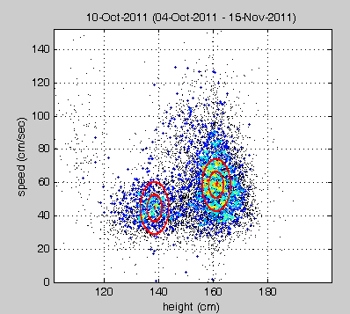
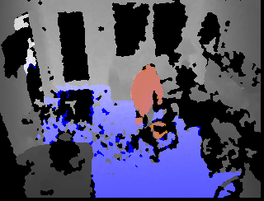
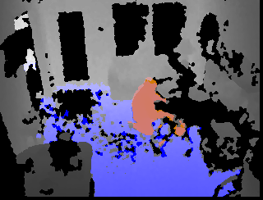
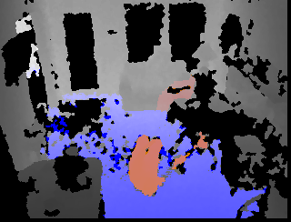
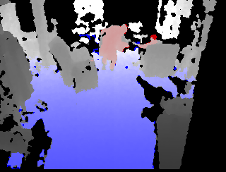
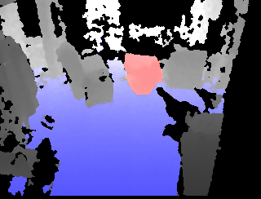
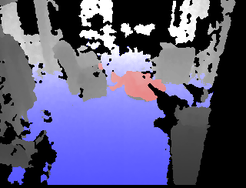

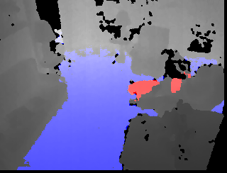
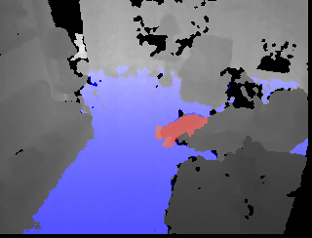
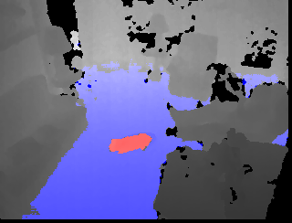
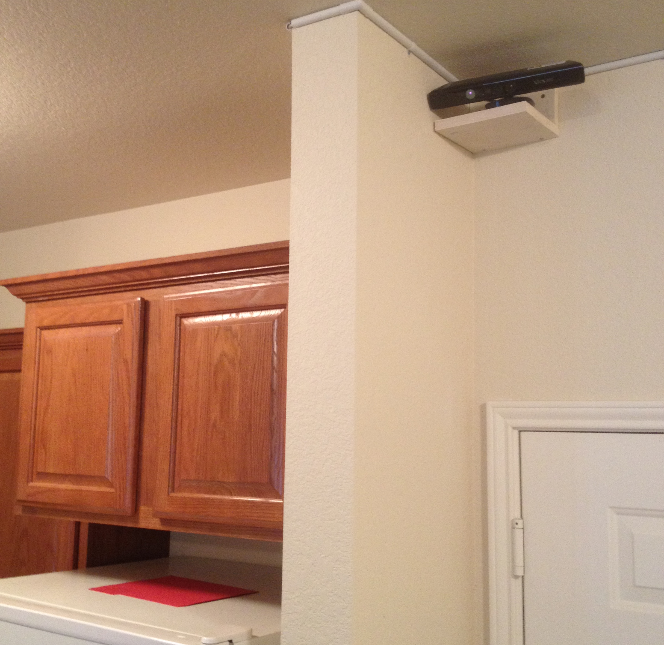
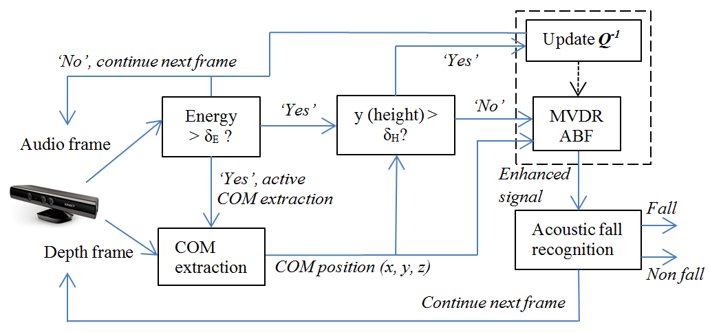
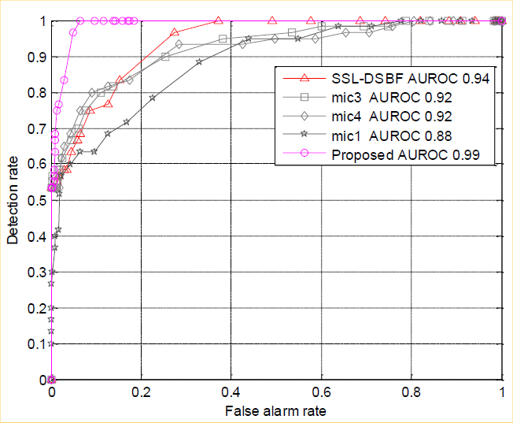
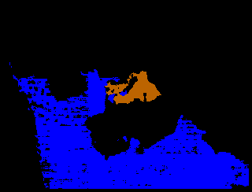
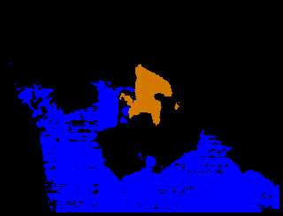
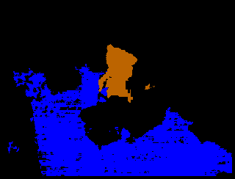
Active Heterogeneous Sensing
for Fall Detection and Fall Risk Assessment
M. Skubic, J. Keller, D. Ho & Z. He M. Popescu M. Rantz C. Abbott
Electrical & Computer Eng. Health Management & Informatics Nursing Physical Therapy
University of Missouri
YEAR 4: Fall detection with depth images is now live in 10 senior apartments. Alerts embed a video clip of the fall to check for injury & false alarms.
Investigating the interplay of anomaly detection and
the risk of anomaly events
YEAR 4: Gait analysis with depth images has been live in 10 senior apartments for over 2 years. Gait changes are tracked automatically to assess fall risk.
Actual resident fall captured in a TigerPlace apartment
Grandchildren
Detection history affects risk assessment
Fall
Detection
Fall Risk
Assessment
Two clusters for two residents
Actual resident fall captured in a TigerPlace apartment
Risk factors affect detection
The gait model is estimated using GMM with
K = # of residents. Parameters include walking speed, stride length, stride time, and height.
Real-World Challenges
Using Vision and Acoustic Sensing
False alarm in a TigerPlace apartment due to a dog
Resident 1
Resident 2
Unstructured, dynamic environments
Low light and variable lighting
Adaptive fusion of multi-scale signals with qualitative data and risk factors
Privacy restrictions
Stone and Skubic, 2013
Decrease in walking speed and stride length
Sensor fusion for fall detection:
Using acoustic and depth sensing from the Kinect
Stone and Skubic, 2013
Capturing in-home sit to stand motions
from depth images for fall risk assessment
4 microphones & depth data from Kinect
Li, Banerjee, Popescu and Skubic, 2013
Banerjee, Skubic, Keller, and Abbott, 2013
Supported by the National Science Foundation under CPS Grant CNS-0931607. See also www.eldertech.missouri.edu for papers.

