Slide 1



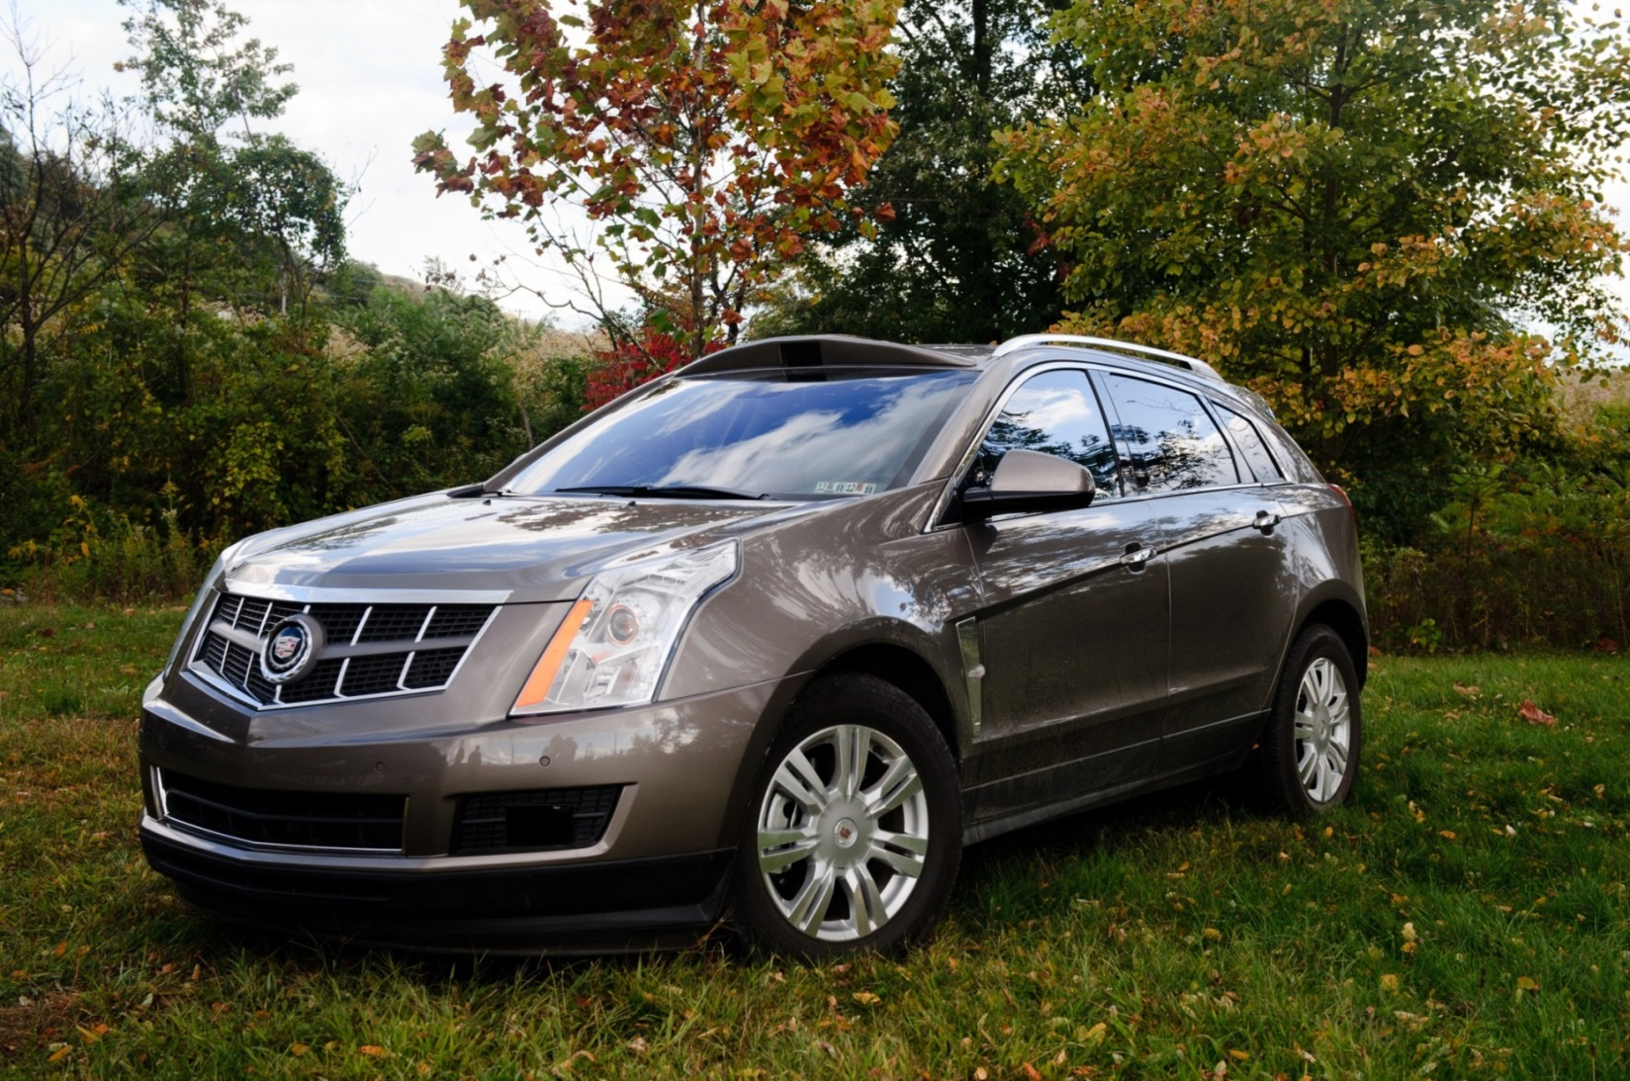
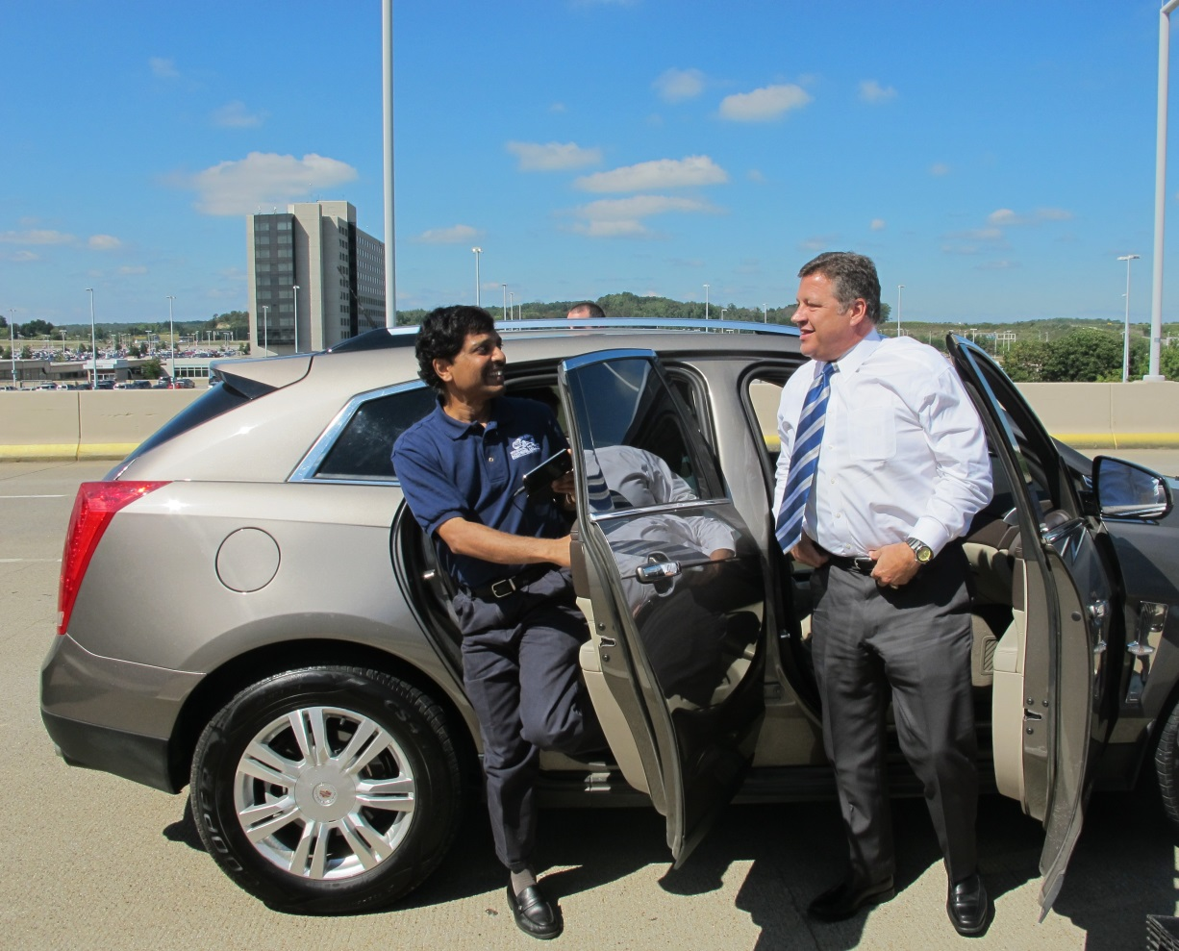
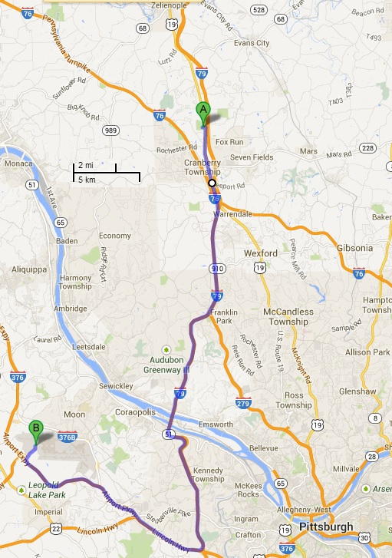
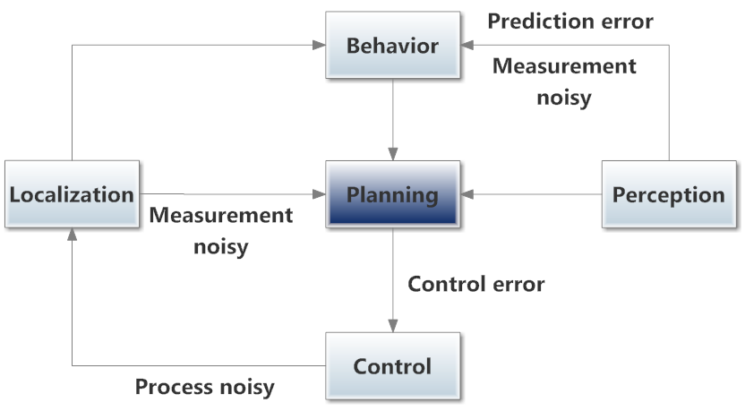
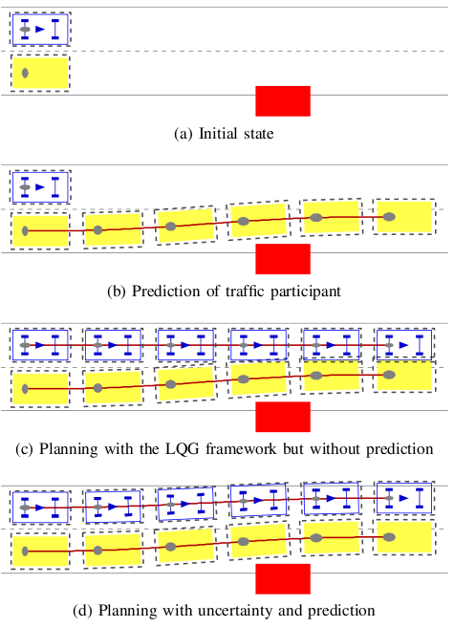






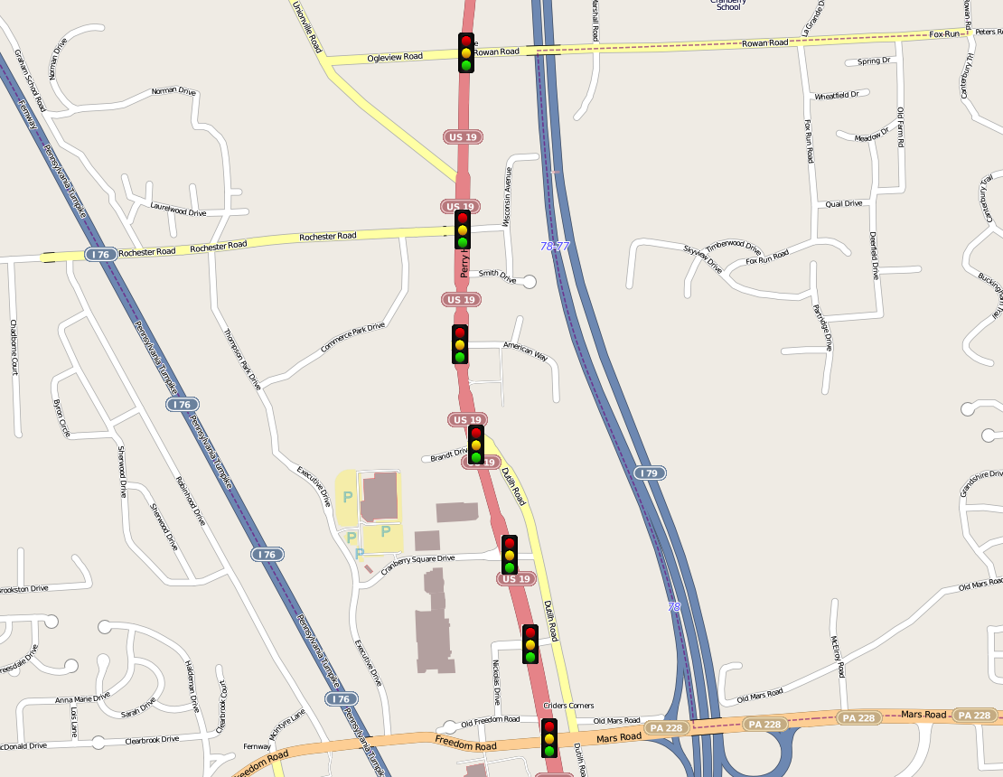







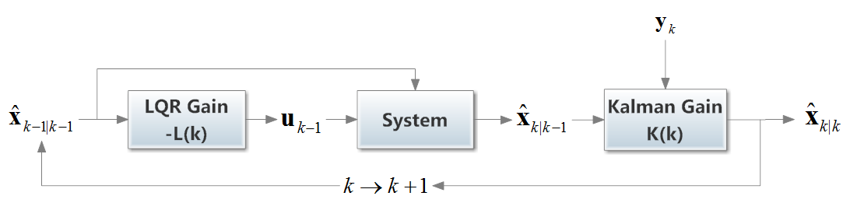





























Advanced Transportation Systems
Cyber-Physical
Systems
Raj Rajkumar (PI), Ed Clarke, John Dolan, Sicun Gao, David Wettergreen
Societal & Economic Impact
Autonomous System Architecture
Safety Verification
1.2 million automotive fatalities worldwide and >32,000 in the US every year
Medical care, disability and property damage cost $518 billion every year.
35 hours per year per person wasted in traffic delays.
Loss of independence & self-esteem for senior and disabled citizens w/o driving licenses.
User Interface
Health Monitor
P
Safety Property
Communication
Interfaces
Perception
Mission
Planning
Road-World Model
Verification
Condition
Generator
Φ
Logic Formula
Logic
Solver
SAT
Sensors
Behaviors
C/C++
Code
Short-Term Path Planning
UNSAT
Vision
Vehicle By-Wire Controls
dReal: SMT Solver for Nonlinear Theories of the Reals
dReach: Reachability Analysis for Nonlinear Hybrid Systems
Data Logger
Drove 33 miles autonomously along Route 19 in multi-lane, dense traffic with lights and two interstate highways
Scientific & technological foundations for Smarter and more Autonomous Transportation
Formal foundations for proof of correctness
Dependable run-time infrastructure
Embedded Computing Platform
V2I Testbed
Planning with Uncertainty
Cranberry Township, PA
Located 20 miles north of Pittsburgh, PA
1.8 mile stretch along Rt. 19 corridor
11 intersections are instrumented for use by autonomous vehicles.
Initial State
Prediction of traffic participant
Dependable Real-Time
Run-Time Infrastructure
Recent Media Coverage
Planning with the LQG Framework w/o prediction
Tolerates a single-point of failure
Fail-safe after second failure
Cost-effective
Tight end-to-end latencies
Uncertainty Propagation: LQG = LQR+ KF
Health Monitor
Time Sync. Mgr
Map Mgr
Status Mgr
Process Launchr
User App
Input
Planning with uncertainty and prediction
SAFER Library
User App
...
SAFER daemon
...
User App
Status Updater
Process Handler
Timing
Enforcer
Output
Library
Library
Library
Network Abstraction
IPC
Nodes
…
Network

