Slide 1


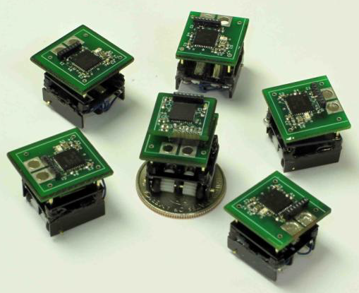
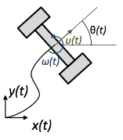
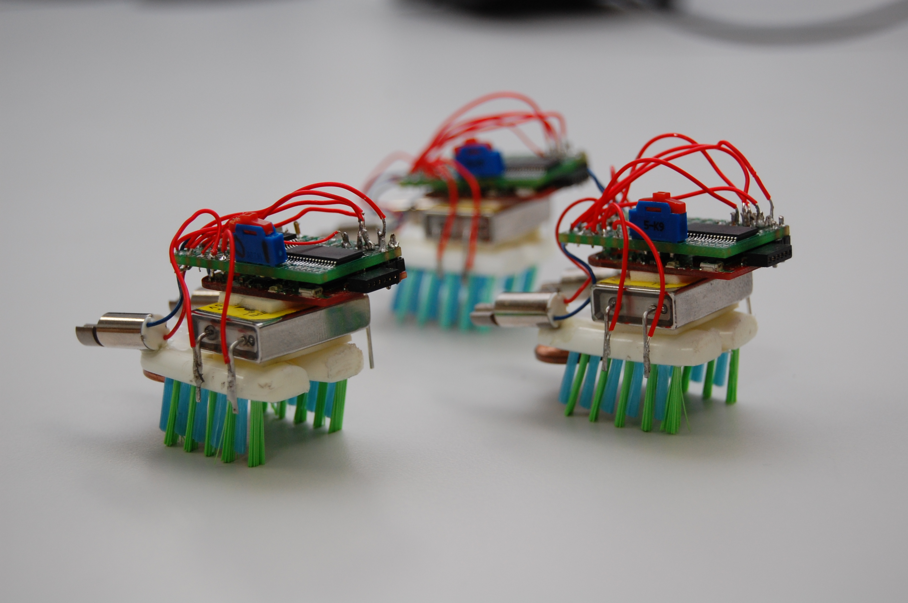
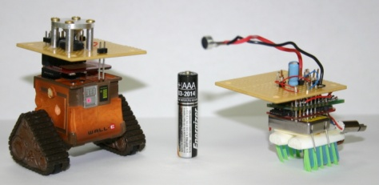
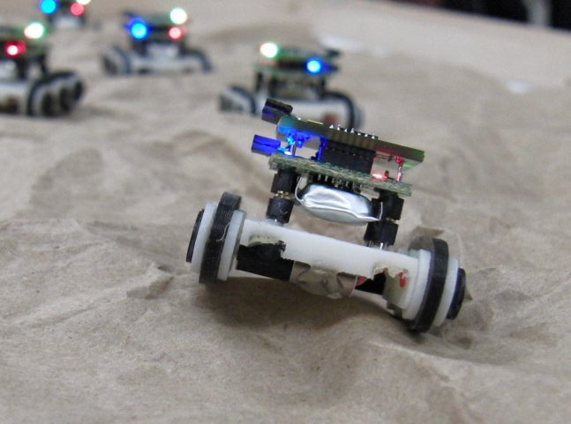
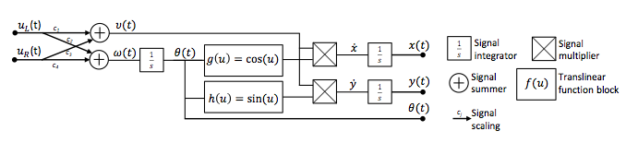
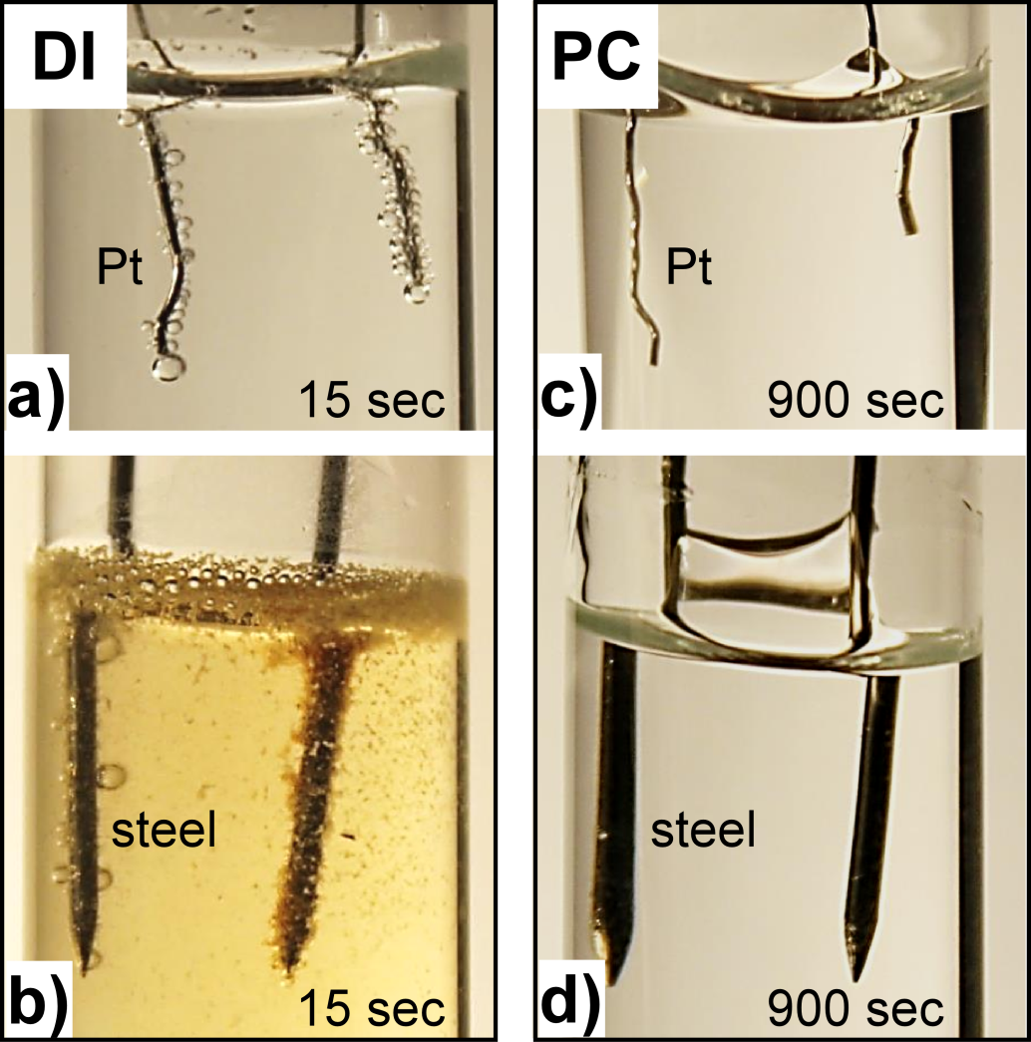
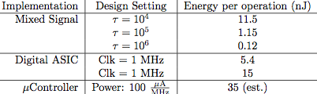
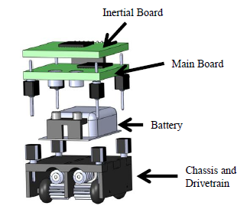
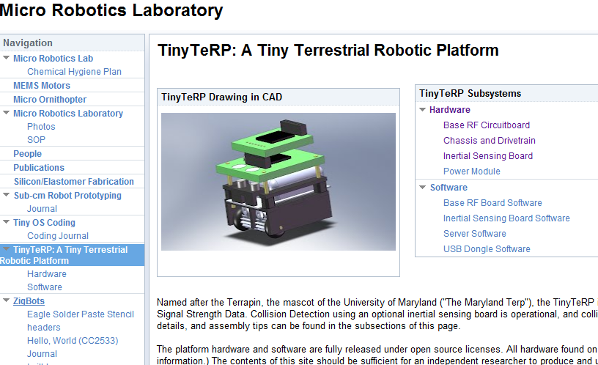
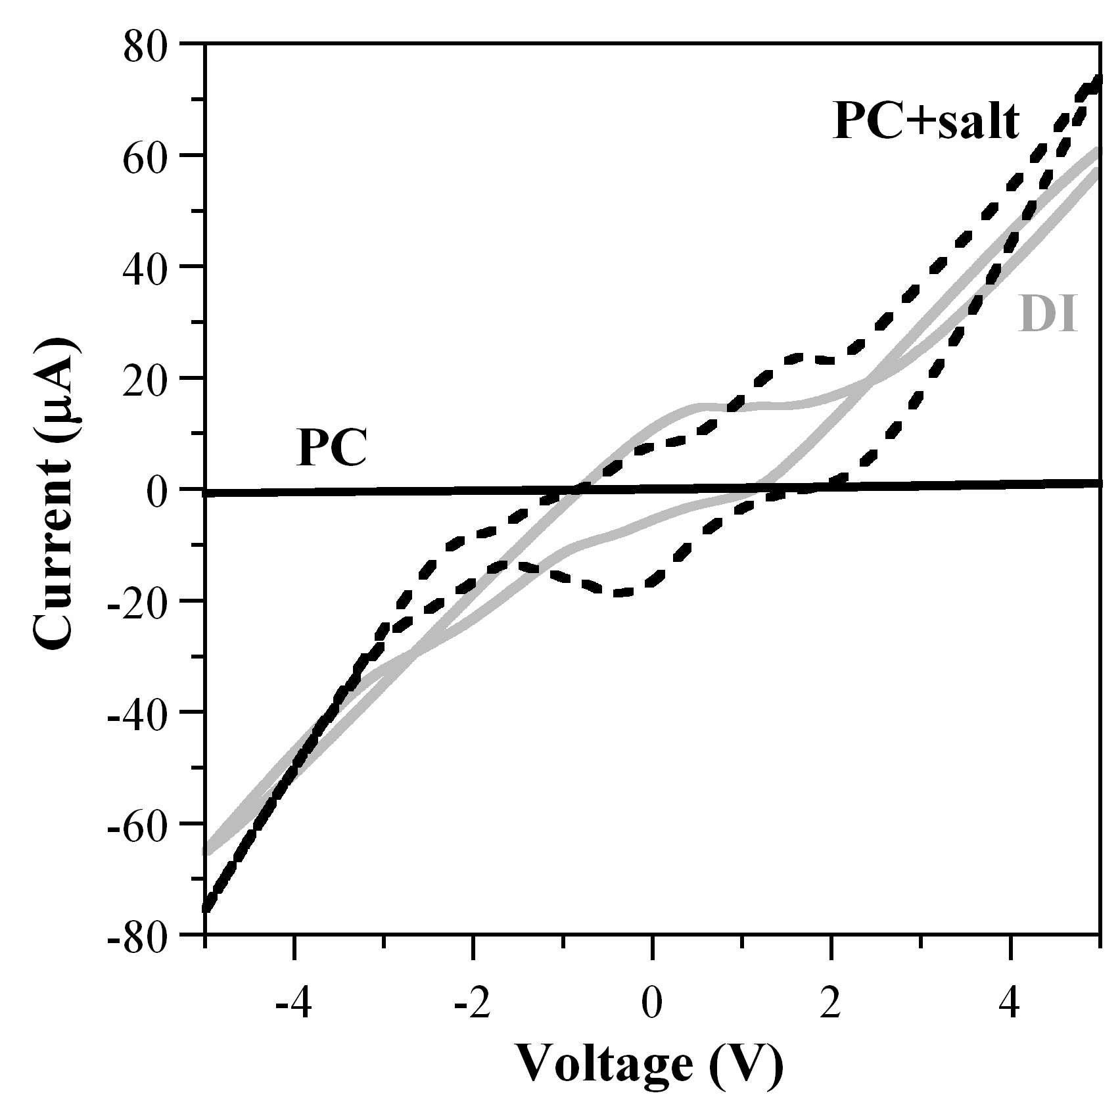
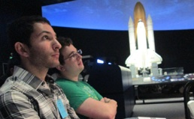
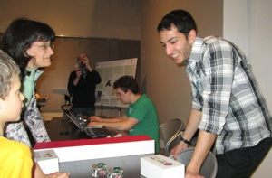
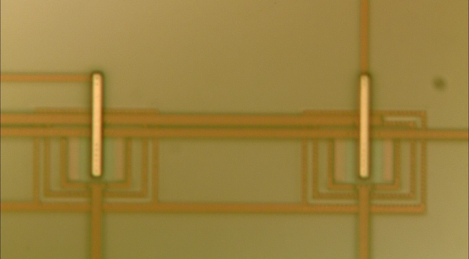
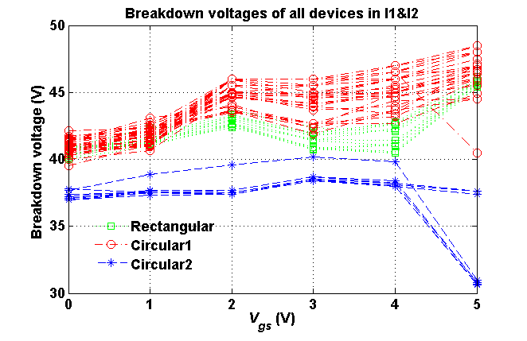
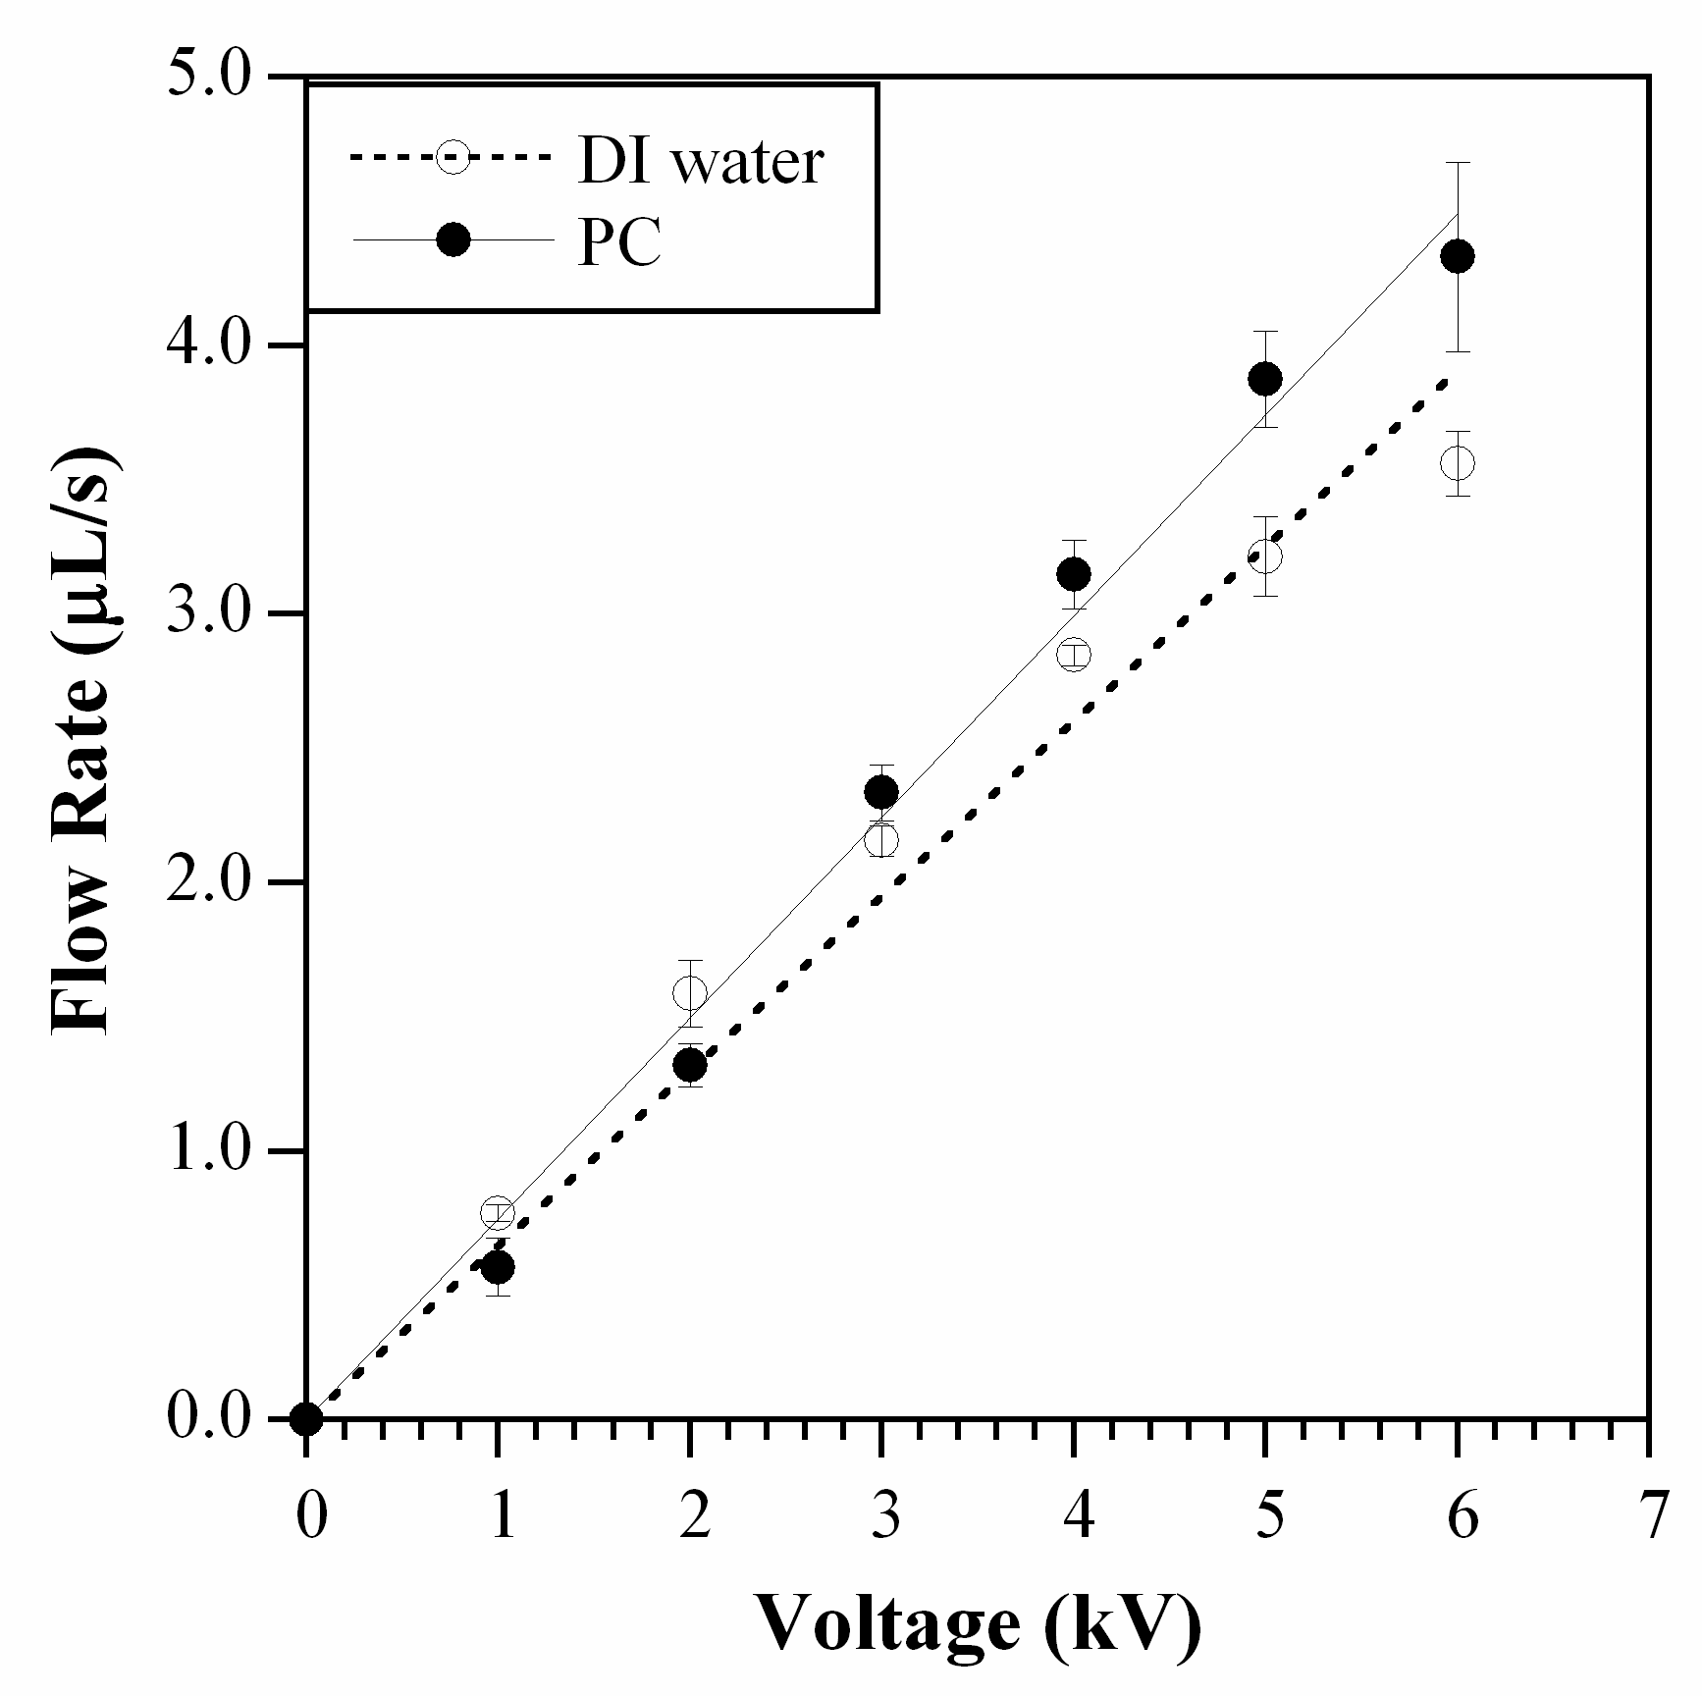
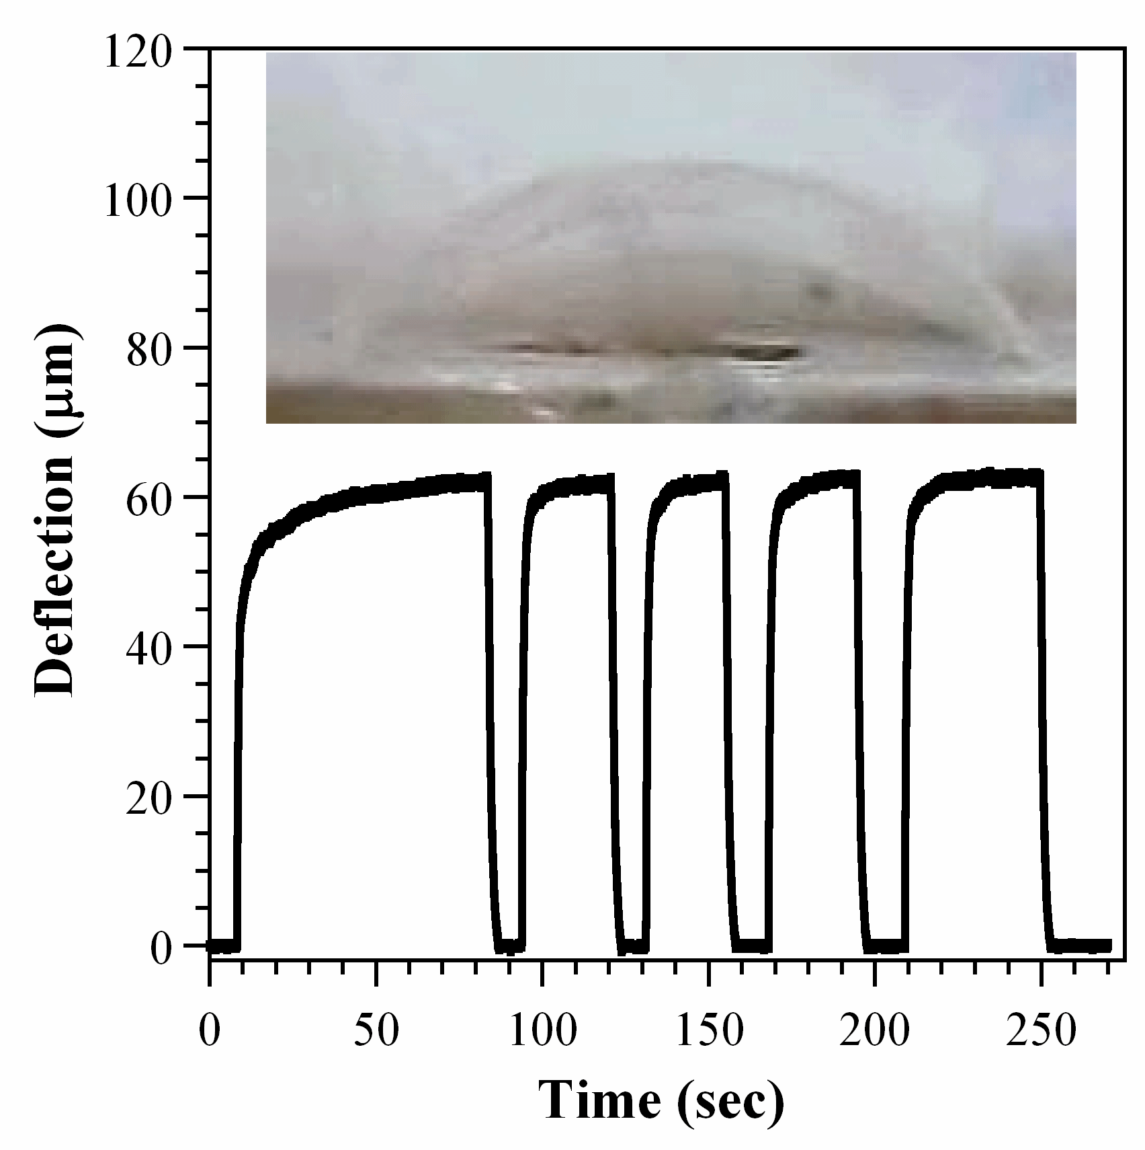
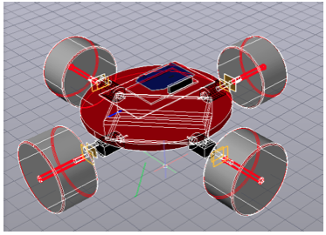
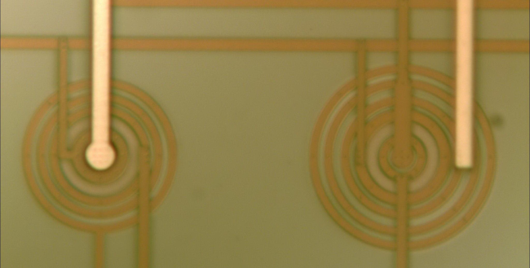
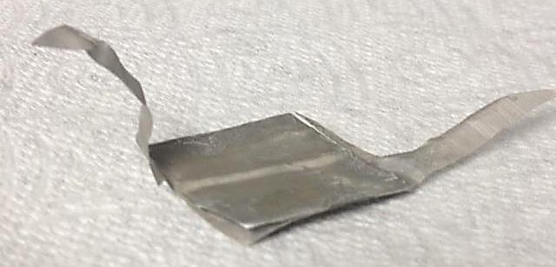


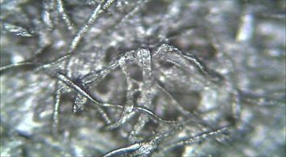
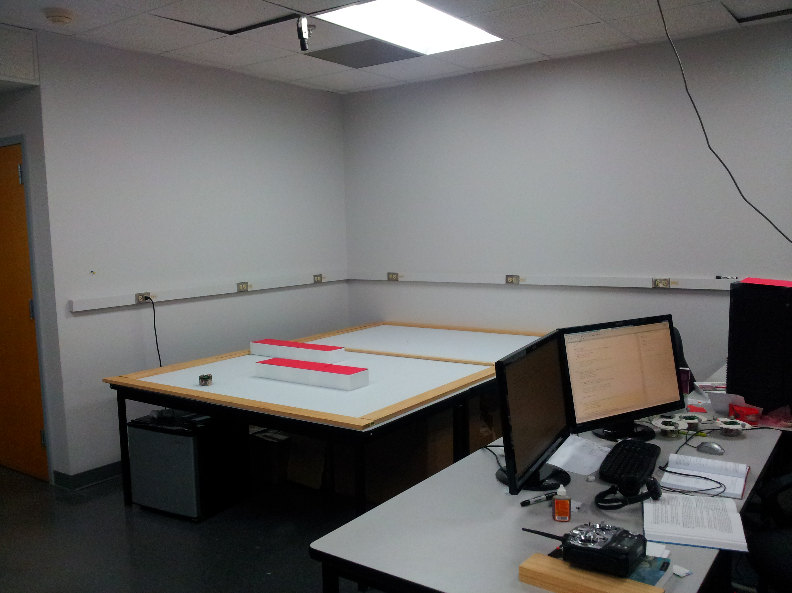
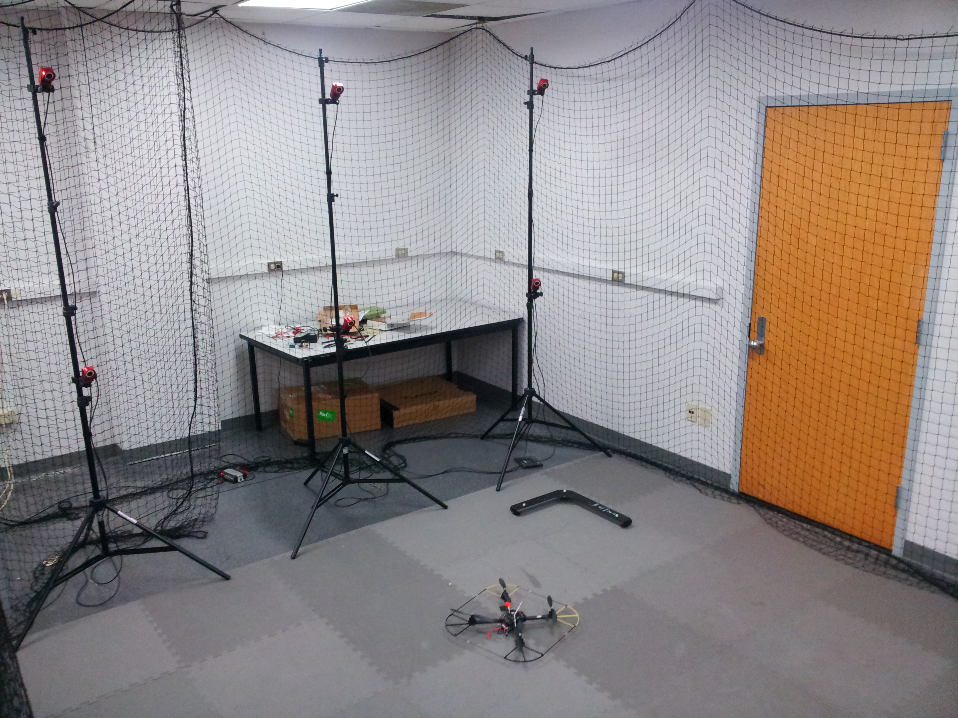
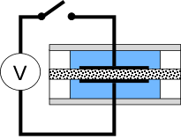
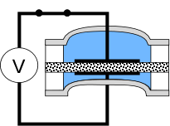
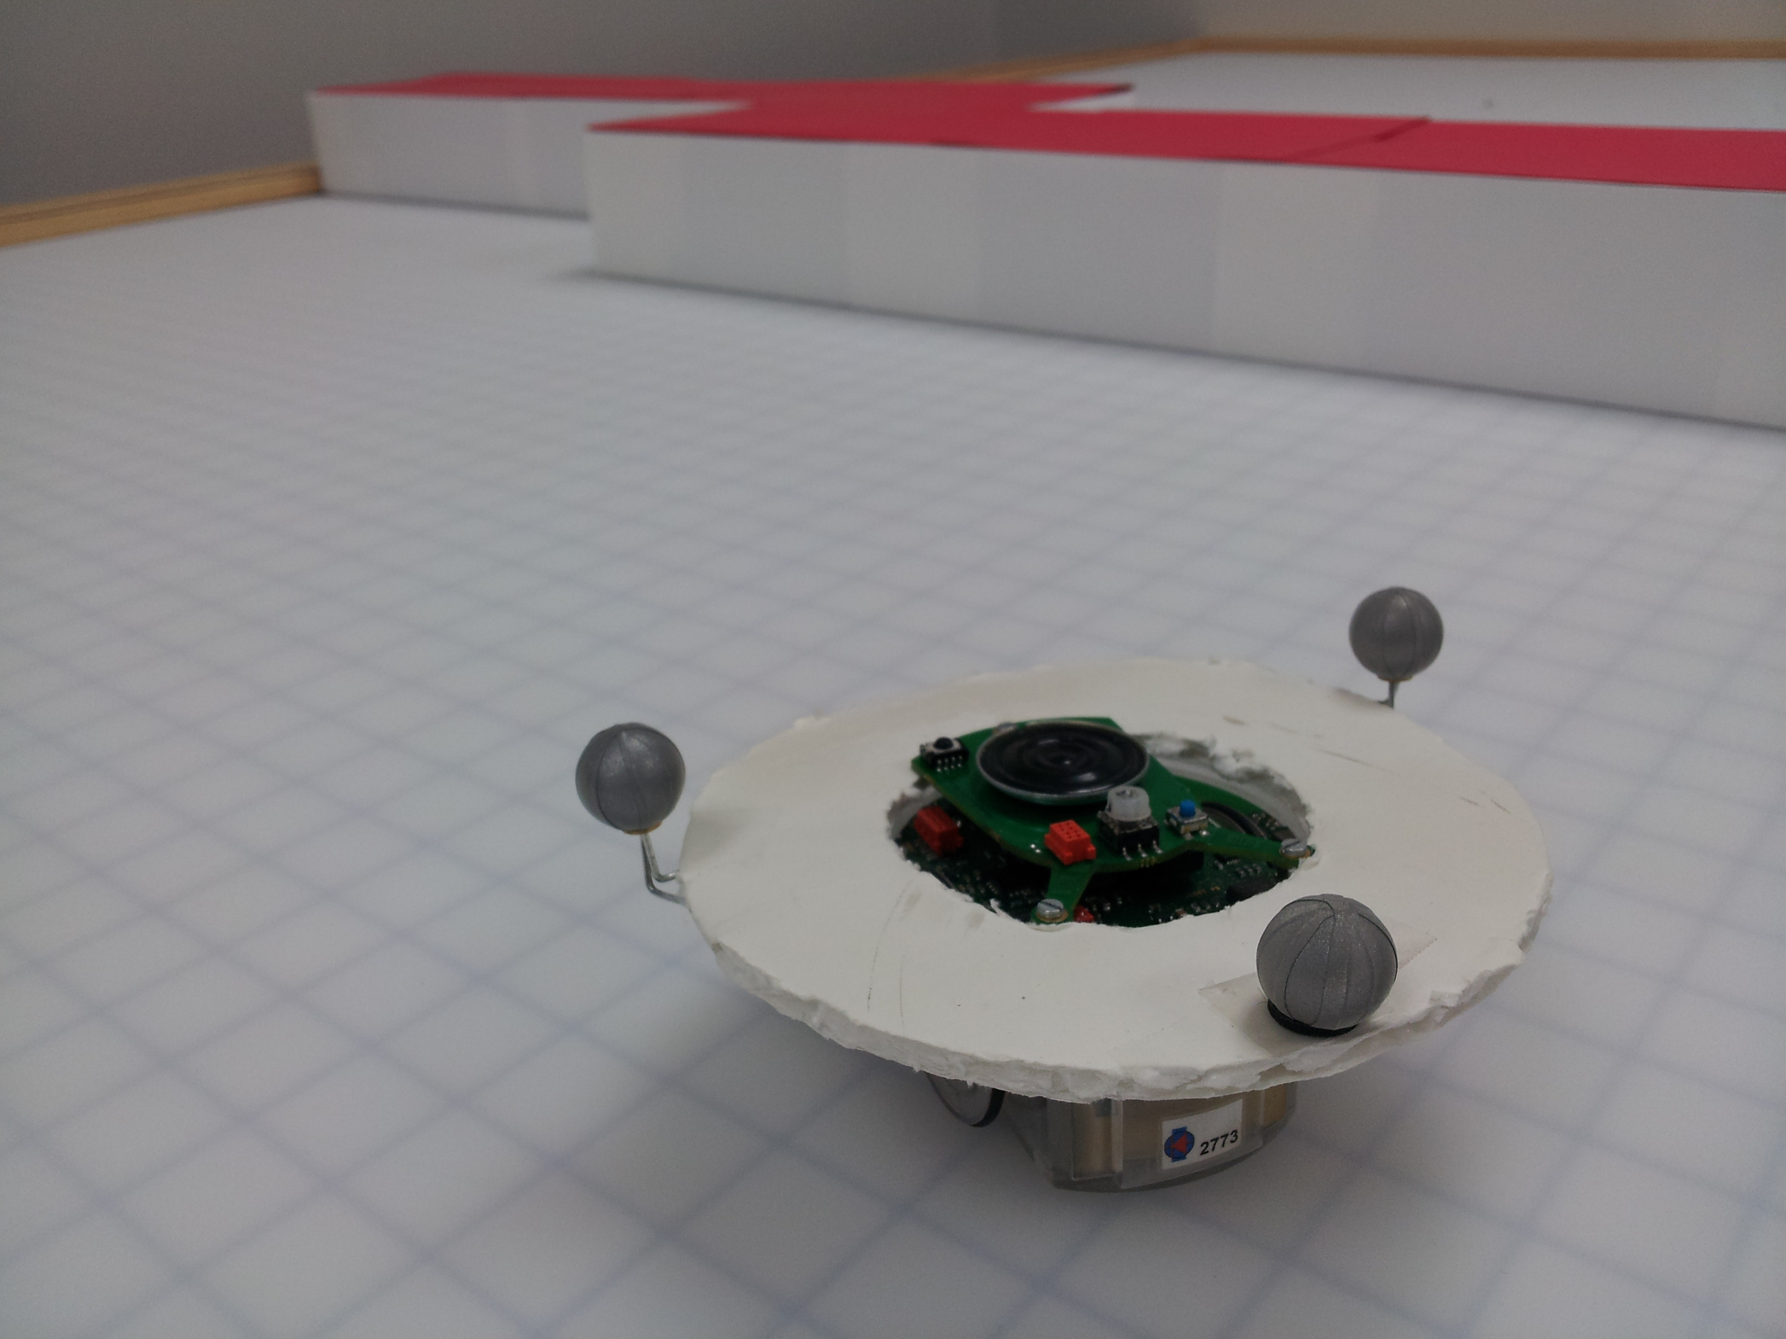
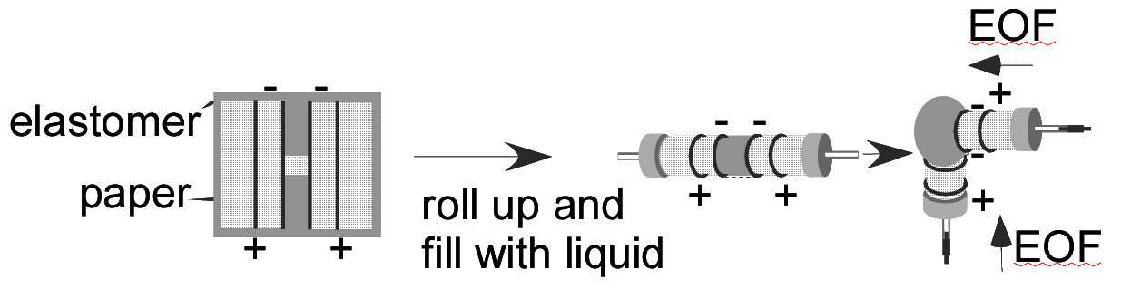

CPS: Medium: Ant-Like Microrobots - Fast, Small, and Under Control
Pamela Abshire, Sarah Bergbreiter, Nuno C. Martins, Elisabeth Smela
C I S E
Award No. 0931878
Objectives
Platforms
TinyTeRPs
Actuators
Circuit Design
Development of the first wireless network of cooperative mobile autonomous robots at a very small scale.
Research Themes:
Small robotic platforms
Control algorithms subject to limited computational capability and to security constraints.
Miniaturized low-power actuation
Sensing and odometry at very small scale
Evolution:
Electroosmotic (EO) Nastic Actuators
Mixed-signal Odometry
Concept: miniature voltage-controlled hydraulic actuators with high force, large displacement.
Research Topics:
Actuation performance (speed, force, stroke)
Actuator Fabrication
Soft robot design, actuation cell design
Characterization of new pumping fluid
Reduction of voltage
Design and simulation of mixed-signal circuits for odometry.
More power-efficient than digital ASIC and μC make it ideal for small robots.
BristleBot
“Wall-e”-Bot
Education and Outreach
TinyTeRPs
TinyTeRPs with tank base
Pumping Fluid:
One of the main goals of the project is to expose undergraduate students to the research environment. Several undergraduate students have collaborated with graduate students in various aspects of the project.
To date 13 graduate and 30 undergraduate students have worked on this project.
We participate in several outreach opportunities to stimulate interest in Robotics and Science in the general public.
Development of modular, low-cost small platform
Open source hardware and software
Addition of tank base for rough terrain
Left: Propylene carbonate (PC), unlike water, does not produce gas, even under high voltage. At left, 3 kV was applied.
Top: System-level design of analog robot kinematics simulator: signal flow and primary computational blocks.
Right: Power comparison between different implementations and design setting
Inertial Board
Main Board
High-Voltage Devices for Tiny Actuators
Battery
CMOS compatible design, optimization and characterization
Techniques: lightly doped drain, field poly, circular structure
4 structures, 315 devices, 3 runs, 99 % yield
Chassis +
Drivetrain
Top: description of the TinyTeRP platform.
Right: TinyTeRP wiki.
Right: without salt, the response of PC is Ohmic; with salt, there are electrochemical reactions.
Generalized Robotic Test Platform
National Robotics Week at the
Air and Space Museum (2013)
Design of a holonomic-drive robot for to validate algorithms
Development of libraries for simulation of various drivetrain types (e.g., differential, front-wheel steering)
Photomicrographs of rectangular structure (top left) and circular structure (bottom right)
Right: breakdown voltages for circular and rectangular structures in run 1 and run 2. The Circular 1 structure achieves the highest breakdown voltages compared to regular NMOS of 12.5 V.
Control Design
Flow velocity and pumping pressure are as good as with water. Membrane inflation occurs in only 1-2 sec.
Publications
Koshland Science Museum (2011)
Search and Surveillance
Fabrication, Lowering Voltage:
G. Sineriz, M. Kuhlman, and P. Abshire, “High Resolution Distance Sensing for Mini-Robots using Time Difference of Arrival,” in IEEE International Symposium on Circuits and Systems, May 2012.
T.-H. Lee and P. Abshire, “40 Volt NMOS in a Standard CMOS Process,” to be presented at IEEE Sensors 2012, Taipei, Taiwan, Oct 29-31, 2012.
M. Kuhlman, E. Arvelo, S. Lin, P. Abshire, and N. C. Martins, “Mixed-Signal Architecture of Randomized Receding Horizon Control for Miniature Robotics,” in IEEE International Midwest Symposium on Circuits and Systems, August 2012.
C. Perkins, L. Lei, M. Kuhlman, T. Lee, G. Gateau, S. Bergbreiter, and P. Abshire, “Distance Sensing for Mini-Robots: RSSI vs. TDOA,” in 2011 IEEE International Symposium on Circuits and Systems (ISCAS). IEEE, 2011, pp. 1984-1987.
T.Datta, P. Abshire, A. Turner, “Towards a Legged Chip”, IEEE International Symposium on Circuits and Systems (ISCAS), Rio de Janeiro, Brazil, 2011.
T.-H. Lee and P. Abshire, “An ultra-low frequency ring oscillator with programmable tracking using a phase-locked loop,” in IEEE International Midwest Symposium on Circuits and Systems, August 2012.
T.-H. Lee and P. Abshire, “Design methodology for a low-frequency current-starved voltage-controlled oscillator with a frequency divider,” in IEEE International Midwest Symposium on Circuits and Systems, August 2012.
T.-H. Lee and P. Abshire, “Design and Characterization of High-Voltage NMOS Structures in a 0.5μm Standard CMOS Process,” in IEEE Sensors Journal, Volume 13, No. 8, August, 2013.
P. Sandborn and P. Abshire, “2D Motion Sensor with Programmable Feature Extraction,” in IEEE International Symposium on Circuits and Systems, May 2013.
M. Kuhlman, T.-H. Lee and P. Abshire, “Mixed-signal odometry for mobile robotics,” Proceedings of the SPIE, Volume 8725, id. 87251H 11 pp. (2013).
A. P. Sabelhaus, D. Mirsky, M. Hill, N. C. Martins, and S. Bergbreiter, “TinyTeRP: A tiny terrestrial robotic platform with modular sensing capabilities,” in IEEE International Conference on Robotics and Automation, Karlsruhe, Germany, May 6-10, 2013, pp. 2585—2590.
A. P. Gerratt and S. Bergbreiter, “Incorporating compliant elastomers for jumping locomotion in microrobots,” Smart Materials and Structures, vol. 22, no. 1, p. 014010, January 2013.
A.P. Gerratt and S. Bergbreiter, “Microfabrication of compliant all-polymer MEMS thermal actuators,” Sensors and Actuators A: Physical, vol. 177, no. 4, pp. 16-22, April 2012.
A.P. Gerratt, B. Balakrisnan, and S. Bergbreiter, “Batch microfabricated bidirectional dielectric elastomer actuators,” in Transducers, Beijing, June 5-9, 2011.
A. P. Gerratt, I. Penskiy, and S. Bergbreiter, “In-situ Characterization of PDMS in SOI-MEMS,” Journal of Micromechanics and Microengineering, vol. 23, no. 4, p.045003, April 2013. JMM cover photo.
A. P. Gerratt and S. Bergbreiter, “Dielectric Breakdown of PDMS Thin Films,” Journal of Micromechanics and Microengineering, vol. 23, no. 6, p.067001, June 2013. IOP Select Article.
D. Sritharan, S. Chen, J. Tumbic, B. Naved, E. Smela, “Bubble-Free Electroosmosis at High Voltage Using Propylene Carbonate”, in preparation for submission to Sensors and Actuators B.
B. Balakrisnan, D. Sritharan, and E. Smela, “Surface Micromachined Dielectric Elastomer Actuators”, in preparation for submission to Journal of Microelectromechanical Systems.
B.Balakrisnan, A. Nacev, J. M. Burke, A. Dasgupta, and E. Smela, "Design of compliant meanders for applications in MEMS, actuators, and flexible electronics," Smart Mater. Struct., 21, 075033 (2012).
S.Alben, B. Balakrisnan, and E. Smela, "Edge effects determine the direction of bilayer bending," Nano Lett., 11 (6), 2280–2285 (2011).
D. Sritharan, M. Motsebo, J. Tumbic, E, Smela, “Stable electroosmotically driven actuators”, SPIE EAPAD, San Diego, California, 2013.
W.Ma, E. Arvelo and N.C. Martins, “Designing Networked Control Architectures for Incremental Robustness”, IFAC 18th World Congress, Milano, Italy, 2011.
W.Malik, N. C. Martins and A. Swami, “Optimal sensor placement for intruder detection: New design principles”, 49th Annual Allerton Conference on Communication, Control and Computing, 2011.
S.Sabau and N.C. Martins, “Norm-optimal Design of a Single Block of a Block-Diagonal Controller”, Yale Control Workshop, 2011.
A.Mahajan, N.C Martins, M. C. Rotkowitz and S Yuksel, “Information Structures in Optimal Decentralized Control”, Conference on Decision and Control, 2012.
S. Park and N. C. Martins. “An augmented observer for the distributed estimation problem for LTI systems”, American Control Conference (ACC), 2012.
E. Arvelo and N.C. Martins. “Maximizing the Set of Recurrent States of an MDP subject to Convex Constraints”, accepted for publication in Automatica, 2013.
S. Sabau and N.C. Martins, “Stabilizability and Norm-Optimal Control Design subject to Sparsity Constraints," accepted for publication in the IEEE Transactions on Automatic Control, 2013.
E.Arvelo, E. Kim and N.C. Martins, “Memoryless Control Design for Persistent Surveillance under Safety Constraints”, in IEEE International Conference on Robotics and Automation, Karlsruhe, Germany, May 6-10, 2013.
W. A. Malik, N. C. Martins, and A. Swami, "LQ Control Under Security Constraints," Proceedings of the 2013 Workshop on Control of Cyber-Physical Systems, Lecture Notes in Control and Information Sciences, Springer, pp. 101-122, 2013.
Novel technique for control design with safety constraints
  Based on entropy maximization principles
  Finitely parameterized convex program: highly scalable
  Determination of where and how many robots to deploy
A pump based on paper, which serves as a microporous channel network, was fabricated.
Unsafe (determined by scenario)
Right: Paper between mesh electrodes, pumps at only 200 V. Prior min. operating voltage, 1 kV.
No guarantee of safety
Demo at a conference in Brazil (2011)
Safe regions
CPS & Cooperative Autonomy Laboratory
Forbidden regions
Development of a testbed with for 2D tracking.
Laboratory equipped with 12- camera 3D tracking system, 4 small robots and 2 quadrotors.
Goal: heterogeneous robotic network involving small robots.
Search and surveillance scenario
Robot
Left: Electrodes are being developed based on thin film metals, carbon, or elastomer composites.
Control under Security Constraints
Goal: control the robot to a specified final position while satisfying bounds on the information available to an adversarial observer, who takes noisy measurements.
  Resulting optimization is shown to be convex.
  Duality techniques are used to find optimal solutions.
Design: New designs for pumping cells and new device configurations.
Robot
Right: New out of plane actuators increase the design possibilities.
t = k
Possible terminal locations
Top Left: in-house testbed with overhead camera. Top Right: 3D tracking system and quadrotor. Right: small robot with IR markers used for fast control and communication algorithms prototyping.
Noisy observations until t = k
Observer
Problem setup for control under security constraints
A knee joint (above) is being developed using novel materials.

