Slide 1



Architectural and Algorithmic Solutions for Large-Scale PEV Integration into Power Grids
P. Bauer, V. Gupta, Y. F. Huang, P. Murphy
D. Kirschen, M. Ortega-Vazquez
U. Topcu
Industrial Advisory Board: AEP, Argonne National Labs, GE Energy, Inovateus Solar, KEMA,MicroSun, Southern California Edison
Funded by the National Science Foundation under the Cyber-Physical Systems Program, 2012

Slide 2
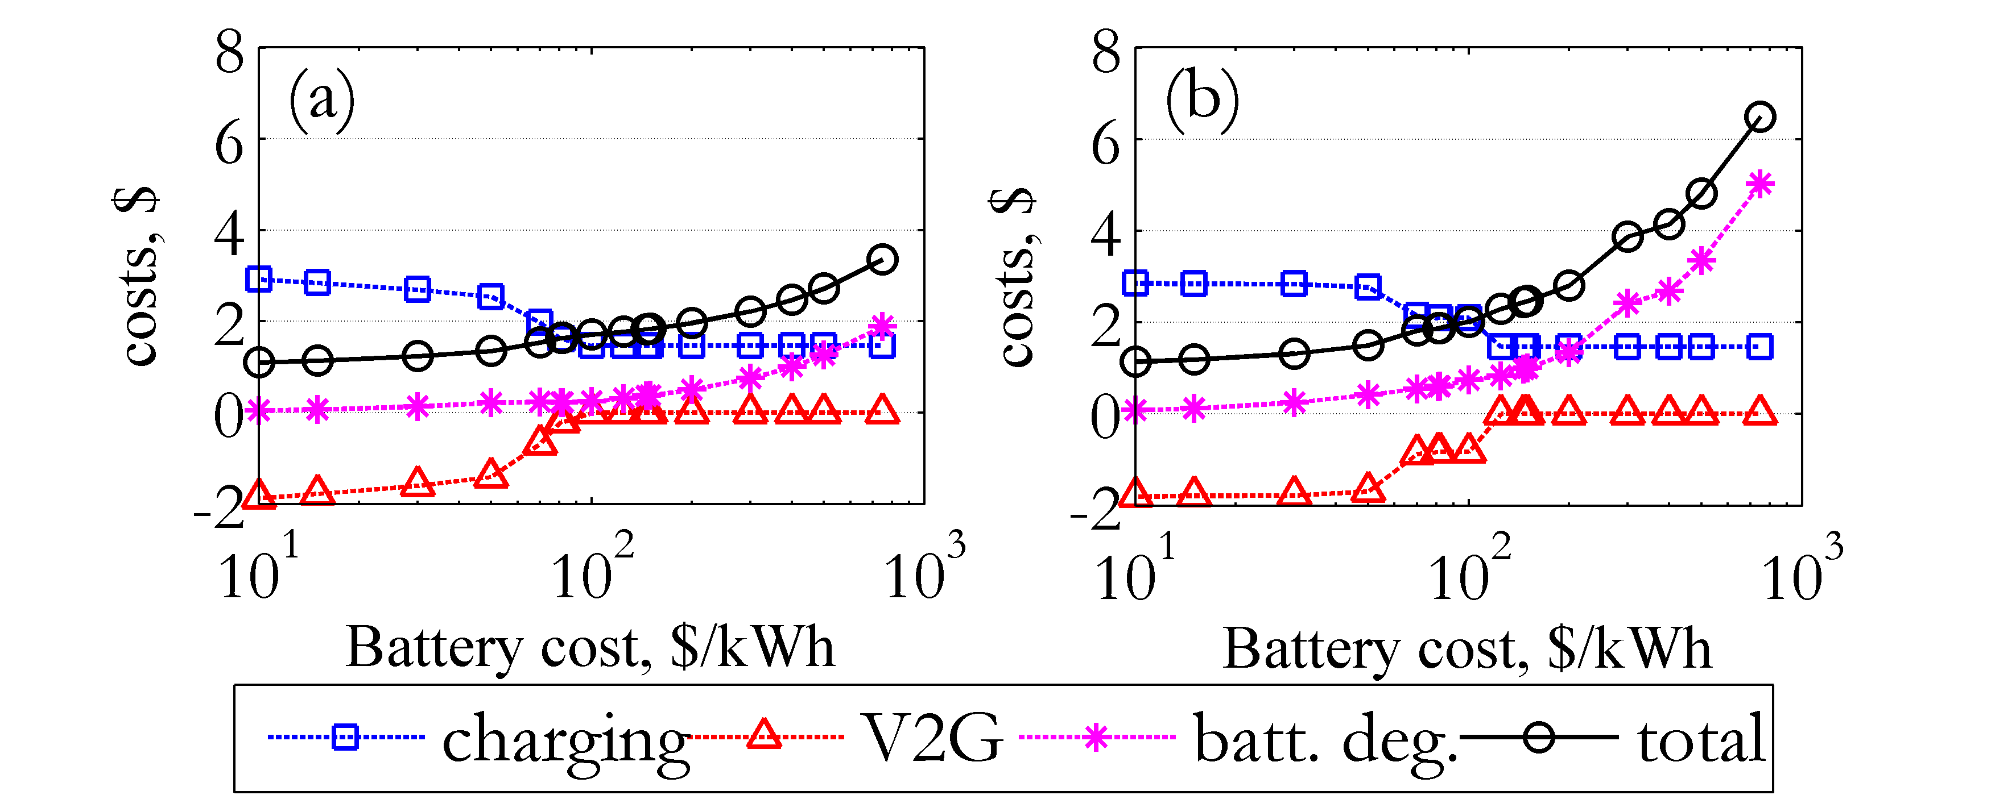
Household energy manager for optimal EV charging and V2G services
EV owners will strive to minimize their electricity costs, accrue revenues for providing V2G services to the grid, and maximize the lifetime of the batteries
V2G provision imposes additional cycling burden to the batteries, and thus degrade their lifetime faster
The optimal charging and V2G schedules of the EVs must account explicitly for the degradation costs in the Objective Function
The optimization is implemented under a Robust framework to manage the uncertainty
Under a real-time pricing scheme, look-ahead electricity prices will not be known with accuracy:
Results are sensitive to battery cost and chemistry:
M. A. Ortega-Vazquez, “Optimal Scheduling of Electric Vehicle Charging and Vehicle-to-Grid Services at Household Level Including Battery Degradation and Price Uncertainty", IET Generation, Transmission & Distribution, Vol. 8, Issue 6, Jun. 2014.

Slide 3
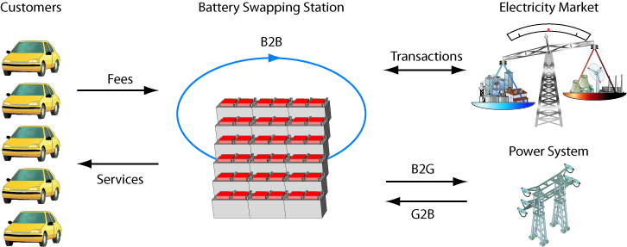
Optimal Operation and Services Scheduling for an Electric Vehicle Battery Swapping Station (BSS)
BSS is a profit-seeking business entity resembling a traditional gasoline station
Provides a fully-charged battery to a consumer and receives a battery in return
Charges the consumer a fee for provided services
Customers that would benefit are those that:
    do not want to invest in additional
    EV charging systems
    cannot install EV charging systems
    do not want to wait for charging
    want more freedom with their EVs
    in an emergency
Sarker, M. R.; Pandzic, H.; Ortega-Vazquez, M. A., "Optimal Operation and Services Scheduling for an Electric Vehicle Battery Swapping Station," IEEE Transactions on Power Systems, IEEE Xplorer: early access, 2014.
Sarker, M. R.; Pandzic, H.; Ortega-Vazquez, M. A., "Electric Vehicle Battery Swapping Station: Business Case and Optimization Model,“ 2013 International Conference on Connected Vehicles & Expo, Las Vegas, NV, USA, 2-6 Dec. 2013. (Best Paper Finalist)

Slide 4
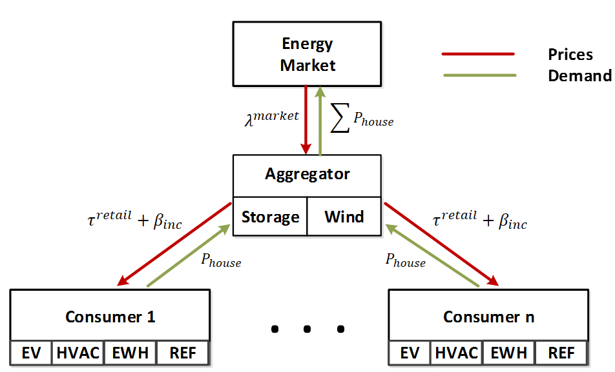
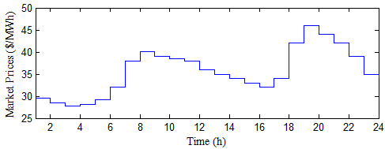
  Optimal Coordination and Scheduling of Demand Response via Transactive Incentives
Real-Time Pricing motivates consumers to shift demand to accrue lower energy costs
However, low-cost hours will incur large demand peaks
Transactive incentives used to shift consumer demand by rewarding them
Consumers equipped with an Energy
Management System (EMS) are able
to schedule controllable loads based
on perceived transactive signals
Controllable loads include: EVs, EWH,
HVACs, dishwasher, Dryers, Washing Machines
Transactive signals are sensitive to the operating conditions
Sarker, M. R.; Ortega-Vazquez, M. A.; Kirschen, D. S., "Optimal Coordination and Scheduling of Demand Response via Monetary Incentives," IEEE Transactions on Smart Grid, under review

