Slide 1










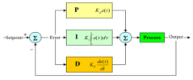




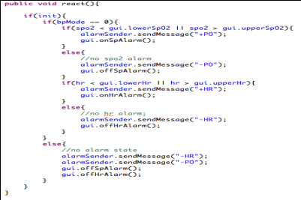
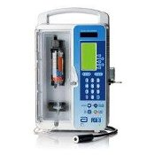
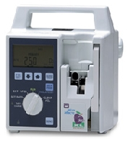
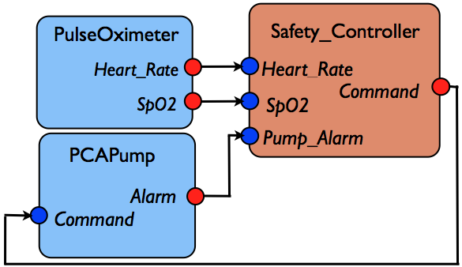
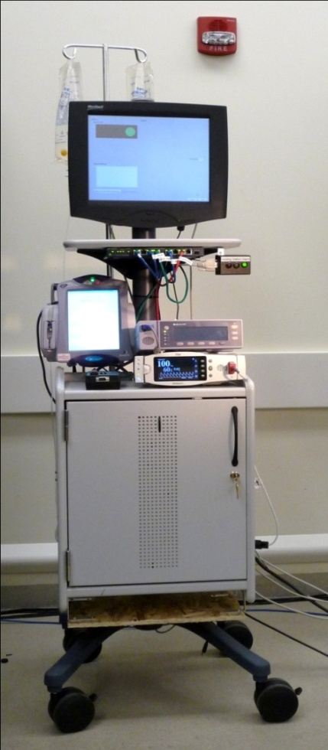
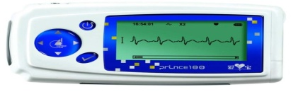

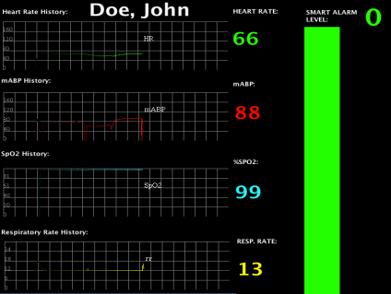


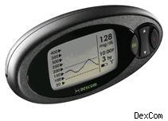
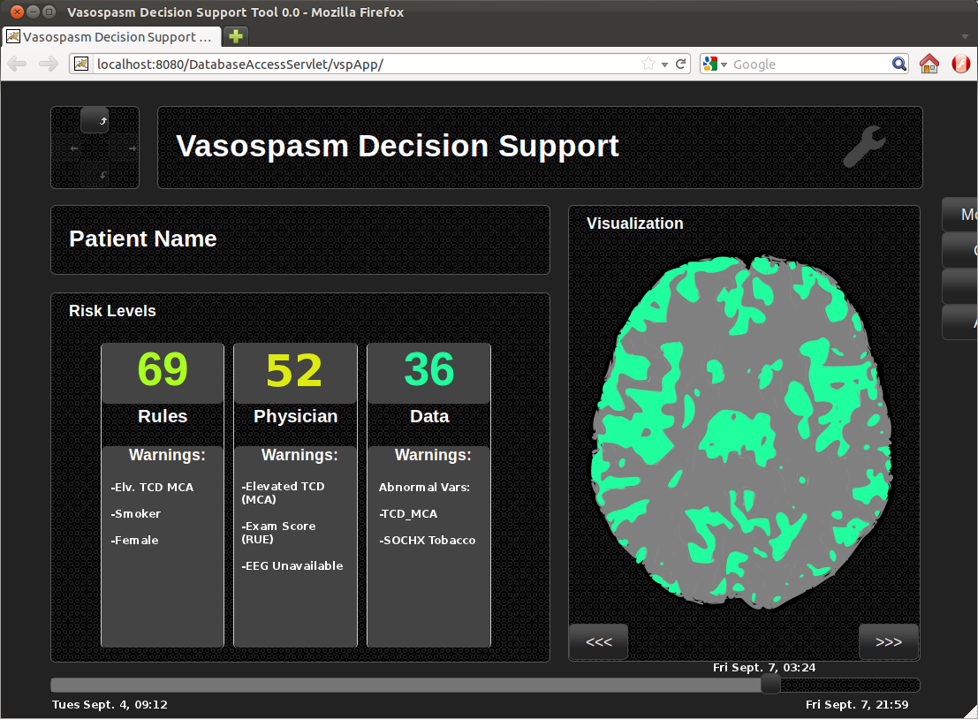
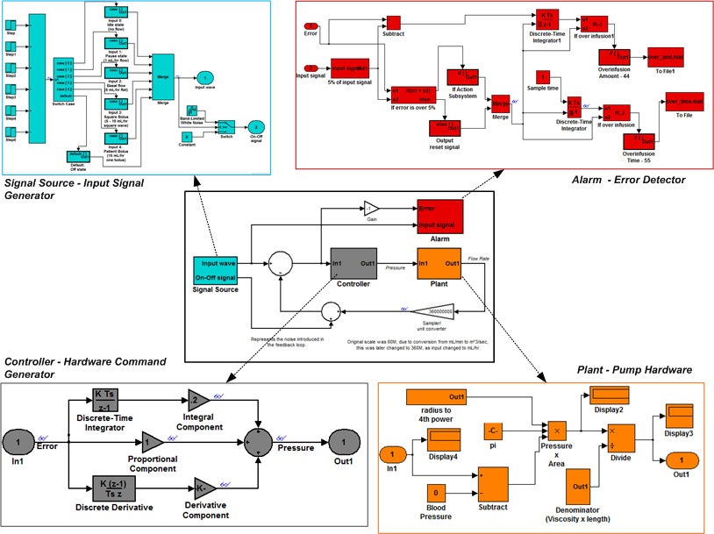
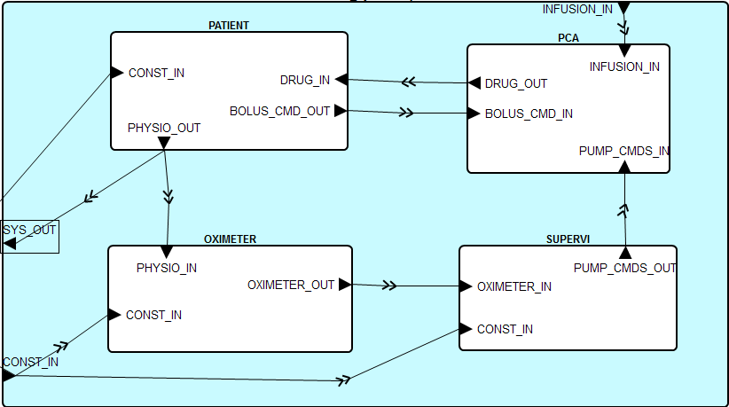
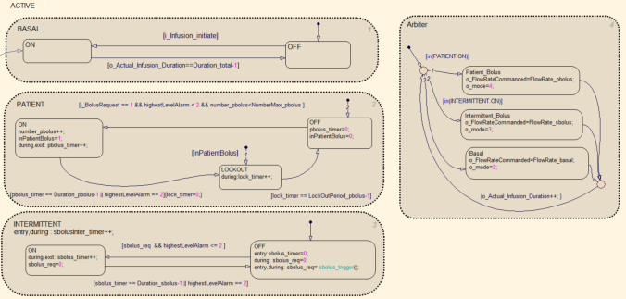
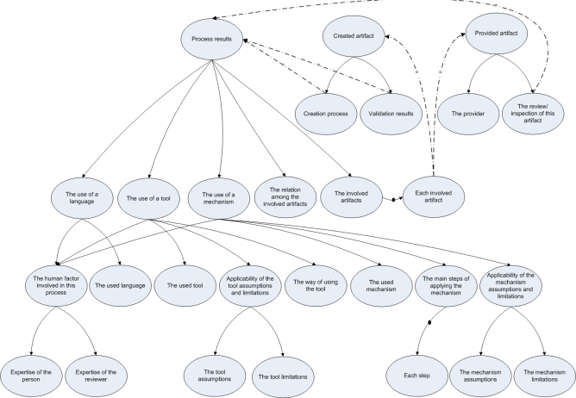
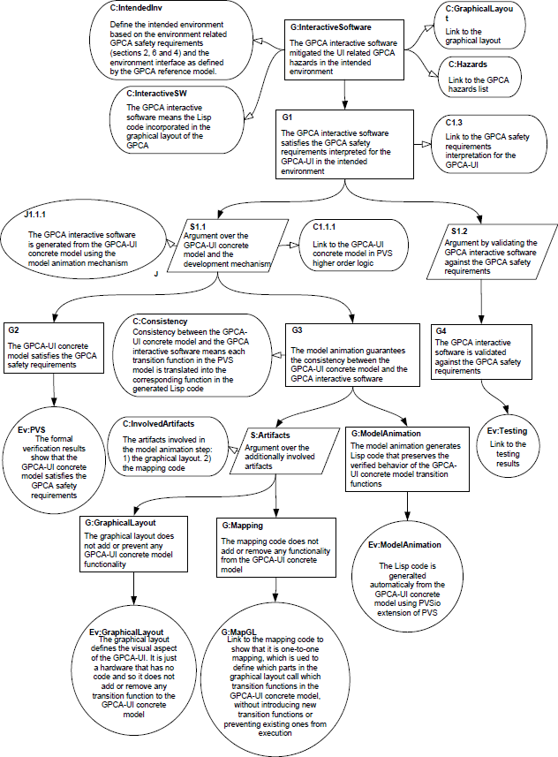

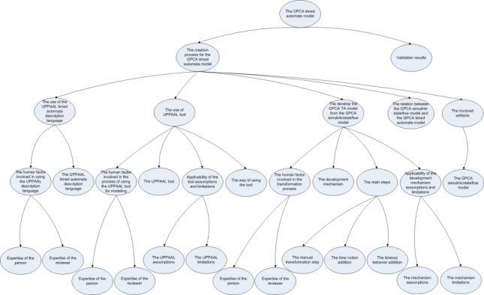
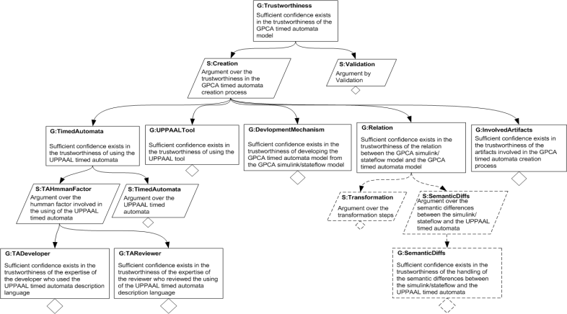
CPS: Large: Assuring the Safety, Security and Reliability of Medical Device Cyber Physical Systems (NSF CNS-1035715)
PI: Insup Lee, University of Pennsylvania (lee@cis.upenn.edu)
2012 CPS PRINCIPAL INVESTIGATOR MEETING, National Harbor, MD
Introduction
Virtual Medical Device (VMD)
MDPnP Lab @ CIMIT
Recent years have seen medical devices go from being monolithic to a collection of integrated systems
  Modern medical device systems have thus become a distinct class of cyber-physical systems, which we call Medical Cyber Physical Systems (MCPS)
  The goal of this project is a new development paradigm for the design and implementation of safe, secure, and reliable MCPS:
  A compositional development framework for safe and secure MCPS
  An approach to evidence-based regulatory approval and incremental certification of MCPS
  Techniques for rigorous evaluation of clinical scenarios, both operational procedures for caregivers and device systems
  Control-theoretic methods to the design of physiological closed-loop scenarios
MCPS: Conceptual View
VMD
Real-time support
for VMD Apps
Progress
VMD Device
Specification Language
Got MDCF code to run on the BeagleBoard development boards we are using in the MD PnP Interoperability Lab
Enable rapid and easy deployment in our lab of prototype systems
Involved with the AAMI standards groups for Assurance Cases and for Infusion Devices for better guidance on clinical issues and safety requirements
Monitoring Medical Devices
Administrative Support
MD PnP (initiative for medical devices interoperability) enables a new kind of medical device, a Virtual Medical Device (VMD), which is composed of medical devices coordinating over a computer network.
VMDs will not physically exist until instantiated by a hospital. The hospital will be the systems integrator.
The Medical Device Coordination Framework (MDCF) is prototype middleware for managing the correct composition of medical devices into VMD. The MIDAS resource manager gives the MDCF hard real-time capabilities.
VMD App lifecycle
Patient
Smart Controller
Smart Alarm
Caregiver
VMD platform implementation using real-time Java (RTSJ) called MDCF/MIDAS
Uses OpenFlow to guarantee real-time communications
Supports a variety of scheduling and admission control algorithms to ensure timing behavior on different types of switches.
Safe online priority remapping allows new apps to start w/o disrupting other applications’ timing.
Publish / subscribe with guaranteed QoS on open networks
Select App
Used by device to announce capabilities
Used by app to specify requirements
Semantics based on Modal I/O automata
App/Device Compatibility machine checkable
Enables compositional reasoning
Enables checking properties of all possible instantiations of a VMD in one pass.
Treatment Delivery Medical Devices
Decision Support
Select Devices
Medical Device Mobile PnP Prototype Platform (MD MP3)
Maintain Patient Records
Actuate Treatment
Enable continuous care
Process data collected
Generate alarms
Automatically initiate treatment
MIDAS Checks Feasibility &
Device / app compatibility
Caregiver
MD MP3 cart is a platform for the development of smart pump control algorithms
It includes two pulse oximeters, a simulated respiratory rate monitor and an infusion pump specially modified to run software based on prior Generic Infusion Pump research that supports external control over the network
It runs a real-time network over Ethernet hardware that guarantees message delivery with bounded latency
+
=
QoS Feasible
Devices compatible
Challenges
Virtual Medical Device
(VMD)
CPU and Network Resources
are Allocated
Supervisor
Interoperability
Decision Support
Device Coordination Algorithm
Medical Device Types
Devices are “bound”
to the app
External
Network
Network Controller
Data
Logger
Model-Driven Development
Closed-Loop Control
MDCF / MIDAS
Adapter
Adapter
Adapter
Security & Privacy
Clinician selects appropriate VMD
MDCF binds appropriate devices into VMD instance
MDCF displays VMD GUI for clinician
Stop App
App tasks active
PulseOx
Pump
PulseOx
A Modal Specification Approach for On-Demand Medical Systems. Andrew L. King, Lu Feng, Oleg Sokolsky, Insup Lee. In 3rd International Symposium on Foundations of Health Information Engineering and Systems (FHIES 2013), Macau, August 2013
Co-Developed with “Trustworthy Composition of Dynamic App-Centric Architectures for Medical Application Platforms,” NSF CPS ACI-1239324
Patient
Smart Alarms and Decision Support
Closed-Loop Medical Devices
Definition
Status
Definition
Projects
  MCPS of multiple devices + “smart” controller
    Filter, analyze, and visualize real-time medical information
    Suppress irrelevant alarms
    Provide summaries of the patient's state, predictions of future trends, smart alarms
  Generic Decision Support Architecture
    Modular: flexible and configurable
    Preprocessing, inference, visualization
  On-going work concentrates on case studies
  MCPS of networked sensors, controllers and actuators
    Continuously monitor patients’ states and configure actuation devices, such as infusion pumps
    The automatic system operates in a pre-defined region
    Caregivers will be notified and take over control when patients’ states become unstable
Blood glucose control: evaluation and enhancement of an intra-operative insulin infusion protocol
  Inpatient glycemic control: caregivers titrate the insulin infusion rate according to paper-based protocols
  Evaluated a currently used protocol by running in-silico experiments using an FDA-approved Type 1 diabetic simulation model
  Developed a new proportional-derivative algorithm to calculate the insulin rate and a numerical approach to optimize the control parameters
  In-silico trials show that the new PD algorithm preserves the strengths of the current protocol and overcomes its weaknesses: the new algorithm minimizes hypoglycemia risk (BG < 70 mg/dL), minimizes the glucose variability and maximizes the BG values that are in the target range (70 – 130 mg/dL)
  The anesthesiologist who designed the current protocol believes the results warrant prospective investigation in-vivo
  In collaboration with Dr. Benjamin Kohl and Margaret Mullen-Fortino at the Hospital of the University of Pennsylvania; the paper is published at ICHI’2013
On-going Work
  Prospective evaluation of the new PD insulin infusion protocol
  A data-driven approach for personalized glucose control and safety lock
  Safety analysis of a multi-mode artificial pancreas system (in collaboration with Dr. Stephen Patek and Dr. Patrick Keith-Hynes at the University of Virginia)
Case Studies
Benefits
  Smart alarm for CABG patients
    Post-CABG surgery patients produce many false alarms
    Simple classification with nurse-generated rules: 57% reduction in false alarms
    Trials on retrospective data beginning
    Vasospasm smart alarm
    Post-SAH surgery patients at risk for vasospasm, suspicion factors for vasospasm are subtle, definitive measure is invasive
    Multiple vital signs used to produce risk assessment for vasospasm in the form of clinical decision support system.
    Additional features to improve accuracy being developed (variability measures)
Benefits
  Improve patient safety
    More accurate than current alarms
    Provide pertinent contextual information
  Reduce clinician workload
    Reducing high number of false alarms, which reduces caretaker fatigue
    Eliminates workflow chokepoints by presenting data when it is relevant
  Facilitates data-driven medical practice
Reduce cognitive burden
    Example: Type 1 diabetics have to manage glucose level by insulin self-treatment, which is a life-long control challenge
Improve patient safety
    Caregivers can focus on making critical decisions
    Some safe actions can be taken automatically, e.g., stop
    infusion to prevent overdosing
  Improve clinical outcomes
    Higher quality of physiological control
Challenging Problems
Challenges
Manage inter-patient variability
    Every patient is different
    Control algorithms need to be personalized
  Hazard analysis
    The failure scenarios need to be systematically identified
Verify safety properties
    New verification and reduction techniques are needed to handle the complexity and uncertainty of physiological models
    Models cannot take into account all real-life factors: how to validate the method using real data?
    Filtering and synchronizing multiple data streams
    Developing context-aware patient models
    Encoding hospital guidelines, extracting expert models, learning models statistically
    Visualizing data concisely and effectively
Future Work
Classification of Vasospasm after Aneurysmal Subarachnoid Hemorrhage Using Data-Driven Machine Learning Techniques. Alex Roederer, John H. Holmes, Insup Lee, Soojin Park, 11th Annual Neurocritical Care Society Meeting, Oct 2013
  Expand Case Studies to include Sepsis
  Unify visuals to ease workflow integration
  Understand and establish safety in these systems
Evaluation and Enhancement of an Intraoperative Insulin Infusion Protocol via In-Silico Simulation. Benjamin Kohl, Sanjian Chen, Margaret Mullen-Fortino, and Insup Lee.
In IEEE International Conference on Healthcare Informatics (ICHI 2013), Philadelphia, PA, September 2013.
GPCA: Model-Based Development
Hierarchical System Verification
Goals
Model Based Requirements Analysis
Benefits of the Approach
Vision
Benefits of the Approach
Develop a set of generic infusion pump development artifacts that can be used as a reference standards and demonstrate safety, using a model based approach.
Control System models
  Complementary models deepen system understanding.
  Improved capture of CPS requirements.
  Well structured and verifiable system decomposition.
  Rigorous and (partially) verifiable path from system requirements to component code.
End to end system verification through compositional and behavioral reasoning supported by formalisms and tools suitable for the task at hand.
Timed Automata Models
UPPAAL
Verification
(UPPAAL)
  Scalable and practical approach to formal hierarchical system reasoning.
  Enables exploration of the solution space using modeling techniques appropriate for each layer of system abstraction.
  Facilitates iterative co-evolution of requirements specification and system design
Approach
  Explore behaviors of physical system.
  Evaluation control approaches.
  Discover system requirements.
Use modeling in the physical domain to elicit requirements.
Provide clear, precise, and formalizable requirements.
Decompose system hierarchically to manage complexity.
Model requirements, component contracts, and component behaviors formally.
Rely on ensemble of verification tools to show the decomposed system meets its top level requirements.
N-Level Modeling & Heterogeneous Analysis
Properties
Architectural models
Next Steps
System-Level Timed Models: Natural representation of top level system; Verify system level requirements using timed automata model checking.
Architectural Models: Discretize and capture requirements, architecture, and component contracts; Compositionally verify behavior of architecture satisfies system requirements.
Behavioral Models: Elaborate component behaviors and verify their conformance to component contracts.
AADL Models
AGREE
Reasoning
(OSATE)
Precisely scope system.
Decompose into components.
Formalize system requirements and component contracts.
Compositionally verify in AGREE
Model structuring guidelines for clarity and verifiability.
Modeling patterns for product families.
Tool assisted construction and verification of architecture based assurance cases to demonstrate GPCA safety.
Generating Platform dependent reference implementation
Remaining Challenges
Challenges
Behavioral models
Properties
Verifiable mapping from continuous to discrete time.
Extend AGREE to support asynchrony.
Assigning blame when properties are violated.
  No guidance as to writing requirements for CPS.
  Approach for architectural decomposition and requirements flow-down lacking.
  Scalable compositional verification tools not available.
  Method for structuring models for verifiability missing.
Capture detailed behavior of components.
Verify behavior satisfies component contract.
Generate code.
Simulink/StateFlow Models
Behavioral
Verification
(SLDV)
Evaluation of Assurance Cases
Compositional Verification of a Medical Device System. Anitha Murugesan, Michael Whalen, Sanjai Rayadurgam and Mats Heimdahl. To appear in ACM SIGAda International Conference on High Integrity Language Technology, Pittsburg, PA, November 2013.
Safety Assurance of VMD
Team
Goal
Interactive Software
VMD is safe
University of Pennsylvania
Hospital of the University of Pennsylvania
  Provide effective means to evaluate the quality of a given assurance case
Use error is serious source of risk for medical devices.
Developed a safety case for the interactive software incorporated in infusion pump user interfaces.
Suggest several ways to improve its structure that would increase confidence in the constructed safety argument.
Goal
  Develop a structure for safety case for an on-demand
  medical CPS based on the VMD approach
Claims
  Top claim: any VMD instantiation is safe
  Subclaims:
    VMD is correctly modeled and the model is verified to be safe
    Modeling assumptions are explicitly captured
    Medical Application Platform (e.g., MDCF/MIDAS) will guarantee
    that incomplete or incorrect instantiations are rejected
    MAP guarantees that VMD instantiation operates according to the model
    MAP guarantee sthat runtime deviations from the model-
    specified behaviors are detected and alarms are raised
Future directions
  Development of the assurance approach is coordinated with the VMD modeling language and MIDAS development
  Interactions with the FDA on evaluating the approach are in progress
Rajeev Alur
Ross Koppel
Insup Lee
Rahul Mangharam
George Pappas
Rita Powell
Oleg Sokolsky
C. William Hanson III
Margaret Mullen-Fortino
Soojin Park
Victoria Rich
Compliant
devices
Clinical
scenario
model
Model is verified to
be safe
Systematic Construction of
Confidence Arguments
The common characteristics map
AND
The Safety Argument Context or Evidence
device specification
communication semantics
Center for Integration of Medicine and Innovative Technology (CIMIT)
  Provide a reasonable mechanism to:
    Systematically construct confidence arguments, and
    Identify safety gaps (assurance deficits)
    Based on common characteristics map
Instantiate the common characteristics map
Compliant
deployment platform
Julian Goldman
University of Minnesota
Mats Heimdahl
Nicholas Hopper
Yongdae Kim
Michael Whalen
Collaborators
John Hatcliff (Kansas State)
Paul L. Jones (FDA)
Yi Zhang (FDA)
University of Waterloo
Assuring the Safety of On-Demand Medical Cyber-Physical Systems. Andrew L. King, Lu Feng, Oleg Sokolsky, Insup Lee. In 1st International Conference on Cyber-Physical Systems, Networks, and Applications (CPSNA 2013), Taipei, Taiwan, August 2013.
Sebastian Fischmeister

