Slide 1

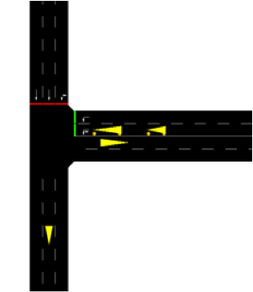
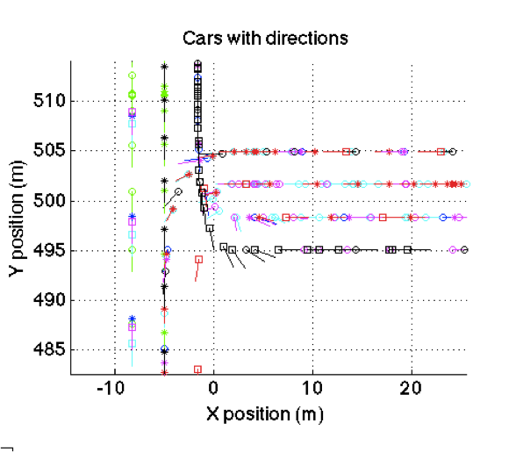
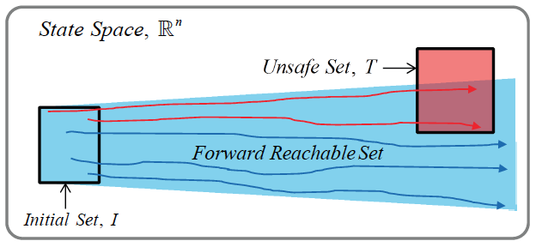
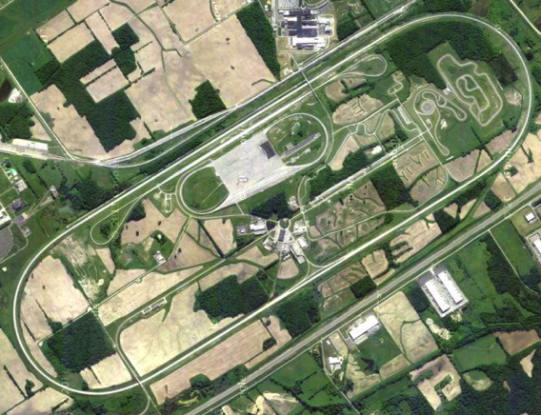
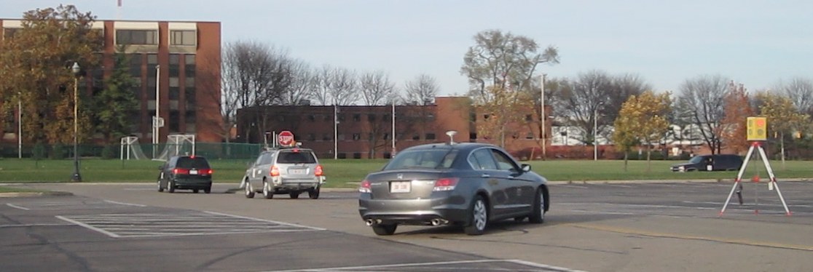
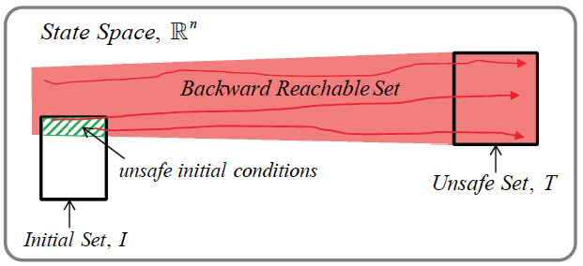
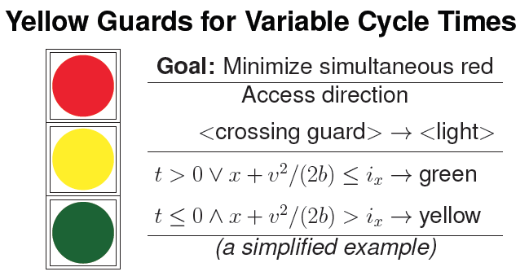
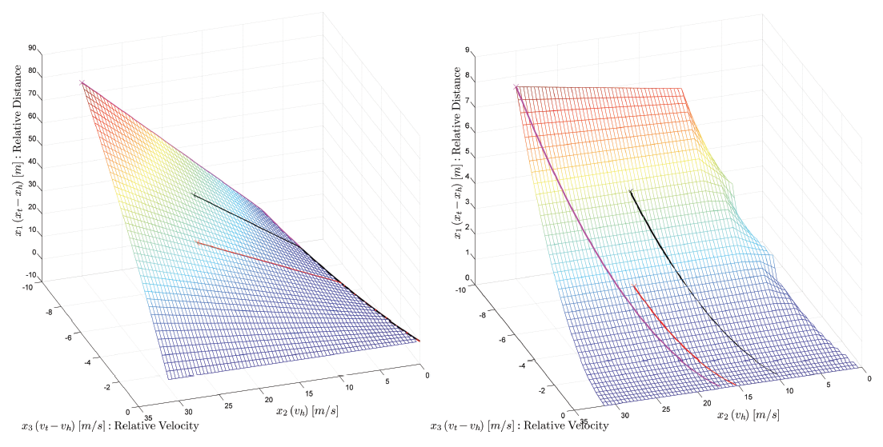
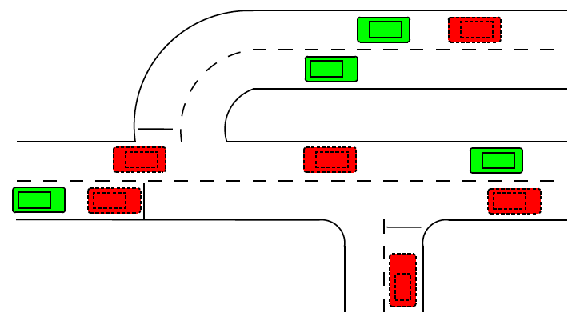
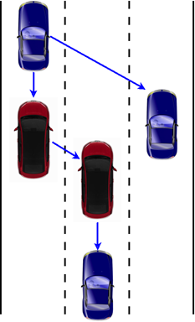
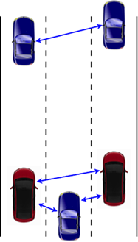
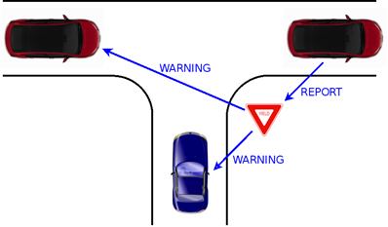
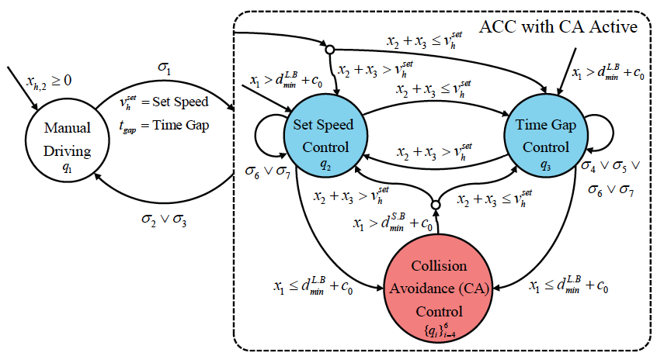
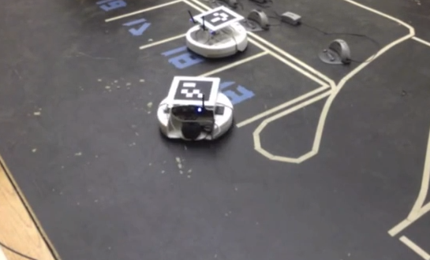
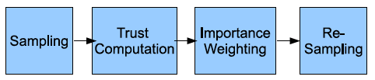
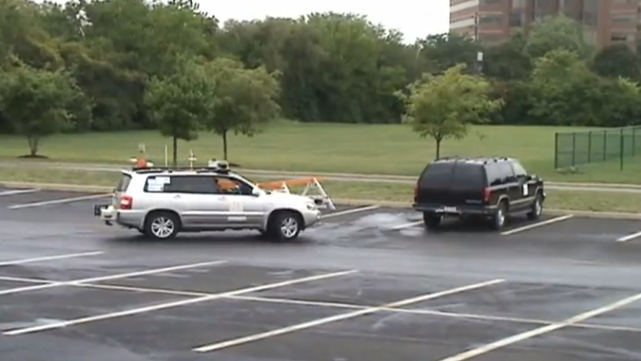
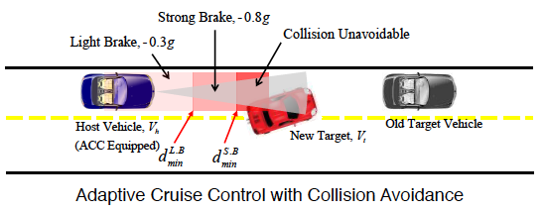
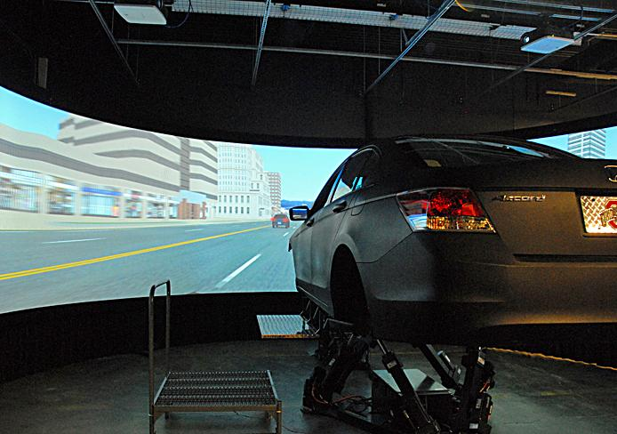
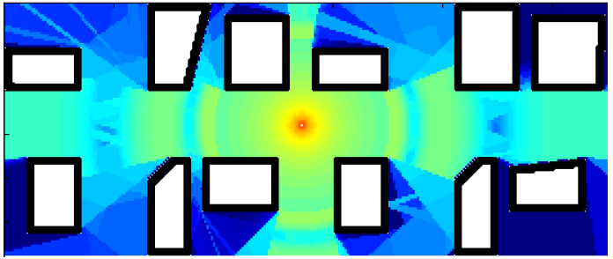
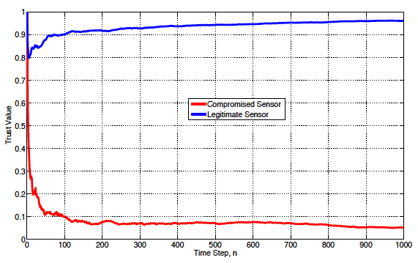
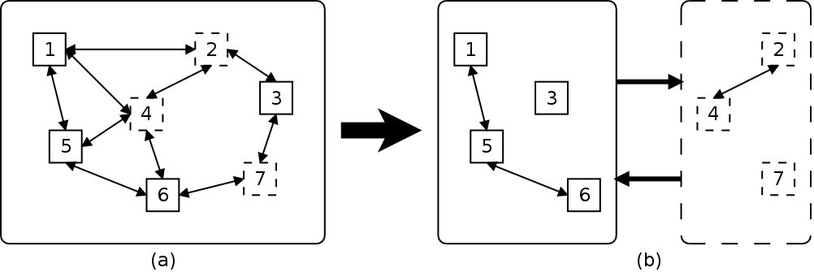


Autonomous Driving in Mixed-Traffic Urban Environments
Ümit Özgüner, Ashok Krishnamurthy, Füsun Özgüner, Keith Redmill, Paul A. G. Sivilotti and Bruce W. Weide
Departments of Electrical and Computer Engineering, Computer Science and Engineering, The Ohio State University, Columbus, Ohio, 43210 USA
Introduction
The Cyber-Physical System Research group at the Ohio State University develops tools and algorithms to address the interdisciplinary problem of fully autonomous driving in real-life urban traffic from multiple angles. The group has worked to address a number of unique problems involving large-scale cyber-physical systems for mixed-mode traffic, where human-driven cars, motorcycles, bicycles, pedestrians and other autonomous and semi-autonomous vehicles interact, poses.
In this poster, a range of recent studies conducted in the OSU CPS group, including verified safe controllers for autonomous vehicles, pedestrian motion analysis and simulation, collaborative traffic mapping, trust-aware sensor fusion, semi-virtualized and scaled-down testing and adaptive intersection access control will be sampled.
Reachability Analysis
Starts from a continuous system and a collision set, by finding an unsafe set for which there exists a target control for all host control such that collision set can be reached.
Designing the controller to avoid the unsafe set is the goal.
Computation of forward and backward reachable sets involve solutions to Hamilton-Jakobi-Isaacs PDE.
Using the calculated unsafe sets, Hybrid-State Controllers can be designed to stay out of these regions.
The surfaces of the unsafe sets are used to create discrete-state transition surfaces.
A Hybrid-State System (HSS) model for different modes of passenger motion were developed, specifically for tracking motion at a bus/subway station, with the pedestrians interacting with vehicles.
Forces between people and between people and doors (attractive or repulsive) can be modeled using perception zones.
Initial traffic mapping simulations were built using SUMO and MATLAB.
Semi-Virtual and Scaled Testing
Testing even a single experimental vehicle for a single autonomous/automated capability takes a significant amount of consideration and resources:
Safety (for equipment and people)
Location (tracks for high-speed tests)
Person hours
Logistics
Weather
Repeatability
Using virtualized systems or subsystems in the experiment, a number of these considerations can be relaxed.
Similar to HIL simulation
Full-size vehicles interacting with the simulation
Simulated agents, scenarios, even sensors
Much lower cost, and safer
Connected vehicle technologies enable a unified and easy to implement interface between virtual and physical.
Parking
Autonomous parking and deparking are non-trivial problems for non-holonomic vehicles
Initial tests help with scenarios/meaneuvers
100-Car Demo
Work in progress
Micro-traffic simulator for bulk of the ambient traffic
OSU Driving simulator for human-controlled virtual vehicles
DSRC simulator for virtual vehicles
Radio interfaces to physical vehicles
HUD for human drivers
Scenario and world coordinators
Generic Cyber-Physical System with virtual components can be decomposed into virtual and physical subsystems and analyzed in parallel.
Adaptive Intersection Signaling
OSU CPS researchers considered a traffic signal at an isolated intersection with one lane of traffic in each of two directions. Researchers focused on V2I communications rather than worrying about how the traffic signal could communicate its "intent" to autonomous vehicles; and modeled each vehicle using standard physics to analyze its position, velocity, and acceleration/braking as a function of time; each (possibly autonomous) driver's behavior as what is needed to maintain a safe following distance behind the vehicle in front of it, and to obey the traffic signal; and the traffic-signal controller as an algorithm that has full information about all vehicles in its vicinity. The study incorporated a fuel-consumption model from the literature to account for instantaneous fuel usage of a typical vehicle as a function of its acceleration and velocity. (Note that acceleration is a critical factor in fuel usage, and it is a key feature not present in standard fluid-flow models.) Then we simulated various situations with various conditions on the arrival rates of vehicles, speed limits, drive reaction times, etc.
Conclusions
Over the years, OSU CPS group addressed a number of research questions related to autonomous driving in realistic traffic. Both experimental and simulation results on feasibility and efficiency of the developed algorithms show great potential and the research group continues to investigate different approaches to expand our understanding of control and sensing for mixed-mode traffic autonomy.
Hybrid passenger model
Security
VANETs are prone to security attacks. In collaborative environments where warning messages and other information are exchanged, trust management is important to address the security issue. Selfish and/or malicious nodes in the network have to be detected and possibly excluded from the collaboration.
There are mainly two types of trust evaluation methods: centralized trust evaluation and distributed trust evaluation. In this research the group considered distributed trust evaluation in which each entity in the network computes the trust value of its neighbors.
As an alternative to the EKF-based estimation, particle filters were investigated. In order to overcome the vulnerability of classical particle filters against false data injection from faulty/compromised sensors, the developed trust-aware particle filter assigns trust/confidence values to different sensors in order to weigh the fused components with respect to reliability.
The figure above shows the parts of the trust aware particle filter. As seen in this figure, a trust computation block is added to the SIR particle filter algorithm in order to inhibit the compromised sensors. The following plot demonstrates the variation of trust value for malicious and legitimate sensors. It can be observed that when the trust aware particle filter starts to run, the trust value of the compromised sensor goes down to very low value i.e γk ≤ 0.1. The fusion processor differentiates between the legitimate and compromised sensors successfully.
Four OSU-CITR vehicles, one with full autonomy, one longitudinally autonomous, and two human driven, all with DSRC radios. The V2I-enabled prototype traffic light is also seen on the right.
Safe Controllers
The group worked on on synthesis and verification of safe controllers for CPS using a game theoretic approach, with particular interest in Intelligent Transportation Systems (ITS) applications.
The example system chosen to illustrate our approach was Adaptive Cruise Control (ACC):
an advanced version of the Cruise Control system;
uses a radar sensor to detect whether slower vehicles are in the vehicle’s path;
and automatically adjust its speed to the traffic.
But, ACC is developed mainly for driver’s comfort:
so it cannot address the situation such as sudden deceleration of the preceding vehicle and cut-in by a slower vehicle;
thus, a Collision Avoidance (CA) system needs to be developed and integrated to the ACC system to avoid a collision and guarantee safety.
The goal of the ACC with CA system is:
• Find the Minimum Safe Distances, 𝑑𝐿.𝐵 and 𝑑𝑆.𝐵
• Apply Light or Strong Brake force to avoid a rear-end collision and guarantee safety.
One feasible and promising approach is to consider the ACC with CA as a two-player zero-sum differential game:
One vehicle (target) tries to cause a collision with the other,
The other vehicle (host) tries to avoid the collision,
Host tries to maintain the desired clearance
Reachability Analysis can be used to obtain the set of states from which the target vehicle can cause a collision with the host vehicle despite host’s best effort.
Avoiding these no-win states is the goal of the controller.
Example
Simulation
VANET examples
Traffic Mapping
Building and maintaining an internal representation of the traffic scene, for the purpose of intelligent/autonomous driving, using information collected through sensing and communication.
A decentralized data fusion algorithm for efficient, accurate, and reliable traffic mapping in mixed-traffic environments.
Scan matching, perception modeling and Kalman Filters are used to generate the traffic map.
Literature
Park, J., Kurt, A., Ozquner, U. (2013, April). A game theoretic approach to controller design for cyber-physical systems: Collision avoidance. In Cyber-Physical Systems (ICCPS), 2013 ACM/IEEE International Conference on (pp. 254-254). IEEE.
Adamey, E., Kurt, A., Ozguner, U. (2013, September) Cooperative Traffic Mapping Using Onboard Sensing and V2V Communication in Mixed-Traffic Environments. In Second International Symposium on Future Active Safety Technology. FAST-zero `13. Nagoya, Japan.
Adamey, E., Kurt, A., Ozguner, U. (2013, September). Agent-Based Passenger Modeling for Intelligent Public Transportation. Intelligent Transportation Systems (ITSC), 2013 16th International IEEE Conference on. The Hague, The Netherlands.
Kurt, A., Redmill, K., Özgüner, Ü. (2013, April). Coordinated autonomous driving with 100 connected vehicles. In Proceedings of the ACM/IEEE 4th International Conference on Cyber-Physical Systems (pp. 244-244). ACM.
Adamey, E., Basciftci, Y. O., Gong, P., Kurt, A., Özgüner, F., Özgüner, U. (2012, April). State Estimation and Sensor Fusion for Autonomous Driving in Mixed-Traffic Urban Environments. In Cyber-Physical Systems (ICCPS), 2012 IEEE/ACM Third International Conference on (pp. 229-229). IEEE.
Peddi, S. P. (2013, April). Real-time adaptive signaling for isolated intersections. In Cyber-Physical Systems (ICCPS), 2013 ACM/IEEE International Conference on (pp. 256-256). IEEE.
Mobile robot parking on our indoor testbed
Full-sized vehicle parking at a parking lot
Pedestrian Modeling
In order to capture the human motion that is part of the mixed-mode traffic, the group investigated pedestrian models.
Using a mixture of agent-based and social force methods, it is possible to capture realistic passenger motion, with emergent realistic behavior not specifically coded into the model.
Acknowledgments
We would like to thank The National Science Foundation for their support and the entire OSU-CITR and OSU-CPS teams.
The studies presented were partially supported by NSF under Cyber Physical Systems (CPS) Program (ECCS-0931669).
For further information
Please contact kurt.12@osu.edu or umit@ece.osu.edu. More information on this and related projects can be obtained at
http://www.osc.edu/cps/ and http://www.ece.osu.edu/citr/
The variation of trust value for legitimate and compromised sensors when attack noise is Gaussian distribution with μa = 3 and σa2 = 10 and there are 5 malicious sensors out of 10 sensors.
Control and Intelligent
Transportation
Research Lab

