Slide 1

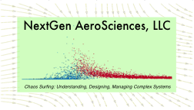
Beyond NextGen:
21st Century Air Mobility
National Science Foundation
Transportation Panel
Dr. Bruce J. Holmes
CEO, NextGen AeroSciences
Williamsburg Virginia

Slide 2
Topics

Slide 3
Slower Growth in Scheduled Service
(Commercial Operations, 1994 to present with annual forecasts)
Source: FAA Aerospace Forecast, 2011 – 2031, and earlier years

Slide 4
Flight Segments Will Be Longer
(Average Flight Stage Length)
Source: FAA Aerospace Forecast, 2011 – 2031, and earlier years

Slide 5
Aircraft Will Be Larger
(Average Seats per Aircraft)
Source: FAA Aerospace Forecast, 2011 – 2031, and earlier years

Slide 6
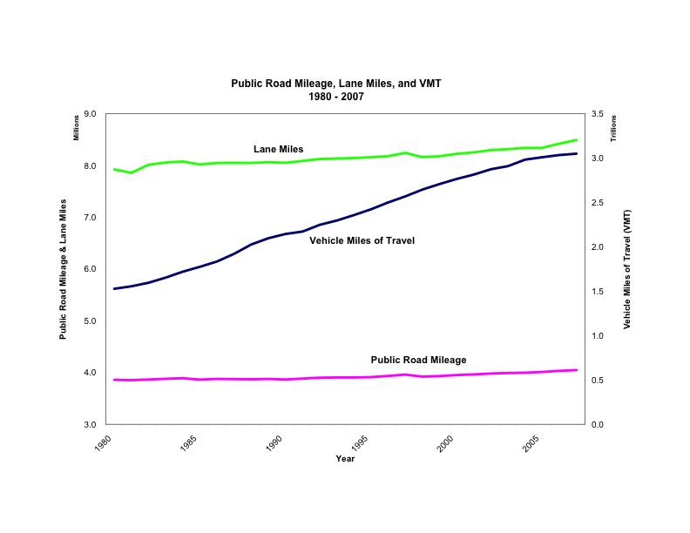
Roads Will Be More Congested
Question: Can our Nation’s roads meet demand for highway travel
in 2020 and beyond?

Slide 7
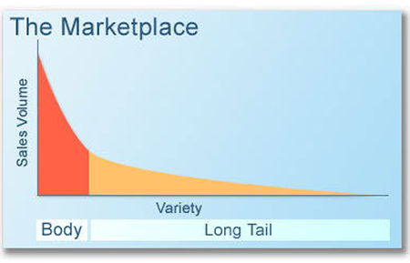
What these forecast data mean
Scheduled service market dynamics mean:
  Fewer, larger markets
  Fewer smaller markets
Thin markets should motivate
On-Demand innovations
in aircraft and service models
Highways alone appear inadequate for our nation’s future mobility needs

Slide 8
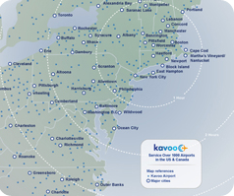


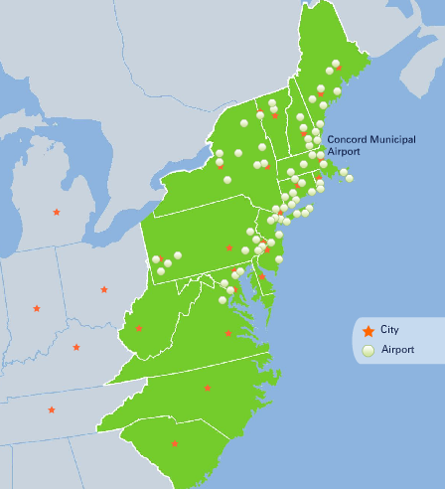
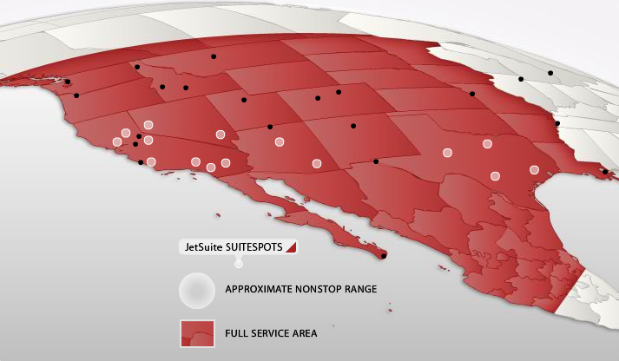


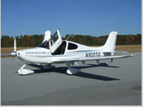

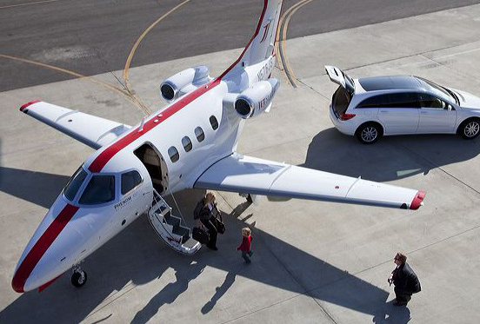

2011 ODM Industry

Slide 9
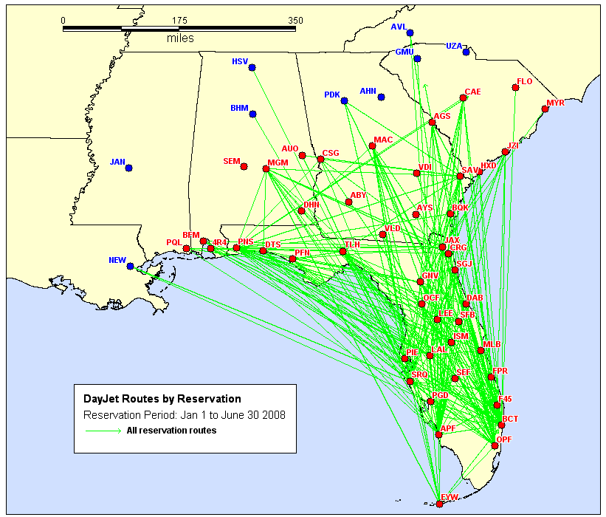
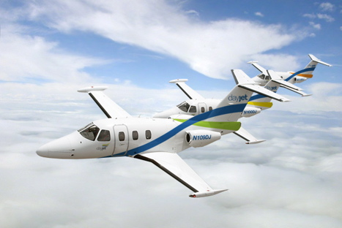
The DayJet Experience
Command Center Ops
  50% fewer dispatchers
  Basis for automation
~ 1 year of revenue ops
28 aircraft
100 pilots
375 cities total; Hard to model U.S. in 2007; now possible to do the nation
FAA Kudos
Notes:
Does it work? Can you engineer it? Yes!

Slide 10
On-Demand Mobility Value Proposition

Slide 11
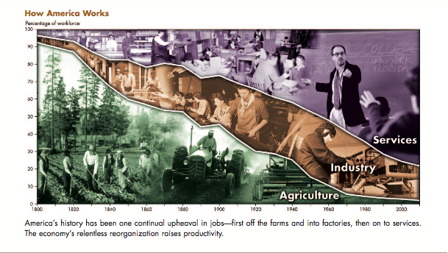
The Nation’s Innovation Mission -
providing technologies that change the game!
Knowledge/Innovation?
Our 21st Century Economic Identity
Innovation leading to increased productivity
is the fundamental source of increasing wealth in an economy.
Notes:
Agriculture, Industry, Services describe how we created wealth, standard of living, quality of life in past epochs
During each life cycle, scarcities were managed to become abundances:
AG: from scarcity to abundance of arable land
IND: from scarcity to abundance of power (horsepower)
SERV: from scarcity to abundance of information
NEXT: from scarcity to abundance of knowledge (for innovation)

Slide 12
NextGen Airspace and Airports
From | To
Ground-Based navigation | Satellite navigation
Analog, Party line radios | Networked Internet Protocol radios
Steam gages in the cockpit | Computer graphics cockpit displays
Jet Routes and Airways | Dynamically optimized trajectories
Staffed control towers | Virtual and automated control towers
Data stove pipes | Network-centric, system-wide shared data
Radar | Airborne-based position data
Slowdowns in bad weather | Same performance in all weather
Ground-managed aircraft separation | Airborne-based separation
After-the-incident safety alerting | Prognostic safety alerting
To:
  Satellite-based

Slide 13
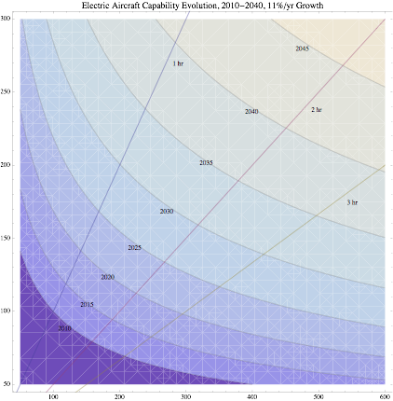
Electric Propulsion Timelines
Based on 11% annual improvements in energy density
2040
Historic average flight segments
for on-demand air carriers
~170 mi. (@ 200 mph)
~250 mi. (@ 400mph)
1 Hr
2035
2 Hr
2030
Speed, mph
2025
3 Hr
2020
Today: 125 mph for 200 miles near 2 hours
2015: 150 mph for 200 miles for ~2 hours
2025: 200 mph for 200 miles for 1 hours
2015
2010
2005
© 2011 NextGen AeroSciences, LLC. All Rights Reserved
Range, miles

Slide 14
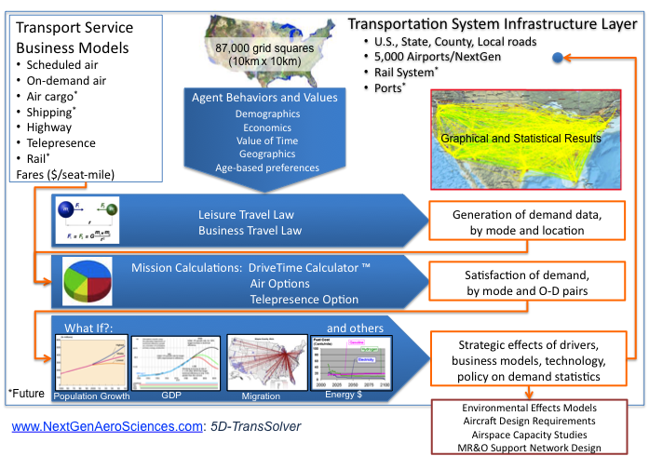
NextAero ABM Demand-Supply Co-evolution Tool

Slide 15

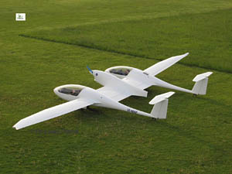

Autonomous Vehicles in Automated Airspace
Alternative piloting system architectures (UAS-like)
e-Sense and Avoid
Synthetic-Enhanced vision
Self-recovery auto-flight
On-board trajectory optimization
“Pocket” airports with virtual towers
Optimized, dynamically interacting aircraft trajectories in Conflict-Free airspace
© 2011 NextGen AeroSciences, LLC. All Rights Reserved

Slide 16
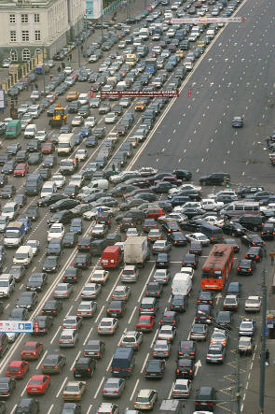
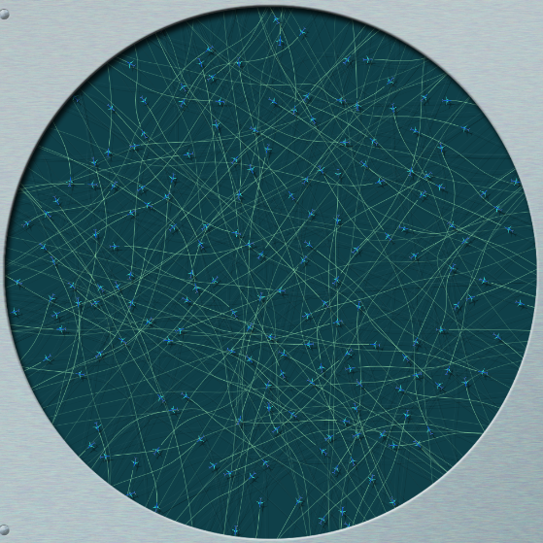
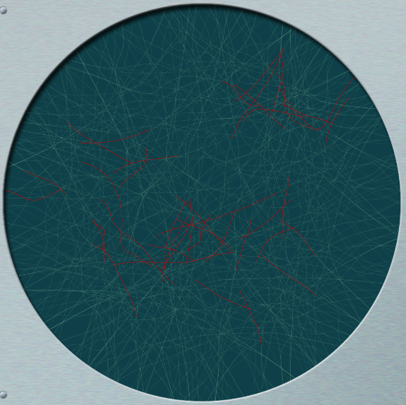
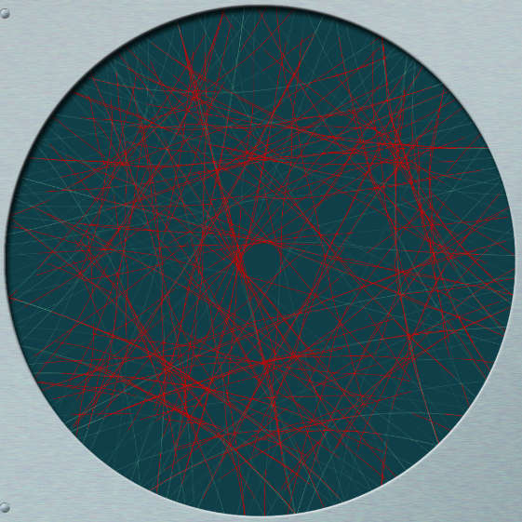
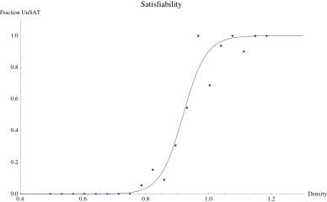
Understanding Airspace Phase States
Traffic Physics inspiration
Phase prediction
Phase control

Slide 17
Strategic Implications
An All-Electric air transportation system appears attractive, even likely
  Battery energy densities equal liquid fuels in a few decades
  Electric is quiet
  No contrails
What are the vulnerabilities of such as system?
  EMP
  Malware
  Jamming
What alternatives require attention?
  Network resilience, robustness
  Optical computing, communications for CNS
  Others?...

Slide 18
A New Architecture for Innovation and Productivity
Paradigmatic Challenges
NextGen as a Commons for Innovation

