Slide 1





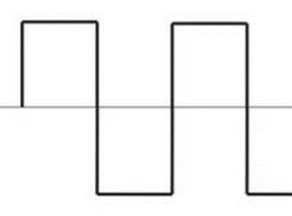



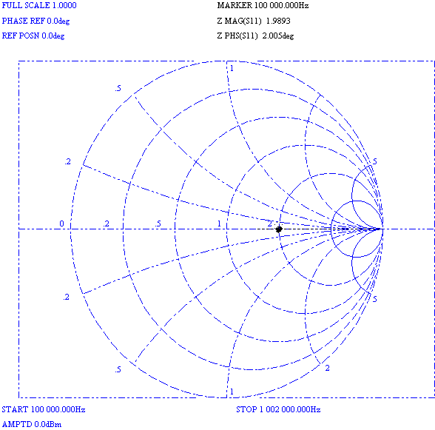
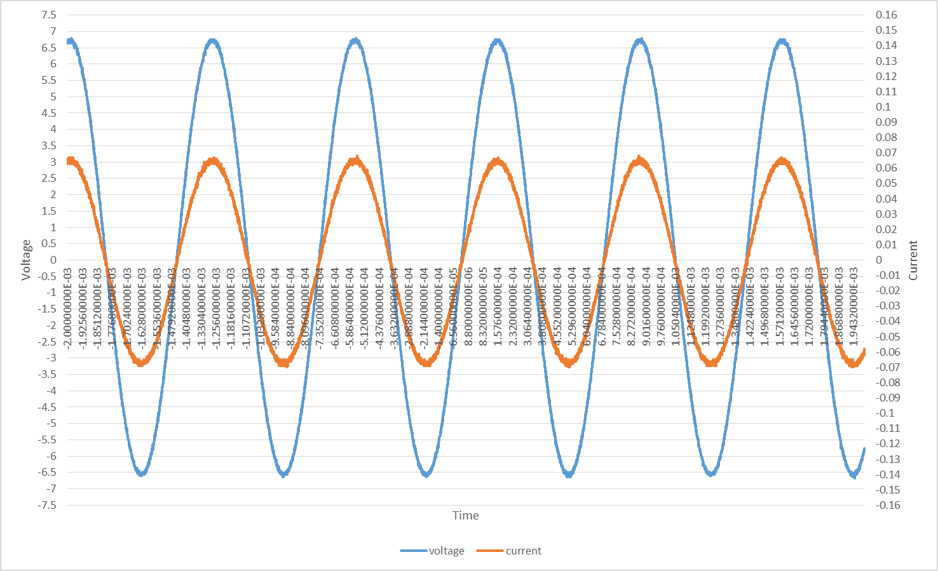

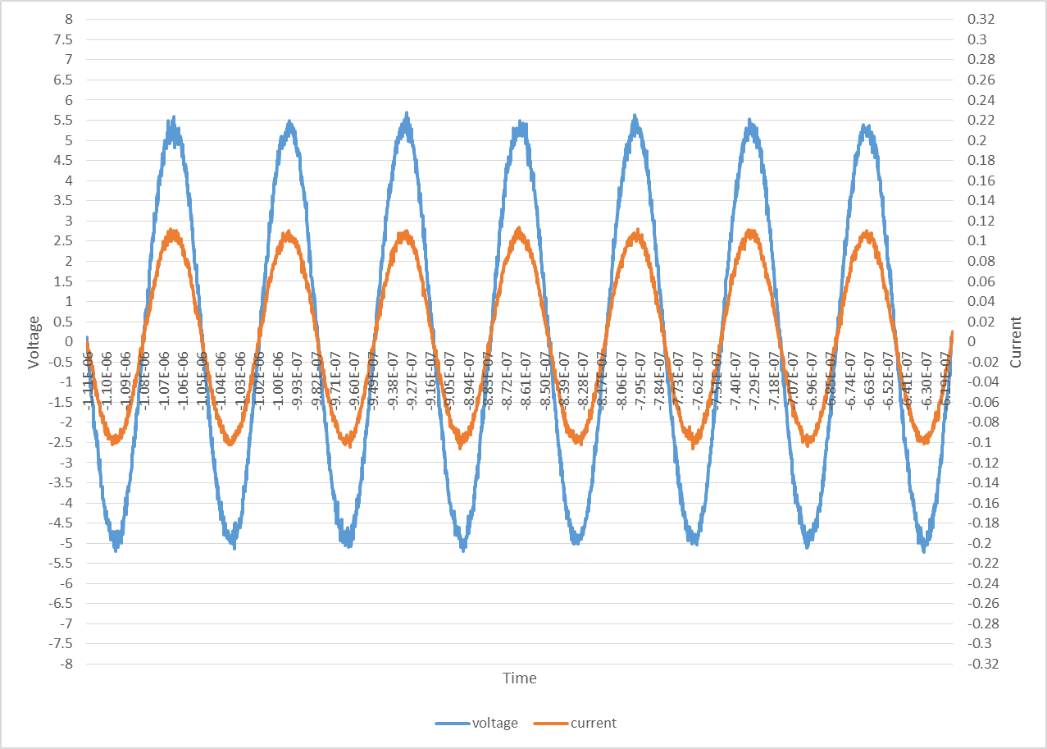


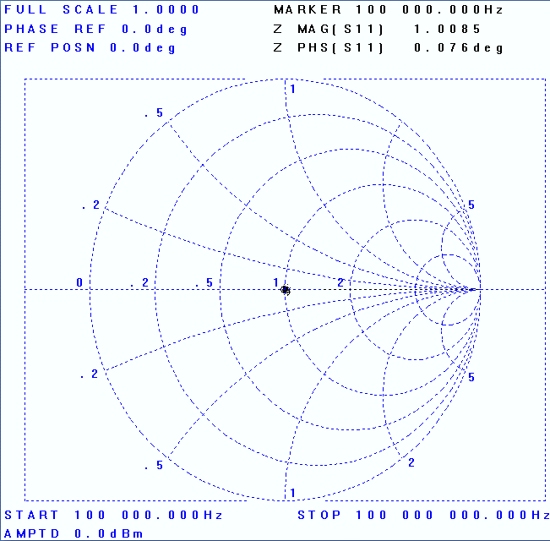
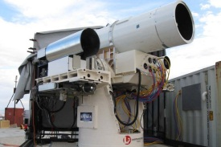

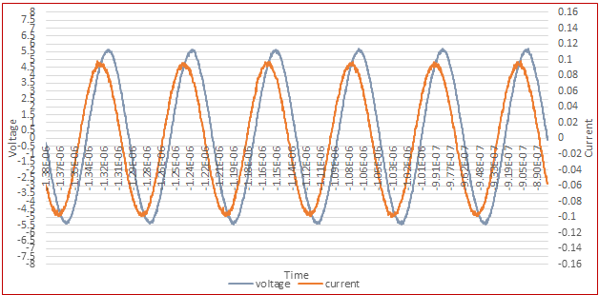
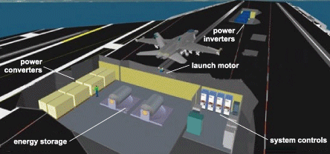

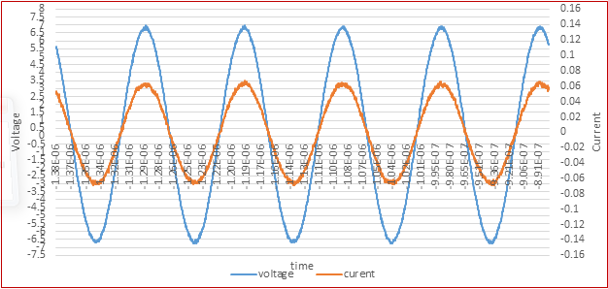
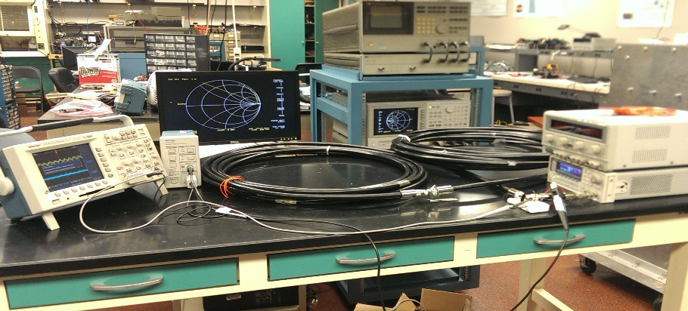

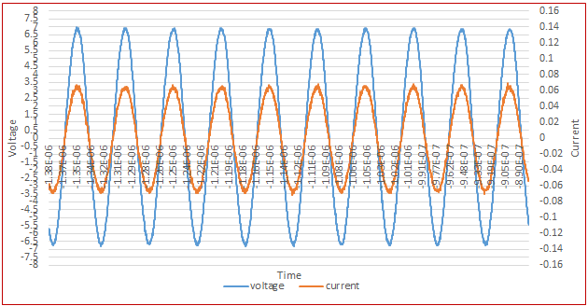




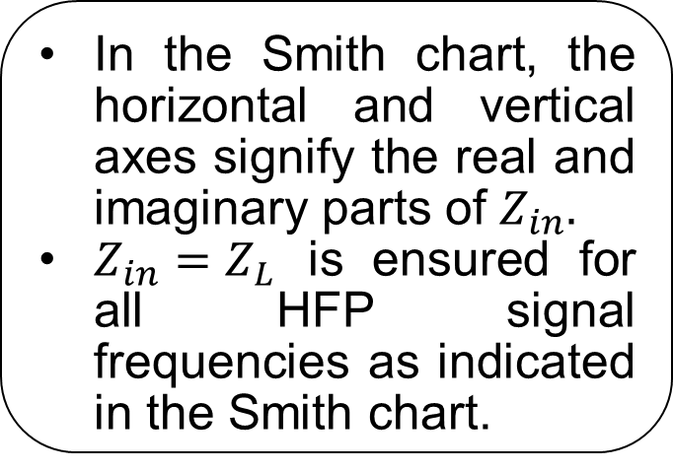
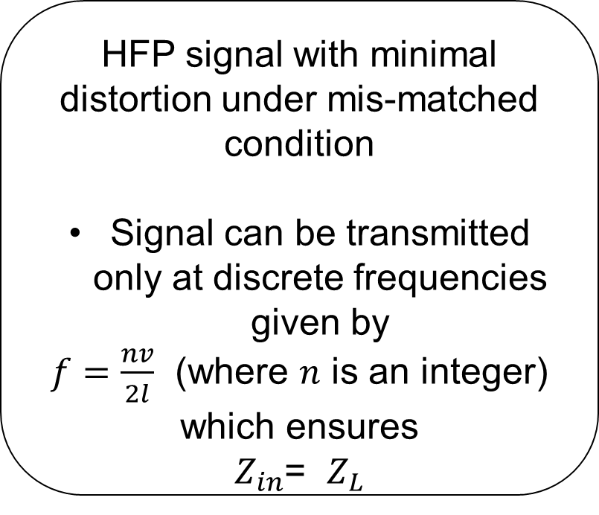
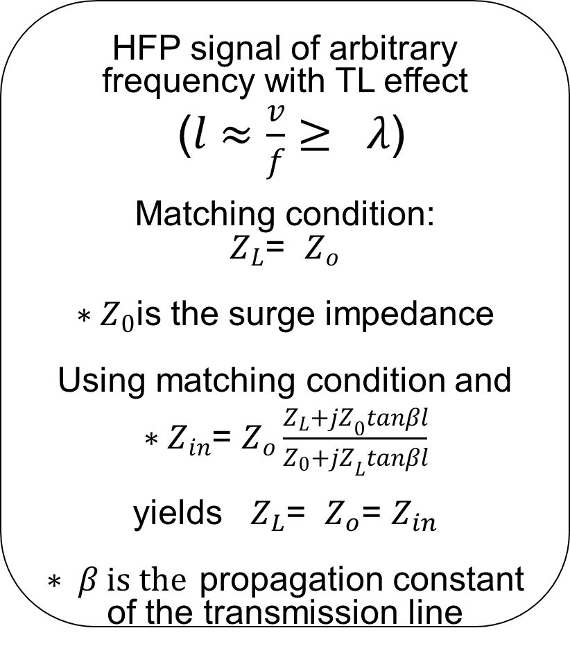



BOOLEAN MICROGRID
PIs: Sudip K. Mazumder (Lead) and P. R. Kumar
Ankit Gupta and Nikhil Kumar (Graduate Students)
NSF (CPS) Award Nos. 1239118 and 1239116
Should Power be Distributed only at 60-Hz AC or at DC and Continuously?
High-Frequency Power Transfer in Boolean Microgrid
Boolean Microgrid¹
Research Issue: For efficient power transfer as well as signal integrity, any arbitrary high-frequency-power (HFP) signal cannot be used power transmission. Selecting an optimal HPF signal, which yields reduced output distortion at the receiving end, needs to be identified.
Boolean microgrid is a radically new CPS that enables dynamic “need based” spatio-temporal “discretized” (and if needed “codified”) power and data delivery over waveguide as well as free space. It can simplify system complexity, mitigate distributed energy storage needs, and yield enhanced efficiency and reliability.
Source
Boolean Microgrid
Load ($Z_{L})$
$l$ represents the length of network
$Z_{in}:Input impedance (i.e., impedance seen from the$source end)
Research Issue: What is/are frequency(ies) of HFP signal delivery over a transmission line (TL) that yields minimal signal distortion when the load and the surge impedance of the transmission line do not match?
Source
Boolean Microgrid
Load
How about for massive computer power servers where high frequency (instead of conventional ac/dc) power distribution can significantly reduce system complexity and reduce energy-storage requirements?
HFP signal of arbitrary frequency without TL effect:
($l≪\frac{v}{f}=λ)$
$${∗Z}_{in}=Z_{L}$$
* $v$ and $f$ are the propagation velocity and frequency of signal
In the Smith chart, the horizontal and vertical axes signify the real and imaginary parts of $Z_{in}.$
$Z_{in}=Z_{L}$ is ensured for all HFP signal frequencies as indicated in the Smith chart.
Integrity of the HFP signal is ensured irrespective of type and no. of loads
Fast power transfer over a pulsating-dc voltage link (PDVL)
(SISO)
Advanced arresting gears
HFP signal of arbitrary frequency with TL effect
($l≈\frac{v}{f}≥ λ$)
Matching condition:
$Z_{L}$= $Z_{o}$
${∗Z}_{0}$is the surge impedance
Using matching condition and
$∗Z_{in}$= $Z_{o}\frac{Z_{L}+{jZ}_{0}tanβl}{Z_{0}+{jZ}_{L}tanβl}$
yields $Z_{L}$= $Z_{o}$= $Z_{in}$
$∗ β is the$ propagation constant of the transmission line
Matched load
Mis-matched load
F = 100 kHz, $Z_{L}=100Ω,Z_{in}=101.84Ω, Ø=0^{o}$
Beam power to aircrafts
High energy lasers
Signal integrity is maintained
F = 15 MHz, $Z_{L}=50Ω,Z_{in}=52.5Ω, Ø=0^{o}$
Dynamic positioning system
Signal integrity is lost
Electromagnetic aircraft launching system
Electromagnetic rail guns
F = 12 MHz, $Z_{L}=100Ω,Z_{in}=65.22Ω, Ø={36.44}^{o}$
How about for next-generation electric warfare ships where the most challenging loads are intermittent and impulsive and distributed energy storage not an inexpensive proposition?
HFP signal with minimal distortion under mis-matched condition
Signal can be transmitted only at discrete frequencies given by
$f=\frac{nv}{2l}$ (where $n$ is an integer)
which ensures
$Z_{in}$= $Z_{L}$
HFP Signal Source
Transmission Line
Application Load
Signal integrity is maintained
¹S.K. Mazumder, “Boolean microgrid”, patent pending, 2013.
Scalability: SISO to MIMO
Vector Network Analyzer
F = 10 MHz, $Z_{L}=100Ω,Z_{in}=104Ω, Ø=0^{o}$
Oscilloscope
Voltage probe
Current probe
Signal integrity is maintained
Similar results are obtained for MIMO cases to ensure minimal distortion under equilibrium condition.
Transmission cable
Load
Function Generator
How about rapid charging of an array of vehicles wirelessly where DC is out question and 60-Hz AC yields huge system size?
Experimental Setup
F = 20 MHz, $Z_{L}=100Ω,Z_{in}=94.7Ω, Ø={0.749}^{o}$
Need based Control Data Transfer in Boolean Microgrid
Source Power Packets
Load Power Packets
And, there are many more such distributed mini/micro grid applications (e.g., for space, electric vehicles, aerospace, telecommunication, robotics, smart buildings, induction heating), where “just in time” power transfer guided by col-located smart communication-control can make significant reductions in system complexity, power loss, energy storage and bandwidth-need.
But, what would that energy cyber-physical system (CPS) mechanism be?
Research Issue: Since the transfer of power is need (e.g., demand) based and generation of these needs may/are not always be periodic, what will be the impact of control based asynchronous data transfer as opposed to conventional TDMA based approaches?
The initial results (as demonstrated in the figures to the left) clearly indicate that there may be a significant improvement in performance with regard to throughput utilization and delay mitigation using need-based control data transfer. Details are provided in M. Tahir and S.K. Mazumder, “Dynamic priority based event-driven communication in smart grid”, in review, IEEE Transactions on Smart Grid, 2014.
PDVL

