Slide 1
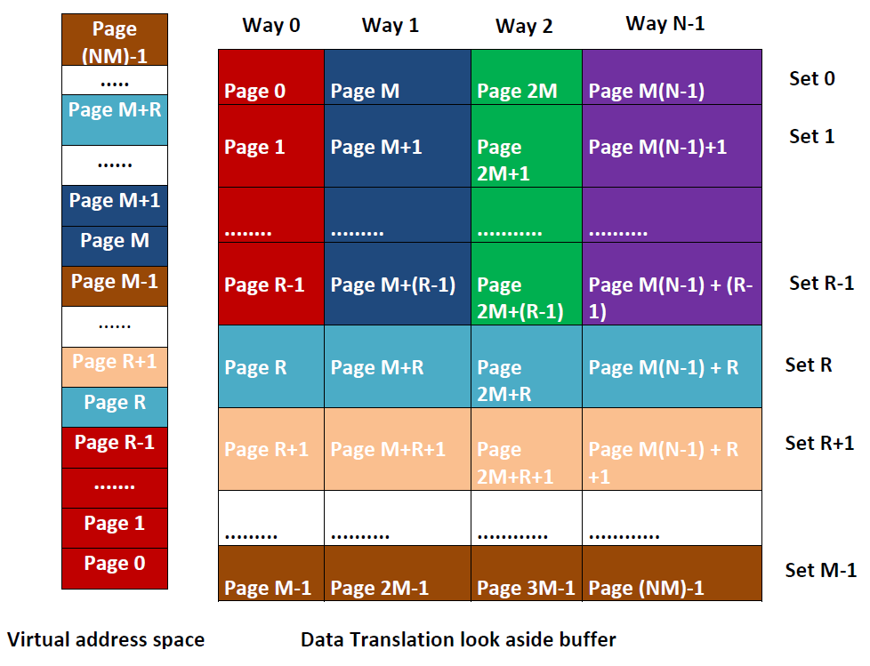
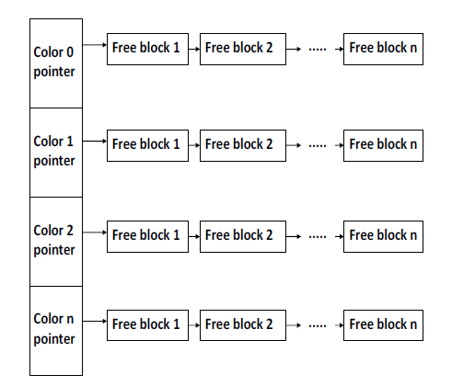
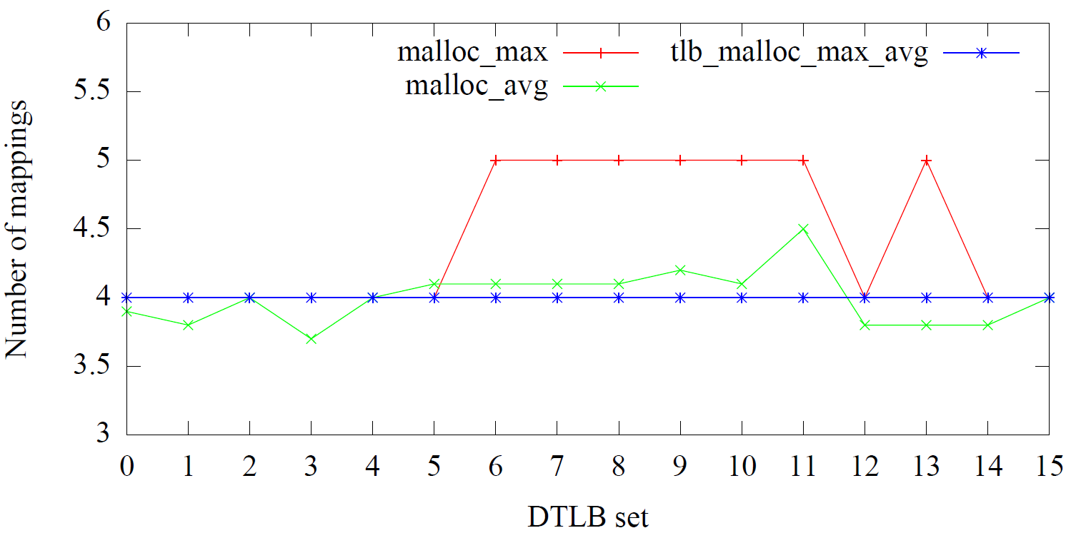
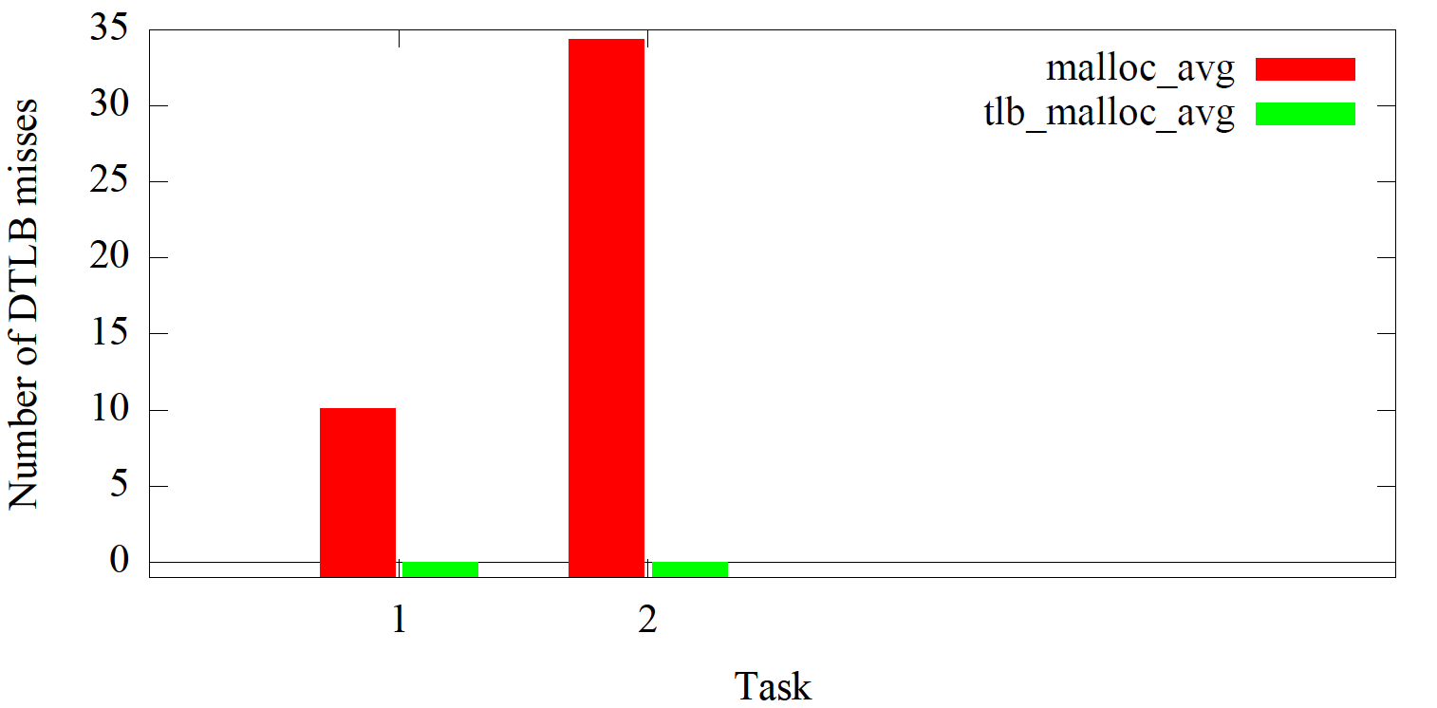
Bringing the Multicore Revolution to Safety-Critical Cyber-Physical Systems
¹University of North Carolina Chapel Hill ²North Carolina State University
PIs: Dr. James Anderson¹ & Dr. Frank Mueller²
Students: Bryan Ward¹, Jonathan Herman¹, Namhoon Kim¹, Shrinivas Panchamukhi²
Motivation
TLB Coloring – Solutions & Results
Cache Management – Solution & Results
Shared hardware like caches & TLBs introduce timing unpredictability for real-time systems (RTS).
Worst-case execution time (WCET) analysis for RTS with shared hardware resources is often so pessimistic that the extra processing capacity of multicore systems is negated.
Different levels of assurance are required for different criticality tasks.
Design
Mixed-Criticality System
CPU 0
CPU 1
CPU 2
CPU 3
A
CE
CE
CE
CE
B
P-EDF
P-EDF
P-EDF
P-EDF
C
G-EDF
D
Best Effort
MC² (mixed-criticality on multicore) architecture
Problem
Assign colors to pages to control the mapping address of memory pages.
Higher-criticality tasks should not be affected by lower-criticality tasks.
Request tokens to reserve cache lines before loading pages.
L2 cache
Main memory
Assign the same color to pages that map to the same DTLB set.
To support greater than page size allocations, R sets are reserved. (Max contiguous allocation = PAGE_SIZE * R)
CPU
L1 cache
a) Memory ref hits in L1 cache – Access latency: 1-4 cycles.
Data Structures and Implementation
Cache Management
Way 0
Way 1
…
Way 7
Main memory
Color 0
CPU 0
CPU
L1 cache
L2 cache
…
CPU 1
CPU 2
Color M
CPU 3
b) Memory ref misses L1 & L2 cache – Access latency: 40-100 cycles.
c) Memory ref misses in TLB – Access latency: +1000 cycles.
tlb_malloc_init()
Sets aside huge virtual address space
tlb_malloc(size, color)
Allocates memory region of size bytes of a particular color
Serves allocations from the pool set aside by tlb_malloc_init
tlb_free(color)
Deallocates memory
Adds memory back to the pool
Partition caches to eliminate interference across processors for Levels A and B.
Global tasks at Level C require tokens to reserve cache lines.
Tighter WCET estimates can be established if we know which references hit in the cache and which do not.
Other shared resources like TLBs show similar timing unpredictability.
Ongoing Work
Implement MC² scheduler in LITMUS^{RT}.
Enable budget enforcement using container abstraction within the OS.
Trap page fault when a job accesses a page for the first time to request token.
Determine whether cache bypass can be selectively applied.
Devise needed schedulability analysis.
Solution
Results
Our solutions focus on two shared resources: shared caches and TLBs.
TLB Coloring:
Control the allocation of memory so that real-time tasks will not interfere with one another in terms of DTLB conflicts.
Make DTLB misses more predictable.
Enable static timing analysis tools to compute tight bound on WCET.
Cache Management:
Leverage the fact that only highly critical components require conservative provisioning.
Provide “temporal isolation” across criticality levels.
Apply a multiprocessor real-time synchronization protocol to manage cache lines.
Enable schedulability gains by reducing WCET.
malloc - non uniform utilization of DTLB sets
tlb_malloc - predictable
Conclusions
Designed TLB coloring techniques to support contiguous page allocations. → eliminate DTLB misses.
Evaluated on Intel 16 core platform.
Conducted experiments using synthetic benchmark, Malardalen benchmark, and MiBench.
Provided task isolation in terms of DTLB conflicts.
Re-implemented a mixed-criticality scheduler in LITMUS^{RT} to support cache management.
Zero misses if tasks use tlb_malloc

