Slide 1
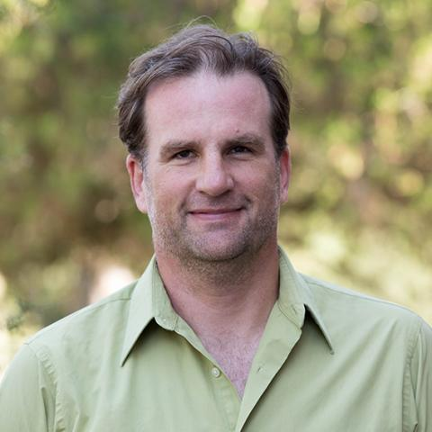
NSF EAGER 1941053: Cyberlearning with Co-Robotic Teachable Agents
Winslow Burleson (PI) University of Arizona
Ken Perlin (Co-PI) - New York University
win@arizona.edu

Slide 2
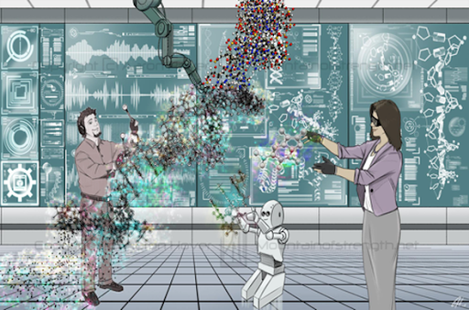
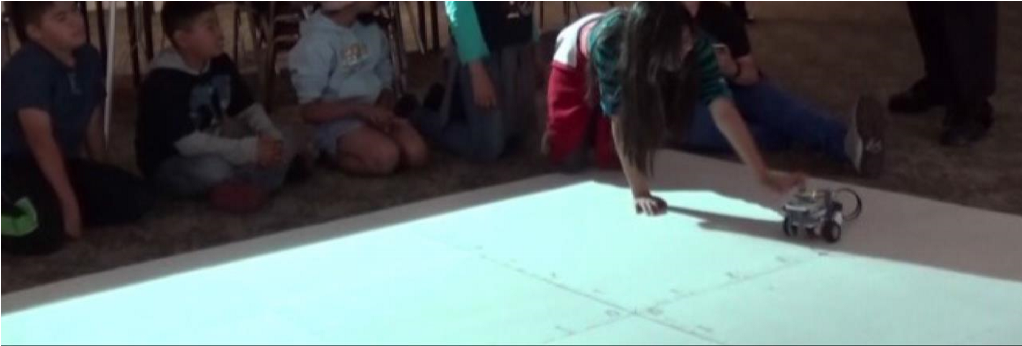
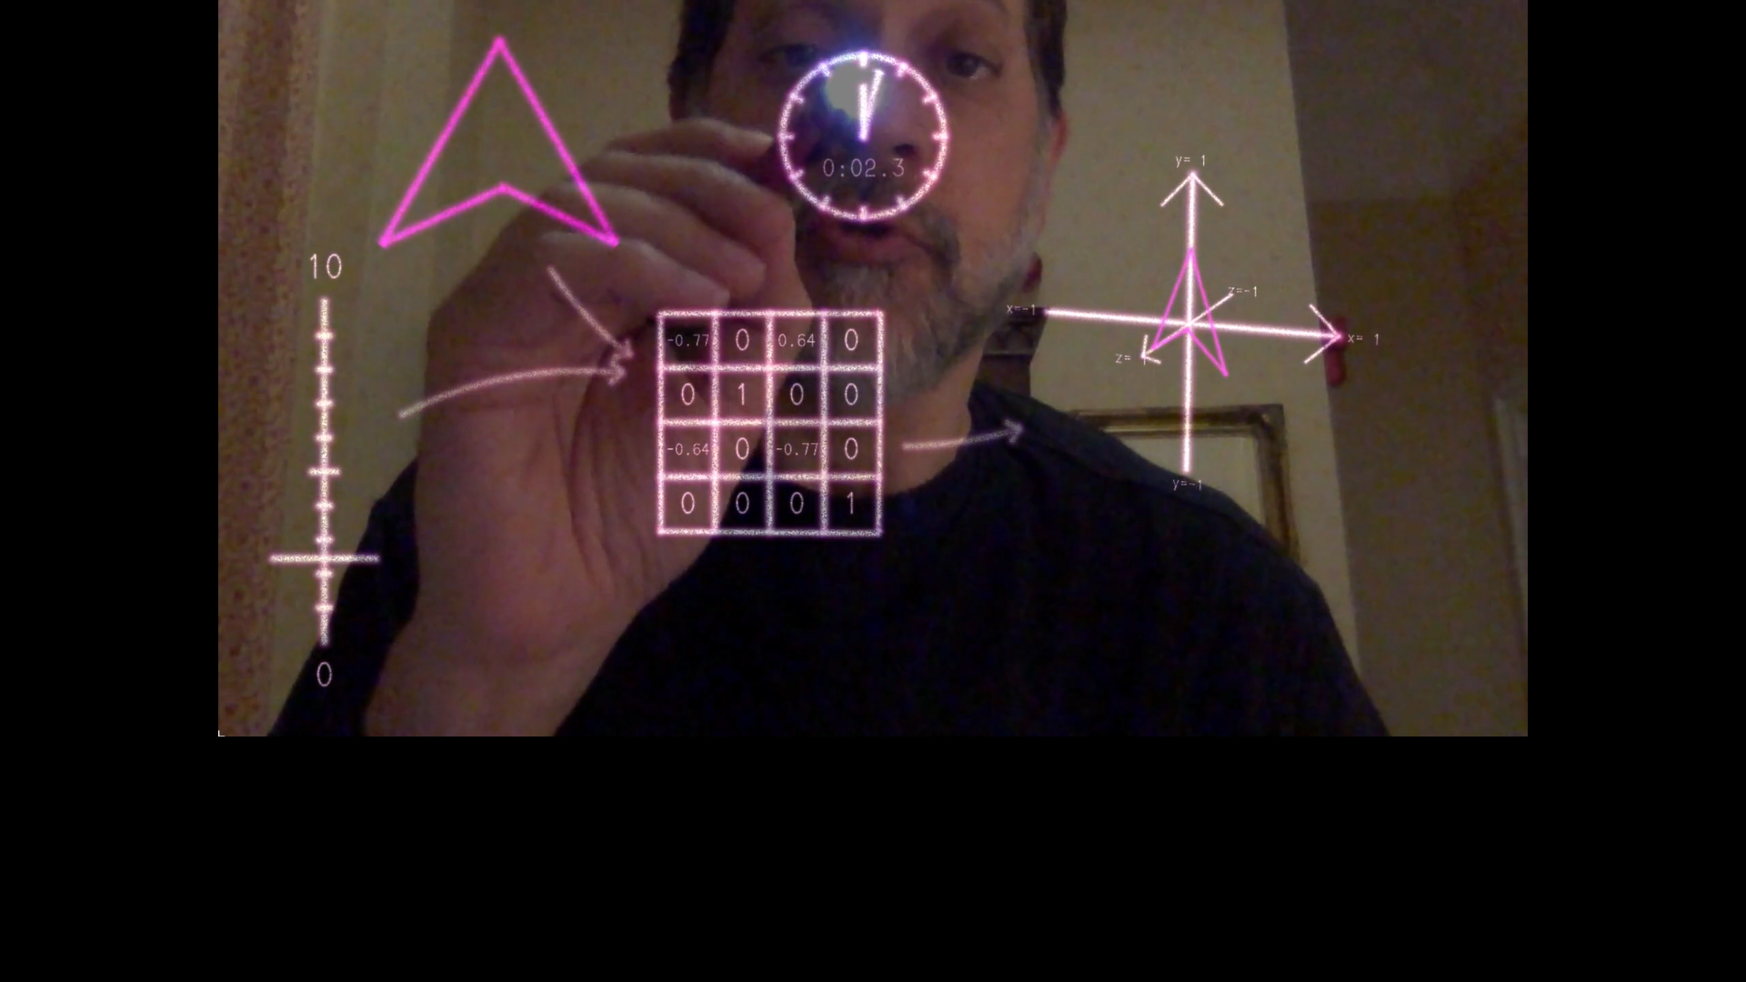
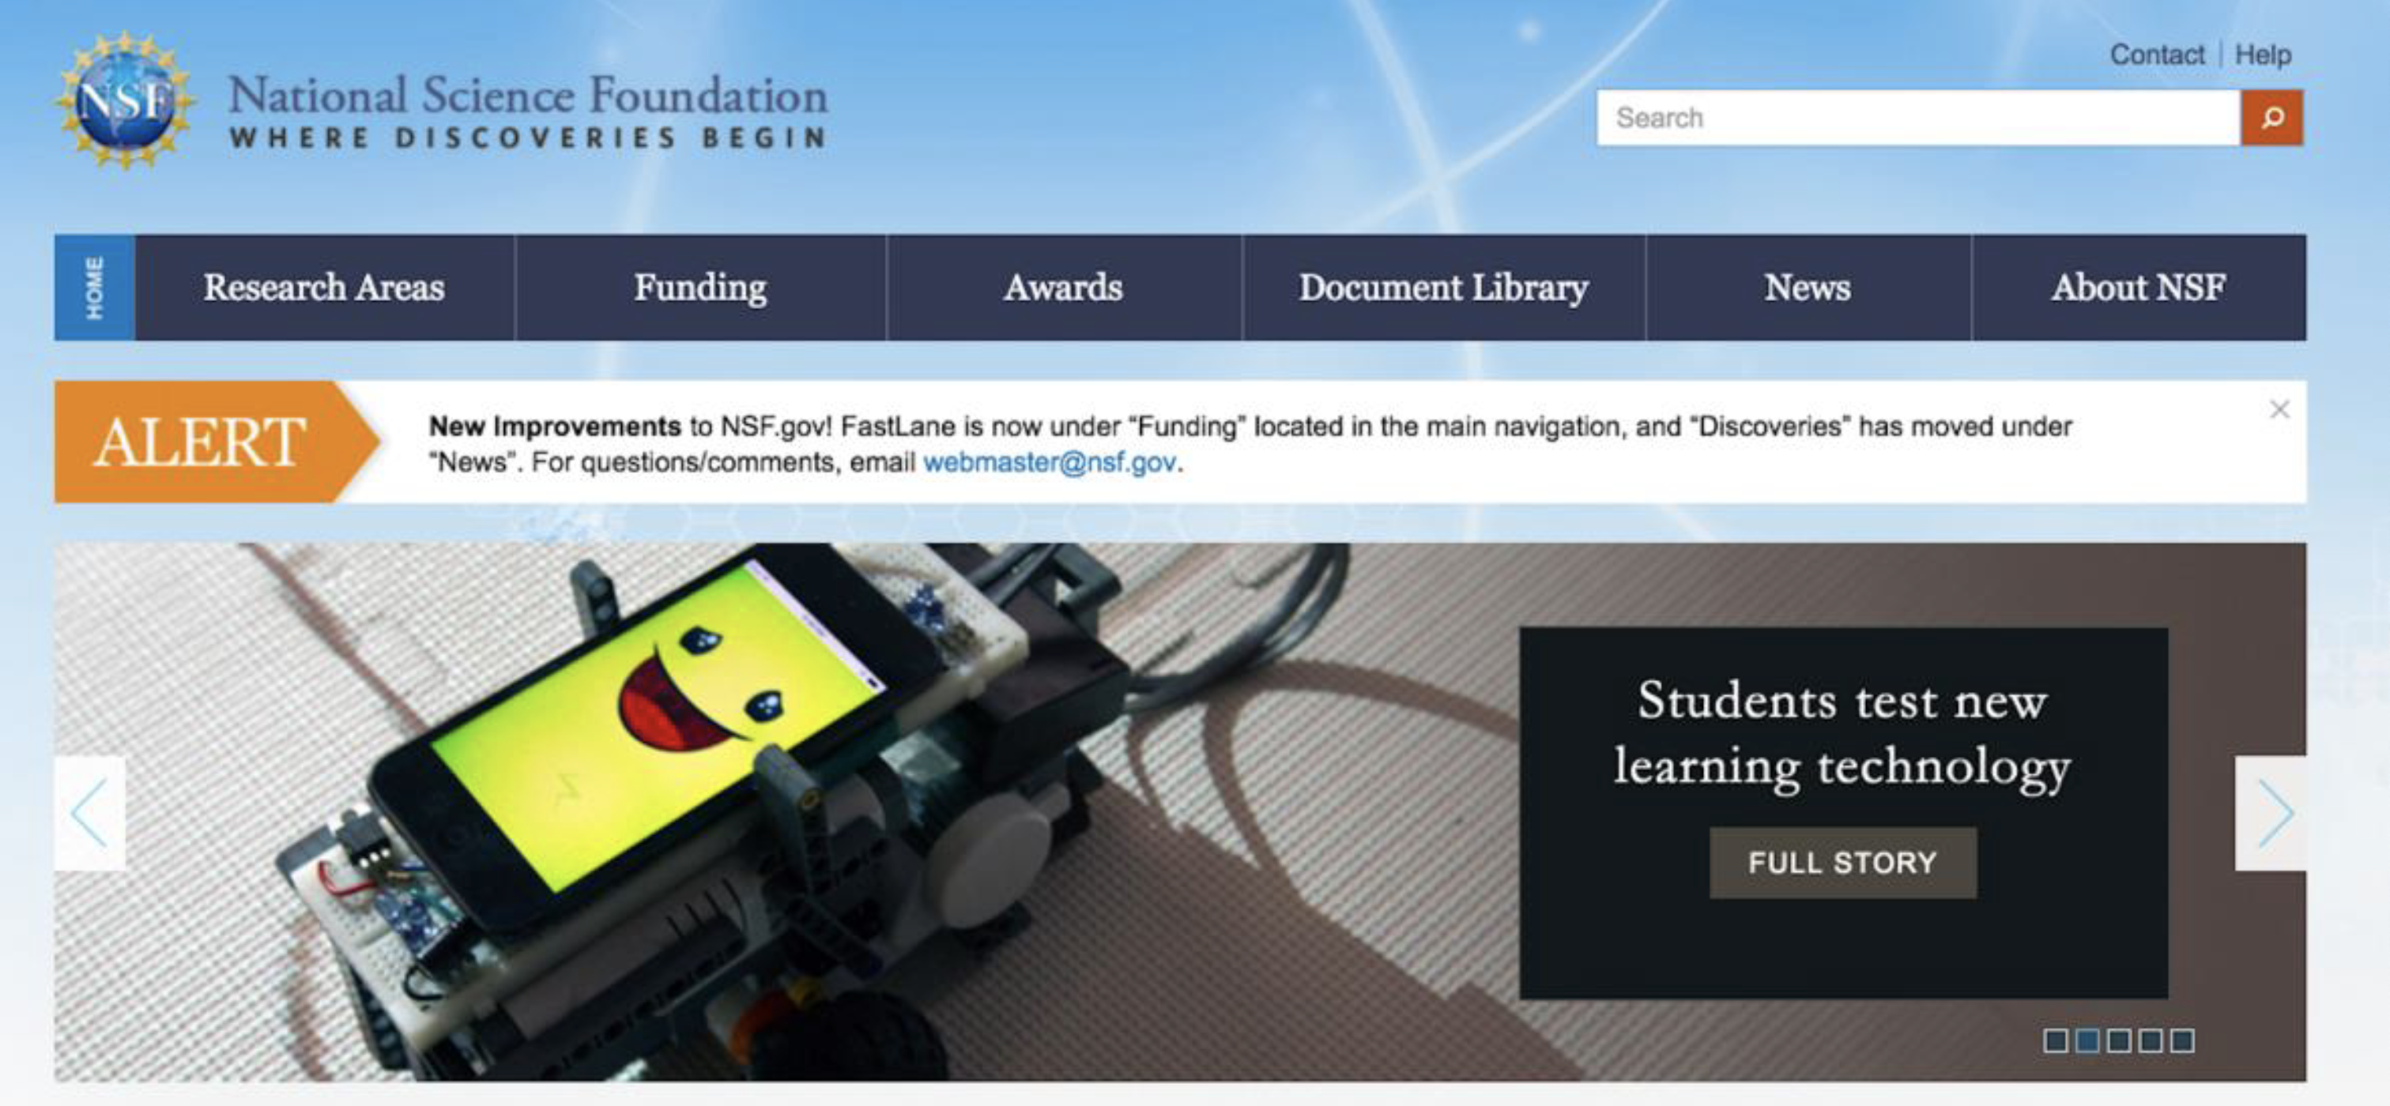
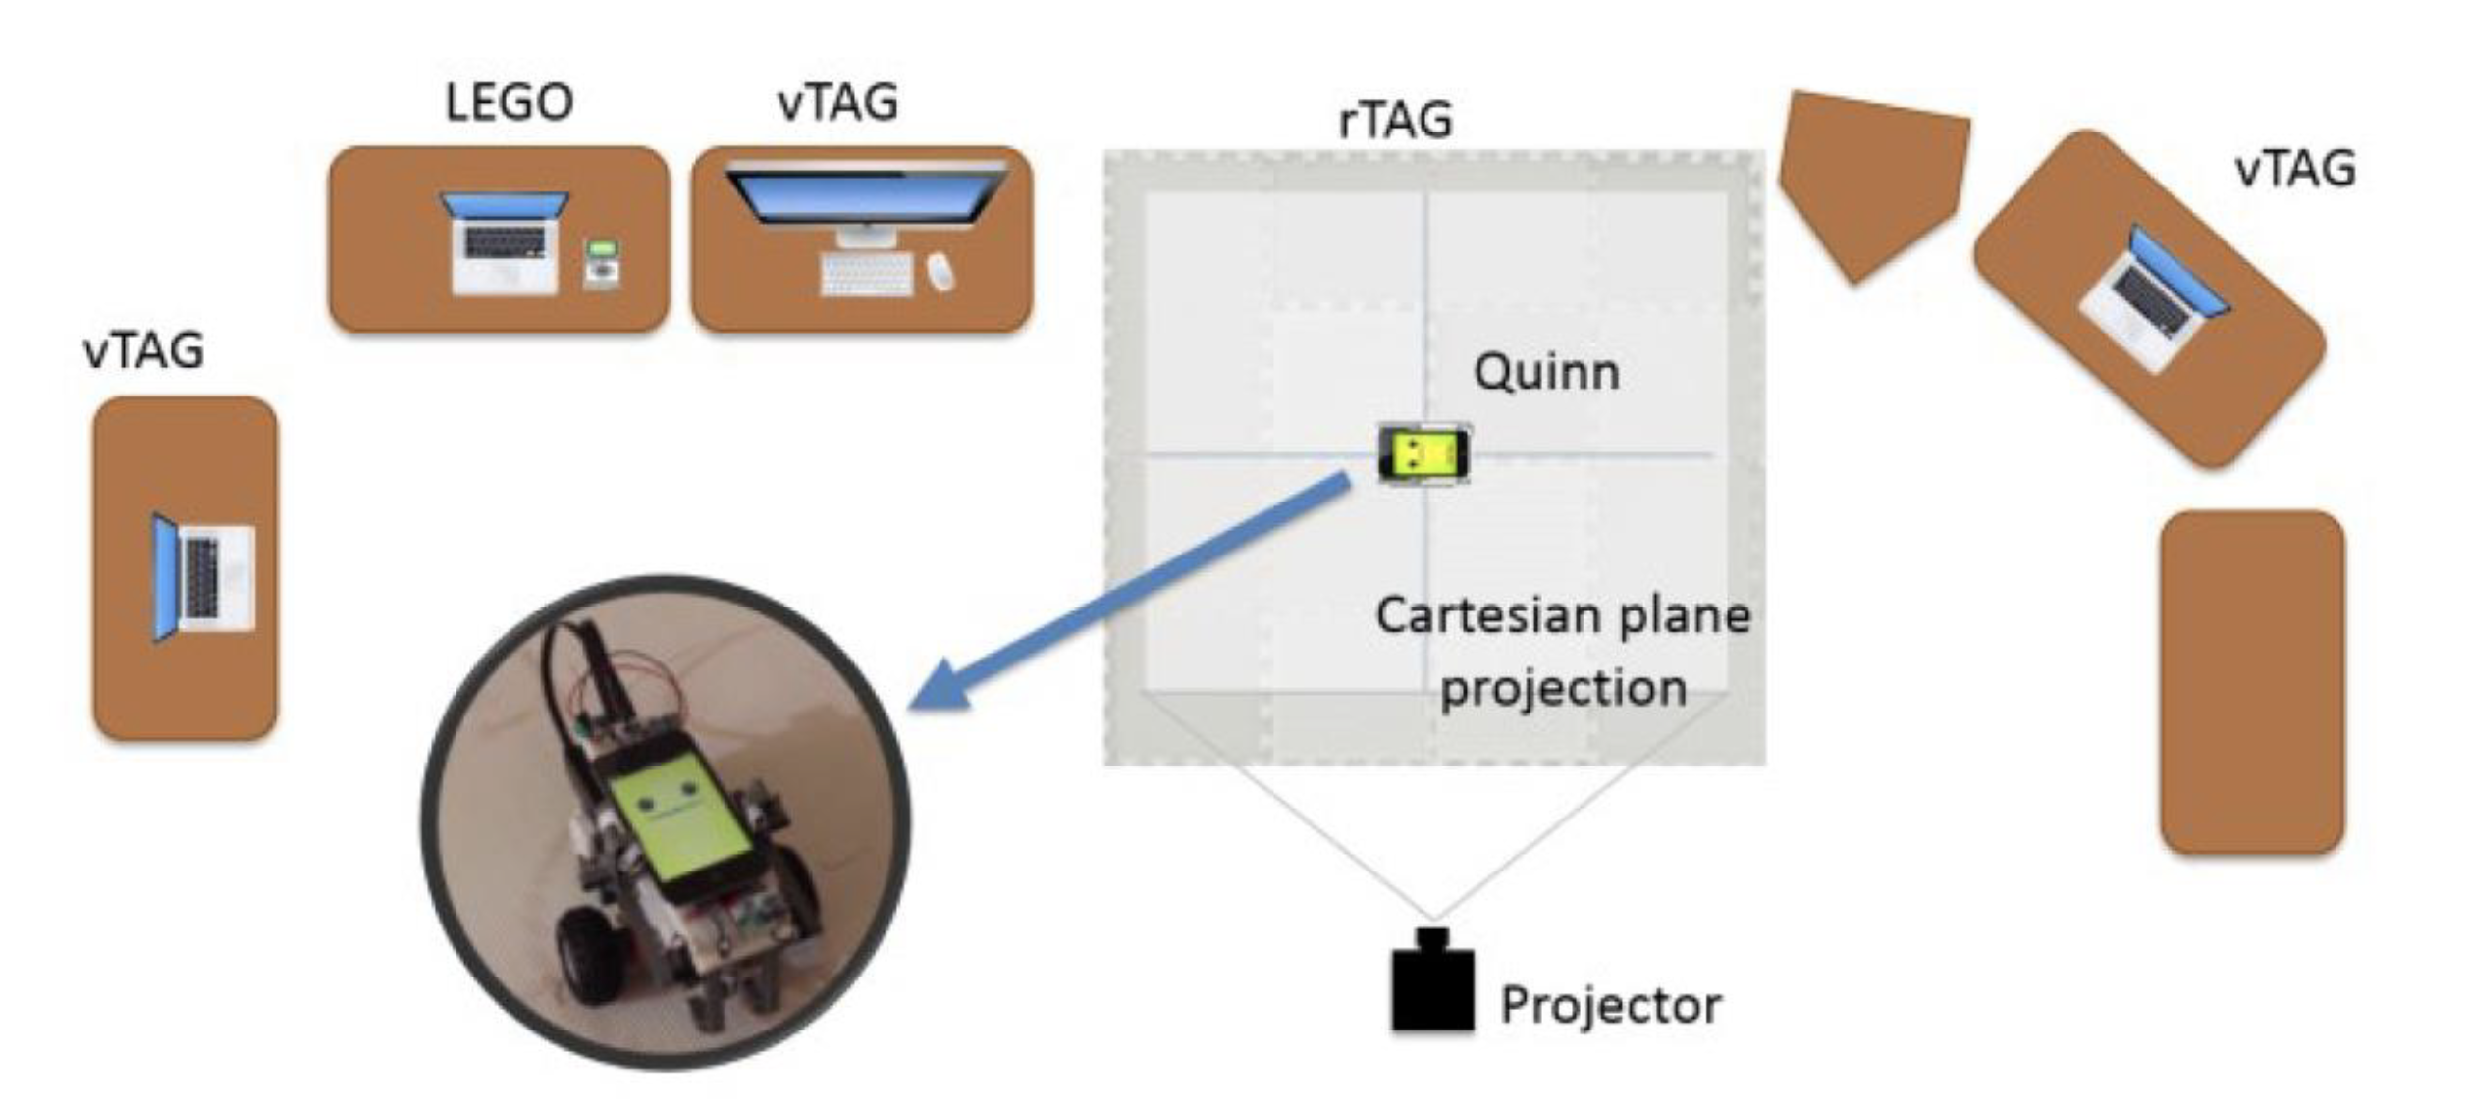
NSF MRI: Experiential Supercomputing: NSF Holodeck
win@arizona.edu

Slide 3
NSF MRI: Experiential Supercomputing: NSF Holodeck
win@arizona.edu

Slide 4
=
NSF MRI: Experiential Supercomputing: NSF Holodeck
win@arizona.edu

Slide 5
win@arizona.edu

