Slide 1

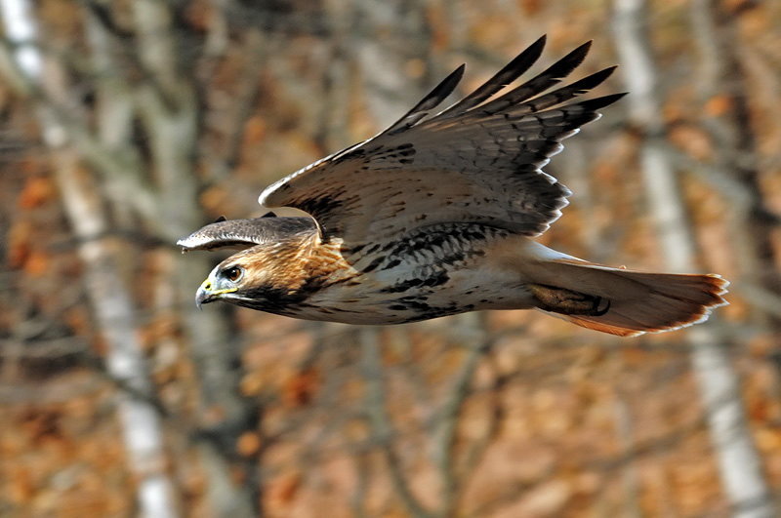
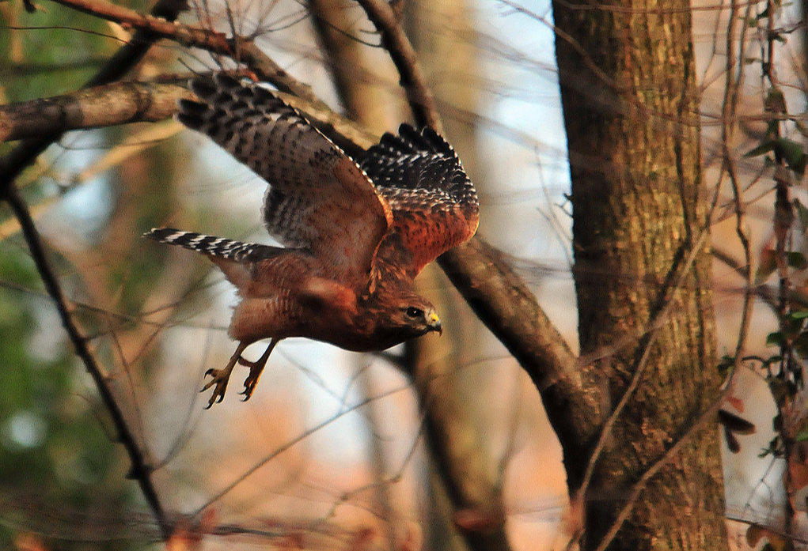
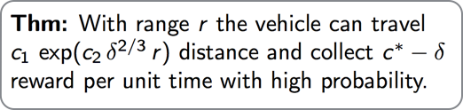
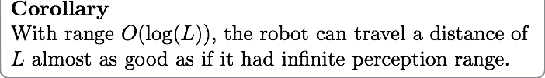
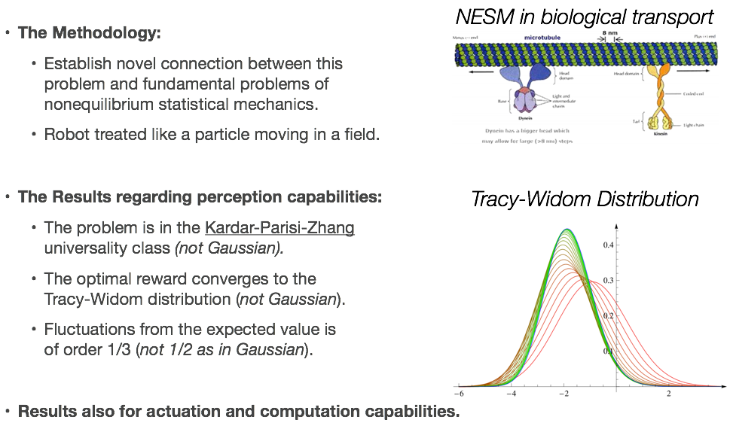
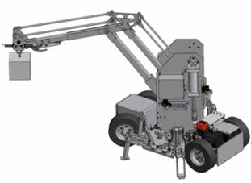
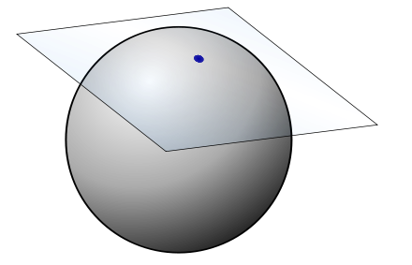
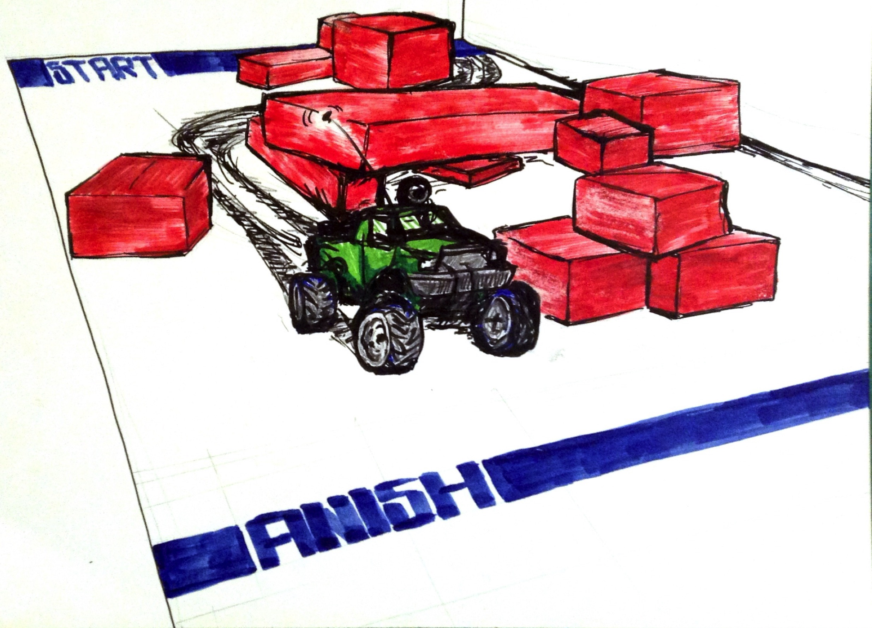
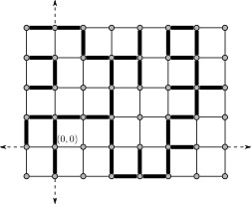
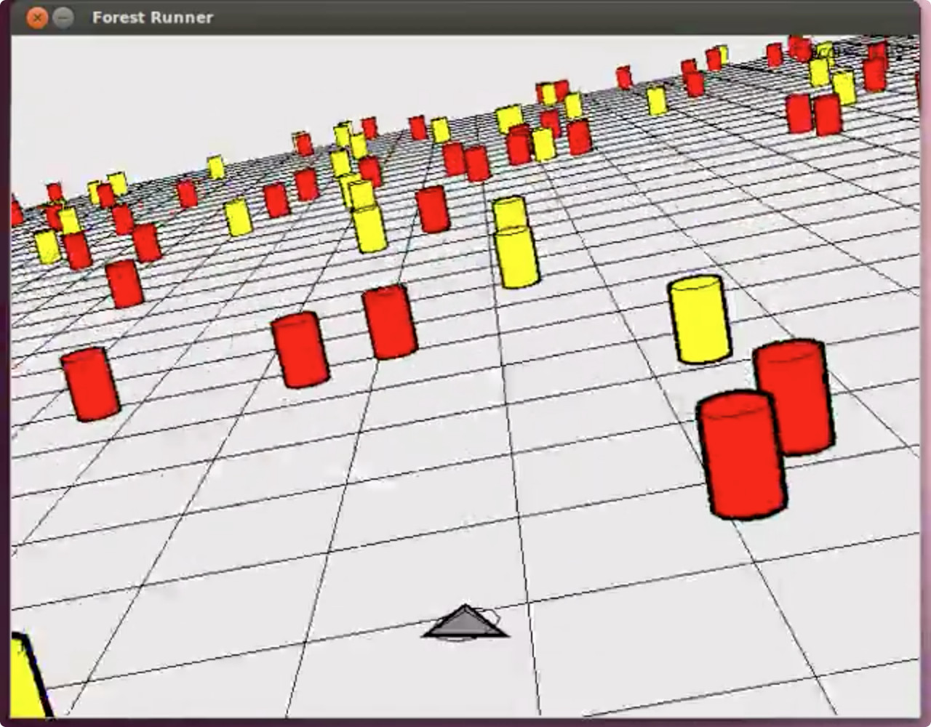
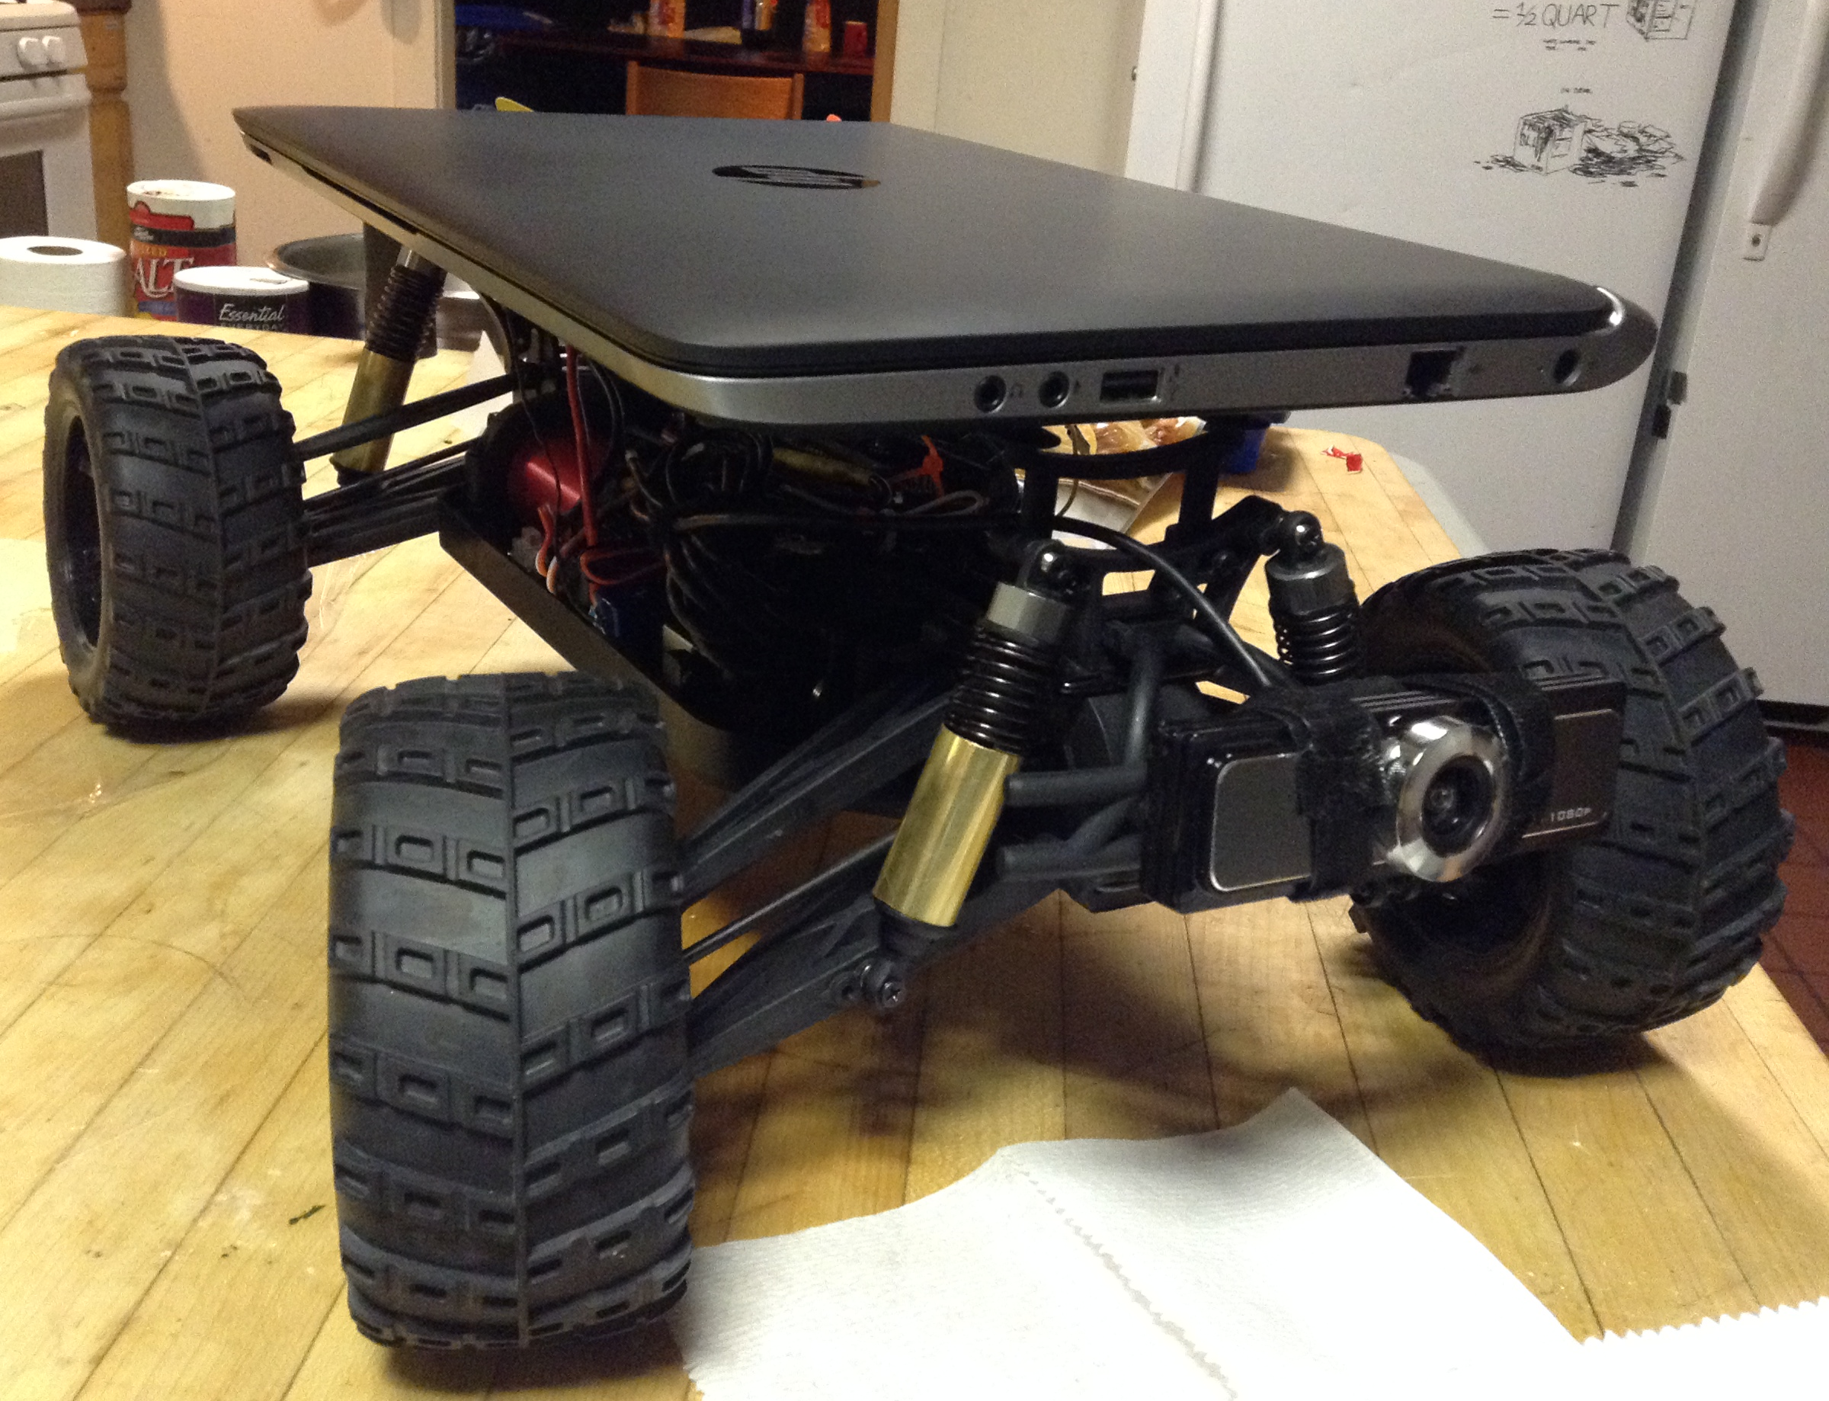
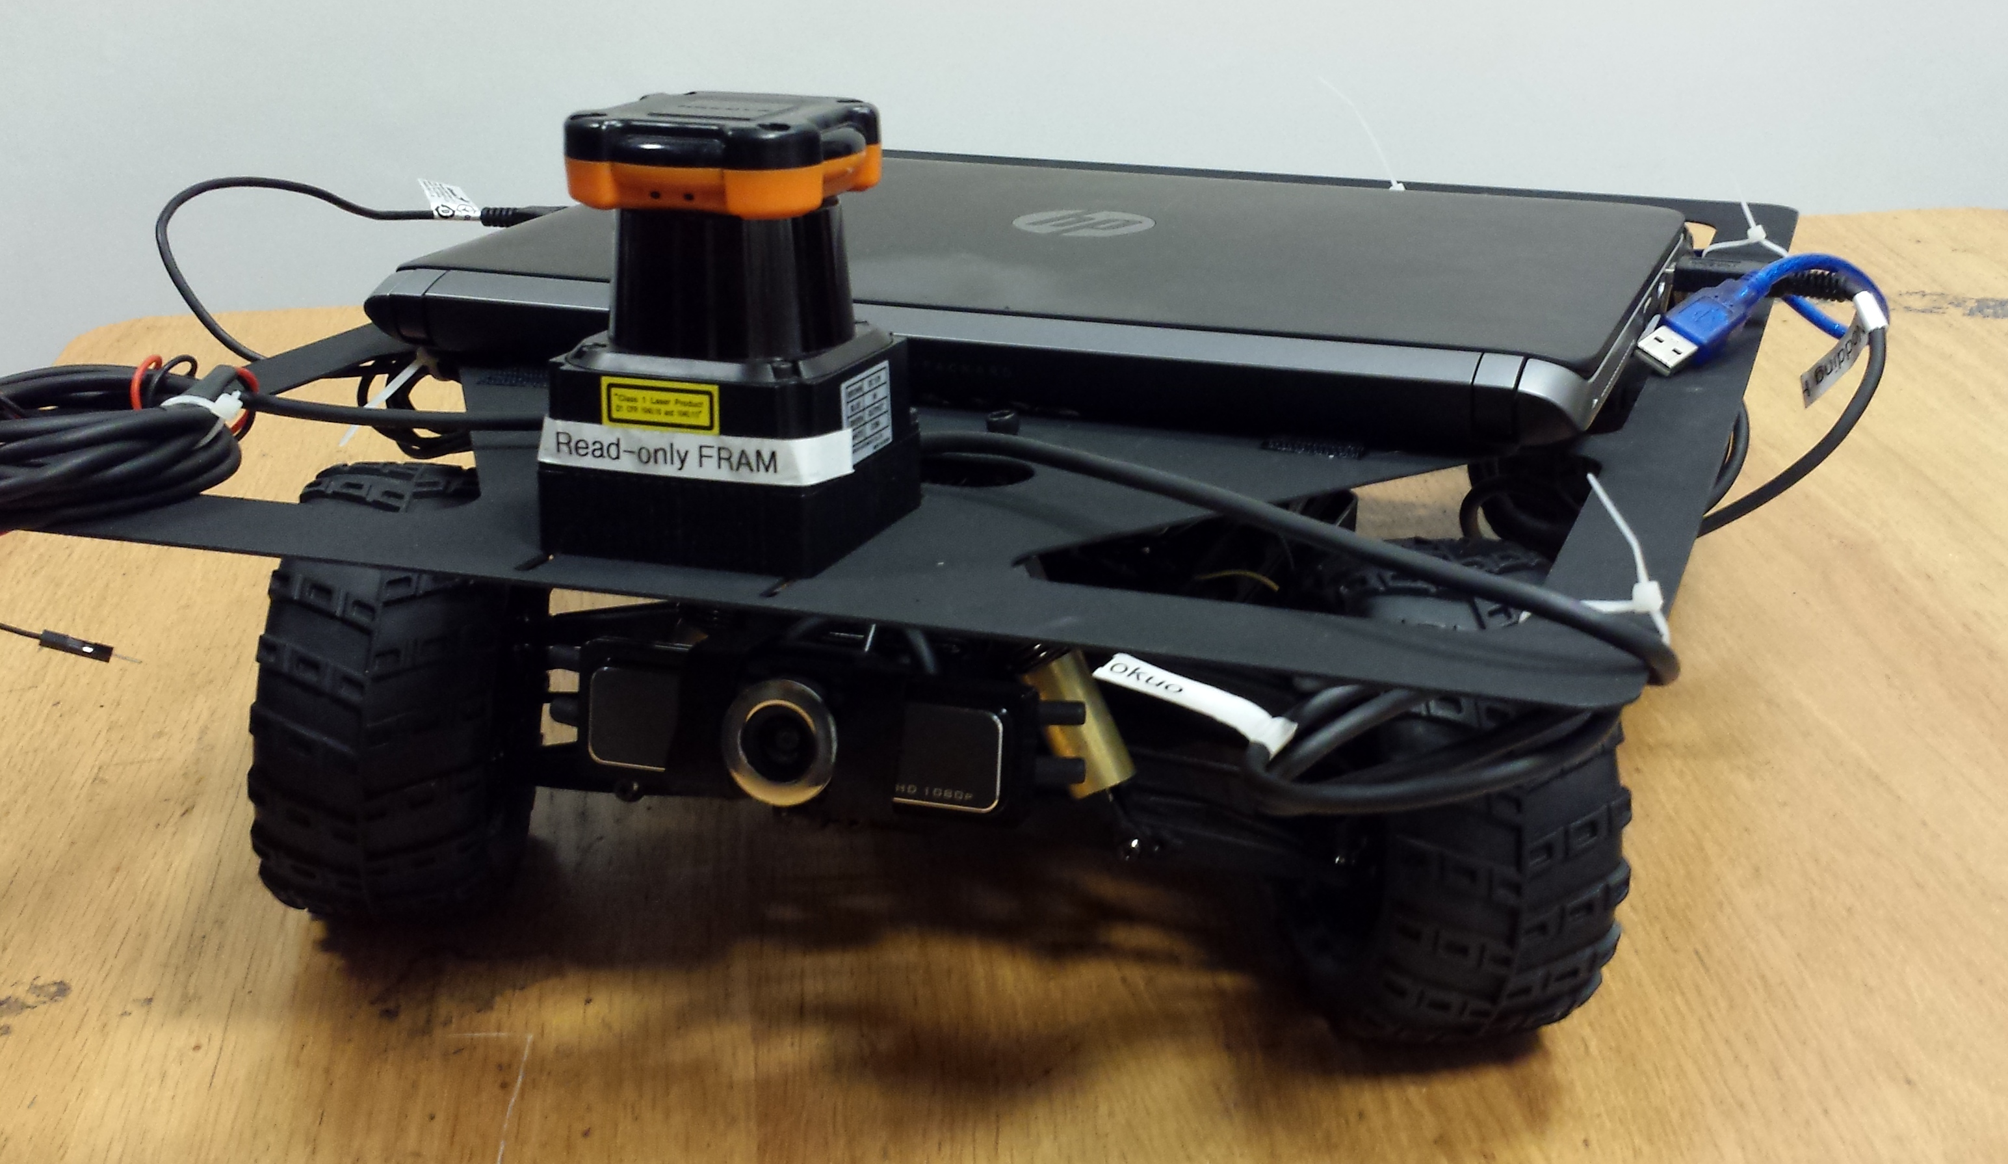
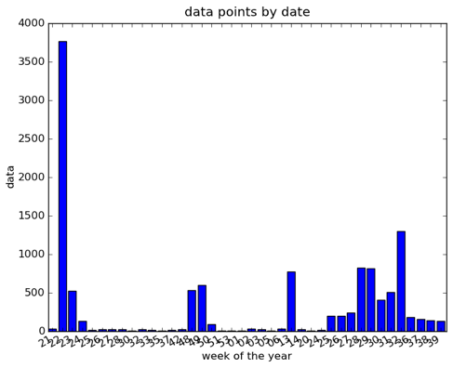
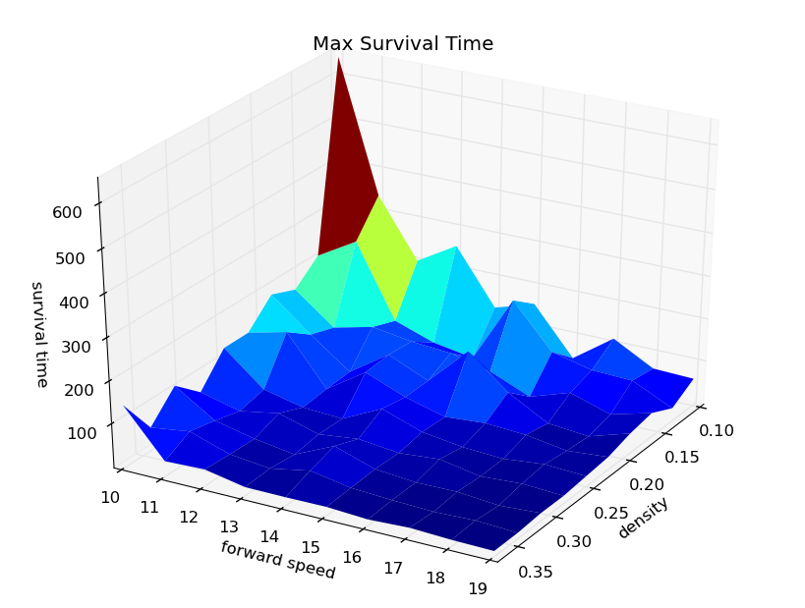

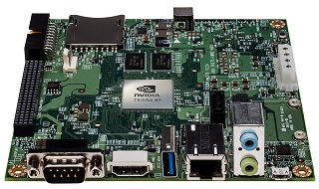

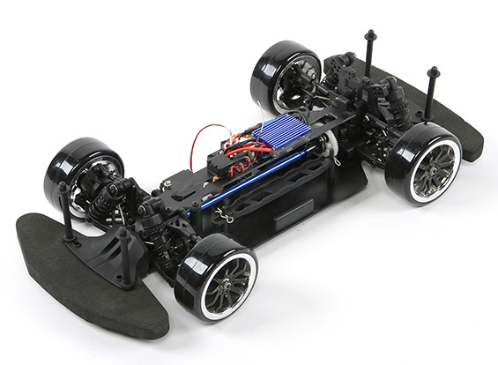

CAREER: Fundamental Limits and Practical
Algorithms for Complex Cyber-Physical Systems
PI: Sertac Karaman,
Assistant Professor,
Dept. of Aeronautics and Astronautics
Massachusetts Institute of Technology
Abstract: Designing software that can properly and safely interact with the physical world is an important cyber-physical systems design challenge. The proposed work includes the development of a novel approach to designing planning and control algorithms for high-performance cyber physical systems. The new approach was inspired by statistical mechanics and stochastic geometry. It will (i) identify behavior such as phase transitions in cyber-physical systems and (ii) capitalize this behavior in order to design practical algorithms with provable correctness and performance guarantees. The algorithms developed through this research effort hold the potential for immediate industrial impact, particularly in the development of real-time robotic systems. These algorithms may strengthen the rapidly developing U.S. robotics industry. The proposed research activity will also vitalize the PI?s educational plans. Undergraduate and graduate courses that make substantial contributions to the embedded systems education at MIT will be developed. The classes will focus on provably-correct controller synthesis for cyber-physical systems, which is currently not thought at MIT. Undergraduate students will be involved in research activities.
Flying through the Ergodic Forest:
Phase Transitions and Fundamental Limits
Maximum Reward Motion in Stochastic
Environments and Nonequilibrium Statistical Mehanics
Hawks fly through forests with little effort
(Ma and Karaman, WAFR 2014)
Model
Target locations are not known a priori; they are discovered on the fly.
Spatial statistics for the target locations are available, e.g., from past experience, satellite imagery, et cetera.
Fundamental questions:
How much information can the smartest algorithm possibly collect?
How does performance scale with perception, actuation, and computation?
Problem setup:
Main Result:
Monte-Carlo Simulations:
Goal: Exploiting connections with statistical mechanics for analysis and design of complex CPS:
Geometric Complexity: Inherent in many robotics applications and beyond. For instance, configuration space describing the geometry of a robot and its environment.
Differential Constraints: Nonlinear, non-holonomic differential equations describing the physics.
Stochastic Constructs: May arise in stochastic environments or in randomized algorithms.
Connections with Non-equilibrium Stat Mech:
Core Research: An Excursion into
Differential and Stochastic Geometry
We are interested in the existence of infinite (i.e., can not be bounded by any compact subset of the infinite plane) collision-free trajectories.
Can the bird fly off to infinity with this speed without colliding with a tree?
1. Differential geometry, in particular sub-Riemannian geometry can characterize small-time reachable sets of complex dynamical systems.
Phase transitions:
Current Educational Activities
New MIT course focuses on the foundations of planning algorithms.
Undergraduate courses with strong experimental components, involving exciting robotics platforms.
The analysis reveals the asymptotic shape of the small-time reachable set, and algorithmic methods to constructs its approximations.
We utilize percolation theory and statistical mechanics to derive these results.
Undergraduate experimental subject: Racing through the obstacle course
Monte-Carlo Simulations and the Phase Diagram:
2. Stochastic geometry, in particular percolation theory, characterizes the topology of random geometric shapes in the Euclidean space.
The legendary MIT tunnels will serve as the race tracks with foam obstacles.
Students will use embedded computational platforms, gain experience working with CPS.
Students will design algorithms and compete to race through the tunnels.
The analysis reveals phase transitions and describes a number of natural and engineered emergent behavior.
Experiments with Human Subjects:
The ForestRunner game was played by more than 1,000 unique players
More than 10,000 data points.
The maximum score for each densitty-speed pair is shown below.
The experiment is ongoing.
An overarching goal of the proposed research effort is to develop differential and stochastic geometry.
In particular, we aim to investigate:
Percolation processes on sub-Riemannian manifolds.
Dynamic stochastic growth processes on sub-Riemannian manifolds.
Current platform is a “laptop on wheels”
The next generation platform will feature the NVIDIA embedded computers with multi-core processors.

