Slide 1
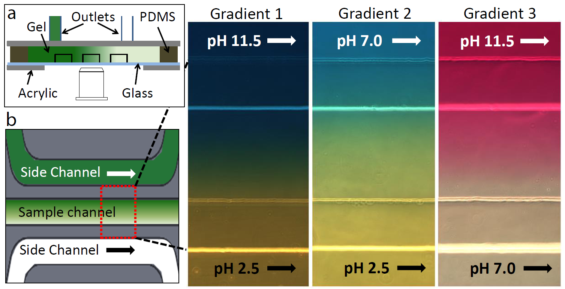
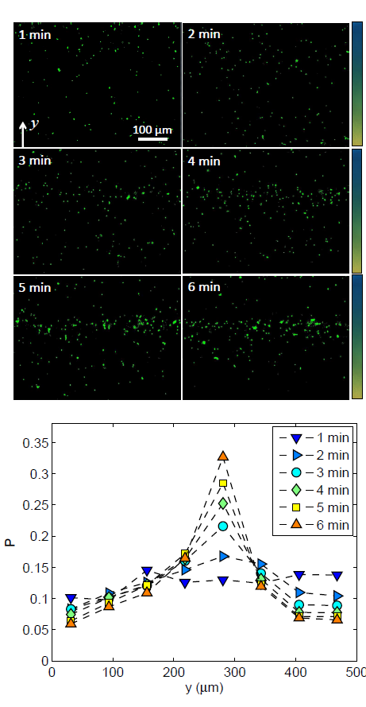
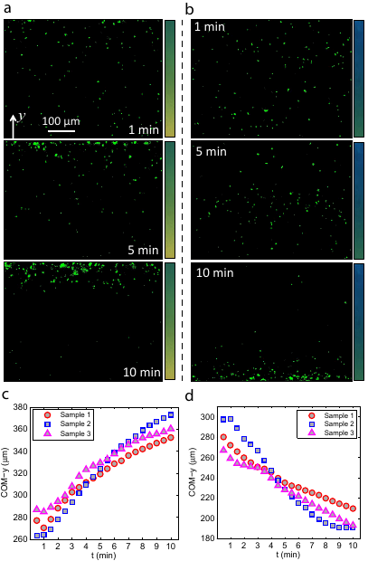
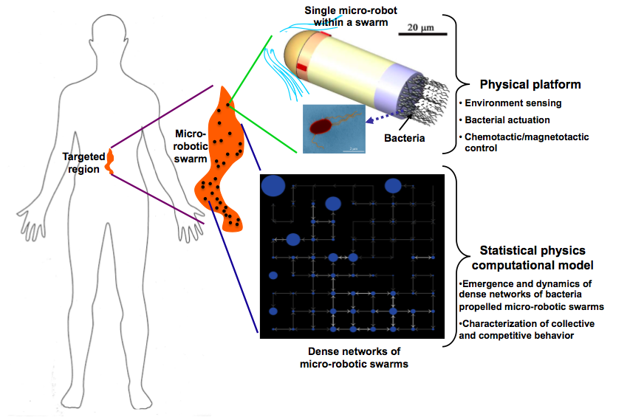
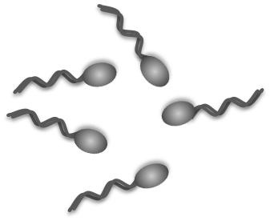
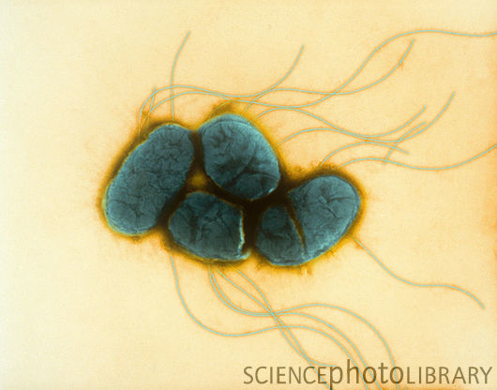
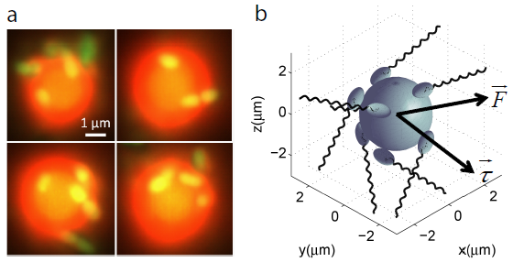
CPS-Medium: Dense Networks of Bacteria Propelled Micro-Robotic Swarms
Metin Sitti, Radu Marculescu, Philip LeDuc, Jiang Zhuang, Rika Carlsen, Guopeng Wei
Overview
pH Gradient Generation
Control of Microrobot Swarm
Objectives: Develop a new computational dense network framework for designing and analyzing stochastic micro-robotic swarms and building a new physical platform by using attached bacteria as on-board actuators, and taxis behaviors as passive drift control methods.
Applications: The goal is to use these micro-robotic swarms for minimally invasive medical diagnosis and treatment applications, such as targeted drug delivery, in regions of the body that contain stagnant or low velocity fluids (e.g. vitreous humor of the eye, cerebral spinal fluid in the spinal cord and brain, etc.)
a. Configuration of a three-channel diffusion-based pH gradient generator (side view). b. Top view of the three parallel channels, and three different gradient profiles visualized in situ by three appropriate pH indicators, where the bright lines in the color profiles indicate the channel walls. The pH gradient are maintained stable by constant feeding flows in the two side channels
Bacterial pH Taxis Response
Conceptual sketch of bacterial propelled microrobots in targeted drug delivery system: physical platform and statistical modeling
On-board Actuation and Sensing
Unidirectional drift control by Gradient 2 (a, c) and Gradient 3 (b, d)
a, c indicate migration of the microrobot swarm away from more acidic region; b, d reveal a transportation away from more alkaline region
Consistent drift processes are observed over three samples for both cases
Decreased slope of COM-y curves (c, d) is due to the wall effects, which become more significant when a large portion of the microrobots are near the wall
Bacterial Specifications
Bacteria Propelled Microrobot
pH Gradient 1 is applied
Microrobots are fluorescently stained
Compared with the free swimming bacteria, distribution of microrobots transits much slower (~6 min)
The steady state distribution profile of microrobots is of high resemblance with that of free swimming bacteria
Bacterial Swarm
Serratia Marcescens
Kwangshin Kim, Science Photo Library
Serratia marcescens:
Multi-flagellated bacterium
Rod-shaped body:
0.5 µm in diameter, 2 µm long
Swimming speed: 26 ± 8 µm/s (20°C)
Natural adhesion to polystyrene surfaces
Chemotaxis and pH taxis
Bacterial swarm distribution at steady state under stable pH gradient profile of Gradient 1
Upon application of pH gradient, bacterial distribution transits rapidly from a random distribution to biased accumulation around the center line of the channel
Free swimming bacteria show bidirectional pH taxis, i.e., away from both more acidic and more alkaline regions
Bacterial pH taxis is mediated by the biased tumble rates base on tracking of the bacterial swimming trajectories
Bacteria propelled microrobots: multiple bacteria randomly attached to polystyrene microspheres (diameters 3 µm)
Average moving speed: ~ 5 µm/s
Conclusions:
Our microrobot swarm preserves the pH taxis behavior of free swimming bacteria
pH taxis constitutes an effective steering control method for microrobot swarm
Trajectory analysis shows that the swimming direction of microrobots is more persistent when they move towards the optimal pH regions, which is an major mechanism of the pH taxis of microrobots
Example 3D trajectory of a single bacterium
Example trajectory of a bacteria-propelled microsphere
Carnegie Mellon University, Pittsburgh, PA
CNS-1135850

