Slide 1
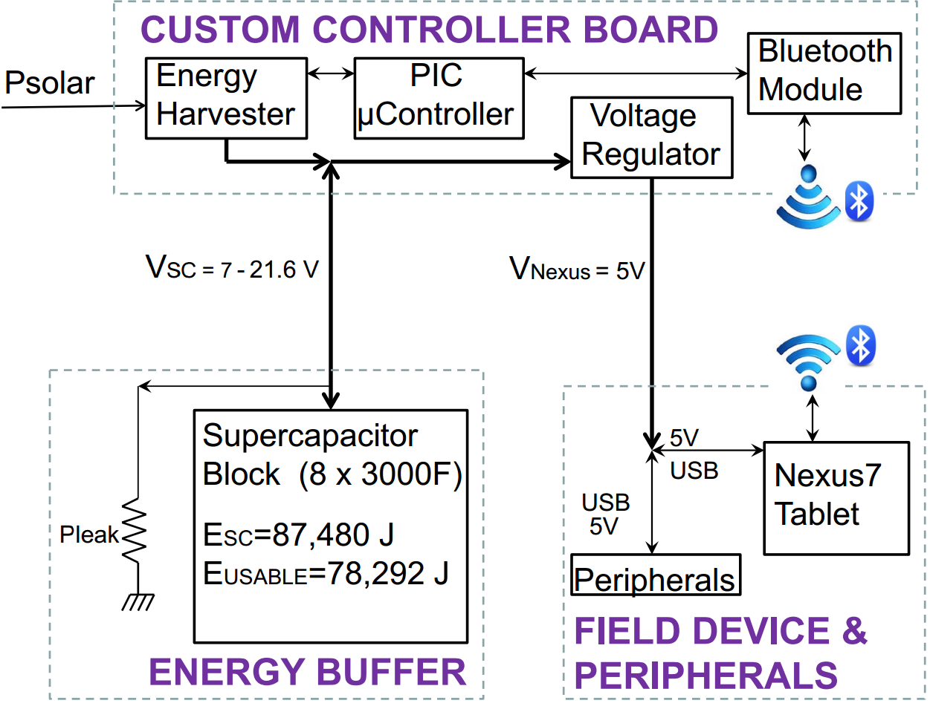
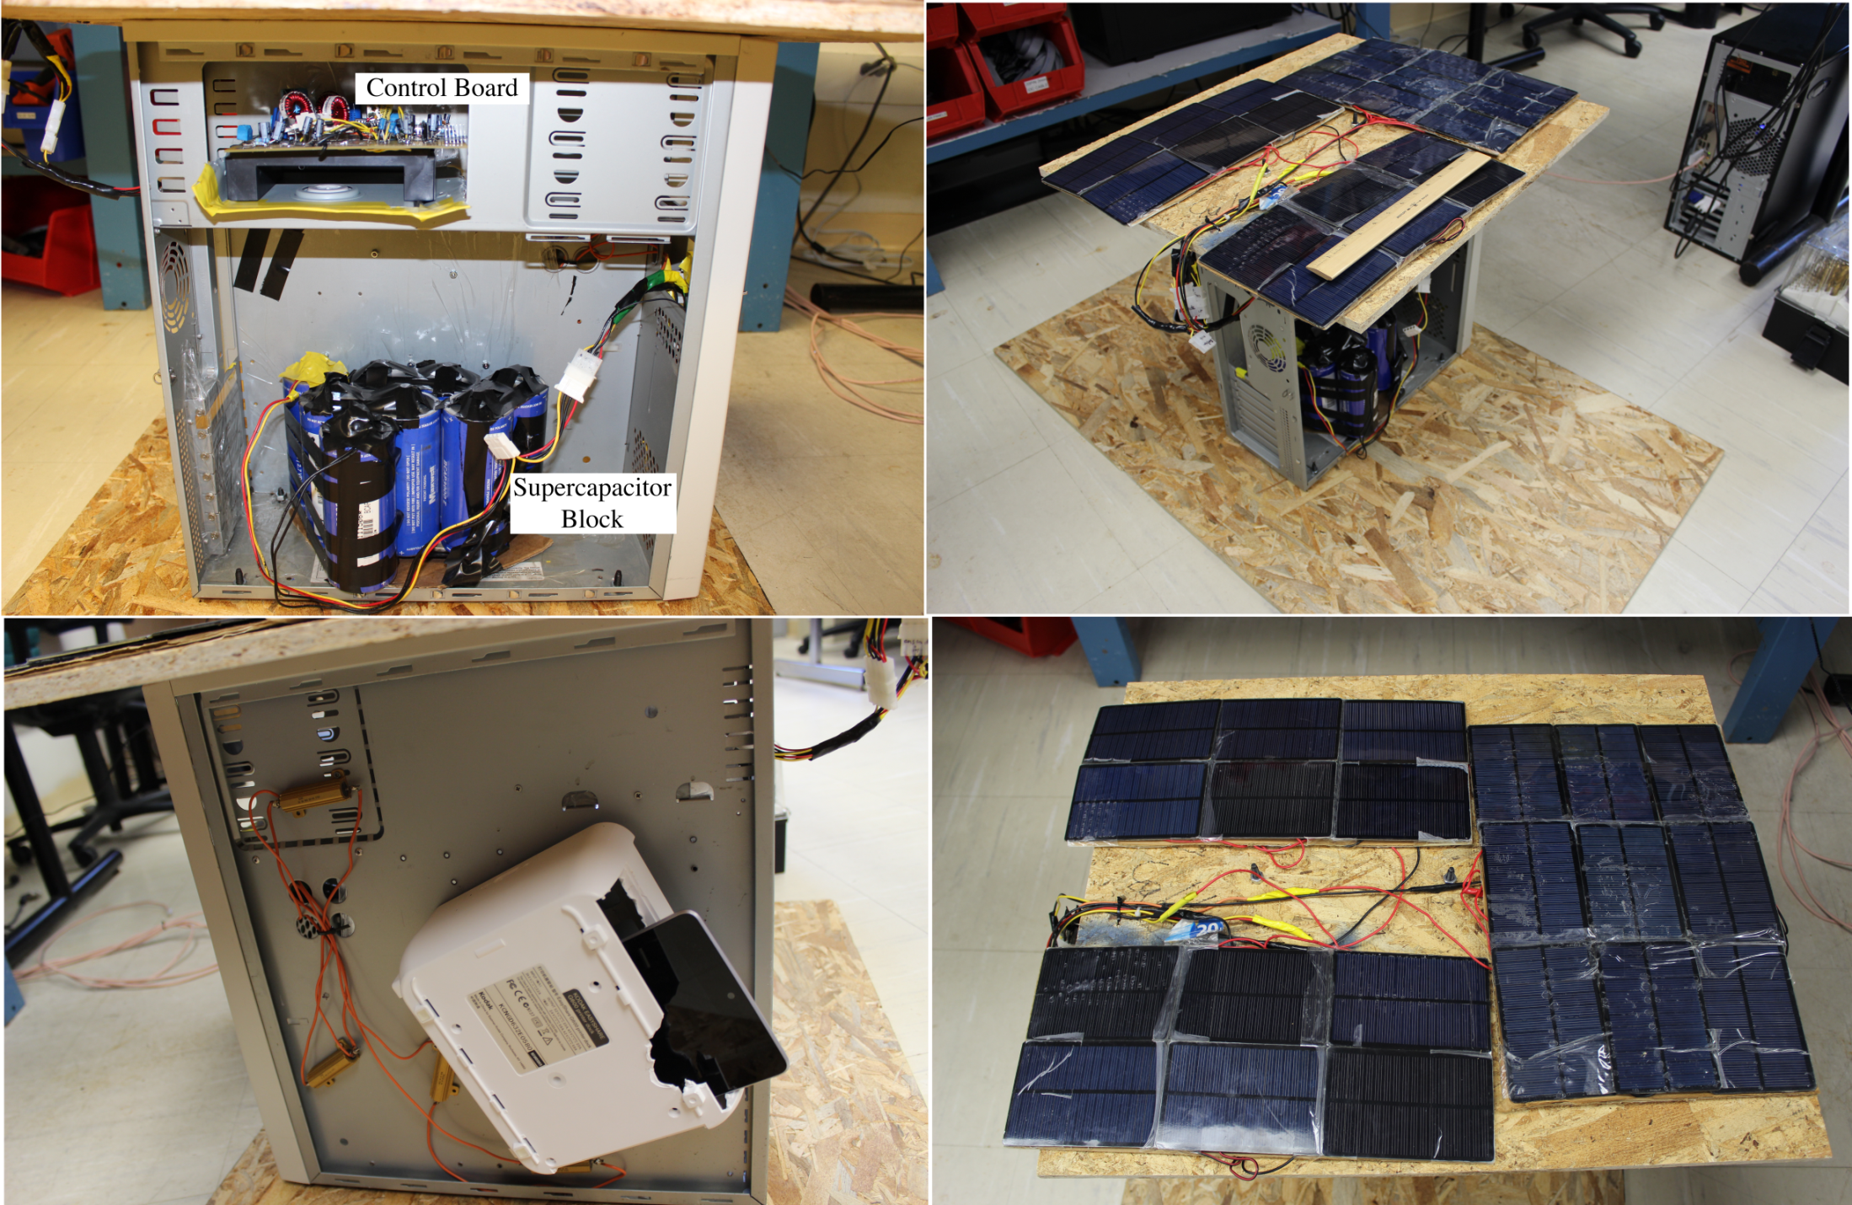
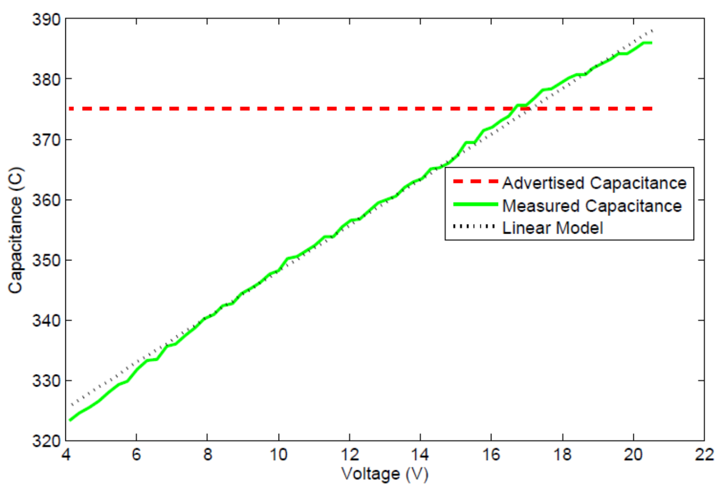
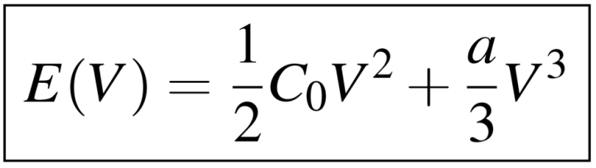
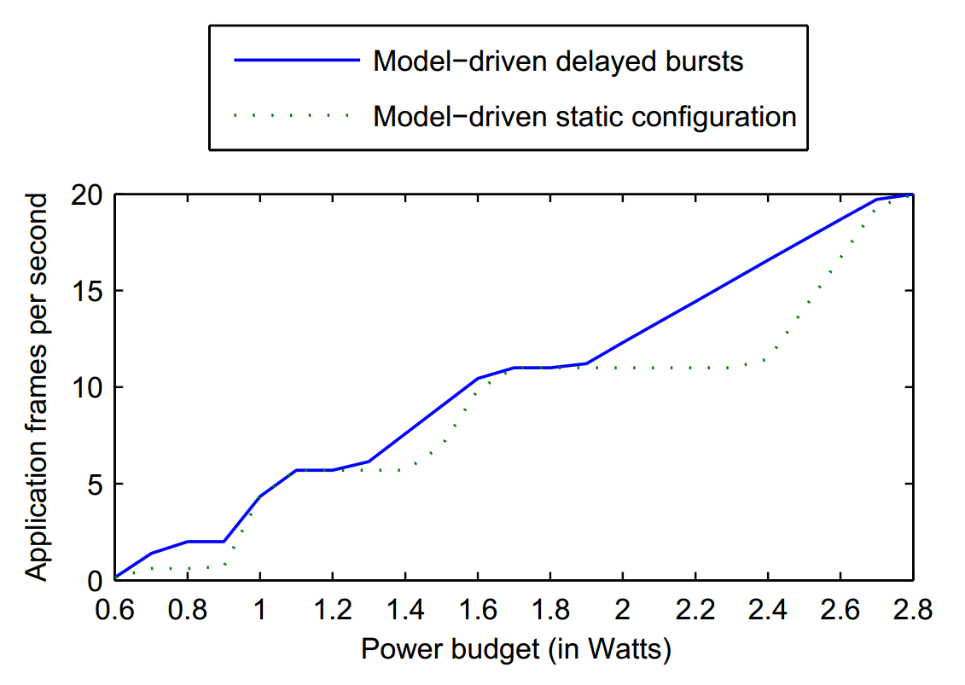
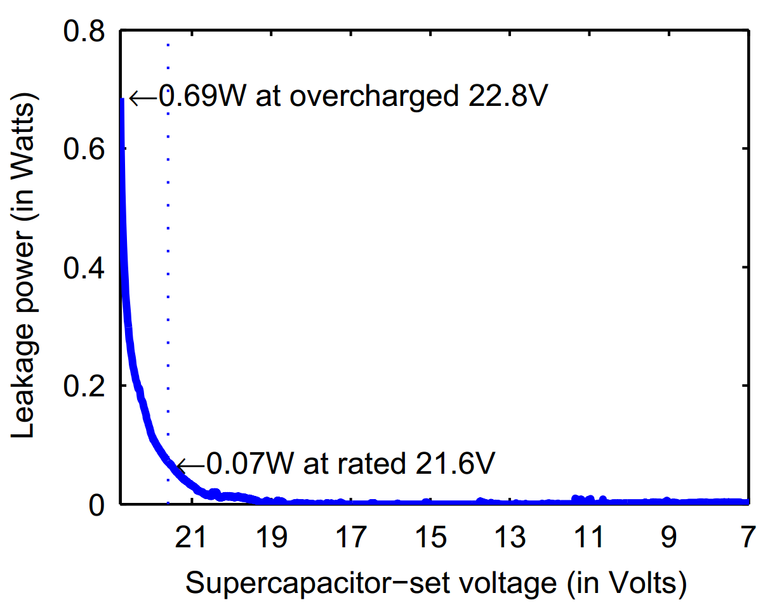
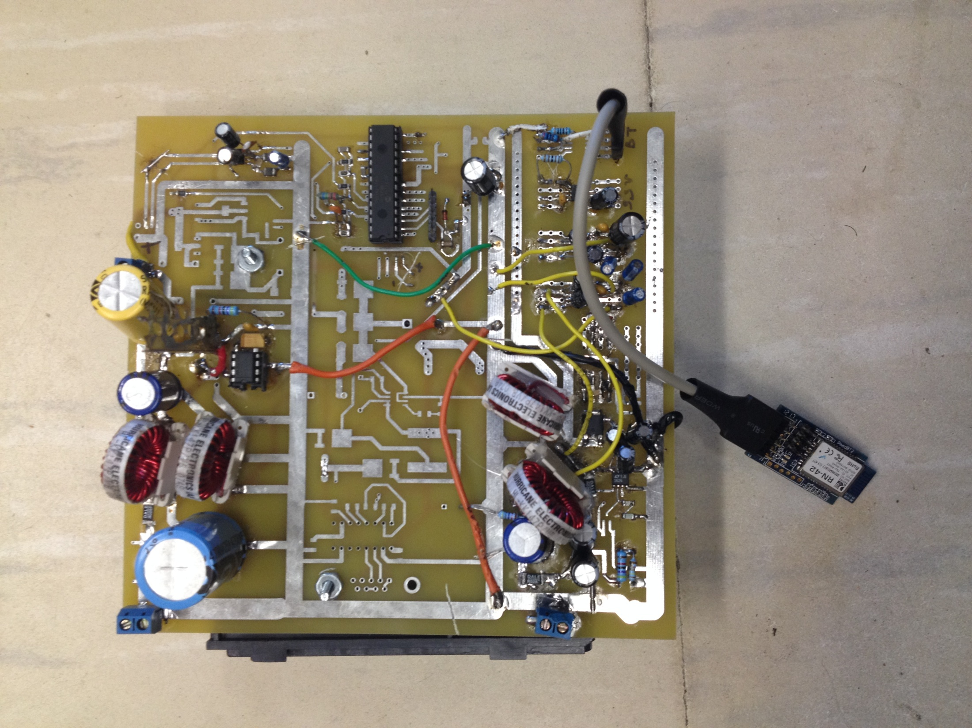
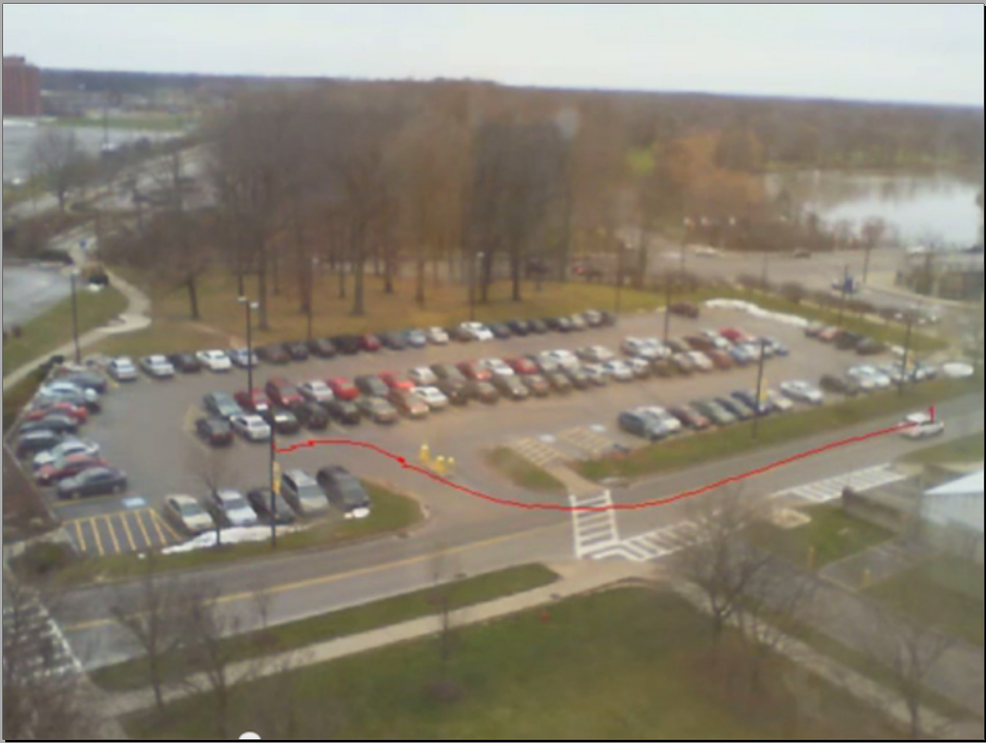
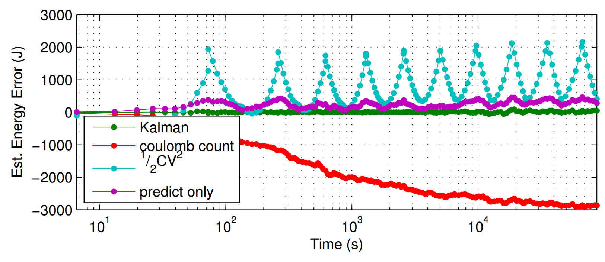
CNS-1239423: CPS: Synergy: Self-Sustainable Data-Driven Systems In the Field
Kai Shen, Wendi Heinzelman, Gaurav Sharma, and Tolga Soyata
University of Rochester
Background and Overview
Continuous, high-speed data processing in the field is important for applications such as wildlife monitoring and highway safety.
Current self-sustainable systems rely on rechargeable batteries that suffer from adverse environmental impact and limited lifetime.
We demonstrate the feasibility of using supercapacitors as the only energy buffering mechanism for continuous field operations.
We utilize synergistic hardware/software techniques (including system modeling).
Summary of Results
Voltage dependent capacitance consideration in supercapacitors helps precise energy buffer modeling and time-to-depletion prediction.
Supercapacitor self-discharge (or leakage) is a minor issue in practical systems where the power consumption far exceeds the leakage.
The supercapacitor instability under varying power uses requires careful voltage-to-charge assessments.
We propose energy/QoS optimization through periodic low-power data capture and bursts of data processing at a higher CPU configuration.
Prototype System Construction
System including supercapacitor block, custom controller board and Nexus 7
Custom controller board including solar harvester, regulator circuit and a microcontroller to communicate information to Nexus 7
Supercapacitor Energy Modeling
Effective Capacitance
15 % error in observed capacitance for low voltages using the advertised capacitance
Leakage
Leakage is a minor issue in field systems
Kalman Filtering for Tracking Super capacitor State of Charge in Dynamic Scenarios
Application & Software System Adaptation
Platforms such as Tegra3 have a wide power range at different CPU configurations and workloads (1-6W in our case).
We propose delayed burst processing where the application alternates between two phases periodically:
  a capture-only phase that stores the captured data without processing,
  and a burst processing phase that processes all previously captured data at the highest data rate allowed by the CPU configuration.
Only burst processing needs a high CPU configuration and the capture-only phase can remain at an energy-efficient low CPU configuration.
Possible application → intelligent transportation systems

