Slide 1


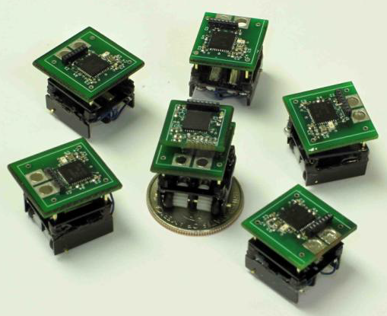
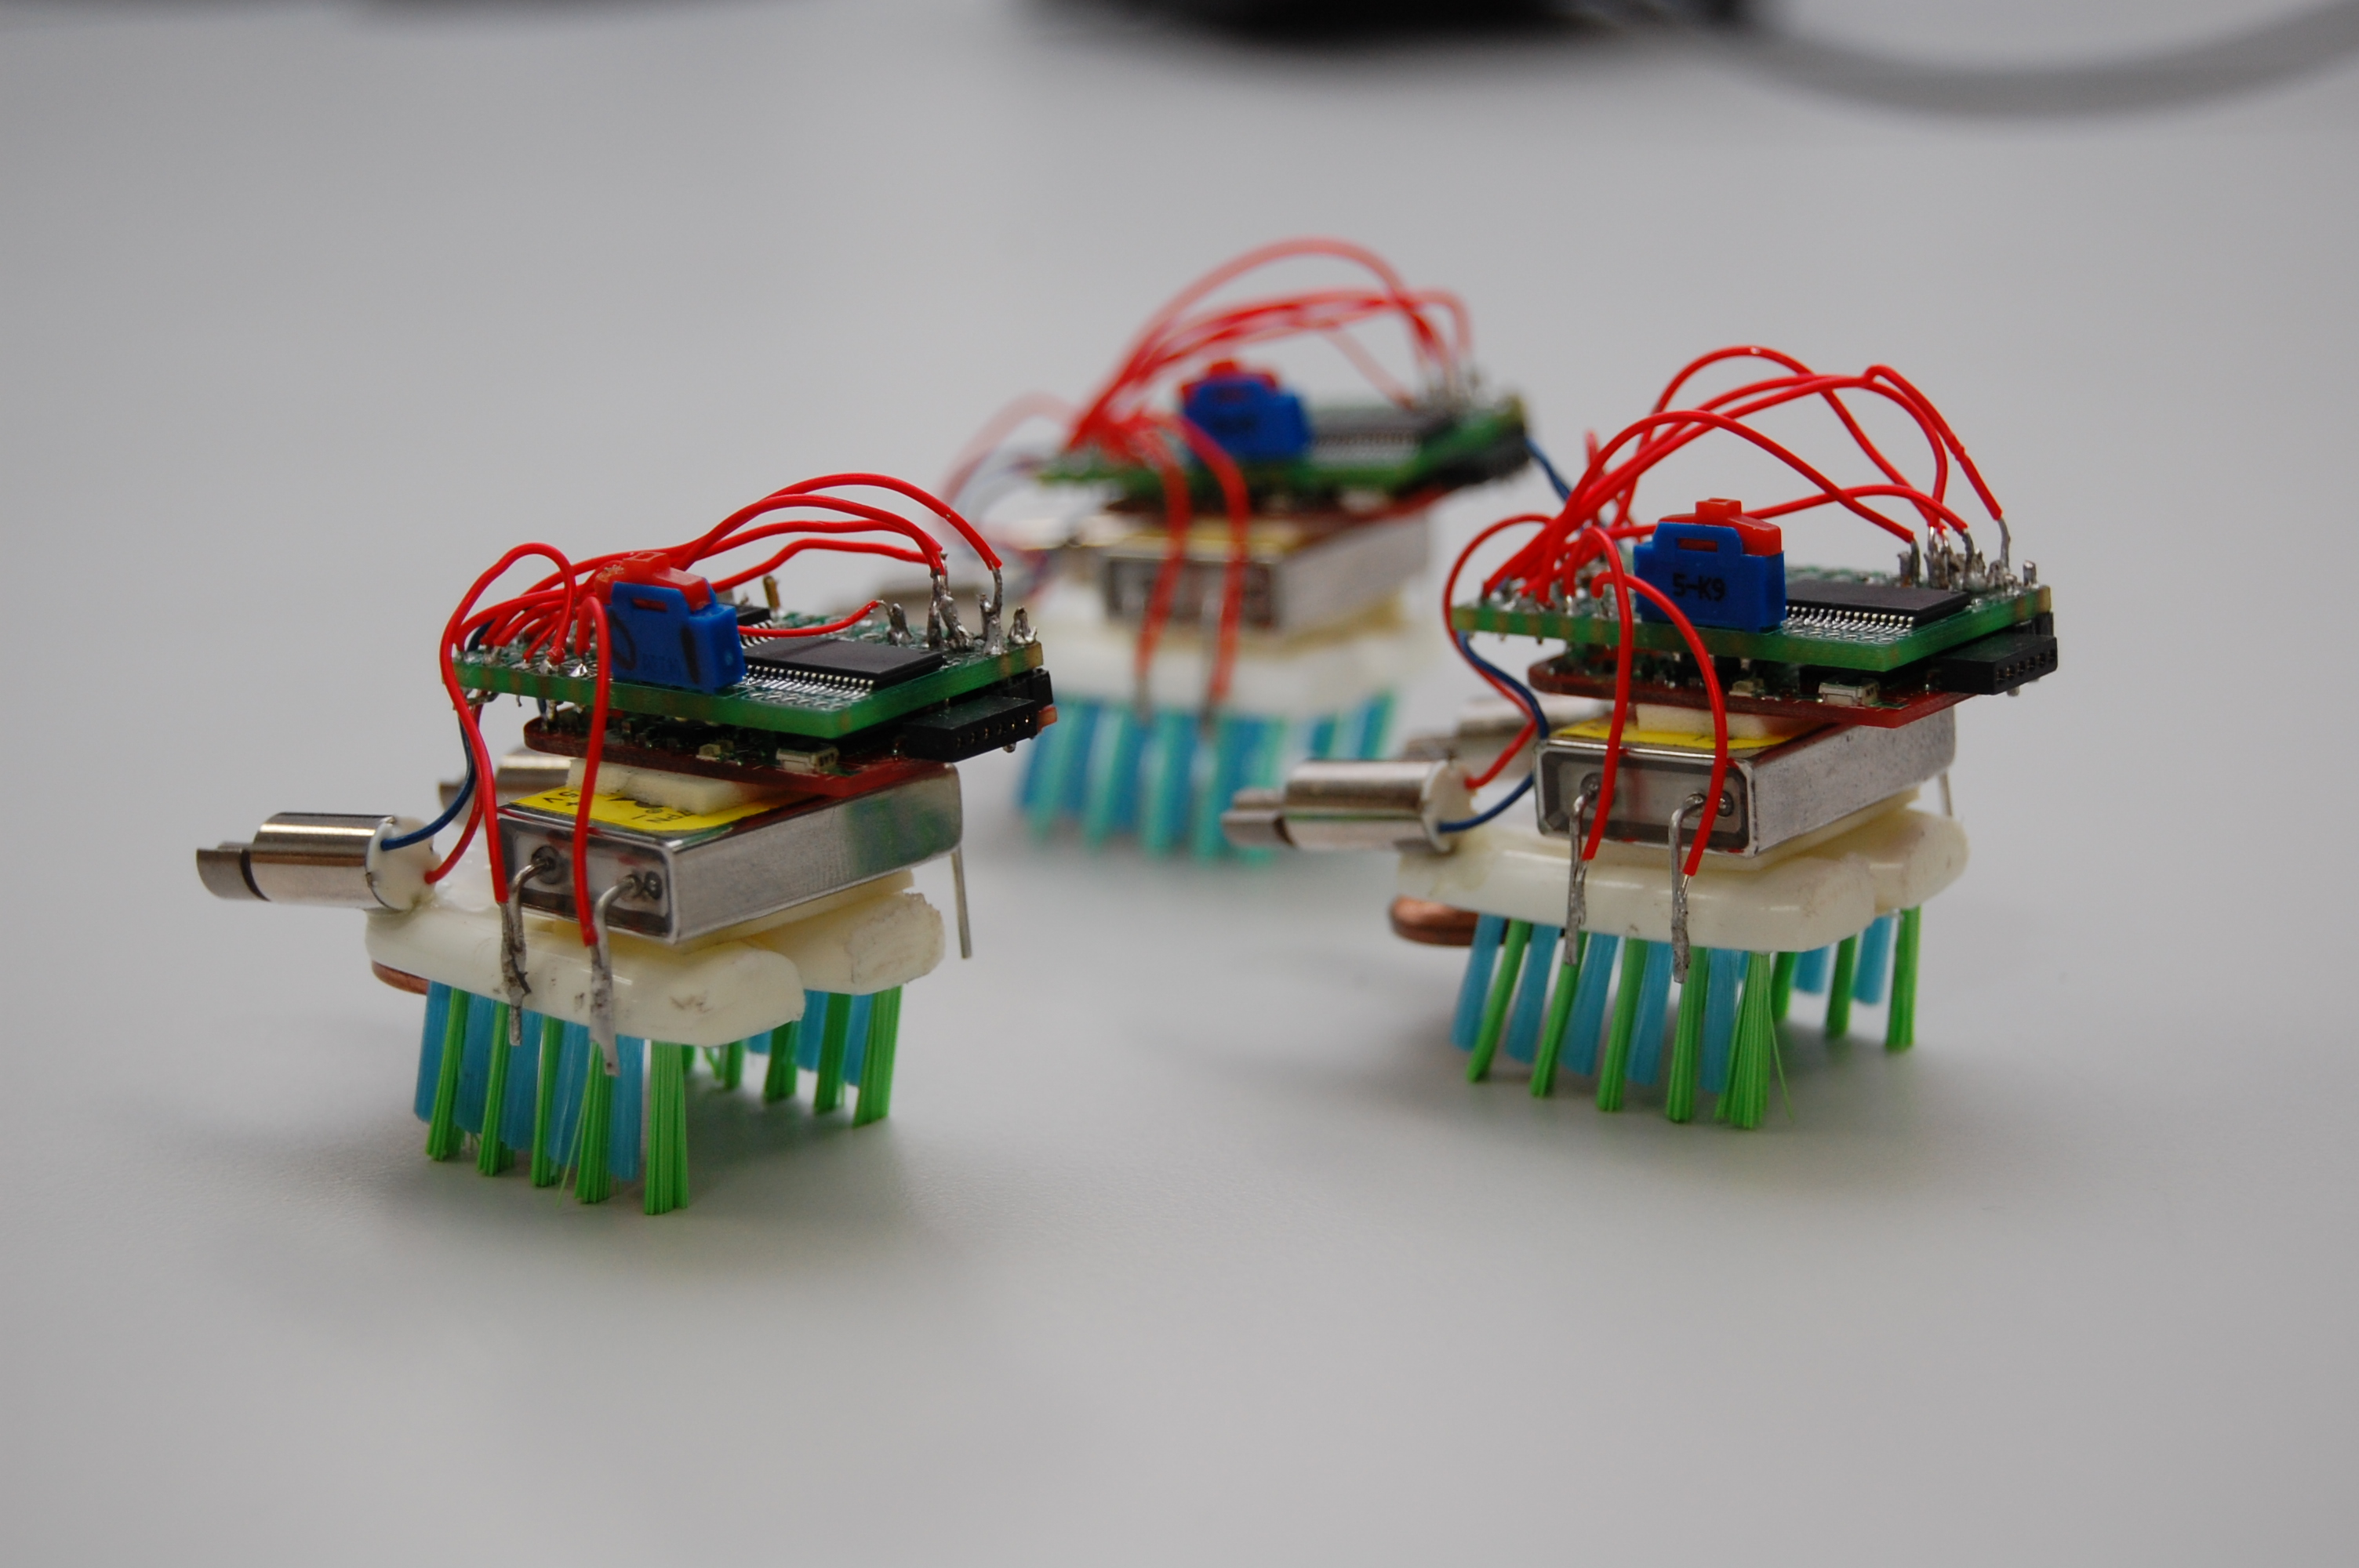
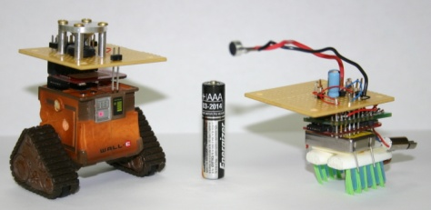
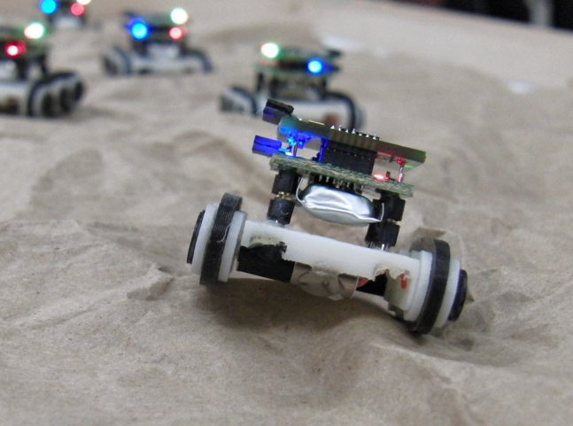
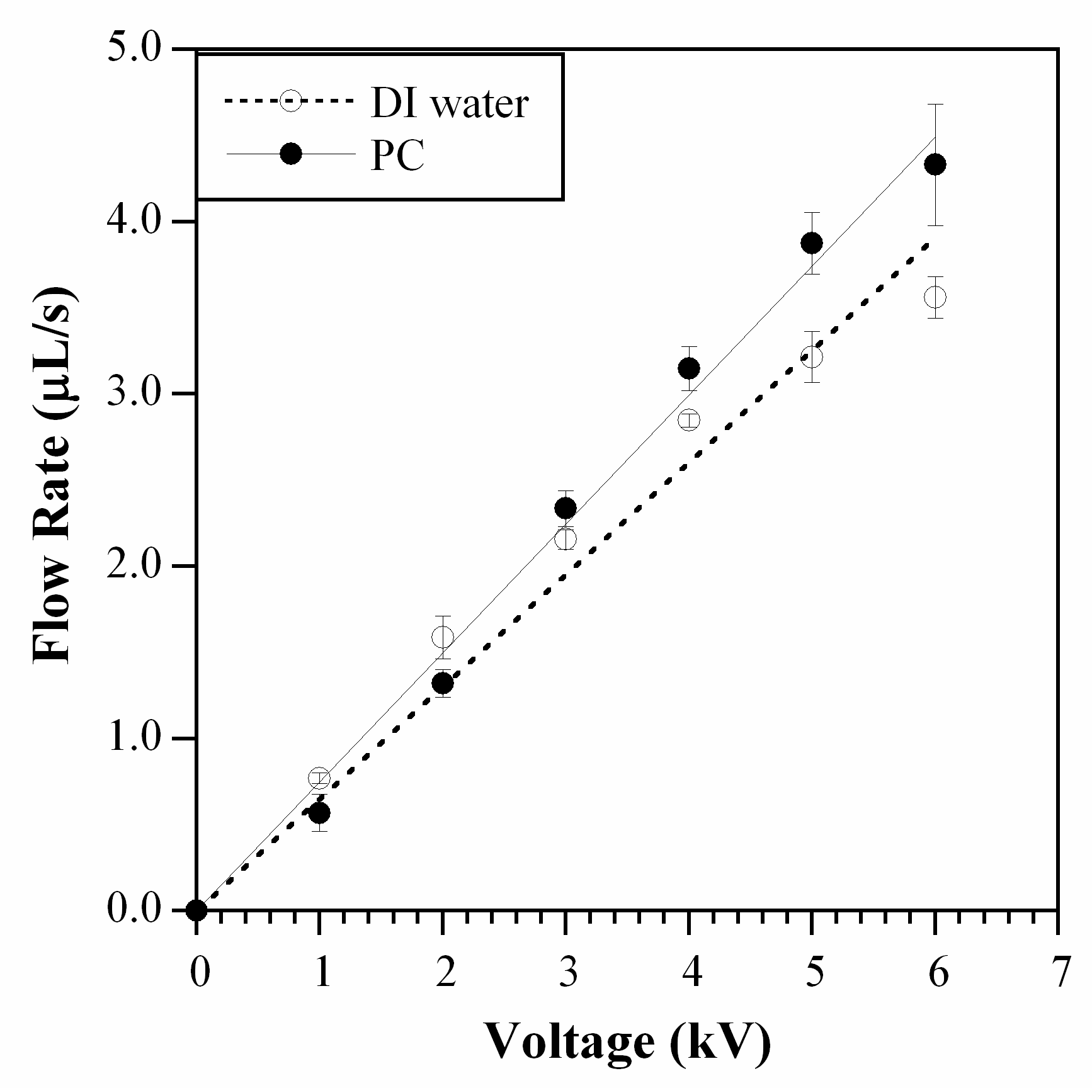
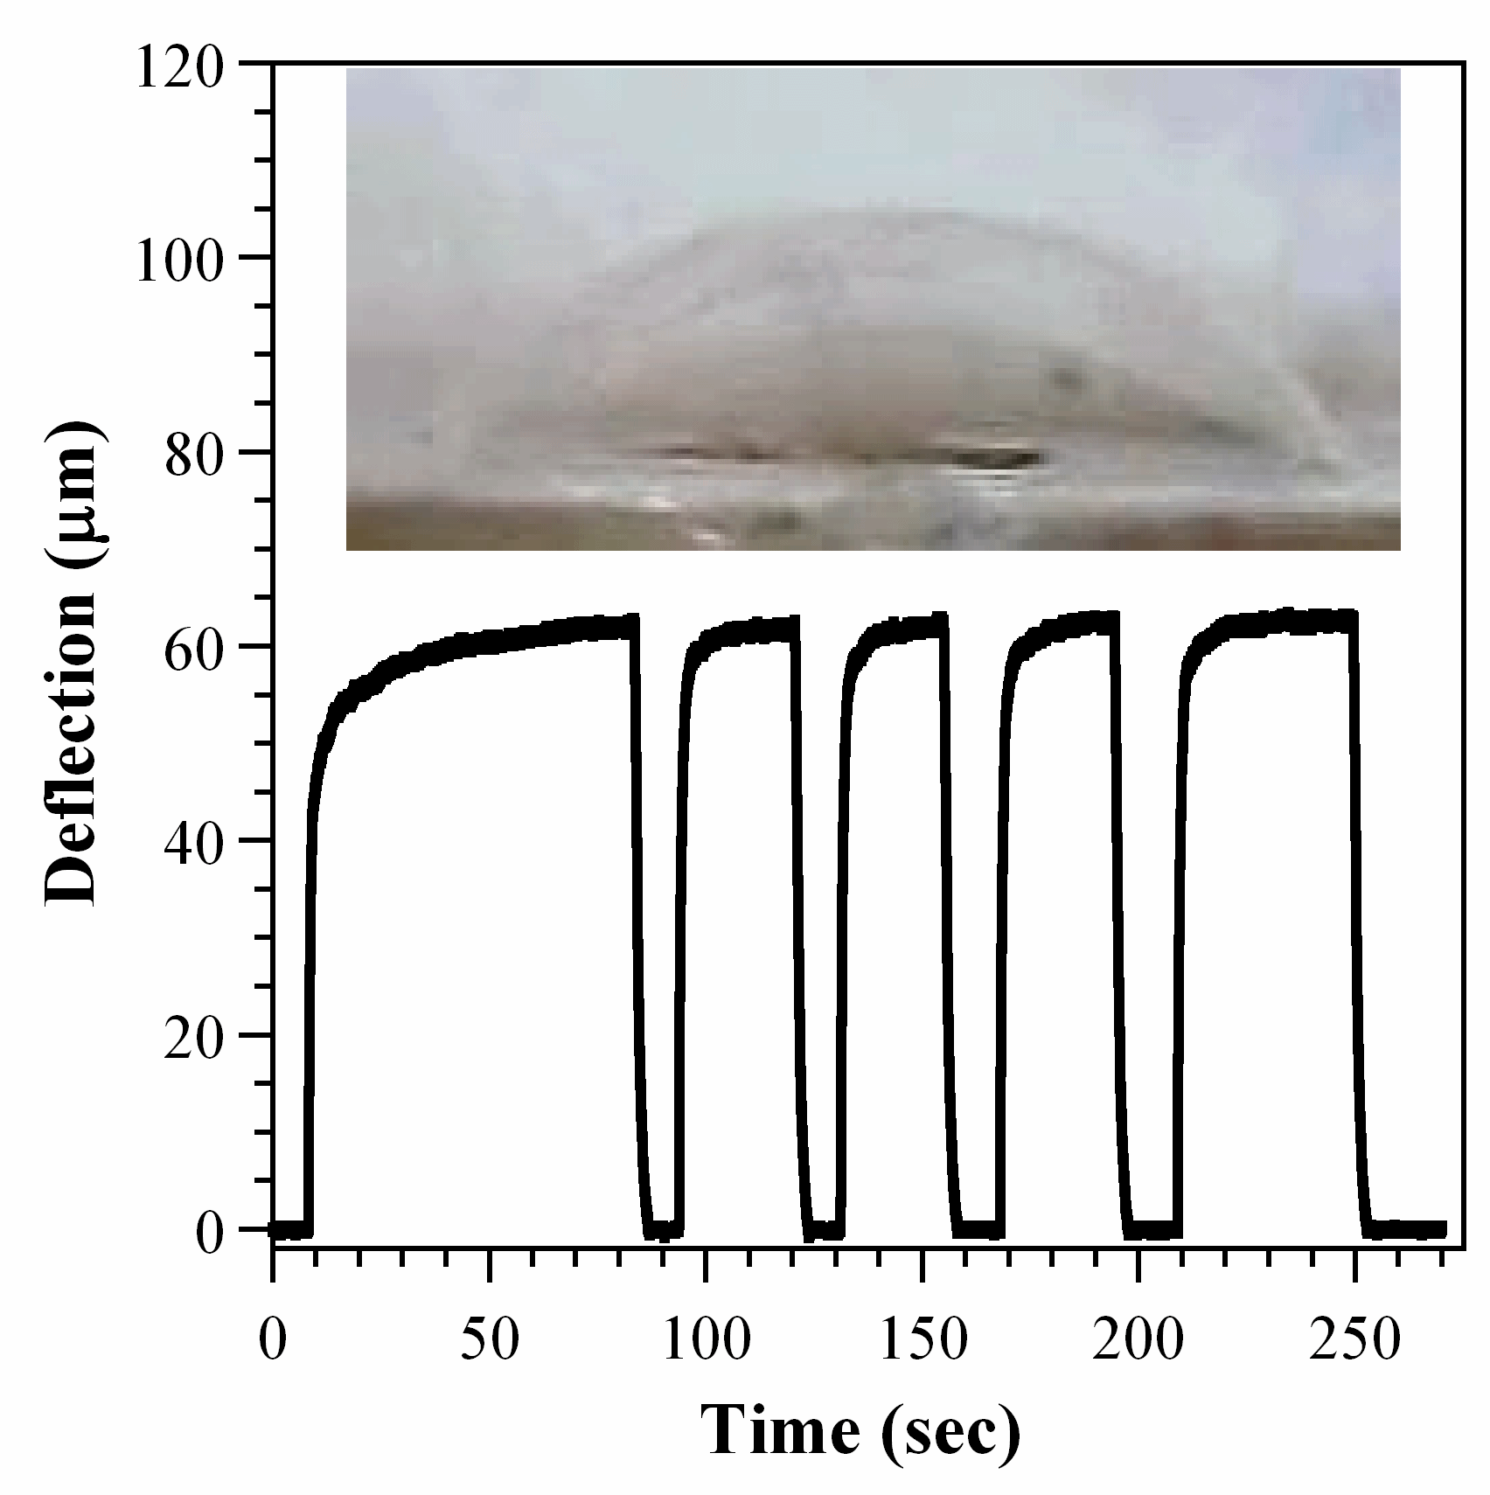
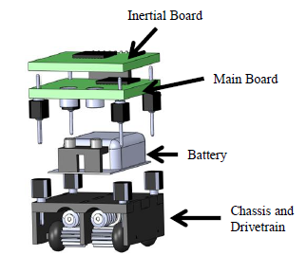
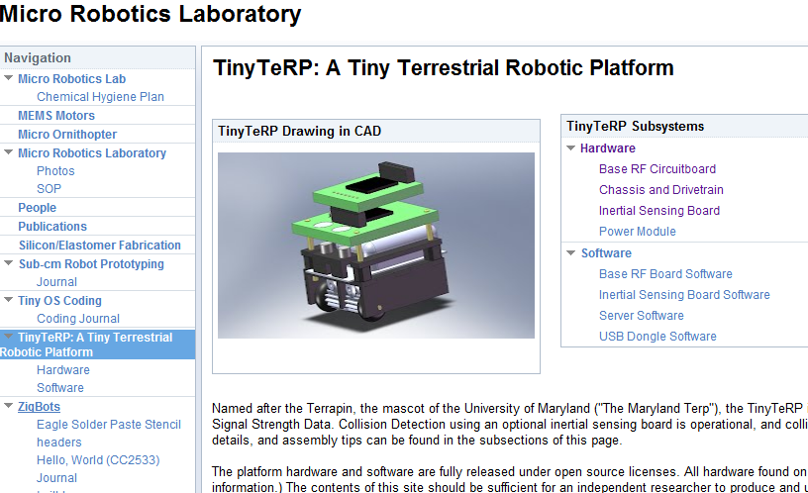
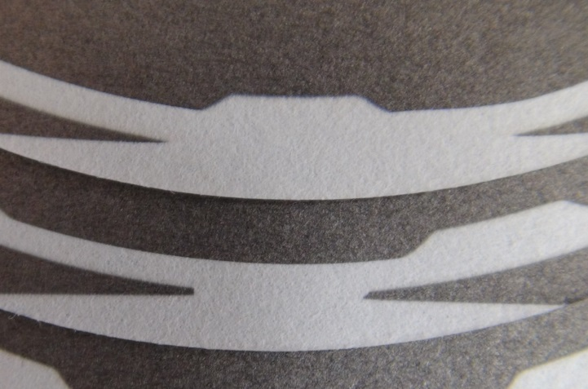
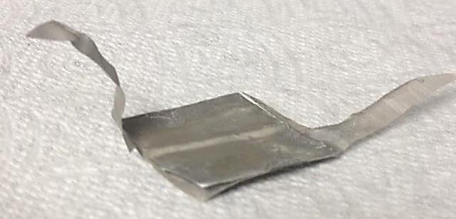
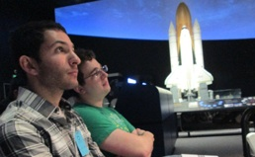
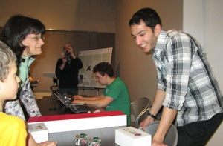
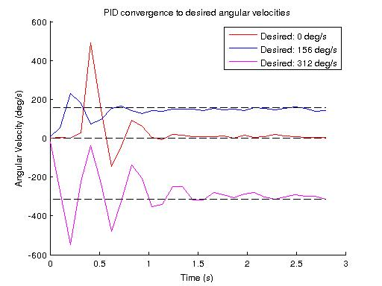
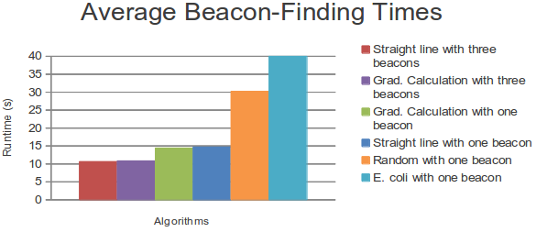
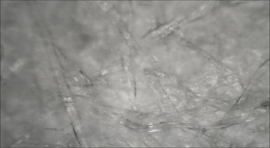
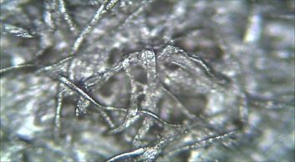
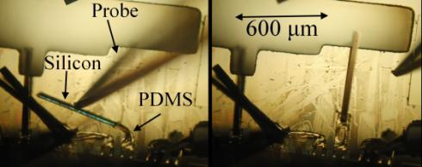
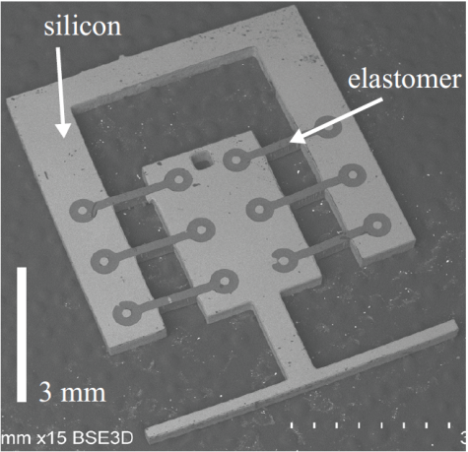
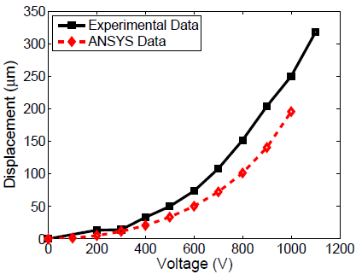
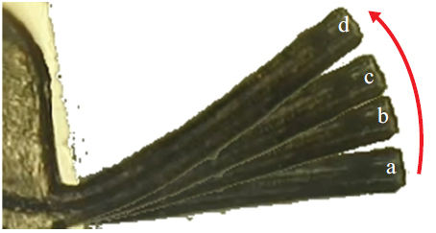
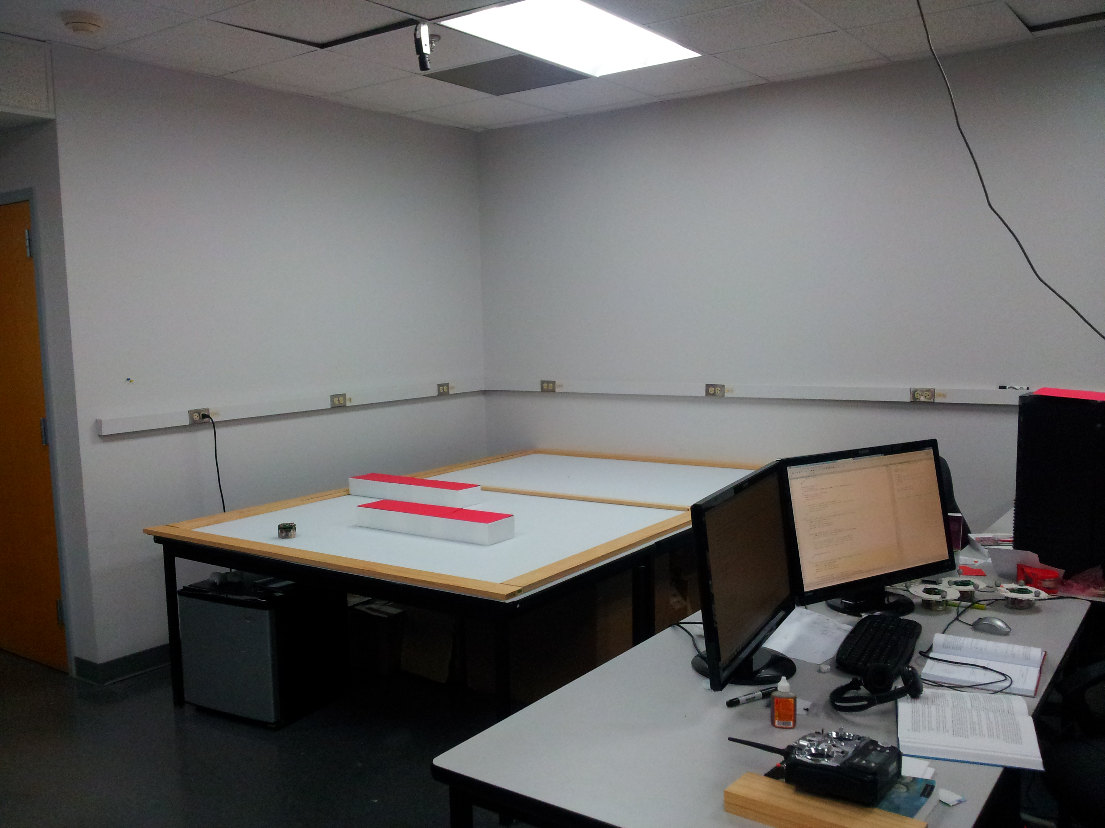
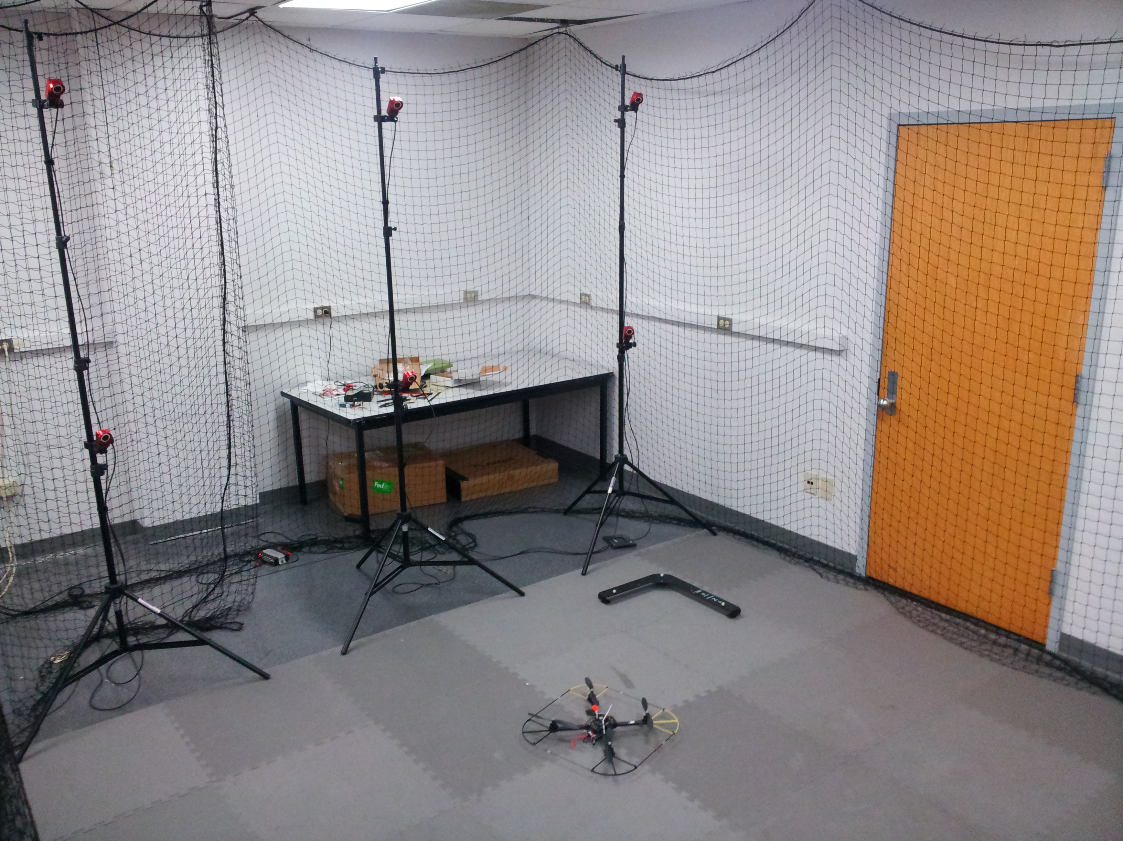
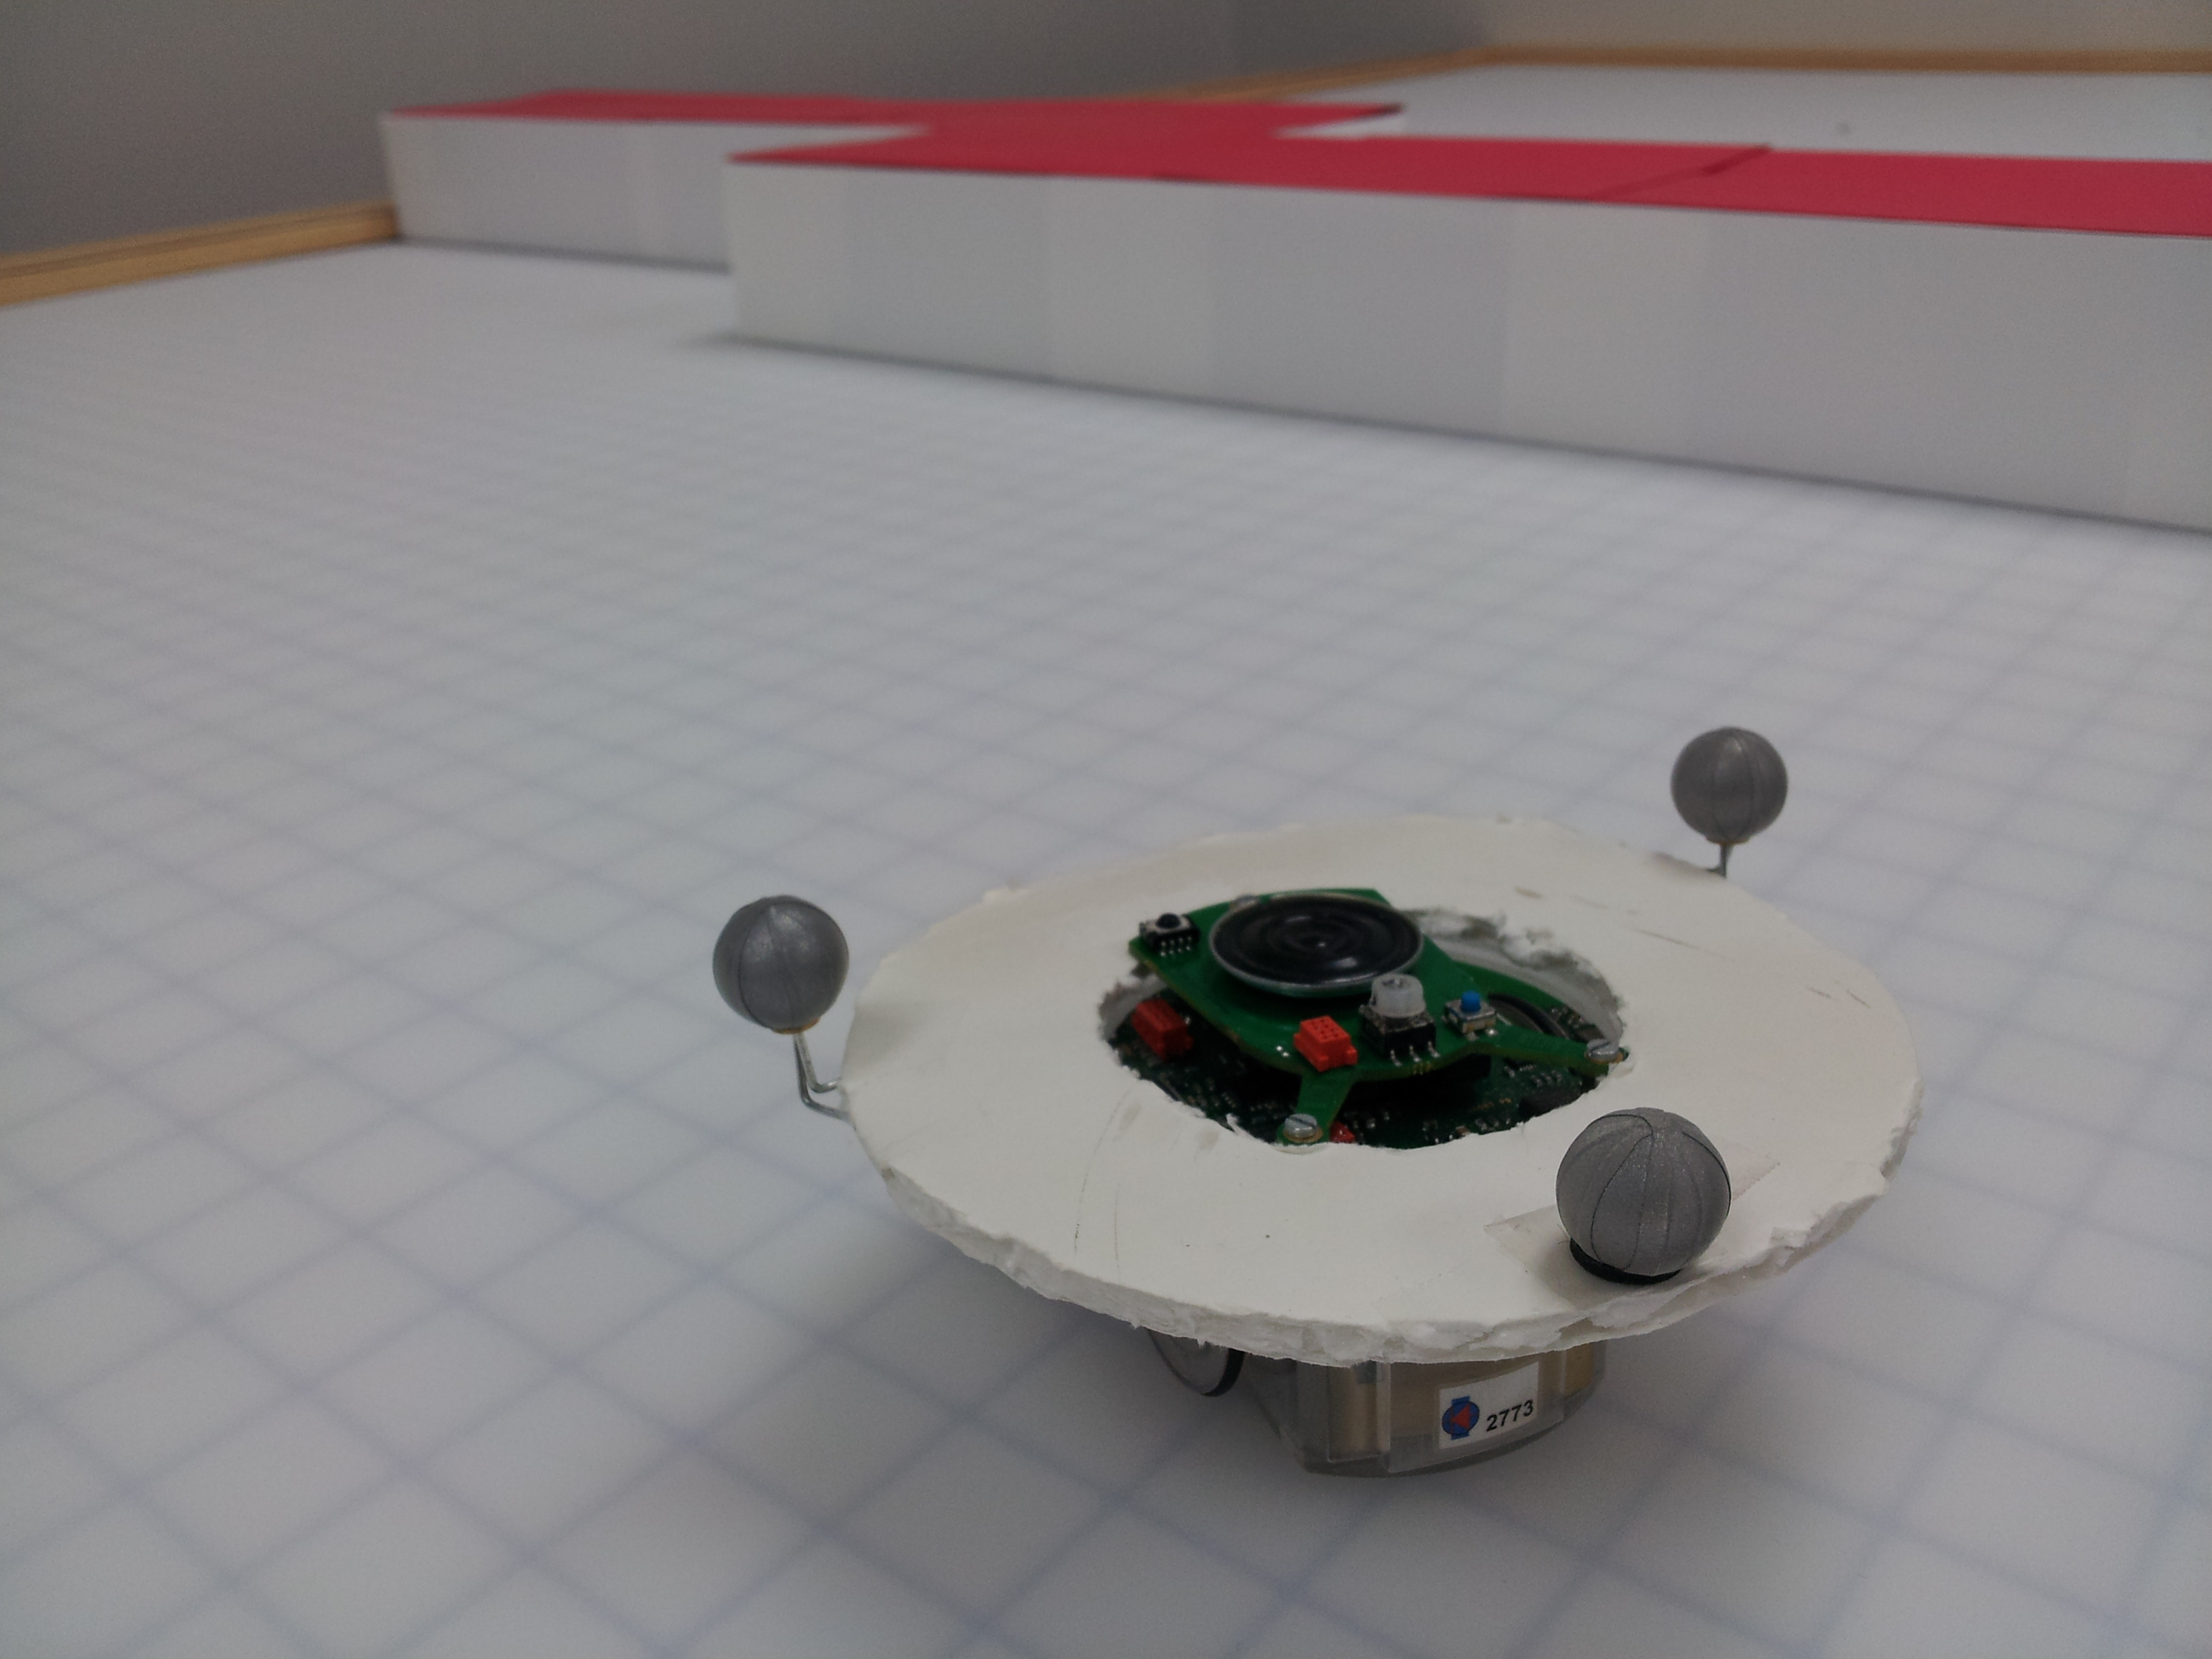
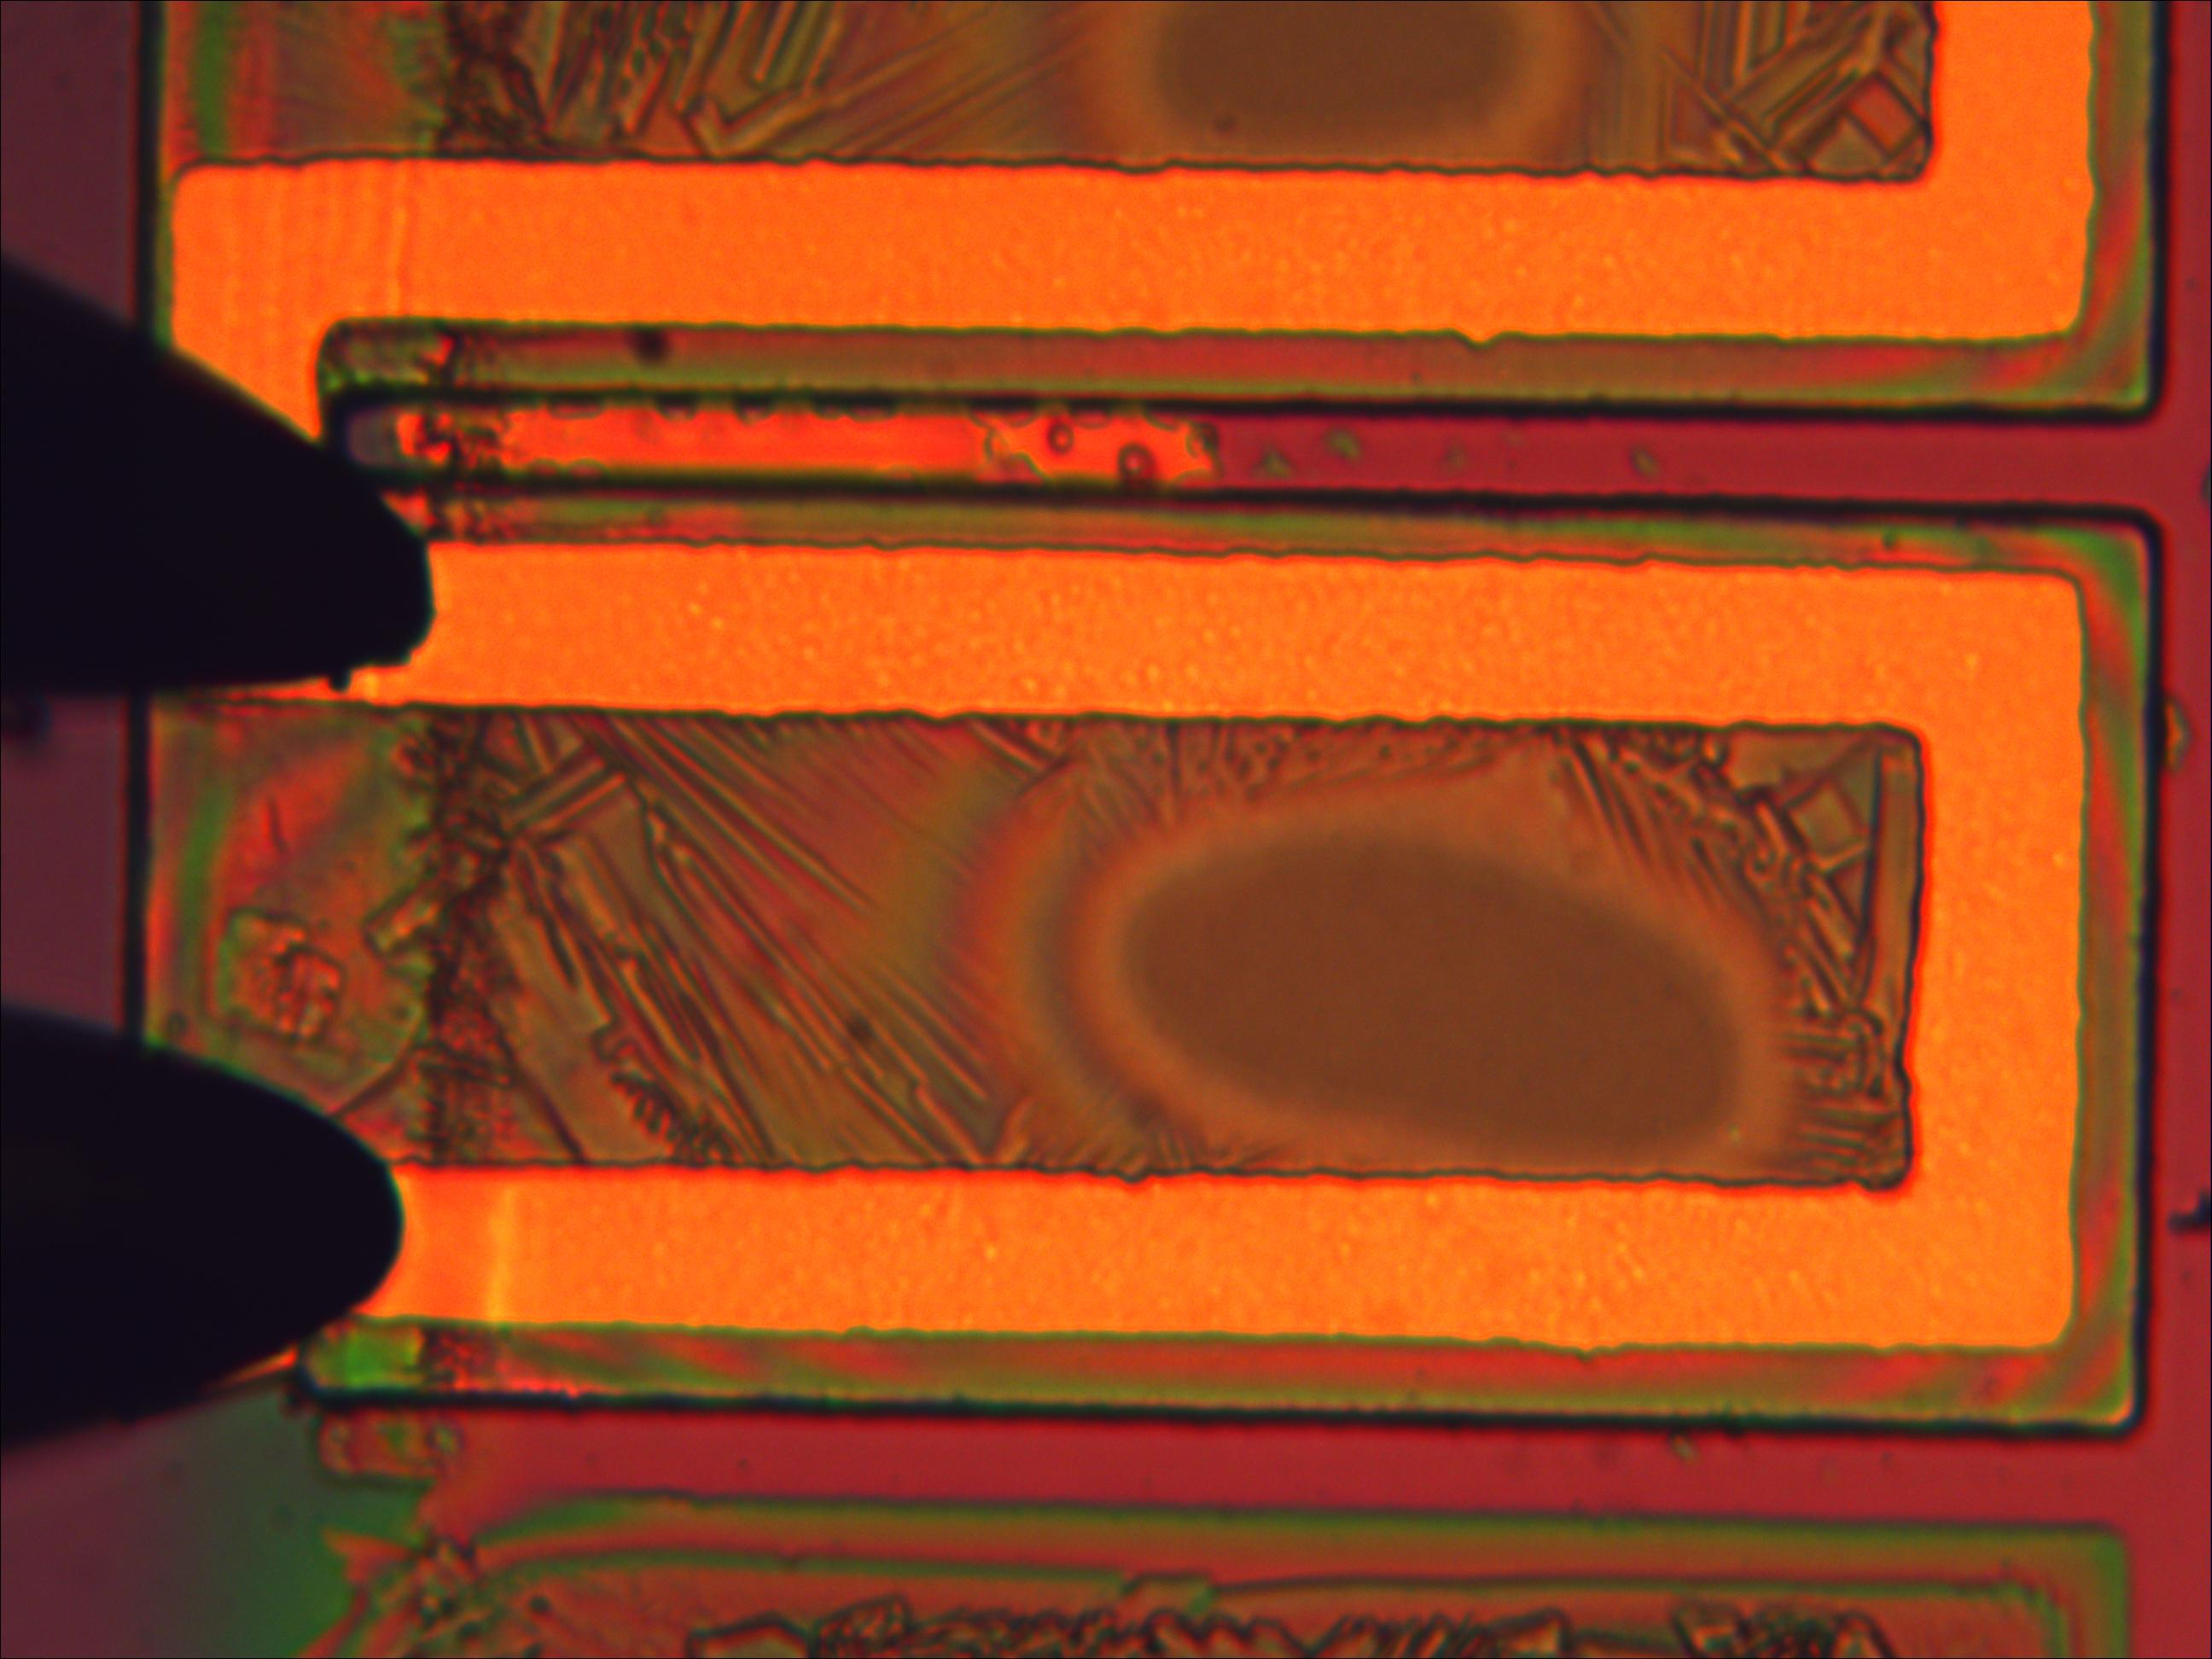
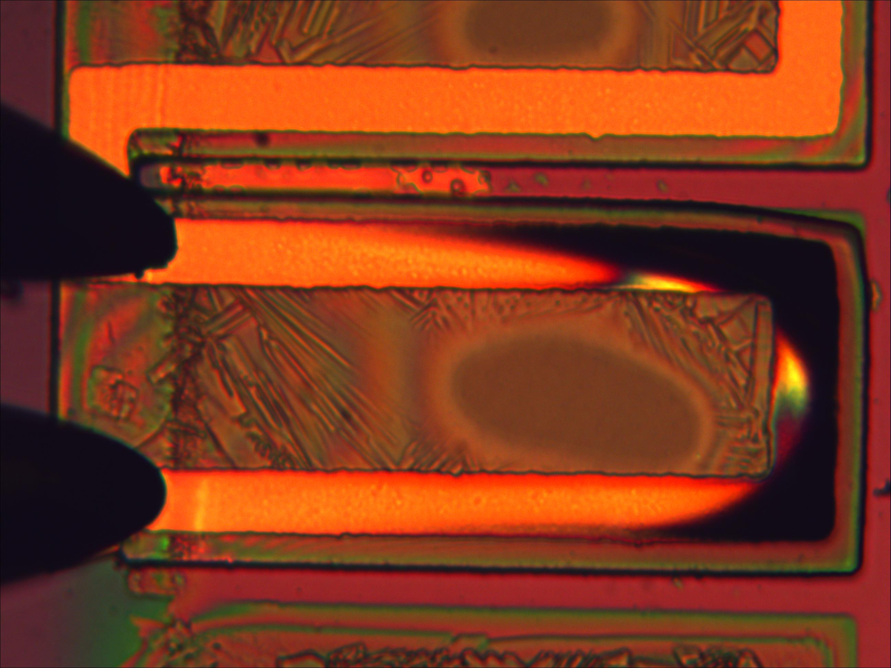

CPS: Medium: Ant-Like Microrobots - Fast, Small, and Under Control
Pamela Abshire, Sarah Bergbreiter, Nuno C. Martins, Elisabeth Smela
C I S E
Award No. 0931878
Objectives
Platforms
TinyTeRPs
Actuators
Low Power Circuits
Development of the first wireless network of cooperative mobile autonomous robots at a very small scale.
Research Themes:
Small robotic platforms with sensing, actuation, control
Control algorithms subject to limited computational capability and to security constraints.
Miniaturized low-power actuators
Power-efficient actuation and computation circuits
Evolution:
Electroosmotic (EO) Nastic Actuators
Mixed-Signal Odometry
Concept: miniature voltage-controlled hydraulic actuators with high force, large displacement.
Power comparison between different implementations and design setting
Pumping Fluid:
Implementation | Design setting |  | Energy / operation (nJ)
Mixed-signal | Warp | 10⁴ | 8.7
 |  | 10⁵ | 0.87
 |  | 10⁶ | 0.087
Digital ASIC | Clock rate (MHz) | 1 | 5.42
 |  | 10 | 14.8
μC (TI MSP430) | Power (μA/MHz) | 100 | 35 (estimation)
BristleBot
“Wall-e”-Bot
Education and Outreach
TinyTeRPs
TinyTeRPs with tank base
One of the main goals of the project is to expose undergraduate students to the research environment. Several undergraduate students have collaborated with graduate students in various aspects of the project.
To date 13 graduate and 30 undergraduate students have worked on this project.
We participate in several outreach opportunities to stimulate interest in Robotics and Science in the general public.
Development of modular, low-cost small platform
Open source hardware and software
Addition of tank base for rough terrain
High-Precision Arbitrary Range Sine Shaper
Comparisons of sinusoidal waveform generator
Inertial Board
Flow velocity and pumping pressure are as good as water. Membrane inflation occurs in only 2 sec.
Ref | Gomez-Quinones, NEWCAS 2011ª | Pengwon, ICCSC 2008^{b} | Yang, JSSC 2011^{c} | This work^{b}
Process (μm) | 0.35 CMOS | 0.18 CMOS | 0.35 SiGe BiCMOS | 0.5 CMOS
Area (μm²) | 3.8x10⁴ | n.a. | 2.7x10^{4 d} | 1.10x10⁵ ^{d}
Power (μW) | n.a. | > 409 | 2.3x10⁴ | 25.1
SFDR (dBc) | n.a. | -54.3 @ 125 | -45.7 @ 2.49G | <-52 @ 0.1-10K -39.5 @ 100K
THD (%@Hz) | < 5.11 @ 8k-21M | 0.22 @ 125 1.18 @ 2.5M | n.a. | <0.37 @ 0.1-10K 1.61 @ 100K
Main Board
Fabrication, Lowering Voltage:
Battery
Paper based pump serves as microporous channel network
Chassis +
Drivetrain
Top: description of the TinyTeRP platform.
Right: TinyTeRP wiki.
a. Not a triangle-to-sine (TSC) design; b. Simulation; c. Only TSC part; d. Estimation
Radio based rendezvous for swarming
Actuation Control Circuit
Floating-gate charge pump phase-locked loop for one-time automatic programming
Programmable frequency and duty cycle
Left: Electrodes are being developed based on thin film metals, carbon, or elastomer composites. Right: Paper between mesh electrodes, pumps at only 200 V. Prior min. operating voltage, 1 kV.
National Robotics Week at the
Air and Space Museum (2013)
Compliant Elastomer
First microfabrication process to incorporate compliant elastomers with silicon MEMS
Left: PID convergence to desired angular velocities.
Right: Comparison of algorithms for radio based rendezvous.
Control Design
Publications
Koshland Science Museum (2011)
Search and Surveillance
T.-H. Lee and P. Abshire, “Accurate, Wide-Range Analog Sine Shaping Circuits” to appear in Proc. IEEE Int. New Circuit and Systems Conference (NEWCAS), Jun. 2014.
A. P. Gerratt, B. Balakrisnan, I. Penskiy, and S. Bergbreiter, "Dielectric Elastomer Actuators Fabricated Using a Micro-Molding Process," Smart Materials and Structures, vol. 23, no. 5, p. 055004, May 2014
E. Arvelo and N.C. Martins. “Maximizing the Set of Recurrent States of an MDP subject to Convex Constraints,” Automatica, vol. 50, no. 3, pp. 994-998, Mar. 2014.
S. Sabau and N.C. Martins, “Youla-Like Parametrizations Subject to QI Subspace Constraints," IEEE Transactions on Automatic Control, vol. 59, no. 6, pp. 1411-1422, Feb. 2014.
T.-H. Lee and P. Abshire, “Design and Characterization of High-Voltage NMOS Structures in a 0.5μm Standard CMOS Process,” IEEE Sensors Journal, vol. 13, no. 8, pp. 2906-2913, Aug. 2013.
A. P. Gerratt and S. Bergbreiter, “Dielectric Breakdown of PDMS Thin Films,” Journal of Micromechanics and Microengineering, vol. 23, no. 6, p. 067001, Jun. 2013. *IOP Select Article.
P. Sandborn and P. Abshire, “2D Motion Sensor with Programmable Feature Extraction,” in IEEE International Symposium on Circuits and Systems (ISCAS), May 2013, pp. 2408-2411.
A. P. Sabelhaus, D. Mirsky, M. Hill, N. C. Martins, and S. Bergbreiter, “TinyTeRP: A Tiny Terrestrial Robotic Platform with Modular Sensing Capabilities,” in Proc. IEEE International Conference on Robotics and Automation (ICRA), May 2013, pp. 2585-2590.
E. Arvelo, E. Kim, and N.C. Martins, “Maximal Persistent Surveillance under Safety Constraints”, in Proc. IEEE International Conference on Robotics and Automation (ICRA), May 2013, pp. 4048-4053.
M. Kuhlman, T.-H. Lee, and P. Abshire, “Mixed-Signal Odometry for Mobile Robotics,” in Proc. SPIE8725, Apr. 2013.
A. P. Gerratt, I. Penskiy, and S. Bergbreiter, “In-Situ Characterization of PDMS in SOI-MEMS,” Journal of Micromechanics and Microengineering, vol. 23, no. 4, p. 045003, Apr. 2013. *JMM cover photo.
D. Sritharan, M. Motsebo, J. Tumbic, and E. Smela, “Stable Electroosmotically Driven Actuators,” in Proc. SPIE8687, Mar. 2013.
A. P. Gerratt and S. Bergbreiter, “Incorporating Compliant Elastomers for Jumping Locomotion in Microrobots,” Smart Materials and Structures, vol. 22, no. 1, p. 014010, Jan. 2013.
W. A. Malik, N. C. Martins, and A. Swami, "LQ Control Under Security Constraints," in Proc. Workshop on Control of Cyber-Physical Systems, Lecture Notes in Control and Information Sciences, vol. 49, pp. 101-120, 2013.
A. Mahajan, N.C Martins, M. C. Rotkowitz, and S Yuksel, “Information Structures in Optimal Decentralized Control”, in Proc. IEEE Conference on Decision and Control (CDC), Dec. 2012, pp. 1291-1306.
T.-H. Lee and P. Abshire, “40 Volt NMOS in a Standard CMOS Process,” in Proc. IEEE Sensors Conference, Oct. 2012, pp. 1-4.
T.-H. Lee and P. Abshire, “Design Methodology for a Low-Frequency Current-Starved Voltage-Controlled Oscillator with a Frequency Divider,” in Proc. IEEE International Midwest Symposium on Circuits and Systems (MWSCAS), Aug. 2012, pp. 646-649.
T.-H. Lee and P. Abshire, “An Ultra-Low Frequency Ring Oscillator with Programmable Tracking Using a Phase-Locked Loop,” in Proc. IEEE International Midwest Symposium on Circuits and Systems (MWSCAS), Aug. 2012, pp. 17-20.
M. Kuhlman, E. Arvelo, S. Lin, P. Abshire, and N. C. Martins, “Mixed-Signal Architecture of Randomized Receding Horizon Control for Miniature Robotics,” in Proc. IEEE International Midwest Symposium on Circuits and Systems (MWSCAS), Aug. 2012, pp. 570-573.
B. Balakrisnan, A. Nacev, J. M. Burke, A. Dasgupta, and E. Smela, "Design of Compliant Meanders for Applications in MEMS, Actuators, and Flexible Electronics," Smart Materials and Structures, vol. 21, no. 7, p. 075033, Jul. 2012.
S. Park and N. C. Martins. “An Augmented Observer for the Distributed Estimation Problem for LTI Systems”, American Control Conference (ACC), Jun. 2012, pp.6775-6780.
G. Sineriz, M. Kuhlman, and P. Abshire, “High Resolution Distance Sensing for Mini-Robots using Time Difference of Arrival,” in Proc. IEEE International Symposium on Circuits and Systems (ISCAS), May 2012, pp. 717-720.
A.P. Gerratt and S. Bergbreiter, “Microfabrication of Compliant All-Polymer MEMS Thermal Actuators,” Sensors and Actuators A: Physical, vol. 177, no. 4, pp. 16-22, Apr. 2012.
W. Malik, N. C. Martins, and A. Swami, “Optimal Sensor Placement for Intruder Detection: New Design Principles”, in Proc. 49th Annual Allerton Conference on Communication, Control and Computing, Sep. 2011, pp. 1537-1543.
W. Ma, E. Arvelo, and N. C. Martins, “Designing Networked Control Architectures for Incremental Robustness”, in Proc. IFAC 18th World Congress, vol. 18, no. 1, Aug. 2011, pp. 6604-6609.
A.P. Gerratt, B. Balakrisnan, and S. Bergbreiter, “Batch Fabricated Bidirectional Dielectric Elastomer Actuators,” in Proc. Transducers, Jun. 2011, pp. 2422-2425.
C. Perkins, L. Lei, M. Kuhlman, T. Lee, G. Gateau, S. Bergbreiter, and P. Abshire, “Distance Sensing for Mini-Robots: RSSI vs. TDOA,” in Proc. IEEE International Symposium on Circuits and Systems (ISCAS), May 2011, pp. 1984-1987.
T. Datta, P. Abshire, and A. Turner, “Towards a Legged Chip”, in Proc. IEEE International Symposium on Circuits and Systems (ISCAS), May 2011, 2501-2504.
S. Alben, B. Balakrisnan, and E. Smela, "Edge Effects Determine the Direction of Bilayer Bending," Nano Lett., vol. 11, no. 6, pp. 2280-2285, Apr. 2011.
S. Sabau and N.C. Martins, “Norm-Optimal Design of a Single Block of a Block-Diagonal Controller”, in Proc. Yale Control Workshop, 2011.
Novel technique for control design with safety constraints
  Based on entropy maximization principles
  Finitely parameterized convex program: highly scalable
  Determination of where and how many robots to deploy
Pushed left
As fabricated
Top: PDMS as flexible joint. Right: A micro jumping robot with elastomer springs.
Unsafe (determined by scenario)
Dielectric Elastomer Actuator
No guarantee of safety
Demo at a conference in Brazil (2011)
Safe regions
CPS & Cooperative Autonomy Laboratory
Forbidden regions
Development of a testbed with for 2D tracking.
Laboratory equipped with 12- camera 3D tracking system, 4 small robots and 2 quadrotors.
Goal: heterogeneous robotic network involving small robots.
Search and surveillance scenario
Robot
Left: Voltage displacement curve of DEA. Right: Overlaid image of the DEA actuator at a) 0 V, b) 700 V, c) 900 V, and d) 1100 V.
Control under Security Constraints
Bilayer Thermal Actuators
Goal: control the robot to a specified final position while satisfying bounds on the information available to an adversarial observer, who takes noisy measurements.
  Resulting optimization is shown to be convex.
  Duality techniques are used to find optimal solutions.
Integration with CMOS chip – legged chip with onboard control
Right: CMOS chip photomicrograph animated with four sets of thermal actuators (blue/yellow overlay) serving as the legs.
Bottom Left: Before actuation.
Bottom Left: Actuator curved up.
Robot
t = k
Possible terminal locations
Top Left: in-house testbed with overhead camera. Top Right: 3D tracking system and quadrotor. Right: small robot with IR markers used for fast control and communication algorithms prototyping.
Noisy observations until t = k
Observer
Problem setup for control under security constraints

