Slide 1
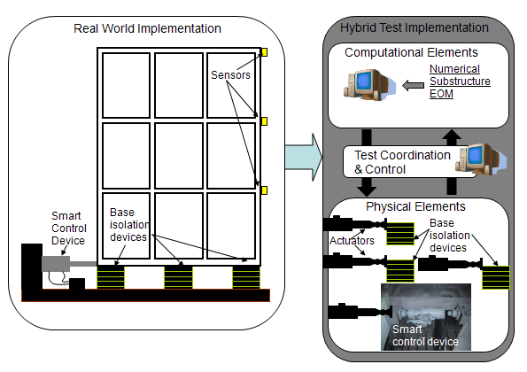
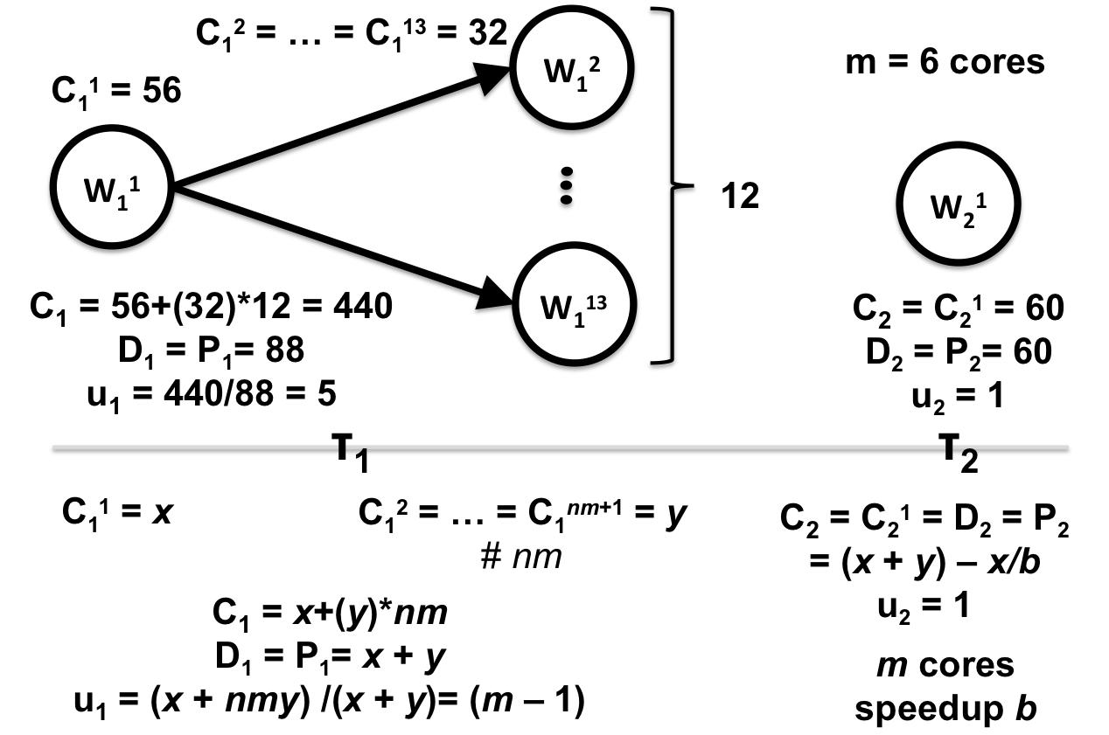
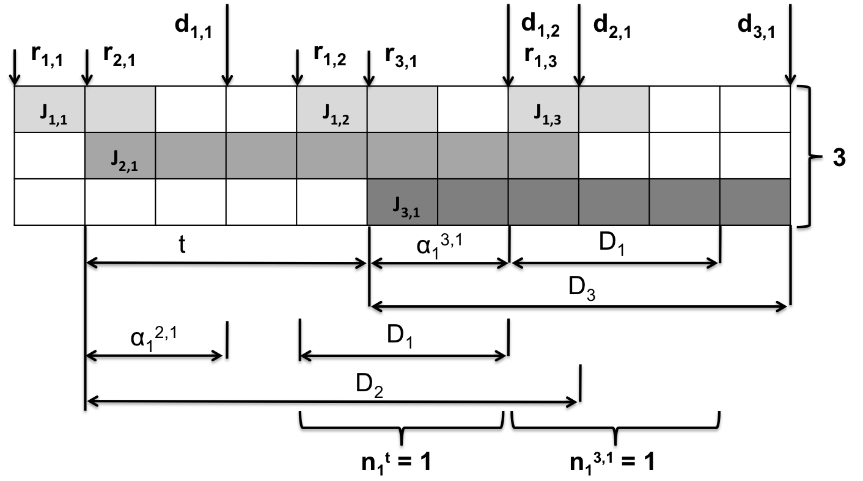
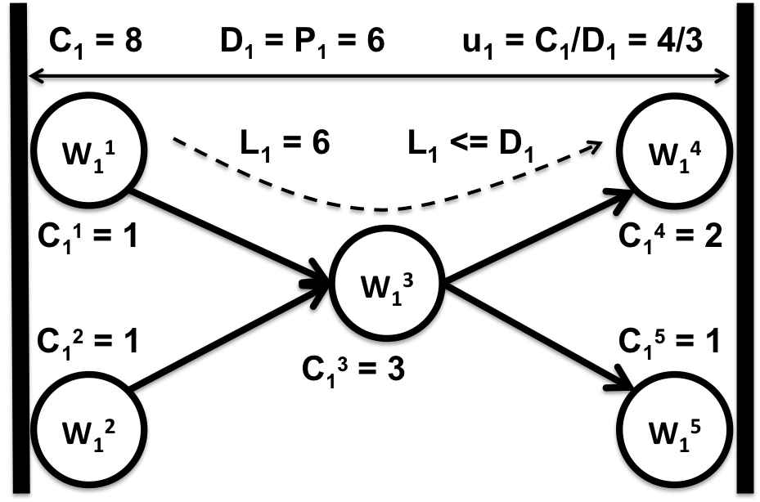
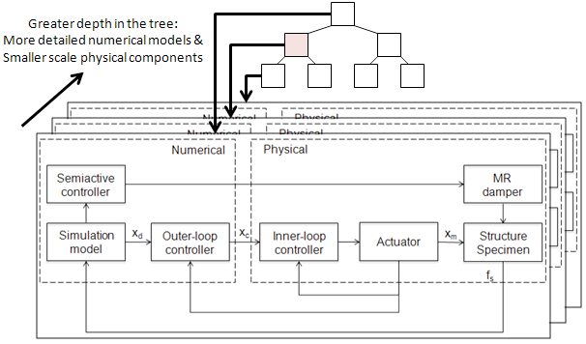
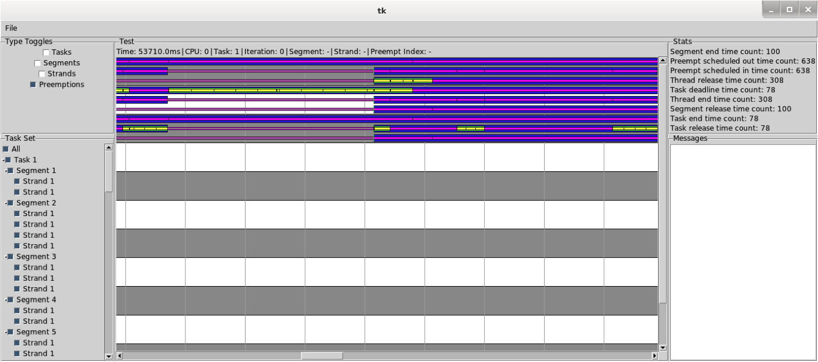
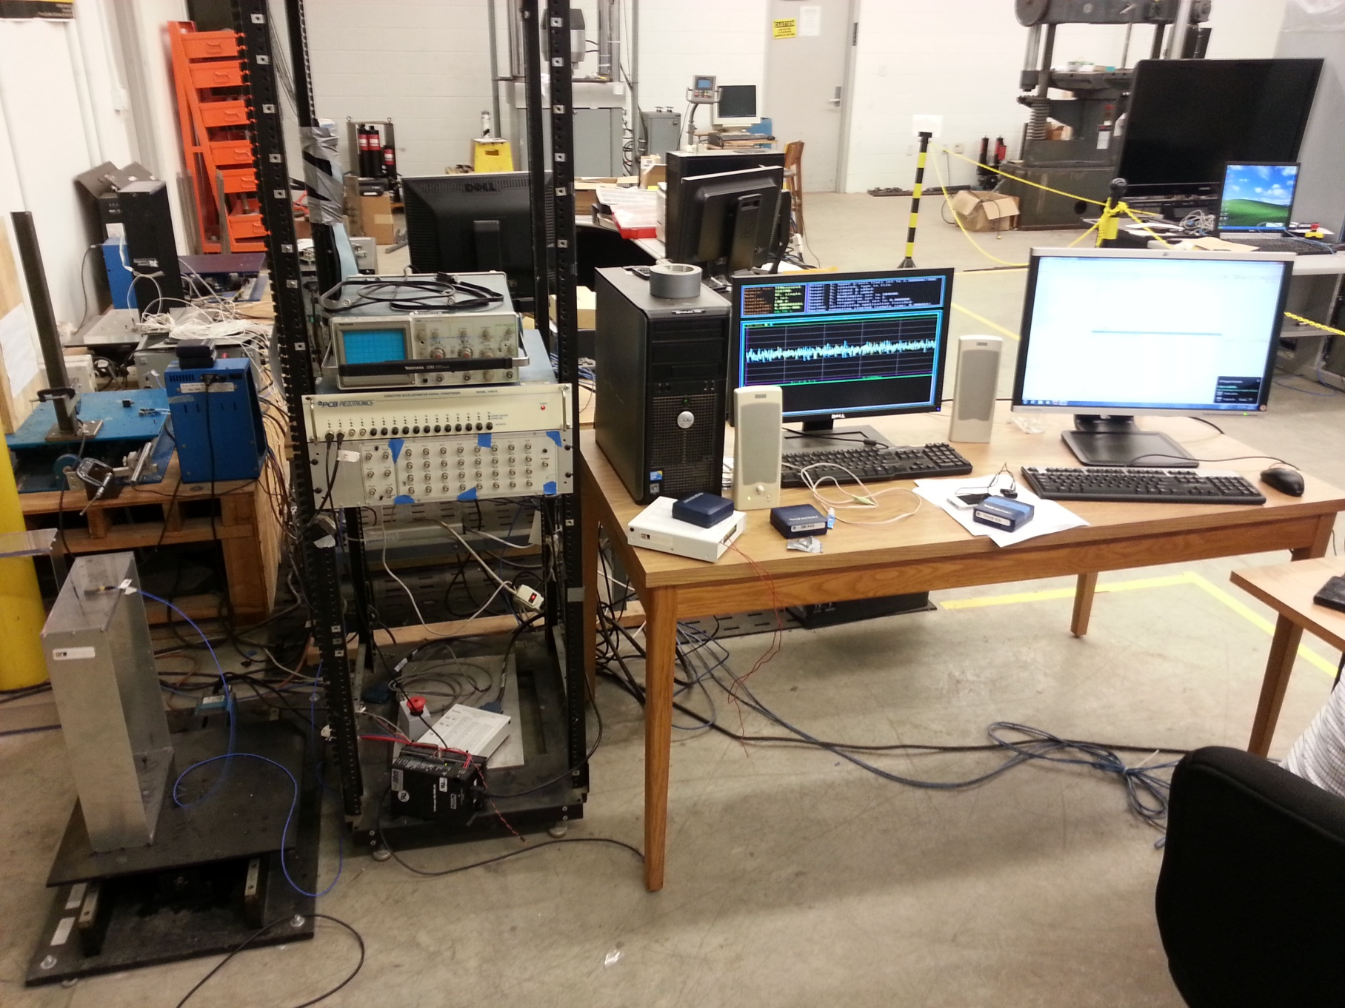
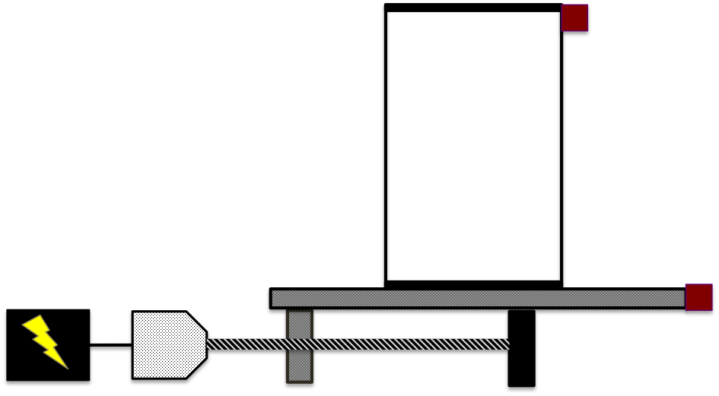
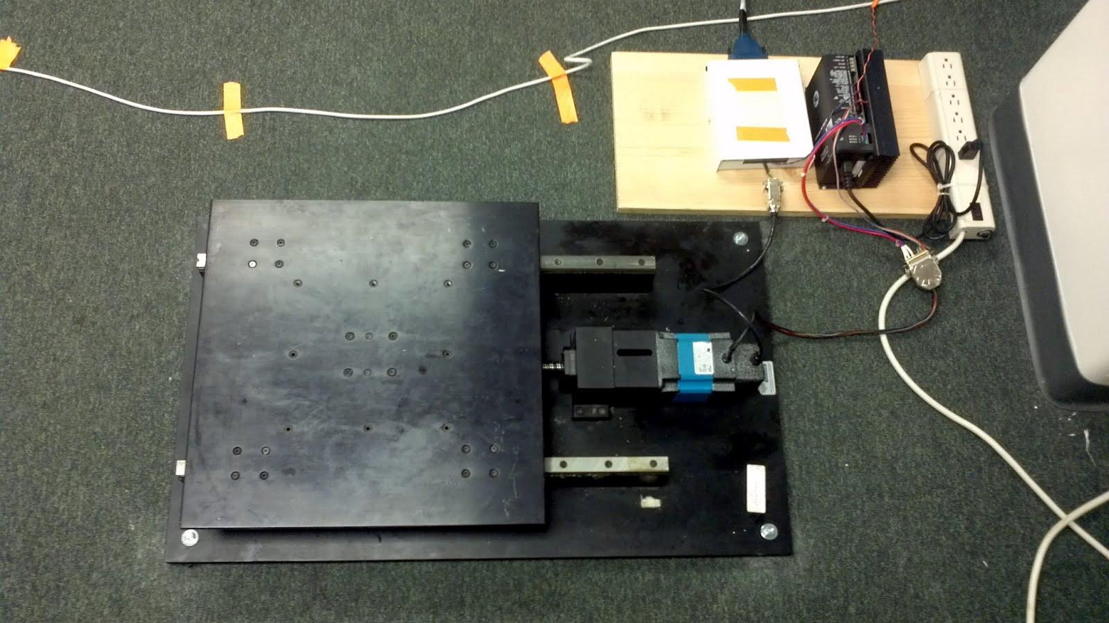
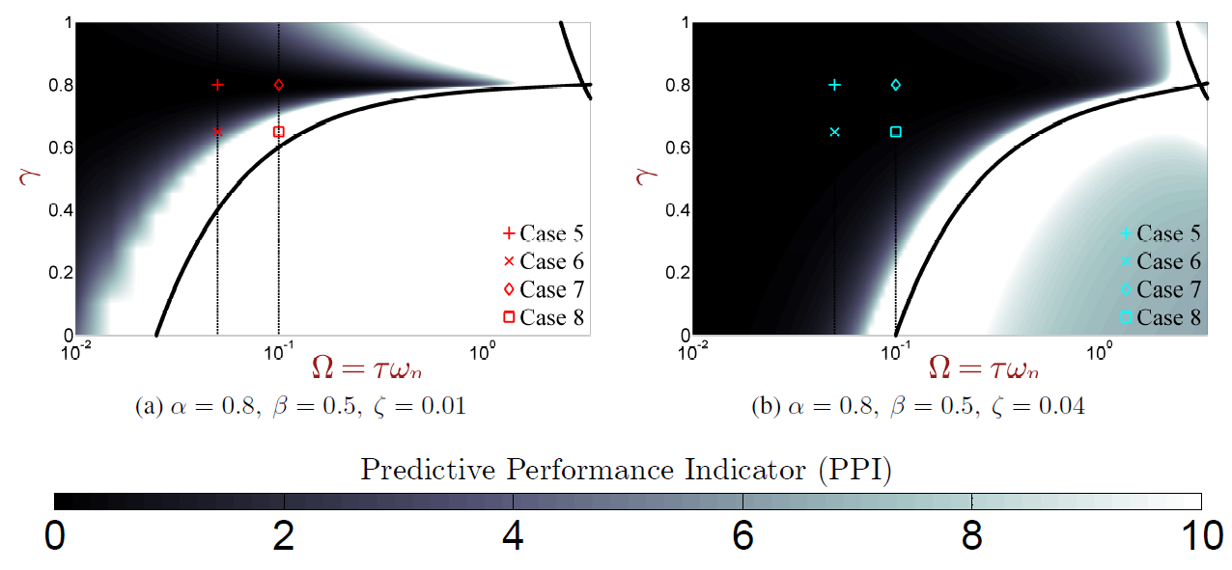
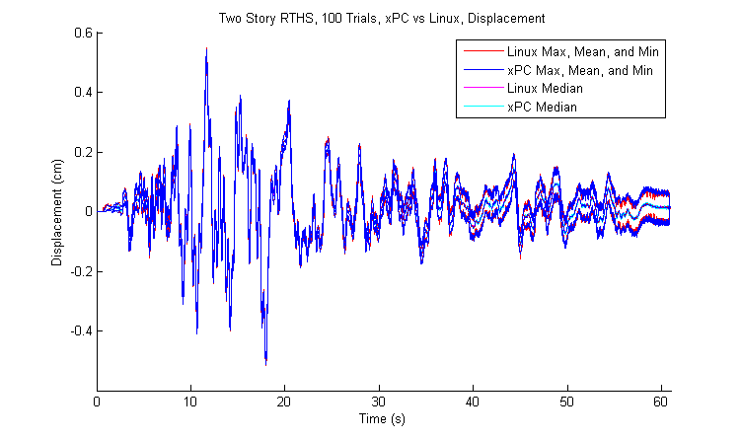
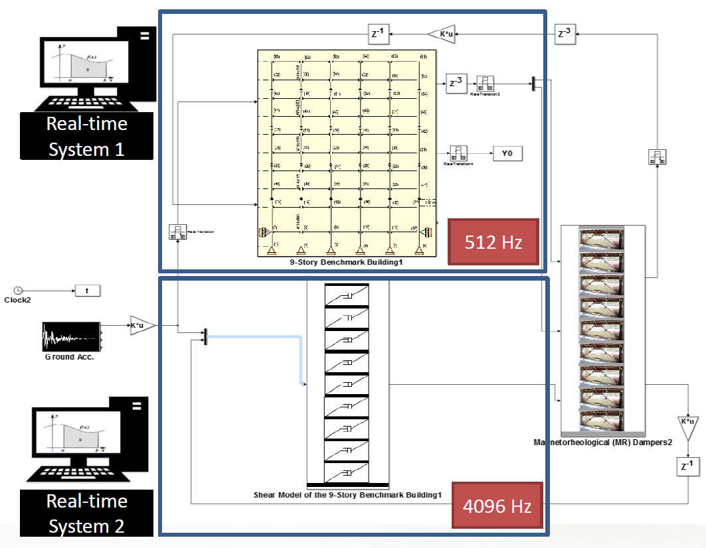
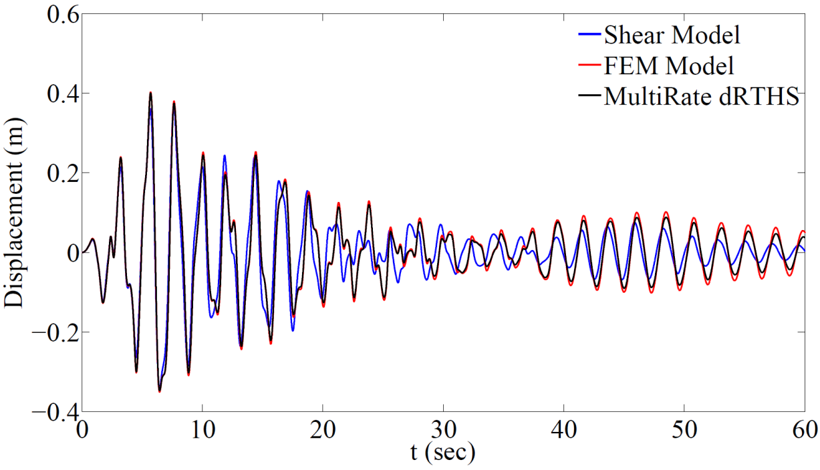
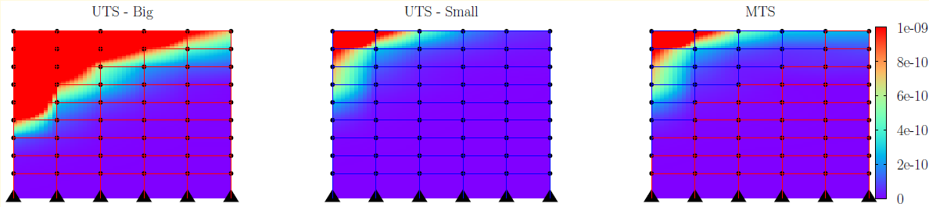
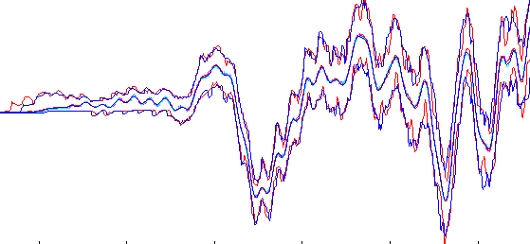
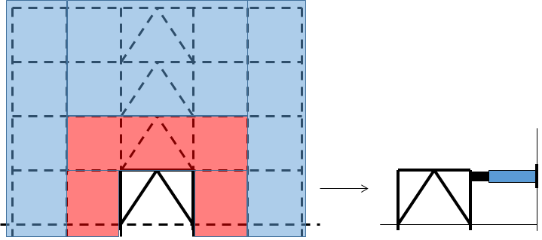
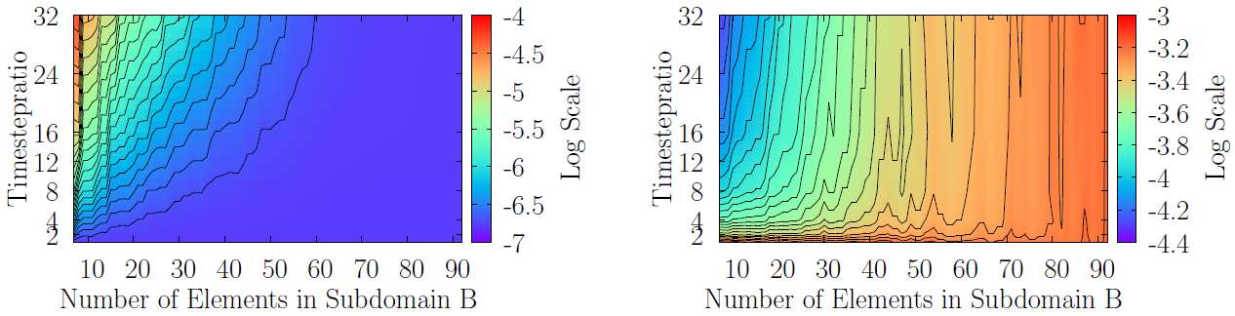



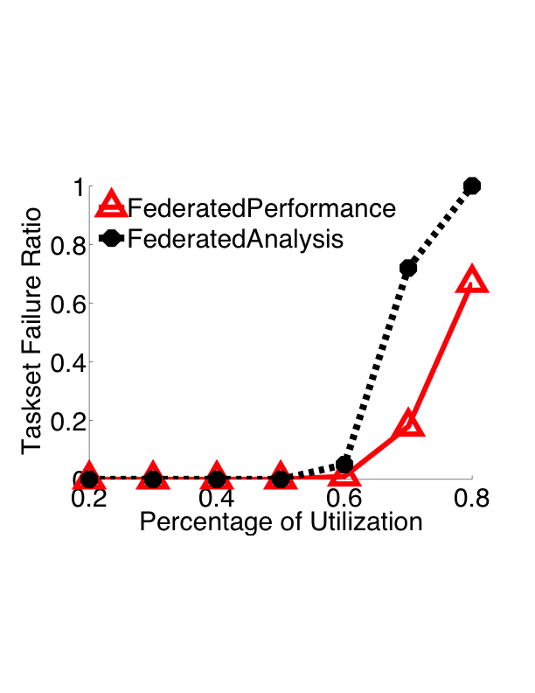
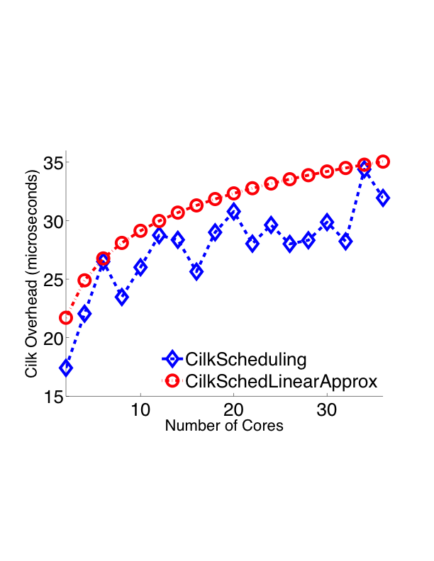
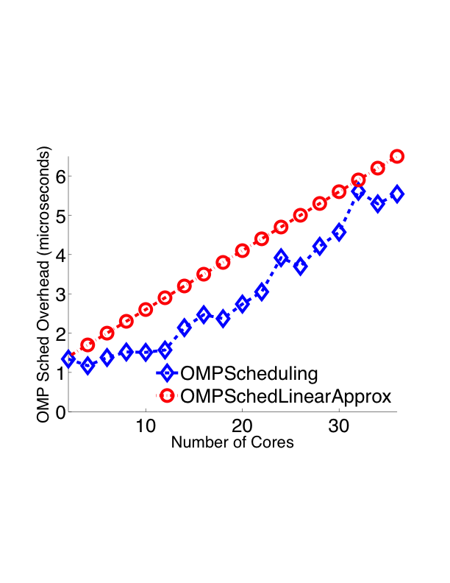
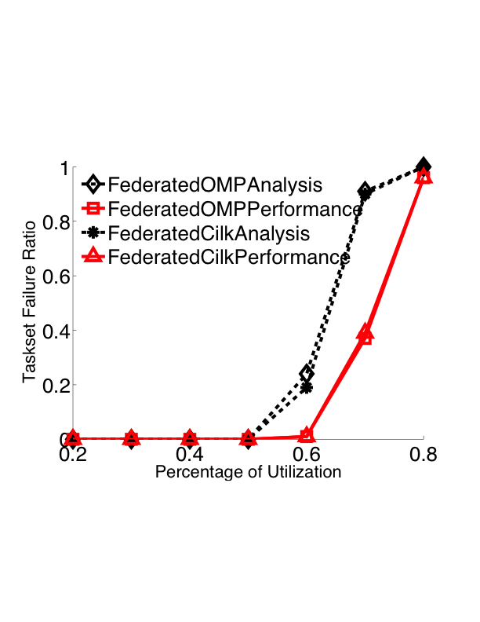
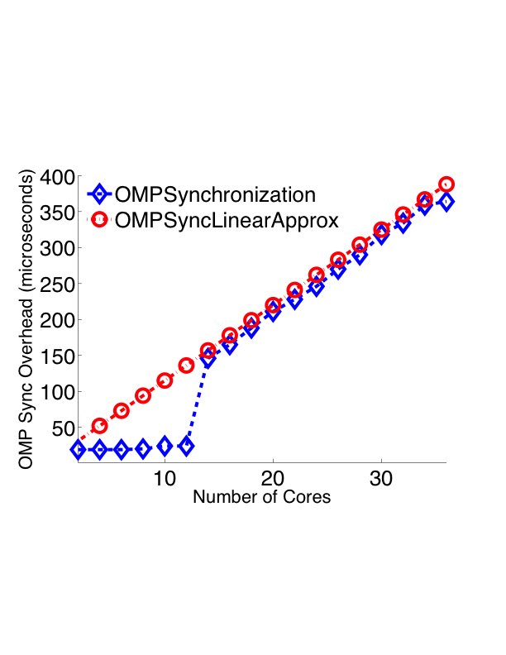
CPS Medium: Collaborative Research: CyberMech, a Novel Run-Time Substrate for Cyber-Mechanical Systems
Christopher Gill, Kunal Agrawal, Chenyang Lu,
{cdgill, kunal, lu}@wustl.edu
Washington University in St. Louis (Grant #: 1136073)
Arun Prakash, Shirley Dyke
{aprakas, sdyke}@purdue.edu
Purdue University (Grant #: 1136075)
Project Dates: September 2011 – August 2015
Introduction
Hybrid Testing: Physical components & numerical model
Real-Time Hybrid Simulation of structural components
Challenges
Complex interaction b/w sensors, actuators, controllers & models etc.
Configurable, adaptive concurrency platform for parallel execution
Real-times constraints: Multiple time-scale dynamics
Asynchronous, on-the-fly adjustments to data flow and control flow
Co-design of physical components, control algorithms, numerical models and the computational platform they run on
Target Application Domains
RTHS with multi-scale models
Tele-operation and interactive
control of cyber-mechanical systems
Cyber-Physical Control Algorithms & Numerical models
RTHS Control & Compensation, Errors Analysis
Stability & Performance Indicators
Multi-rate RTHS
A Concurrency Platform for Cyber-Mechanical Systems
Cyber-Physical Real-Time Parallel Task Model
Platform Scheduling Policies
Concurrency Platform Architecture (Compatible with OpenMP and Cilk Plus)
Empirical Evaluation
Developmental and Validation Studies, Concurrency Platform & Shake Table Integration
RTHS on CyberMech platform
Control of Irregular Structures – Improved Algorithms using Hybrid Testing
a b c d
e g
Adaptive Multi-scale Models
Errors Computational Cost

