Slide 1
CPS Network Simulation with Variable Fidelity
Ruida Zeng
(ruida.zeng@vanderbilt.edu)
Advisor: Dr. Himanshu Neema
Vanderbilt University
Notes:
Communication network system in the context of cyber-physical systems - where communication network simulation is one of the most important simulators. When we use network simulation in core with other simulators, we may want to vary the fidelity of variable network simulation to achieve fast simulation.
Cyber-Physical systems are engineering systems where the functionality emerges from networked interactions among the physical and computational components. Thus for simulation based evaluation of CPS, communication network simulation is a central piece that must almost always be integrated with rest of the heterogeneous simulations. In such large-scale CPS simulation based studies, the actual mechanism by which certain network effects such as cyber-attacks, or packet delays and drops, becomes less important as compared to the overall impact of such effects.

Slide 2
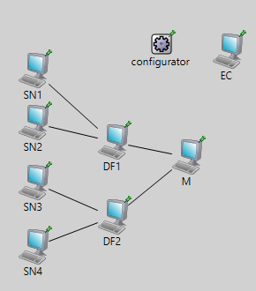
Application
Transport
Network
Link
Physical
Application
Transport
Network
Link
Physical
Notes:
For that to be simulated along with large CPS simulations, it becomes highly expensive to simulate communication networks at packet levels through all the OSI layers. At the same time, for certain effects to be simulated that is exactly is necessary. In order to balance the increased efficiency of higher-level network simulation with high-fidelity of packet-level simulation, we create an architecture that allows the simulators to dynamically vary the fidelity level of the network simulation during run-time.
General OSI layers, all the layers are simulated in general - depending on required accuracy at different times in the simulation, we may only need to simulate up to a certain fidelity level. For example, … UDP delay attack -> application layer & full integrated attack/replay attack -> need network layer
Simple sensor network for our experiments. Sensors located in different geographical locations. A bunch of sensors interact with a data fusion node, and all the data fusion nodes interact with the central master node.
More deeper the layers are simulated, the most accurate is the simulation, but it takes more computation time and power.
At runtime...

Slide 3
Implementation Challenges
Whenever scheduled “switch” signal arrives, receiver’s sockets are closed immediately to transition to direct messages delivery
Packets that are currently on the wire, or still in transition, have nowhere to go, which will result in a compilation error for OMNeT++
No packet consistency
Direct messages cannot handle multicast and broadcast messages
Wireless network protocol will require a new interface
Notes:
Challenges in general about CPS network simulation with variable fidelity.

Slide 4
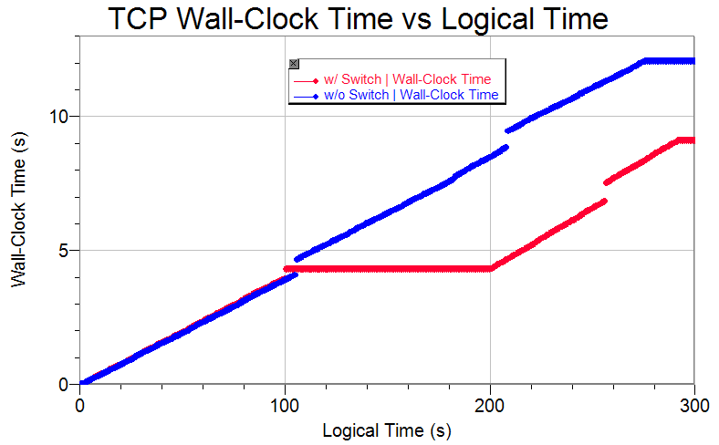
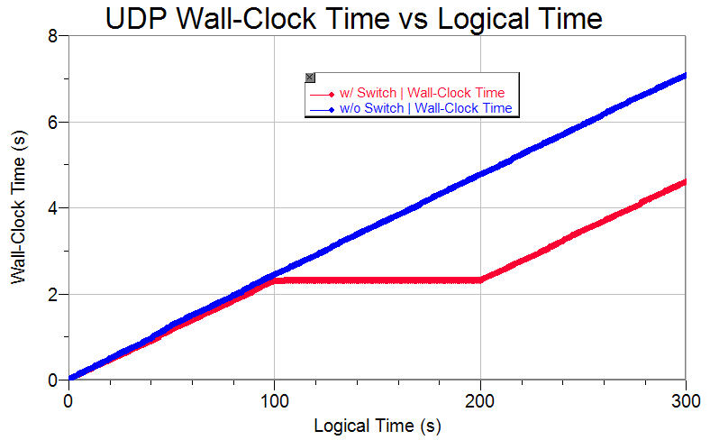
Approach 1: The Simplest Approach
Drop all packets currently on the wire
Results in an inconsistent simulation before and after the switch

Slide 5
Approach 2: Achieve packet consistency by introducing switching time delay
A slightly delayed route switch to allow the packets still in the queue to pass through along the normal TCP/UDP connection.
Reschedules the route switch until all the packets that are currently on the wire are either received, or dropped in the case of UDP.
Albeit the delayed time is minimal, there is still a “indeterminate factor” as a result of such delay

Slide 6
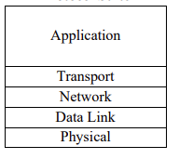
Approach 3: Achieve packet consistency by retransmitting the packets on the wire
Stores each packet at corresponding layers before it is sent
Retransmission of data packets as direct messages after route switch
Add dynamically computed “network delay” for each direct messages to ensure simulation time consistency
Routes: source & destination
Packet Size
Layers
Protocols
Traffic Congestion
TCP | Approach 2 | Approach 3
Logical Time | 300 s | 300 s
Wall Clock Time | 11.49 s | 11.23 s

