Slide 1
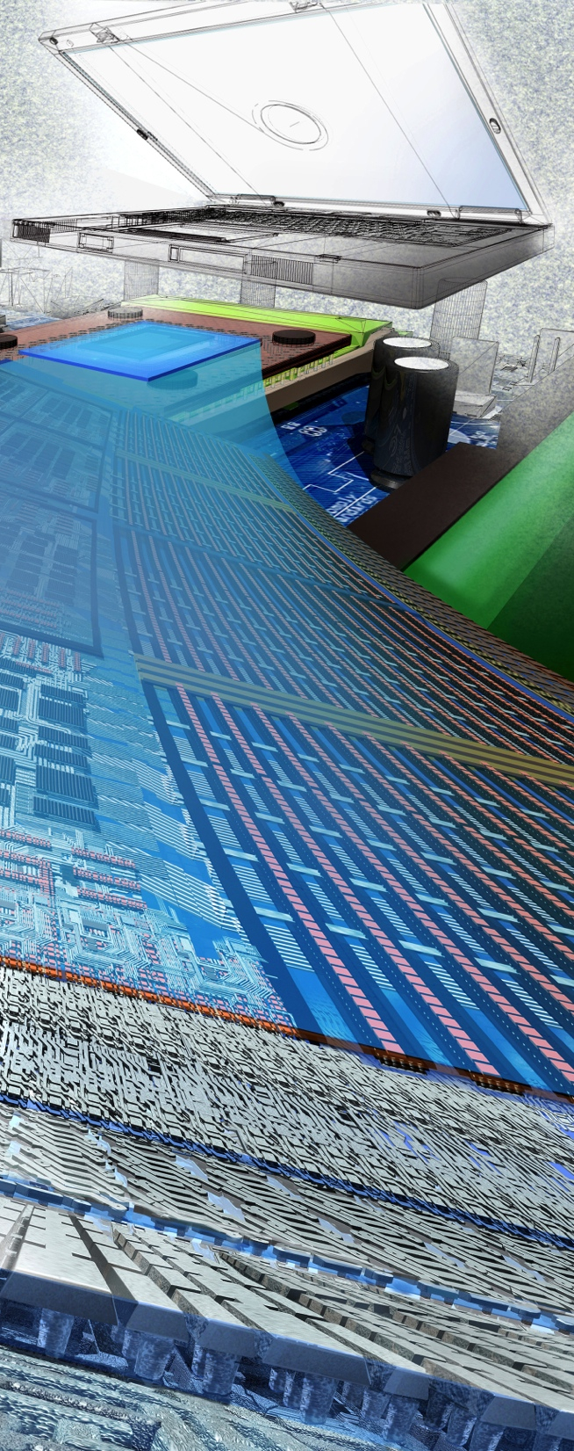


2012 CPS PI Meeting
Farnam Jahanian
CISE Directorate
National Science Foundation
Oct 3, 2012
Image Credit: Exploratorium.

Slide 2

How can we design, build and verify reliable, predictable, safe and secure cyber-physical systems upon which people can - and will - bet their lives?
Image Credit: CCC and SIGACT CATCS
Notes:
As automation and information technology pervades new platforms, cyber physical systems have become ubiquitous in our everyday lives and grow increasingly complex every year. They fly our planes, control our nuclear power plants, run our medical devices, and so much more.
How can we build and verify systems upon which people can - and will – bet their lives?

Slide 3
CPS and National Priorities
Broadband & Universal Connectivity
Secure Cyberspace
Health & Wellbeing
Transportation & Energy
Education and Workforce Development
Environment & Sustainability
Manufacturing, Robotics, & Smart Systems
Emergency Response & Disaster Resiliency
Image Credit: MicroStrain, Inc.
Image Credit: Nicolle Rager Fuller, NSF
Image Credits: Texas A&M University
Image Credit: Cisco, Inc.
Image Credit: Nicolle Rager Fuller, NSF
Image Credit: ThinkStock
Image Credit: Georgia Computes! Georgia Tech
Notes:
Advances in CPS are closely intertwined with and will have a pervasive impact on many of our national priorities
Including smart systems for manufacturing and robotics,
environment and sustainability, emergency response
and on to healthcare,
and transportation and energy networks and infrastructure

Slide 4
CPS and National Priorities
Broadband & Universal Connectivity
Secure Cyberspace
Health & Wellbeing
Transportation & Energy
Education and Workforce Development
Environment & Sustainability
Manufacturing, Robotics, & Smart Systems
Emergency Response & Disaster Resiliency
Image Credit: MicroStrain, Inc.
Image Credit: Nicolle Rager Fuller, NSF
Image Credits: Texas A&M University
Image Credit: Cisco, Inc.
Image Credit: Nicolle Rager Fuller, NSF
Image Credit: ThinkStock
Image Credit: Georgia Computes! Georgia Tech
Notes:
Advances in CPS are closely intertwined with and will have a pervasive impact on many of our national priorities
Including smart systems for manufacturing and robotics,
environment and sustainability, emergency response
and on to healthcare,
and transportation and energy networks and infrastructure
You can imagine a day when…
static infrastructure is adaptable and safe
Static infrastructures, such as buildings and bridges, are transformed into smart spaces that adapt to consumption, growth, and/or changing environmental needs or can continuously monitor and identify risk, moderate the impact of failures, and avoid disasters through the use of networked instrumentation and software control.
Imagine a day where…
we can forecast and mitigate ecological change
By developing rich ecological and environmental monitoring systems, we can create accurate models that support forecasting and management of increasingly stressed resources.
Imagine a day where…
we can prevent, mitigate, and recover from disasters
During the time of a natural disaster or a national emergency, unmanned search, rescue, and recovery is a reality through the use of autonomous, highly coordinated, and remotely operated robots in shared physical spaces – the promise of distributed, low-power sensing combined with communications and control.

Slide 5
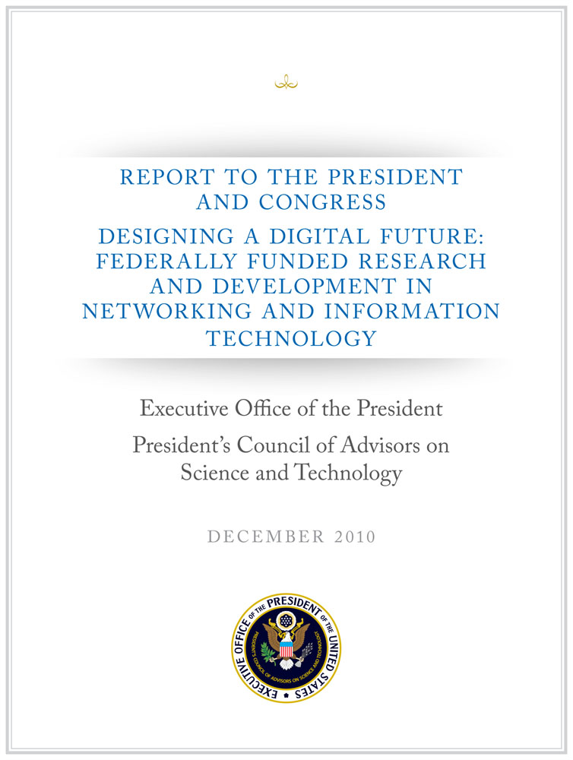
A National Imperative
2007 PCAST NITRD Report –Recommended cross-disciplinary programs to accelerate work in CPS by Federal R&D agencies
2010 PCAST NITRD Report – Expanded this recommendation to energy, transportation, health care, and homeland security
2011 PCAST Advanced Manufacturing Report – Recommended investments to strength US leadership in the areas of robotics, cyber-physical systems, and flexible manufacturing
Notes:
The need for investment in CPS as a national imperative is echoed in 3 recent reports by the President’s Council of Advisors on Science & Technology (PCAST).
--------
A PCAST 2007 report recommended that Federal R&D agencies strengthen existing programs or create new, cross-disciplinary ones programs to accelerate work in this area. The 2010 PCAST Networking and Information Technology (NIT) R&D report expanded on this recommendation, particularly as it applied to energy, transportation, health care, and homeland security. A PCAST 2011 report on Advanced Manufacturing has called for focused investments in advanced manufacturing to “strengthen U.S. leadership in the areas of robotics, cyber-physical systems, and flexible manufacturing” as a means to promote sustainable economic growth and job creation. These recommendations, consistent with President’s Innovation Strategy (2011), all arise from the accelerated demand and the increasing technical challenges they bring for new capabilities and services all deemed to be intelligent or “smart,” including transportation systems, medical technologies, buildings, and manufacturing.

Slide 6
As the trend towards increasingly cyber-enabled systems grows, so does the need to secure those systems.
Notes:
As the trend towards increasingly cyber-enabled systems grows, so does the need to secure those systems.

Slide 7
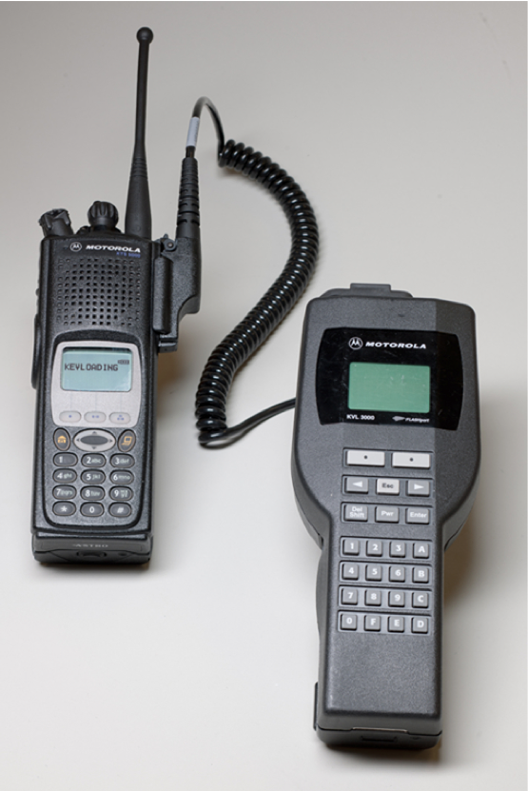
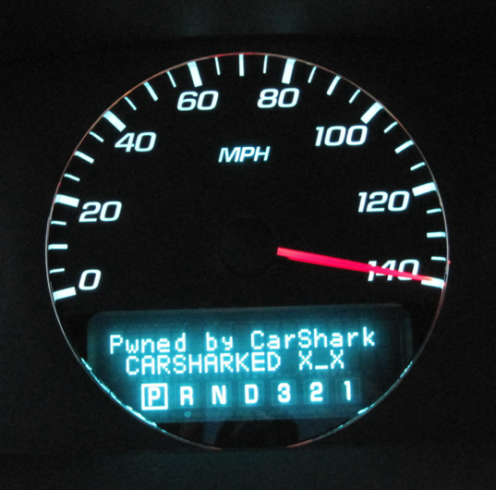
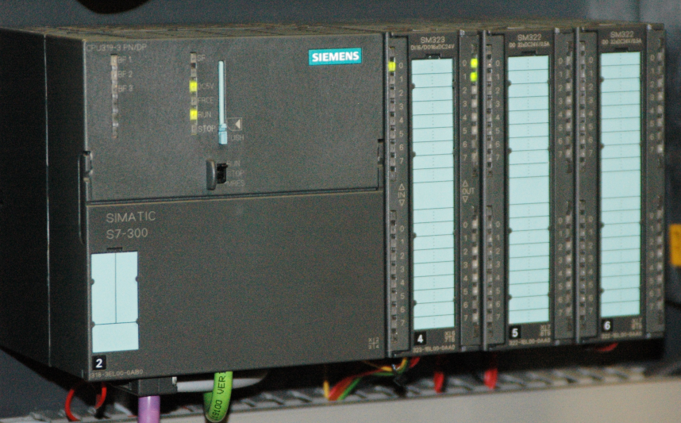
Cyber-Physical Security Risks
Embedded Medical Devices
Law Enforcement Communications
Credit: Halperin et al., IEEE Sym. Security & Privacy
Credit: Matt Blaze
Control Systems
Automobiles
Credit: Karl Koshner
Notes:
Each sector that becomes cyber-enabled becomes vulnerable to attacks.
Healthcare, education, and finance are already at risk, and physical infrastructure –manufacturing, energy production, and transportation – will be next.
This trend toward increasingly cyber-physical systems, the integration of computation, communication, and control into physical systems, will continue to offer new challenges.
For example, in healthcare, embedded wireless medical devices such as pacemakers are vulnerable to cyber attacks. Researchers have shown that by gaining wireless access to a combination heart defibrillator and pacemaker, they were able to reprogram it to shut down and to deliver jolts of electricity that could potentially have been fatal if the device had been in a person.
For example, in transportation, researchers have shown that by connecting to a standard diagnostic computer port included in late-model cars, they were able to do some unusual things, such as turning off the brakes, changing the speedometer reading, blasting hot air or music on the radio, and locking passengers in the car.
Consider, for example, the recent STUXNET worm. Discovered in July 2010, this worm targeted SCADA systems that were configured to monitor and control a kind of centrifuge used in Iranian nuclear fuel processing facilities.

Slide 8
Cyber-Physical Systems Program
Deeply integrating computation, communication, and control into physical systems
Launched in 2009
Aims to develop the core system science needed to engineer complex “smart” cyber-physical systems
Serves key national priorities
Coordinated across NSF and with other government agencies
Transportation
Energy
Critical Infrastructure
Healthcare and Biomedical
Manufacturing and Industrial Automation
200+ total awards since 2009:
$140M+ total investment
350+ PIs and Co-PIs
35 states
FY 12 commitment:
45 new awards (29 projects)
$30M+ investment
Cross-Directorate Effort: CISE and ENG
Notes:
Cyber-physical systems aim to … Deeply integrate computation, communication, and control into physical systems
These are smart systems that have cyber technologies, both hardware and software, that are
deeply embedded in and interacting with physical components,
sensing AND changing the state of the real world
New smart cyber-physical systems will drive innovation and competition in sectors such as the power grid, transportation, buildings, medical technologies, and industrial automation advanced manufacturing.
Advances in CPS hold the potential to reshape our world with more responsive, precise, and efficient systems
Launched in 2009
Coordinated across NSF and with other government agencies

Slide 9
Three CPS Research Themes
Science of Cyber-Physical Systems:
New models and theories that unify perspectives, capable of expressing the interacting dynamics of the computational and physical components of a system in a dynamic environment. A unified science would support composition, bridge the computational versus physical notions of time and space, cope with uncertainty, and enable cyber-physical systems to interoperate and evolve.
Technology for Cyber-Physical Systems:
New design, analysis, and verification tools are needed that embody the scientific principles of CPS, and that incorporate measurement, dynamics, and control. New building blocks are also needed, including hardware computing platforms, operating systems, and middleware.
Engineering of Cyber-Physical Systems:
New opportunity to rethink principles of systems engineering, built on the foundation of CPS science and technology and able to support open cyber-physical systems. Focus on system architecture, design, integration, and design space exploration that produce certifiably dependable systems.
Notes:
Realizing the potential of CPS requires an ambitious research agenda addressing:
Three themes:
Science of Cyber-Physical Systems: The classical models of computation and physics are separately inadequate to capture the semantics of CPS. CPS require new models and theories that unify perspectives, capable of expressing the interacting dynamics of the computational and physical components of a system in a dynamic environment. A unified science would support composition, bridge the computational versus physical notions of time and space, cope with uncertainty, and enable cyber-physical systems to interoperate and evolve.
Technology for Cyber-Physical Systems: New design, analysis, and verification tools are needed that embody the scientific principles of CPS, and that incorporate measurement, dynamics, and control. The tools should offer important perspectives into behaviors and interactions. New building blocks are also needed, including hardware computing platforms, operating systems, and middleware. The chain of tools and building blocks must integrate to support end-to-end assurances, and cover the full lifecycle of systems. Particular attention should be given to interfaces, interface management, extensibility, interoperability, and the controlled visibility of explicit and implicit assumptions. A particular goal is to enable evidence-based certification, and maintain certification as a system evolves.
Engineering of Cyber-Physical Systems: CPS opens a new opportunity to rethink principles of systems engineering, built on the foundation of CPS science and technology and able to support open cyber-physical systems. Attention should be given to system architecture, design, integration, and design space exploration that produce certifiably dependable systems. New engineering principles are needed to systematize design for the growing numbers of CPS that entail adaptation and autonomy. All advances should be assessed and validated for relevance, usability, and effectiveness by appropriate benchmarks. The engineering processes must support certification and maintenance of certification over the system lifecycle.

Slide 10
CPS Support across NSF
Cyber-Physical Systems
Smart Health & Wellbeing
Science, Engineering & Education for Sustainability (SEES)
National Robotics Initiative (NRI)
Secure and Trustworthy Computing (SaTC)
CISE and ENG Core Programs
Cyber-Physical Systems (CPS)
Expeditions
Notes:
The CPS program is only but one of many opportunities that address CPS and available to this community.
And this community will be able to seize other emphasis areas for the foundation that will soon be announced, e.g., one in the area of natural disasters/hazards.

Slide 11
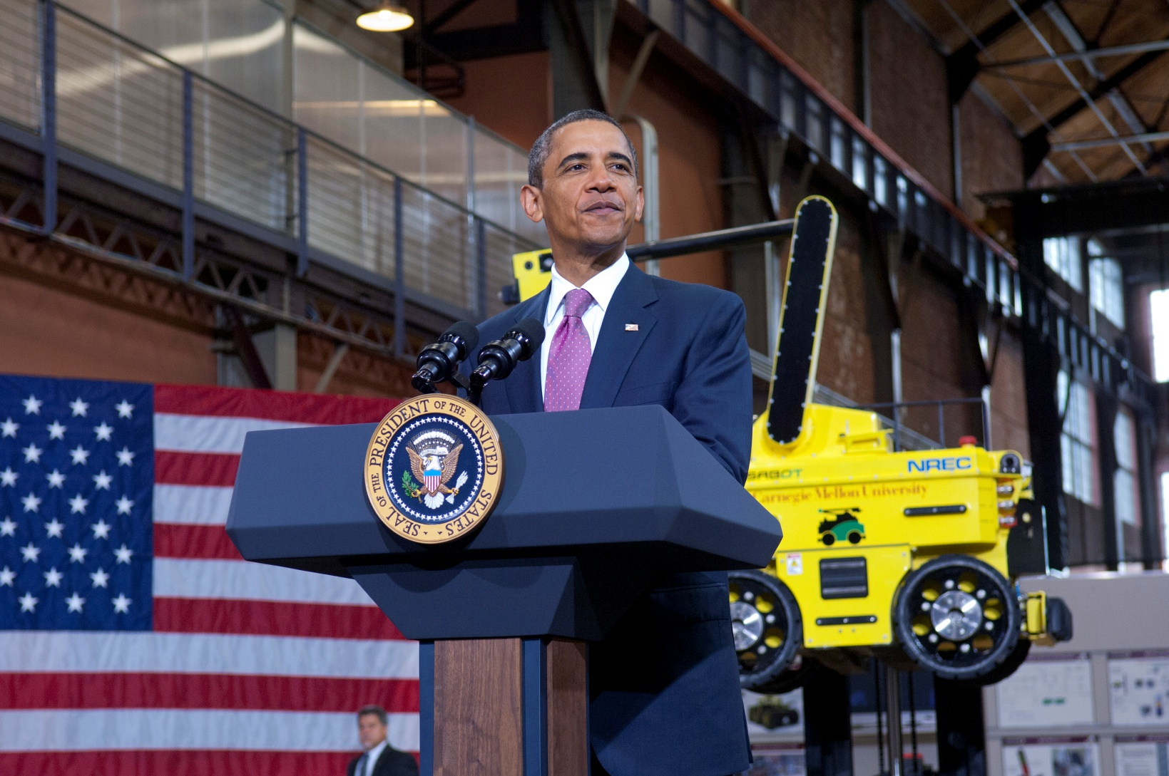




The National Robotics Initiative (NRI)
A nationally coordinated program across multiple government agencies to develop the next generation of robotics, to advance the capability and usability of such systems and artifacts, and to encourage existing and new communities to focus on innovative application areas.
Notes:
National Robotics Initiative
Develop the next generation of collaborative robots, or co-robots, that work beside and cooperatively with people
A nationally concerted cross-agency program to provide U.S. leadership in science and engineering research
Fundamental research in robotics science & engineering
Understanding the long term social, behavioral, and economic implications across all areas of human activity
Use of robotics to facilitate and motivate STEM learning across the K-16 continuum
Will enhance personal safety, health, and productivity
Cornerstone of this initiative is a joint solicitation among the four agencies represented on this slide.
President Obama Announced the Launch of NRI in June 2011
108 Researchers and 65 Institutions in 22 states funded

Slide 12
“If you build it, they will come”
Solicitation Released June 24, 2011
1st Round of Proposals due Dec 15
Over 700 proposals submitted
Over $1B in funding requested
Notes:
Note: Slide change
Dec 15 deadline - 460 “small” ($150,000-$400,000) per year for 1-4 years; independent and collaborative proposals
Jan 18 deadline - 240 “large” ($400,000-$1,500,000) per year for 1-5 years

Slide 13
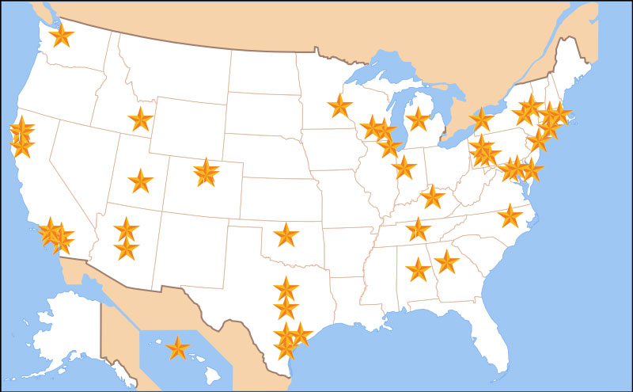
$50M NRI Investment Supports 108 Researchers, 65 Institutions and 22 State
Notes:
The NRI solicitation posted on June 24, 2011
1st round of proposals due Dec 15
Over 700 proposals requesting over $1B were submitted.
Pleased to let you know that more than institutions from 20 states will directly benefit from this program
My colleagues from other agencies are going to talk about some of the innovative research activities that are being funding through the NRI solicitation.

Slide 14

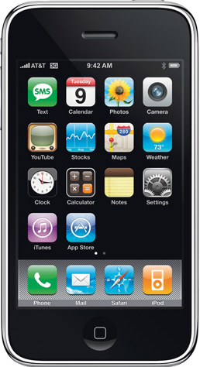
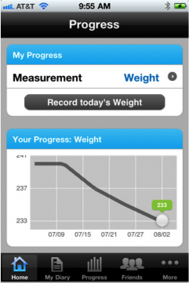

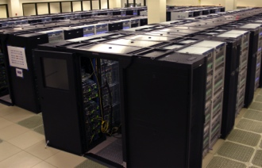
Smart Health
Transforming healthcare from reactive and hospital-centered to preventive, proactive, evidence-based, person-centered and focused on wellbeing rather than disease
Training
Coaching
GPS
EEG
Chronic Care
Decision Support
Population Statistics
Epidemiology
Evidence
Pulmonary Function
SpO₂
Social Networks
Health Information
Posture
ECG
Gait
Blood Pressure
Inference
Datamining
Balance
Step Height
Performance
Step Size
Prediction
Early Detection
Cross-Directorate Program: CISE, ENG, and SBE
Notes:
Information and communications technologies are poised to transform our access to and participation in our own health and well-being.
From Episodic, Reactive Focus on Disease
To Proactive and Preventive, evidence-based, focus on Wellbeing, Quality of Life
preventing the onset of diseases, improving diagnoses and treatments, enhancing the quality of health care delivery,
and empowering us to participate in our own health and well-being
Cross-Directorate Program: CISE, ENG, SBE

Slide 15
Smart Health
Transforming healthcare knowledge, delivery, and
quality of life through IT
Training
Coaching
GPS
EEG
Chronic Care
Decision Support
Population Statistics
Epidemiology
Evidence
Pulmonary Function
SpO₂
Social Networks
Health Information
Posture
ECG
Gait
Blood Pressure
Inference
Datamining
Balance
Step Height
Performance
Step Size
Prediction
Early Detection
Cross-Directorate Program: CISE, ENG, and SBE
Notes:
Information and communications technologies are poised to transform our access to and participation in our own health and well-being.
preventing the onset of diseases, improving diagnoses and treatments, enhancing the quality of health care delivery,
and empowering us to participate in our own health and well-being
From Episodic, Reactive Focus on Disease
To Proactive and Preventive, evidence-based, focus on Wellbeing, Quality of Life

Slide 16
Smart Health
Transforming healthcare knowledge, delivery, and
quality of life through IT
Paradigm Shift: transforming healthcare from reactive and hospital-centered to preventive, proactive, evidence-based, person-centered and focused on wellbeing rather than disease.
Digital Health Information Infrastructure
Informatics and Infrastructure
Data to Knowledge to Decision
Reasoning under uncertainty
Empowered Individuals
Energized, enabled, educated
Sensors, Devices, and Robotics
Sensor-based actuation
Research Thrusts
Cross-Directorate Program: CISE, ENG, and SBE
Notes:
Information and communication technologies are poised to transform healthcare … preventing the onset of diseases, improving diagnoses and treatments, enhancing the quality of health care delivery, and empowering us to participate in our own health and well-being
Cross-Directorate Program: CISE, ENG, SBE

Slide 17
Thriving CPS Community
Including, increased federal collaboration and attention
Cybersecurity for Cyber-Physical Systems, hosted by NIST in April 2012
CTO Roundtable on Cyber-Physical Systems: Building Safety, Security, Reliability, and Robustness into the Smart Systems of the Future, hosted by NIST in June 2012
New Senior Steering Group (SSG) for Cyber-Physical Systems under the Networking and Information Technology Research and Development (NITRD) Program announced September 2012
ARPA-E, DARPA and NSA have joined the CPS Virtual Organization and contribute to the technology repository
NSF, NIH and FDA working towards technology sharing for medical CPS
MOU between NSF and DOT
…
Notes:
Indeed, the CPS community is growing and thriving.
There has been outstanding progress in increasing federal collaboration for this area. NIST sponsored two events, which I had the pleasure to participate….
The formation of a new senior steering group, or SSG, for CPS under the NITRD program, was just announced earlier this month.
MOU with DOT
And, ARPA-E and DARPA increased engagement with VO…

Slide 18
CPS Virtual Organization (VO)
Objectives:
Community building
Technical support for collaboration
Technology transfer and translational research
International collaboration
Principles & Services:
Community controlled
Information dissemination to and by the research community
Services for collaborative activities Support for SIGs
Industry academy interactions
Built on open source framework
Home for the community’s historical reference materials
Advertising of new events (e.g., calendar of upcoming events)
Discussion forums and instant messaging
Community members list and matchmaking
http://cps-vo.org
1450+ users
increasing interest by other federal agencies to provide open source results and to increase interactions among research communities
Notes:
And, of course, realizing the promise of CPS requires the collective intellect and efforts across this community. The VO has provided a framework to build on your shared interest, expertise, and partnerships, engaging nearly 1000 users for closer collaborations, relationships, and knowledge sharing.
---------
TOTAL: 1458 users
SoS: 61
AVM: 121
CPS: 1300+ (as of 10/1)
Already being used for:
Information dissemination to and by the research community
Advertising of new events (e.g., CPS Week HiCoNS)
Management of annual NSF CPS PI meeting
Certification SIG is active
Program management for SOS (“lablets”)
Archiving results from DARPA META, iFAB,
and Adaptive Vehicle Make (AVM) programs
In discussion with other agencies wanting to
provide advanced research results for use in
CPS Open Source and other technical communities of interest
arrange programmatic interaction with NSF-funded researchers
share lab resources, etc.
open experimental platform
Potential for higher visibility of research results, evaluation, transition to practice
Brad Martin confirms that mentioning that the Science of Security Virtual Organization is hosted in the CPS VO is just fine.

Slide 19

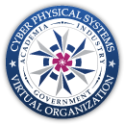
CPS Virtual Organization
Community Building
promoting collaboration and close interaction between academia, industry & government
facilitating interactions across technical disciplines & across applications areas
cross-fertilization of research in CPS core sciences and applied research in domain- and mission-oriented problems in a multi-agency setting
Collaboration Support via Portal
information flow and awareness of CPS activities
collaboration and professional networking
knowledge repository to facilitate the open exchange of challenge problems, research results, tools, and educational materials
http://cps-vo.org
~1450+ users increasing interest by other federal agencies to provide open source results and to increase interactions among research communities
* Supporting CPS/NITRD community activities
Notes:
And, of course, realizing the promise of CPS requires the collective intellect and efforts across this community. The VO has provided a framework to build on your shared interest, expertise, and partnerships, engaging nearly 1000 users for closer collaborations, relationships, and knowledge sharing.

Slide 20
Enabling Smart Systems for the Future
Many of tomorrow’s breakthroughs will occur at the intersections of diverse disciplines.
We need to invest in a research pipeline comprising of long-term foundational research for cyber-physical systems, experimental prototypes, and early deployments to spur innovative applications.
The CPS R&D community will continue to have a transformative and durable impact on our national priorities.
NSF is committed to foster this emerging, consolidating research community and to reinforce its sustained role in advancing frontiers of science and engineering innovation.
A vibrant discovery and innovation ecosystem is critical to success.

Slide 21
We need your help!
Nurture and Support a Culture of Engagement and Service
Embrace a Collaborative Culture Enabled by Foundational Research
Educate and Empower the Next Generation
Help shape the future directions of the field, priorities for the nation, and formulate a research and education agenda to address societal challenges.
Advances in CPS are pushed by long-term investment in foundational research and cross- and inter-disciplinary research and pulled by expanding complexity, scope, and scale of global priorities.
Lead a cyber- and technology-enabled transformation in education and learning to develop the next generation IT workforce and contribute to universal, transparent, and affordable participation in a knowledge-based society.
Notes:
(1) As a community, we need to nurture and support a culture of engagement and service.
As a community, we have the opportunity to…
to shape the future directions of the field and priorities for the nation
to formulate research and education agenda to address societal challenges
Community engagement can happen at many level at many levels
And as leaders of our community … encourage and reward national service
(2) Long-term investment in foundational research is imperative
Interactions of research ideas multiply their impact and seed new ideas with the potential to lead to unanticipated advances.
There is often a long, unpredictable incubation period – requiring sustained investment – between initial exploration and impact.
Unanticipated outcomes are often as important as the anticipated ones.
Advanced cyberinfrastructure will accelerate the pace of discovery and innovation in all areas of inquiry and enables a platform on which cross- and inter-disciplinary research thrives.
Cross- and inter-disciplinary research is pushed by advances in IT and pulled by the expanding complexity, scope, and scale of global priorities.
Tremendous opportunity exists for the CISE community to work with other disciplines in true collaborations and to address challenges facing humanity.
(3) Computing and communications discipline forms a pervasive intellectual fabric that connects all other disciplines:
Develop the next generation of the computing, communication, and information technology workforce.
Empower citizens by promoting understanding of the principles and uses of computation- and data-intensive techniques.
Lead a cyber- and technology-enabled transformation in education and learning.
Contribute to universal, transparent, and affordable participation in a knowledge-based society.

Slide 22
1. Nurture and Support a Culture of Engagement and Service
Why Serve?
Opportunity to shape the future directions of the field and priorities for the nation
Formulate research and education agenda to address societal challenges
How?
Community engagement at many levels
University and industry leadership: encourage and reward national service
Notes:
As a community, we need to nurture and support a culture of engagement and service.
As a community, we have the opportunity to…
to shape the future directions of the field and priorities for the nation
to formulate research and education agenda to address societal challenges
Community engagement can happen at many level at many levels
And as leaders of our community … encourage and reward national service

Slide 23
Many Opportunities for Community Engagement
Come to NSF
Proposal merit review
Program review - Committee of Visitors
CISE Advisory Committee (Subcommittees and Working Groups)
Community Visioning Activities
CCC, CRA, CSTB and ACM Interactions
Studies with the National Academies
Program Webinars
CAREER Proposal Writing Workshops
CS Bits & Bytes
CI Fellows Program
PI Meetings & Conferences
Broadening Participation in Computing Alliances (CRA-W, NCWIT, etc.)
Public outreach

Slide 24
Recent Rotators from across the US
Carnegie Mellon University
Case Western Reserve University
Catholic University of America
Cornell University
Duke University
Florida Institute of Technology
Florida State University
George Mason University
Georgetown University
Georgia Institute of Technology
Iowa State University
Oak Ridge National Laboratory
Old Dominion University
Oregon Health and Science University
Penn State University
Purdue University
Rensselaer Polytechnic Institute
Rutgers University
SRI International
University of Arizona
UC Davis
UCLA
UC San Diego
University of Chicago
University of Denver
University of Kansas
University of Maryland
University of Massachusetts
University of Michigan
University of Minnesota
University of Oklahoma
University of Pennsylvania
University of Southern California
University of Texas at Arlington
University of Texas at Austin
University of Toledo
University of Utah
University of Vermont
Virginia Tech

Slide 25
2. Embrace a Collaborative Culture Enabled by Foundational Research
Long-term investment in foundational research is imperative.
There is often a long, unpredictable incubation period – requiring sustained investment – between initial exploration and impact.
Interactions of research ideas multiply their impact and seed new ideas with the potential to lead to unanticipated advances.
Unanticipated outcomes are often as important as the anticipated ones.
Advanced cyberinfrastructure will accelerate the pace of discovery and innovation in all areas of inquiry.
Cross- and inter-disciplinary research is pushed by advances in IT and pulled by the expanding complexity, scope, and scale of global priorities.
Notes:
Long-term investment in foundational research is imperative
Interactions of research ideas multiply their impact and seed new ideas with the potential to lead to unanticipated advances.
There is often a long, unpredictable incubation period – requiring sustained investment – between initial exploration and impact.
Unanticipated outcomes are often as important as the anticipated ones.
A strong foundation enabled by core research drives advances in other areas and enables a platform on which cross- and inter-disciplinary research thrives.
Tremendous opportunity exists for the CISE community to work with other disciplines in true collaborations and to address challenges facing humanity.
There is overwhelming consensus worldwide that scientific discovery and technological innovation, driven by a creative and skilled science and engineering workforce, are the new engines of economic growth.

Slide 26
3. Educate and Empower the Next Generation
Develop the next generation of the computing, communication, and information technology workforce.
Empower citizens by promoting understanding of the principles and uses of computation- and data-intensive techniques.
Lead a cyber- and technology-enabled transformation in education and learning.
Contribute to universal, transparent, and affordable participation in a knowledge-based society.
Notes:
Computing and communications discipline forms a pervasive intellectual fabric that connects all other disciplines:
Develop the next generation of the computing and information technology workforce with skills essential to succeed in the increasingly competitive, global market.
Empower citizens by promoting understanding of the principles and uses of computation- and data-intensive techniques.
Lead a knowledge-based and technology-enabled transformation in education and learning.
Contribute to universal, transparent, and affordable participation in a knowledge-based society.

Slide 27

Thanks!
fjahania@nsf.gov

Slide 28
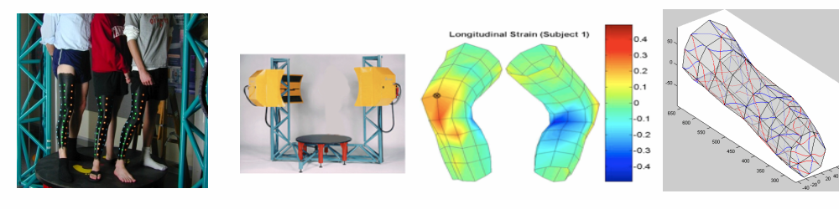
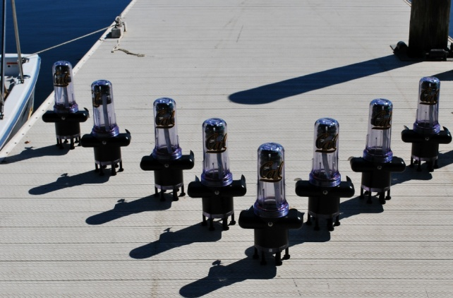
NSF CPS Awards Span Many Sectors
Assistive Medical Technologies: Programmable second skin senses and re-educates injured nervous systems. (Eugene Goldfield, Harvard Medical School)
Credit: Wyss Institute, Harvard University
Environmental Sensing: Modeling and software allow actuated sensing in dynamic environments, such as rivers. (Jonathan Sprinkle, U. Arizona; Sonia Martinez, UCSD; Alex Bayen, UC Berkeley)
Autonomous Vehicles: Development of precision and real-time sensors, smart algorithms, and verification tools enables self-driving cars. (Ragunathan “Raj” Rajkumar, CMU, et al.)
Credit: Jonathan Beard
http://www.nsf.gov/news/special_reports/science_nation/carswithoutdrivers.jsp
Notes:
Here are 3 examples from our portfolio …
Improving medical technologies
A self-reconfiguring “second skin orthotic sleeve” consisting of programmable materials. The orthotic sleeve, worn over one or more limbs of brain-injured individuals, may restore brain function by promoting enriched exploration of self-produced limb movements.
Environmental Sensing
Transformation from static sensing into mobile, actuated sensing in dynamic environments, with a focus on sensing in tidally forced rivers.
The approach is to develop inverse modeling techniques to sense the environment, coordination algorithms to distribute sensors spatially, and software that uses the sensed environmental data to enable these coordination algorithms to adapt to new sensed conditions.
Autonomous vehicles
Center for Autonomous Transportation Systems (1035813)
Basic research contributions in the domains of safety-critical real-time fault-tolerant distributed cyber-physical platforms, end-to-end resource management, cooperative vehicular networks, cyber-physical system modeling and analysis tools, dynamic object detection/recognition, hybrid systems verification, safe dynamic behaviors under constantly changing operating conditions, and real-time perception and planning algorithms. Multiple intermediate capabilities in the form of active safety features will also be enabled.

Slide 29
$47.5M allocated across participating agencies from FY 2012 soliciation
Notes:
This isn’t just about the money. It’s about building a broad federal portfolio of R&D in this area
- Unique opportunity to bring together multi-disciplinary researchers together
- A separate solicitation from each participating agency would not have resulted in the rich portfolio…
Blue NSF
Red NASA
Green NIH
Purple USDA

Slide 30
Broad distribution of research areas across participating agencies
Notes:
With multiple agencies participating, the areas of research were incredibly broad
Areas in key are listed clockwise:
Blue - Field robotics
Red - Manipulation
Green - Social computing
Purple - Assistive technology
Teal - Human-robot int
Orange - Exoskeleton
Light blue - Perception
Light red - Soft/ mechanisms
---------
Word cloud instead?

Slide 31
Discovery and Innovation Ecosystem
Universities and research labs
Private
sector
Public-private partnerships
Scientists
and
engineers
Infrastructure
Venture
capital
Government investments
Notes:
To create a discovery and innovation ecosystem, we need:
Leading-edge universities and research labs
Scientists and engineers in a flexible talent-rich labor market
Vibrant private sector catalyzed by American entrepreneurial spirit
Government investments in research and education - the building blocks of discovery and innovation
Public-private partnerships
Infrastructure
Venture capital
And, the extraordinarily productive interplay of these parts – of federally funded university research, federally and privately funded industrial research, and entrepreneurial companies founded and staffed by people who moved back and forth between universities and industry is, as the NAS report I pointed to earlier, the principal reason for the dramatic advances in information technology and the subsequent increase in innovation and productivity. This flow of ideas and people, stimulated by investments in research, is a critical element of the IT R&D ecosystem.
_____
From p 132:
The principal reason for the dramatic advances in information technology and the subsequent increase in innovation and productivity is the “extraordinarily productive interplay of federally funded university research, federally and privately funded industrial research, and entrepreneurial companies founded and staffed by people who moved back and forth between universities and industry.” This flow of ideas and people, stimulated by investments in research, is a critical element of the IT R&D ecosystem.

Slide 32
Discovery and Innovation Ecosystem
Universities and research labs
Public-private partnerships
Private
sector
Scientists
and
engineers
Venture
capital
Infrastructure
Government investments
Notes:
To create a discovery and innovation ecosystem, we need:
Leading-edge universities and research labs
Scientists and engineers in a flexible talent-rich labor market
Vibrant private sector catalyzed by American entrepreneurial spirit
Government investments in research and education - the building blocks of discovery and innovation
Public-private partnerships
And, the extraordinarily productive interplay of these parts – of federally funded university research, federally and privately funded industrial research, and entrepreneurial companies founded and staffed by people who moved back and forth between universities and industry is, as the NAS report I pointed to earlier, the principal reason for the dramatic advances in information technology and the subsequent increase in innovation and productivity. This flow of ideas and people, stimulated by investments in research, is a critical element of the IT R&D ecosystem.
_____
From p 132:
The principal reason for the dramatic advances in information technology and the subsequent increase in innovation and productivity is the “extraordinarily productive interplay of federally funded university research, federally and privately funded industrial research, and entrepreneurial companies founded and staffed by people who moved back and forth between universities and industry.” This flow of ideas and people, stimulated by investments in research, is a critical element of the IT R&D ecosystem.

