Slide 1
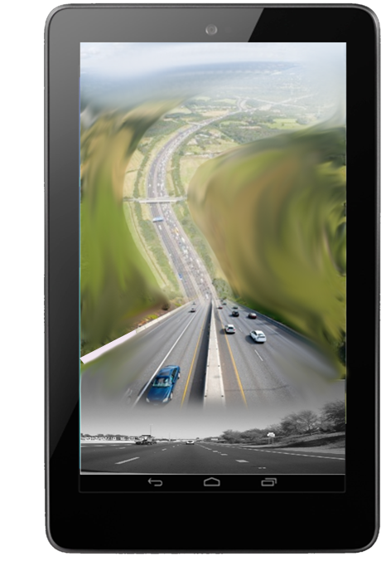
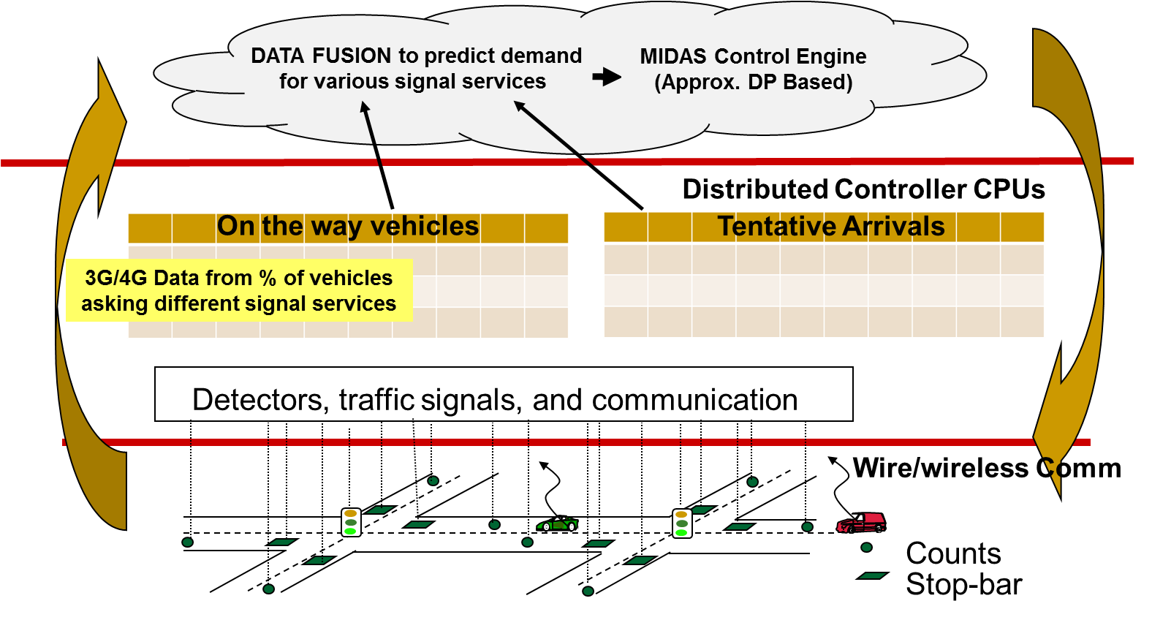
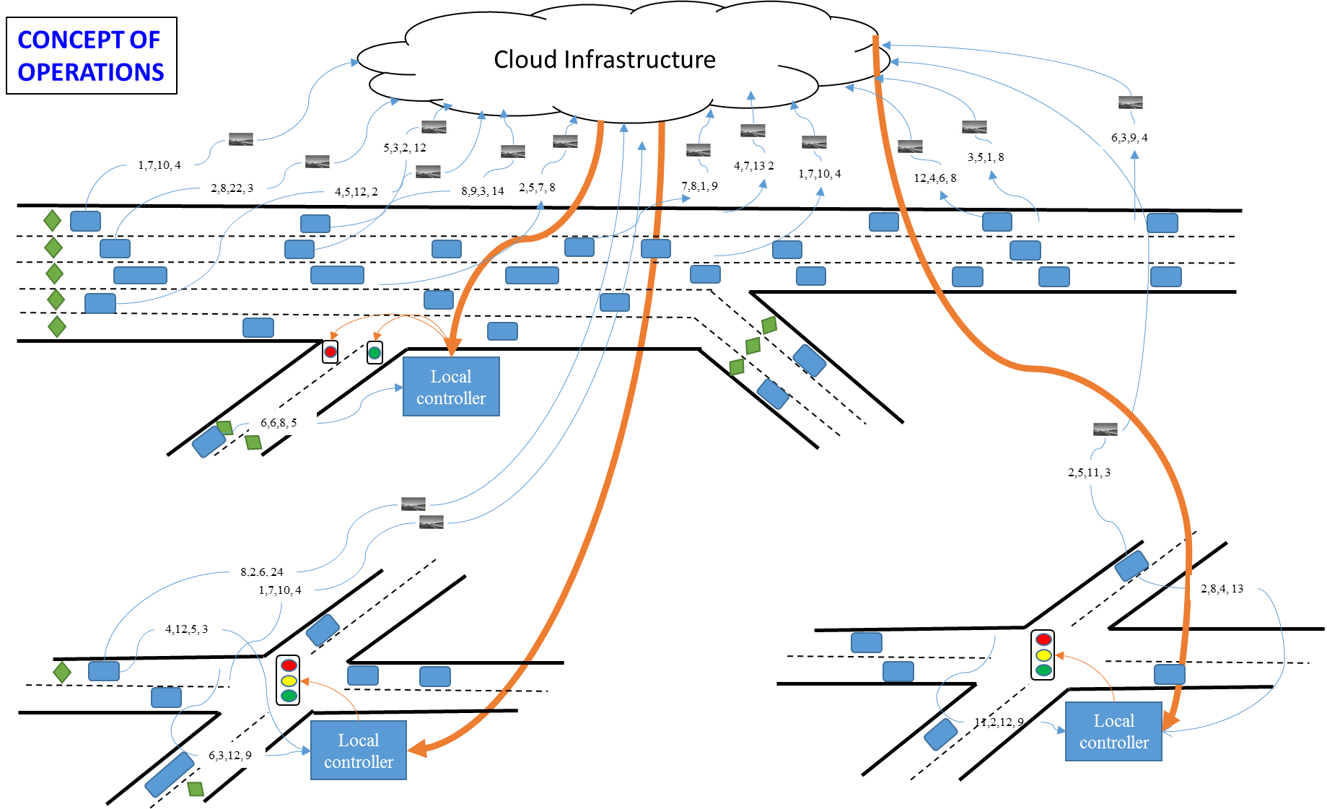
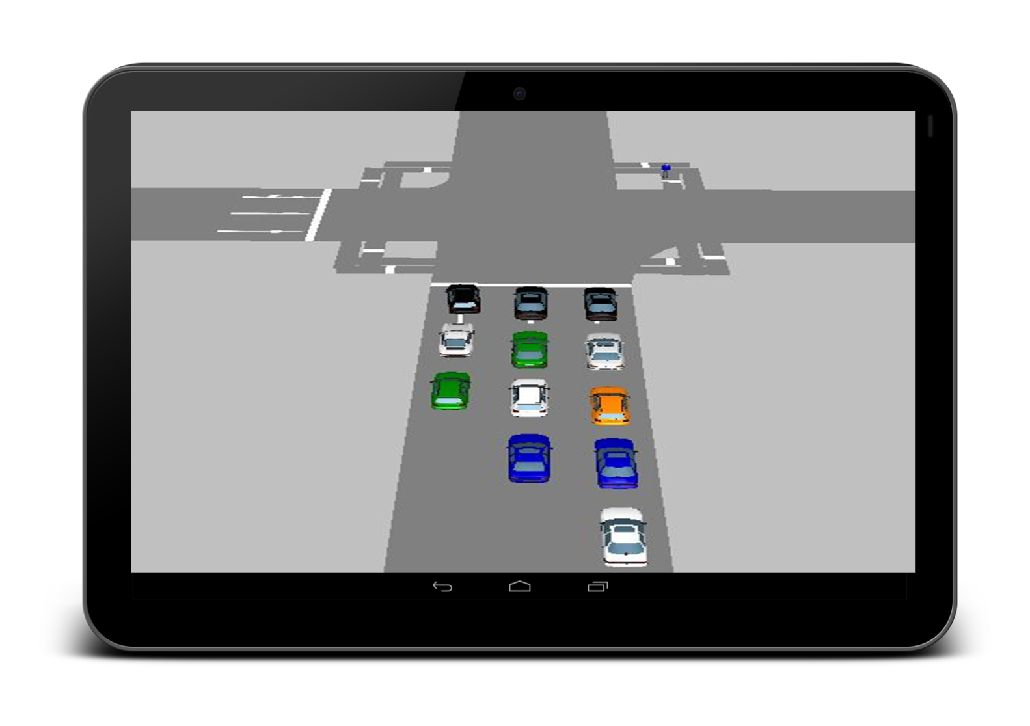
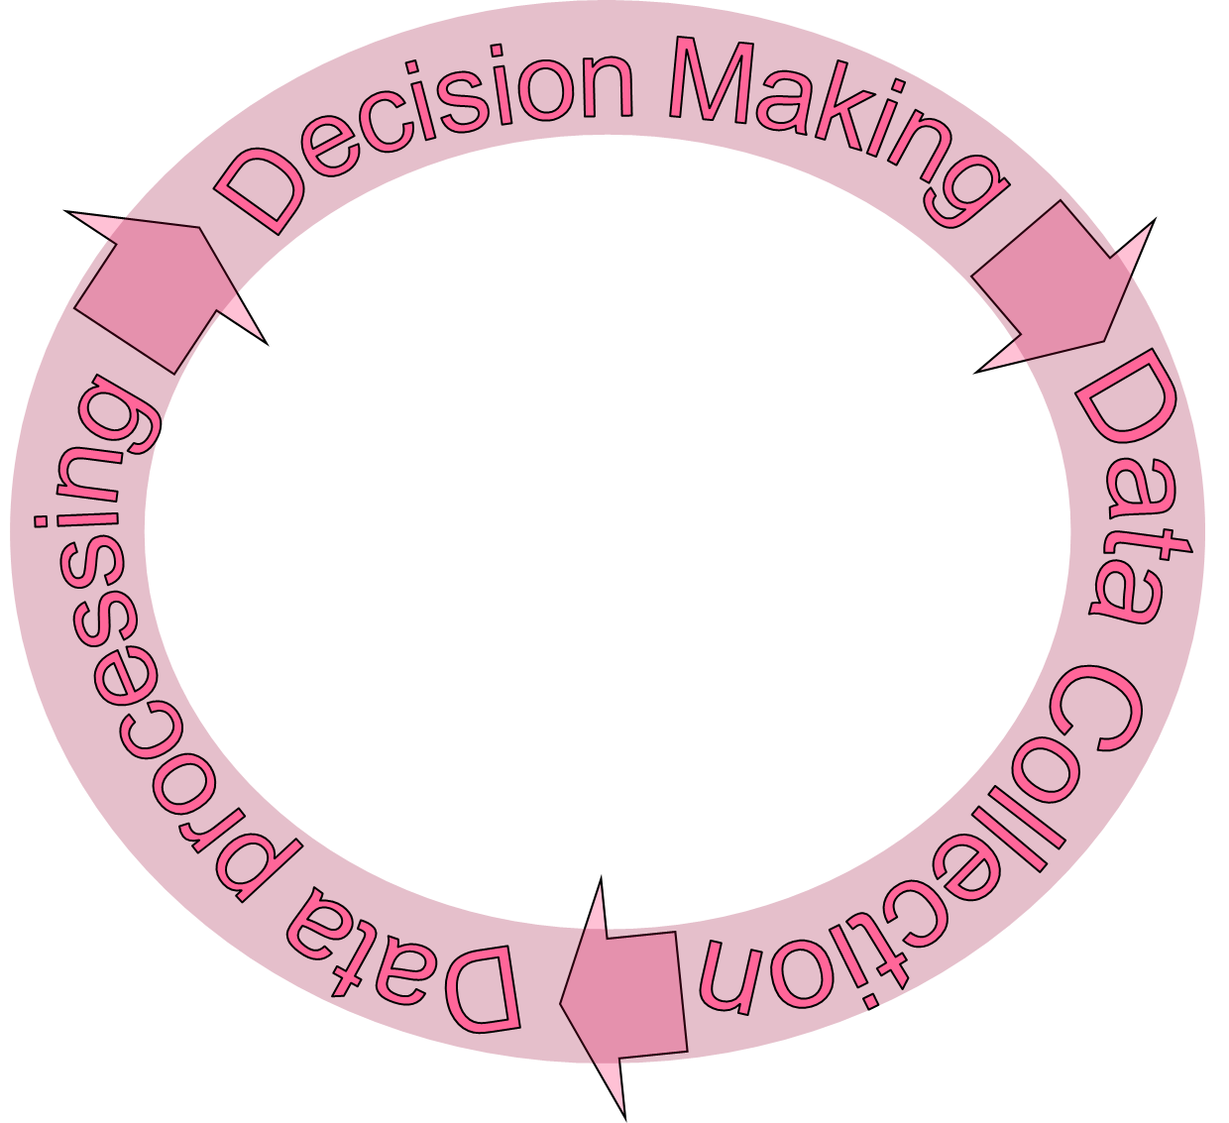
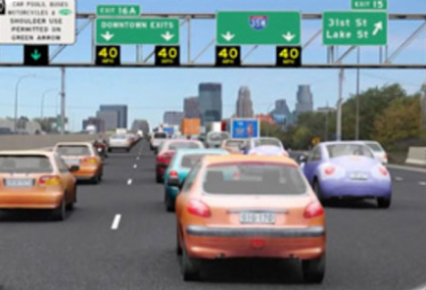
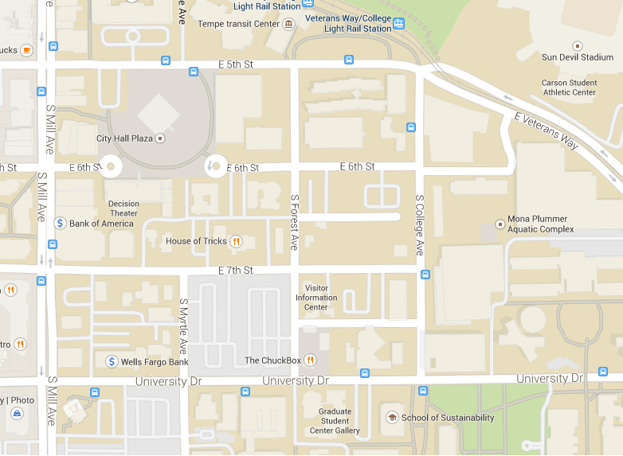
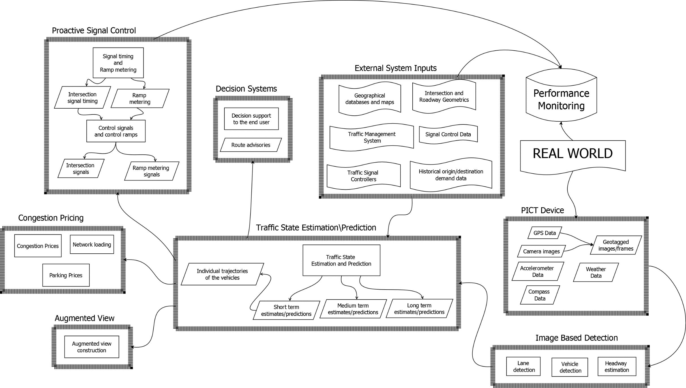
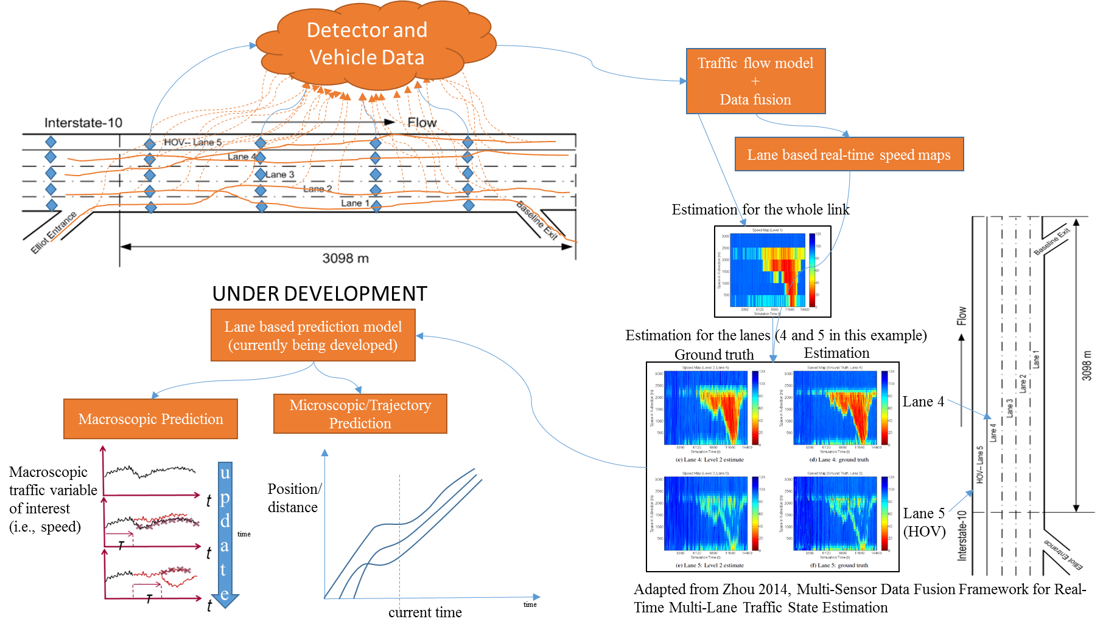
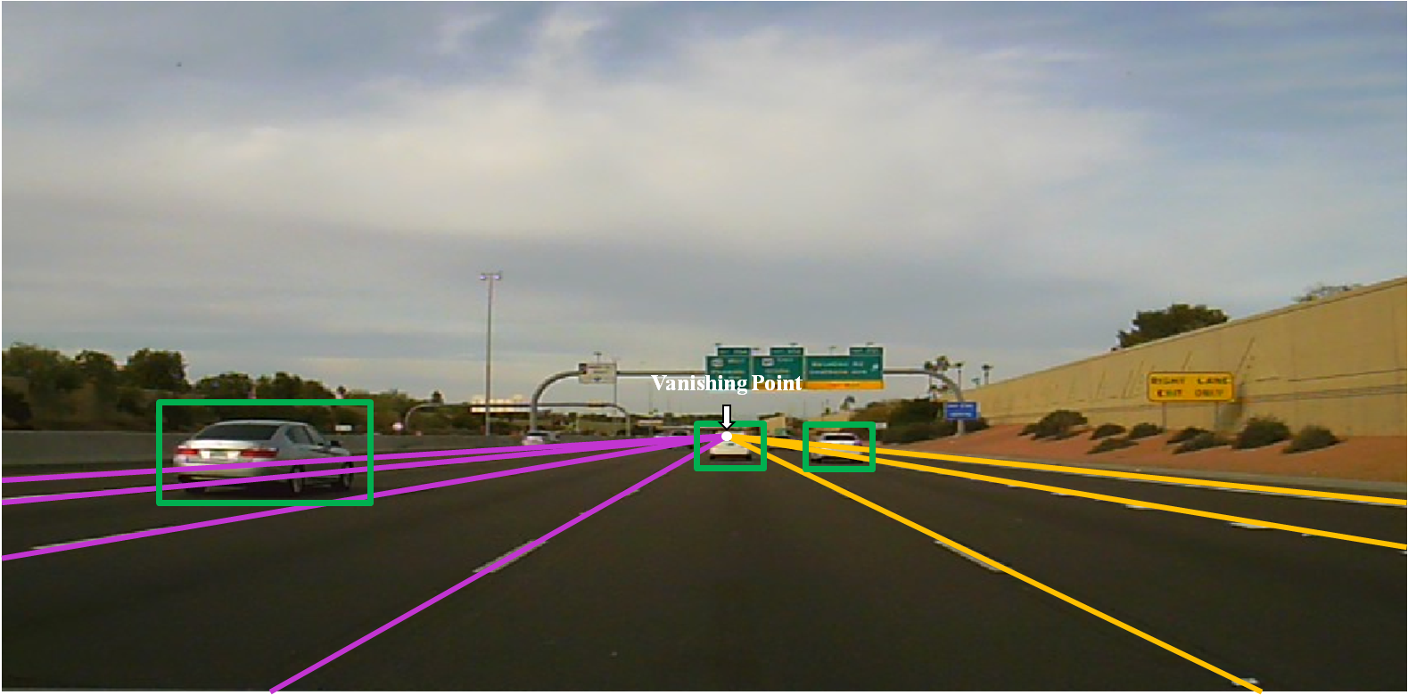
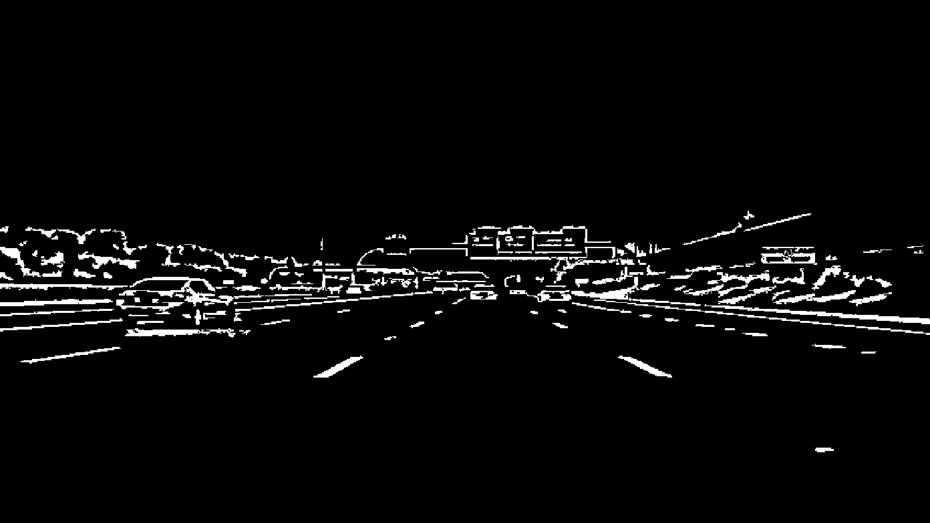
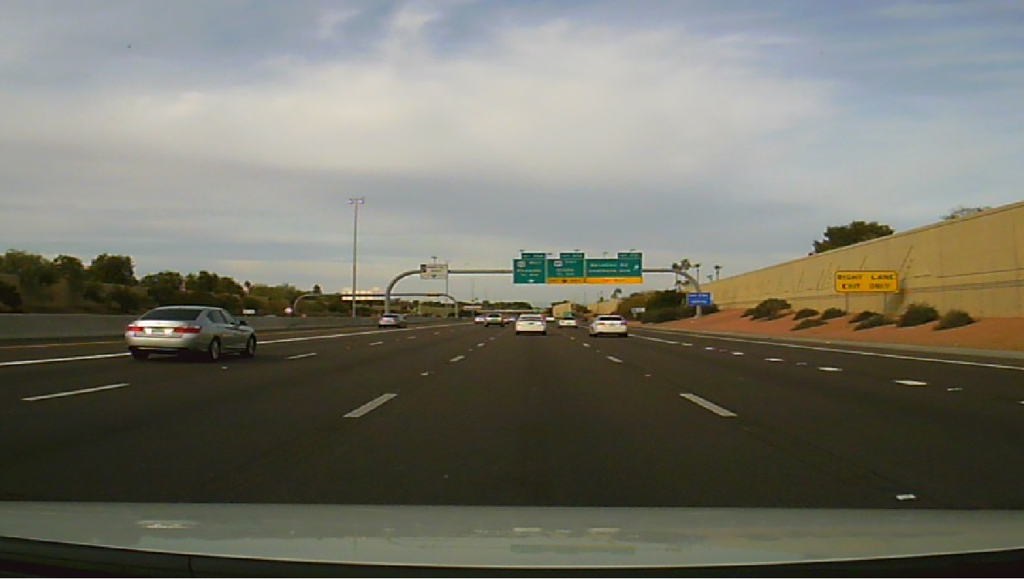
MIDAS: A Cyber Physical System for Proactive Traffic Management
to Enhance Mobility and Sustainability
Pitu Mirchandani (PI, ASU), Dijiang Huang (ASU), Baoxin Li (ASU), Yafeng Yin (UF)
Proactive Traffic Management
Utilizing interfaces with various transportation control and communication systems, MIDAS will be capable of Managing Interacting Demands and Supplies in order to provide proactive traffic management. As detailed in the architectural diagram, MIDAS will bring together data about vehicle location and routes via PICT devices, as well as connections to geographical databases and traffic management systems for the purpose of providing proactive controls and advisories, allowing drivers to make better route choices, especially in the presence of congestion, whether recurrent or non-recurrent, and with an augmented view of the traffic system, Appropriate methodologies for congestion pricing or reward systems are also included in this system to influence travel demand.
Cloud-based Infrastructure
The cloud is the backbone of MIDAS, providing a secure and resilient cyber infrastructure to efficiently collect, organize and process data, perform image processing, execute algorithms and interface with the underlying communication system.
A prototype (MobiCloud - mobicloud.asu.edu) has been developed to address the research challenges of maintaining privacy and addressing security requirements during the data collection process and demonstrating methods for the construction of resource provisioning systems for effective and sustainable traffic management.
$
3.2
$
2.5
$
10
$
8
$25
$15
$15
$35
$25
$15
$15
$15
$15
Congestion Pricing
When predicted measures of performance such as heavy delays, emissions, etc., are not acceptable, then tolls/incentives and re-routing guidance may be imposed to move towards more acceptable performance. Through our new PICT technological infrastructure, MIDAS-CPS will provide required congestion prices (or incentives), including but not limited to (a) pricing on routes, (b) pricing on links, (c) pricing for subnetworks in the region, and (d) pricing for parking, the prices/incentives being based on the short-term prediction of congestion levels, traffic demands manifested through the MIDAS-CPS controls, and historical traffic demands.
Visual Computing
Real-time lane and vehicle detection is necessary to identify the lane location of vehicles within the roadway and their proximity to other vehicles in order to place the vehicle at the proper location in the traffic network and make effective use of the imagery and telemetry provided by the PICT devices. While most algorithms use a process called inverse perspective mapping, which imposes significant limitations on camera mounting and device selection, our lane detection system allows non-rigid positioning of the dashboard camera using a guided filter for lane detection and gradient orientation algorithms plus other methods to remove false positives. This results in a system that is fast and reliable that could support a variety of PICT devices. Future work: Real-time determination of vehicle position and abnormal event detection.
Online Traffic Estimation and Prediction
Real-time traffic state estimation is the backbone of any traffic management system as it provides the necessary grounds for further online prediction which is essential for proactive traffic management. In our study, we combine a mesoscopic traffic model formulated in the Lagrangian coordinate system with a recursive correction module that exploits the information provided by the PICT devices and processed in the cloud infrastructure. The resolution of the traffic model can be adapted so that short, medium and long term predictions can be provided in reasonable time for different traffic management purposes.
PICT (position-image-communication with time stamp) Technology
Using PICT, MIDAS-CPS will monitor, manage and guide drivers through an urban environment, both in regular recurrent congestion conditions and in more complicated non-recurrent conditions. These PICT devices will utilize cellular communications to interact with traffic-management systems and other PICT device-enabled vehicles through a secure cloud-based computing environment to efficiently channelize vehicle flow through the transportation network, using traffic controls, route advisories and augmented reality views of conditions outside of the drivers’ normal limited field of view, while advising/guiding individual drivers on paths that are equitable, trading off individual benefits with societal considerations of energy and environment sustainability.

