Slide 1
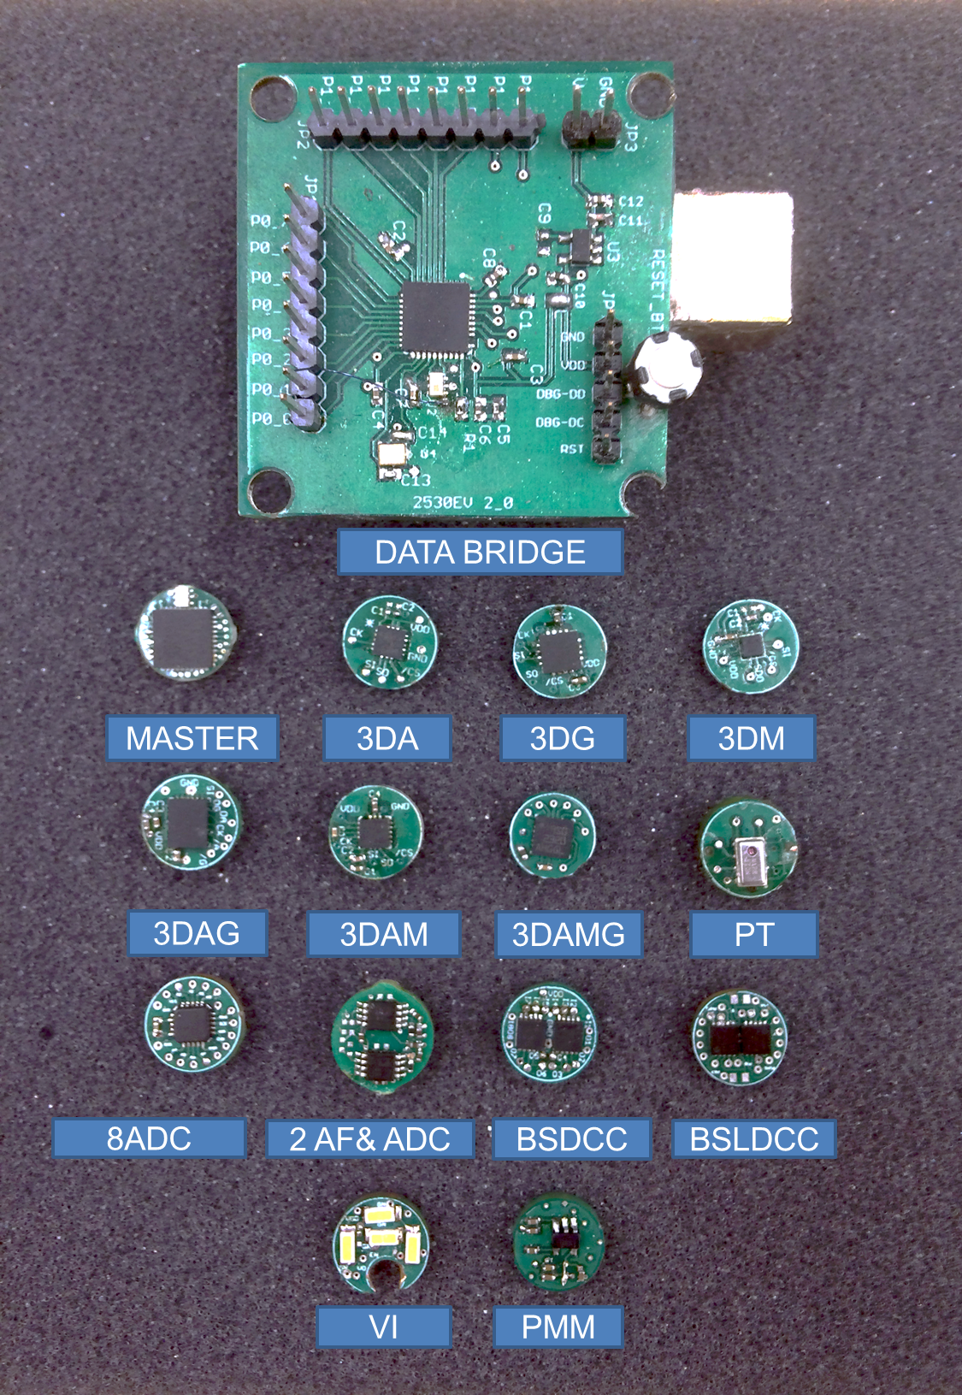
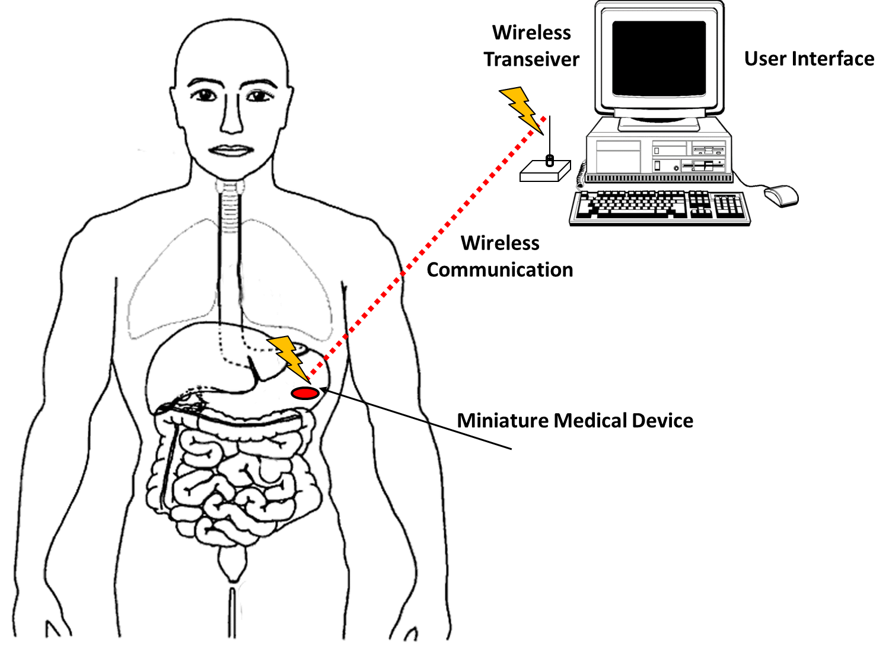
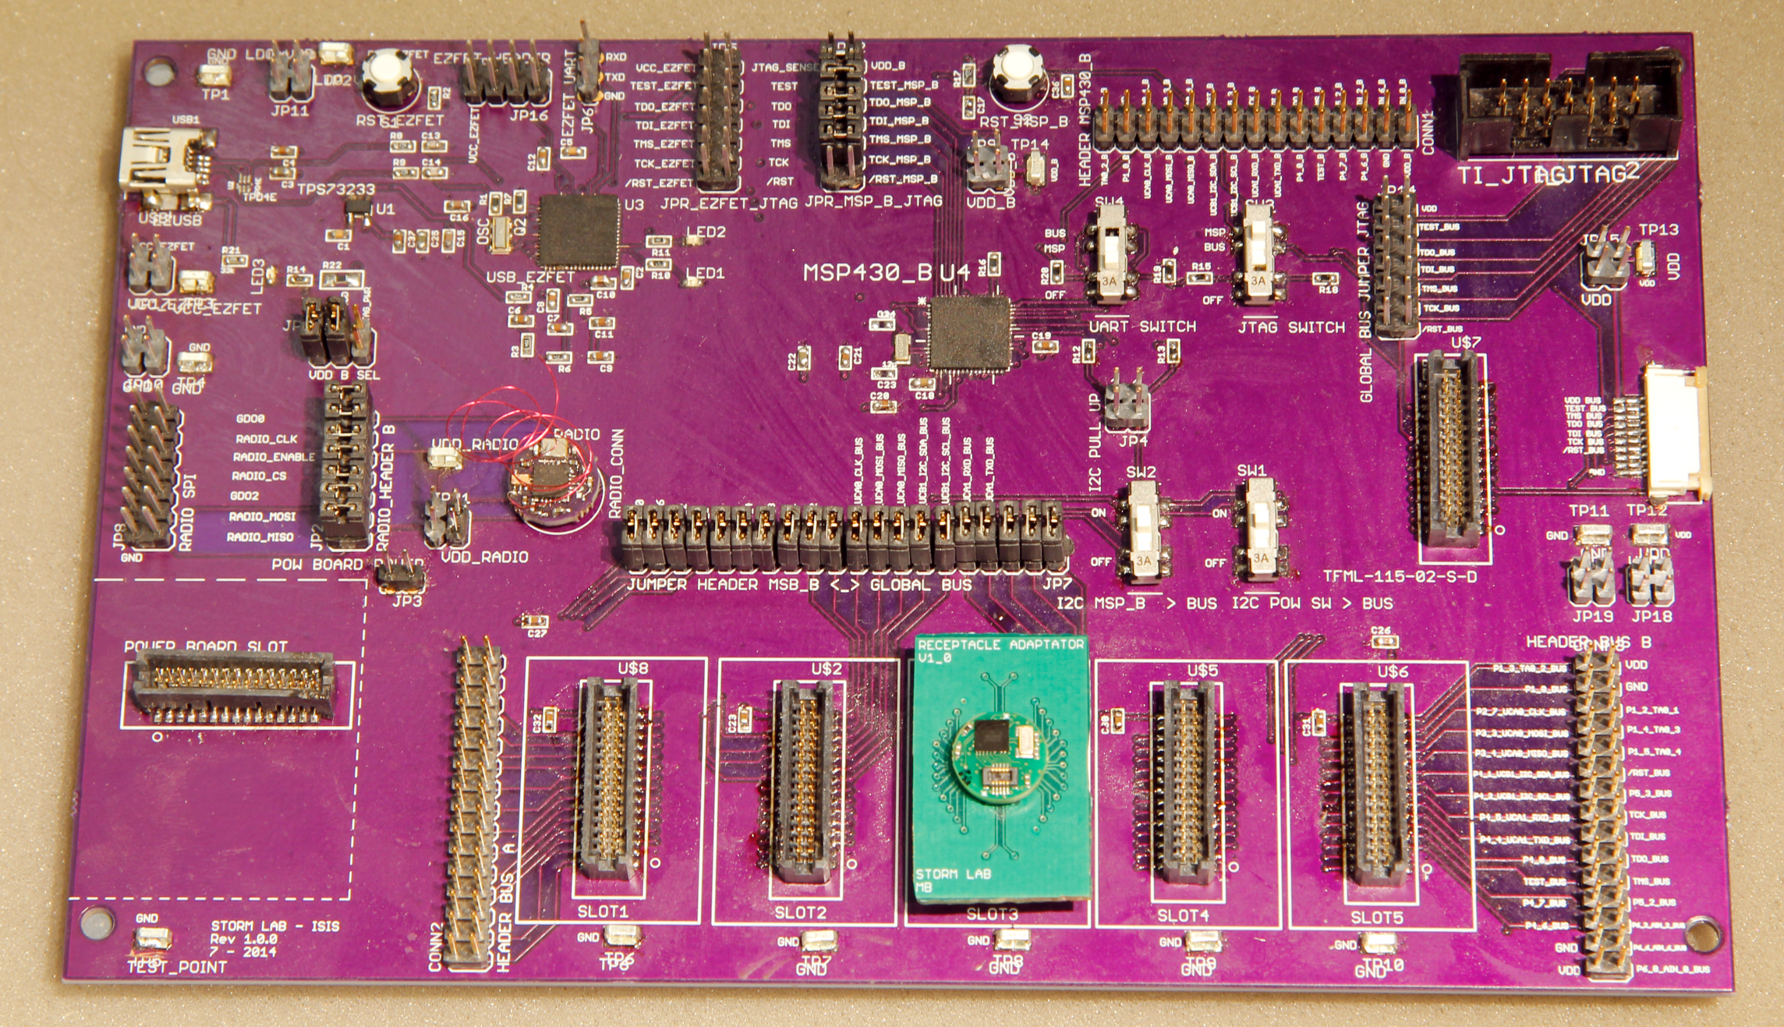
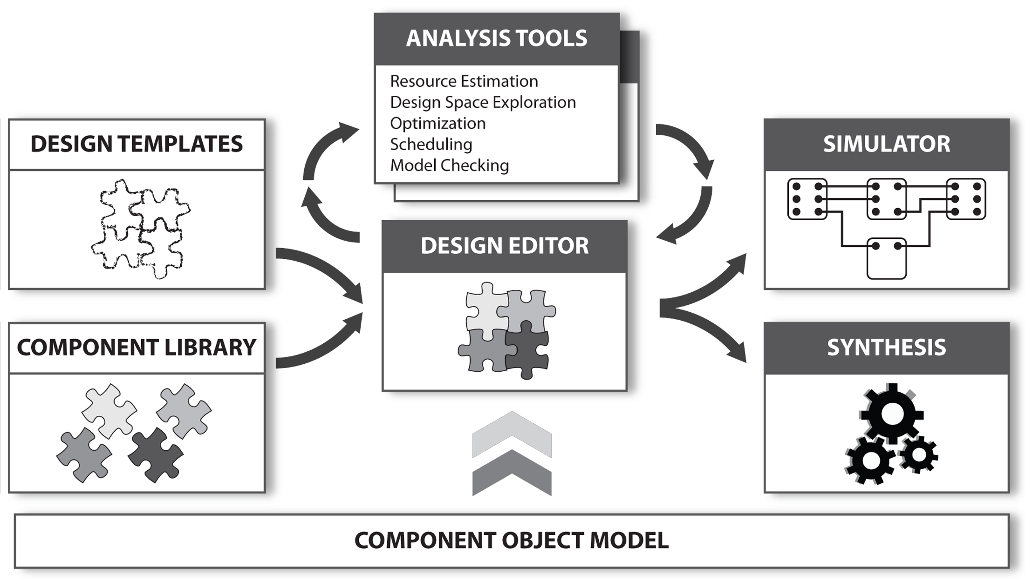
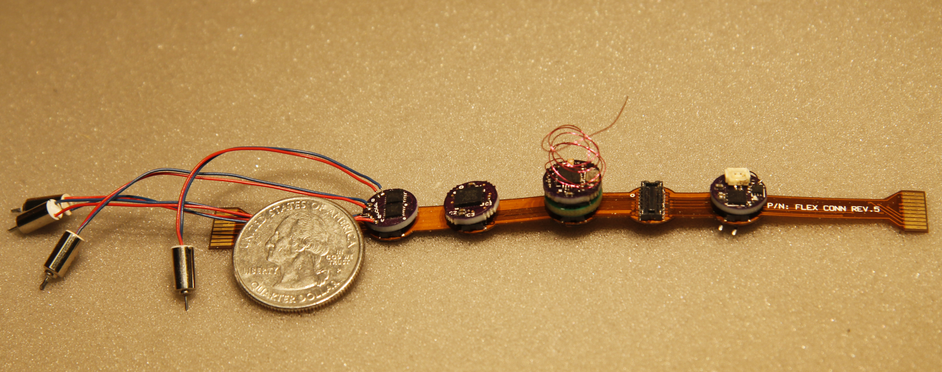
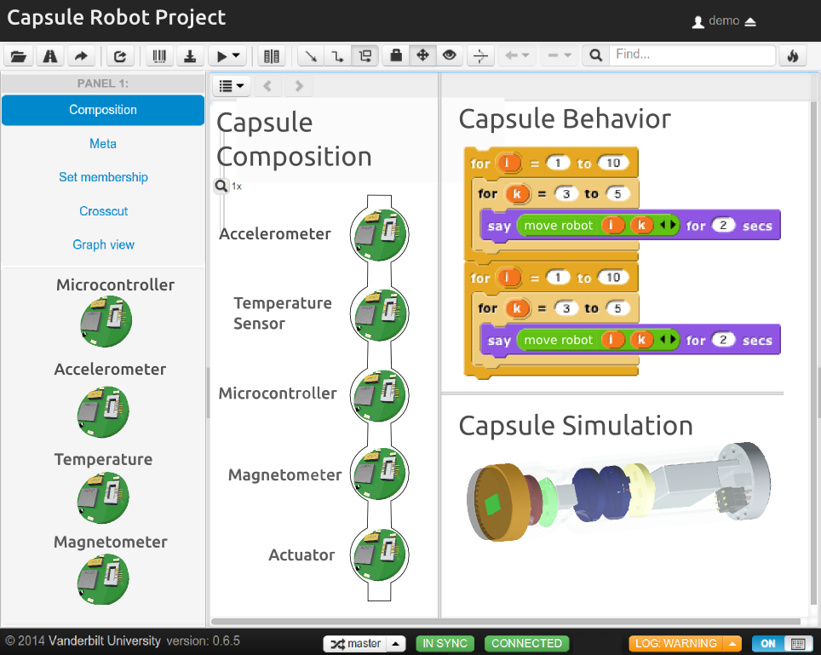
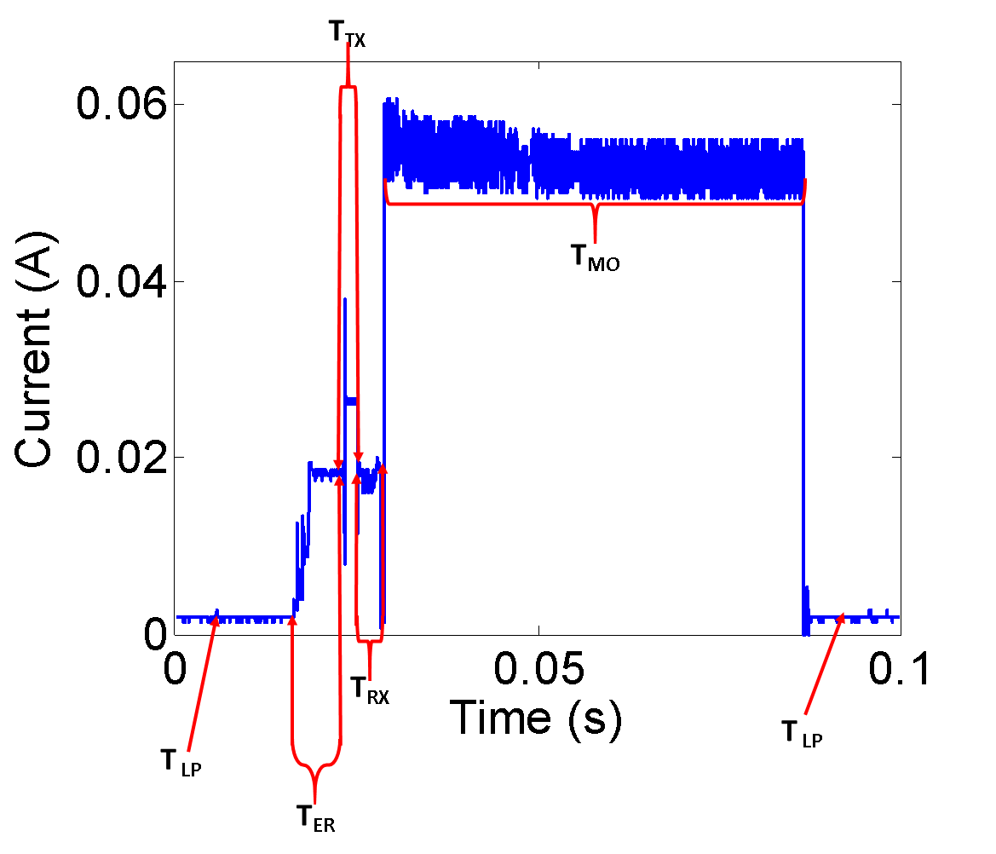
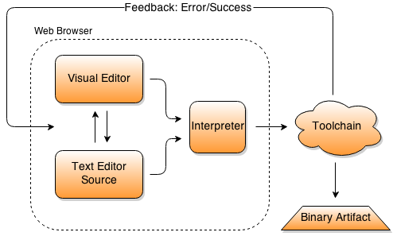
CPS: Synergy: Integrated modeling, Analysis and Synthesis of Miniature Medical Devices
The STORM Lab
Pietro Valdastri, Marco Beccani, Addisu Taddese, Robert J. Webster III, Péter Völgyesi, Ákos Lédeczi http://github.com/pillforge
BACKGROUND
Miniature medical devices are classical CPS that can operate autonomously within the human body to augment surgeons’ ability to diagnose, prevent, monitor, and cure diseases
MODULE NAME | FUNCTIONALITY | INTEGRATED CIRCUIT (IC) | DIAMETER (mm) | Thickness (mm) | Max Consumption (mA)
Wireless CPU | CPU and 2.4 GHz Wireless | CC2530 | 9.8 |  | 36
Microcontroller | CPU | MSP430F5528 | 10.5 | 3.84 | 2.32
433 MHz Radio | Wireless Communication | CC1101 | 10.5 |  | 29.2
3DA | 3D Accelerometer | LIS331DLH | 9 |  | 0.25
3DG | 3D Gyroscope | L3GD20 | 9 |  | 6.1
3DM | 3D Magnetometer | LIS3MDL | 9 |  | 0.27
3DAG | 3D Accel. – Gyro | LIS330DLC | 10 |  | 6.11
3DAM | 3D Accel – Magn. | LIS303D | 9.8 |  | 0.3
3DAMG | 3D Accel. - Gyro.– Mag. | LSM9DS0 | 9.8 |  | 6.15
PT | Pression & Temperature | MPL115A1 | 9.8 |  | 0.005
2AF&ADC | 2 Ch. Front End ADC | AD623 – ADS8320 | 9.8 |  | 2.57
8CHADC | 8 Ch. ADC | AD7689 | 10 |  | 3.78
VI | Vision - Illumination | NUD533 | 9.8 |  | 30
BSLDCC | Brushless Motor | BH67172NUX | 9.8 |  | 4.5
BSDCC | Brushed Motor | A3901 | 10 |  | 800 (Max)
PMM1 | Power – Battery Monitor |  | 9.8 |  | 200 (Max)
PMM2 | Power- Battery Monitor - Charger |  | 10 | 3.84 | 500 (Max)
Miniature Medical Device
Human machine interface
Other miniature devices
Energy Source
Environment
Sensors
CPU
Wireless Comm.
Actuators/ Mechanisms
Colorectal cancer strikes more than 170,000 in the USA each year and kills approximately 50,000 [1] with a projected 62% increase by 2030 [32]. If we are successful in promoting the implementation of a painless alternative to traditional colonoscopy, this could have a transformative impact on medicine.
The SMAC platform hardware modules. [Beccani et al, IJARS, 2014]
DESIGN ENVIRONMENT
The objective of this project is to create a focused cyber-physical design environment to accelerate the development of miniature medical devices.
A versatile component model will provide the structural and semantic foundation for the entire model-based design flow
An integrated simulation framework will provide insight into the dynamic behavior of the design before manufacturing
A pre-built component library will provide the building blocks for design construction
Static analysis tools will provide performance and cost estimates before system synthesis
WIRELESS COMMUNICATION
MODULE
DESIGN CONSIDERATIONS
DC MOTORS
ACTUATION
MODULE
POWER
MODULE
The CPS design framework must address crosscutting constraints such as (1) size – ideally, a capsule device should be small enough to swallow or to enter natural orifices without requiring a dedicated incision; (2) power consumption – given the limited space available onboard, energy is limited; (3) communication bandwidth – wireless signals must be transmitted through the human body with a sufficient data rate; (4) fail safe operation – since the device is deep inside the human body, the user has no access to it; and (5) effective interaction with the target site, according to the specific functions the device is required to fulfill
SENSING
MODULE
MICROCONTROLLER
MODULE
The goal is to synthesize application software, printed circuit board (PCB), computer aided design (CAD) models, and bill of materials with cost estimates with minimal manual guidance
Crosscutting Constraints
FAIL-SAFE OPERATION
POWER CONSUMPTION
MODULAR HARDWARE
SIZE
WIRELESS COMMUNICATION
INTERACTION WITH ENVIRONMENT
MODULAR SOFTWARE ABSTRACTION
TinyOS
Current consumption of the MCR prototype showing levels of current consumed for low power, idle, transmission, reception and motor actuation
Sponsor: The National Science Foundation (Award: IIS 1239355)

