Slide 1
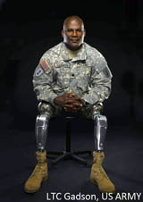
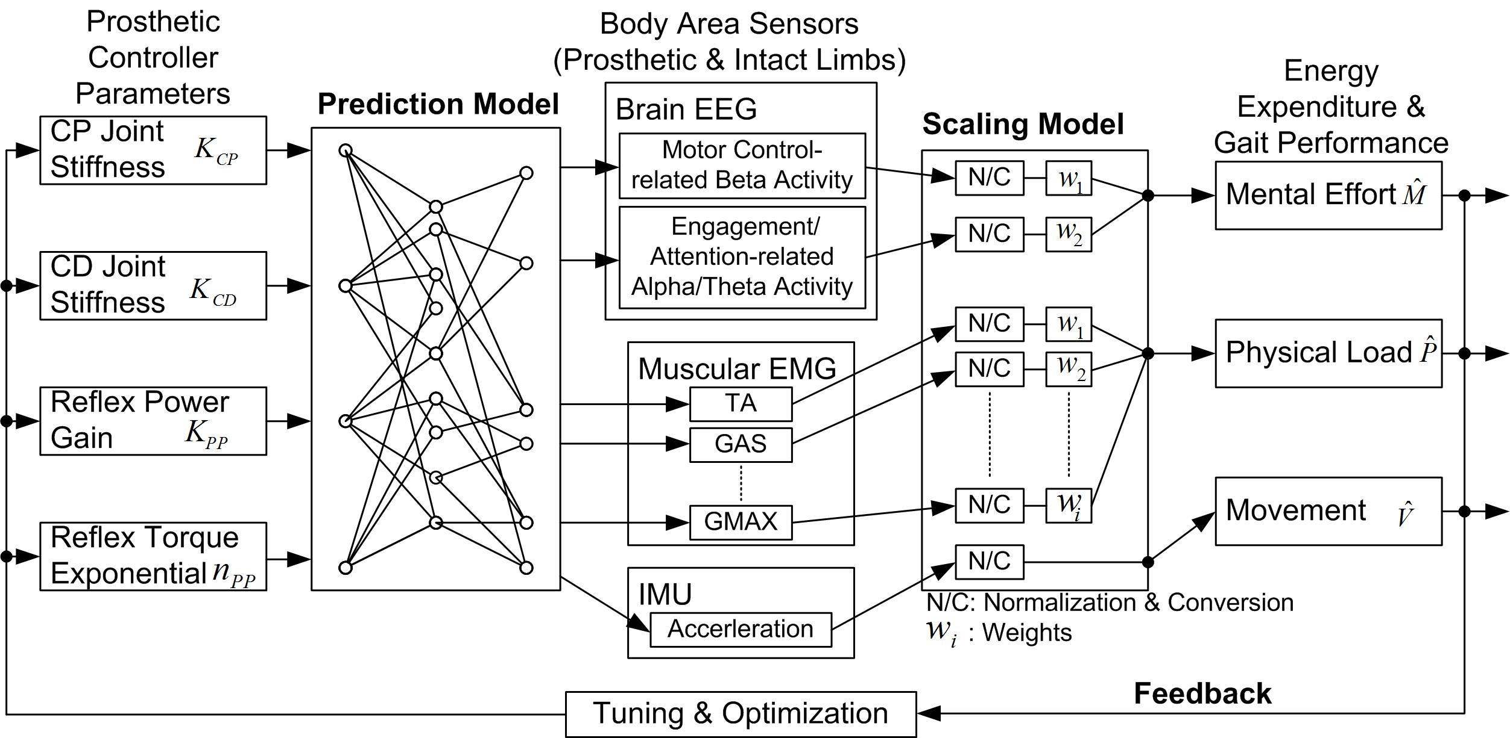
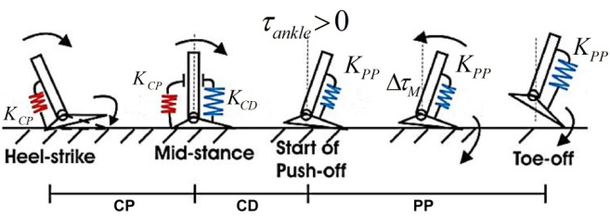
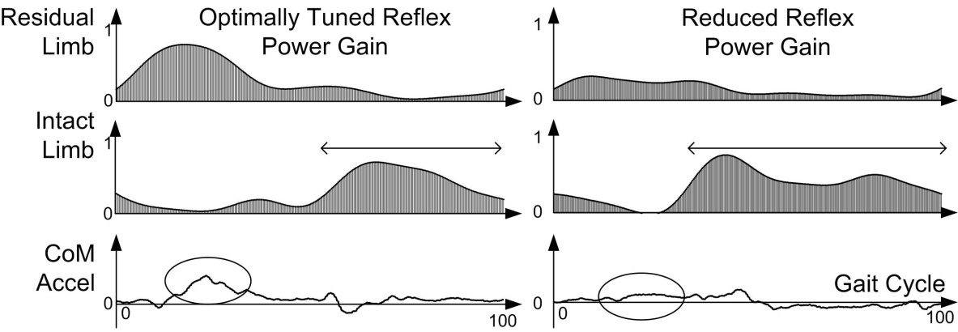
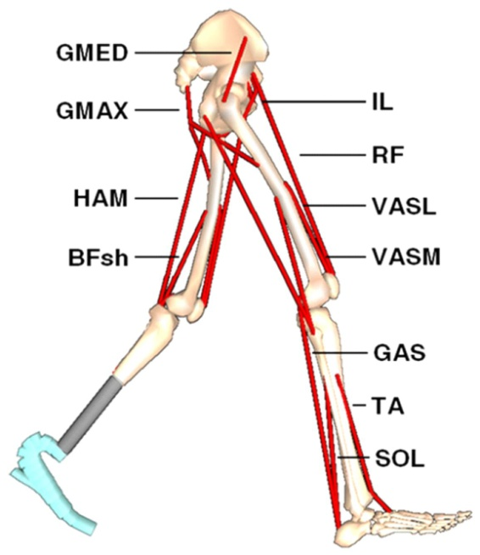
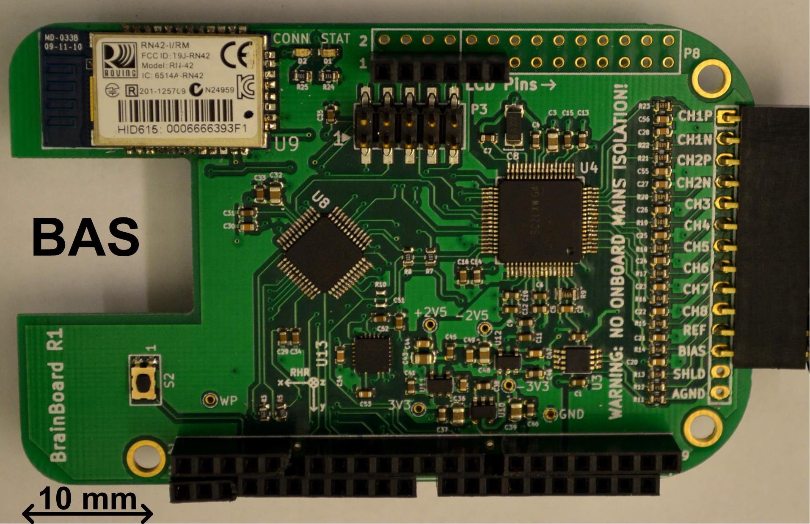
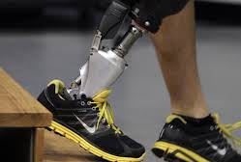
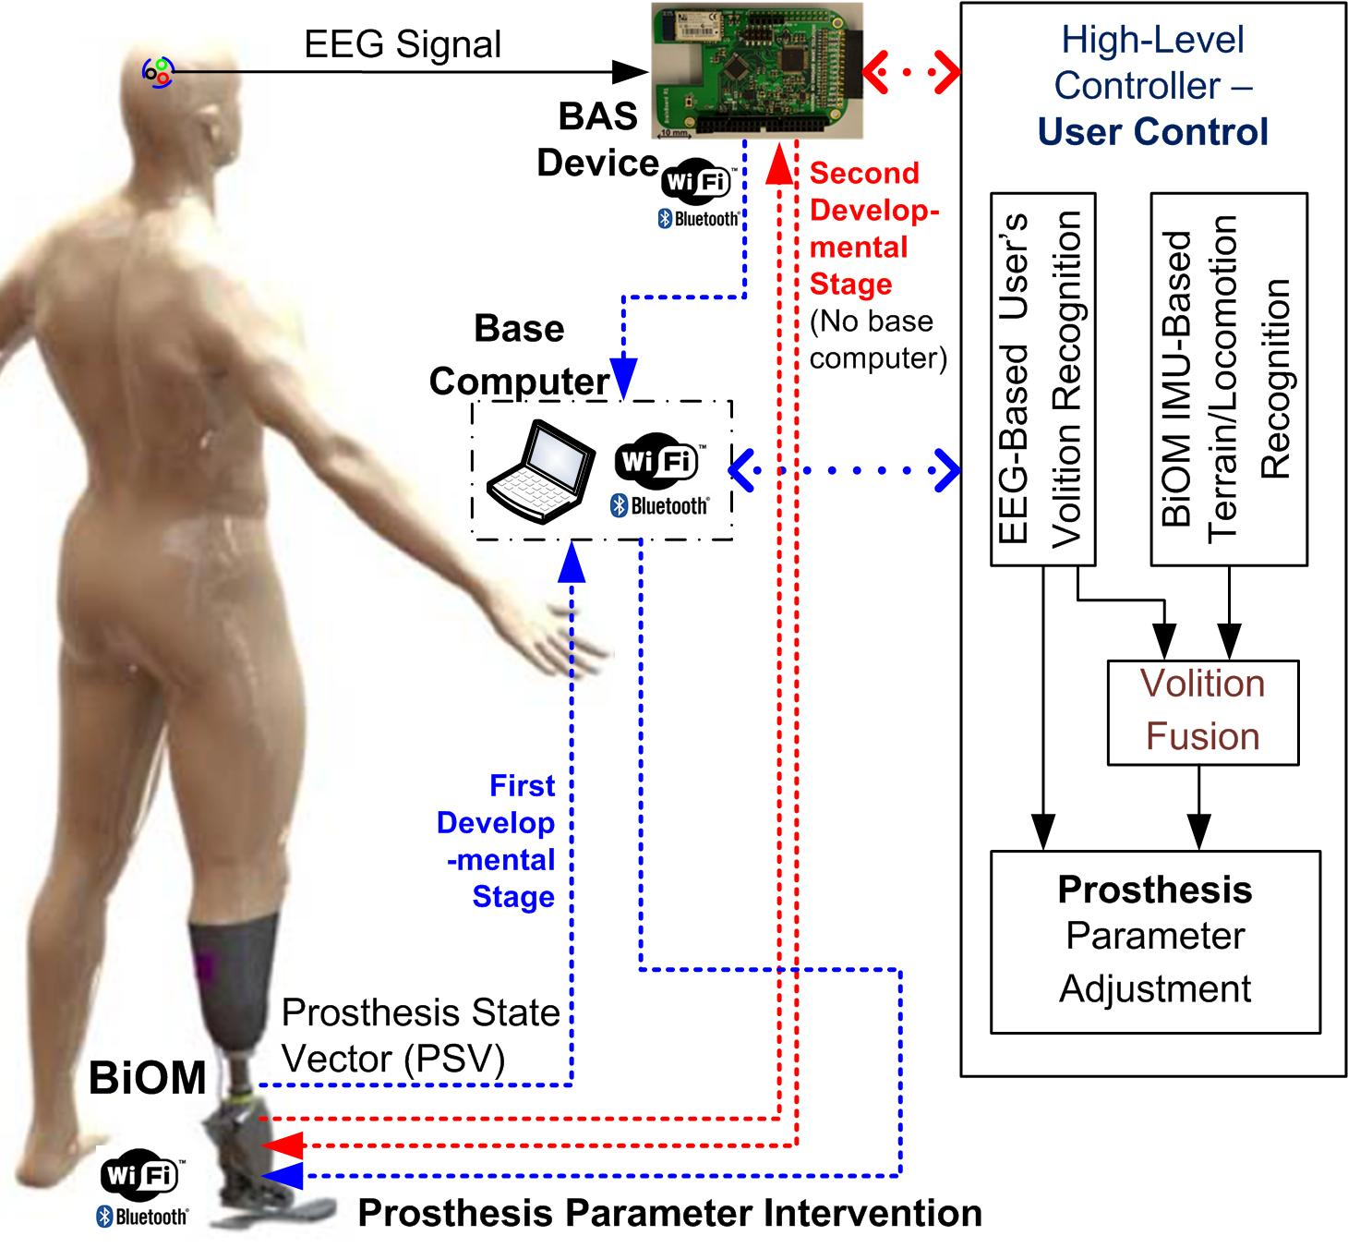
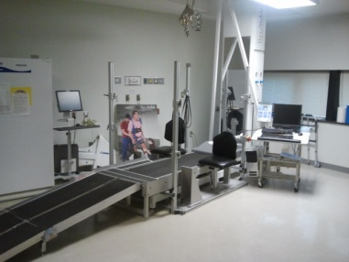
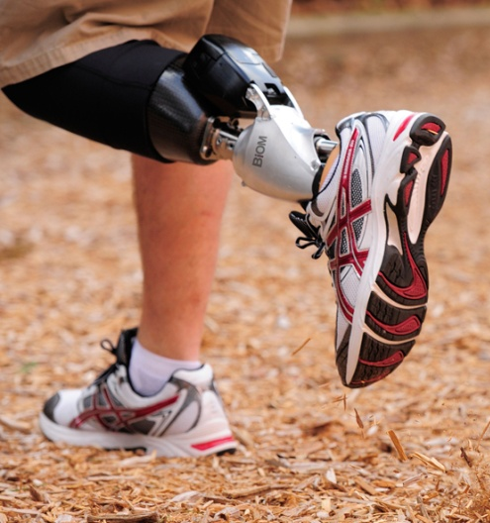
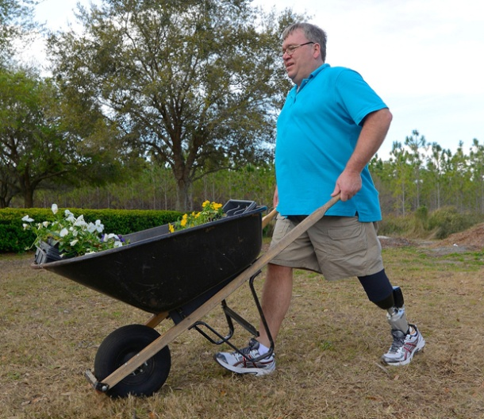
CPS: Synergy: Sensor Network-based Lower-Limb Prosthesis Optimization and Control
Ou Bai^{PI,1}, Douglas Murphy², Ashraf Gorgey², Ding-Yu Fei¹, and Zhixiu Han³
¹Virginia Commonwealth University, ²Hunter Holmes McGuire VA Medical Center, and ³iWalk Inc.
Background
PROJECT DESIGNS
Preliminary DATA
More than one million people are living with lower-limb amputation in the United States, including a large number of warfighters who lost their limbs in the military missions.
A. Proposed Approach for Minimizing Energy Expenditure
EMG Indication of Energy Expenditure related to the Tuning of Prosthetic Control Parameters
Clinical Barriers:
Increased energy expenditure may in amputees induced fatigue, secondary body damage, asymmetric joint loading, and increased risk of falls, etc.
Technical Challenges:
Though state-of-the-art lower-limb prostheses may provide net-positive power to reduce amputees’ energy expenditure, however
Light-Weighted, Low-Power Consumption, Battery-Powered and Wireless-enabled Body Area Sensor
Muscular Model for Lower Limbs
Prostheses may not be tuned to maximally reduce energy expenditure in current clinical prosthetic practice due to the subjective tuning;
Prostheses are designed and tuned for optimizing the level walking; amputees would have difficulty in slope/stair walking, and/or walking on uneven plain.
Task A.1: Design of a low-cost, wireless-enabled, wearable body area sensor (BAS) device
Task A.2: Design of physical load and mental effort prediction model and model database using machine learning technology
Task A.3: Development of automatic prosthesis optimization technology
Task A.4: EEG/EMG enhancement using spatiotemporal/statistical signal processing
User Control of Prosthesis using a Brain-Computer Interface-based Volition-Recognition Technology
Objectives and Specific Aims
References
The objective of this project is to develop Cyber-Physical Systems (CPS) technology for the prosthesis optimization to minimize the user’s energy expenditure and for extending the capacity of the prosthesis to adapt to dynamic situations and environments.
B. Proposed Approach for User Control of Prosthesis
D. Huang, K. Qian, D. Y. Fei, W. Jia, X. Chen, and O. Bai, “Electroencephalography (EEG)-based brain-computer interface (BCI): a 2-D virtual wheelchair control based on event-related desynchronization/synchronization and state control,” IEEE Trans Neural Syst Rehabil Eng, vol. 20, no. 3, pp. 379-88, May, 2012.
K. Qian, P. Nikolov, D. Huang, D. Y. Fei, X. Chen, and O. Bai, “A motor imagery-based online interactive brain-controlled switch: paradigm development and preliminary test,” Clin Neurophysiol, vol. 121, no. 8, pp. 1304-13, Aug, 2010.
S. K. Au, J. Weber, and H. Herr, “Powered Ankle-Foot Prosthesis Improves Walking Metabolic Economy,” IEEE Transactions on Robotics, vol. 25, no. 1, pp. 51-66, Feb, 2009.
From Reactive to Proactive Control
Specific Aim #A: Design of a wearable body area sensor network system and computational algorithms for real-time measurement of the user’s physical load and mental effort to support personalized prosthesis optimization for the goal of maximally reducing the user’s energy expenditure;
Specific Aim #B: Development of volitional prosthesis control technology for comfortable and effortless user control of prosthesis for the adaptation to altered situations and environments.
Task B.1: Automatic recognition of user’s volition to adjust the reflex power gain – Automatic (Binary) Volition Recognition
Task B.2: Fusion of mental activity-based volition recognition and physical activity-based intent recognition for locomotion mode shifting – Automatic Recognition of Multiple Volitions
Task B.3: Design of embedded system for volition recognition
Acknowledgment
The investigators are very grateful for the support from NSF CPS program (Award Number: CNS-1446737).
Impact
The prosthesis optimization as well as the user’s control of prosthesis will promote a natural gait and minimize amputee’s energy expenditure in prosthetics use. An optimized prosthesis with user control capability will increase equal force distribution and decrease the risk of damage to the intact limb from the musculoskeletal imbalance or pathologies. Maintenance of health in these areas is essential for the amputee’s quality of life and well-being.
Evaluation Environment in VA Medical Center
Better & Healthy Walking

