Slide 1
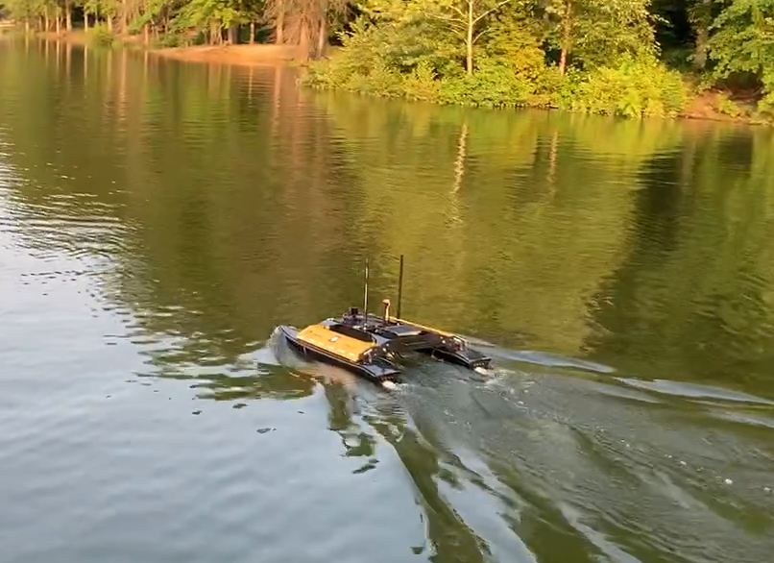
CAREER: Autonomous Live Sketching of Dynamic Environments by Exploiting Spatiotemporal Variations Beyond Uncertainty Minimization: Variability and Outlier Informed Active Sensing
Lantao Liu
Vehicle Autonomy and Intelligence Lab
Indiana University

Slide 2
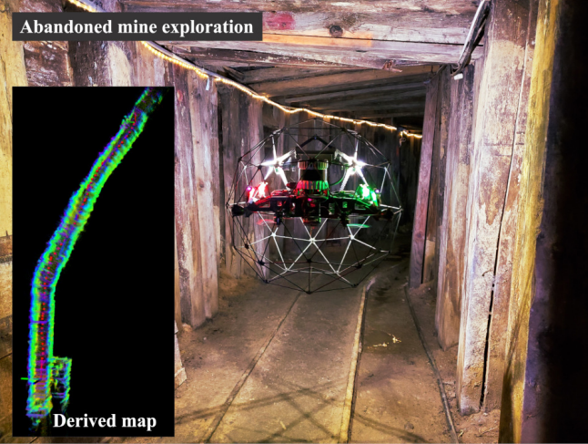
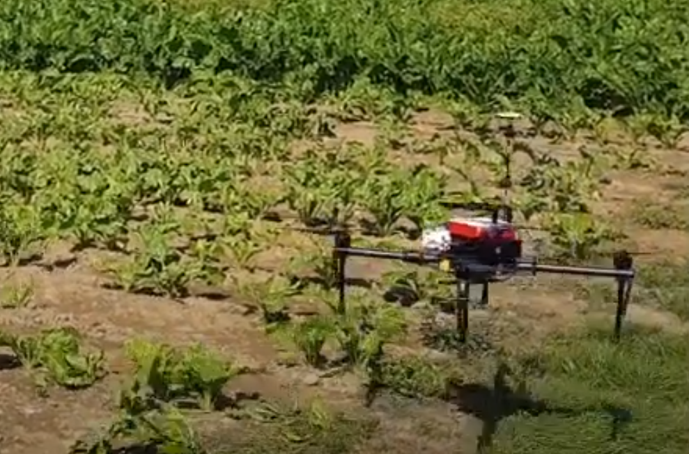
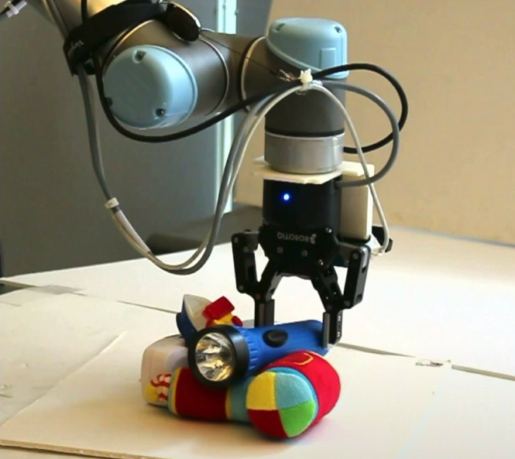
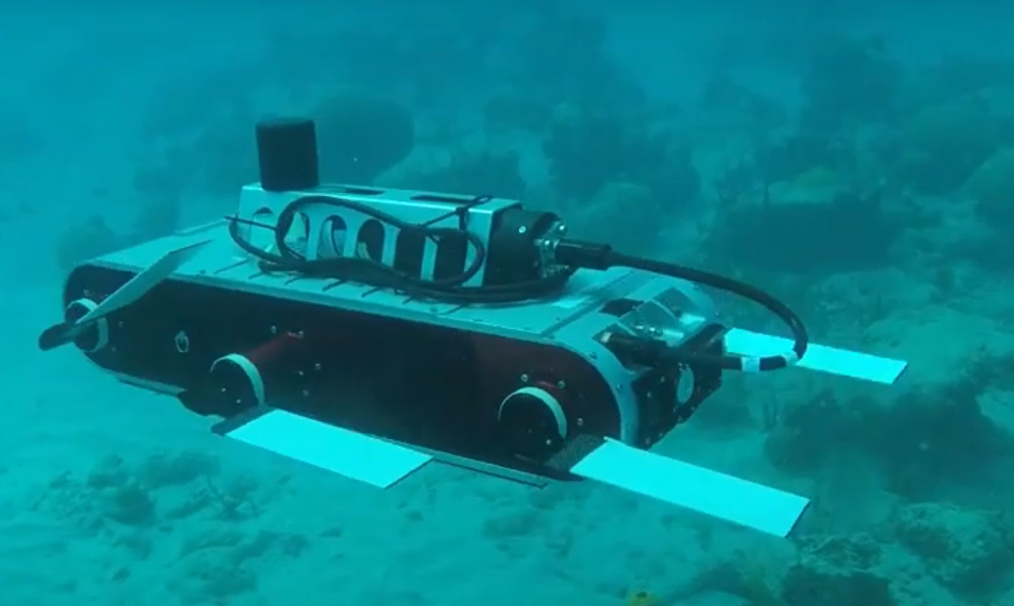
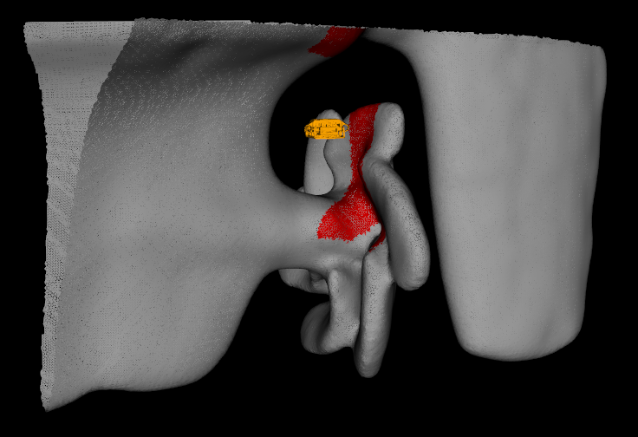
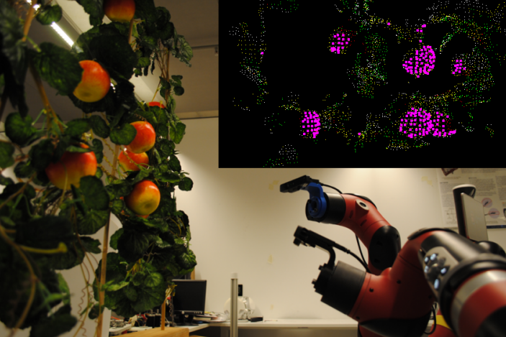
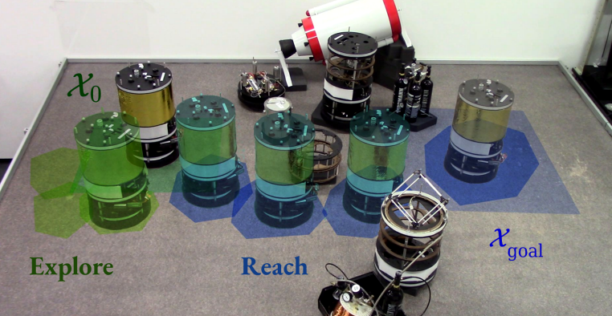
Information-Driven Sensing
Collect the most informative data to minimize the uncertainty of a model
[Hitz et al, JFR17]
[Manjanna et al, ICRA18]
[Modasshir et al, ICRA20]
…...
[Hollinger et al, IJRR18]
[Papachristos et al, ROS19]
[Schmid et al, RAL20]
…...
[Tokekar et al, TRO16]
[Popović et al, AURO20]
[Sukkar et al, ICRA19]
…...
[Buisson-Fenet et al, L4DC20]
[Lew et al, TRO22]
…...

Slide 3
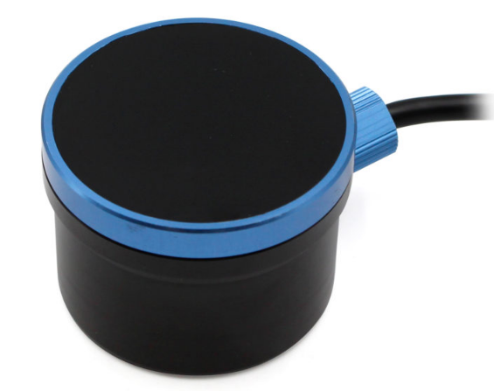
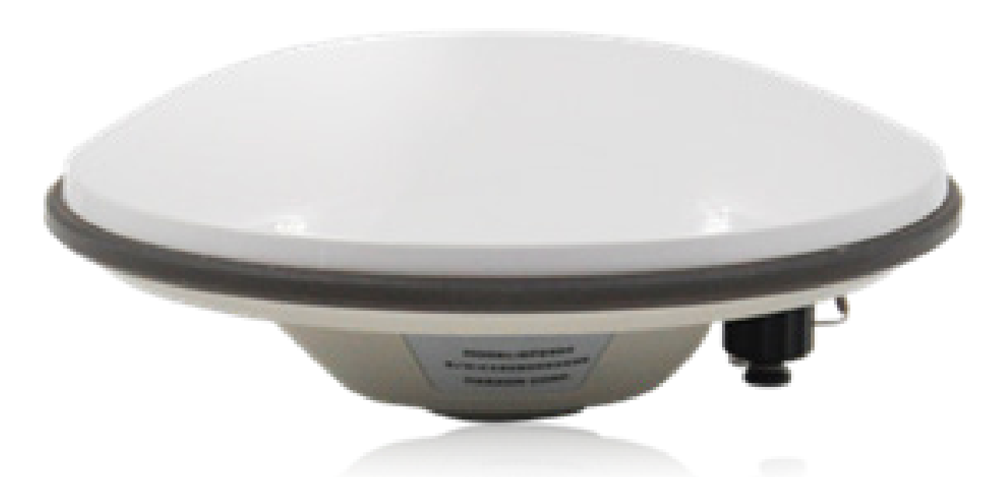
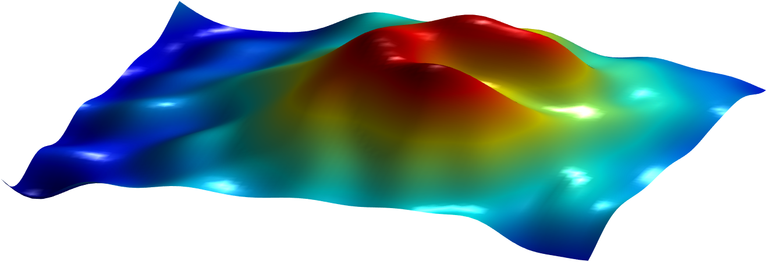
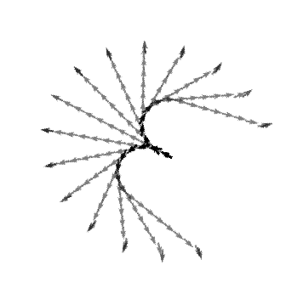
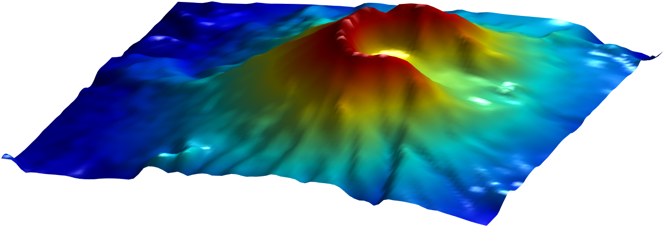
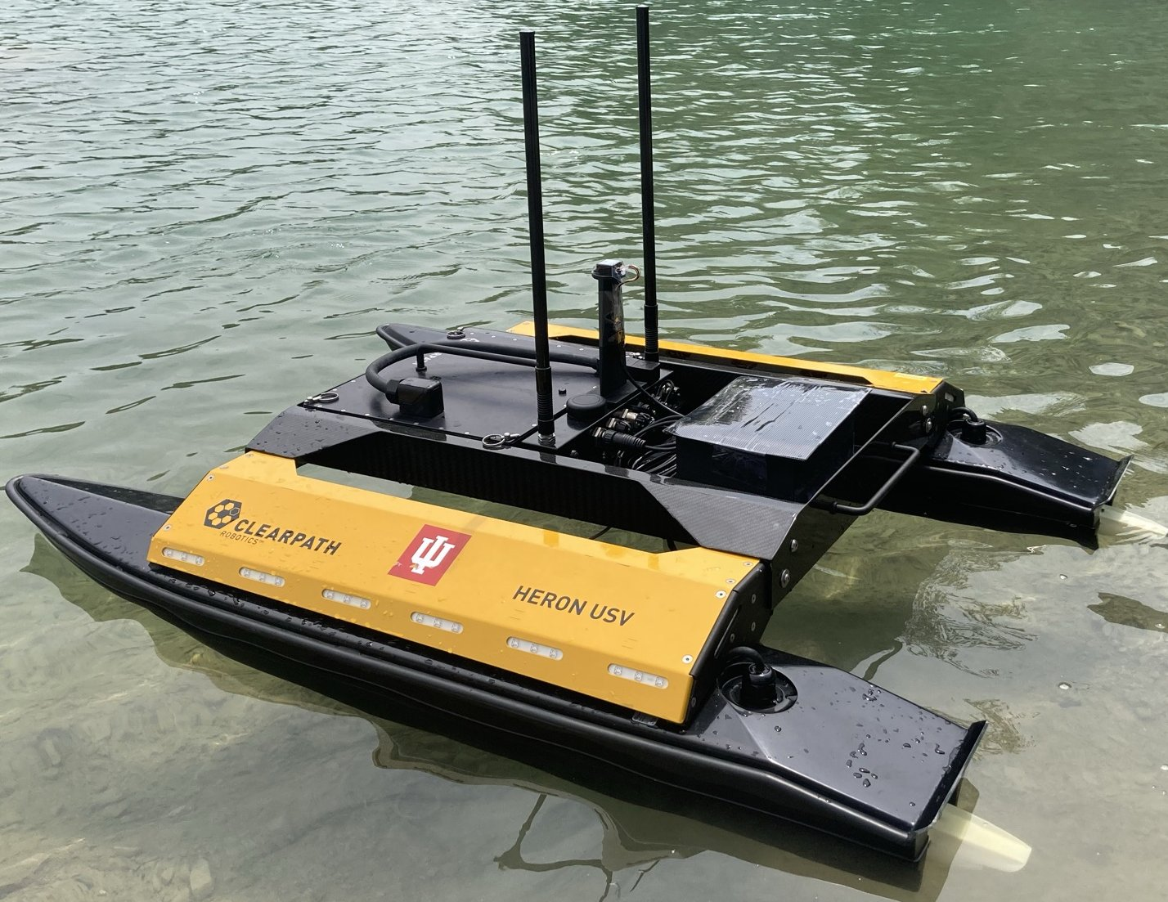
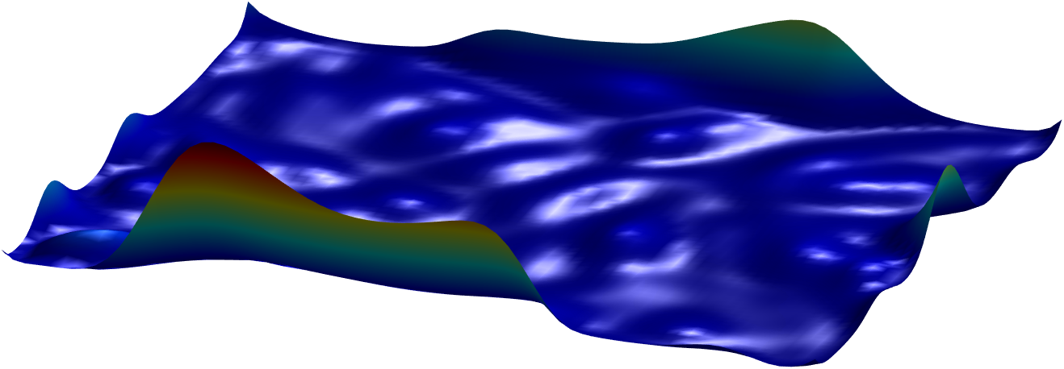
Significance: New Definition of “Information-Driven Sensing”
Sonar
GPS
IMU
Prediction
Environment
(seabed volcano)
Uncertainty
Informative Planner
Probabilistic Model
Existing work typically has strong assumptions of the probabilistic model:
Stationarity: different locations have the same degree of variability
Gaussian observational noise -> sensing outliers are ubiquitous in practice
Our work assumes data is of non-stationarity and with outliers

Slide 4
Field Experiments with Nonstationary Kernel

Slide 5
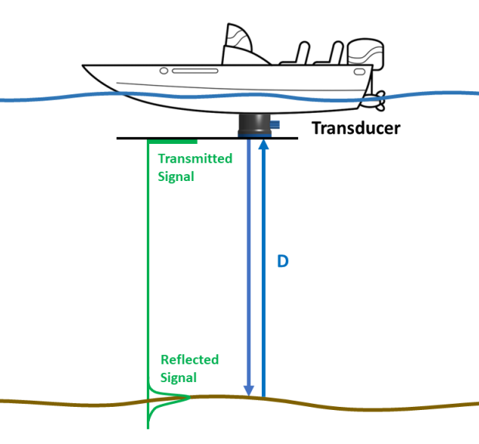
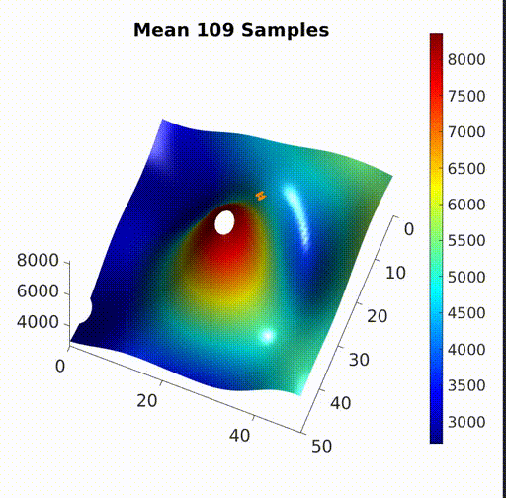
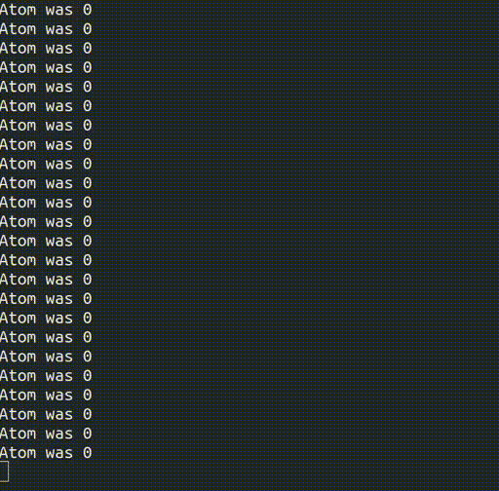
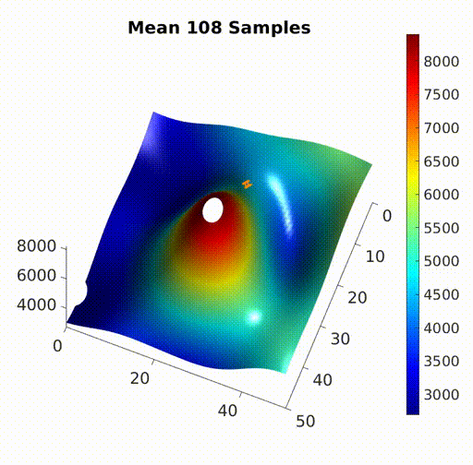
Outlier Filtering and Important Location Revisiting
Environment
No Filtering
Filtering
Filtering + Revisiting
Environment model learned on the fly with streamed sensing data

