Slide 2
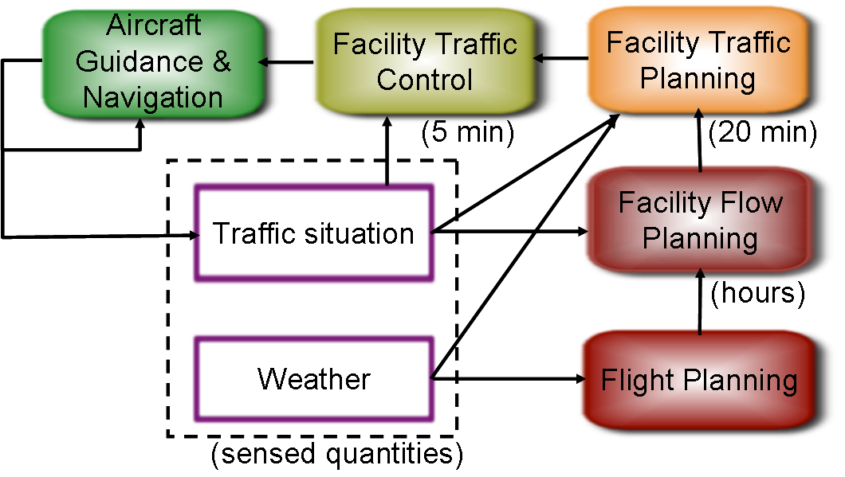
A Feedback View of NextGen Airspace
ActionWebs
In 2007, domestic air traffic delays cost the US economy $41 billion
    24% of arrivals at least 15 min late (avg. delay: 46 min)
    ~20% of total domestic flight time was delay
    1,565 flights delayed on the ground (not at gate) for over 3 hours
Notes:
Data sources: IATA, FAA ASPM and OPSNET databases, Bureau of Transportation Statistics, Joint Economic Committee, Airline Quality Rating 2008
More decentralized decision-making
More flexible and dynamic trajectories
Increase efficiency of operations
Increase operational robustness in the presence of weather
Decrease fuel burn and environmental impact
Multi-objective control techniques for balancing tradeoffs

Slide 3
CPS Features of NextGen and beyond:
Adaptive systems: “How to certify adaptive systems? How do you develop trust in these systems?”
Distributed systems
Human interactions
Incorporation of disruptive technologies
  Autonomy, electric aircraft
Mixed criticality systems: “Should we certify all 34000 pieces of equipment in the NAS infrastructure the same way we certify the airplane? What about new systems, like UAVs?”
Security in the loop: “Can we think about incorporating security evaluation into safety certification?”
Specification: “How to certify non-specified parts of the system?”
Non-deterministic code
Increased use of COTS components: integration
Design for certification
Design for re-use
Working in a living laboratory

