Slide 1
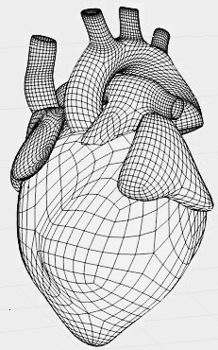
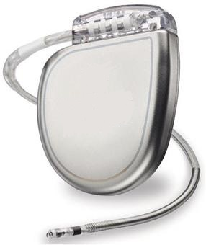
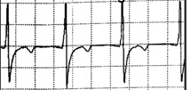
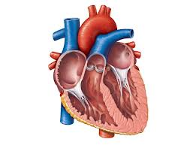
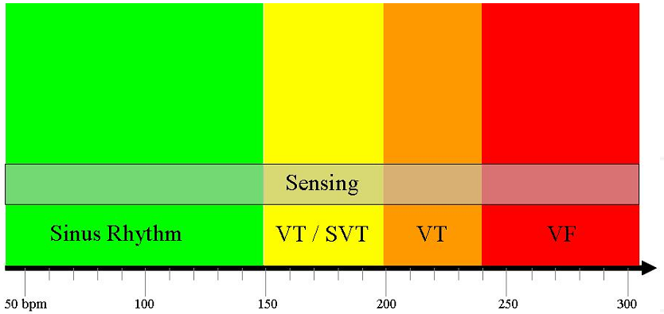
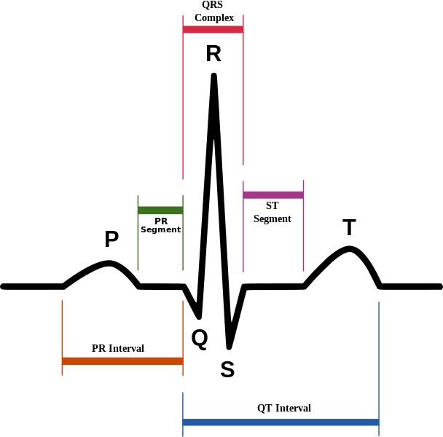
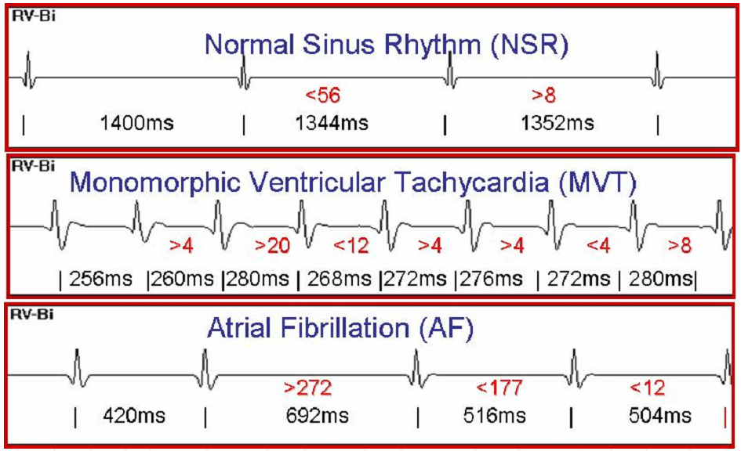
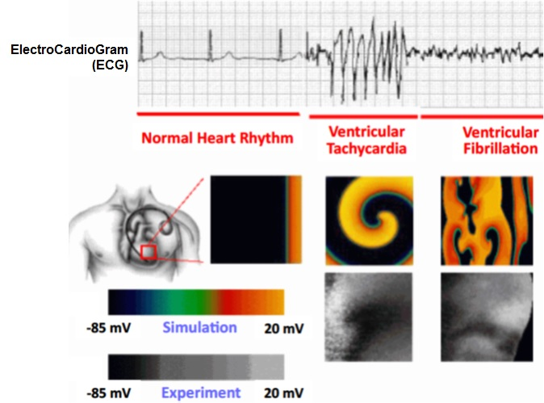
Closed-Loop Formal Verification of ICDs
using Cardiac Electrophysiological Models
Scott A. Smolka and Abhishek Murthy
Department of Computer Science, Stony Brook University
Formal Verification
Simulation-based Model Checking
Control Envelopes
Compositionality: $H×D$
Abstraction/
Refinement
$$⊨$$
Applications
ICD Control
$$φ$$
Defibrillation
?
VT-SVT Discrimination
$D$: ICD model
Heart State
$H$: Heart model
TFL Specifications
Electroporation
TFL Learning Maximize specificity
Device Modeling
Electrogram Features for
TFL Learning
PROJECT SUMMARY
Implantable Cardioverter Defibrillators (ICDs) are at the forefront of preventing sudden death in patients suffering from ventricular arrhythmias. ICDs have evolved into complex Cyber-Physical Systems (CPSs) that use sophisticated hardware & embedded software to diagnose arrhythmias based on electrogram signals & control cardiac excitation under varying physical conditions. Despite these advancements, the Verification & Validation (V&V) techniques used for establishing the reliability & safety of ICDs have remained somewhat informal, reliant on unit testing & largely agnostic to the patient's physiological conditions. The National Science Foundation (NSF)/Food & Drug Administration (FDA) Scholar-In-Residence (SIR) at FDA project will develop a model-based framework for formal verification of ICDs. Formal verification techniques, such as simulation-based model checking & reachability analysis, will be applied to high-fidelity cardiac electrophysiological models that capture the electrical excitation induced by the ICD’s control software. Safety requirements pertaining to common ICD problems, such as inappropriate shocking & VT/Supra-VT discrimination, will be specified using a Time-Frequency Logic (TFL), & automatically verified.
Time
Hear Rate (HR)
Interval Stability
Sudden Onset
Atrio-Ventricular HR ratios
Template-based Morphology
INTELLECTUAL MERIT & BROADER IMPACT
Intellectual Merit: The project will undertake several problems that are fundamental to CPS theory & deliver cross-cutting tools that can be applied to multiple CPS-based domains. An automated proof technique will be developed to establish input-to-output stability & robustness of dynamical systems. The proof technique will be used to create a hierarchy of cardiac models, ranging from highly detailed mechanistic ones to minimal caricature models, for verifying properties at varying levels of granularity. TFL, developed for requirements specification, can be applied to formally specify the emergent properties of a wide range of reaction-diffusion systems including the brain tissue.
Broader Impact: The project will have far-reaching impacts on device verification & regulation practices. The models & the algorithms delivered by the project would form the basis of an automated tool chain that can be used to verify compliance with device standards. By enabling the verification of complex requirements, such as VT/SVT discrimination & optimal shock delivery, the project aims to raise the standards of safety & reliability of ICDs. In the short term, the project will contribute to significantly minimizing device recalls & the risks of software-related failures. The next-generation verification tools developed in the project will be applicable to other medical devices such as infusion pumps & cardiac resynchronization therapy devices.
Hierarchy of Cardiac Models
Time
Far-field & near-field electrogram signals
Closed-Loop Verification Framework for ICDs.
CLOSED-LOOP COMPUTATIONAL MODELING
TIME-FREQUENCY LOGIC (TFL) SPECIFICATION
Device model $D$ & heart model $H$ are composed: $H×D$ captures electrical excitation of heart under ICD-control
Hierarchy of heart models for tractable V&V: Let $H_{1}$ be detailed model & $H_{2}$ abstract model
QRS Complex
PR Segment
ST
Segment
Heart Rate Ranges
PR Interval
QT Interval
Composed model: $H_{1}×D$
Composed model: $H_{2}×D$
ICD Control
?
ICD Control
Heart State
(Concrete)
$$≅_{δ}$$
Heart State
(Abstract)
$$D$$
$$H_{1}$$
$$D$$
$$H_{2}$$
Compositional Approach to ICD Verification.
Abstraction: i) model-order reduction of cell-level DEMs (depth), & ii) taking coarser networks of DEMs
Hierarchy of models: preserve properties-of-interest
Approximate equivalence characterized by Input-to-Output Stability
Stability
Using temporal and frequency-domain aspects of electrograms for specifying VT-SVT discrimination.
MOTIVATION
TFL [3] will be used to specify VT-SVT discrimination based on the following features of electrograms:
Heart Rate: inverse relationship with cycle length, the time interval between two consecutive R-peaks of the periodic electrogram.
Stability: variability in cycle lengths.
Sudden Onset criterion: compares the R-R interval to mean values & measures changes in the cycle lengths.
QRS Complex Morphology: compares the shape of the QRS complex to nominal patterns.
Atrio-Ventricular Heart-Rate Ratios: the ratio between the measured heart rates from the atria & the ventricles.
Dominant Frequency: efficacy of defibrillation depends on the Fourier transform of the electrograms.
Incremental Abstraction
EDUCATION & OUTREACH
JSR
NSR
Minimal Model
Repeatability Evaluation
Dissemination of Benchmarks
Course at FDA
(external input)
Buffer
Buffer
Subspace
Schematic diagram of the 67-variable Iyer et al. model [1].
Intermediate model
ACKNOWLEDGEMENTS
We thank NSF for the NSF/FDA SIR postdoctoral fellowship grant and previous grants CCF-0926190 and CCF-1018459.
Rest of the
IMW model
V
Rest of the
IMW model
V
REFERENCES
V. Iyer, R. Mazhari, & R. L. Winslow. A computational model of the human left-ventricular epicardial myocytes. Biophysical Journal, 87(3):1507-1525, 2004.
M. A. Islam, A. Murthy, A. Girard, S. A. Smolka, & R. Grosu. Compositionality results for cardiac cell dynamics. In Proceedings of the 17th International Conference on Hybrid Systems: Computation & Control. ACM, 2014.
A. Donzè, O. Maler, E. Bartocci, D. Nickovic, R. Grosu, and S. Smolka. On temporal logic and signal processing. In S. Chakraborty and M. Mukund, editors, Automated Technology for Verification and Analysis, Lecture Notes in Computer Science, pages 92–106. Springer Berlin Heidelberg, 2012.
Differential Equations-based Models (DEMs) of cardiac excitation
for model-based ICD verification.
$$Σ_{I}$$
Identify
Approx. Equivalent Abstractions using Curve Fitting
$$Σ_{H}$$
Since 2002, about 54 ICD-related recalls have been issued, of which 7 (13%) were due to software design
V&V of ICDs can leverage closed-loop DEMs of heart under ICD-control
13-var.
Sodium channel subsystem $Σ_{I}$
(13-var.)
(2-var.)
2-var.
Sodium channel subsystem $Σ_{H}$
Channel conductance $O$
$$O$$
Feedback-composition of the subsystems of the IMW model
First-order reduction: $Σ_{I}$ is replaced by approximately equivalent abstraction $Σ_{H}$
Hierarchy of models: detailed cell-level DEMs are incrementally reduced, one subsystem at a time [2].

