Slide 1


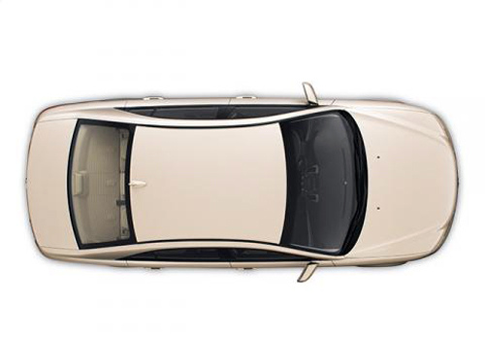



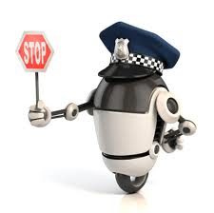
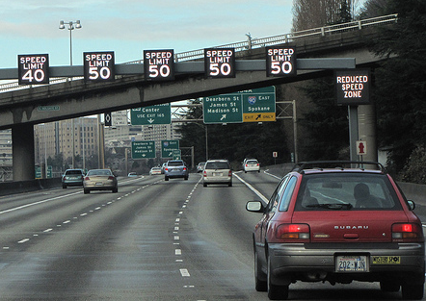
NSF Award 1232602
Collision Free Autonomous Ground Traffic: A Model Predictive Control Approach
P. R. Kumar (Texas A&M University), Kyoung-Dae Kim (University of Denver)
Motivation
Objective Function
Yield Protocol and Liveness
Intersection Crossing Algorithm
Ground Traffic System
Route planning
  Sequence of way points
MPC-level planning
  Drive a vehicle to way point
  Performance
    Time
    Comfort
    …
No guarantee for Lane Change Protocol
Inter-Vehicle (V2V) Ordering
  Given cars c¹ and c² at time t,
FIFO Crossing Algorithm (FCA)
Distributed
Robust
Safety-critical
  Consider cars c¹ and c² at time t.
    If c² has arrived earlier than c¹, then
Vehicles in C_{t} are totally ordered.
But, conservative
  At most one vehicle in A_{I}
Lane 1
Lane 2
Vehicle Kinematic Constraint
Yield means to slow down its speed.
Discrete-time unicycle vehicle model
  State: x := (x, y, θ)^{T}
  Input: u := (v, ω)^{T}
➔ c¹ yields to c²
Can we design autonomous ground traffic systems with provable system-wide safety?
Equality Constraint
Concurrent Crossing Algorithm (CCA)
    ‘Yield Protocol’ enforces that ‘Lane Change Condition’ will be satisfied, eventually.
Basic Idea
  Permit a vehicle if its intersection route does not conflict with already permitted vehicles
Perpetual Safety of Multi-lane Traffic
Our Approach
Longitudinal State Constraint
Lane Change Protocol
Keep safe distance to the front
  At least shortest-braking distance, d^{S}(v)
Multi-lane Traffic Safety
at time t
Yield Protocol
Multi-lane Traffic Safety
at time t+h
Safety and Liveness of CCA
Vehicle-Intersection Coordination
Existence of
MPC–based
Safe Motions
Safety
  Irrevocable permit to cross A_{I}
  No conflict between permitted vehicles
Liveness
  Every vehicle will eventually be permitted.
Intersection Crossing Algorithm
Inter-Vehicle Coordination
MPC for Autonomous Driving
Inter-Vehicle
Coordination
Lateral State Constraints for Maintaining Safety during Lane Change
Intersection
Key Idea
  Ensure that a vehicle stays within the free space during lane change
Track
Intersection Region (A_{I})
Communication Region (A_{C})
Inlet & Outlet Tracks
Intersection Route
Result on Safety and Liveness
MPC for Autonomous Driving
A_{C}
Concurrent IC Algorithm
IC Protocol
MPC for Motion Plans
Why MPC for Autonomous Driving?
A_{I}
Allow flexible choice of individual objective function for driving performance
Inter-vehicle safety in discrete domain provided by intersection infrastructure
V2I Interaction
Inter-vehicle safety in continuous domain provided by each vehicle
Time
C_{t} := A set of vehicles in A_{C} at
time t that need to cross A_{I}.
Inter-Vehicle Coordination
Intersection-Crossing Traffic is
Safe and Live
Lane Change Protocol
Intersection Crossing (IC) Protocol
Fuel
Comfort (Jerk)
When is a vehicle safe to change its lane?
Lane change is allowed only when these conditions are satisfied
  Suppose set of cars C_{t} is ordered by some ordering algorithm
  No lane change is
  allowed within A_{C}
  Stop before A_{I}
  if not allowed to enter A_{I}
  Highest order vehicles are
  allowed to enter A_{I}
Conclusion
Can incorporate various driving constraints
Vehicle constraints
  Acceleration, braking distance, steering limit, …
Other constraints
  Speed limit
  Lane width
  Safe distance
  …
Autonomous Ground Traffic System
  Distributed
  Robust
  Provably Safe and Live
Future Works
  Less conservative separation distance constraint
  High throughput intersection crossing algorithm
A_{C}
A_{I}

