Slide 1


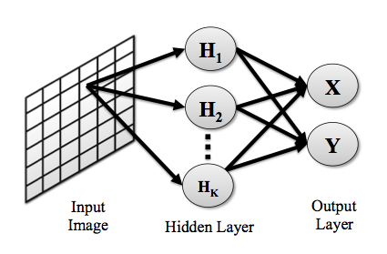
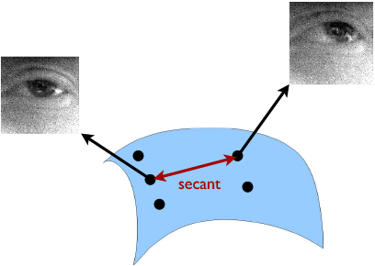
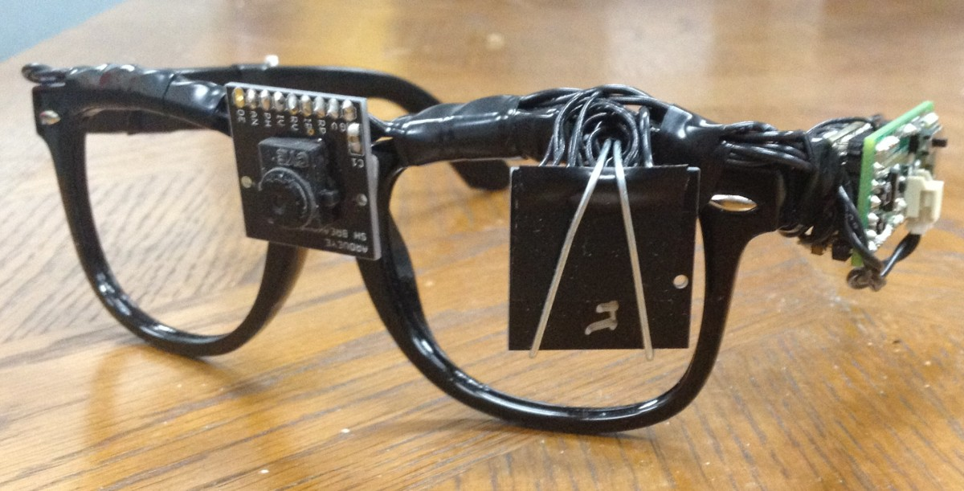
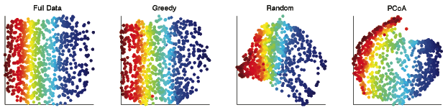
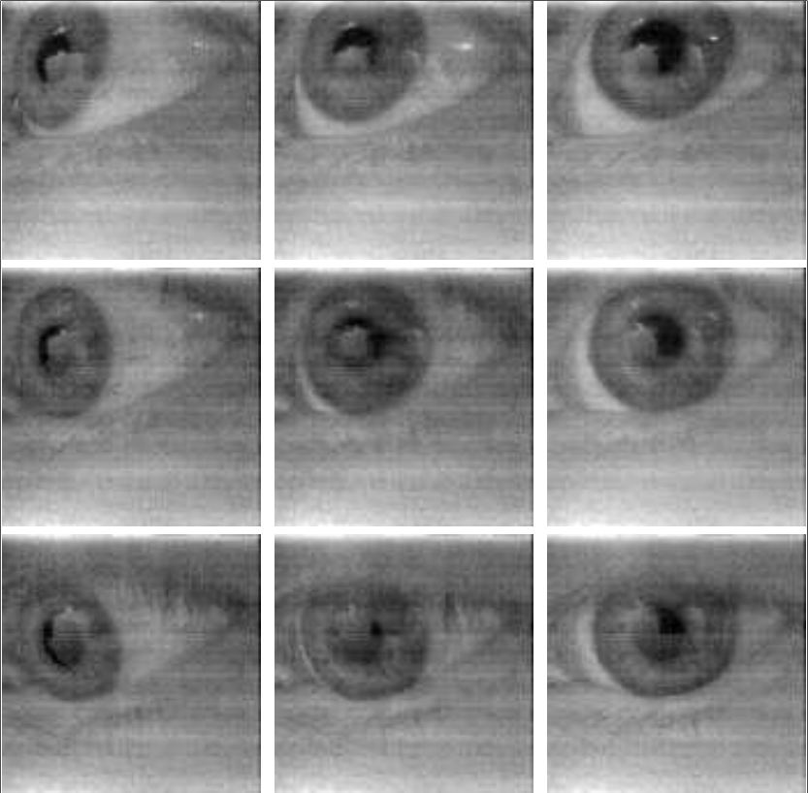

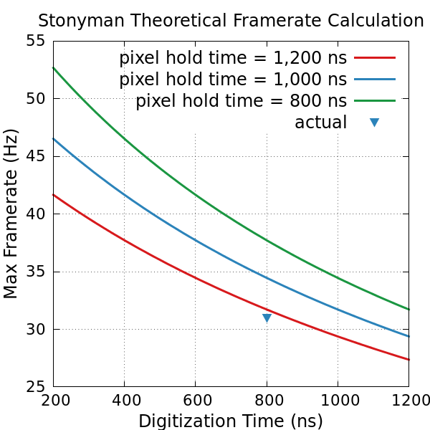
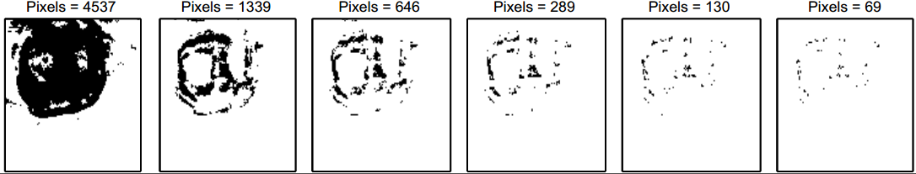
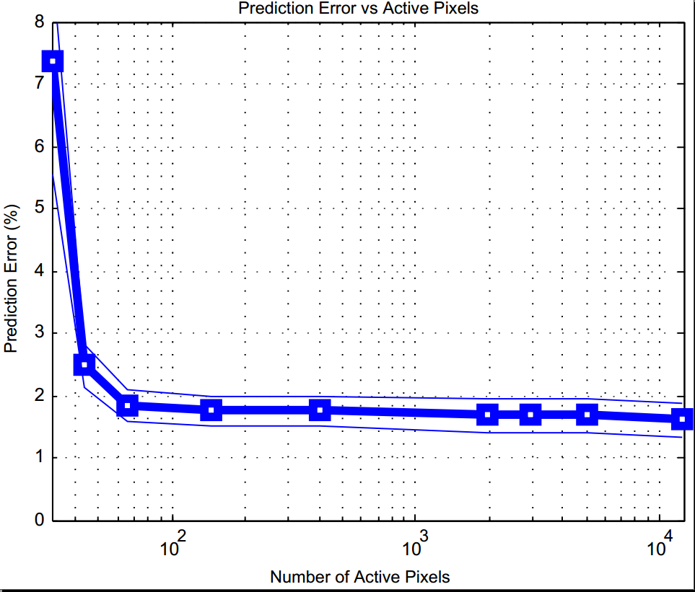
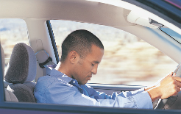
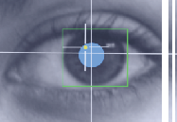
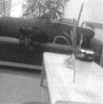
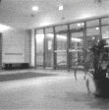
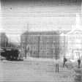

Computational Eyeglasses for Advanced Context Sensing
Faculty: Deepak Ganesan, Prabal Dutta, Benjamin Marlin, Marco Duarte, Christopher Salthouse
Students: Addison Mayberry, Russ Bielawski, Boyan Lu, Pan Hu, Hamid Dadkhahi, Venkatesh Murthy, Pengyu Zhang, Jeremy Gummeson
A Computational Eyeglasses Platform
Sparse Image Capture for Gaze Tracking
Subsampling Manifold Modeled Datasets
Mobile Crowdsourcing
Introduction
We posed gaze tracking as a classification problem
Our camera is accessed pixel-by-pixel, so if we are able to use fewer pixels we conserve power
By treating the pixels as our features, we can do an analysis to determine which pixels are providing the most valuable information
Manifold Learning: obtain a nonlinear low-dimensional representation of data that preserve the geometric structure present in higher-dimensional training data.
Manifold Learning on subsampled data: Subsampling the dimensions while preserving the structure relevant to manifold learning
The SensEye project aims to develop an end-to-end system that includes novel ultra-low power computational eyeglasses capable of detecting eye movement and features of the external environment. It will provide real-time sensing, processing, and inference capability. Using this system, we will be able to provide the fundamental knowledge base necessary to discover patterns of human behavior and to leverage such patterns to improve transportation and healthcare.
Classifier Model:
Subsampling Methods:
Optimization method: devise a subsampling that preserves the secants of the neighborhood graph. A fast greedy algorithm is used as an approximation
Random subsampling
Principal Coordinate Analysis (PCoA): picks pixels with highest variance
Computational Eyeglasses Prototype
Wireless eyeglasses platform prototype, consisting of a microcontroller, Bluetooth radio, lithium battery and two imagers. The eyeglasses can run continuously for six hours and weigh 65 g.
We collected training data of an eye looking at locations within a 3x3 grid
To develop a sparse model, we penalized the weights of pixels in a multinomial logistic regression
We are able to get low gaze prediction error with a small number of pixels
The SensEye prototype compares favorably with UCLA’s Cyclops, delivering twice the energy efficiency, with performance commensurate with the gaze prediction requirements.
The ground truth capture platform captures frames at 31 Hz, close to the theoretical limit of almost 35 Hz given a 1,000 ns pixel hold time.
Manifold structure is preserved with a subsampling rate of only 3%.
Sample Training Data
 | Cyclops+Telos | SensEye v1
Transmit Power (mW) | 52.9 | 227
Imaging Power (2) (mW) | 42 | 3.2
Processor Power (mW) | 5.4 | 56
Aggregate Power (mW) | 142.3 | 289.4
Theoretical Bandwidth (kbps) | 250 | 1500
Actual Bandwidth (kbps) |  | 921.6
Data Transmission Cost (nJ/bit) | 569.2 | 314
(a)
(b)
(c)
The resulting subsampling masks using (a)Random, (b)Greedy, and (c)PCoA methods.
The Sparse Model Generates Sparse Pixel Masks that require a small fraction of image data
CPS Applications
Sparse Pixel Sampling reduces energy consumption while maintaining high % Accuracy
Residual variance measures the correlation between the geodesic distance for full images and the Euclidean distances after masking and manifold learning.
Drowsiness Detection
Gaze Tracking
Scene Classification
Acknowledgements
Partial funding for the project came from the National Science Foundation, NSF Grant: 1239341
For More Information on SensEye, Please Visit:
http://sensors.cs.umass.edu/projects/senseye

