Slide 1

Control Computing and Communication
K. J. Åström
Department of Automatic Control LTH
Lund University

Slide 2
Computing
Physics
Engineering
Biology
Economy
Mathematics
Control
Communication

Slide 3
What is Controls?
Requirements: Specifications
Architecture: System structure, sensors, actuators, computers, communication, HMI
Modeling and simulation: Physics and data
Control Design: Models, algorithms and logic
Implementation: Verification and validation
Commissioning and tuning
Operation: Diagnostics, assessment, fault detection
Reconfiguration and upgrading
Notes:
Controls?

Slide 4
The Power of Feedback
Accurate systems from imprecise components
Reduce effects of disturbances and component variations
Regulate, stabilize and shape behavior
Drawbacks
  Risk of instability
  Sensor noise is fed into the system

Slide 5
The Computing Revolution
Vannevar Bush 1927. Engineering can progress no faster than the mathematical analysis on which it is based. Formal mathematics is frequently inadequate for numerous problems, a mechanical solution offers the most promise.
Herman Goldstine 1962. When things change by two orders of magnitude it is revolution not evolution.
Gordon Moore 1965: The number of transistors per square inch on integrated circuits has doubled in approximately 18 months.
Goldstine + Moore: A revolution every 10 years!

Slide 6
1. Introduction
2. A Bit of History
3. Simulation & Modeling
4. Computer Control
5. Summary

Slide 7
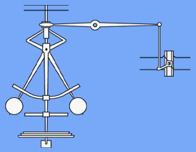
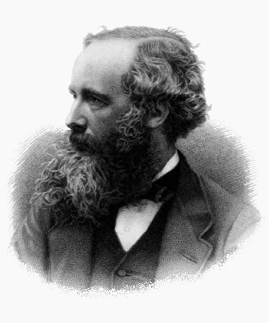
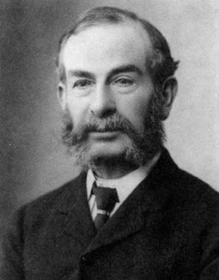
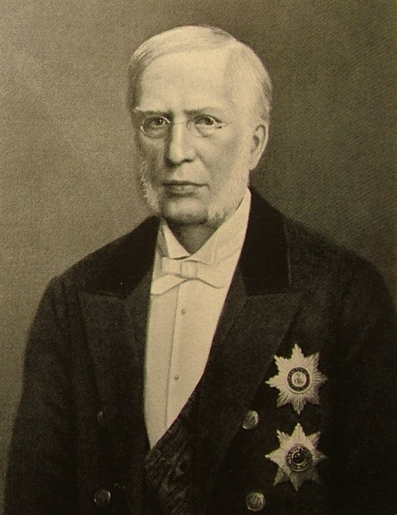
Governors
Problem: Run steam engines at constant speed
Solution: Centrifugal governor
Sensing, actuation, computing, communication, by mechanical devices
Stability theory Maxwell, Routh, Vyshnegradski
Integral action by differentials and ball and disk integrators

Slide 8
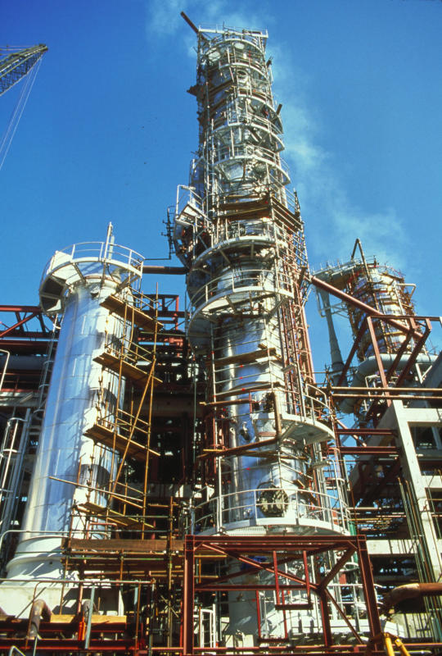
Process Control
Problem: Keep pressure, temperature and concentration constant in chemical processes
Solution: Pneumatic PID controller
Communication: Tubes with standard dimensions and connectors 3-15 psi, 4-20mA

Slide 9
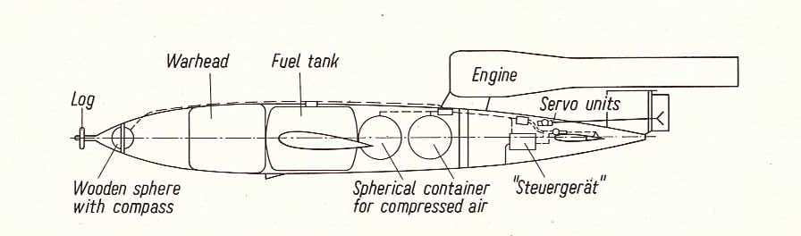
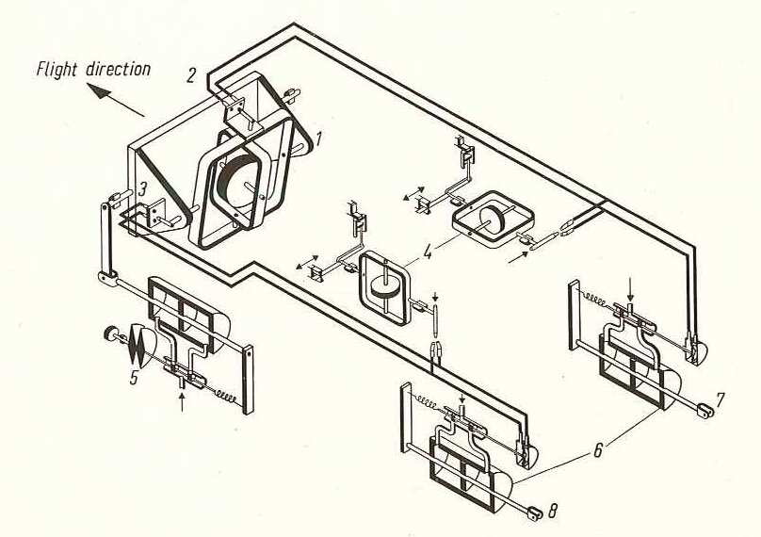
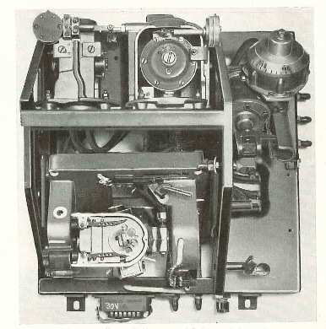
V1 Cruise Missile

Slide 10
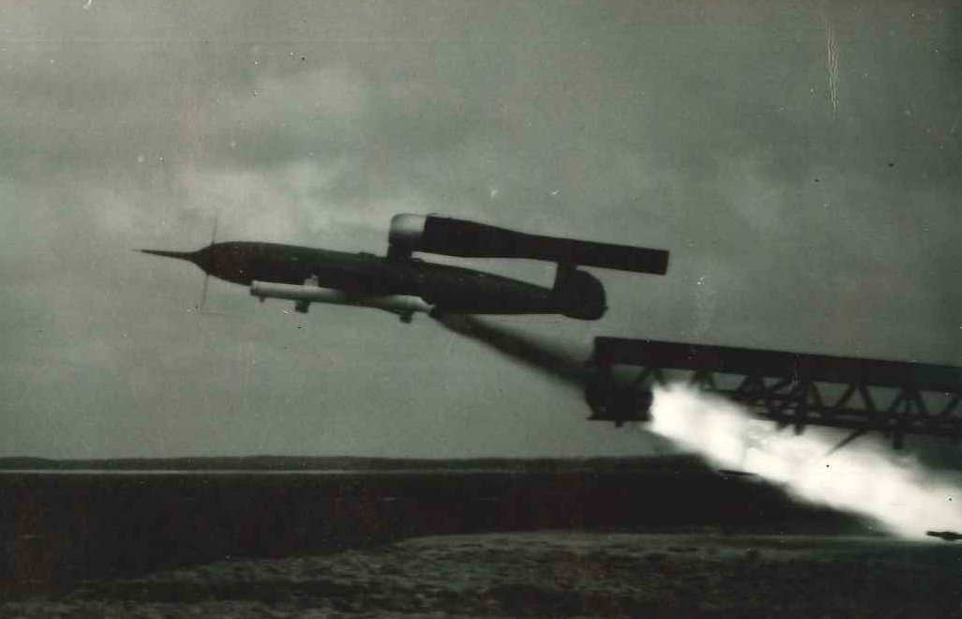
SS20 Cruise Missile

Slide 11
1. Introduction
2. A Bit of History
3. Simulation & Modeling
4. Computer Control
5. Summary

Slide 12
What is Controls?
Requirements: Specifications
Architecture: System structure, sensors, actuators, computers, communication, HMI
Modeling and simulation: Physics and data
Control Design: Models, algorithms and logic
Implementation: Verification and validation
Commissioning and tuning
Operation: Diagnostics, assessment, fault detection
Reconfiguration and upgrading
Notes:
Controls?

Slide 13
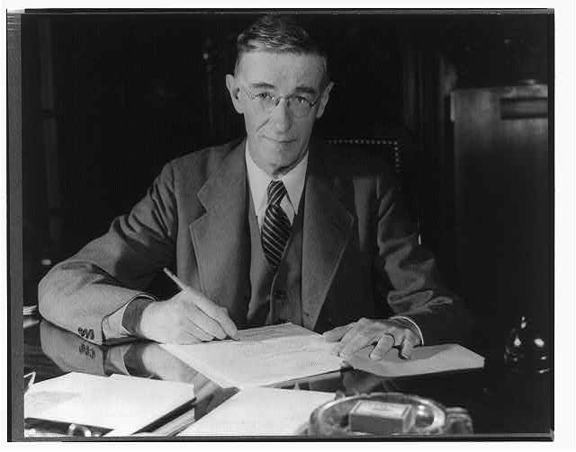
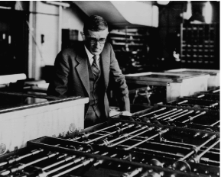
Vannevar Bush 1927
Engineering can progress no faster than the mathematical analysis on which it is based. Formal mathematics is frequently inadequate for numerous problems, a mechanical solution offers the most promise. (could solve 6 order ODE)

Slide 14
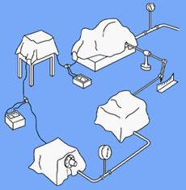
Block Diagram Modeling
Information hiding
Very useful abstraction
Essential for control
Close to analog computing
Causal inputs-output models
Blocks described by ODE
Base of analog computing
BUT not for serious physical modeling
Oppelt 1954

Slide 15
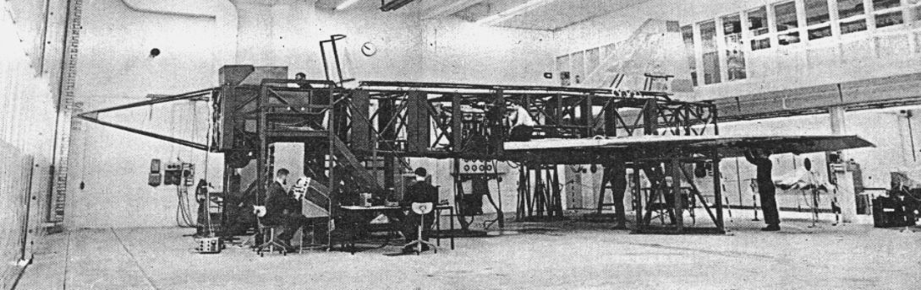
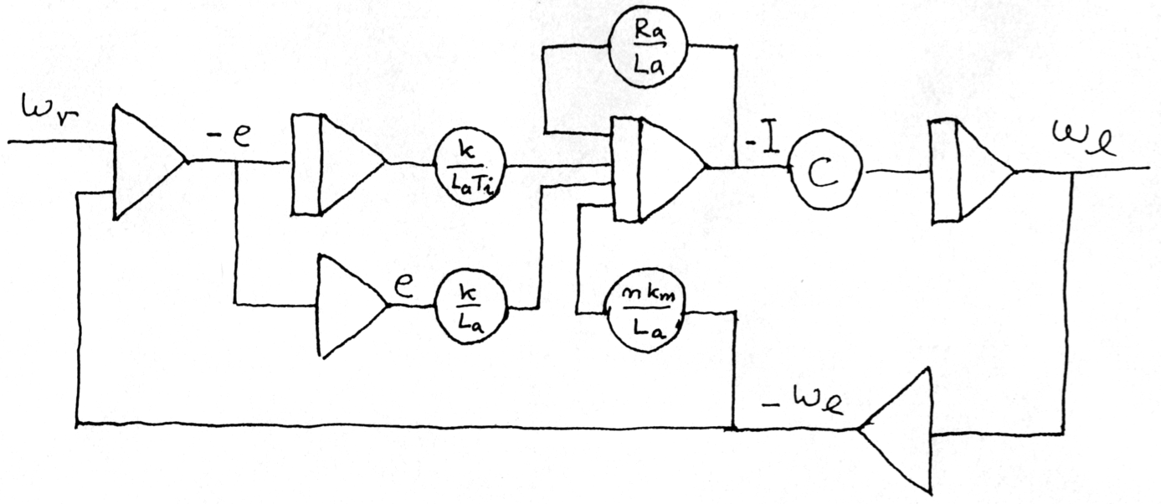
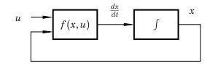
Analog Computing
Use a feedback loop to solve ODEs
Integrators and function generation
Parallelism
Algebraic loops
ODE
Granularity and aggregation
Alarms for out of scale!!

Slide 16
Digital Emulators
CSMP IBM 1962
MIMIC Wright-Patterson 1965
Babels tower > 30 emulators by 1965
CSSL Simulation Council 1967
ACSL Gauthier and Mitchell 1970
SIMNON Elmqvist 1975
MATLAB Cleve Moler 1980
System Build, MatrixX 1984
LabView 1986
Simulink 1991
Notes:
The differential analyzer
The ball and disk integrator and the torque amplifier
Vannevar Bush Hazen MIT
6 integrators
Copies in Manchester, Cambridge, Oslo
The electronic Differential Analyzer
The operational amplifier
George Philbrick, Ragazzini
Electronic Associates
Many homebrew Foa, Flygteknik, 1950
1955 SAMS

Slide 17
Simnon Elmqvist 1975
A block diagram language and an interactive simulator
Formal syntax in Bachus Naur format
Six basic commands: SYST, PAR, INIT SIMU, PLOT, AXES
Seven auxiliary: STORE, SHOW, DISP, SPLIT, HCOPY, ALGOR, ERROR
CONTINUOUS SYSTEM proc
Input u
Output y
State x
Der dx
dx=sat(u,0.1)
END
CONNECTING SYSTEM
yr(reg)=1; y(reg)=y(proc)
u(proc)=u(reg)
END
DISCRETE SYSTEM reg
Input yr y
Output u
State I
New nI
Tsamp ts
ts=t+h
v=k*e+I
u=sat(v.0.1)
nI=I+k*h*e/Ti+u-v
k:1
h:0.1
END
Notes:
The differential analyzer
The ball and disk integrator and the torque amplifier
Vannevar Bush Hazen MIT
6 integrators
Copies in Manchester, Cambridge, Oslo
The electronic Differential Analyzer
The operational amplifier
George Philbrick, Ragazzini
Electronic Associates
Many homebrew Foa, Flygteknik, 1950
1955 SAMS

Slide 18
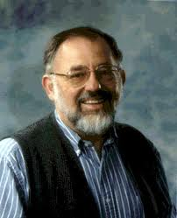
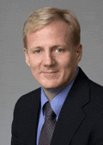
Matlab
Linpac, Cleve Moler 1980: MATLAB – An Interactive Matrix Laboratory, Workshop on Numerical Methods in Automatic Control Lund Sept 1980
Systems Control Inc Palo Alto CTRL-C – Control extensions to Moler’s FORTRAN code
Integrated Systems Inc (ISI), Matrix-X 1982, SystemBuild 1984, Code generation
John Little MathWorks1984, PC Matlab, C, Simulink, Toolboxes
Scilab INRIA 2003, Octave GNU 1993, SysQuake (interactive) Calerga 1998
Comsol FemLab (PDE modeling) 2000
Notes:
The differential analyzer
The ball and disk integrator and the torque amplifier
Vannevar Bush Hazen MIT
6 integrators
Copies in Manchester, Cambridge, Oslo
The electronic Differential Analyzer
The operational amplifier
George Philbrick, Ragazzini
Electronic Associates
Many homebrew Foa, Flygteknik, 1950
1955 SAMS

Slide 19
Simulink the Ultimate
Block Diagram Tool
Mimics the analog computer with more general blocks
Each block a state model
Matlab-Simulink
Granularity and Structuring
Graphical aggregation and disaggregation
Much manual manipulation from physics to blocks
Formal syntax not publicly available

Slide 20
Drawbacks of BDM
States may disappear – warning algebraic loop
Composition does not work
Much manual labor, the same parameter in many blocks
Block diagrams not suitable for physical modeling

Slide 21
Modeling Paradigms
Block diagram modeling not suitable for serious physical modeling
Bondgraphs (Paynter) works well if there is only one essential balance equation but very complicated otherwise
Circuit theory: two ports, Kirchoffs laws, DAEs, Gears integration algorithm 1971
Back to physics: mass, momentum and energy balances equation+based
Notes:
The differential analyzer
The ball and disk integrator and the torque amplifier
Vannevar Bush Hazen MIT
6 integrators
Copies in Manchester, Cambridge, Oslo
The electronic Differential Analyzer
The operational amplifier
George Philbrick, Ragazzini
Electronic Associates
Many homebrew Foa, Flygteknik, 1950
1955 SAMS

Slide 22
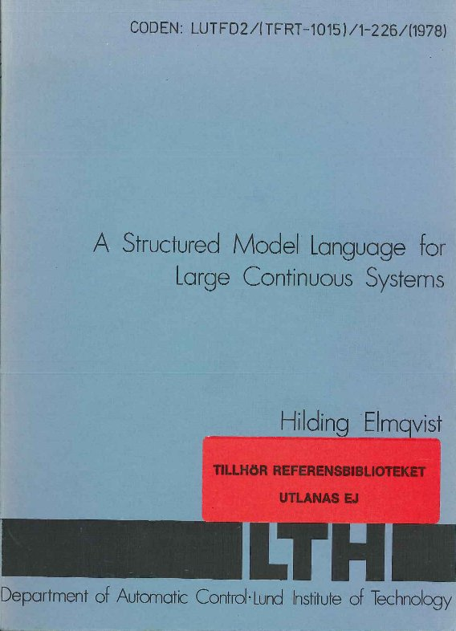
Early Development
SPICE Electrical Circuits – Physics much richer
DAE Solvers Gear Petzold
SPEEDUP Chemical
Multibody Mechanical Adams
Dymola Elmqvist LTH BNF
Object orientation (Simula)
Extensive symbolic computing
Boiler-turbine test case
Great idea but premature
Omola-Omsim LU 1990 --
Dynasim 1991 – Dymola (Toyota Prius, DLR)
1978
www.control.lth.se/Publication/elm78dis.html
Notes:
The differential analyzer
The ball and disk integrator and the torque amplifier
Vannevar Bush Hazen MIT
6 integrators
Copies in Manchester, Cambridge, Oslo
The electronic Differential Analyzer
The operational amplifier
George Philbrick, Ragazzini
Electronic Associates
Many homebrew Foa, Flygteknik, 1950
1955 SAMS

Slide 23
Computations
Eliminate trivial equation
Index reduction
Reduction to BLT (Block lower triangular form)
Analytic solution of linear equations
Solve nonlinear equations (tearing, iterations)

Slide 24
The Road to Modelica
Too much for a single group: multi-domain modeling, numerics, computer science, control, software
Omola Omsim (LTH) & Dmola (Dynasim 1991)
ESPRIT Simulation in Europe, Lund Sept 1996
COSY meeting Lund Sept 5-7, 1996
European groups: 23 participants, 17 talks from Dynasim, LTH, ETH Zurich, INRIA Paris, DLR Munich, VTT Helsinki, Imperial College London, LTH Lund, RWTH Aachen, Barcelona, Groningen, Valencia, Wien
Modelica language group formed
First Modelica language specification Sept 1997

Slide 25

A unified object-oriented language for systems modeling
Component-based, multi-domain physical systems
Syntax formally defined
Behavior-based (equation-based, declarative, DAE)
Automatic inversion, efficient real-time code generation
Libraries and reuse
Modelica association Non-proprietory
Language Specification 3.3 May 2012
Modelica’2012 9th Modelica Conference
78th Modelica Design Meeting Mar 11 2013
Modelica home page www.modelica.org

Slide 26
Modeling Cyber Systems
Safe mission critical embedded system
Control
Differential & difference eqations
Logic & finite state machines
Communication
  Delays, data loss, protocols
Distributed systems – synchronizatoion
French research in synchronous languages
Modelica 3.3
Variables – units
Time – rational number: sample, hold
Hierarchical finite state machines
Notes:
The differential analyzer
The ball and disk integrator and the torque amplifier
Vannevar Bush Hazen MIT
6 integrators
Copies in Manchester, Cambridge, Oslo
The electronic Differential Analyzer
The operational amplifier
George Philbrick, Ragazzini
Electronic Associates
Many homebrew Foa, Flygteknik, 1950
1955 SAMS

Slide 27
A Tool Chain
One tool cannot do everything
Requirements
Architecture: System structure, sensors, actuators, computers, communication, HMI
Modeling and simulation: Physics and data
Control Design: Models, algorithms and logic
Implementation code generation: V&V and HIL
Commissioning and tuning
Operation: Diagnostics, assessment, fault detection
Reconfiguration and upgrading

Slide 28
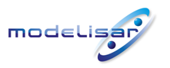
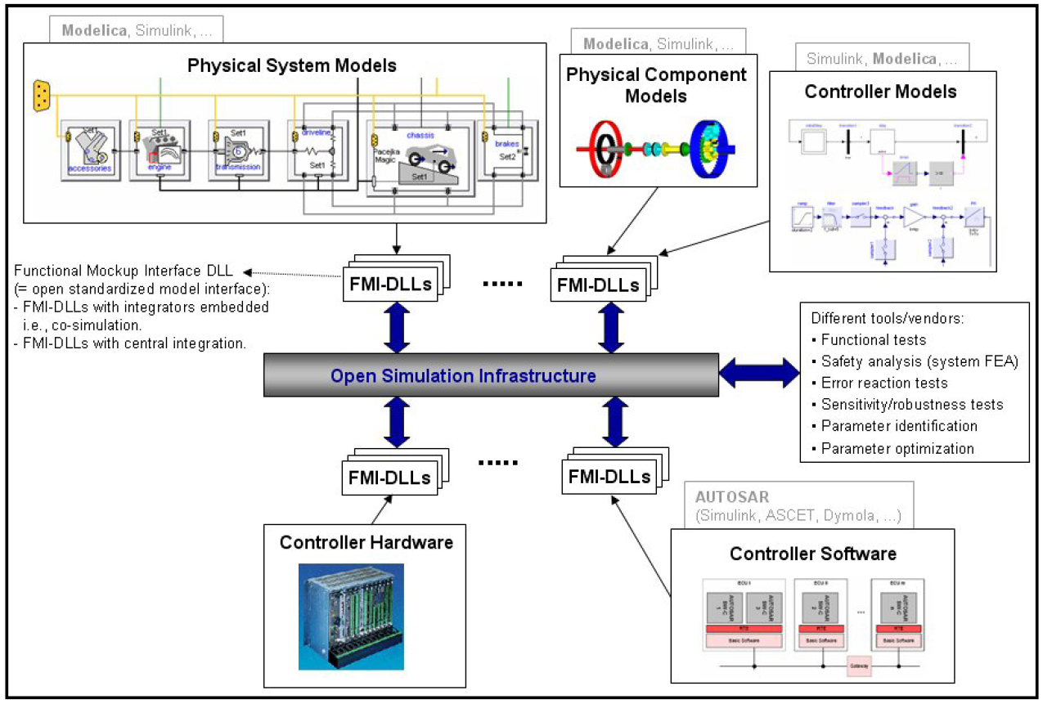
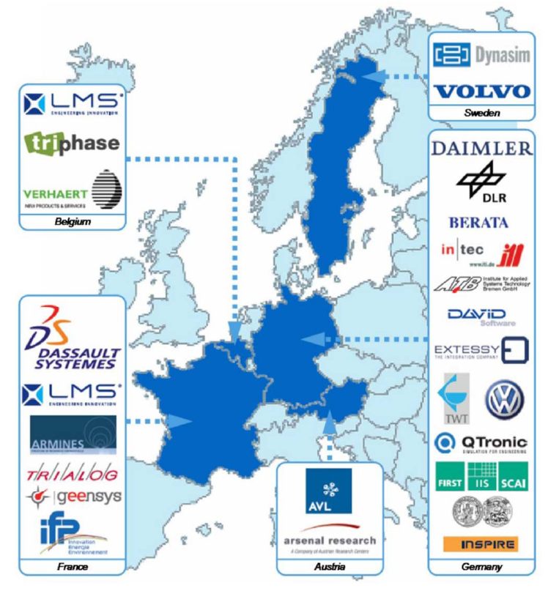
Combining Tools
Functional mockup interface FMI

Slide 29
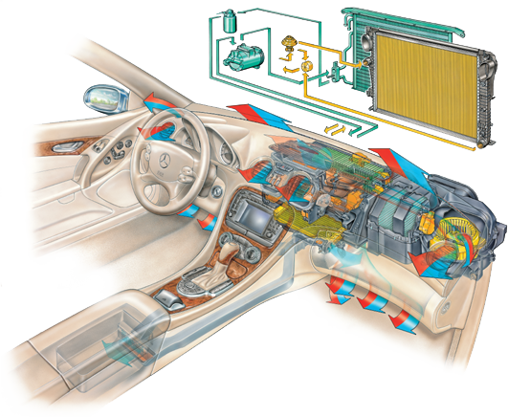

Automotive Climate Control
  Audi, BMW, Daimler, Ford, Volvo, VW and their suppliers have standardized MBD based on Modelica
Suppliers provide components and validated Modelica
Car manufacturers evaluate complete system by simulation
IP protected by extensive encryption
Substantial reduction of road & climate chamber testing
Picture courtesy of Behr GmbH & Co.

Slide 30
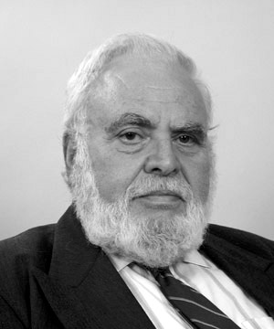
Golomb On Modeling
Don’t apply a model until you understand the simplifying assumptions on which it is based and can test their applicability.
Distinguish at all times between the model and the real world. You will never strike oil by drilling through the map!
Don’t expect that by having named a demon you have destroyed him
The purpose of notation and terminology should be to enhance insight and facilitate computation – not to impress or confuse the uninitiated
Solomon Golomb: Mathematical models – Uses and limitations. Aeronautical J 1968

Slide 31
1. Introduction
2. A Bit of History
3. Simulation & Modeling
4. Computer Control
5. Summary

Slide 32
What is Controls?
Requirements: Specifications
Architecture: System structure, sensors, actuators, computers, communication, HMI
Modeling and simulation: Physics and data
Control Design: Models, algorithms and logic
Implementation: Verification and validation
Commissioning and tuning
Operation: Diagnostics, assessment, fault detection
Reconfiguration and upgrading
Notes:
Controls?

Slide 33
Computer Conntrol 1960-2000
Driving force 1: Space race, cold war: Polaris, SAGE, Apollo, flight control
Driving force 2: Computerized process control:
Port Arthur – TRW 1959, IBM 1710. 1720, 1800
Direct Digital Control 1962
DCS Honeywell Yokogawa 1975
Fieldbus, wireless and networks 1985, 1995
Driving force 3: Automotive

Slide 34
Sampled Data Control
Represent y(t) by {y(kh)} for k = 0, 1, 2, . . .
Injectivity if h < 1/ f Shannon reconstruction
Time invariant continuous systems periodic systems
Nice theory: Stroboscopic model, intersample behavior, lifting
Powerful control design methods
Standard way to design computer controlled systems
Time-triggered architecture for safe implementation
Difficulties with
Multi-rate sampling
Communication nets, variable delays, sampling jitter
Biological systems – other signal forms no central clock

Slide 35
Event Based Control
Riemann or Lebesgue sampling

Slide 36
Example
dx=udt+dw
Minimize mean square output
V_{zoh}=0.79 h, V_{ih}=0.5h, V_{eih}=0.17h

Slide 37
Simulation

Slide 38
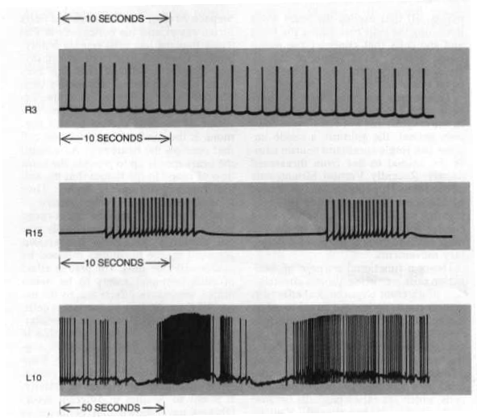
Real Neurons

Slide 39
Polaris Computer
Late 1950s
Digital differential analyzer
Early use of integrated circuits
Draper (Instrumentation) Lab MIT
Eldon Hall (Hall diagram)
Apollo Guidance Computers : 16 bit, 2 MHz, 2k RAM (core), 36k ROM

Slide 40
Computer Control 1964
IBM 1720 (spec ver 1620 decimal architecture)
Core Memory 40k words (decimal digits)
Disk 2 M decimal digits
80 Analog Inputs, 22 Pulse Counts
100 Digital Inputs
45 Analog Outputs (Pulse width)
14 Digital Outputs
Fastest sampling rate 3.6 s
One hardware interrupt (special engineering)
Home brew operating system

Slide 41
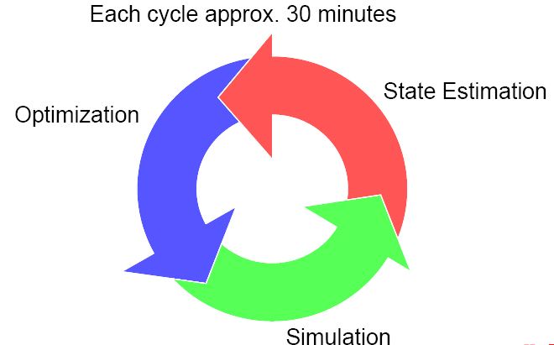
Mill Wide Control
Dynamic
mass balance
Billerud Gruvön plant
Lockmannkolonn
inletPulp
inletSteam
outletNCG
7
8
outletBL
6
Diffusören är inbakad i kokaren
Flash 1-spliten är en intern loop
inletWL
outletCondensate
Modelica modeling
inletWater
outletPulp
25 Production units
38 Buffer tanks
250 Streams
250 Measurements
2500 Variables
Slide from Alf Isaksson ABB

Slide 42
Global Enterprise Control
Strategic, Enterprise system, global, 1-10 years
Tactical, Manufacturing system, 10 km, year, shift,
Operational, Process Control, 1 km, shift, ms

Slide 43
Driving Forces 2000--
Networks
Autonomy
Complexity
Correctness by design
Scalability
Telecom LTE/4G 100 ms vs 5G (~2020) 1ms
Embedded Systems: Software enabled control, ARTIST, ARTEMIS
Cyber-physical systems

Slide 44
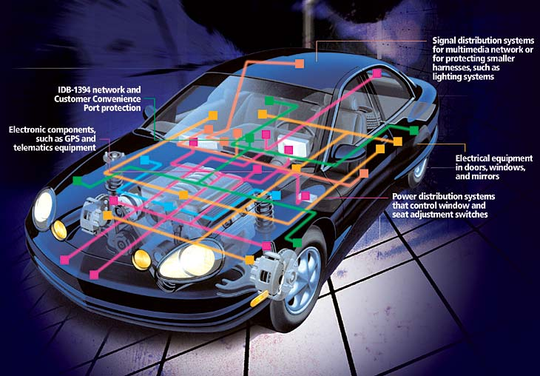
Automotive
Strong technology driver 8 million cars per year!Microcontroller, Autosar
Power trains
Adaptive cruise control
Collision avoidance
Traction control
Lane guidance assistance
Traffic flow control
Platooning
Autonomy
KTH & Scania
Notes:
Slide Page Guidelines
The slide title can be 36-point or 32-point (but never smaller) and always BOLD.
The slide title should not be underlined or italicized, and the text box that contains it should never be moved.
The body of the slide should follow the above format with regard to size and bullet format.
The body text CAN be emphasized (bold, italics, underline).
Graphic Guidelines
Graphics belong below the major text, not above it. (Captions may be included below the graphics.)
Graphics go to the right of the body text.
Colors should be darker and not muted. Do not use yellow, orange, or other light colors for important information. Keep in mind this information needs to show up when printed in black and white.
Colors should not “define” something in the text. You are not able to match the color definition when printing in black and white.

Slide 45
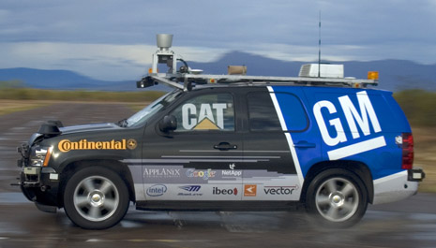
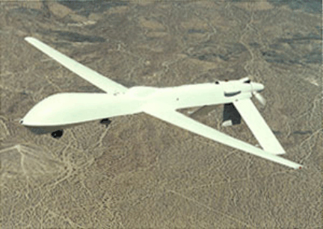
Autonomous Systems
Adaptation
Learning
Cognition
Safety
Diagnostics
Maintenance
Reconfiguration
Darpa Urban Challenge
Dickmanns 1995 - 95% autonomi
Google driverless car

Slide 46
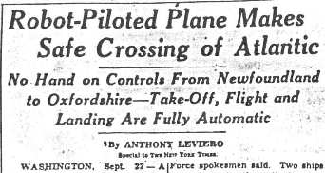
Autonomy
September 1947 C-54
Sperry A-12 autopilot
Bendix automatic throttle control
IBM punch card equipment provided input to autopilots
Notes:
September 23, 1947 C-54
Sperry A-12 autopilot
Bendix automatic throttle control
IBM punch card equipment provided input to autopilots
No human touched the controls from start until landing
Selection of radio station, course, speed, flap setting,
landing gear position, final application of wheel brakes all
accomplished from program stored on punch cards.

Slide 47
1. Introduction
2. A Bit of History
3. Simulation & Modeling
4. Computer Control
5. Summary

Slide 48
What is Controls?
Requirements: Specifications
Architecture: System structure, sensors, actuators, computers, communication, HMI
Modeling and simulation: Physics and data
Control Design: Models, algorithms and logic
Implementation: Verification and validation
Commissioning and tuning
Operation: Diagnostics, assessment, fault detection
Reconfiguration and upgrading
Notes:
Controls?

Slide 49
Educational Challenges
  Educating the future engineers
  Control, communication, computer science
  The dilemma of emerging fields
  Filter out the fundamentals and exploit advances in computing. Curriculum compression!
  Deep knowledge in specific areas
  Broad knowledge of neighboring fields
  Ability to communicate and to work in teams

Slide 50
Computing
Physics
Engineering
Biology
Economy
Mathematics
Control
Communication

Slide 51
NAE The Engineer of 2020

Slide 52
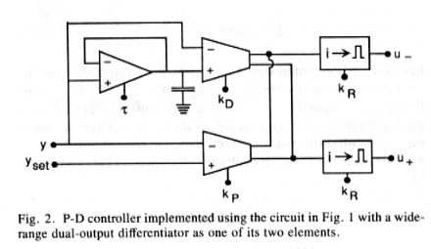
Silicon Neurons
Analog VLSI integrated with sensors,
redundancy by multiple circuits.
DeWeerth, Nielsen, Mead, Astrom A simple neuron servo. IEEE Trans. Neural Networks 1991(2),248-251

Slide 53
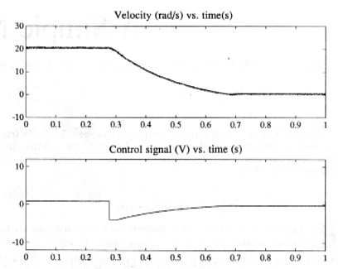
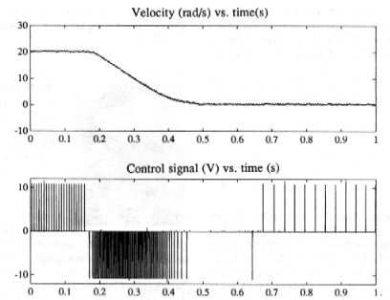
Experiments
Neurons implemented as asynchronous systems in analog
VLSI, processing of the encoder signals were made on the
same chip. Many parallel systems implemented pulses were
added to give high reliability!

Slide 54
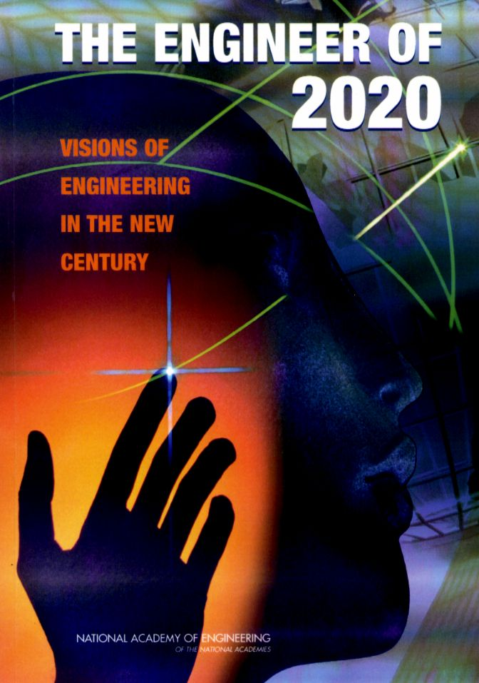
The Systems Perspective
In the past steady increases in knowledge has spawned new microdisciplines within engineering. However, contemporary challenges – from biomedical devices to complex manufacturing designs to large systems of networked devices – increasingly require a systems perspective
NAE The Engineer of 2020

Slide 55
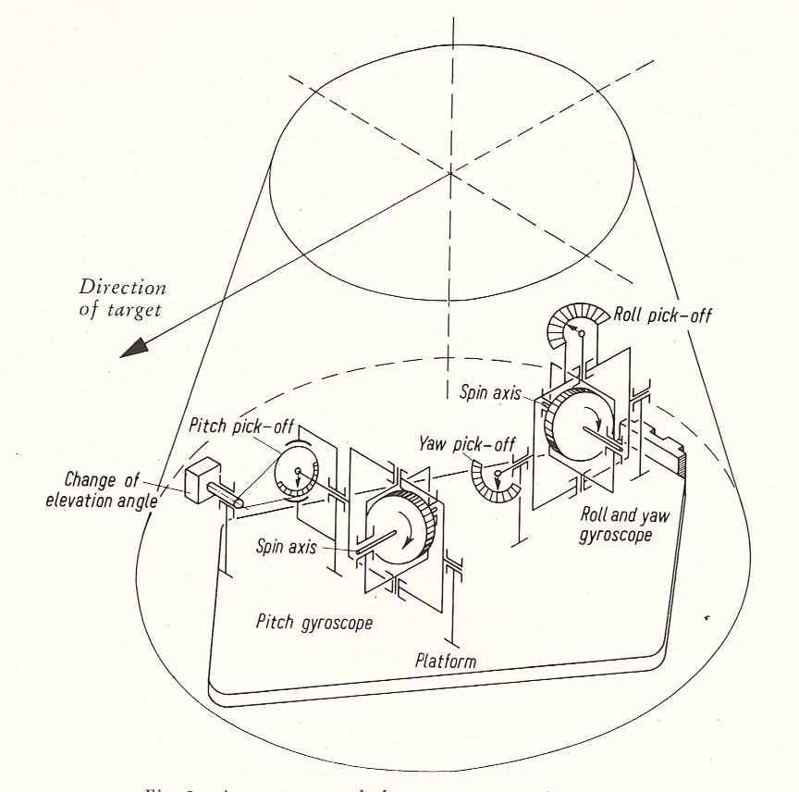
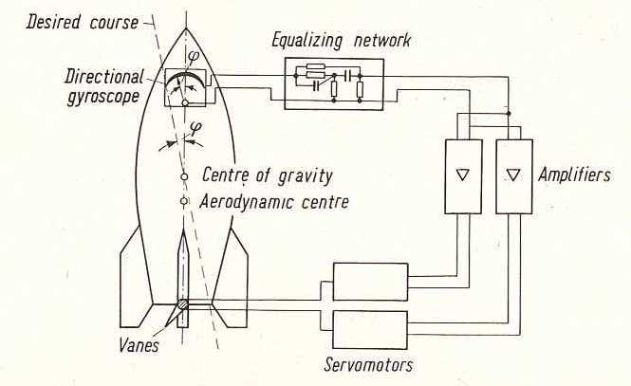
V2 Ballistic Missile

Slide 56
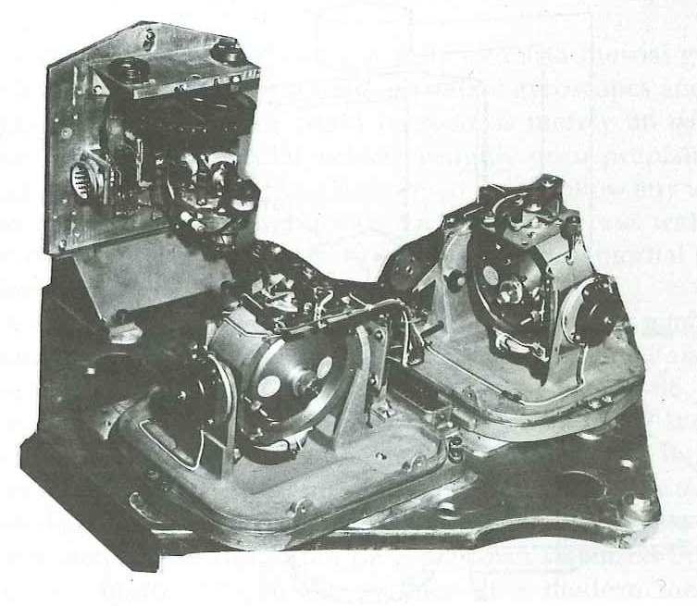

Slide 57
Analog Computing
Use a feedback loop to solve ODEs
Integrators and function generation
Parallelism
Algebraic loops
Ordinary differential equations
Granularity and aggregation
Alarms for out of scale!!

Slide 58
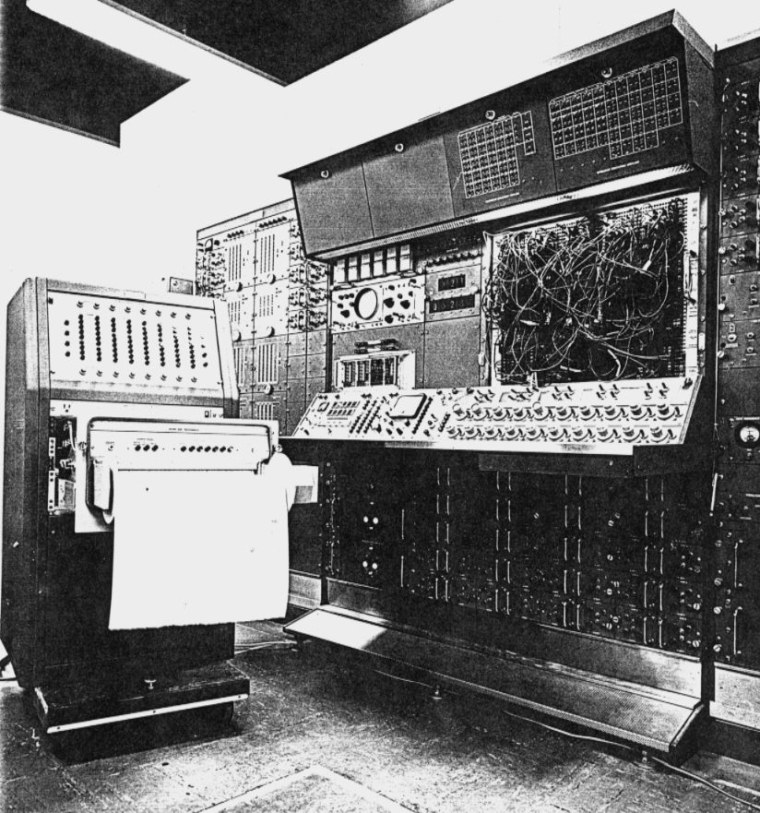
Analog Simulation - HIL
Ordinary differential equations dx/dt=f(x,p)
Scaling
Patching
Set initial conditions and parameters
Direct manipulation of parameters
Print results
Hardware in the loop simulation
Simulation centers

Slide 59
Elmqvist’s PhD Thesis
Control requires models from many domains
Strong industrial interest in SIMNON, demands for extensions, matrices, hierarchies. Is this a good thesis topic? Transpiration/inspiration?
More interesting to make a modeling language
Modeling paradigm – balance equations
Object orientation (Simula)
Symbolic computations DAE
Great ideas but premature
Bolier model worked
1978
Notes:
The differential analyzer
The ball and disk integrator and the torque amplifier
Vannevar Bush Hazen MIT
6 integrators
Copies in Manchester, Cambridge, Oslo
The electronic Differential Analyzer
The operational amplifier
George Philbrick, Ragazzini
Electronic Associates
Many homebrew Foa, Flygteknik, 1950
1955 SAMS

Slide 60
Omola-Omsim Modelica
Research on CACE stopped around 1980 because of computer, software techology and MATLAB
New research project 1990 Object Oriented Modeling and Simulation: Mattsson, Andersson, Nilsson, Bruck
Extensive symbolic manipulation (Mattsson)
Index reduction
Dynasim Lund 1991, DLR, Toyota Prius
The 1996 Lund Workshops and Modelica meeting
Johan Åkesson Optimica and JModelica

Slide 61
Physical Modeling
Cut a system into subsystems
Define interfaces account for interactions
Mass, momentum and energy balances for each subsystem
Subsystems described by DAE not ODE
Constitutive equations and data bases for material properties
Symbolic computing to transform the model
Libraries for reuse

Slide 62
Modeling and Simulation
There will be growth in areas of simulation and modeling around the creation of new engineering “structures”. Computer-based design-build engineering ... will become the norm for most product designs, accelerating the creation of complex structures for which multiple subsystems combine to form a final product.
NAE The Engineer of 2020

