Slide 1
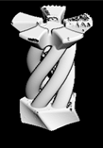
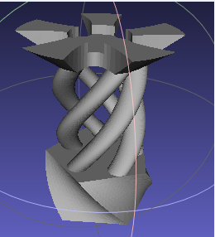
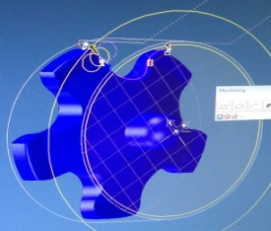
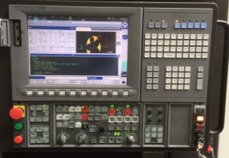
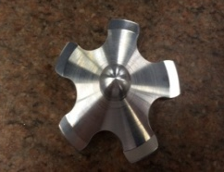
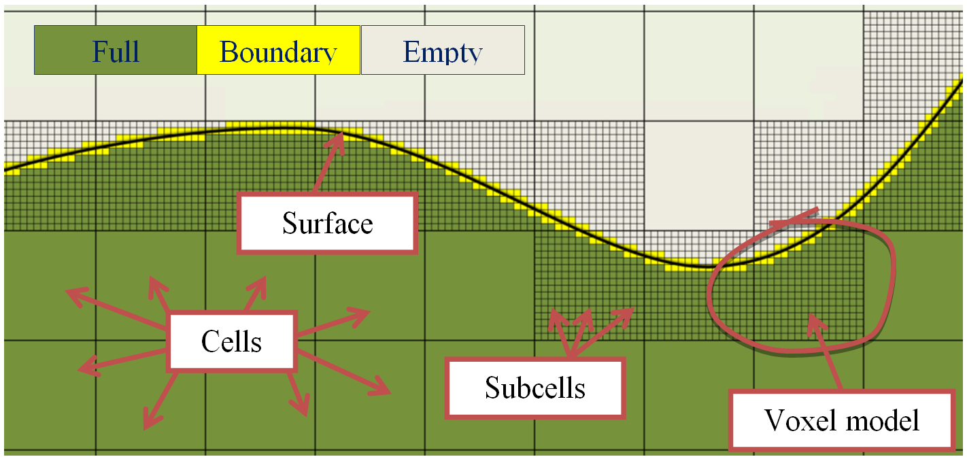
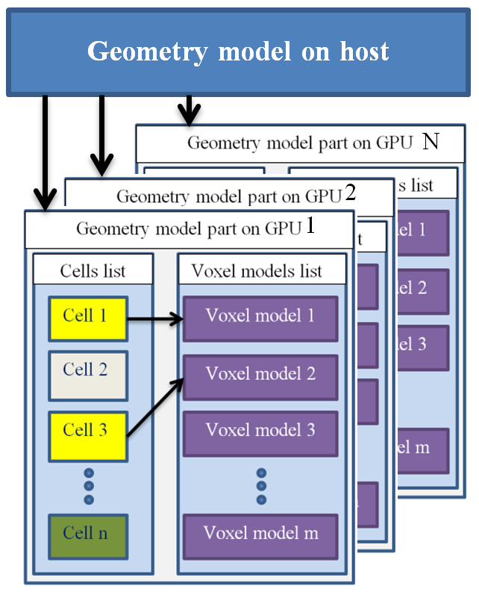
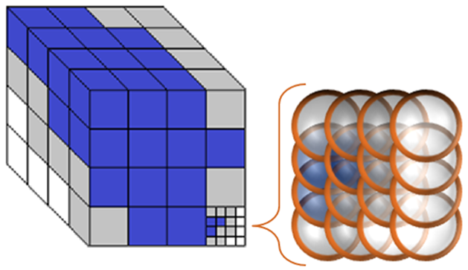
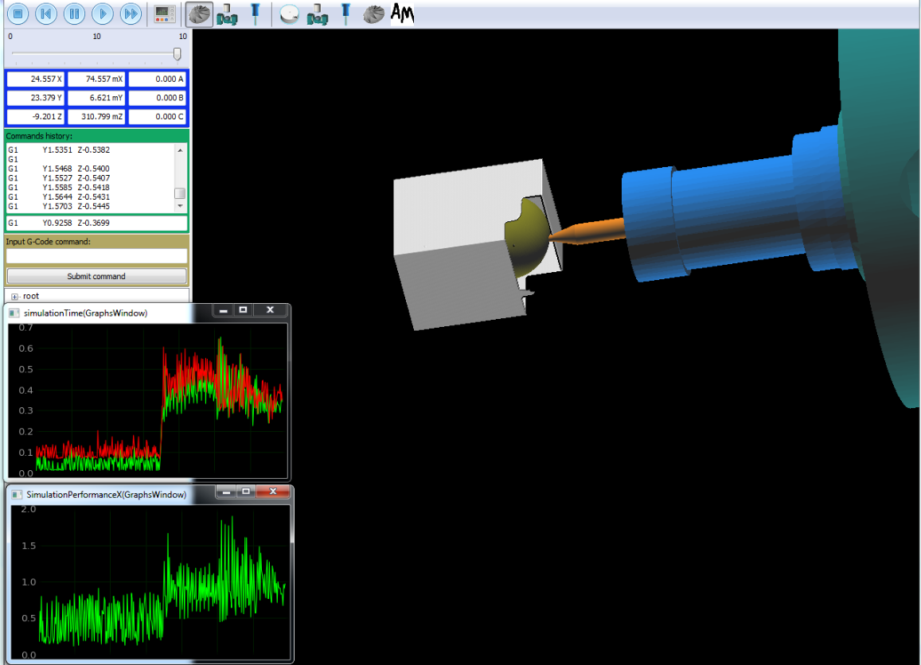
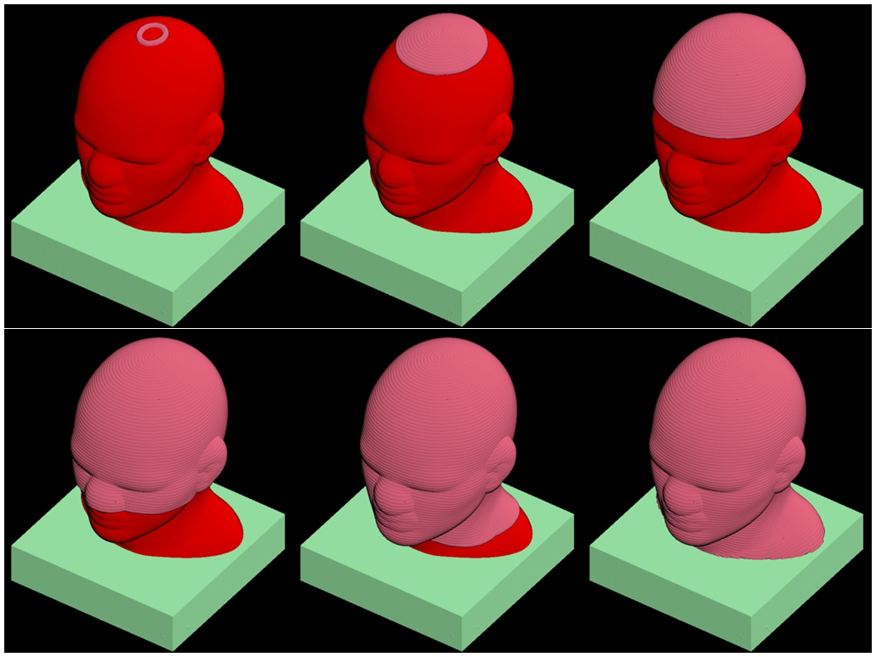
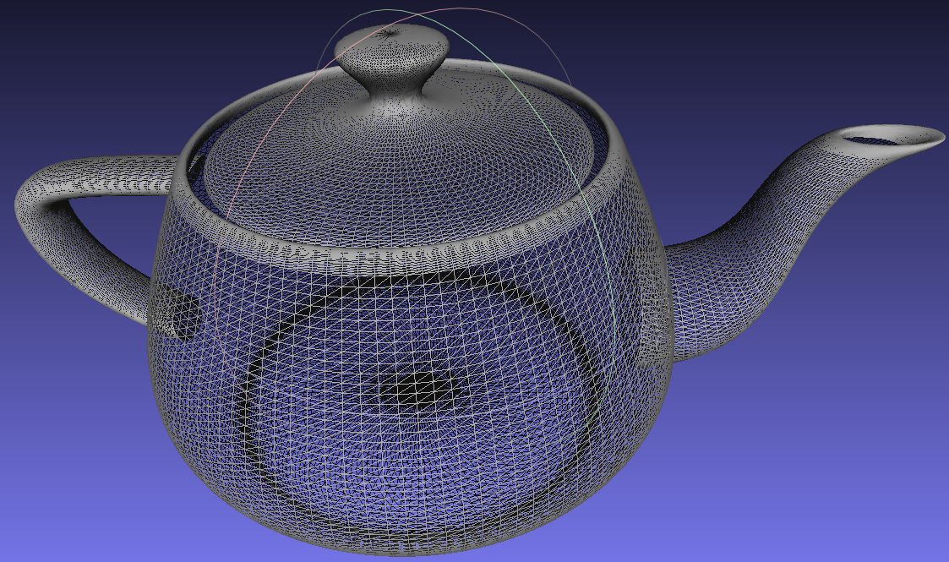
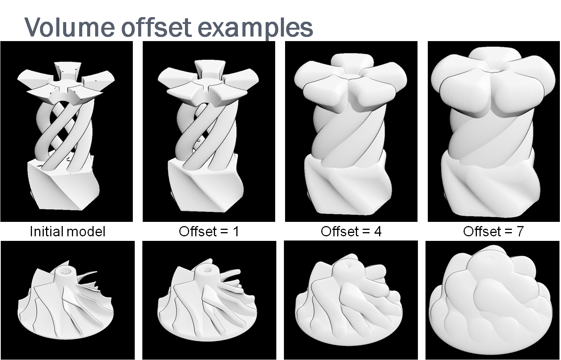
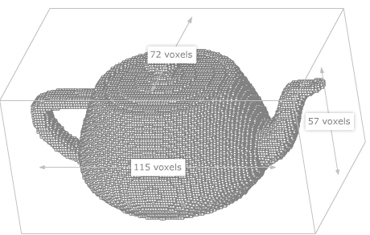
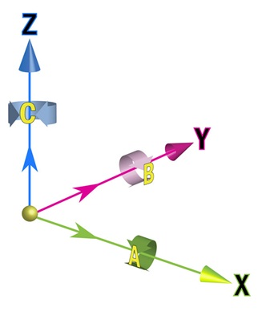
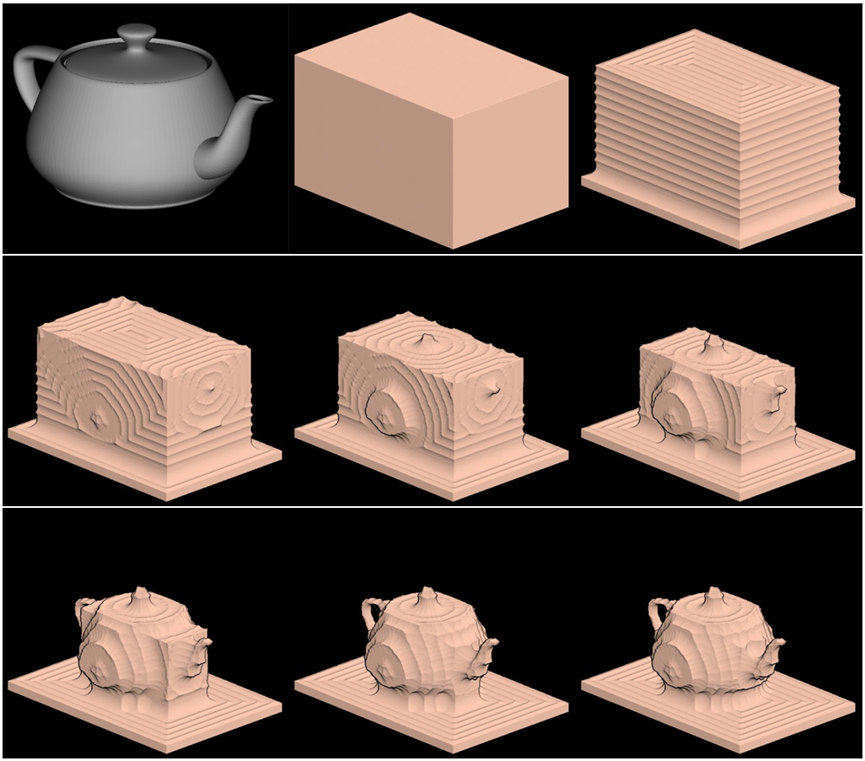
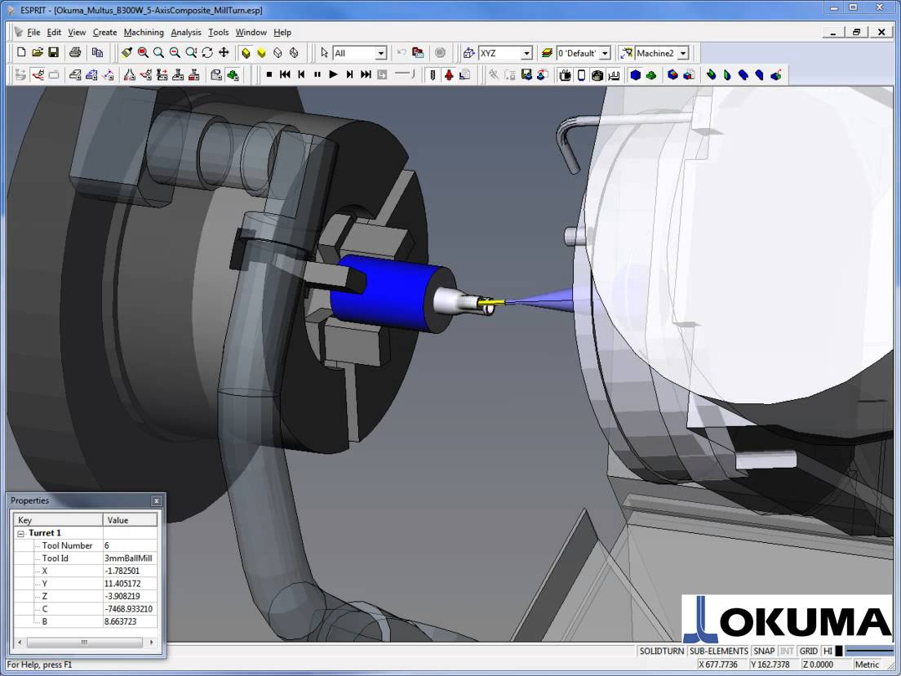
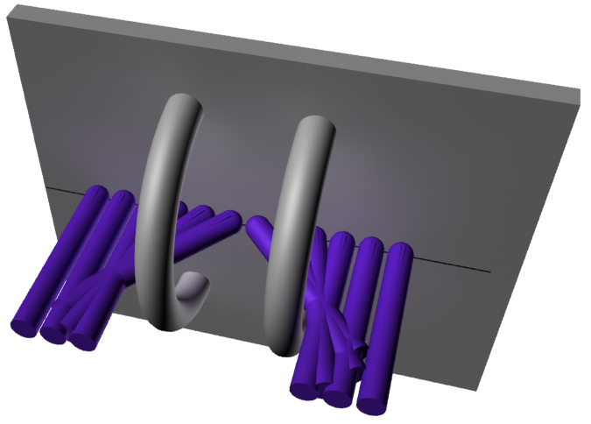
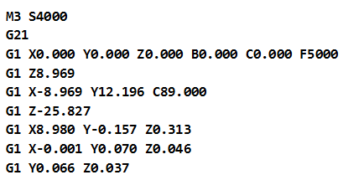
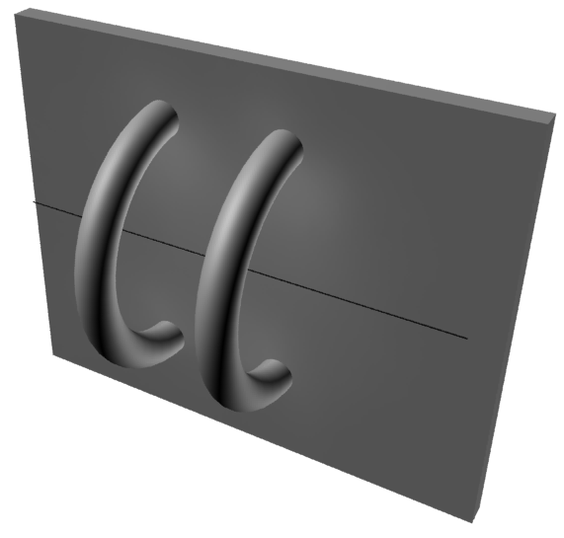
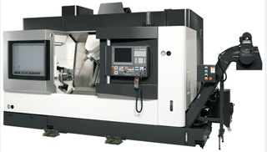
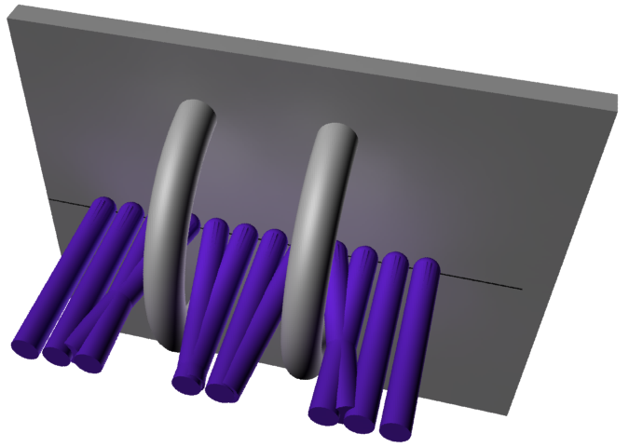
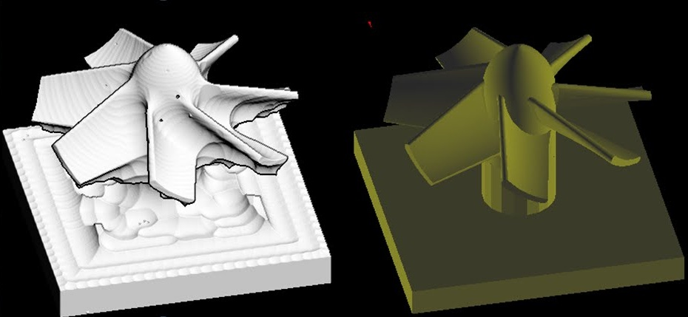
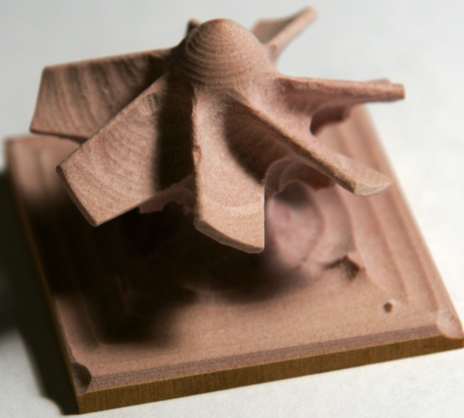
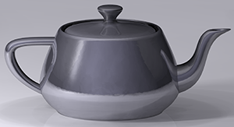
Converting Multi-Axis Machine Tools into Subtractive 3D Printers
by using Intelligent Discrete Geometry Data Structures
designed for Parallel and Distributed Computing
System Integration Scope
Intelligent Discrete Geometry Data Structures
Interactive 3D Rendering of Model
Tree-like to cluster resolution at the boundary where it is needed.
Tailored specifically for parallel processing such as GPUs
Input from Target &
Strategy
Conceptual
Logical
Physical
Application
Vision &
Metrics
Business Target
Machine Structure
Multi-Axis Component
Parts & Tools
Software Platform
Data & load Structure
Parallel Processing
GPU Processing
CAD
Automation
Optimize
Feature & Function
Product
Quality
Performance (Time & Cost)
Root
Voxel-like at leaves to provide constant time inside/outside testing.
Cell
Cell
Cell
Cell
Software Interface
Subcell
Subcell
Subcell
Subcell
Subcell
G-code simulation with performance graphs:
System Components
Tool Positioning
Model Representation
Machining Simulator
Multi-axis Machining
Offset volume provides surface where a tool of a given radius travels without over/under-cutting.
Input Mesh (STL)
Voxelized Model
Iterative Toolpath Generation
Successive offset volumes provide a sequence of XYZ points for a tool path.
Demonstration of iterations of volume removal:
Axes Configuration
&
Kinematics
Tool Orientation and Tool Retractions
Multi-axis Machining Simulation
A tool positioned on the offset volume must assume an orientation that avoids collisions.
Sometimes the path encounters a “dead end” in accessibility space and must jump to a new open “tunnel” in order to continue.
An “accessibility map” provides allowable orientations for the tool.
G-codes
Resulting Parts
Multi-axis CNC Machine
Stacked in sequence, the accessibility maps form an accessibility space.
These events in accessibility space correspond to tool retractions.
Machined Part

