Slide 1
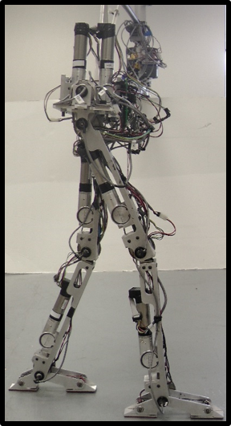
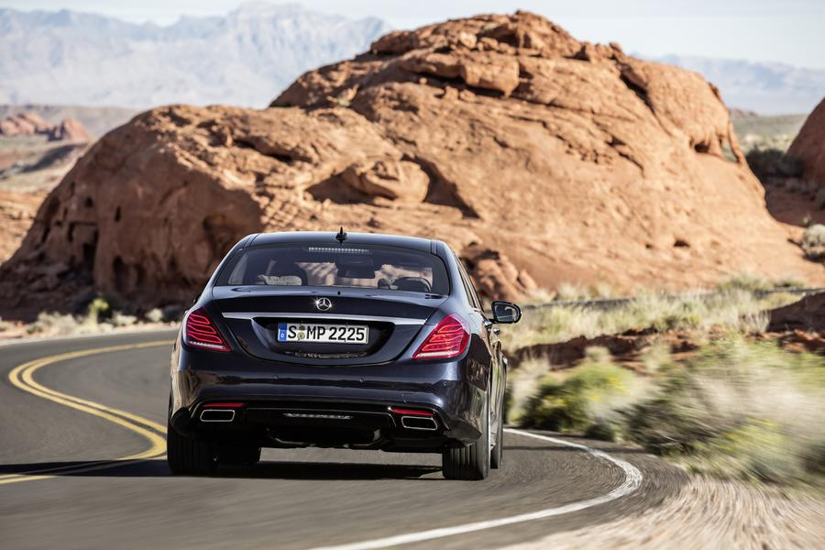
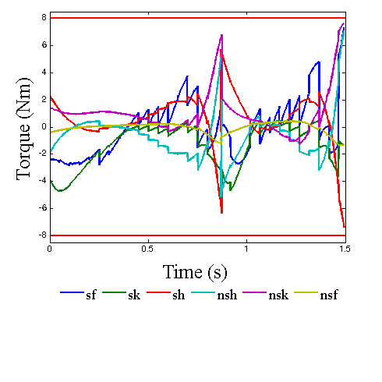
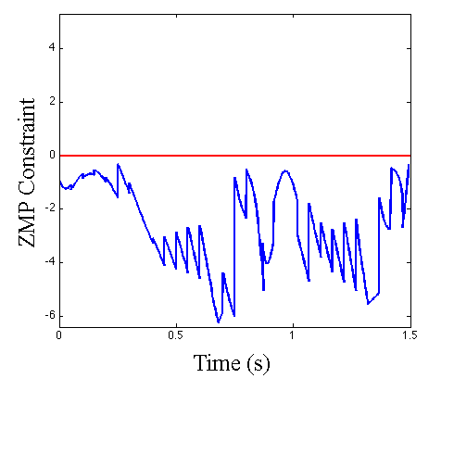
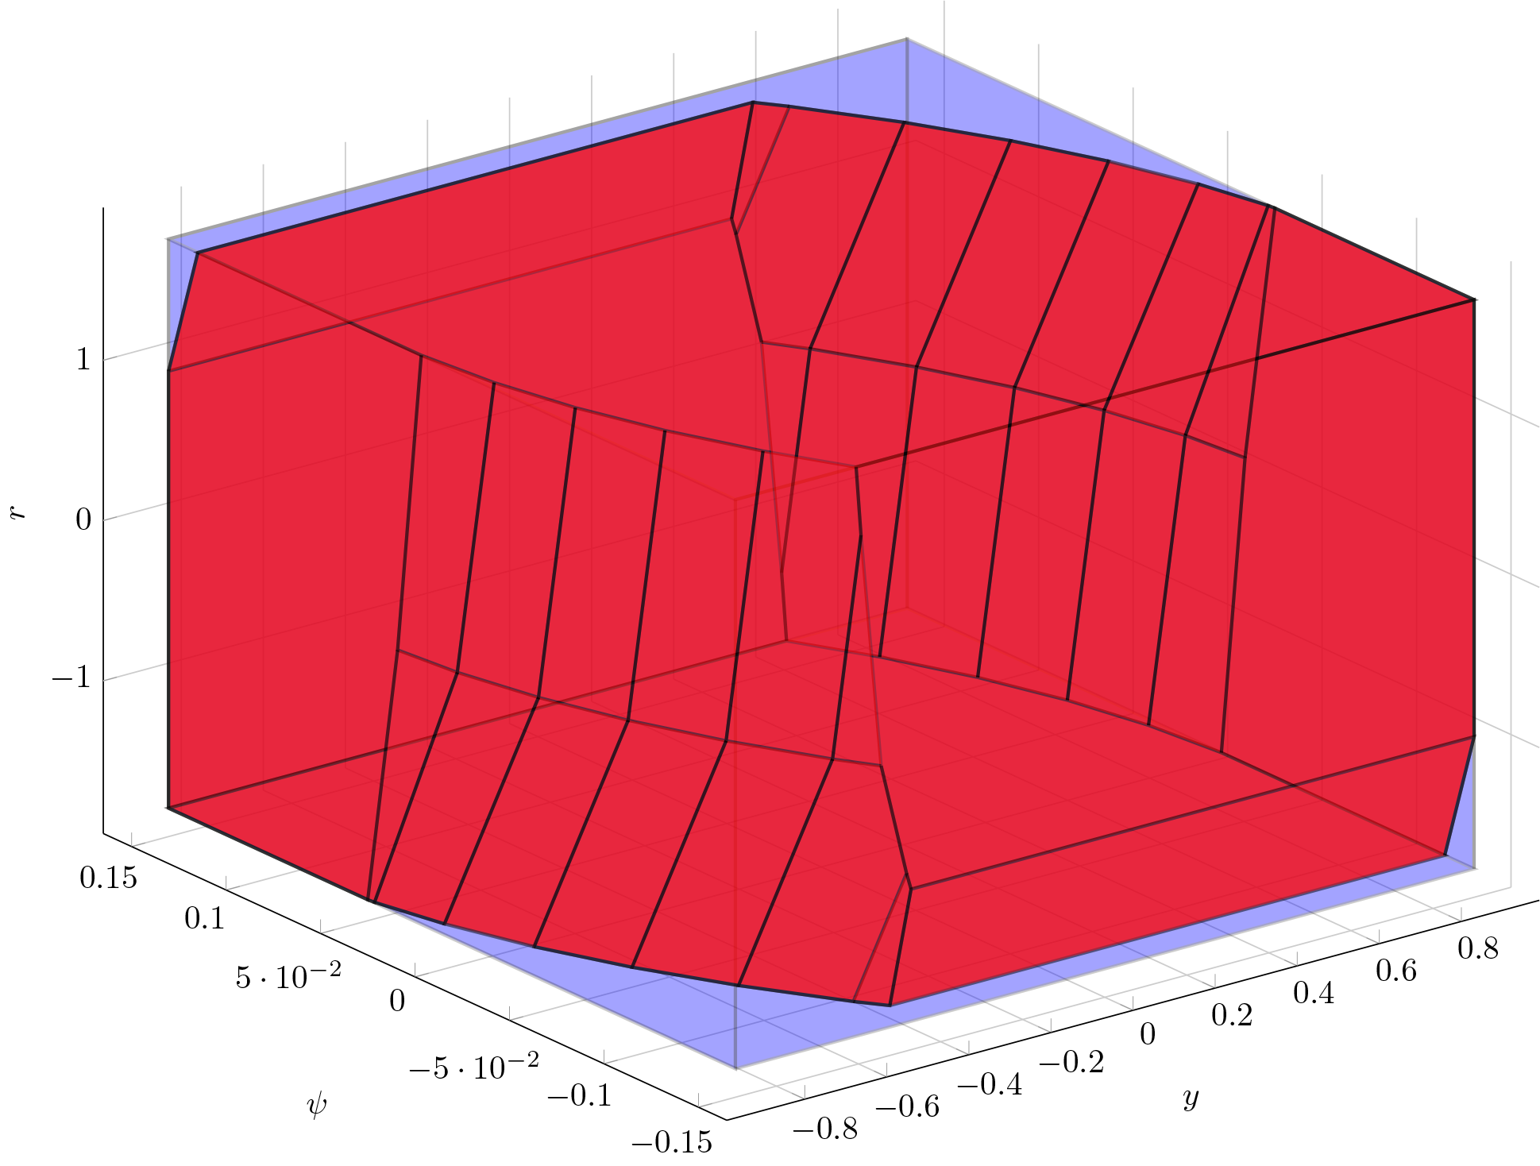
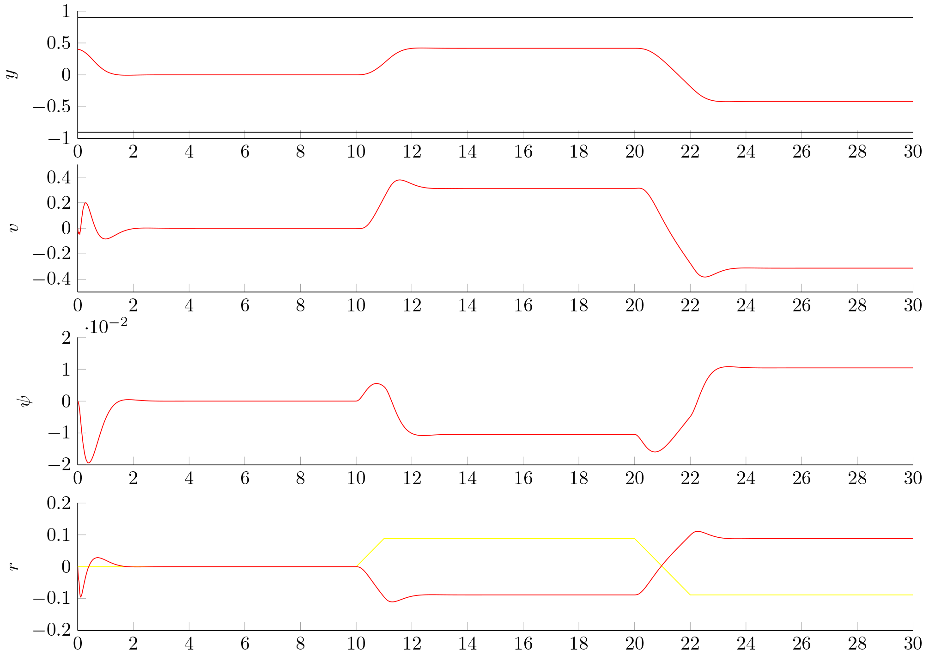




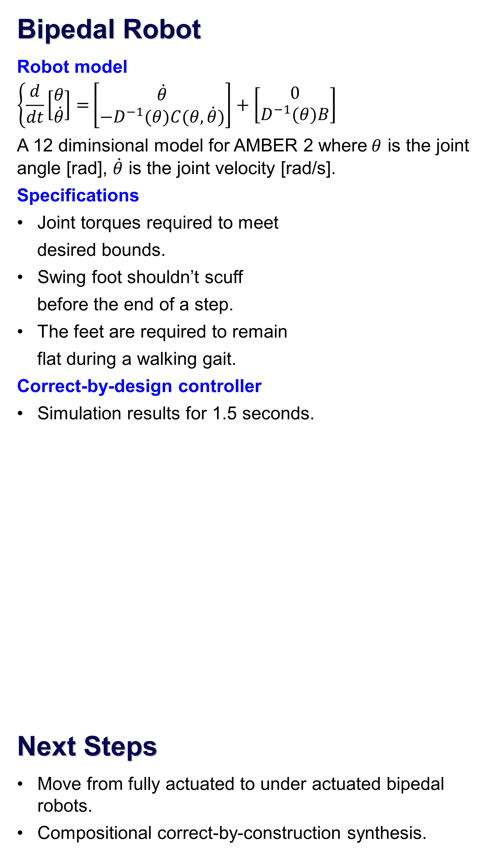




Frontier: Correct-by-Design Control Software Synthesis for Highly Dynamic Systems
Jessy Grizzle and Huei Peng
University of Michigan
Paulo Tabuada
UCLA
Aaron Ames
Texas A&M
Hartmut Geyer
Carnegie Mellon
Objectives
Develop a formal framework for correct-by-construction software synthesis for highly dynamic CPSs.
Realize this framework experimentally for an advanced vehicle safety system and a bipedal robot.
  Highly dynamic CPS: Cyber-physical systems where the difference between stable (safe) behavior and catastrophic (unsafe) behavior occurs in milliseconds
  Correct by construction: “Specify and compile” instead of “design and verify”.
  Examples: Adaptive cruise control (ACC); Lane keeping; Landing a UAV on an aircraft carrier; Bipedal robot rushing through rubble.
  State of the art:
  Control software development for highly dynamic CPSs relies on trial and error;
  small changes in hardware often require extensive labor-intensive retesting and redesign of software;
  no guarantees on closed-loop behavior.
Key Challenges
Curse of dimensionality (e.g., nonlinear models greater than dimension 2) → Hybrid models comprised of motion primitives and low-level control software.
Environmental uncertainty (e.g. terrain variation) → adding adversarial non-determinism to the discrete abstractions; 2-player game for robust synthesis.
Team
Advisors from Ford and Toyota.
Prof. Necmiye Ozay and Postdoc Xiangru Xu (UMich), Postdoc Eric Dallal (UCLA).
Students: Yuxiao Chen and Petter Nilsson (UMich), Omar Hussien (UCLA), Forrest Berg (TAMU) and Albert Wu (CMU).
Lane Keeping
Lateral-Yaw model
$$\left\{\frac{d}{dt}\left[\begin{matrix}\begin{matrix}y \\ v_{y}\end{matrix} \\ ψ−ψ_{d} \\ ω_{z}\end{matrix}\right]=\left[\begin{matrix}\begin{matrix}0 & 1 \\ 0 & \frac{−(C_{f}+C_{r})}{mv_{x}}\end{matrix} & \begin{matrix}v_{x} & 0 \\ 0 & \frac{bC_{f}−aC_{r}}{mv_{x}}−v_{x}\end{matrix} \\ \begin{matrix}0 & 0 \\ 0 & \frac{bC_{f}−aC_{r}}{I_{z}v_{x}}\end{matrix} & \begin{matrix}0 & 1 \\ 0 & \frac{−(a^{2}C_{f}+{b^{2}C}_{r})}{I_{z}v_{x}}\end{matrix}\end{matrix}\right]\right.\left[\begin{matrix}\begin{matrix}y \\ v_{y}\end{matrix} \\ ψ−ψ_{d} \\ ω_{z}\end{matrix}\right]+\left[\begin{matrix}\begin{matrix}0 \\ \frac{C_{f}}{m}\end{matrix} \\ 0 \\ \frac{aC_{f}}{I_{z}}\end{matrix}\right]δ_{f}+\left[\begin{matrix}\begin{matrix}0 \\ 0\end{matrix} \\ −1 \\ 0\end{matrix}\right]ω_{zd}$$
where y is lateral displacement [m], $v_{x}$ and $v_{y}$ are longitudinal and lateral speed [m/s], $ψ$ and $ψ_{d}$ are yaw and desired yaw angles [rad], $ω_{z}$ and $ω_{zd}$ are yaw and desired yaw rates [rad/s], $δ_{f}$ is steering angle [rad].
Specifications
Provide steering input to keep
the car centered in the lane.
Displacement from center
shouldn’t exceed 0.9 meters.
Correct-by-design controller
Moving with constant longitudinal velocity [100 km/hr].
Lane keeping such that lateral displacement is less than 0.9 meters.
Bipedal Robot
Robot model
$$\left\{\frac{d}{dt}\left[\begin{matrix}θ \\ \dot{θ}\end{matrix}\right]=\right.\left[\begin{matrix}\dot{θ} \\ −D^{−1}(θ)C(θ,\dot{θ})\end{matrix}\right]+\left[\begin{matrix}0 \\ D^{−1}(θ)B\end{matrix}\right]$$
A 12 diminsional model for AMBER 2 where$θ$ is the joint angle [rad], $\dot{θ}$ is the joint velocity [rad/s].
Specifications
Joint torques required to meet
desired bounds.
Swing foot shouldn’t scuff
before the end of a step.
The feet are required to remain
flat during a walking gait.
Correct-by-design controller
Simulation results for 1.5 seconds.
Next Steps
Move from fully actuated to under actuated bipedal robots.
Compositional correct-by-construction synthesis.
Source: Forbes
$$\text{y}$$
$$ω_{z}$$
$$v_{y}$$
$$ψ$$
$$ω_{z}$$
$$ψ$$
$$\text{y}$$
Time (s)

