Slide 1
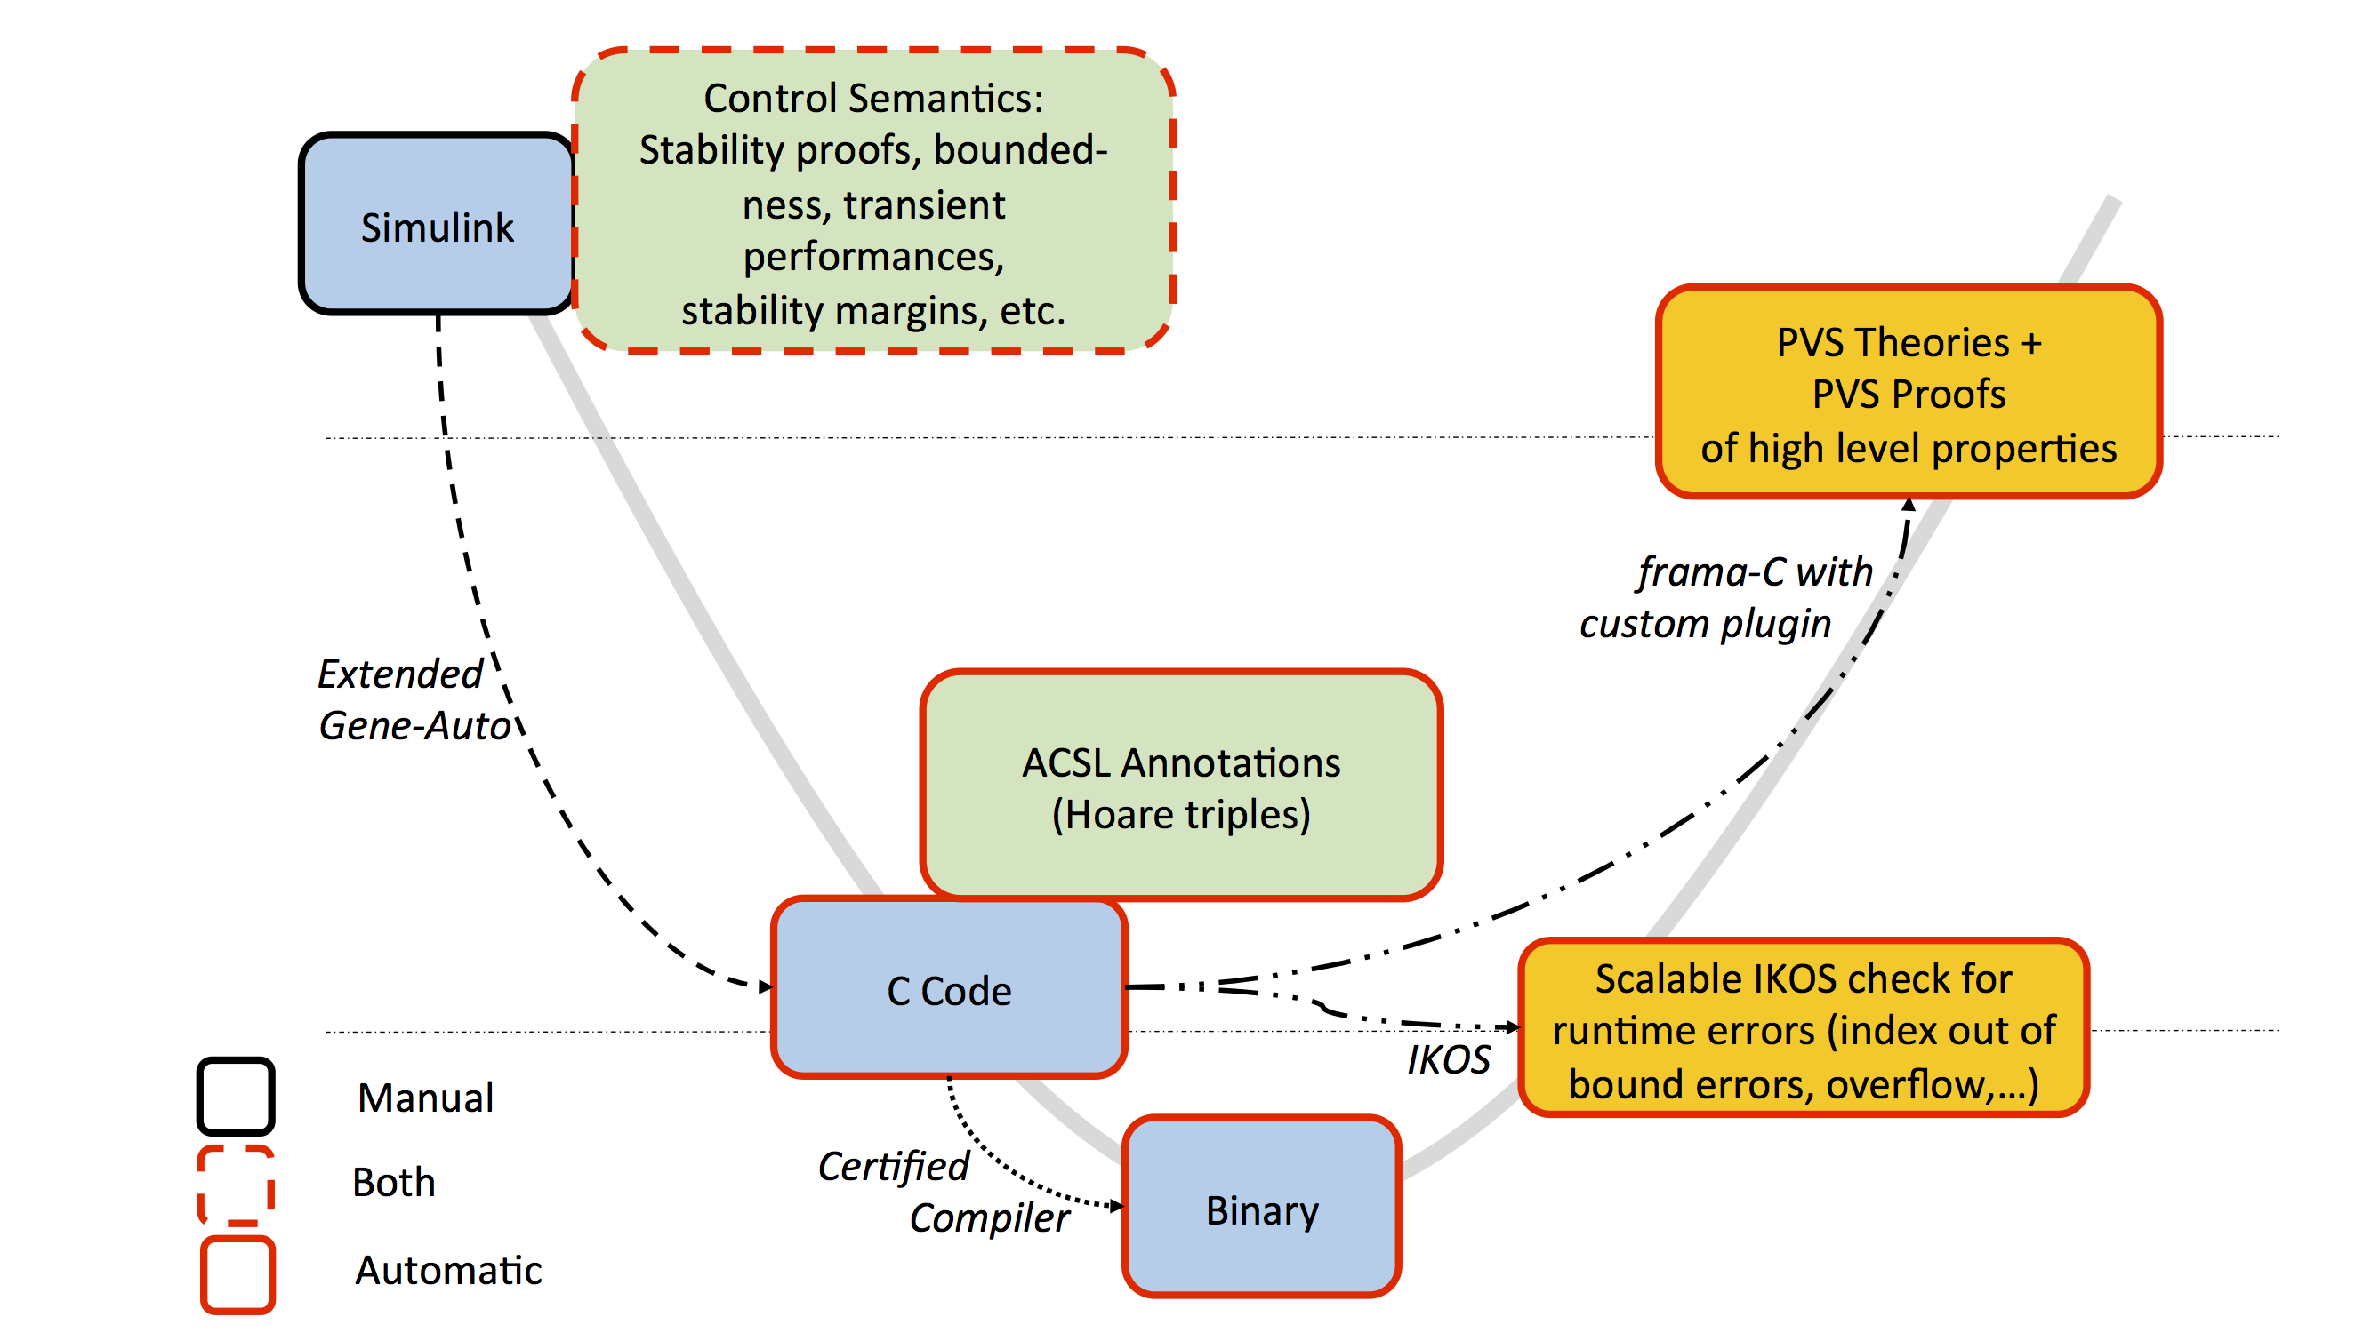
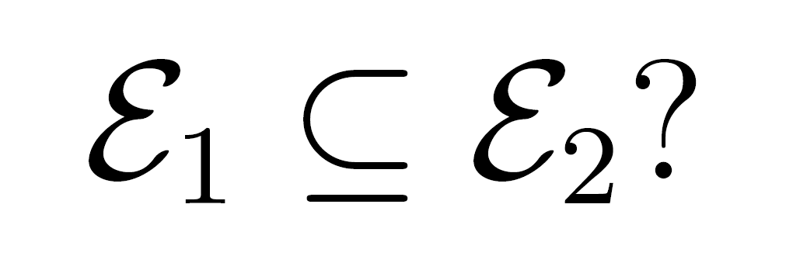
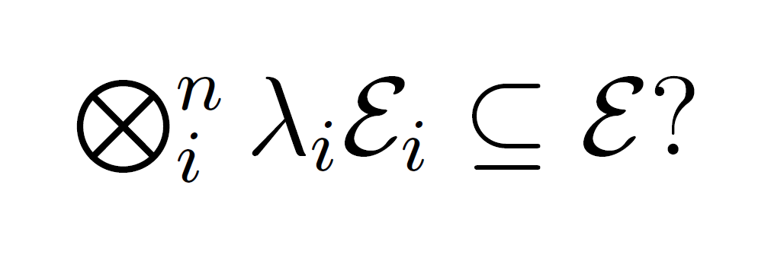
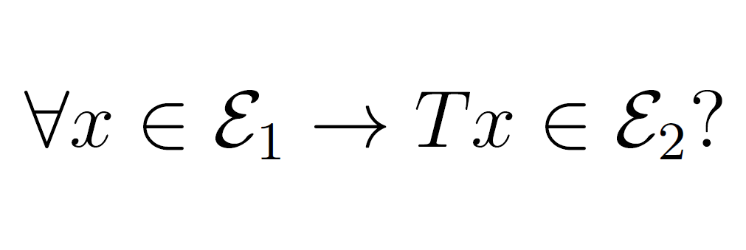
Credible Autocoding and Verification of Embedded Software (CrAVES)
Goal:
Critical control software is becoming increasingly complex and certification standards, high. In this context it becomes necessary to drive certification costs down while improving safety assurance. We provide a development framework which draws from control theory concepts and formal analysis to offer a credible, automated control software generation tool.
Towards a Formally Verified Process
The IKOS platform: a modular and scalable way to address language specific issues by abstract interpretation
Development of a new numerical abstraction in IKOS: the Gauge Domain:
Based on Abstract Interpretation ⟹ no false negatives
Customizable for various classes of software ⟹ low false positive rate
Supports many dialects of C/C++ (based on GCC and LLVM)
Scales to 270+ KLOC code bases
Runs analyses in minutes
Floating-Point Analysis
Proofs as C Programs
Issues:
Annotated proofs verified in real semantics (Gene-Check)
But we also need to verified the same proof in floating-point semantics.
ACSL
Annotations
Ellipsoid Inclusion
S Procedure
Specialized Abstract Interpreter for Floating-point semantics (fluctuat)
Accuracy comparable to convex polyhedra
Scales linearly with the size of the code
Outperforms state-of-the-art commercial static analyzers
C Code
Affine Transformation
IKOS has been applied to various flight software and a large cyber-security benchmark:
Ongoing applications to NASA software:
Space mission flight system
Aerodynamic analysis software
Ground-control system for a satellite
IKOS has been applied to various flight software and a large cyber-security benchmark:
Ongoing applications to NASA software:
Space mission flight system
Aerodynamic analysis software
Ground-control system for a satellite
On Going / Future Work
Generating ACSL readable annotations describing closed loop behavior
Automatically discharge the proofs of these properties
Develop suitable abstract domains of ellipsoids for static analysis
Study the effect of various model transformations on the validity of the proof (e.g. from an abstraction standpoint):
Discretization
Floating-point arithmetic
Machine-level constructs (pointers)

