Slide 1
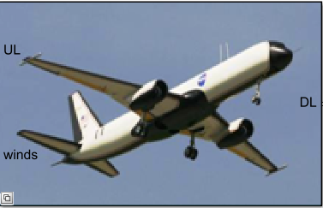
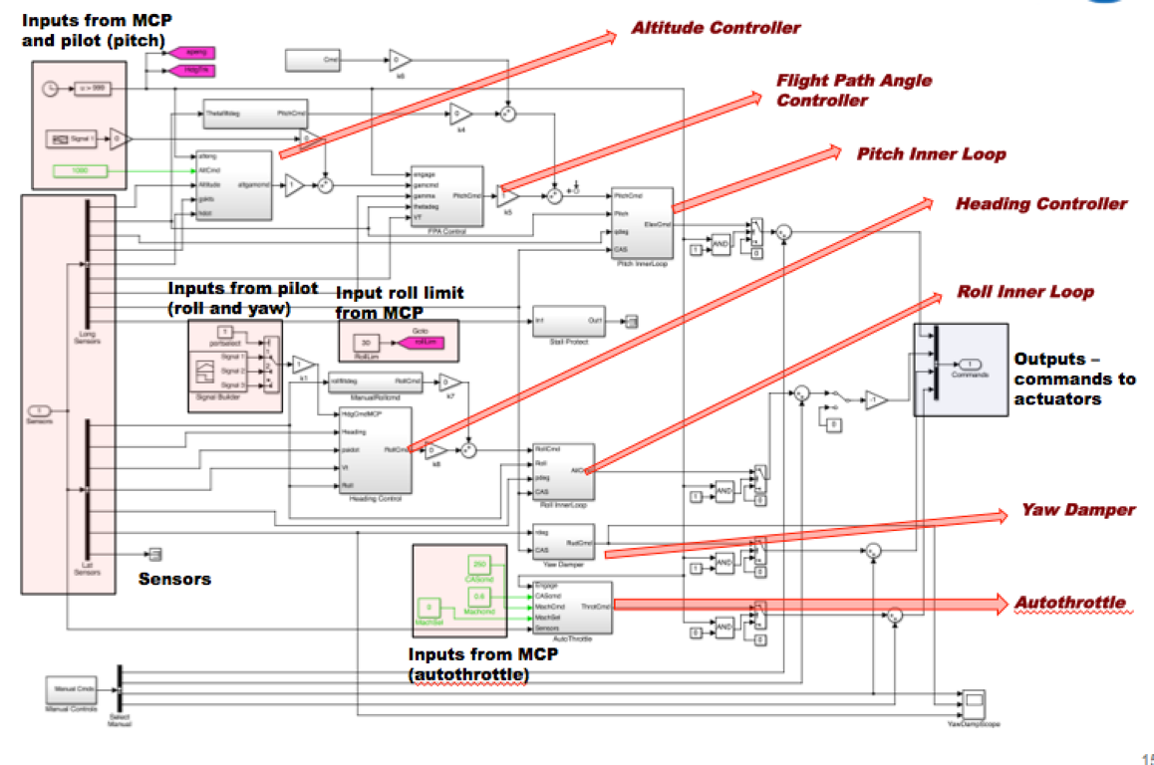
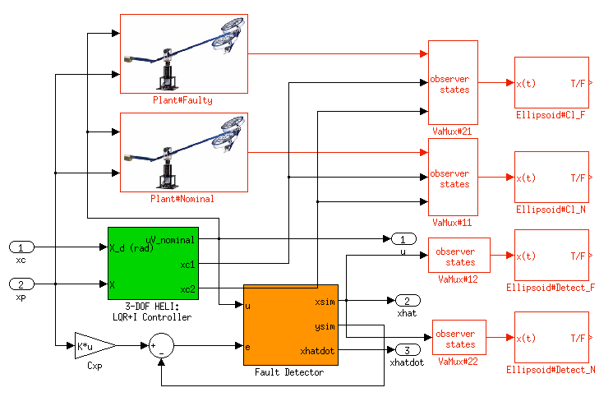
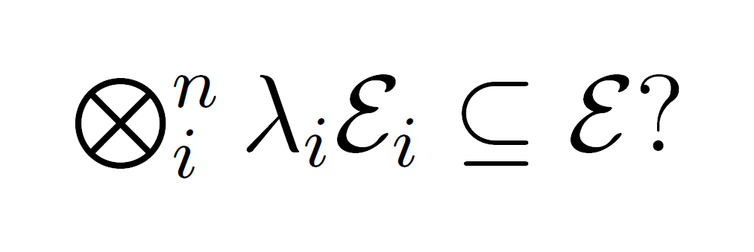
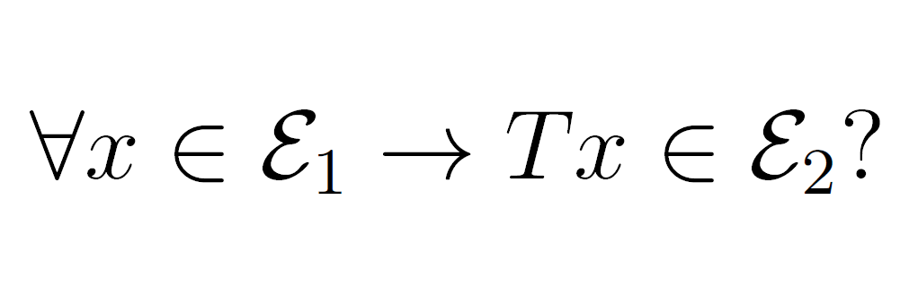
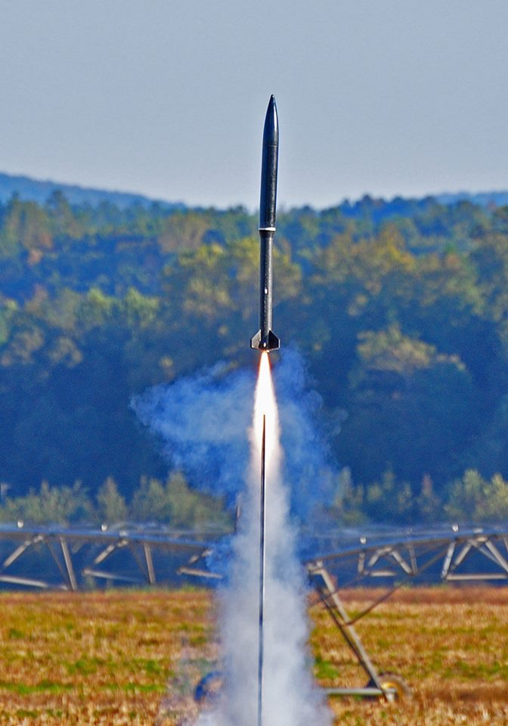
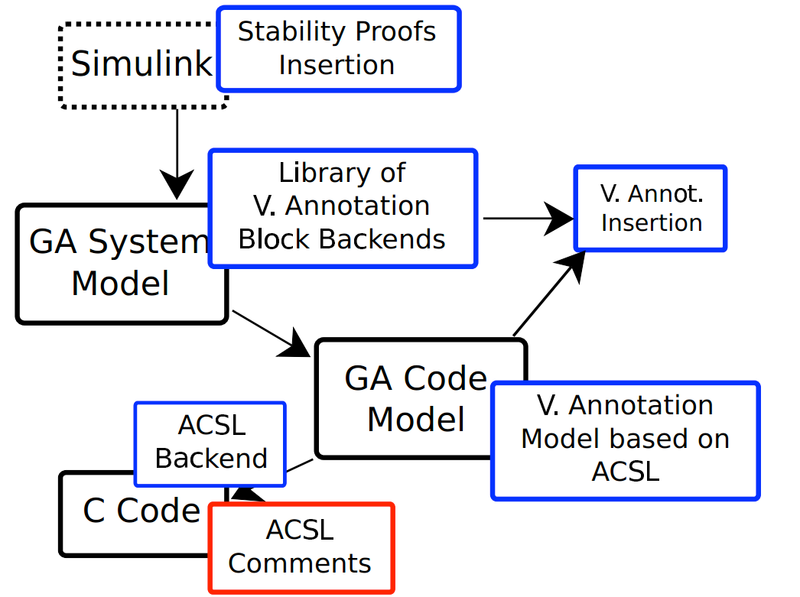
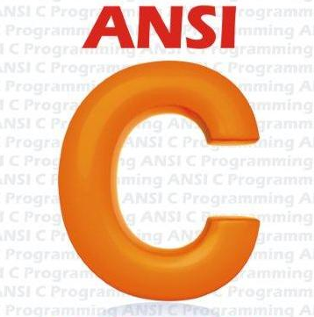
Credible Autocoding and Verification of Embedded Software (CrAVES)
Pr. Eric Feron (co-PI), Romain Jobredeaux, Timothy Wang, Georgia Institute of Technology
Temesghen Kahsai (Co-PI), Carnegie Mellon University
Dr. Pierre-Loïc Garoche, ONERA, France
Pr. Marc Pantel, Arnaud Dieumegard, ENSEEIHT, France
Goal:
Critical control software is becoming increasingly complex and certification standards, high. In this context it becomes necessary to drive certification costs down while improving safety assurance. We provide a development framework which draws from control theory concepts and formal analysis to offer a credible, automated control software generation tool.
D. IKOS: a generic and scalable abstract interpretation tool
Towards a Formally Verified Process
Simulink
Control Semantics:
stability, bounded-ness, transient performances,
stability margins, etc.
PVS Theories +
PVS Proofs of high level properties
Based on Abstract Interpretation ⟹ no false negatives
Customizable for various classes of software ⟹ low false positive rate
Supports many dialects of C/C++ (based on GCC and LLVM)
Scales to 270+ KLOC code bases
Runs analyses in minutes
C
A
Lustre Code
A. Safety verification via Model Checking
B
Application: Transport Class Model (TCM)
GAL : Gene-Auto for Lustre (Compilation from Simulink to Lustre)
Modular encoding that preserves hierarchical structure of Simulink models.
Safety properties are encoded as synchronous observers.
At Lustre level verification performed by PKind and Zustre.
PKind : Parallel SMT-based model checker.
Zustre : Property-directed reachability based verifier for Lustre.
ACSL Annotations
(Hoare Triples)
- A twin-engine tube and wings configuration aircraft simulation, scaled up from the Generic Transport Model (GTM).
- Intended as an experimental platform for controls and health management system
C Code
Scalable IKOS check for runtime errors (index out of bound, overflow…)
D
Manual
Static Analyzer
- Contains approx. 5700 Simulink blocks
- 20 safety properties derived from Federal Aviation Regulations and Boeing 737 pilot training manual
- Safety analysis done via PKind / Zustre and compositional verification
Both
Binary
Credible Autocoder
Automatic
Certified Compiler
B. Modular compilation and validation
C. Credible Autocoder with Verification: Gene-Auto extended with the translation and generation of control semantics, Gene-Check for their verification
Floating-Point Analysis
Proofs as C Programs
Issues:
Annotated proofs verified in real semantics (Gene-Check)
But we also need to verify the same proof in floating-point semantics.
ACSL
Annotations
Ellipsoid Inclusion
Specialized Abstract Interpreter for Floating-point semantics (fluctuat)
Gene-Auto extended:
Translates ellipsoid synchronous observers(to express the stability of the closed-loop system) to ACSL function contracts.
Analyses the generated code for forward propagation of the inserted ellipsoid invariants.
Generates ellipsoid invariants for every statements of the generated code through forward propagation
S Procedure
We used the GeneAuto translation tool, which offers compilation of various graphical modeling languages to C and ADA.
We wrote an extension of the tool, which adds custom blocks to a diagram that express a stability proof
It then translates the model, along with those new blocks, into C code, annotated with an equivalent of the proof in ACSL.
C Code
Educational Outreach: Collaboration with local High School in NASA’s USLI
Affine Transformation
NASA’s University Student Launch Initiative is a Rocket Launch Contest
Undergraduate students work in partnership with Atlanta public Douglass High school to build a rocket and an autonomous ground support for launch
Introduce minority students interested in engineering to software issues in cyber-physical systems, and STEM fields in general (meteorology, mechanical engineering, rocket mechanics).
Perspectives
The feasibility of a credible autocoding toolchain has been demonstrated through the creation of various prototype tools, applied to small subset of system and properties
Perspective future research directions include:
Using domain specific knowledge from other fields (e.g. optimization) to produce verifiable safety-critical code
Expanding the current work to account for more properties and more complex systems
Gene-check:
uses frama-C (+ custom plugin) on the annotated code to generate the verification conditions (VC) for PVS (=theorems to be proven).
Automatically discharges proof obligations, resulting in a replayable proof that the annotations are correct.
PVS
ACSL

