Slide 1

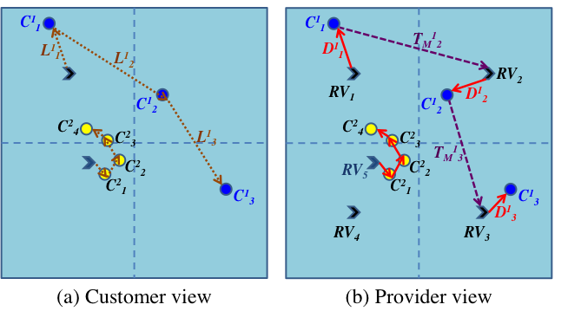
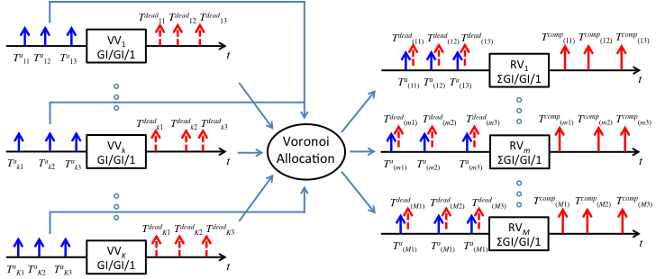
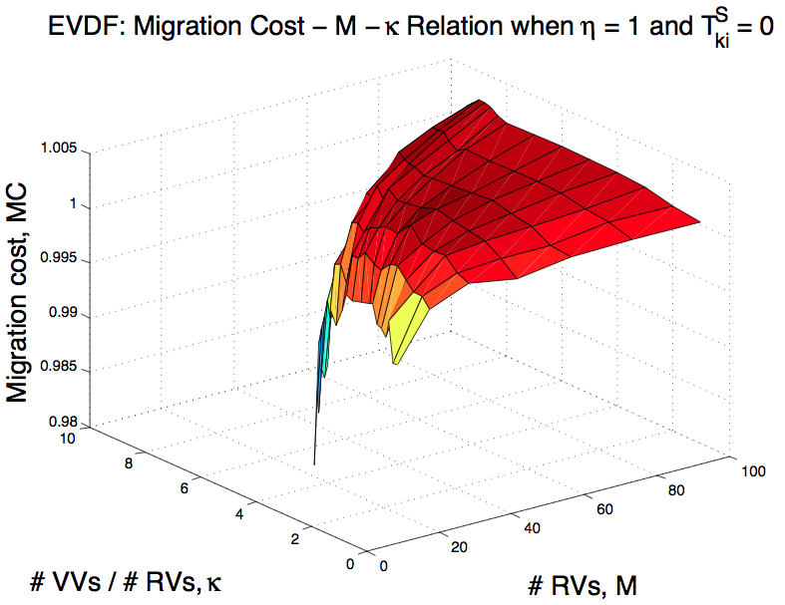
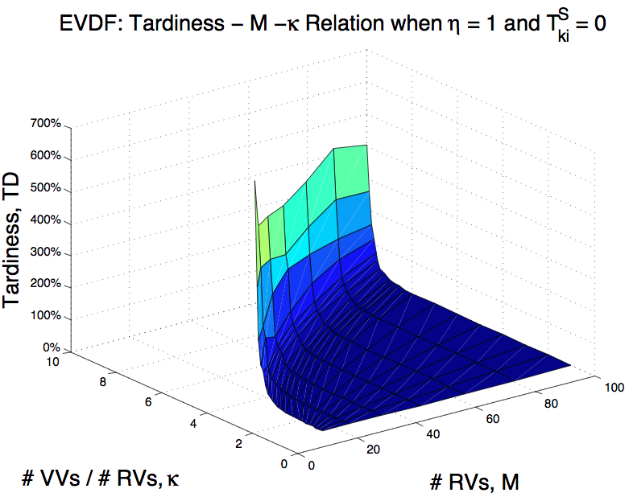
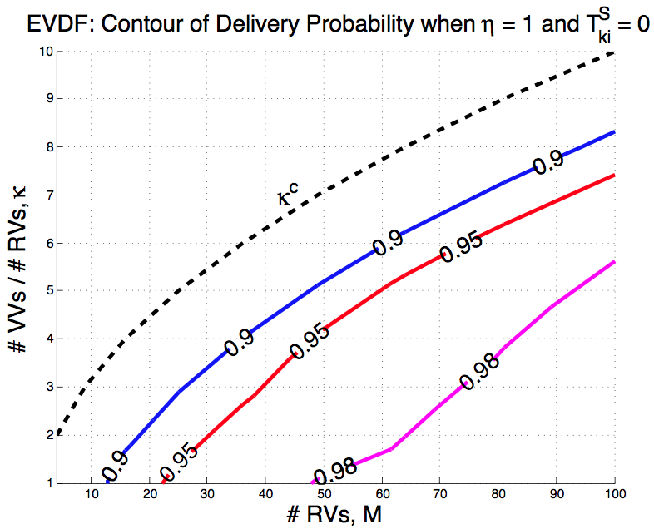
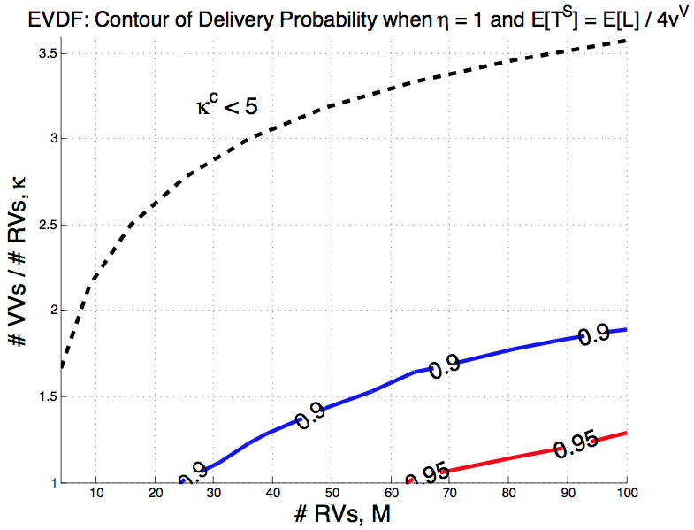
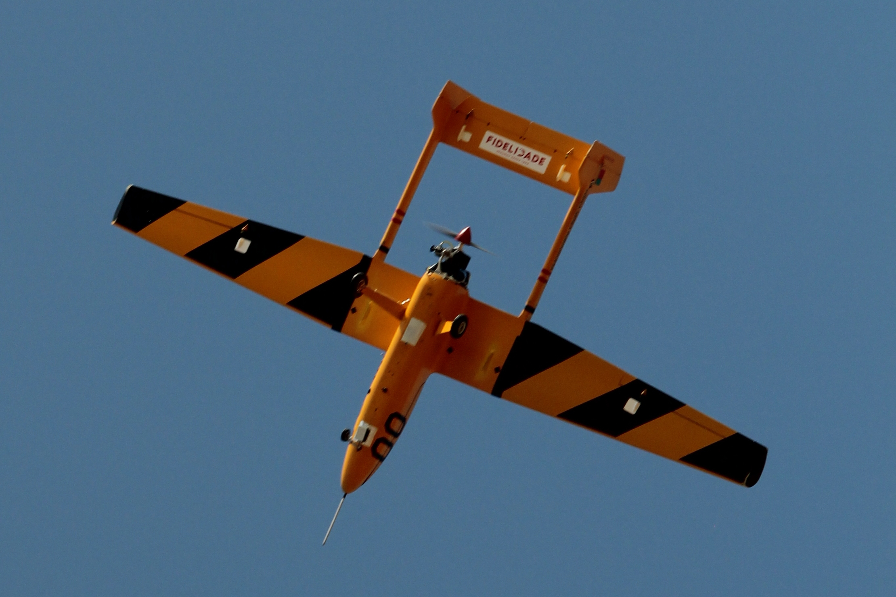
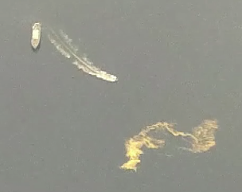
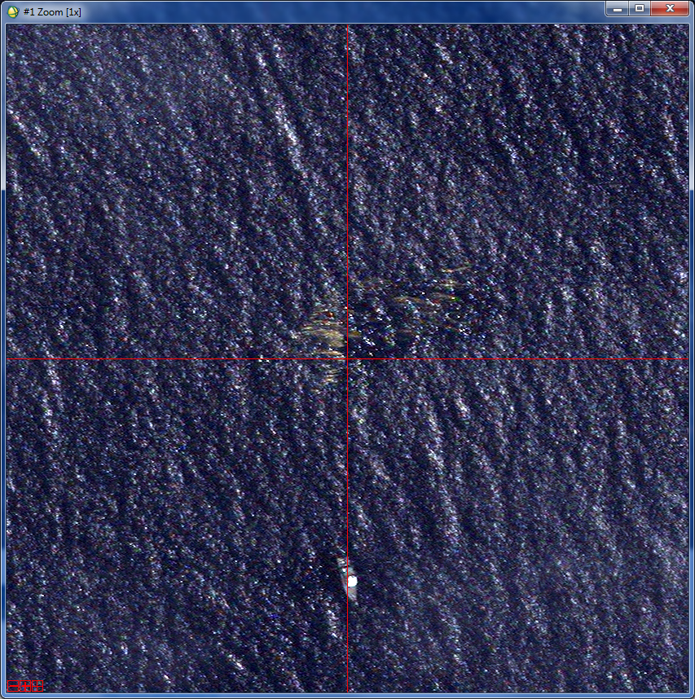
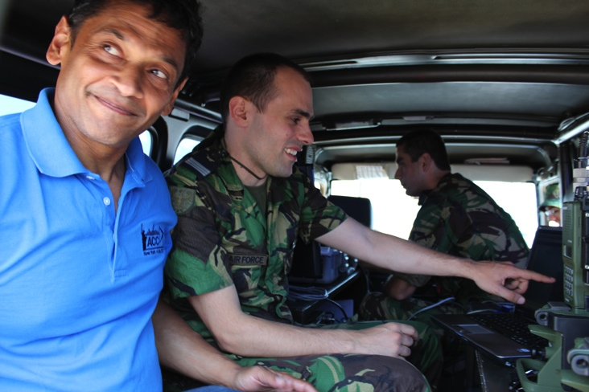





Cyber-Physical Cloud Computing
cpcc.berkeley.edu
PI: Raja Sengupta^{(a)}
Co-PI: Christoph Kirsch^{(b)}, Karl Hedrick^{(c)}
^{(a)}Systems Engineering, Department of Civil and Environmental Engineering, University of California, Berkeley. Email: rajasengupta@berkeley.edu
^{(b)}Department of Computer Sciences, University of Salzburg. Email: ck@cs.uni-salzburg.at
^{(c)}Department of Mechanical Engineering, University of California, Berkeley. Email: khedrick@me.berkeley.edu
  BigActors – Ubiquitous Computation over Worlds with Dynamic Structure
  Virtual Vehicle (VV): Virtual Machine + Virtual Speed.
  Physical-mobility, Cyber-mobility
BigActor Model is a bridge between programs and machines with dynamic structure (location and connectivity)
BigActors are Actors [1] hosted at a Bigraph abstraction of the world [2] that can:
  Compute, communicate, observe, control and migrate
  Voronoi Allocation:
  Theorem 2: Each RV is a ΣGI/GI/1 queue.
Runtime environment for mobile robotics:
  BigActors Scala DSL - API
  bigraphDriver: abstracts the world as a bigraph
  brrDriver: handles the execution of control actions
  gateway: distributed bigraph estimation and communication
  Theorem 1: Each VV is a GI/GI/1 queue.
Case study: networked robotics
Gain: # VVs / # RVs at a given Performance Isolation
  Multiplexing gain, Migration gain
Scheduling: Earliest Virtual Deadline First (EVDF)
  Theorem 3: EVDF achieves minimum tardiness.
  Tardiness = max{Actual completion time – Virtual deadline, 0}
  Conclusion:
  High migration gain and high performance isolation.
  Economy of scale: migration gain increases with # RVs.
  Migration gain happens when traveling, not standing still.
  Migration cost is bounded.
Example 1: logical space programming
"gotoOil" hosted_at "uav0" with_behavior{
loop{
MOVE_HOST_TO oilSpill
}
}
=>
Example 2: handover
autopilotWaypointCtr(Lat0,Long0,Alt0,radius)
autopilotWaypointCtr(Lat1,Long1,Alt1,radius)
autopilotWaypointCtr(Lat2,Long2,Alt2,radius)
autopilotWaypointCtr(Lat3,Long3,Alt3,radius)
…
"handover" hosted_at "GCS0" with_behavior{
HANDOVER uav0 TO GCS1
}
Demo: oil spill monitoring
Satellite image. Courtesy of EMSA
=>
UAV Alfa Extended
Mobile Control Station
UAV Onboard image
[1] R. Milner, “The Space and Motion of Communicating Agents”, Cambridge, 2009.
[2] G. Agha, “Actors: a model of concurrent computation in distributed systems”, MIT Press, 1986.
[3] E. Pereira et al., “Bigactors - A Model for Structure-aware Computation,” in ACM/IEEE 4th International Conference on Cyber-Physical Systems, 2013.
[4] E. Pereira et al., “Modeling and controlling the structure of heterogeneous mobile robotic systems: A bigactor approach,” in 2013 IEEE International Systems Conference (SysCon), 2013.
[5] E. Pereira et al., “A Networked Robotic System and its Use in an Oil Spill Monitoring Exercise,” in Swarm at the Edge of the Cloud Workshop (ESWeek’13), 2013.
  Supported in part by:

