Slide 1
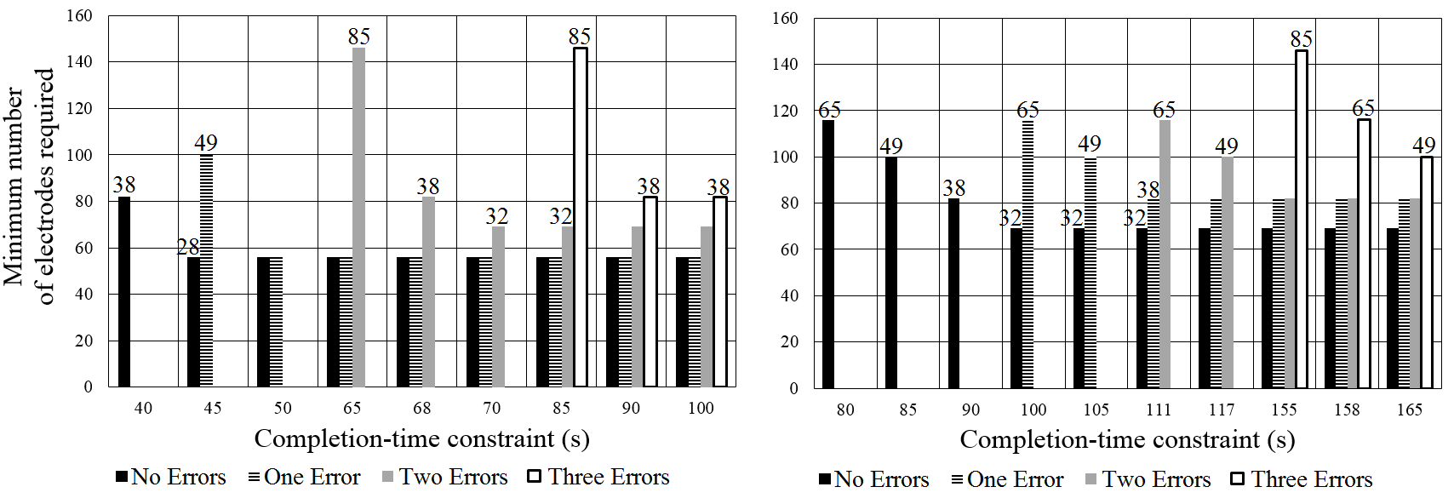
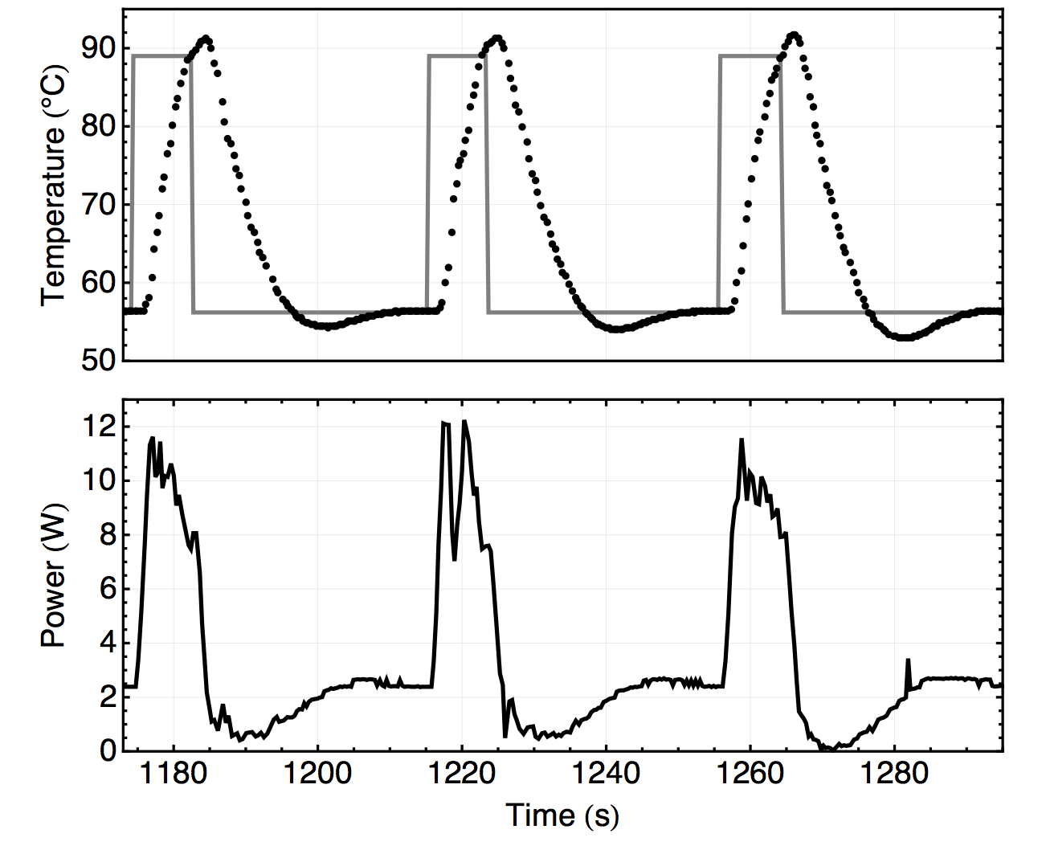
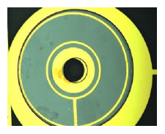
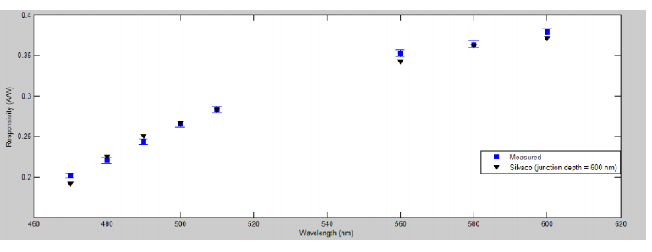
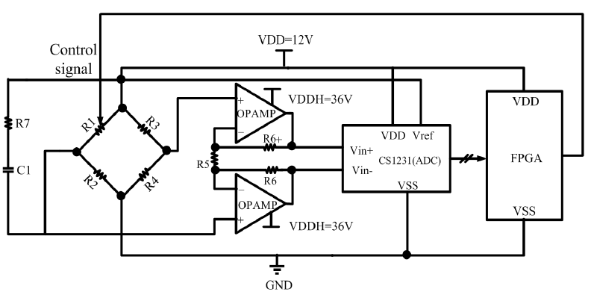
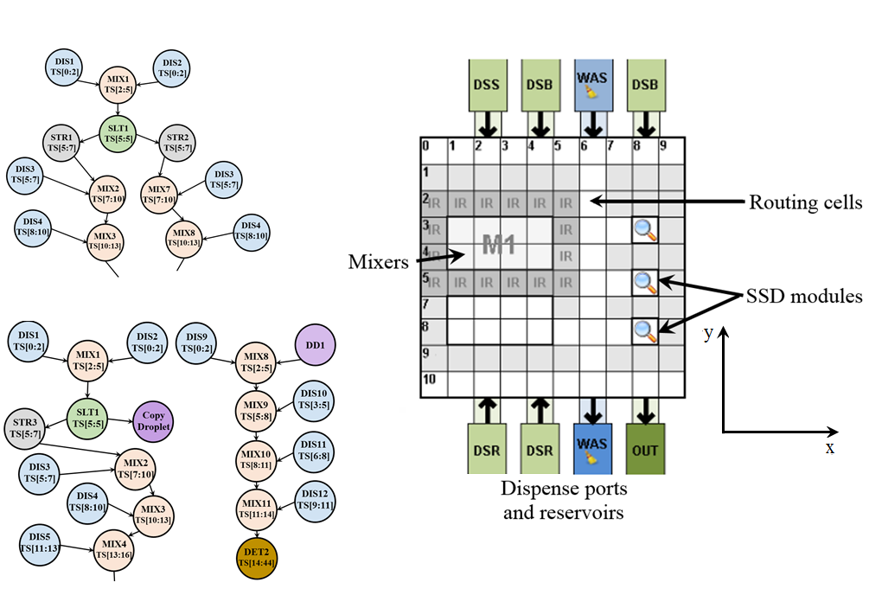
Cyberphysical Integration for Digital Microfluidic Biochips (NSF CNS-1135853)
Krishnendu Chakrabarty (PI), Richard Fair (Co-PI), Nan Jokerst (Co-PI)
PhD Students: Mohamed Ibrahim, Kai Hu, Zipeng Li, Aditi Dighe, Liji Chen
Department of Electrical and Computer Engineering, Duke University, Durham, NC 27708
Research Components (Year 3)
Error recovery time on FPBs is comparable to its counterpart on direct-addressing biochips.
FPBs provides significant reduction in pin-count usage.
Optical Sensor
Microfluidic Device
Optimizations for cyberphysical design:
Efficient on-line error recovery using sensor data, using field programmable biochips (FPBs) for pin-count reduction, recoverability analysis
Optimized self-adaptive heater design for PCR
Microfluidic Device:
On-chip DNA purification and sequence identification: minimizes hands-on time
Error recovery: prevents loss of precious DNA samples due to device malfunction
Optical Sensor:
Annular thin film Si photodetectors (PDs) are heterogeneously integrated in the top plate of the digital microfluidic system for fluorescence sensing
PDs characterized for their spectral response
A thin-film Si photodetector is modeled to predict its spectral response using commercial software SILVACO Atlas
Thin-film annular photodetector embedded into the top plate of the microfluidic system
Fabrication process:
p-SOI with 8 µm device layer diffused with phosphorus, photolithography defines the active area of the PD, deep RIE is used to define mesa and etch bulk-Si layer. The fabricated PDs are heterogeneously bonded to the pyrex substrate, which acts as the top plate. Nitride is deposited as an anti-reflection coating and a surface passivation layer
2. Integration of IPF with qPCR Sequence Identification
(a) Preparation of Plasmid DNA (b) Protein
Recoverability Analysis:
3. Thin-Film Resistive Heater
(a) Preparation of Plasmid DNA (b) Protein
Microphotograph of the PD active area; the circular region will be used for excitation of the sample under test
Cyberphysical system integration
Optimized self-adaptive heater design for PCR
A. Proposed heater structure
Characterization and comparison of Spectral Response:
Spectral response of the PD is measured using an 8 channel Xenon lamp and the response is measured and compared against the spectral response obtained from SILVACO model
Physical Subsystem
Cyber Subsystem
Upper plate
Detector
Droplet
A combined electrode/heater structure is proposed.
Reduce the amount of chip area devoted to heaters.
Increases the reconfigurability of the chip.
4. Performance Characterization
Lower plate
Computer
Purification power: 1.25 x 10⁴ with two washes
Nucleic acid retention: 32%
PCR time: 40 thermocycles in 30 ~ 50 minutes
Amplification efficiency: 76%
Sample-to-answer time: 1 hr
Electrodes
Dielectric layer
Hydrophobic Layer
B. Self-adaptive heating system
Temperature control must be precise and ramp-up rapid
Two threshold values to control heater start and stop
Actual experimental results match Multisim results
Algorithmic Innovations
Efficient error recovery using FPB platform
Measured Dark Current: 12 pA
Conclusions
Optical Sensing Using Fluorescence
Microfluidic Device
Efficient error recovery with minimum response time and pin-count, no interruption of other operations
Limitations of chip resources on recoverability
Optimized self-adaptive heater for PCR
Annular thin-film PDs are fabricated and heterogeneously integrated into the top plate of the digital microfluidic system. The spectral response of the PD correlates well to the modeled behavior.
On-chip DNA purification and quantification have been demonstrated. Currently, the detection limit is approximately 243 copies of Alu Yb8 per 92 nl PCR mix, and the dynamic range is 10³.
Fluorophore: 6-Hex (Absorption peak= 535 nm, Emission peak = 556 nm)
Fluorophores are tagged to the biomolecules to be detected. Then, they are excited by a pump signal (532 nm)
Detection is carried out by on-chip thin-film Si PDs
1. DNA Purification by Immiscible Phase Filtration (IPF)
Using FPB platform for cyberphysical error recovery reduces the cost.

