Slide 1


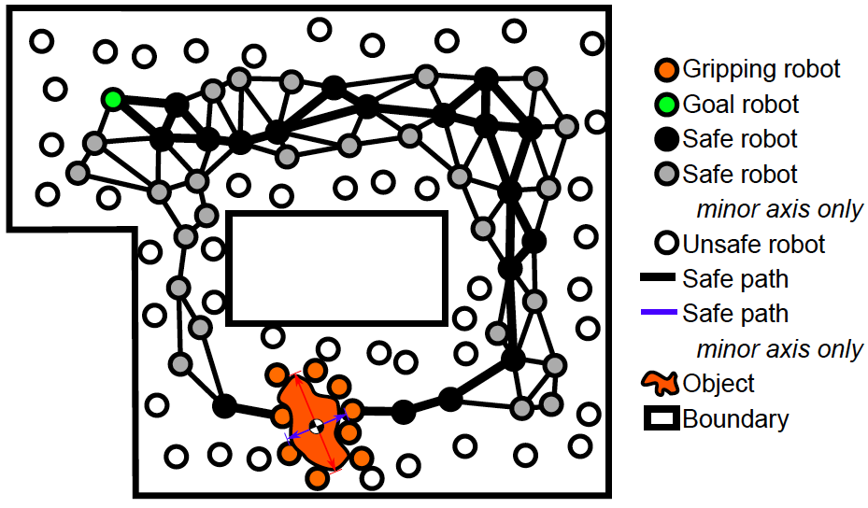
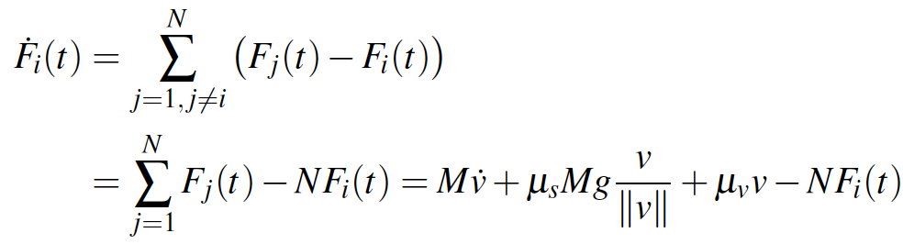
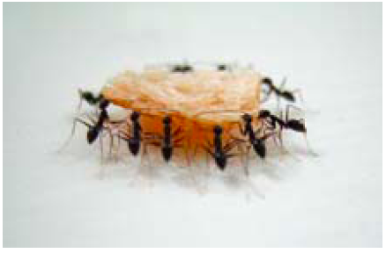
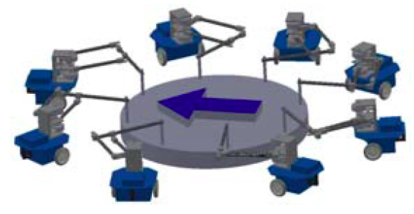
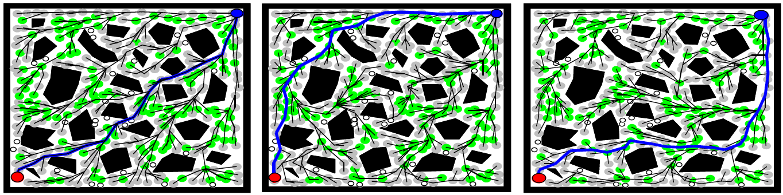
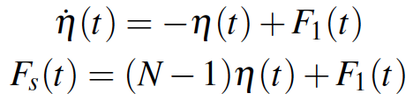
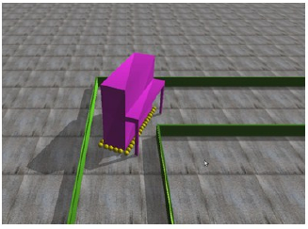
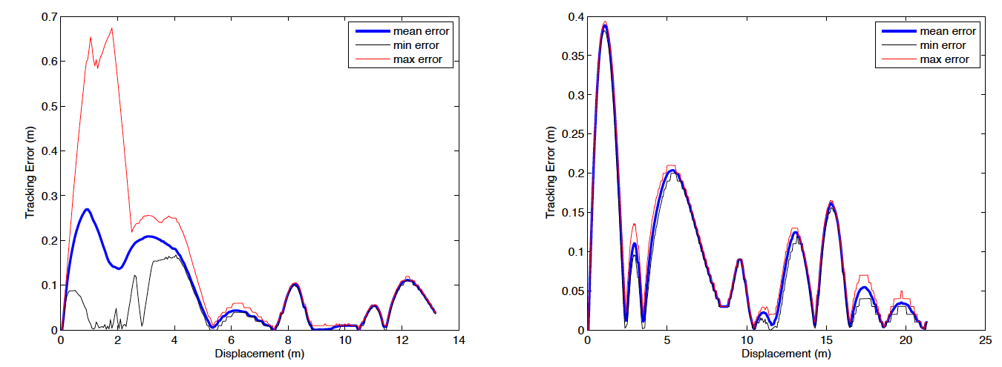
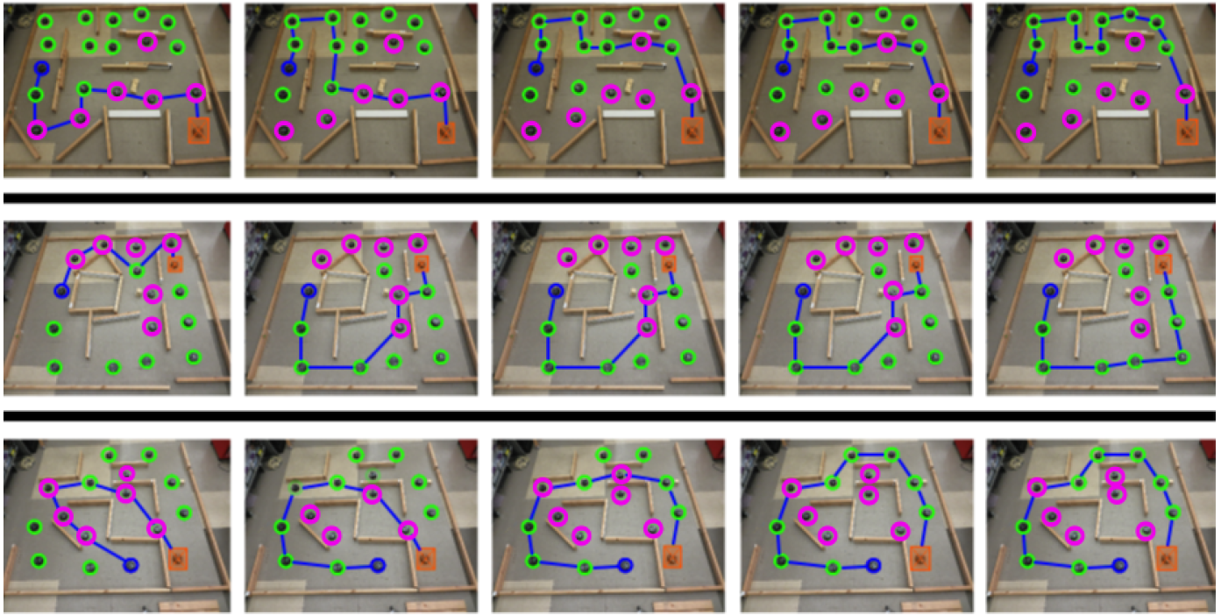

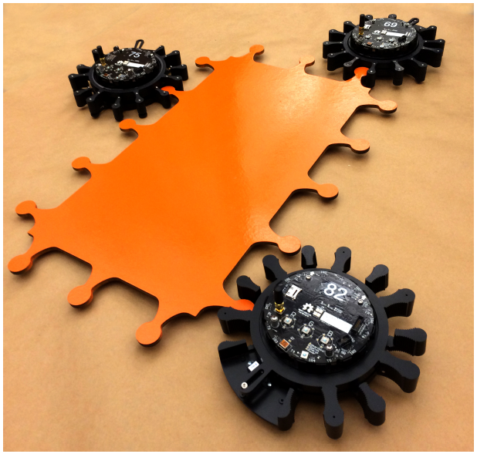
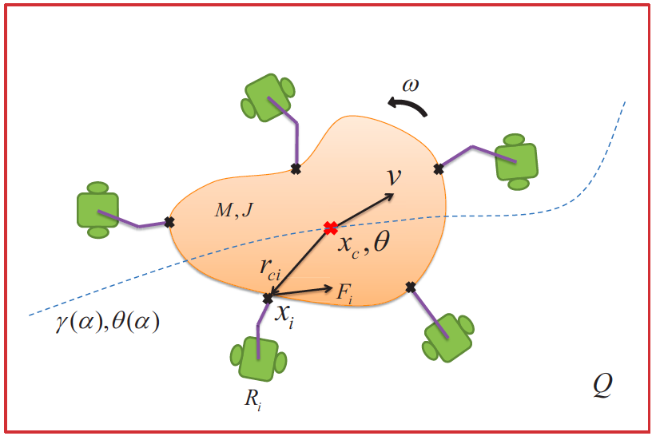
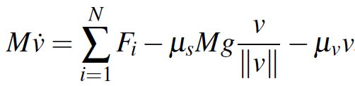
Cyber-Physical Manipulation (CPM): Locating, Manipulating, and Retrieving Large Objects with Large Populations of Robots
NSF CNS-1330036, PI: Mac Schwager, Mechanical Engineering, Boston University,
PI: James McLurkin, Computer Science, Rice University
Summary
Distributed Path Planning
Follower force feedback law:
Standard linear consensus
Ant-style manipulation for locating and transporting large objects with many small robots
Full system including exploration, object discovery, object manipulation, object transport
Studying information asymmetry and spectrum of robot capabilities
Distributed Bellman-Ford
Computed over network
Nearest nodes along path beckon gripping robots
Cost corresponding to collision likelihood
No communication required
Closed-loop system is 1st order:
Newton’s 2nd law
Leader input
Sum of forces
Leader uses proportional
control with nonlinear term:
Simulation results with various network topologies.
Project Thrusts
Structured exploration: Deploy robots to form mesh network covering environment of environment
Object Grasping: Surround and grasp object
Geometric Characterization: Determine major and minor axes of object
Distributed Path Planning: Plan path through mesh network
Force Consensus: Initiate object motion by force consensus
Distributed Trajectory Tracking: Follow planned path
Convergence speed increases exponentially in no. of robots:
1000 robots transport a scale piano through maze
Publications
[5] Z. Wang and M. Schwager, “Multi-Robot Manipulation with No Communication Using Only Local Measurements,” IEEE Intl. Conf. on Robotics and Automation (ICRA), 2015, Submitted.
Experimental results with various environment. Rows: different environments. Columns: different clearance requirements for object.
Coordination without Communication
[4] A. Pierson and M. Schwager, “Bio-Inspired Non-Cooperative Multi-Robot Herding,” IEEE Intl. Conf. on Robotics and Automation (ICRA), 2015, Submitted.
Robotic Hardware
[3] Z. Wang and M. Schwager, “Multi-robot Manipulation without Communication,” Intl. Symp. on Distributed Autonomous Robotic Systems (DARS), pp. 43-56, Nov 2014.
R-One Robot
WiFi and IR communication
Range and bearing to neighbors
Built in gripper
No localization
Robots achieve force consensus to move object
No communication
No global localization
Object itself acts as communication medium
[2] G. Habibi, W. Xie, M. Jellins, J. McLurkin, “Distributed Path Planning for Collective Transport Using Homogeneous Multi-Robot Systems,” Intl. Symp. on Distributed Autonomous Robotic Systems (DARS), pp. 57-70, Nov 2014.
[1] G. Habibi, L. Schmidt, M. Jellins, J. McLurkin "K-redundant Trees for Safe Multi-robot Recovery in Complex Environments,” Intl. Symp. on Robotics Research (ISRR), Singapore, Dec 2013.

