Slide 1
Don Winter
VP - Flight & Systems Technology
Boeing Research & Technology
Cyber-Physical System (CPS) Challenges in the NextGen

Slide 2
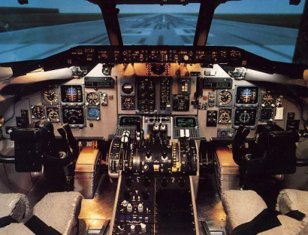
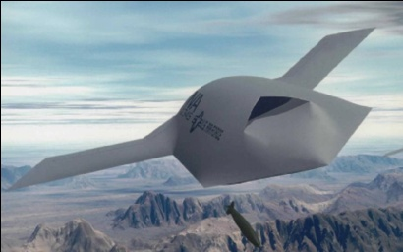
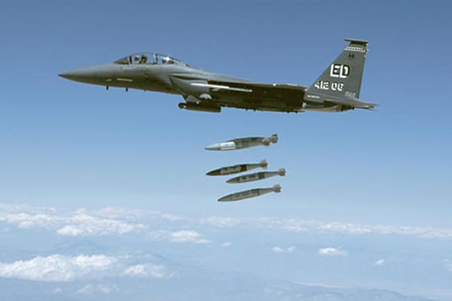
Boeing is a Key CPS Stakeholder
The Boeing Company is working a rich set of application areas that are benefiting from CPS research
  Air (military and commercial)
  Space (high-reliability applications)
  Land (networking land elements)
  Air Traffic Management
Applications involve multiple, networked CPS systems
  Safety-critical aspects
  Security
  Need for predictability in face of dynamic environments
Aircraft platforms
  Commercial
    Stringent certification and V&V processes
    and standards
  Military
    Piloted and autonomous vehicles
    Support all services
    Unmanned vehicles in NAS
    Varying levels of V&V requirements

Slide 3
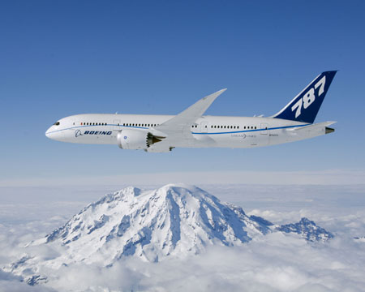
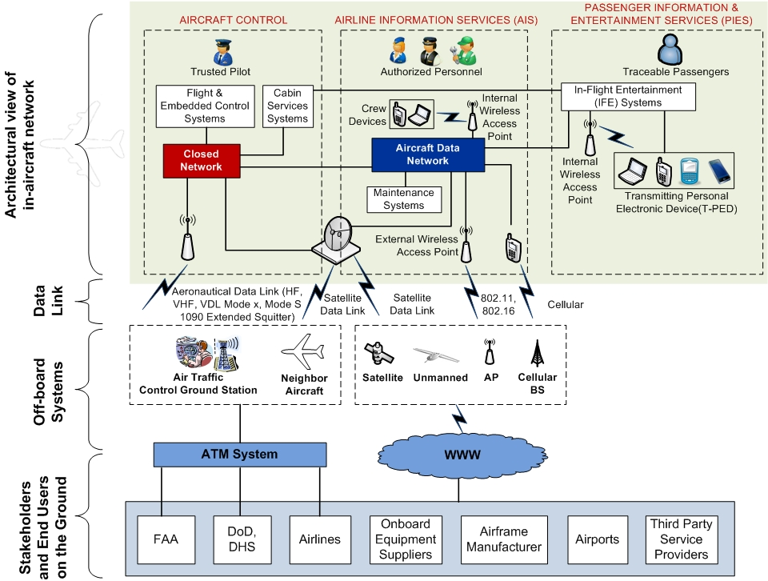

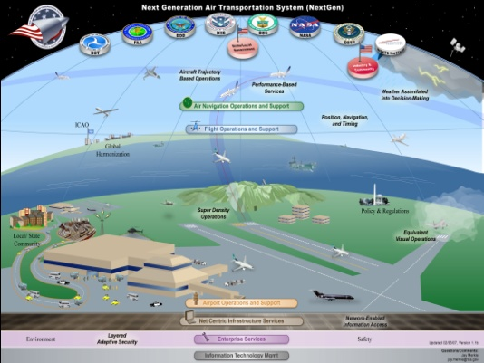
Aviation CPS Applications: Future Aircraft and NextGen
Future Aircraft
Abstract System Architecture
NextGen
Tight integration within aircraft, and between aircraft and off-board systems

Slide 4
NextGen is a Large-Scale CPS
Today’s NAS
(Loose Integration, “Stovepiped”)
NextGen
(Tight Integration)
Physical
Landing
Enroute
Taxi
Takeoff
Cyber-Physical Interactions
Cyber
Cyber
Transformation
NextGen uses “cyber,” i.e., networking, software, computing, to tightly weave taxing, takeoffs, enroute flight paths, and landings

Slide 5
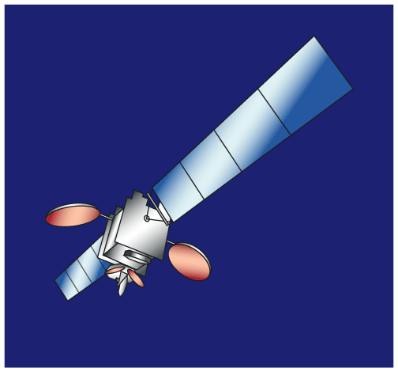
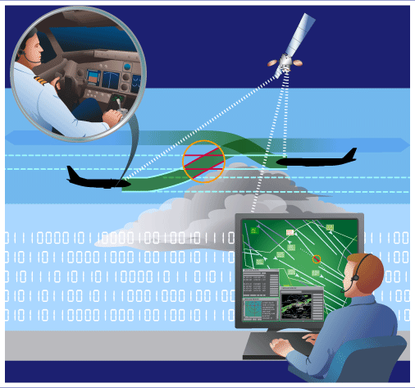
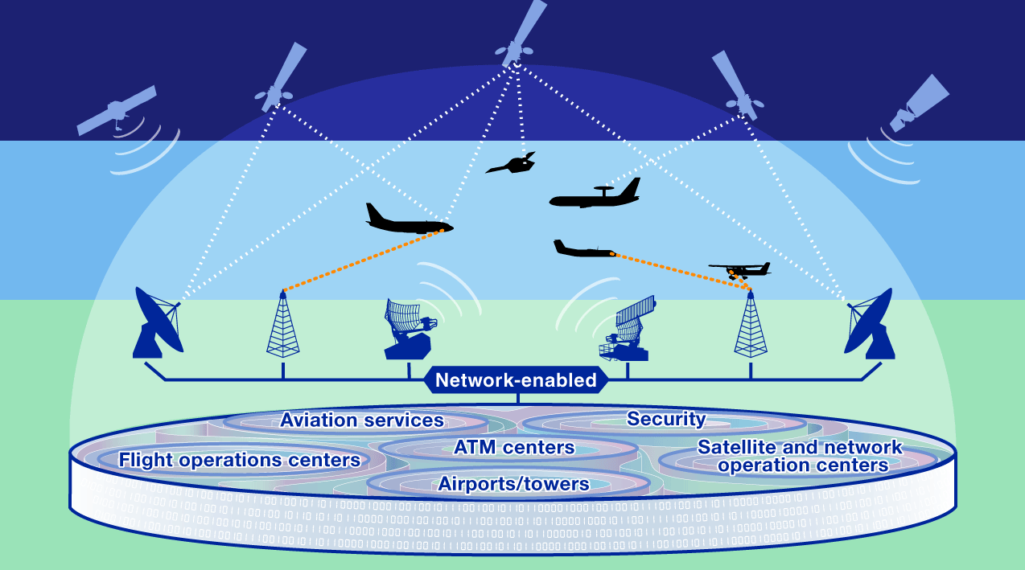
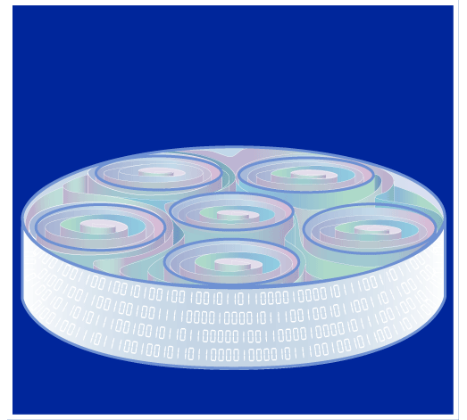
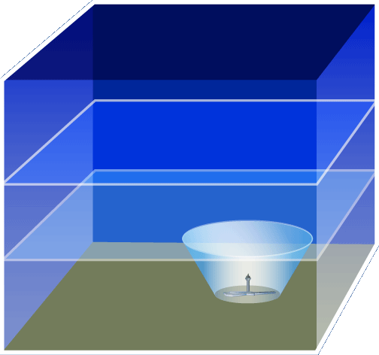
Tight Integration in the NextGen: Examples
Higher Precision Flight Anywhere
Improved Capacity,
Safety & Efficiency
Enhanced CNS
(e.g., GPS, ADS-B)
Performance-based Operations
Information Infrastructure
Enables
Enabled Applications/Services
Create
Transformed Global
Air Traffic System
System Wide
Information Management
Dynamic
Seamless Airspace
3X⁺ capacity
Environmental benefits
$10-30B/yr global savings
Global interoperability
Accident reduction
Threat deterrence
Higher Precision Common Awareness
Improved Agility,
Security & Economy

Slide 6


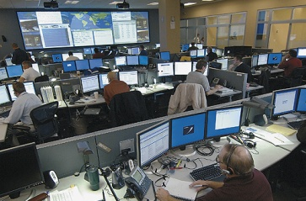
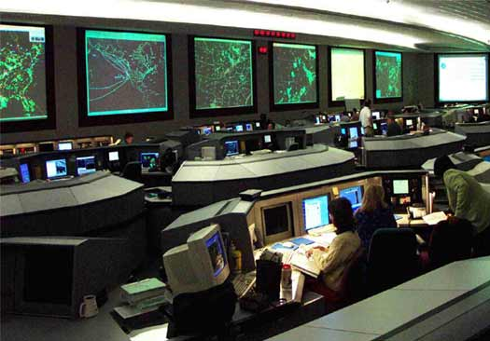
Cyber-Physical Interactions in the NextGen: Examples
Coordination for airborne
sensing and action webs
Aircraft
Airspace
Control and coordination
for flight safety and efficiency
Control and coordination for
separation assurance and
hazard avoidance
FOC
ANSP
In-flight coordination
Flight Operations Centers
Service Providers
Cyber components? Aircraft digital communications; weather/traffic forecast, flight planning/optimization algorithms; situation awareness and decision support software
Physical components? Mobile aircraft; dynamic airspace traffic, weather, pollution, noise; pilots, air traffic controllers, airlines crew

Slide 7
Grand CPS Challenges of the NextGen
Highly collaborative
Advanced CPS applications monitor and effect change in aircraft and airspace, automatically and/or with the human-in-the-loop
Presence of cyber and physical risks/threats to performance
How to study the joint dynamics of this collaborative system?
How to provide deterministic, highly predictable and provable behavior for this collaborative system?
Crew
(pilots, traffic controllers, etc.)
Command and
Control
Formation
Processing
Sensor
Physical
Risks and
Threats
(e.g., weather,
solar flares)
Enabled Services/Applications
Seamless, rich interaction
Networks
Software
Cyber
Risks and
Threats
(e.g., system
failures,
disruptions)
Computing
Aircraft and Airspace

Slide 8
CPS Research Challenges in the NextGen (1)
Extremely heterogeneous with many types of aircraft and users – Need to consider aircraft limits & user preferences in CPS solutions
Mixed criticality for information assets – Need prioritization of cyber and physical resources; functions to handle information of various trust levels; cyber security advances
Networking employed from in-aircraft system to global system scales – Need worldwide interoperability for aviation networks; advances in communications, signal processing and wireless security, data fusion
Large systems-of-systems for sharing critical real-time data – Need advances in cross-domain interoperability, assured timely end-to-end information exchange, distributed coordination
Verification, validation and certification are essential – Need efficient V&V techniques; advances in visualization and virtual reality, security versus safety, and software development assurance

Slide 9
CPS Research Challenges & Implications for NextGen (2)
Complexity at multiple temporal/spatial scales – Need advances in data mining, sensor network, operations research, weather models
High degrees of automation, control loops close at all implemented scales – Need advances in human-automation interface, crew fatigue management, close coupling of networking with aircraft mobility control, air traffic control algorithms, cyber-physical security
Autonomous operations and national security are vital – Need advances in sense-and-avoid and control of unmanned systems; integrated airspace surveillance capability
Legacy system integration and migration – Need new solutions to be reverse and forward compatible
Longevity is a must, since system lifetimes is several years to decades – Solutions must have a long lifespan or be inexpensively and independently upgradeable

Slide 10
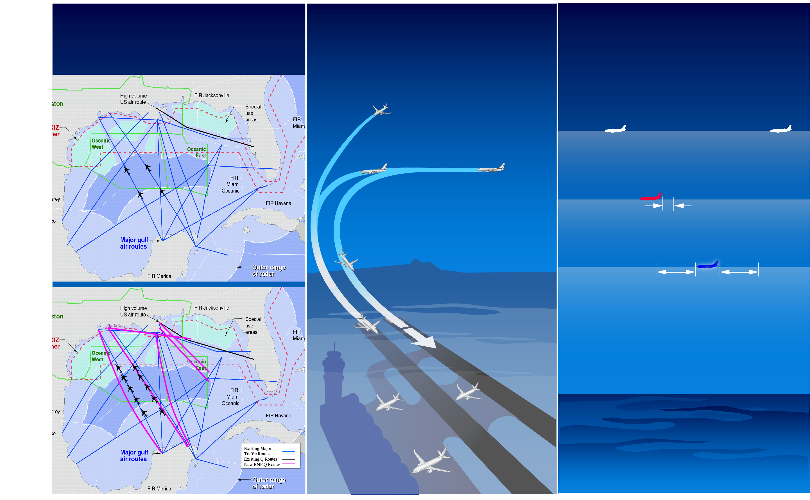
Operations Enabled With ADS-B
Reduced-Separation in
Non-Radar Airspace
Merging and Spacing,
Surface Operations,
and Closely-Spaced
Parallel Approaches
In-Trail Procedures
FL360
Blocking Aircraft
FL360
ITP Criteria
ITP Aircraft
FL360
Standard Longitudinal
Separation Requirement
Notes:
Because of lack of effective surveillance, aircraft in oceanic regions operate under procedural control with large separation criteria. In this particular scenario, where we have multiple aircraft at different altitudes, the blue aircraft would not be permitted to climb to a more fuel-efficient altitude, say FLT 360, because its proximity to the red aircraft is less than the standard longitudinal separation.
The In Trail Procedures concept calls for the blue airplane to be equipped with an appropriate spacing application based on ADS technology (potentially ADS-C or ADS-B). This self-spacing capability is expected to reduce the required longitudinal separation between aircraft, and allow the blue aircraft to climb through FL 350 occupied by the red aircraft, in spite of less than standard longitudinal separation.
This procedure can also be used for descending through an occupied altitude, although the opportunities for benefits are much less common than for a climb situation. In-trail climb and descent procedures present a significant opportunity for improving flight time, fuel burn and emissions by enabling airplanes to obtain desired altitudes in congested oceanic airspace.
This can have significant benefits for very long haul flights such as between Asia and Europe, North America and the South Pacific and across the polar region between Asia and North America. In some cases such fuel-saving procedures can prevent a diversion, which is costly for the airlines and an undesirable experience for airline passengers.

Slide 11
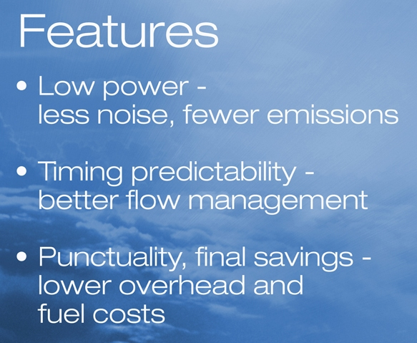
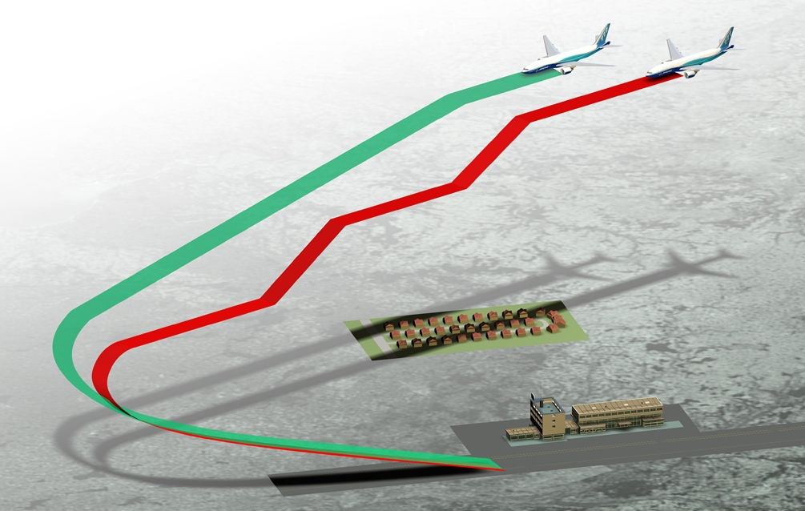
Continuous Descent Approaches
Notes:
Current operational procedures call for airplanes to be gradually stepped down from its TOD point to touchdown, as shown by the red ribbon. Repeated idling and spooling up of engines during the descent phase is not fuel efficient and offers the opportunity for fuel savings.
The optimal descent into an airport means flying at cruise altitude until the exact point at which bringing the engines to idle will result in the least fuel burn until the engines are spooled up just before touchdown. As shown by the green ribbon – and these procedures have been labeled Continuous Descent Approaches.
Sometimes, ill-conceived noise abatement procedures also result in leveling airplanes during descent which in turn means engines are spooled-up, flaps and perhaps gear are deployed all of which results in more noise. Better designed lateral flight profiles, combined with Continuous Descent Approaches can result in lower fuel burn, fewer emissions and less noise. This takes us to the next concept called Tailored Arrivals.
Note:
Because perfect information about winds does not exist and because terrain can sometimes get in the way, attaining the optimum descent may remain an ideal. We can, however, come much closer to the ideal by eliminating many of the inefficiencies that have been engineered into the system over time. In many places airspace design results in step-downs which cost fuel and cause greater emissions than are necessary. that is an arrival much closer to the ideal. The vertical profile improvements are combined with horizontal arrival improvements in a concept called ….. (Tailored Arrivals).

Slide 12
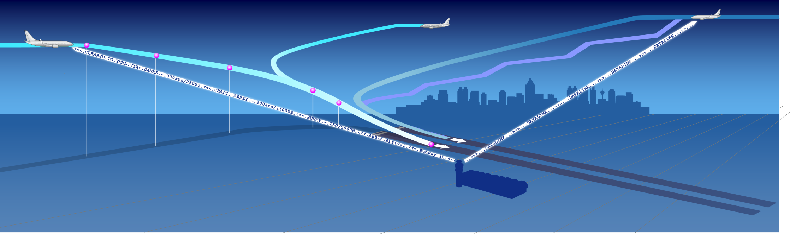

A Near-Term Example – Tailored Arrivals
Top of Descent
DANKS
CHAPI
ARBEY
Typical
arrival
BUNKY
11,000 ft
300 kt
9,000 ft
190 kt
28,000 ft
300 kt
Tailored arrivals are CDAs, or near-CDAs, flown on 4D paths that are shaped for local constraints and timed for merging traffic.
AMS
SFO
SYD
MEL

Slide 14
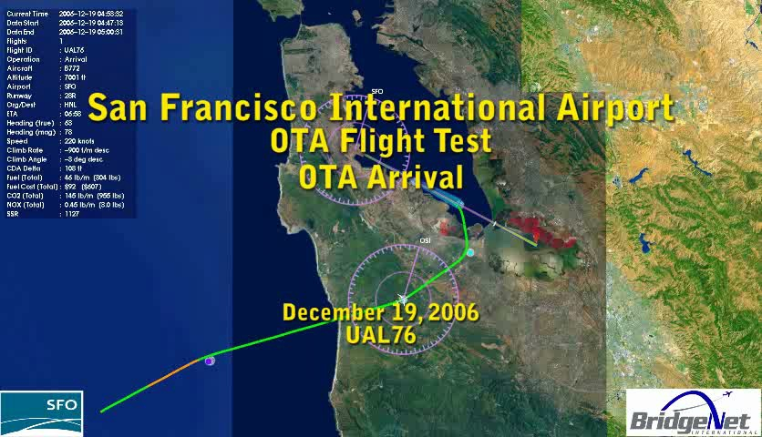
Tailored Arrival Trial at SFO

