Slide 1

Cyber-enabled Manufacturing Systems (CeMS)
J. Beaman ^{[1]} and A. Mok ^{[2]}
[1] Department of Mechanical Engineering
[2] Department of Computer Science
The University of Texas at Austin

Slide 2
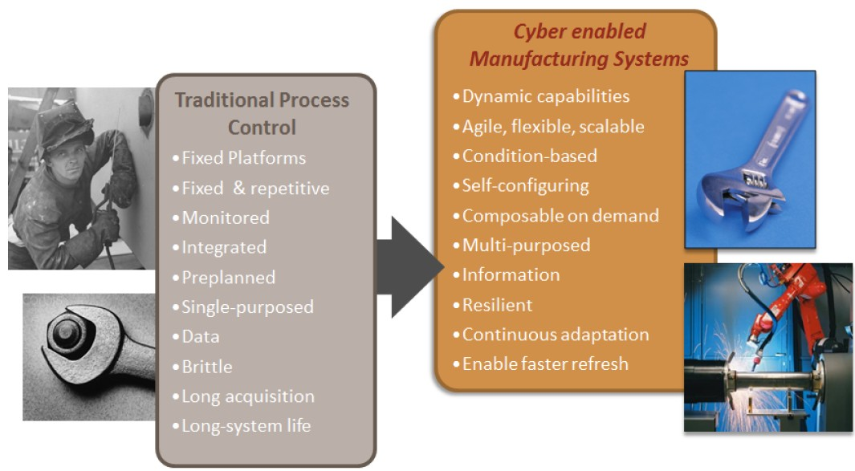
Motivation
Statistics-based process control requires a substantial amount of data to specify acceptable process variation limits. Therefore, it is not effective in predicting defects in short-run and small-lot manufacturing. Cyber-enabled process control seeks to incorporate physics-based models and multiple, but uncertain, measurements of a process directly into a computer-driven monitoring and control system. As a result, changes in manufacturing requirements can be handled by the control algorithm without new extensive testing.

Slide 3
Objective
To perform real-time monitoring and prediction of manufacturing defects. Also, changes in manufacturing parameters such as substitution of materials, differing processing speeds, differing product geometries, etc., can be handled by the model-based controller in real-time without new extensive testing as required with present statistical control. In addition, disruptions in control because of external factors (e.g., material property variations, environmental temperature and humidity variations, etc.) can be compensated by adjustments of the physics-based algorithm.

Slide 4
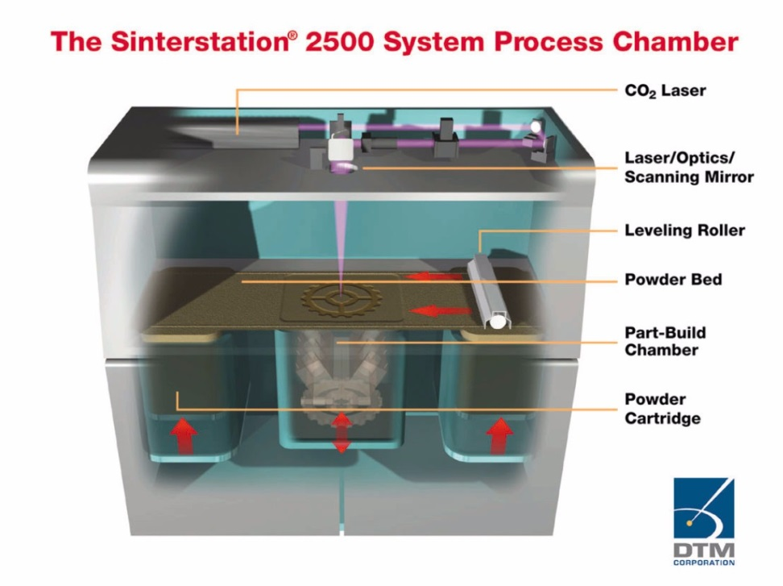
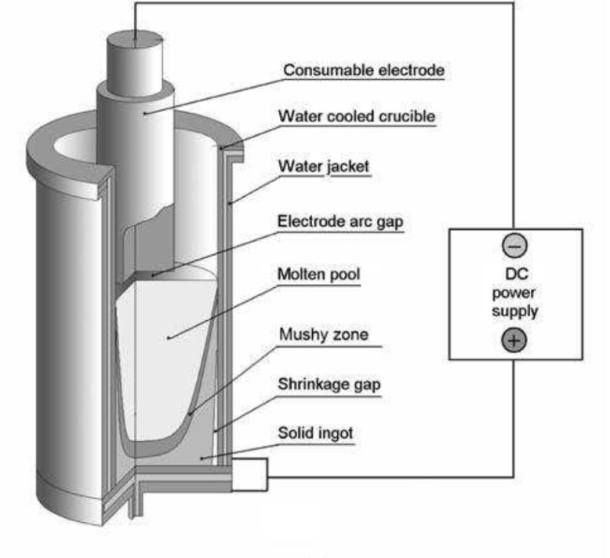
Experimental test beds: SLS and VAR
Selective laser sintering (SLS, a.k.a. Rapid Prototyping) was developed specifically for small-lot manufacturing. The SLS process was developed and commercialized by UT Austin [4]. Another process studied by our research team is Vacuum Arc Remelting (VAR), in which the high cost of each VAR ingot makes it important to prevent all defect to ensure the quality in the final product.
Both processes share similarities, as both include thermal phenomena that results in phase transformations. An open architecture SLS machine is being built in our facilities. Industrial collaborators provide access to VAR furnaces for experiments.

Slide 5
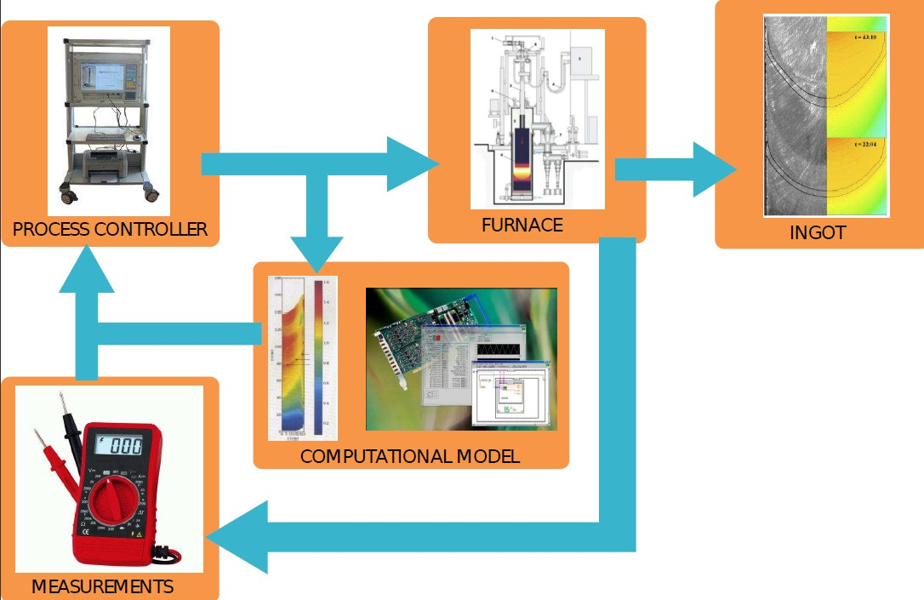
Methodology
The proposed method requires the ability to accurately model the physical system in order to predict its future state on the estimated current state and inputs. The model must be simulated in less than the characteristic time scale of the process to be used to monitor the formation of defects. The physics-based model is used along with the sensors to provide noisy measurements to a state estimator which returns an estimate used for real-time control.

Slide 6
Methodology
The barriers to the implementation of this approach are the need for embedded systems and algorithms (and combination of different types of them) for real-time computation and data acquisition, selection of appropriate sensors, and techniques for quantifying uncertainty. Cyber-physical systems (CPS) focus on the optimal interaction of computing (decision making) with the evolving state of the physical world, in order to establish a defect-free environment for the target manufacturing applications. In traditional process control systems, computations for control and estimation are assumed to be completely independent of the physical system, which is not the case in CPS where the nature and amount of computation may depend on the state of the physical component. In our proposed approach, the computational process works in close synchronization with the physical process, resulting in collaboration of both the physical and cyber components. Complete integration of CPS in the CeMS approach requires real-time guarantees of physics simulation, controller and estimator computation, as cyber components; and the manufacturing process, as physical component.

Slide 7
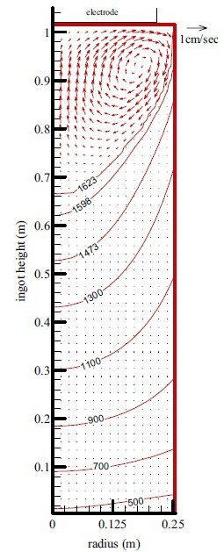
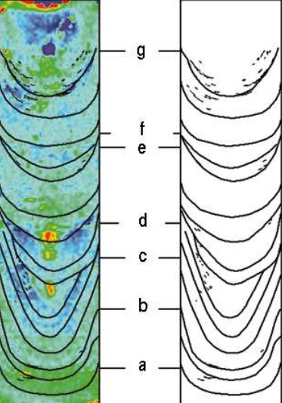
High-fidelity modeling
Detailed models of the multiples physical domains present in the process are required. Researchers from the Institute of Computational Engineering and Sciences (ICES) of UT Austin are working on the development of a physics-based high-fidelity model for VAR and SLS. These model will be used as: a basis for reduced-order models, as surrogate systems on which to test control strategies, and to predict the details of the system based on the limited measurements available.
In the case of VAR, a finite volume model is already available and has been used to prevent macrosegregation defects in the solidification front of remelted ingots.

Slide 8
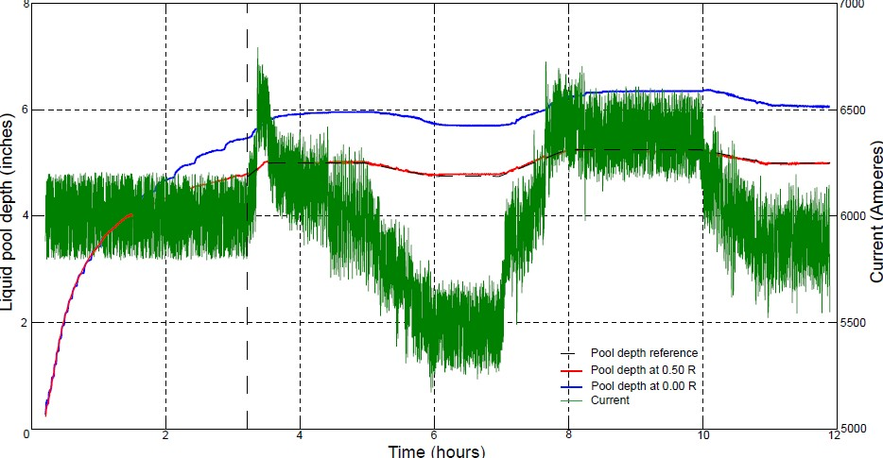
Reduced-order modeling
High-fidelity models are often nonlinear and high-dimensional, and therefore unsuitable for real-time control applications. Several techniques for obtaining reduced-order from high-fidelity models are currently being studied, e.g. spectral methods [1], singular perturbation approximation based on balanced realizations[2], POD methods, etc.

Slide 9
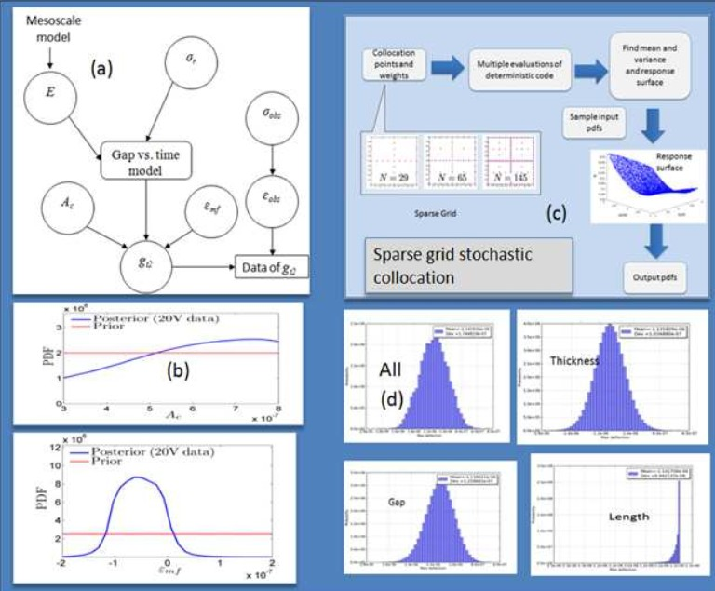
Uncertainty quantification
We propose to adopt an integrated decision framework for validation, sensitivity analysis and uncertainty quantification. Our work is based on a Bayesian framework for uncertainty quantification in complex systems. In this approach, the system or process being simulated is represented as a directed acyclic graph , with the nodes in the graph representing random variables, and the graph edges representing conditional probabilities as dictated by the
underlying model or simulation. Given input random variables, the objective is to compute the probability density function (PDF) of outputs. Such a prediction enables us to determine precisely what percentage of our small-lot production will meet specifications. Furthermore, the Bayesian framework allows determination of global output sensitivity to the PDFs of all nodal variables, thus enabling the identification of the most sensitive models, data and processes.

Slide 10
Sensors and measurements
In CeMS the measurement of process parameters is crucial to accurate modeling of the complex physics of the system. While the sensor measurements may be noisy, they provide a statistical bound on the current system state and a point of calibration of the physical model. In conjunction with the physical system model, the sensor feedback also allows accurate estimation of system states. In our SLS test bed, a high-temperature machine, the sensor suite has been expanded to a full 2-dimensional thermal array which should allow significantly more accurate state estimation of the system state, and thus better control of the final product. In the case of VAR, no measurements are available from the solidifying ingot. Thus, the same high-fidelity model will run in parallel to the process to provide estimated measurements of the variables of interest.

Slide 11
Real-time prediction
Accurate characterization of the process dynamics is required in order to detect process anomalies, and to correct the dynamics to prevent defects. Kalman filters are commonly used for estimation, but their performance in nonlinear non-Gaussian applications is poor. Sequential Monte Carlo methods follow a Bayesian approach to estimate the complete probability distribution of all random variables, without assuming linearity or normality. However, these methods are computationally intensive and that prevents their implementation for real-time operation.
The most common algorithm is the particle filter [5], but several variations of the main algorithm have been proposed to decrease the computational cost in the sampling part, e.g. HMC filters. All of these methods are parallelizable.

Slide 12
SMC for estimation
Timing is a crucial aspect of feedback-controlled manufacturing processes. The stability of the control loop requires rapid computation and data acquisition of the cyber components. Given the fact that SMC methods are highly parellelizable, it is natural to implement them by a combination of Central Processing Units and Graphics Processing Units (CPU+GPUs). GPU offers unprecedented computational performance by allowing the offloading of compute-intensive portions of the application to the GPU, while the serial portion of the code still runs on the CPU. Cyber-physical applications can run significantly faster on a CPU + GPU combination because CPUs consist of a few cores optimized for serial processing, while GPUs consist of thousands of smaller, more efficient cores designed for parallel computation. We call this CPU+GPU architecture a heterogeneous system and our goal is to support code generation for heterogenous systems.

Slide 13
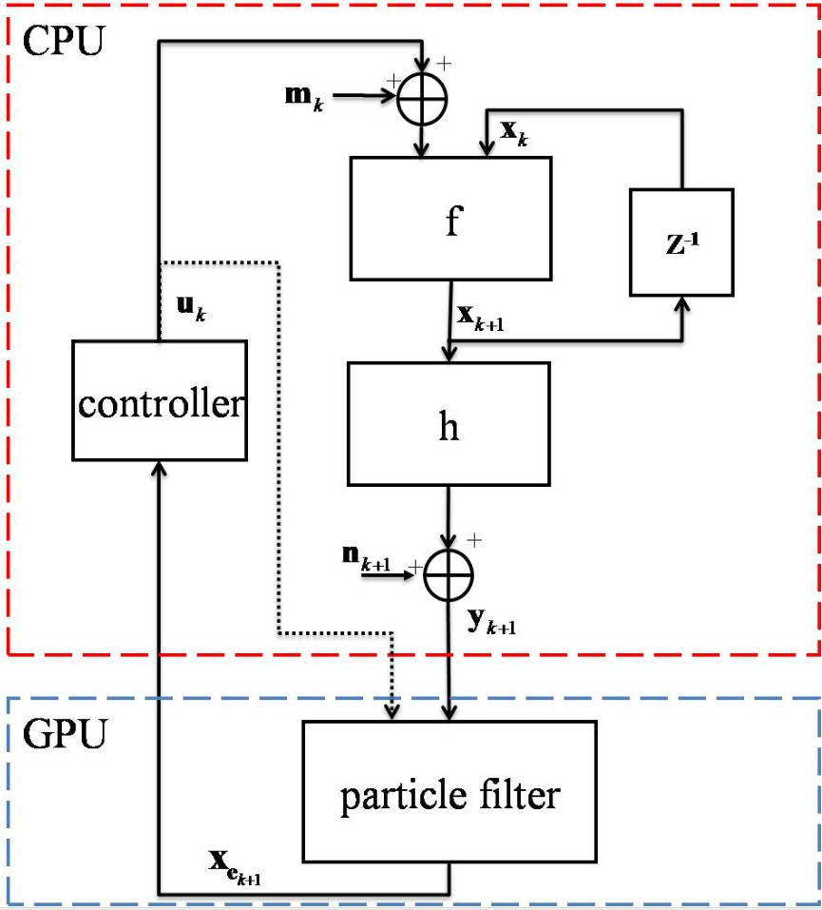
Real-time computer monitoring architecture
A computational architecture that can meet the real-time constraints of the manufacturing process is essential to the success of the CeMs approach. Our physics-based control relies on time-critical simulation of the physical state of the system, by using Particle Filters. The particle filter is implemented in parallel on a GPU with NVIDIA's Compute Unified Device Architecture (CUDA). This architecture is targeted to provide a platform for general-purpose computing on graphics processing units (GPGPU) technique.The CUDA architecture is built upon an array of Streaming Multiprocessors (SMs). For example, the graphics card we are using is GeForce GTX TITAN, which has 14 SMs. Since each SM has 192 Scalar Processor cores, there are totally 2688 cores for massive parallel computing.

Slide 14
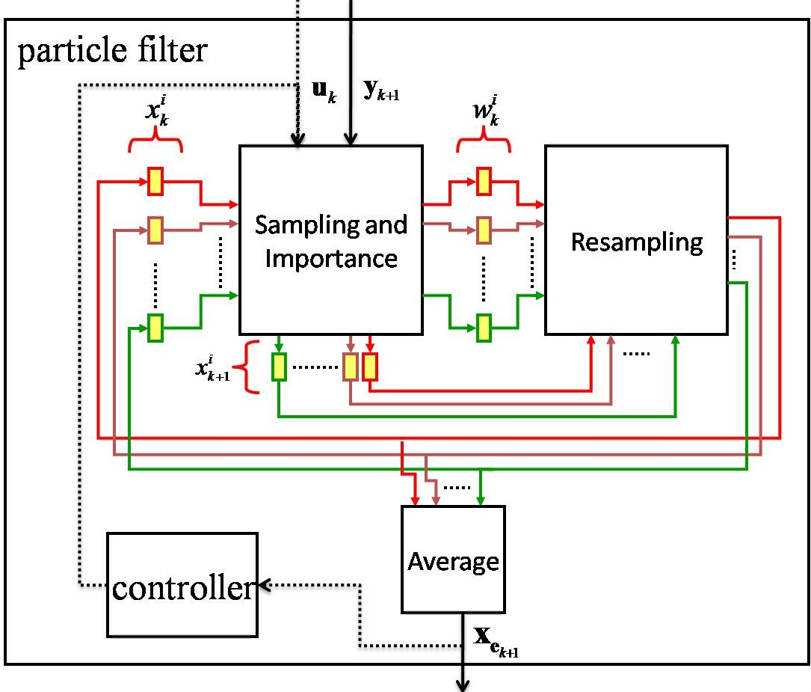
Real-time computer monitoring architecture
The computation involves a part that is done on a multi-core CPU and a massively parallel part that is done on a GPU. At each iteration, the CPU part simulates the physical process with one reference state. Following the physical model f, the observation vector y is generated according to the measurement model h. It is then input to GPU, which executes the particle filter part of the program. Inside the particle filter on GPU, there are three modules : Sampling and Importance, Resampling, and Average. After GPU computation, GPU outputs the estimation state vector to CPU, which then simulates a controller that generates the control signal. By taking advantage of the massive parallelism of the GPU, we expect this computational architecture can meet the real-time deadlines imposed by the physics-based manufacturing process.

Slide 15
References
[1] Joseph Beaman, Felipe Lopez, and Rodney Williamson, Modeling of the vacuum arc remelting process for estimation and control of the liquid pool profile, submitted to the ASME Journal of Dynamic Systems, Measurements and Control.
[2] Felipe Lopez and Joseph Beaman, Control of the solidification front in a remelting process using a finite volume model, submitted to the 2014 American Control Conference.
[3] Trevor Watt et al., Solidification mapping of a Nickel 718 laboratory VAR ingot, Proceedings of the 2013 International Symposium on Liquid Metal Processing and Casting.
[4]Joseph J. Beaman: Solid freeform fabrication: a new direction in manufacturing: with research and applications in thermal laser processing, Boston: Kluwer Academic Publishers (1997).
[5]Arnaud Doucet et al., Sequential Monte Carlo methods in practice Springer (2001).

