Slide 1

Homeland Security Advanced Research Projects Agency
DHS Cyber Security Research and Cyber Physical System Security
November 7, 2014
Dr. Dan Massey
Program Manager

Slide 2


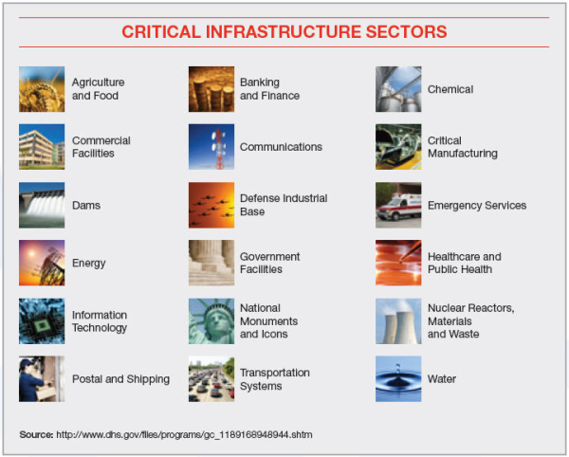


CSD Mission & Strategy
REQUIREMENTS
CSD MISSION
Develop and deliver new technologies, tools and techniques to defend and secure current and future systems and networks
Conduct and support technology transition efforts
Provide R&D leadership and coordination within the government, academia, private sector and international cybersecurity community
CSD STRATEGY
Trustworthy Cyber Infrastructure
Cybersecurity Research
Infrastructure
Network & System Security and Investigations
Cyber Physical Systems
Transition and Outreach
Open Source
IT Security Companies
Venture Capital
Government
International

Slide 3










Cyber Security Division (CSD) Research Requirement Inputs
White House/NSS
National Strategy 2003
Comprehensive National Cybersecurity Initiative (CNCI)
EO 13636/PPD 21
National CISR R&D Plan (in progress)
Transition to Practice (TTP)
Cyber Economic Incentives Research
National Initiative for Cybersecurity Education (NICE)
Cybersecurity Framework Support
Departmental Inputs
QHSR 2009 & 2014
Blueprint
NPPD/CS&C/NCCIC
ICE HSI / IPR
USSS
CBP
USCG
TSA
DHS CIO/CISO Councils
Interagency Collaboration
Cyber Security and Information Assurance (CSIA) IWG
SCORE – Classified R&D WG
Cyber-Physical Systems (CPS) SSG
Big Data SSG
Cyber Forensics WG
Critical Infrastructure Sectors (Private Sector)
Energy (Oil & Gas, Electric Power)
Banking and Finance
Communications/IT
Cross-Sector Cyber Security WG
CSD
State/Local
S&T First Responders Group
FRAC/TTWG
SWGDE (FBI)
International
Collaborations
3

Slide 4
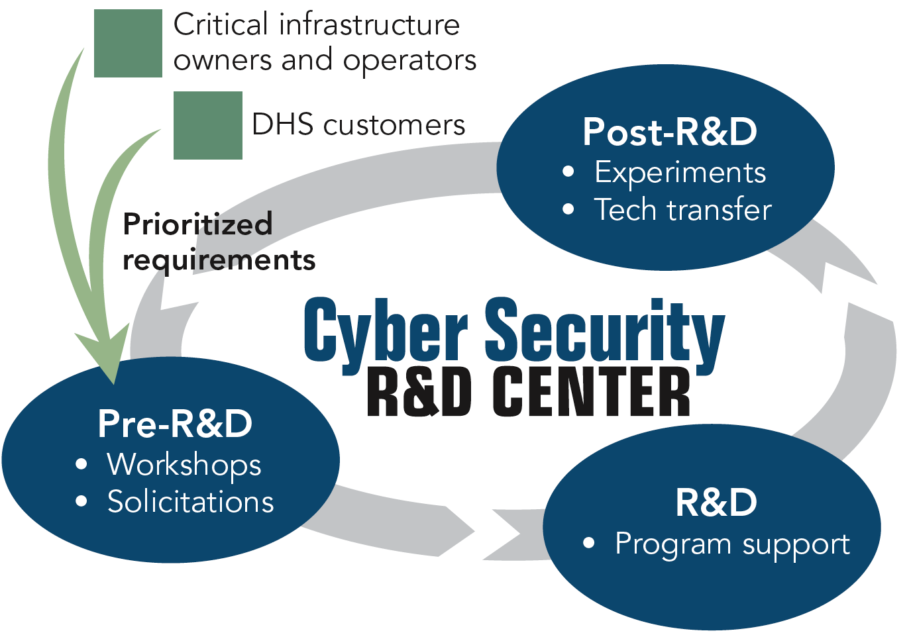
CSD R&D Execution Model
Successes
Over 30 products transitioned since 2004, including:
2004 – BAA 04-17
5 commercial products
2 Open Source products
2005 – BAA 05-10 (RTAP)
1 commercial product
1 GOTS product
1 Open Source product
2007 – BAA 07-09
2 commercial products
2011 – BAA 11-02 (more to come)
1 Open Source product
1 Research Infrastructure
Law Enforcement Support
2 commercial products
1 Open Source product
Multiple Knowledge products
Identity Management
1 Open Source standard and GOTS solution
SBIRs
8 commercial products
1 Open Source product
Research, Development,
Test and Evaluation &
Transition (RDTE&T)
"Crossing the ‘Valley of Death’: Transitioning Cybersecurity Research into Practice,"
IEEE Security & Privacy, March-April 2013, Maughan, Douglas; Balenson, David; Lindqvist, Ulf; Tudor, Zachary http://www.computer.org/portal/web/computingnow/securityandprivacy
4

Slide 5
Transition To Practice (TTP) Program
R&D Sources
DOE National Labs
FFRDC’s (Federally Funded R&D Centers)
Academia
Small Business
Transition processes
Testing & evaluation
Red Teaming
Pilot deployments
Utilization
Open Sourcing
Licensing
New Companies
Adoption by cyber operations analysts
Direct private-sector adoption
Government use
Implement Presidential Memorandum – “Accelerating Technology Transfer and Commercialization of Federal Research in Support of High-Growth Businesses” (Oct 28, 2011)

Slide 6

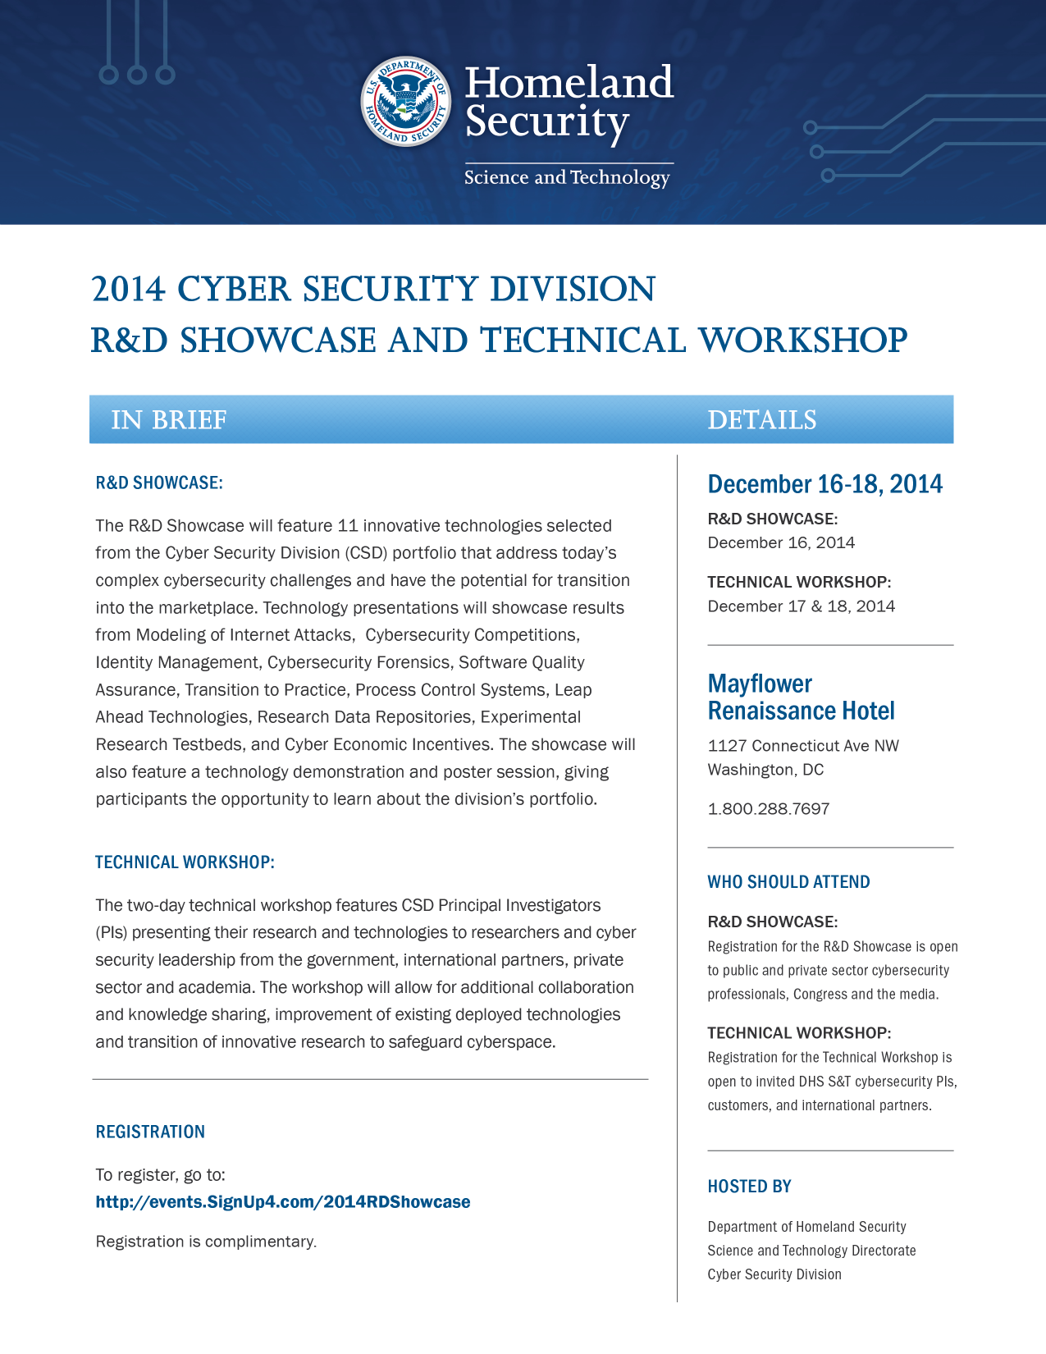

Slide 7

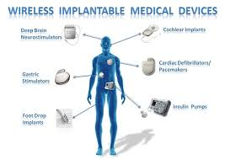

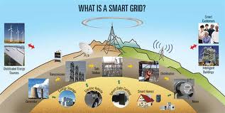
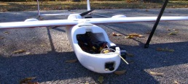


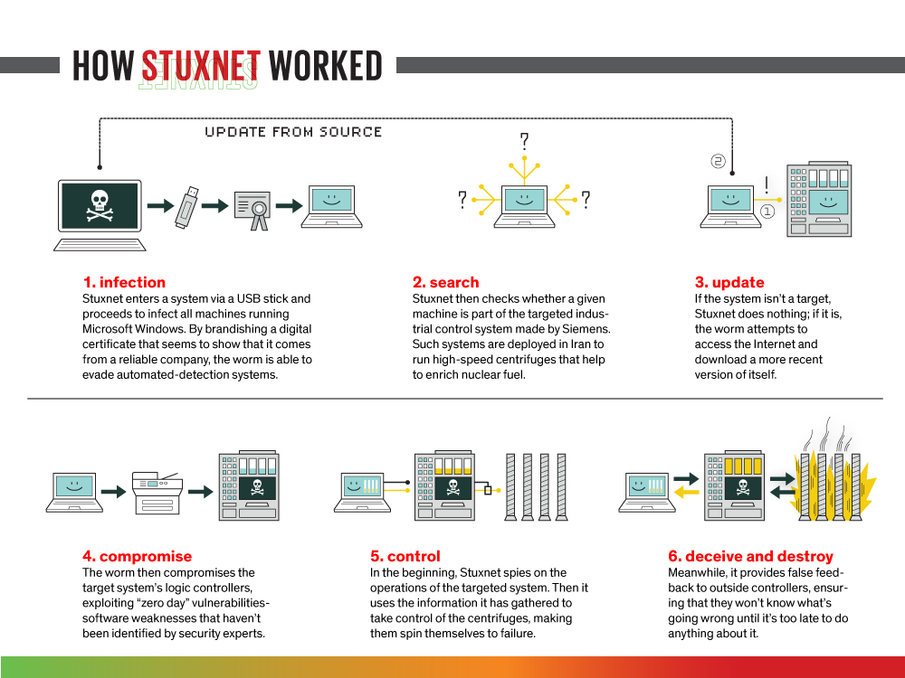
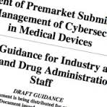
CPSSEC Overview
PPD 21 Identifies critical infrastructure as “interdependent functions and systems in both the physical space and cyberspace” and aims to strengthen security and resilience “against both the physical and cyber attacks”
Cyber Physical Systems Are Becoming Ubiquitous:
Smart cars, smart grids, smart medical devices, smart manufacturing, smart homes, and so on
You will “bet your life” on many of these systems
Fast moving field focusing on functionality now and will bolt on security later…
Drones Could Help Tulsa Firefighters During Search, Rescue
Need to Build Security In at this Early Stage
Promote security at onset
Connect research and industry
Enable security as integral component
http://news.engr.arizona.edu/news/ua-engineers-and-local-dot-test-smart-traffic-systems-reduce-first-responder-deaths
http://news.cnet.com/8301-1009_3-57596847-83/car-hacking-code-released-at-defcon/
Opportunity Now To Build Security Into Emerging Cyber Physical Designs

Slide 8

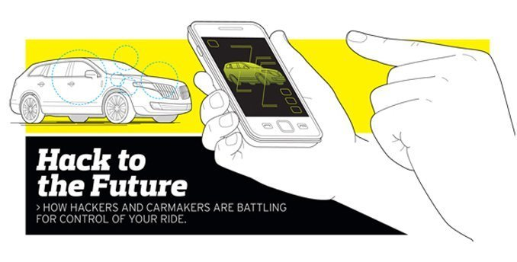
Problem: Building In Security
Emerging CPS designs haven’t identified threats, are full of vulnerabilities, and lack security as integral part of design:
Industry driven by functional requirements and fast moving market
Research disconnected from market drivers and tangible security problems
Security concerns cross company and even sector boundaries, requiring shared solutions
Increasing number of interconnected systems where you bet your life that security can be added later
ARPAnet design goals by Clark in 1988
Function despite loss of networks/gateways
Support multiple types of services
Accommodate a variety of networks
Distributed management of resources
Cost effective
Low level of effort to add a host
Provide accounting of resources used
Led to today’s challenges in accounting (last goal) and lack of security (non-goal)
“Just like the internet in its early days, car networks
don’t employ very much security” says Brad Hein.
We are setting the CPS design goals now
Security will NOT emerge on its own Must provide a framework that addresses real threats and real incentives
enables collaboration across companies & sectors
What you pay for in life, you get. What you don’t pay for, you don’t get.

Slide 9

CPS Security Pyramid
OBJECTIVE
APPROACH
Enable tangible progress through cooperation and market-driven requirements
INDUSTRY CONSORTIUM
Develop sector-specific groups
1.
Industry
Specific
Demonstrate real vulnerabilities and economically viable mitigations
2.
Transportation &
Emergency Response, Energy, Healthcare
APPLIED RESEARCH
CPSSEC Program
Leverage cross-cutting aspects across general CPS
3.
Transportation, Emergency Response, Energy Healthcare, Building Controls, Manufacturing & Industry, Agriculture, Defense
JOINT RESEARCH
Foundational research
Inter-Agency
NITRD CPS SSG

Slide 10


Slide 11
Cyber Security Program Areas
Trustworthy Cyber Infrastructure
Working with the global Internet community to secure cyberspace
Research Infrastructure to Support Cybersecurity
Developing necessary research infrastructure to support R&D community
R&D Partnerships
Establishing R&D partnerships with private sector, academia, and international partners
Innovation and Transition
Ensuring R&D results become real solutions
Cybersecurity Education
Leading National and DHS cybersecurity education initiatives
Recent Efforts
Mobile Device Security, Data Privacy, Denial of Service Defense, and Cyber Physical Systems

Slide 12
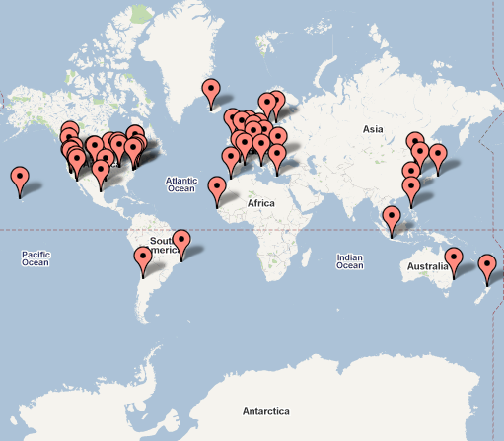
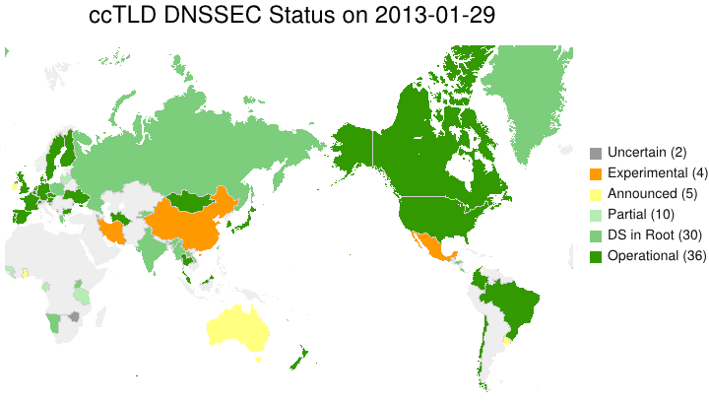
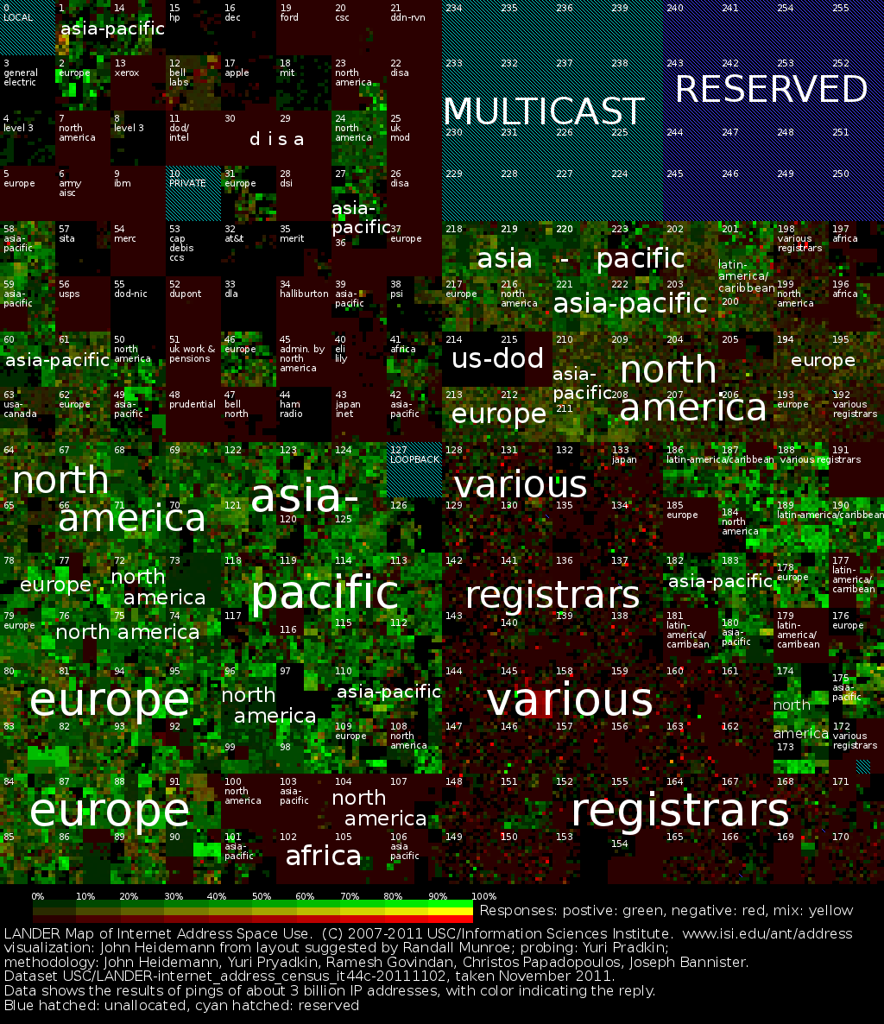
Trustworthy Cyber Infrastructure
Secure Protocols
DNSSEC – Domain Name System Security
Govt and private sector worked together to make this happen
Started in 2004; now 111 top level (gTLD) and country code (ccTLD) domains adopted globally including the Root
SPRI – Secure Protocols for Routing Infrastructure
Internet Measurement and Attack Modeling
Geographic mapping of Internet resources
Logically and/or physically connected maps of Internet resources
Monitoring and archiving of BGP route information
Co-funding with Australia
http://www.isi.edu/ant/address/browse/

Slide 13
Research Infrastructure (RISC)
Experimental Research Testbed (DETER)
Researcher and vendor-neutral experimental infrastructure
Used by over 200 organizations from more than 20 states and 17 countries
Used by over 40 classes, from 30 institutions involving 2,000+ students
http://www.deter-project.org
Research Data Repository (PREDICT)
Repository of network data for use by the U.S.- based cyber security research community
More than 200 users (academia, industry, gov’t); Over 600TB of network data; Tools are used by major service providers and many companies
Phase 2: New datasets, ICTR Ethics, International (CA, AUS, JP, EU)
https://www.predict.org
Software Assurance Market Place (SWAMP)
A software assurance testing and evaluation facility and the associated research infrastructure services
Homeland Open Security Technology (HOST)
Support and Promote Open Source Security Technology
Discovery and Collaboration links open source community with researchers, industry, and government
Investments programs makes small strategic investments in key open source technologies

Slide 14
R&D Partnerships
Oil and Gas Sector
LOGIIC – Linking Oil & Gas Industry to Improve Cybersecurity
Electric Power Sector
TCIPG – Trustworthy Computing Infrastructure for the Power Grid
Banking and Finance Sector
FI-VICS – Financial Institutions – Verification of Identity Credential Service
DECIDE – Distributed Environment for Critical Incident Decision-making Exercises
State and Local
PRISEM - Public Regional Information Security Event Management
PIV-I/FRAC TTWG – State and Local and Private Sector First Responder Authentication Credentials and Technology Transition

Slide 15
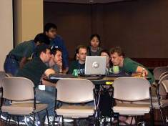
Cybersecurity Education
Cyber Security Competitions (http://nationalccdc.org)
National Initiative for Cybersecurity Education (NICE)
NCCDC (Collegiate); U.S. Cyber Challenge (High School)
Provide a controlled, competitive environment to assess a student’s depth of understanding and operational competency in managing the challenges inherent in protecting a corporate network infrastructure and business information systems.
DHS Cyber Skills Task Force (CSTF)
Established June 6, 2012 - Homeland Security Advisory Council
Over 50 interviews (DHS internal and external)
Identify best ways DHS can foster the development of a national security workforce capable of meeting current and future cybersecurity challenges;
Outline how DHS can improve its capability to recruit and retain sophisticated cybersecurity talent.
11 recommendations in 5 key areas

Slide 16
New DHS Program Areas
Mobile Device Security
Data Privacy
Distributed Denial of Service Defense
Cyber Physical System Security

Slide 17
Security Models And Interactions
Understand how cyber and physical system components are expected to interact.
Essential to consider that cyber physical systems integrate both cyber and physical in the system
“All three words (cyber, physical, system) count”
Illustrative Issues:
Security models and taxonomies
Combining security with safety
Metrics and ratings
Building Codes for Cyber Physical Systems
Model-based Testing and Validation

Slide 18
Secure System Design and Implementation
Build Security Into Cyber Physical System Design.
Again “All three words (cyber, physical, system) count”
Expected results to include prototype implementation
Illustrative Issues:
Authentication and Authorization
Monitoring and Logging
Intrusion Detection, Mitigation, and Tolerance
Secure Updates

Slide 19
Experiments and Pilot Projects
Bridge the gap between advances in fundamental science and the cyber physical systems being deployed today.
Focus on cyber physical systems in use today
Experiment and Pilot Projects
Clearly identify proposed system technical readiness level
Identify safety concerns and appropriate risk mitigations
Clearly explain how attacks are introduced and analyzed

Slide 20
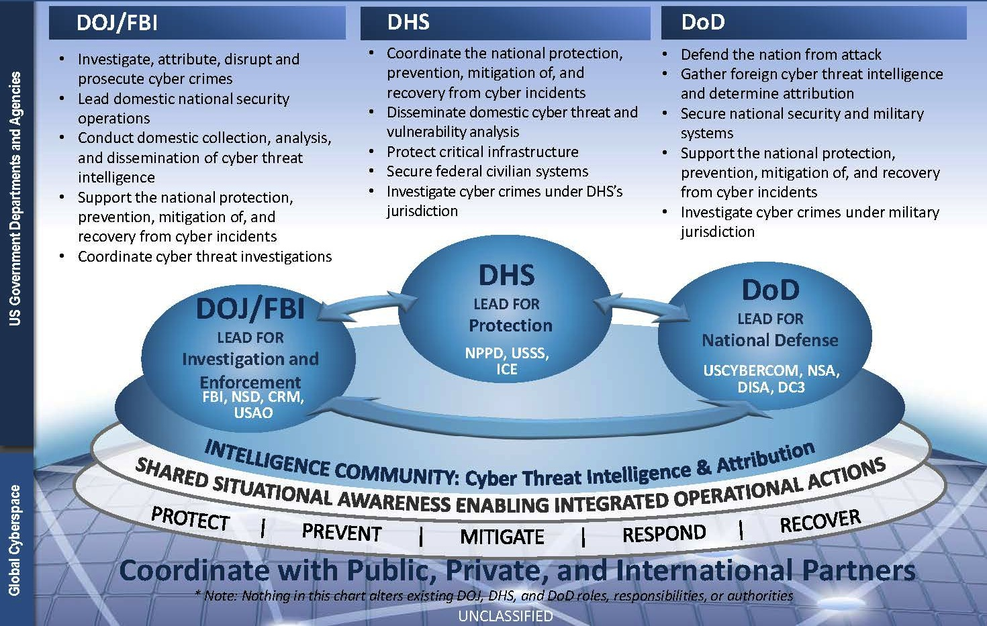
U.S. Federal Cybersecurity Operations Team National Roles and Responsibilities
20

Slide 21
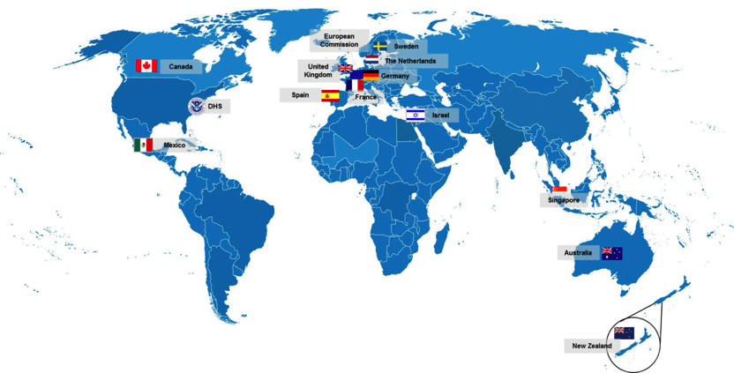
S&T International Engagements
International Bilateral Agreements
Government-to-government cooperative activities for 13 bilateral Agreements
Continuing to expand international research partnerships
Canada (2004)
Australia (2004)
United Kingdom (2005)
Singapore (2007)
Sweden (2007)
Mexico (2008)
Israel (2008)
France (2008)
Germany (2009)
New Zealand (2010)
European Commission (2010)
Spain (2011)
Netherlands (2013)

