Slide 1
Cybersecurity Research
Directed By Dr. Jules White
Members: Acar Ary, Charlie Xu, Camren Hall and Shiliang Tian

Slide 2
Research Directions
Cyber Physical Security in Supply Chain with Impedance Identity
Impedance Identity Uniqueness
Diminishing Returns Displayed in ΔP
Java Spring Security Vulnerability
Generalization of what we learned
Application Description

Slide 3
Background for Supply Chain/Impedance Identity
The Issue of Counterfeiting
Crucial for safety critical systems
Issue with Serial Numbers
Additional Issues to Consider
IP Theft & Part Tampering
Solution Approach -> Signed Physically Unclonable Identities
Impedance - measured in ohms to determine the resistance
Piezoelectric sensors and how the technology works
Impedance Identities for Object Instances
Frequency vs Impedance
Hypothesis: Every instance of an object has a unique impedance identity that can be used to represent its exact physical structure

Slide 4
Impedance Identity Uniqueness
Approach: Use a statistical analysis to determine the probability that an instance of a certain object type could replicate the impedance identity of another instance of the same object type
Threshold needed for a set standard to measure against
Mean difference of all pairs of instances within the object set
Z-score to determine the probability that an instance within the object set can fall within the threshold
VERY, VERY LOW PROBABILITY of impedance identity replication/recreation
Results suggest that our impedance identities are unique
If an individual could replicate the unique identity,, then they have recreated the same object anyways

Slide 5
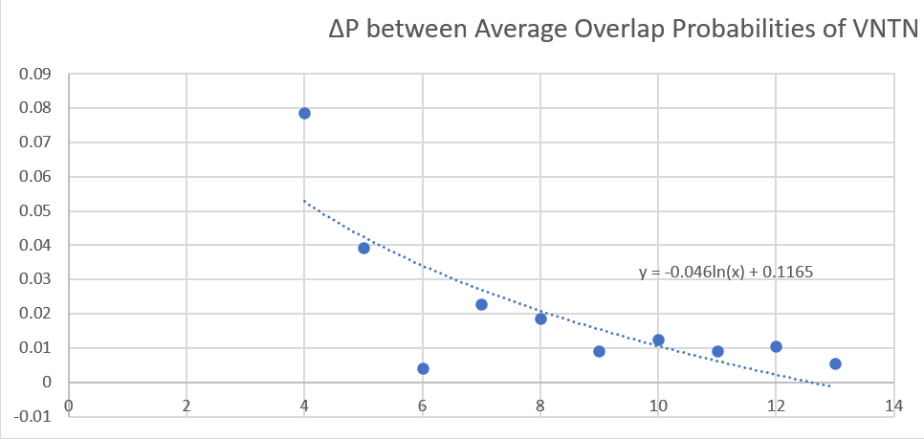
Diminishing Returns
Conducted a thorough statistical analysis regarding accuracy in ΔP.
Observed that with multiple scans, the magnitude of ΔP diminishes.
This lends to a much more certain conclusion that rigid parts have unique impedance identifiers.

Slide 6
Cybersecurity Vulnerability
Study of Checklist Usage in Secure Software Development
Study of Vulnerabilities in Java Spring Framework

Slide 7
Checklist Usage in Secure Software Development
Checklists are used to improve software security by setting a standard
There are loopholes in the checklists we found online:
Non-deterministic Read-respond Items
Undecidable Read-respond Items
Failed Generalization for Reuse in Read- respond Questions
Missing Description of the Expected Checklist Context
Study of checklist in different areas:
SQL server security
Java security
C++ security
PHP and PHP laravel security.

Slide 8
Process of Investigation
Steps:
Search the top results on Google
Go through each checklist item and record feedback
Conclude results in words and tables
Result:

Slide 9
Java Spring Security Vulnerability Generalization
Web applications may and often do contain security vulnerabilities
Cross-site Request Forgery (CSRF) Attack
Cross-site Scripting (XSS) Attack
SQL Injection
Improper handling of vulnerabilities can have severe consequences
Memory corruption
Bypassing firewall
Client information leakage
Create a web application using Java Spring Boot Framework
Security loopholes that exist on backend implementation
Will be used in cybersecurity class for Fall 2020 as homeworks

Slide 10
Application Project - Frank
Designed as an assignment for student
To find vulnerabilities and fix them
Provide test cases to give feedbacks
Guitar Shop Application with Java Spring & SQL
A simple online guitar shop website
User make http requests and get response from the server
Allows users to log in as either an administrator or a user
Basic functionalities: Access orders and products info, edit personal info
Cybersecurity Implementations
SQL Injections, XSS Injections, Improper API Design, Brute Force Attack on login info

Slide 11
Application Project - Charlie
YES course registration Application with Java Spring & SQL
A simplified version of the vandy YES system
Allows individuals to log in as either an admin, an instructor, or a student
An admin can manage users and add new courses to the catalog, etc.
An instructor can manage students in his/her courses, etc.
A student can enroll, waitlist, or drop from courses, etc.
Data stored on SQL database
Cybersecurity Implementations
Password Encoding, SQL Injections, XSS Injections, Improper API Design, Authorization and Authentication

Slide 12
Application Project - Camren
Library Management Web Application
Back-End handled by Java Spring framework
Database handled my MariaDB MySQL
Allows an individual to create a Library account
Search media by name, author, publishing date, identifier
“Check-out” media, which is then reflected in the DB
Allowed to check-out up to three things at a time
Return media, which is then reflected in the DB
Cybersecurity Implementations
XSS Injections, SQL Injections, Improper API Design, Authorization and Authentication

Slide 13
Application Project - Acar
Expense/Finance Tracker Application with Java Spring & SQL
Allows an individual to create a manager to manage their finances and expenses
Add accounts to your manager (Checking, Savings, Loan, Credit, Investment)
Modify the accounts - Withdrawals and Deposits
Transaction history tracker and net worth tracker
Cybersecurity Implementations
XSS Injections, SQL Injections, Improper API Design, Authorization and Authentication

