Slide 1
DATA-DRIVEN PROBLEM SOLVING FOR PUBLIC TRANSIT SYSTEMS
Riyan Kabir
SCOPE Lab
Mentors: Dr. Abhishek Dubey, Michael Wilbur
Notes:
This summer I worked in the SCOPE Lab run by Dr. Abhishek Dubey. Their research involves large scale and distributed data decision making in cyber-physical systems; under that broad umbrella, I worked specifically with public transportation datasets and transit problems faced by Nashville and Chattanooga. These transit-related projects focused on database management, data fusion, and data analysis.

Slide 2
DATASETS &
SOFTWARES
Notes:
Here are some of the data sources and technologies that I used over the summer. You may or may not be familiar with some of the products, companies, or organizations pictured; I certainly wasn’t entirely acquainted and had to get accustomed to a lot of new datasets and softwares. The datasets that I worked with dealt with bus position, bus fuel levels, bus stops, traffic, elevation, weather, bus ridership and census information.

Slide 3
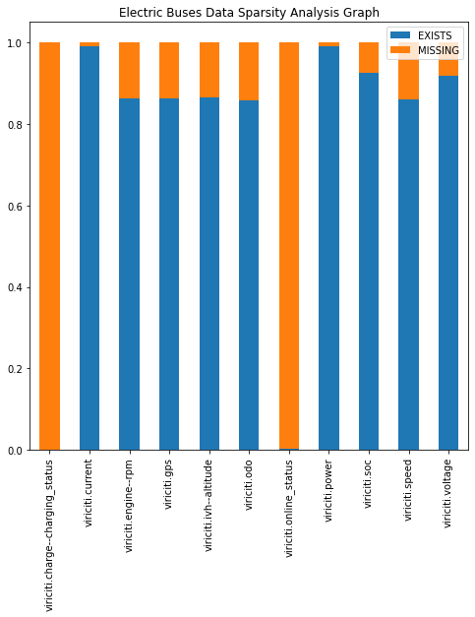
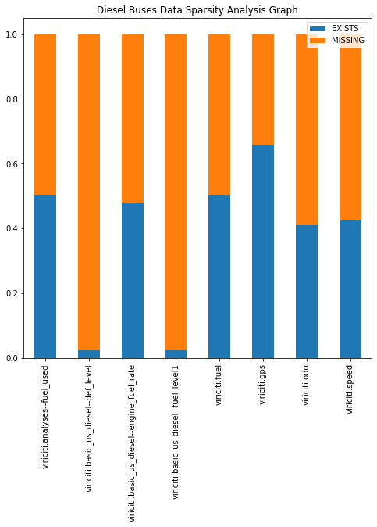
Data Quality Analysis
Figure 1. Data Sparsity of Electric Buses
Figure 2. Data Sparsity of Diesel Buses
Good dataset infrastructure for analysis relies on having quality data. This means checking if the necessary data from bus sensor datasets were organized, consistent overtime, and not missing important data values.
Notes:
My role in database management was to check if the data was in good shape so that the analysis was meaningful. The tasks to ensure data quality ranged from creating a script that checked the amounts of data recorded daily to checking the data sparsity of specific collections. These graphs are samples from the work I did analyzing missing information in the datasets on energy level of transit buses in Chattanooga. As you can see, on average about 90% of the data was in good shape for analysis of electric buses, whereas only 50% of the data was in good shape for analysis of diesel buses.

Slide 4
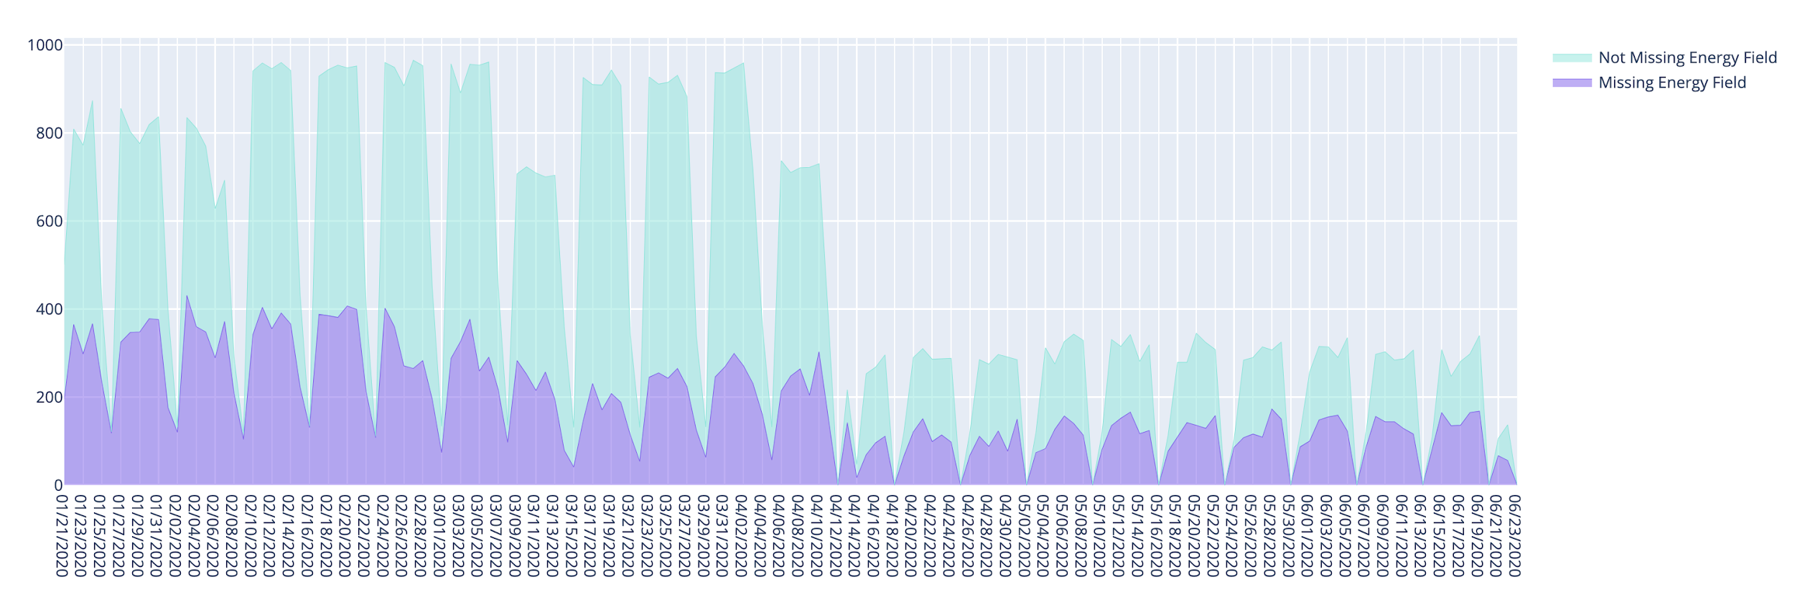
Sensor Fusion Analysis
Sensor fusion is the combination different sources of data on a shared factor, typically on a vehicle_id and timestamp (a.k.a. data-join).
Batch processing vs. stream processing (real-time data)
Merge into discrete, unique trips to analyze energy consumption, bus delay, etc.
Figure 1. Energy Field Data Sparsity of Trip-Level Aggregate
Notes:
Now, there is no single dataset that holds every facet about a bus trip. That’s why sensor fusion becomes necessary. You perform a data-join on all the different sensor recordings. One of the areas that I am going to continue working on is translating the batch processing into a stream processing. The former performs data joins on time windows in the past, while the latter performs data joins in real time. Each processed individual document after the data-join represents a disjoint moment in time on a specific bus from the tens of thousands of trips taken in the past six months. So for easy analysis of something like energy consumption on trips, I was able to merge the documents into their specific trip and aggregate attributes like starting and ending fuel or charge levels.

Slide 5
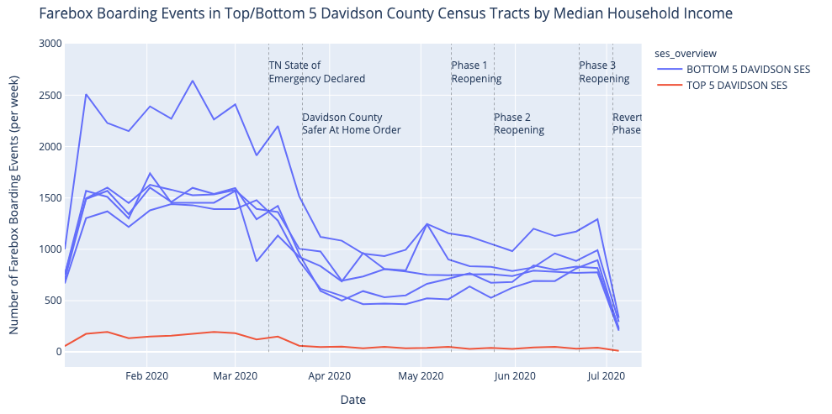
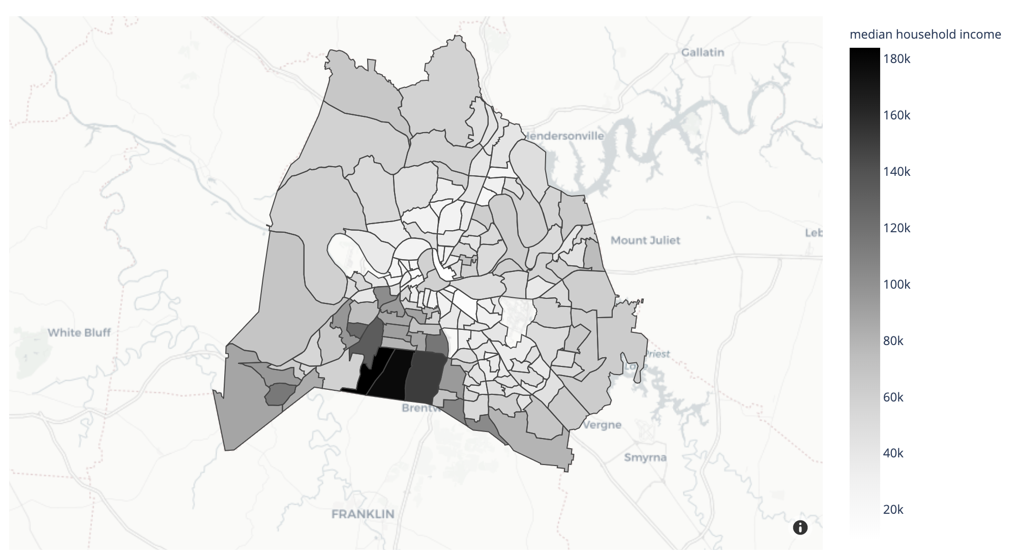
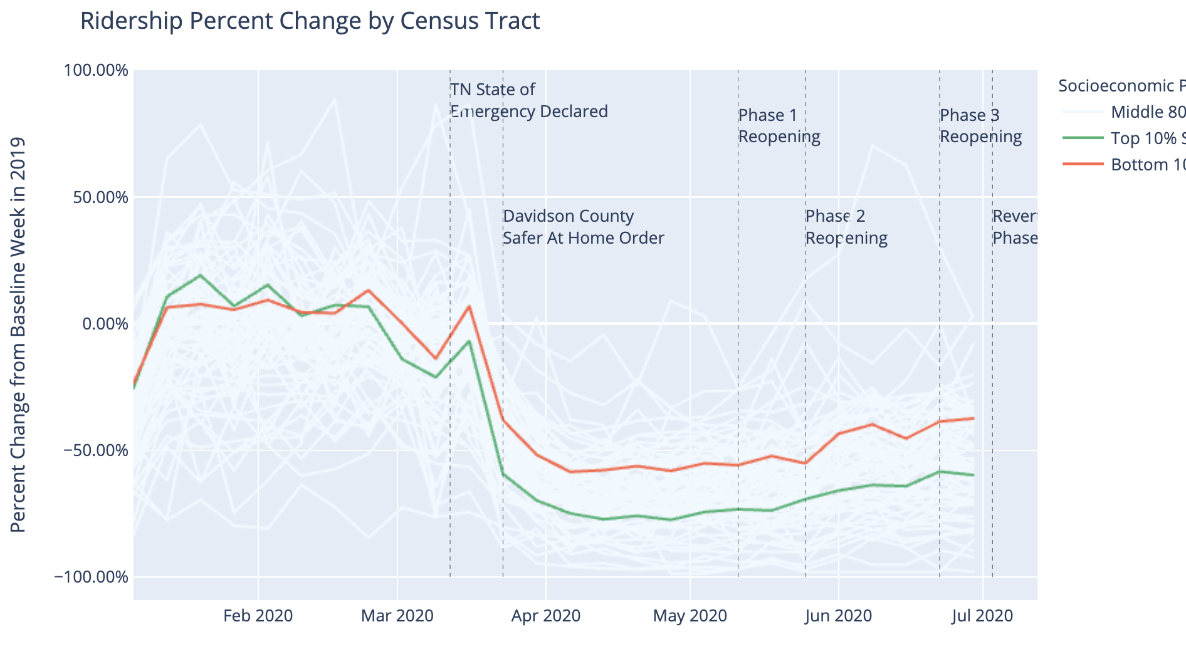
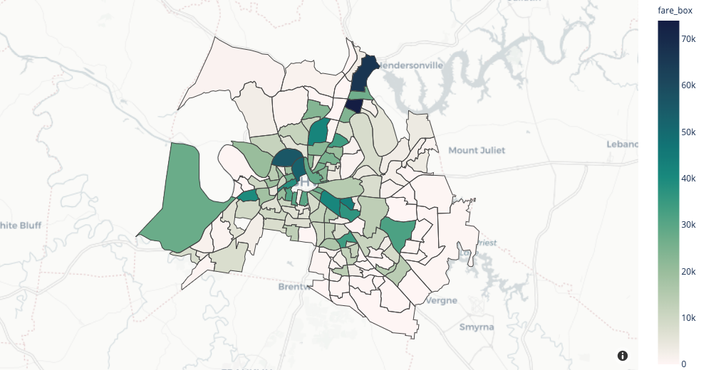
COVID Public Transportation Analysis
Figure 1. Weekly Ridership in Top and Bottom SES Tracts
Figure 3. SES Levels in Davidson Cty. by Census Tract
How did people utilize public transportation in response to the COVID-19 pandemic in Nashville and Chattanooga? What role did different factors [of bus route availability, travel to popular destinations, public awareness of the pandemic, socioeconomic disparity] play in ridership behavior?
Figure 2. Ridership Percent Change from Week in 2019
Figure 4. 2020 Ridership in Davidson Cty. by Census Tract
Notes:
In the past three weeks, I was working more heavily with ridership data in Nashville because the lab was working on publishing a paper about the effects of the COVID pandemic on public transit. Before you are the big questions we aimed at answering. One part of the paper that I tackled was how socioeconomic disparity in different census tracts of Davidson county affected ridership behavior. I used median household income of a census tract as the basis of socioeconomic level and graph 3 shows this breakdown. Graph 1 shows amounts of people boarding a bus each week in the past six months in the top 5 SES and bottom 5 SES census tracts and Graph 4 shows the total people boarding a bus in each census tract in the past 6 months.

Slide 6
Figure 1
Figure 3
Figure 2
Figure 4
Notes:
Here is a larger view of the graphs. From graphs 1, 3 and 4, it is clear that there are more people boarding buses from lower socioeconomic census tracts than there are in higher SES census tracts. Graph 2 shows the percent change in ridership from the same week in 2019, again each line in the plot representing different census tracts; the red and green lines represent the highest and lowest 10% of income level by census tracts. This analysis showed that compared to ridership in 2019, higher income areas initially had a greater percent change at the beginning of the year, but had a much greater drop when the pandemic hit, implying that there is less reliance on public transportation in higher income areas to access services like doctors offices, grocery stores, or work places during a pandemic. In my python notebooks, these graphs are all interactive and you can hover over each census tract or point on a line for more granular information. Analyses like these are crucial for public transit agencies to understand how they can safely serve the populations that need their services most, as the pandemic and regulations rapidly evolve in Davidson County.

Slide 7
CONCLUSION
Lessons
Importance of learning new technologies to ease and optimize problem solving
Employing powerful data tools (pandas, plotly, etc.) to easily analyze and plot huge datasets
Challenges
“Cleaning” datasets with missing values, inconsistent entries, incompatible data types
Dealing with datasets with millions of data records
Working with new programs or packages
Worked Well
Cooperative team that helped with any road blocks
Collaborative tools (Github, Google Colab, Microsoft Teams, Zoom)
Notes:
The summer research was a incredibly interesting and I had a lot of fun investigating the intricacies of public transit. Though I faced difficulties working with huge and at times inconsistent datasets, I learned a lot about python packages or mongodb queries that I had never used before that simplify analyzing millions of data records. From my mentors, I also learned a lot about the research process and creating in depth papers. None of this would have been possible without the cooperative nature of the team; so, I am super greatful for Dr. Dubey, Mike Wilbur and the rest of the team. Even though the internship was remote, the solution to any of my roadblocks was just a Team’s message or zoom call away.

