Slide 1
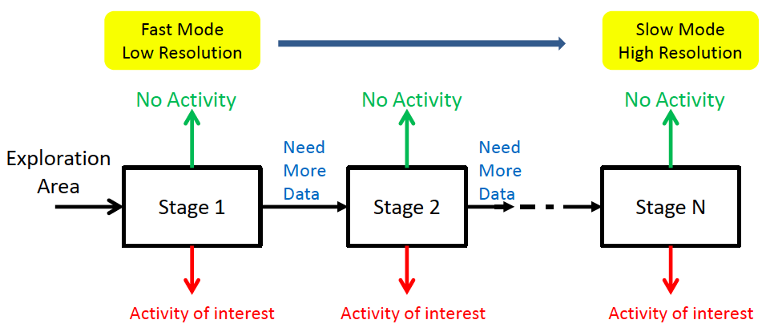
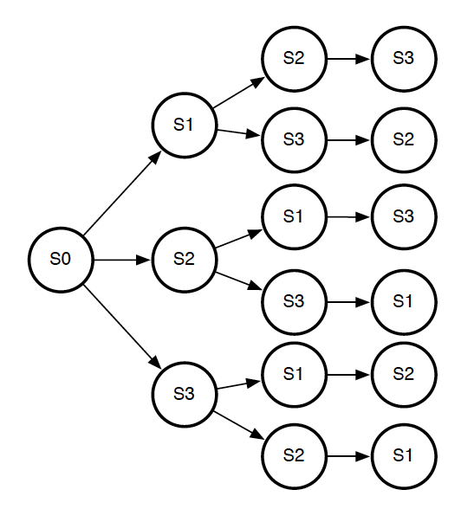
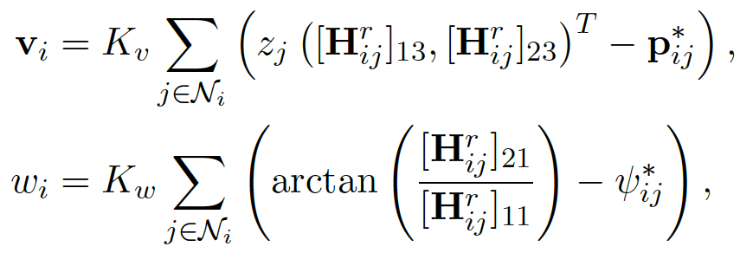
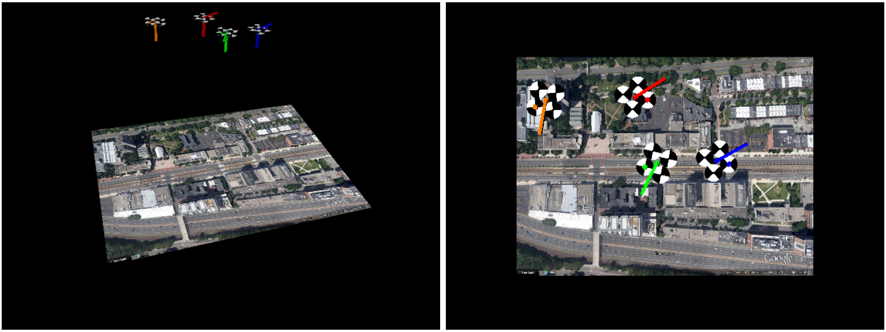
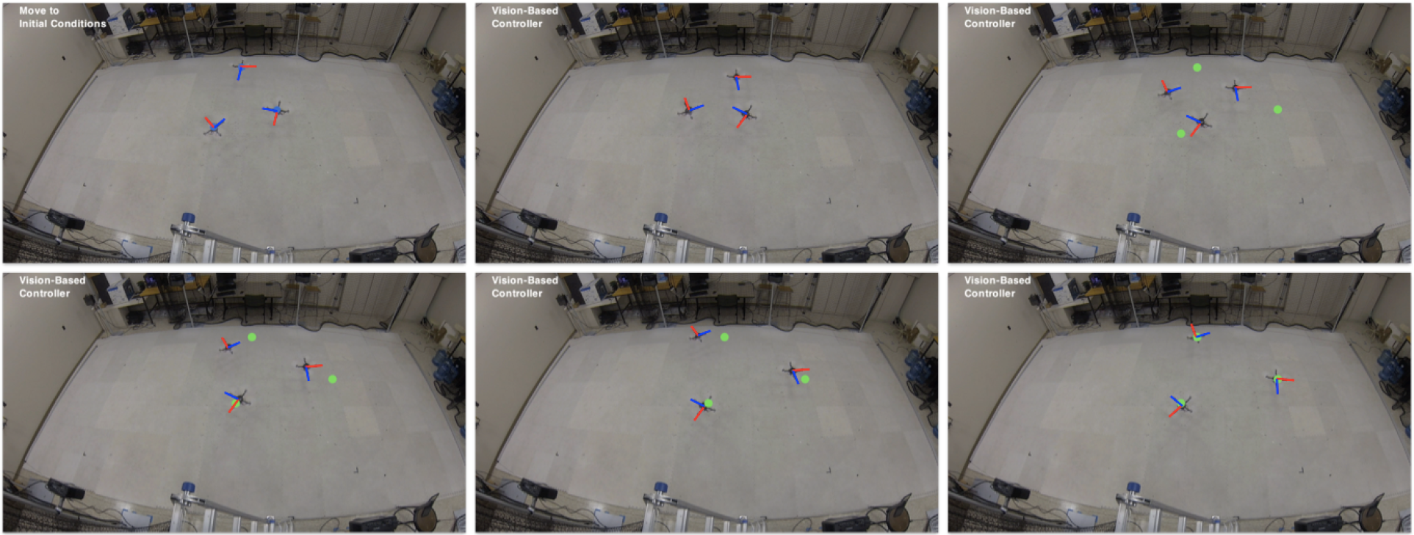
Data Driven Intelligent Controlled Sensing for
Cyber Physical Systems
NSF CNS-1330008, PI: Venkatesh Saligrama, Co-PIs: Mac Schwager, David Castanon
Electrical Engineering, Mechanical Engineering, Boston University
Summary
Fixed schedule:
Tools for UAV Network Control
Develop algorithms for data-driven decision making
Policies for choosing a sensor given sensing cost and previous sensing outcomes
Polices for locating mobile sensing platforms given cost of motion and previous sensing outcomes
Probabilistic sensing model not available, must build decision rules through examples
Applications to medical decision making, airport security, archaeological surveying
Formation controller without a global reference frame
Uses only relative position and orientation
Downward vision used to obtain relative pose
Formation control law:
homographies
Sensor schedule:
position:
decision tree approach:
Greedy decision rule:
orientation:
Project Thrusts
Fixed schedule: Sensing order is fixed before hand based on increasing sensing cost. For UAVs, a sensing path is fixed before hand. The algorithm decides when to stop based on collected sensor measurements
Sensor scheduling: The order of sensors must be found as part of the policy. We propose a decision tree approach, also with sample-based cost-to-go estimate.
Mobile sensor networks: Continuous sensing path of UAV must be controlled, with decision rule for when to stop moving.
Mobile Sensing Networks
Active sensing with network of UAVs
Data-driven approach
Learned sensing models/transportation cost
Downward vision for sensing
High fidelity simulations with vision in the loop.
Approach
Distributed approx.
cost-to-go update:
Optimal DP approach intractable:
Sample-based approx cost-to-go
Experiments with three quadrotors.
Publications
[1] M. Hanawal, V. Saligrama, “Efficient Detection and Localization on Graph Structures,” ICASSP, 2015 (submitted).
[2] E. Montijano, D. Zhou, M. Schwager, C. Sagues, “Distributed Formation Control Without a Global Reference Frame,” American Control Conference, pp. 3862—3867, Portland, OR, June 2014.
[3] J. Wang, T. Bolukbasi, K. Trapeznikov, V. Saligrama, “Model Selection by Linear Programming,” ECCV 2014.
[4] J. Wang, K. Trapeznikov, V. Saligrama, “Sequential Learning
under a Budget,” AISTATS 2014.
[5] F. Nan, J. Wang, K. Trapeznikov, V. Saligrama, “Fast Margin-based Cost-Sensitive Classification,” ICASSP 2014.
Sensing distributions not available, only sample
Even if they were, the DP recursion intractable
Propose approximate sample based cost-to-go function:
Approximate DP recursion:
Sample-based approx cost-to-go
Application to archeological surveying with UAVs
Collaboration with BU archaeologists
Annotated training data set for active classification of burial mounds.

